Slide 1

STAT7: Discussion Section #2

Slide 2
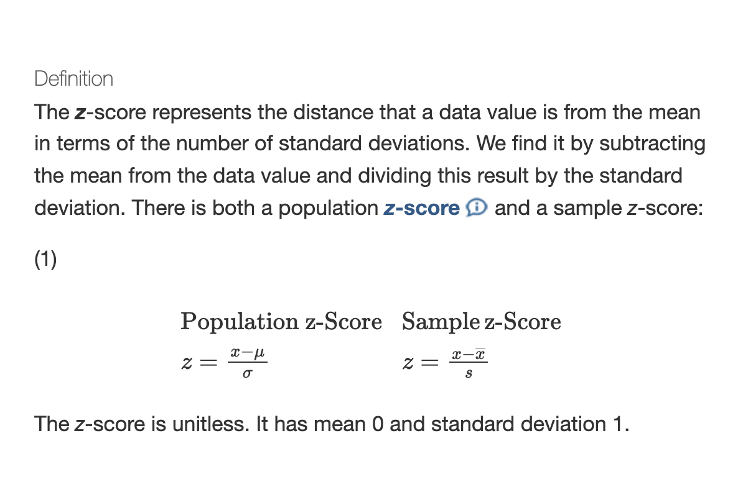
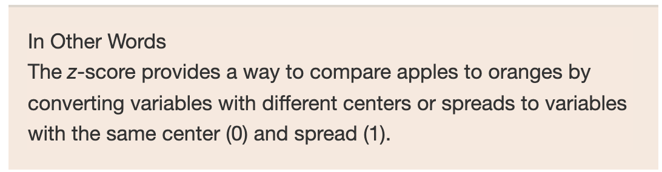
Section 3.4: Measures of Position and Outliers
In this section we are now interested in describing the relative position of a certain data value within the entire set of data.
We can accomplish position detecting using the z-score
STAT7 Discussion Section

Slide 3
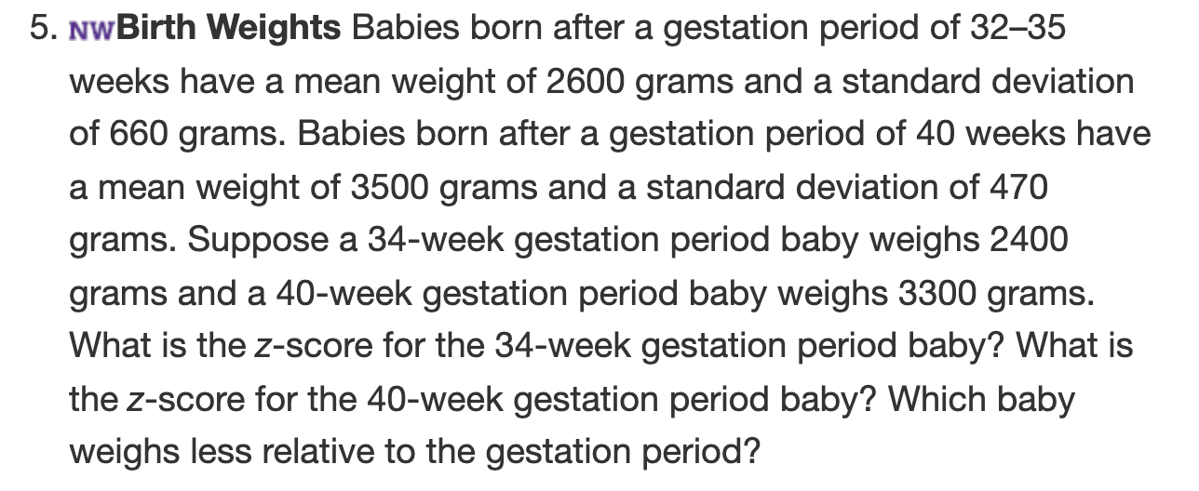
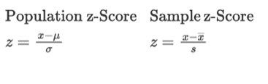
Z-score Practice

Slide 4
Z-score Practice
$$z=\frac{2400-2600}{660}=-0.30$$
$$z=\frac{3300-3500}{470}=-0.43$$
40-week period weighs less due a to a farther standard deviation from the mean

Slide 5
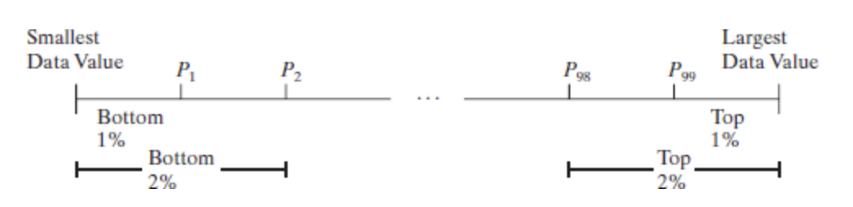
3.4: Percentiles
The kth percentile, denoted $P_{k}$, of a set of data is a value such that k percent of the observations are less than or equal to that value.
Percentiles divide a set of data that is written in ascending order into 100 parts. For example $P_{1}$ divides the bottom 1% of the observations from the top 99%. $P_{2}$ divides the bottom 2% of the observations from the top 98% and so on.

Slide 6
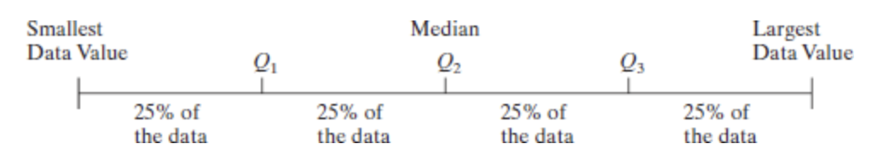
3.4 Quartiles
The most common percentiles are quartiles. Quartiles divide data sets into fourths, or four equal parts.
The first quartile, denoted $Q_{1}$, divides the bottom 25% of the data from the top 75%. There for the first quartile is equivalent to the 25th percentile.
The second quartile ($Q_{2}$) is equivalent to the 50th percentile or the median.
The third quartile ($Q_{3}$) divides is equivalent to the 75th percentile.

Slide 7
3.4: Calculating Quartiles
To calculate quartiles the data must first be arranged in ascending order. Then we can apply the following equations.
Step 1: Arrange the data in ascending order.
Step 2: Determine the median, M, or second quartile, $Q_{2}$
Step 3: Divide the data set into halves: the observations below (to the left of) M and the observations above M. The first quartile, $Q_{1}$, is the median of the bottom half of the data and the third quartile, $Q_{3}$, is the median of the top half of the data.

Slide 8
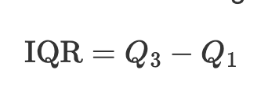
3.4: Interquartile and Outliers
The interquartile range (IQR) is the range of the middle 50% of the observations in the dataset.
Outliers are detected via the upper fence and lower fence of a dataset. If a data value is less than the lower fence or greater than the upper fence, it is considered an outlier.
Lower fence = $Q_{1}$ - 1.5 (IQR)
Upper fence = $Q_{3}$ + 1.5(IQR)

Slide 9
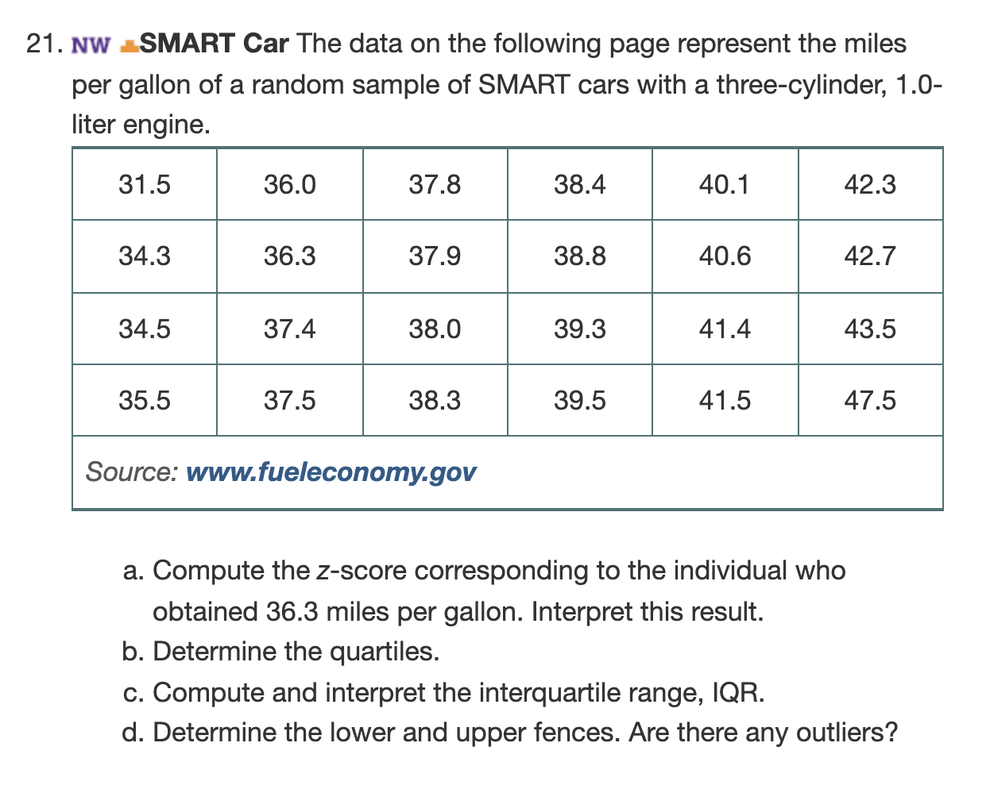
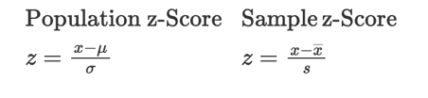
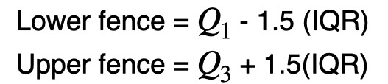
3.4: Example
Calculate z-score for an individual who obtained 36.3 mpg.
Hint: You need the sample mean and sample standard deviation
Need to calculate $Q_{1}$, $Q_{2}$, and $Q_{3}$.
Recall:

Slide 10
$$z=\frac{36.3-38.775}{3.42}=-0.72$$
$$Q_{1}=36.85$$
$$Q_{2}=38.35$$
$$Q_{3}=41$$
IQR = 41 - 36.85 = 4.15
UF = 36.85 - 1.5(4.15) = 30.625
LF = 41 + 6.225(4.15) = 47.225

Slide 11
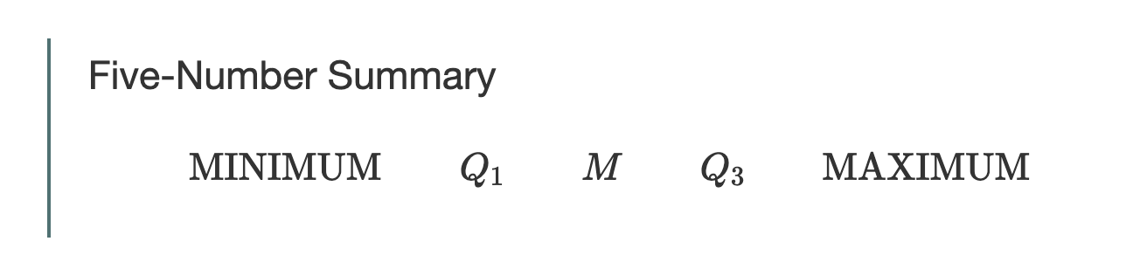
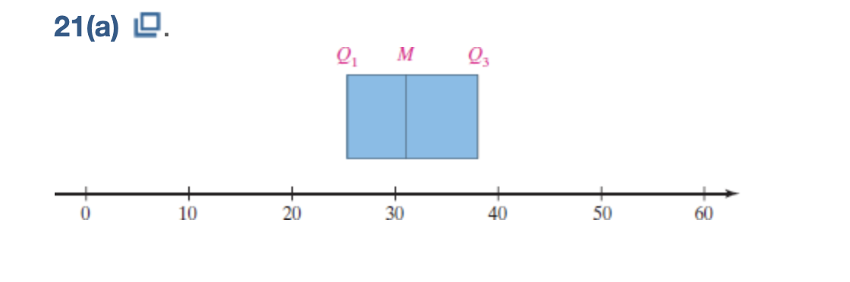
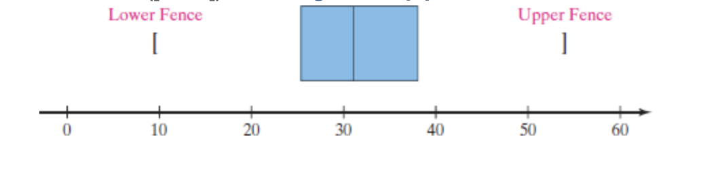
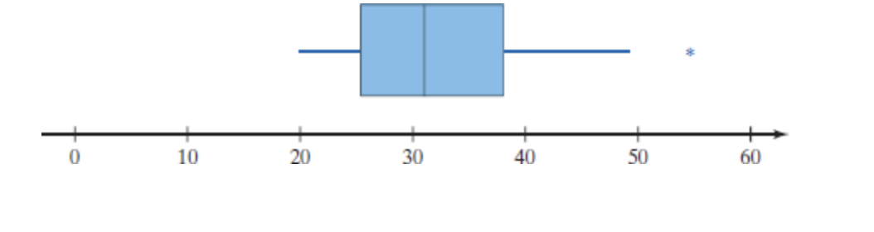
3.5 The Five-Number Summary and Box Plots
The five-number summary of a set of data consists of the smallest data value, $Q_{1}$, the median, $Q_{3}$, and the largest data value. We organize the five-number summary as follows:

Slide 12
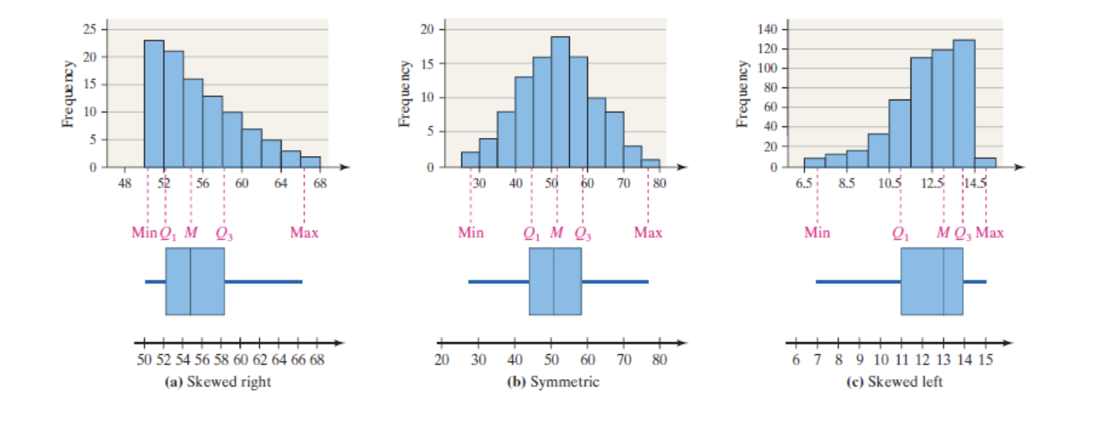
3.5: How Boxplots Visualize Distributional Characteristics

Slide 13
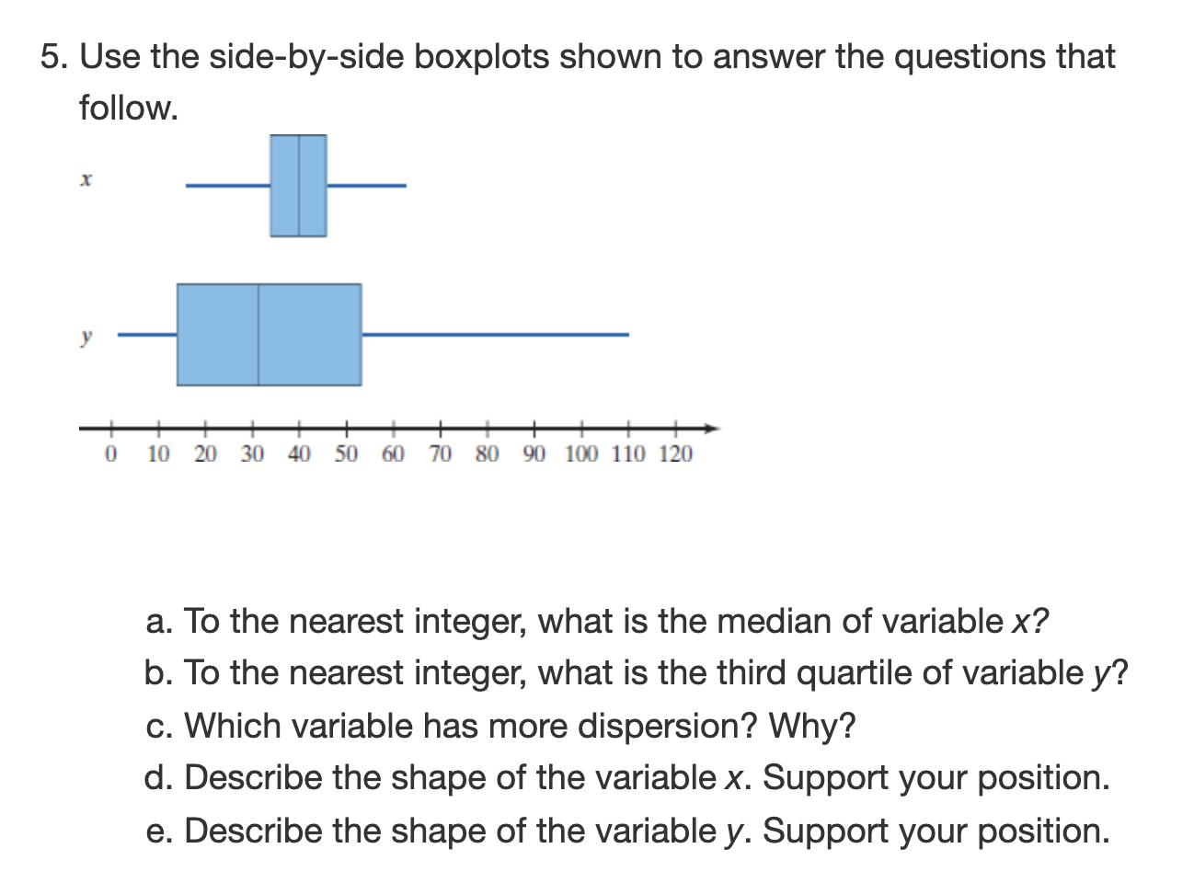
3.5. Example

Slide 14
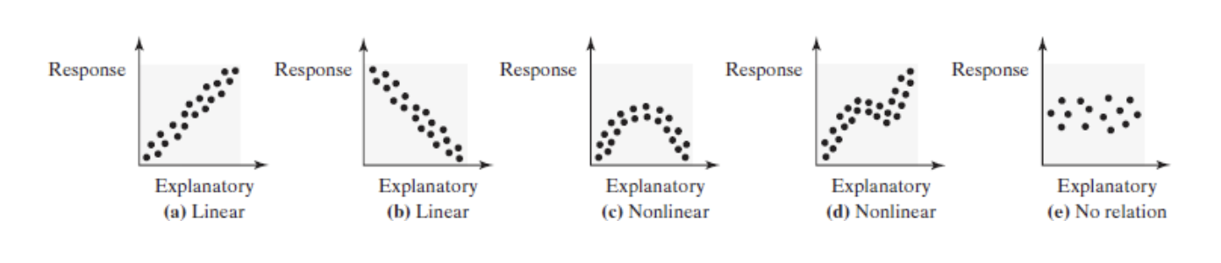
4.1: Scatter Diagrams and Correlative
A scatter diagram is a graph that shows the relationship between two qualitative variables measured on the same individual.

Slide 15
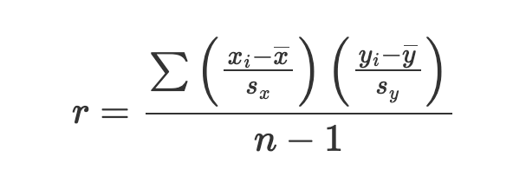
4.1: Sample Linear Correlation Coefficient
The linear correlation coefficient is a measure of the strength and direction of the linear relation between two quantitative variables.
The linear correlation coefficient is always between -1 and 1inclusive.
The closer r is to +1, the stronger the evidence of positive association between the two variables.
The closer r is to -1, the stronger the evidence of negative association between the two variables.
If r is close to 0, then little or not evidence exists of a linear relation between the two variables.

Slide 16
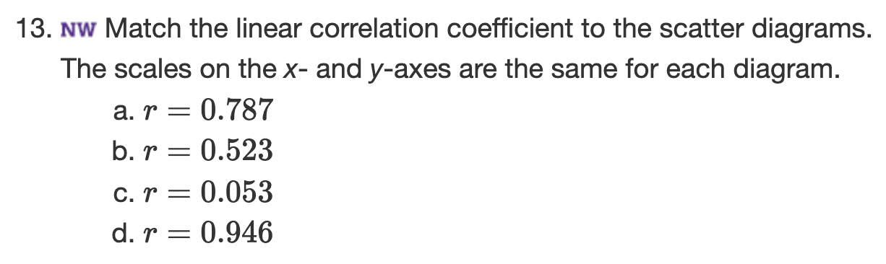
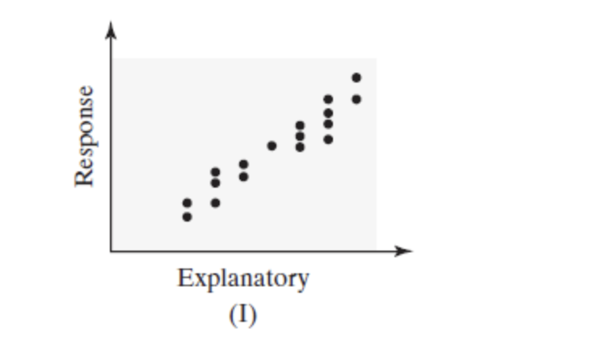
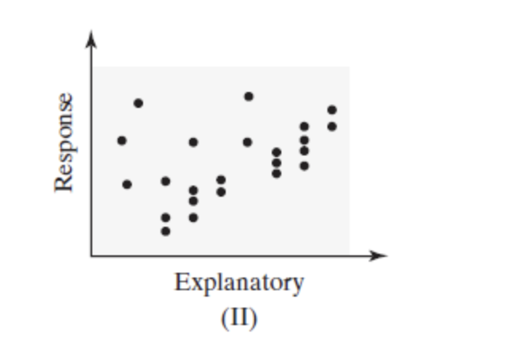
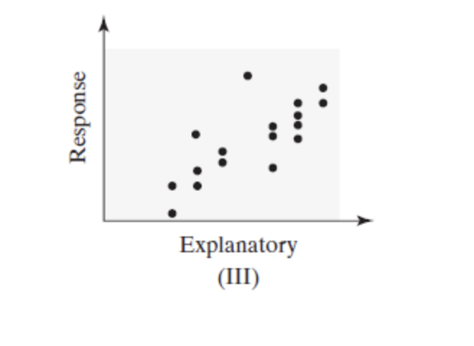
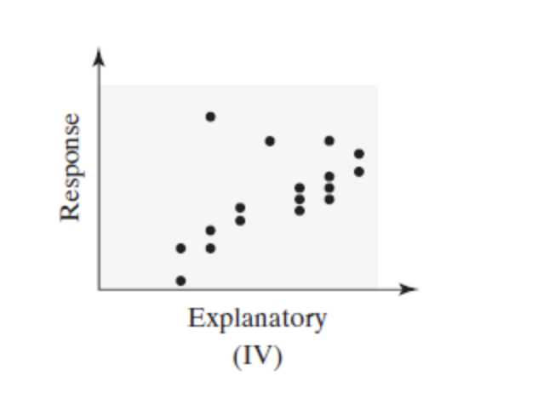
4.1: Example-Linear Correlation Coefficient

Slide 17
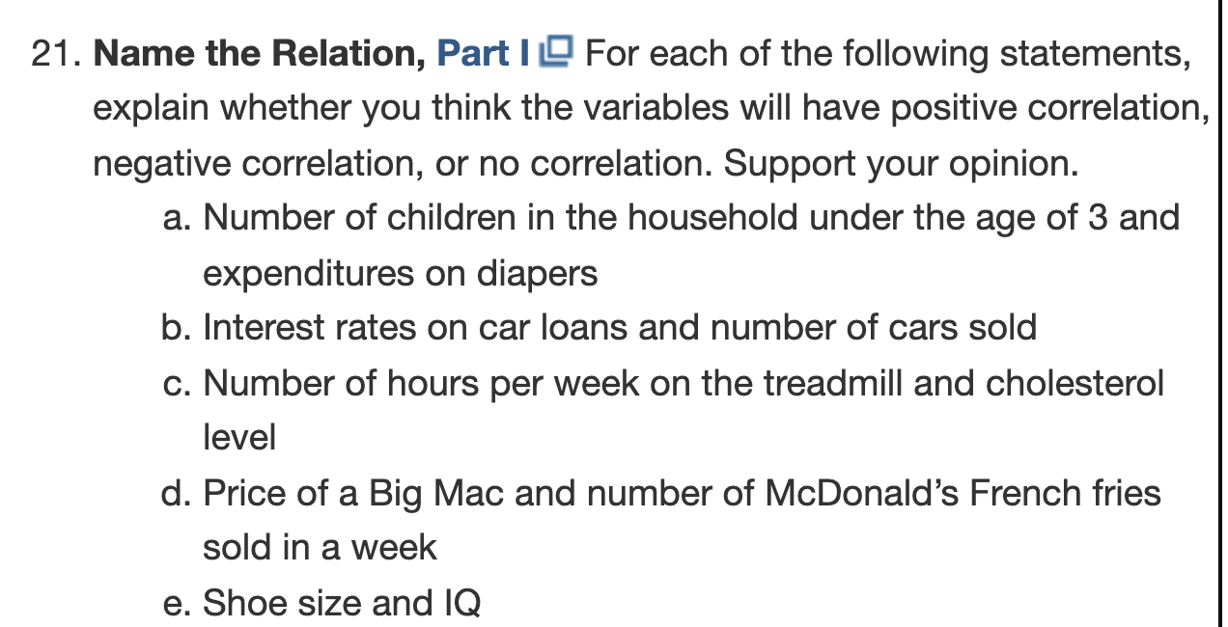
4.1: Example: Conceptualizing Correlation

Slide 18
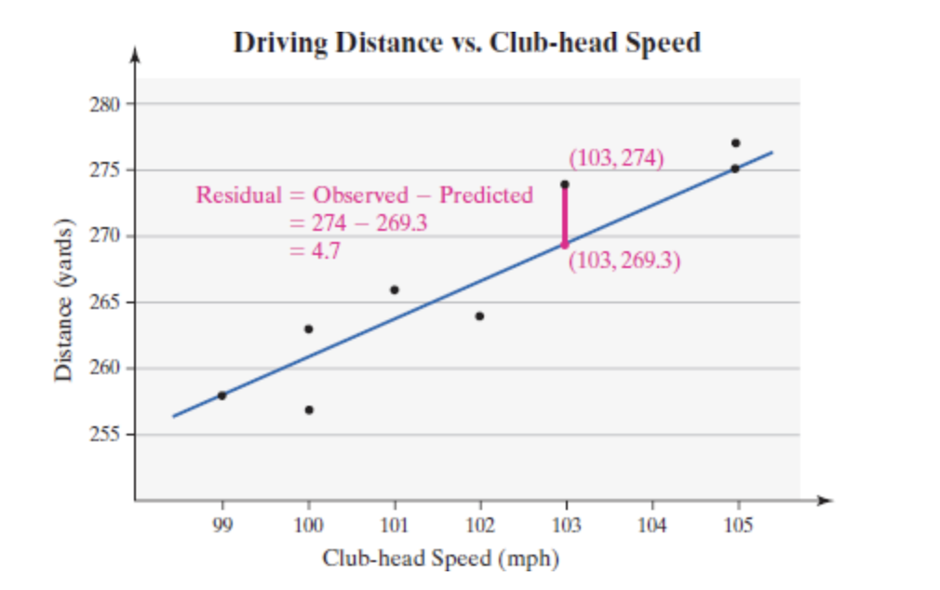
4.2: Least Squares Regression
The least-squares regression line is the line that minimizes the sum of the squares errors (or residuals).
This line minimizes the sum of the squares vertical distance between the observed values $y$ and those predicted by the line $\overset{̂}{y}$ (read “y-hat”)
$$\overset{̂}{y}=b_{1}x+b_{0}$$
$b_{1}=r×\frac{s_{y}}{s_{x}}$
$$b_{0}=\overline{y}-b_{1}\overline{x}$$

Slide 19
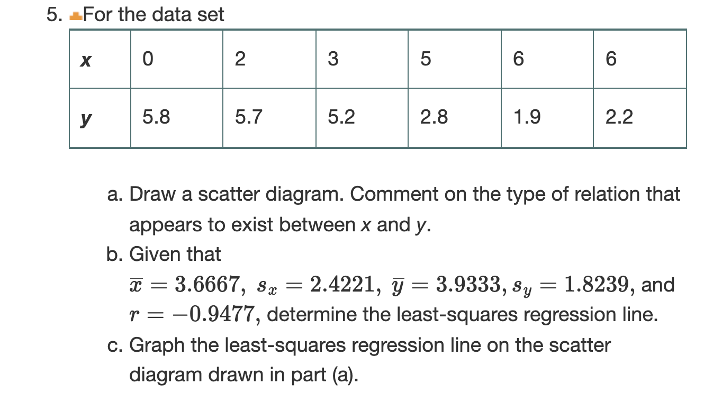
4.2: Linear Regression Example

Slide 20
4.3: The Coefficient of Determination
The coefficient of determination $R^{2}$, measures the proportion of total variation in the response variable is explained by the least-squares regression line.
The coefficient of determination is a number between 0 and 1, inclusive.
$R^{2}$ is a measure of how well the least-squares regression line describes the relation between the explanatory and response variables.
In the least-squares linear regression context: $R^{2}=r^{2}$
NOTE: This method does not work in general and is a property of the working in the least-squares context as we do in this course.

Slide 21
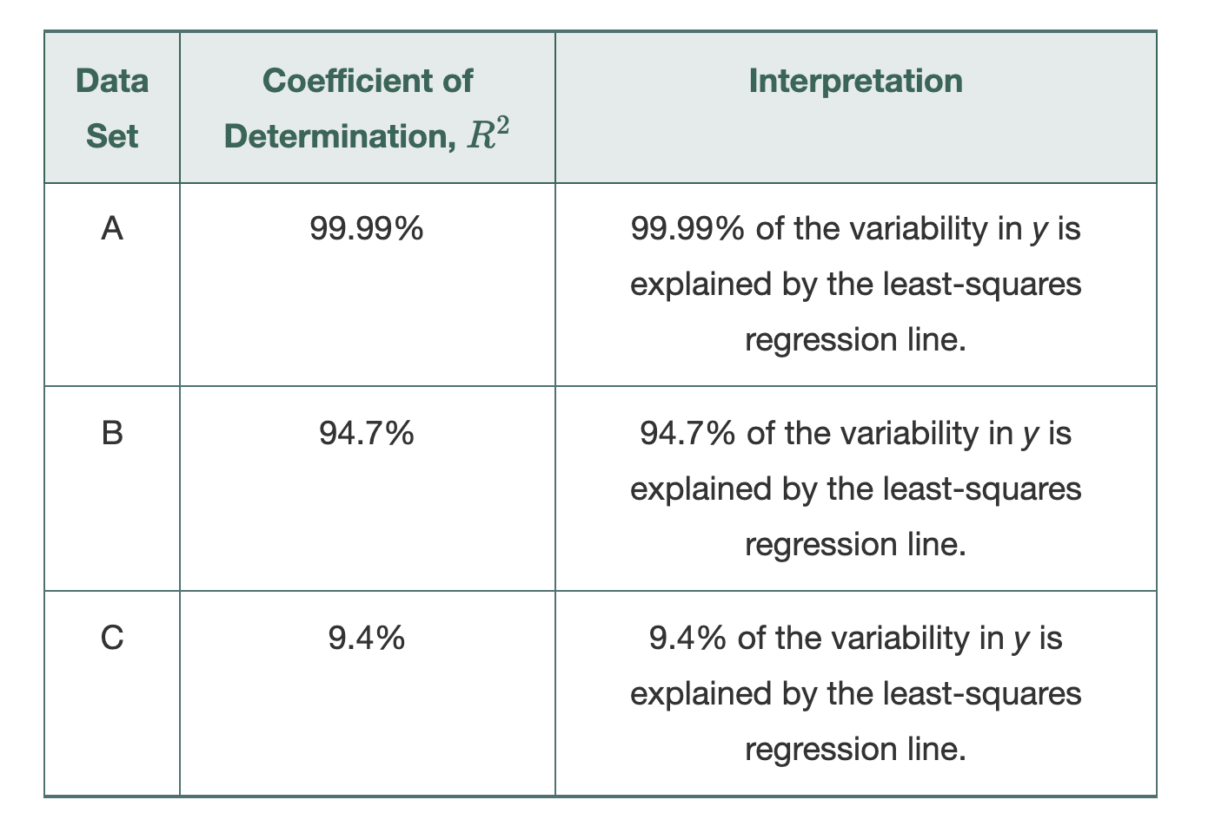
$R^{2}$ Interpretation

Slide 22
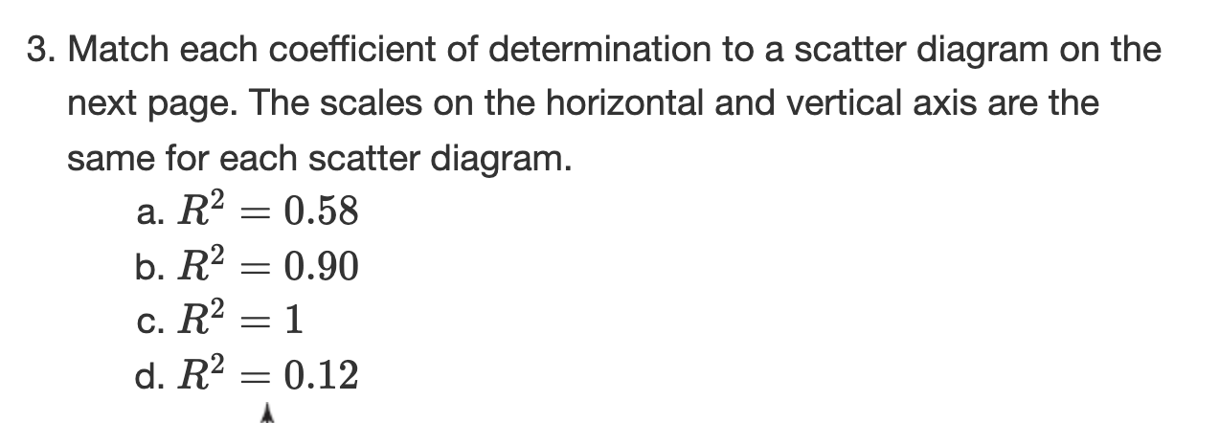
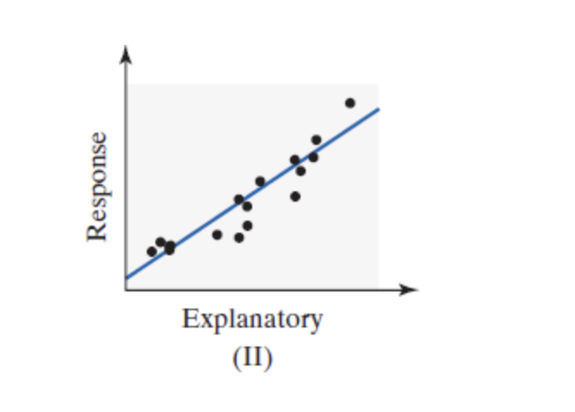
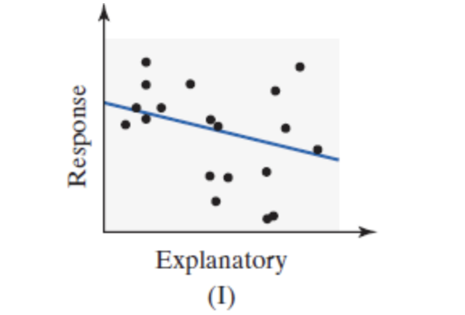
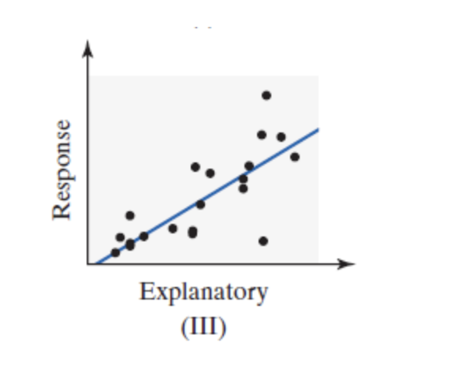
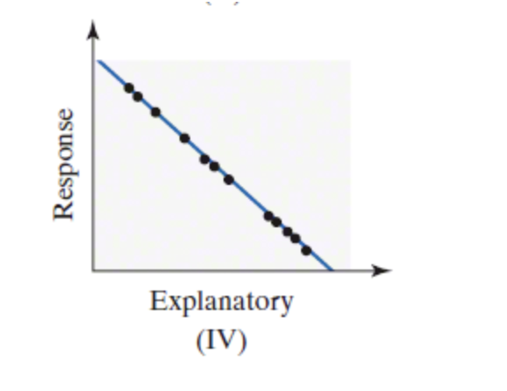
$R^{2}$ Example

Slide 23
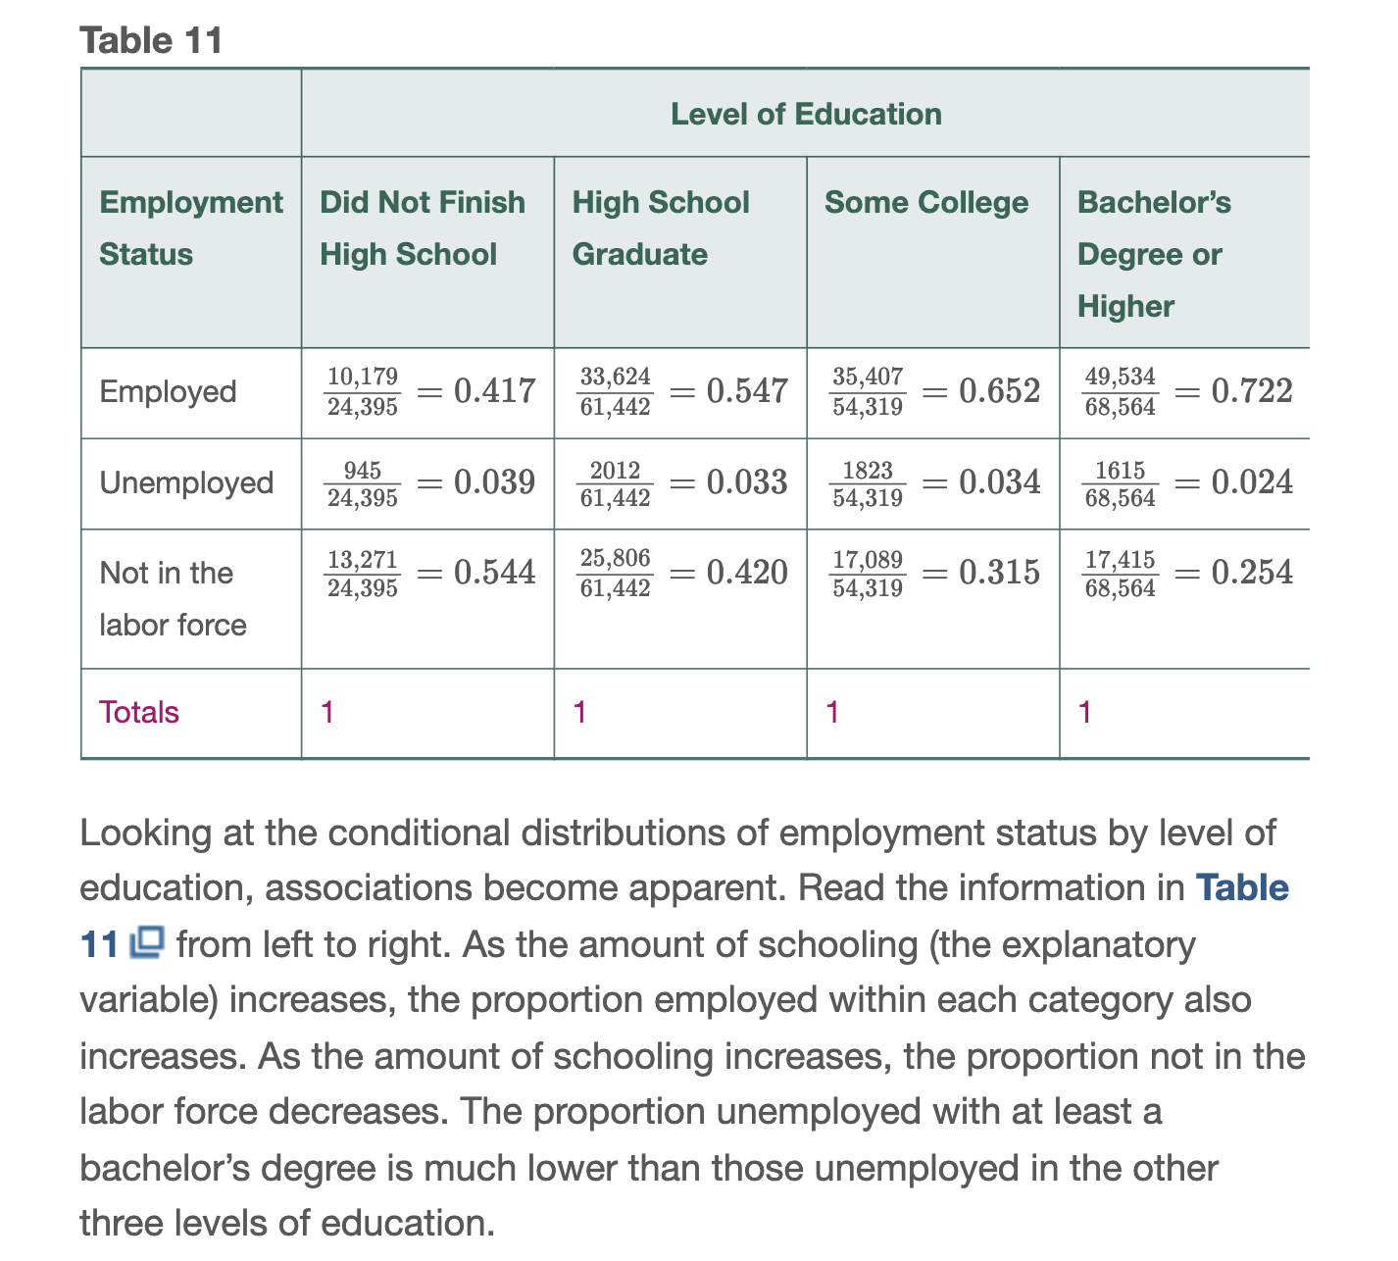
4.4: Contingency Tables and Association
A marginal distribution of a variable is a frequency or relative frequency distribution of either the row or column variable in the contingency table.
A conditional distribution lists the relative frequency of each category of the response variable, given a specific value of the explanatory variable in the contingency table.
Example of inspecting conditional distributions and deriving associations between variables.

Slide 24
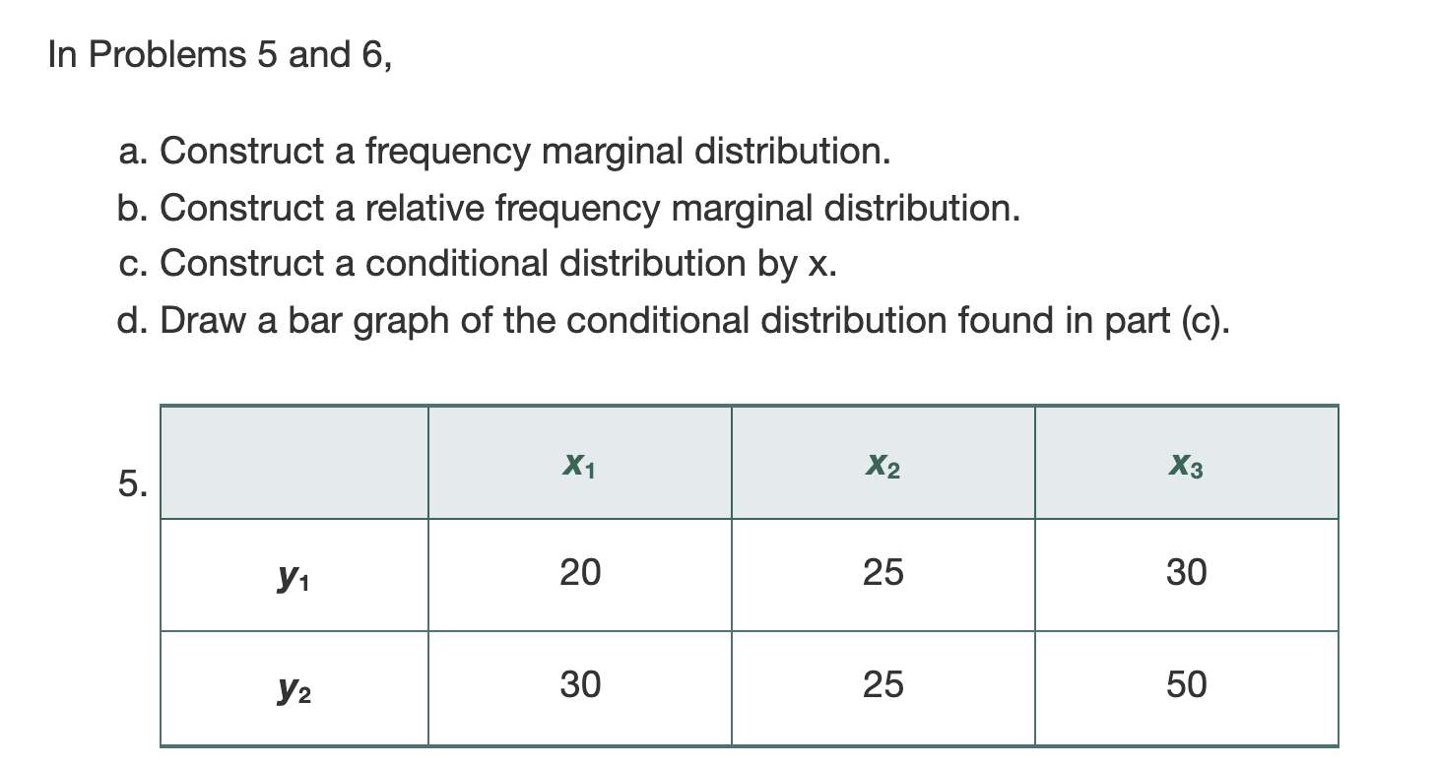
4.4 Example of Deriving Distributions

