Slide 1
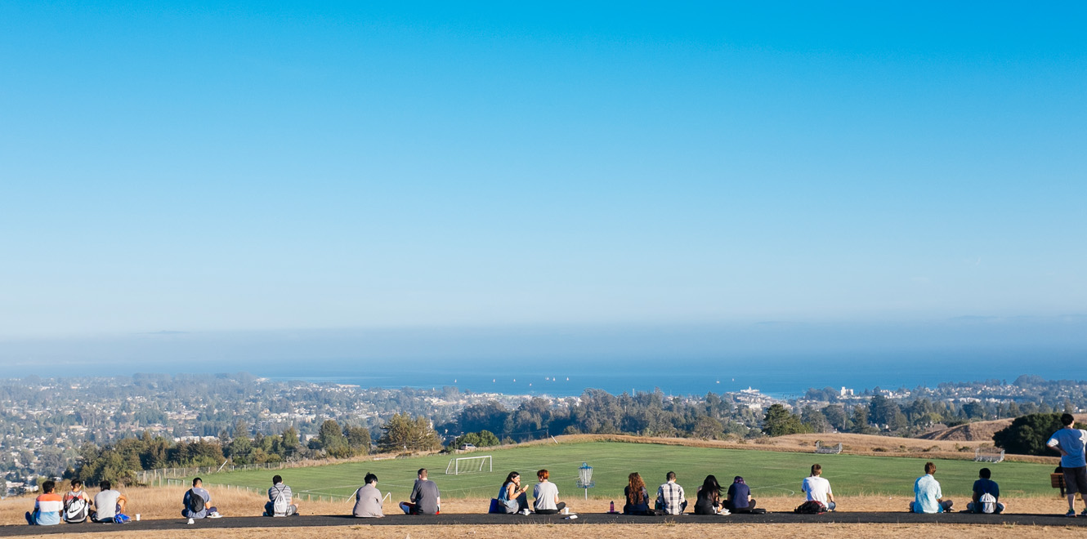
STAT7: Discussion Section #4
Jan 31, 2022

Slide 2
QUIZ
Link:
Open book, Open note
You MAY use your textbook / note / or even internet search.
Rubric
If you get more than 1 complete answers (with trials for all problems): 100
If you make 1 or 0 complete answer (with full trials): 90
If you have no correct answer (without full trials): 80
Late submission: 70
No submission: 0
Notes:
https://forms.gle/yNSw12Cyk1dYCDpX8

Slide 3
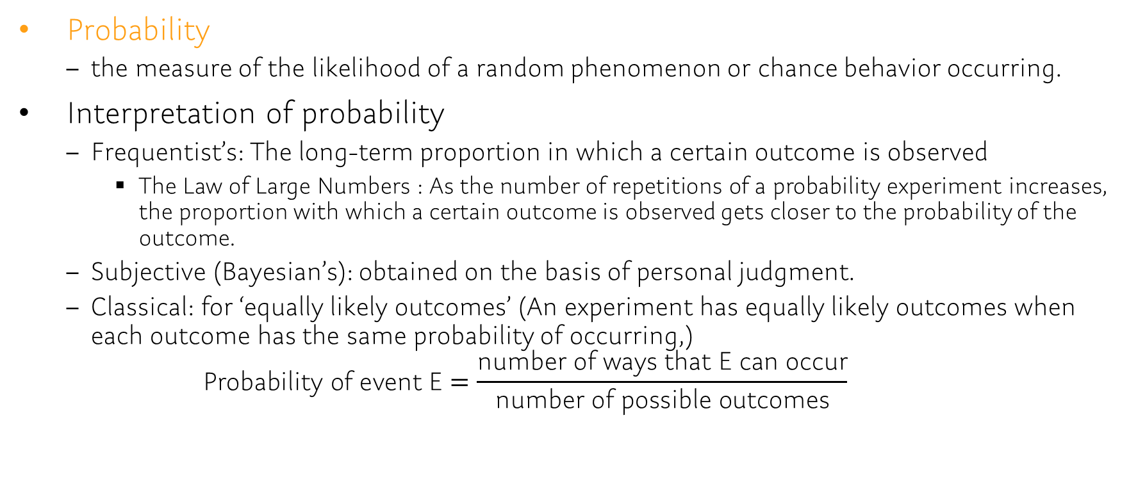
Chap5.1
Probability
the measure of the likelihood of a random phenomenon or chance behavior occurring.
Interpretation of probability
Frequentist’s: The long-term proportion in which a certain outcome is observed
The Law of Large Numbers : As the number of repetitions of a probability experiment increases, the proportion with which a certain outcome is observed gets closer to the probability of the outcome.
Subjective (Bayesian’s): obtained on the basis of personal judgment.
Classical: for ‘equally likely outcomes’ (An experiment has equally likely outcomes when each outcome has the same probability of occurring,) $\text{Probability} \text{of} \text{event} \text{E}=\frac{\text{number} \text{of} \text{ways} \text{that} \text{E} \text{can} \text{occur}}{\text{number} \text{of} \text{possible} \text{outcomes}}$
Notes:
random short-term results = outcomes

Slide 4
Problem: example
[5.1.13] According to Nate Silver, the probability of a senate candidate winning his/her election with a 5% lead in an average of polls with a week until the election is 0.89. Interpret this probability.
[5.1.15] Suppose that you toss a coin 100 times and get 95 heads and five tails. Based on these results, what is the estimated probability that the next flip results in a head?
[5.1.17] Bob is asked to construct a probability model for rolling a pair of fair dice. He lists the outcomes as 2, 3, 4, 5, 6, 7, 8, 9, 10, 11, 12. Because there are 11 outcomes, he reasoned, the probability of rolling a two must be 1/11.
What is wrong with Bob’s reasoning?
Notes:
[5.1.13] In 100 elections, where a senate candidate is winning his/her election with a 5% lead in the average of polls with a week until the election, we would expect the leading candidate to win about 89 of the elections.
[5.1.15] The empirical probability is 0.95.
[5.1.17] Since the outcomes are not equally likely, P(2) is not 1/11.

Slide 5
Problem
[5.1.48] Determine whether the probabilities below are computed using classical methods, empirical methods, or subjective methods.
The probability of having eight girls in an eight-child family is 0.00390625.
On the basis of a survey of 1000 families with eight children, the probability of a family having eight girls is 0.0054.
According to a sports analyst, the probability that the Chicago Bears will win their next game is about 0.30.
On the basis of clinical trials, the probability of efficacy of a new drug is 0.75.

Slide 6
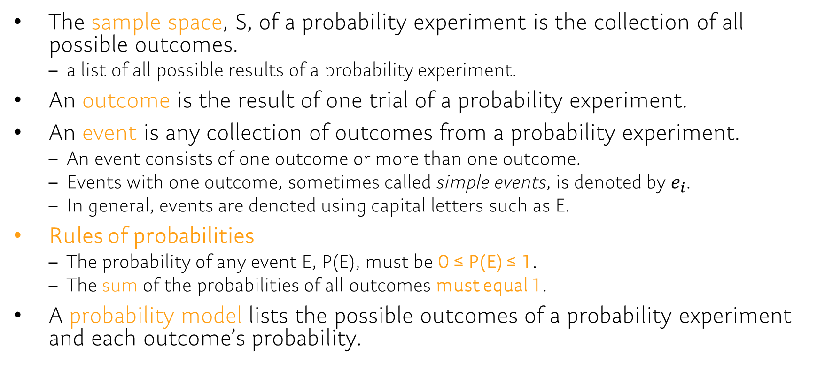
Chap5.1
The sample space, S, of a probability experiment is the collection of all possible outcomes.
a list of all possible results of a probability experiment.
An outcome is the result of one trial of a probability experiment.
An event is any collection of outcomes from a probability experiment.
An event consists of one outcome or more than one outcome.
Events with one outcome, sometimes called simple events, is denoted by $e_{i}$.
In general, events are denoted using capital letters such as E.
Rules of probabilities
The probability of any event E, P(E), must be 0 ≤ P(E) ≤ 1.
The sum of the probabilities of all outcomes must equal 1.
A probability model lists the possible outcomes of a probability experiment and each outcome’s probability.

Slide 7
Problem: Example
Let the sample space be S = {1,2,3,4,5,6,7,8,9,10}. Suppose the outcomes are equally likely.
[5.1.23] Compute the probability of the event E={1,2,3}
[5.1.25] Compute the probability of the event E = "an even number less than 9.”
With the table, which of the assignments of probabilities-
[5.1.39] are consistent with the definition of a probability model?
[5.1.40] should be used if the coin is known to be fair?
[5.1.41] should be used if the coin is known to always come up tails?
[5.1.42] should be used if tails is twice as likely to occur as heads?
Assignments | HH | HY | TH | TT
A | 1/4 | 1/4 | 1/4 | 1/4
B | 0 | 0 | 0 | 1
C | 3/16 | 5/16 | 5/16 | 3/16
D | 1/2 | 1/2 | -1/2 | 1/2
E | 1/4 | 1/4 | 1/4 | 1/8
F | 1/9 | 2/9 | 2/9 | 4/9
Notes:
[5.1.23] 3/10 = 0.3
[5.1.25] 4/10 = 0.4
[5.1.39] A, B, C, and F are consistent with the definition of a probability model.
[5.1.40] A
[5.1.41] B
[5.1.42] F

Slide 8
Problem
Let the sample space be S = {1,2,3,4,5,6,7,8,9,10}. Suppose the outcomes are equally likely.
[5.1.24] Compute the probability of the event E={3,5,9,10}
[5.1.26] Compute the probability of the event E = "an odd number.”
[5.1.36] In a national survey conducted by the Centers for Disease Control to determine college students’ health-risk behaviors, college students were asked, “How often do you wear a seatbelt when driving a car?” The frequencies appear in the following table:
Construct a probability model for seatbelt use by a driver.
Is it unusual for a college student to never wear a seatbelt when driving a car? Why?
Response | Frequency
Never | 118
Rarely | 249
Sometimes | 345
Most of the time | 716
Always | 3093

Slide 9
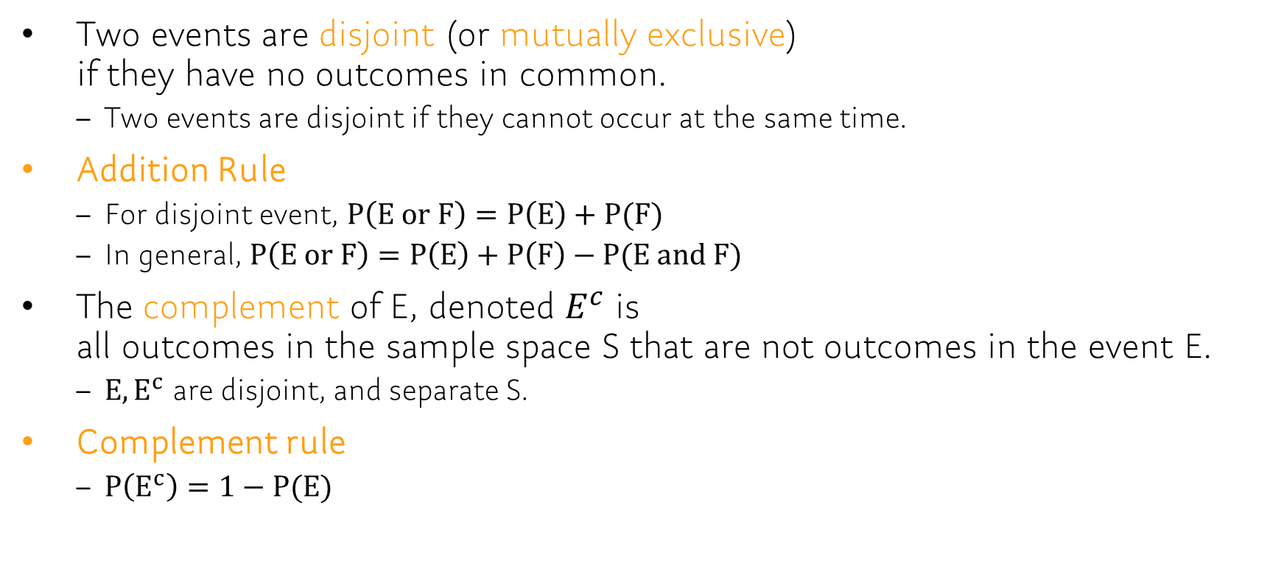
Chap5.2
Two events are disjoint (or mutually exclusive) if they have no outcomes in common.
Two events are disjoint if they cannot occur at the same time.
Addition Rule
For disjoint event, $P\left(E or F\right)=P\left(E\right)+P(F)$
In general, $P\left(E or F\right)=P\left(E\right)+P\left(F\right)−P(E and F)$
The complement of E, denoted $E^{c}$ is all outcomes in the sample space S that are not outcomes in the event E.
$E,E^{c}$ are disjoint, and separate S.
Complement rule
$P\left(E^{c}\right)=1−P(E)$
Notes:
Setting: Let S denote the sample space of a probability experiment and let E and F denote events.

Slide 10

Problem: Example
Let E, F be events with P(E)=0.25, P(F)=0.45
[5.2.13] P(E or F) if P(E and F) = 0.25
[5.2.14] P(E and F) if P(E or F) = 0.6
[5.2.15] P(E or F) if E and F are mutually exclusive
[5.2.16] P(E and F) if E and F are mutually exclusive
[5.2.17] $P(E^{c})$
[5.2.18] $P(F^{c})$
Notes:
[5.2.13] 0.55
[5.2.14] 0.1
[5.2.15] 0.7
[5.2.16] 0
[5.2.17] 0.75
[5.2.18] 0.55

Slide 11
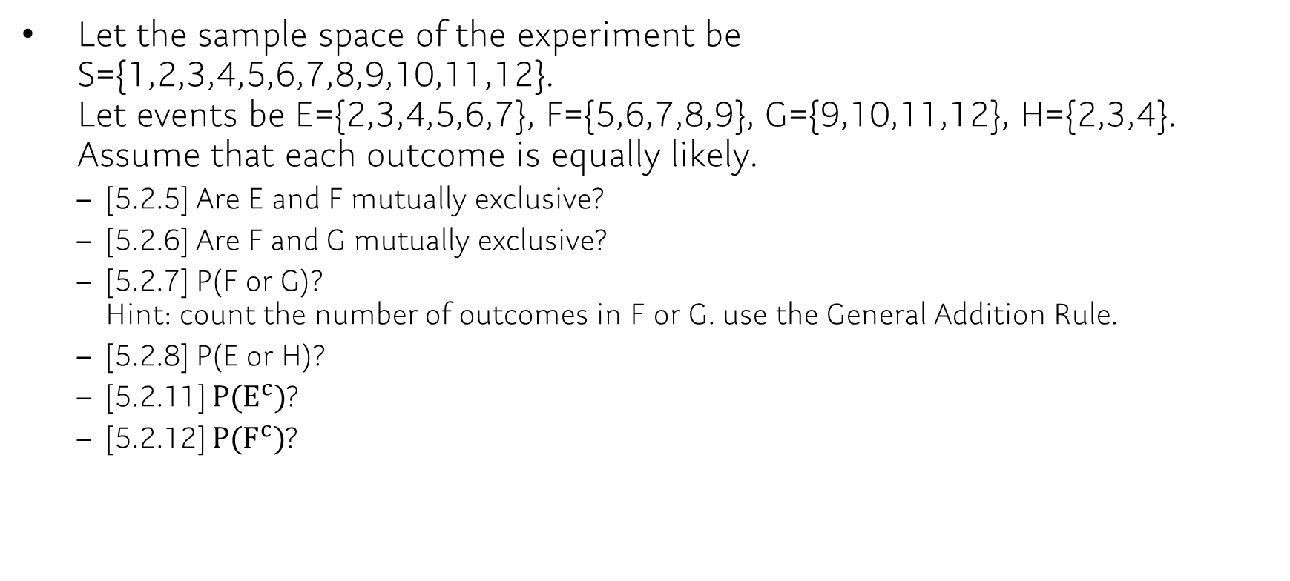
Problem
Let the sample space of the experiment be S={1,2,3,4,5,6,7,8,9,10,11,12}. Let events be E={2,3,4,5,6,7}, F={5,6,7,8,9}, G={9,10,11,12}, H={2,3,4}. Assume that each outcome is equally likely.
[5.2.5] Are E and F mutually exclusive?
[5.2.6] Are F and G mutually exclusive?
[5.2.7] P(F or G)? Hint: count the number of outcomes in F or G. use the General Addition Rule.
[5.2.8] P(E or H)?
[5.2.11] $P(E^{c})$?
[5.2.12] $P(F^{c})$?

Slide 12
Problem
A Deck of Cards A standard deck of cards contains 52 cards, as shown in Figure 9 on page 246. One card is randomly selected from the deck. Compute the probability of randomly selecting~
[5.2.31] a heart or club from a deck of cards.
[5.2.31] a heart or club or diamond from a deck of cards.
[5.2.31] an ace or heart from a deck of cards.
[5.2.32] a two or three from a deck of cards.
[5.2.32] a two or three or four from a deck of cards.
[5.2.32] a two or club from a deck of cards.
Notes:
[5.2.31]: example problem [5.2.32]: for students
[5.2.31] P(heart or club) = 1/2 = 0.5, P(heart or club or diamond) = 3/4 = 0.75, P(ace or heart) = (4+13-1)/52=16/52=4/13=0.308

Slide 13
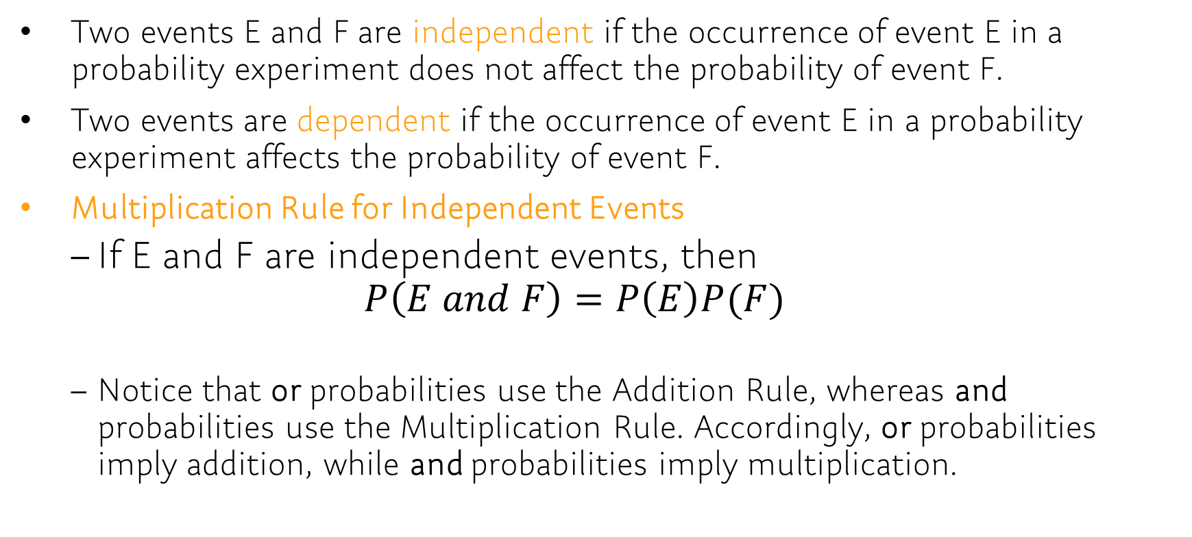
Chap 5.3
Two events E and F are independent if the occurrence of event E in a probability experiment does not affect the probability of event F.
Two events are dependent if the occurrence of event E in a probability experiment affects the probability of event F.
Multiplication Rule for Independent Events
If E and F are independent events, then $P\left(E and F\right)=P\left(E\right)P(F)$
Notice that or probabilities use the Addition Rule, whereas and probabilities use the Multiplication Rule. Accordingly, or probabilities imply addition, while and probabilities imply multiplication.

Slide 14
Problem: Example
[5.3.7] Determine whether the events E and F are independent or dependent.
E: Speeding on the interstate. VS F: Being pulled over by a police officer.
E: You gain weight. VS F: You eat fast food for dinner every night.
E: You get a high score on a stat7 exam. VS F: The Boston Red Sox win a baseball game.
[5.3.15] The ELISA is a test to determine whether the HIV antibody is present. The test is 99.5% effective, which means that the test will come back negative if the HIV antibody is not present 99.5% of the time. The probability of a test coming back positive when the antibody is not present (a false positive) is 0.005. Suppose that the ELISA is given to five randomly selected people who do not have the HIV antibody.
What is the probability that the ELISA comes back negative for all five people?
What is the probability that the ELISA comes back positive for at least one of the five people?
Notes:
[5.3.7] Dependent, Dependent, Independent
[5.3.15] P(all five are negative) = 0.995^5 = 0.9752, P(at least one is positive) = 1-0.9752 = 0.0248

Slide 15
Problem
[5.3.8] Determine whether the events E and F are independent or dependent.
E: The battery in your cell phone is dead. VS F: The batteries in your calculator are dead.
E: Your favorite color is blue. VS F: Your friend’s favorite hobby is fishing.
E: You are late for school. VS F: Your car runs out of gas.
[5.3.18] The probability that a randomly selected 40-year-old female will live to be 41 years old is 0.99855 according to the National Vital Statistics Report, Vol. 56, No. 9.
What is the probability that five randomly selected 40-year-old females will live to be 41 years old?
What is the probability that at least one of five randomly selected 40-year-old females will not live to be 41 years old?
Would it be unusual if at least one of five randomly selected 40-year-old females did not live to be 41 years old?

Slide 16
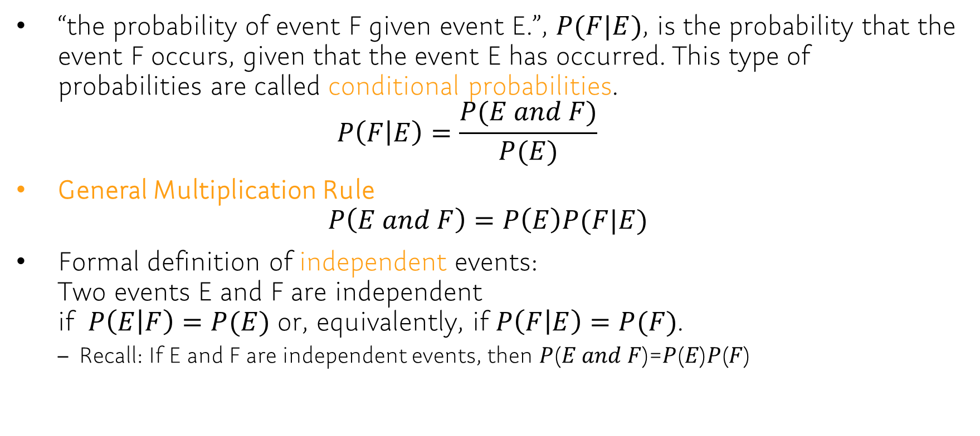
Chap 5.4
“the probability of event F given event E.”, $P(F|E)$, is the probability that the event F occurs, given that the event E has occurred. This type of probabilities are called conditional probabilities. $P\left(F | E\right)=\frac{P(E and F)}{P(E)}$
General Multiplication Rule $P\left(E and F\right)=P\left(E\right)P(F|E)$
Formal definition of independent events: Two events E and F are independent if $P\left(E | F\right)=P(E)$ or, equivalently, if $P\left(F | E\right)=P(F)$.
Recall: If E and F are independent events, then 𝑃(𝐸 𝑎𝑛𝑑 𝐹)=𝑃(𝐸)𝑃(𝐹)

Slide 17
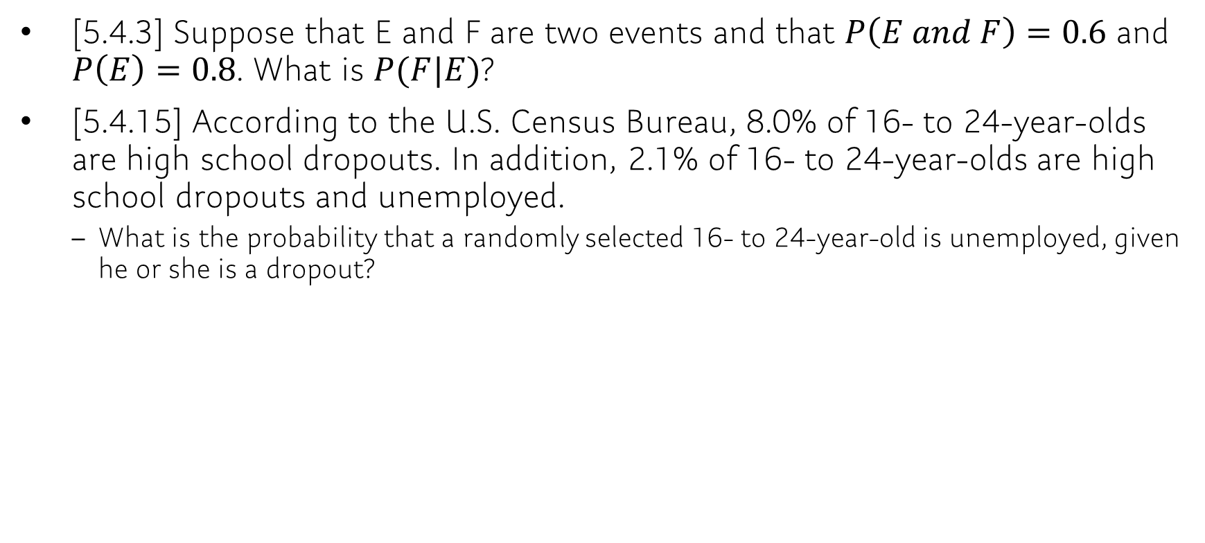
Problem: Example
[5.4.3] Suppose that E and F are two events and that $P\left(E and F\right)=0.6$ and $P\left(E\right)=0.8$. What is $P(F|E)$?
[5.4.15] According to the U.S. Census Bureau, 8.0% of 16- to 24-year-olds are high school dropouts. In addition, 2.1% of 16- to 24-year-olds are high school dropouts and unemployed.
What is the probability that a randomly selected 16- to 24-year-old is unemployed, given he or she is a dropout?
Notes:
[5.4.3] P(F|E)=0.6/0.8=0.75
[5.4.15] P(unemployed | dropout) = 0.021/0.08=0.263

Slide 18
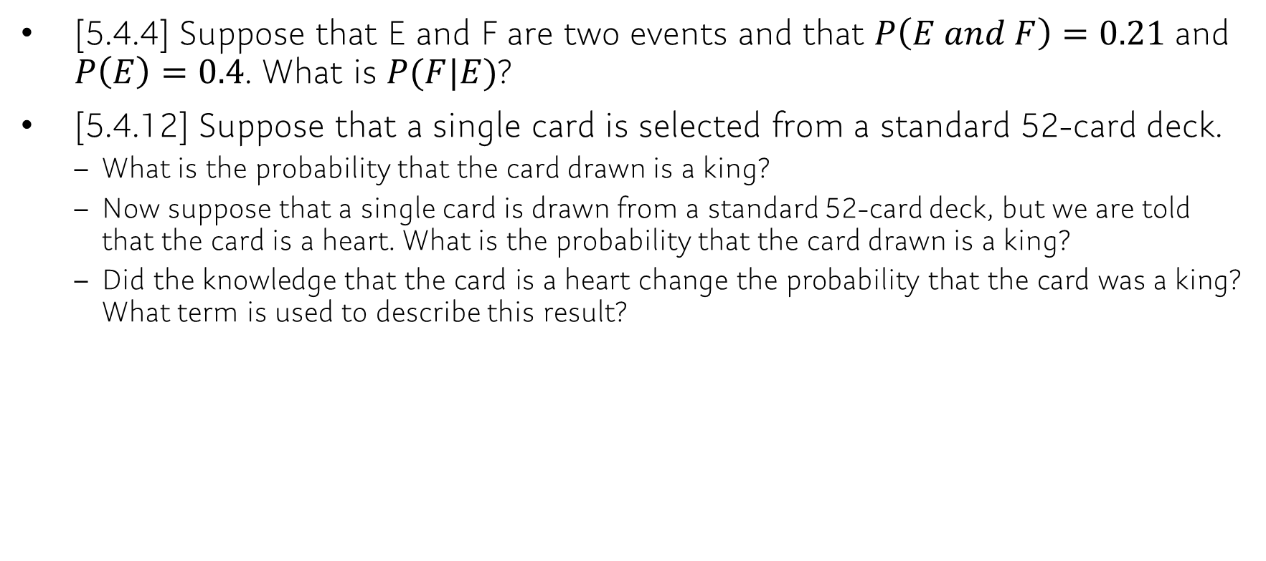
Problem
[5.4.4] Suppose that E and F are two events and that $P\left(E and F\right)=0.21$ and $P\left(E\right)=0.4$. What is $P(F|E)$?
[5.4.12] Suppose that a single card is selected from a standard 52-card deck.
What is the probability that the card drawn is a king?
Now suppose that a single card is drawn from a standard 52-card deck, but we are told that the card is a heart. What is the probability that the card drawn is a king?
Did the knowledge that the card is a heart change the probability that the card was a king? What term is used to describe this result?

Slide 19
Problem: Example
[5.4.17] In a recent Harris Poll, a random sample of adult Americans was asked, “When you see an ad emphasizing that a product is ‘Made in America,’ are you more likely to buy it?”
What is the probability that a randomly selected individual is 35–44 years of age, given the individual is more likely to buy a product emphasized as “Made in America”?
What is the probability that a randomly selected individual is more likely to buy a product emphasized as “Made in America,” given the individual is 35–44 years of age?
Are 18- to 34-year-olds more likely to buy a product emphasized as “Made in America” than individuals in general?
 | 18–34 | 35–44 | 45–54 | 55+ | Total
More likely | 238 | 329 | 360 | 402 | 1329
Less likely | 22 | 6 | 22 | 16 | 66
Neither | 282 | 201 | 164 | 118 | 765
Total | 542 | 536 | 546 | 536 | 2160
Source: The Harris Poll
Notes:
P(35–44 | more likely)=329/1329=0.248
P(more likely | 35–44) =329/536=0.614
No; they are less likely to buy American; 238/542=0.439 for 18- to 34-year-olds compared to 1329/2160=0.615 in general.

Slide 20
Problem
[5.4.18] Adult Americans (18 years or older) were asked whether they used social media (Facebook, Twitter, and so on) regularly. The following table is based on the results of the survey.
What is the probability that a randomly selected adult American uses social media, given the individual is 18–34 years of age?
What is the probability that a randomly selected adult American is 18–34 years of age, given the individual uses social media?
Are 18- to 34-year olds more likely to use social media than individuals in general? Why?
 | 18–34 | 35–44 | 45–54 | 55+ | Total
Use social media | 117 | 89 | 83 | 49 | 338
Do not use social media | 33 | 36 | 57 | 66 | 192
Total | 150 | 125 | 140 | 115 | 530
Source: Harris Interactive

Slide 21
Q&A / Announcement
Survey:
Temporarily, office hours would be held via Zoom.
Next week:
Chap 7.1, 7.2, 7.3, 8.1, 8.2
Don’t forget to submit your homework (due: Friday 5:00 pm)!!

