Slide 1

STAT7: Discussion Section

Slide 2
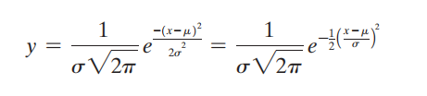
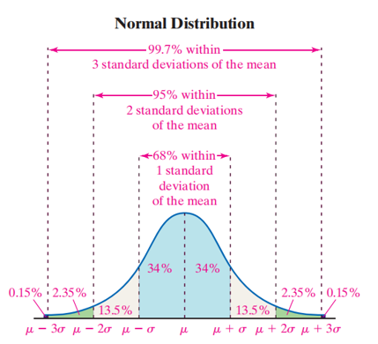
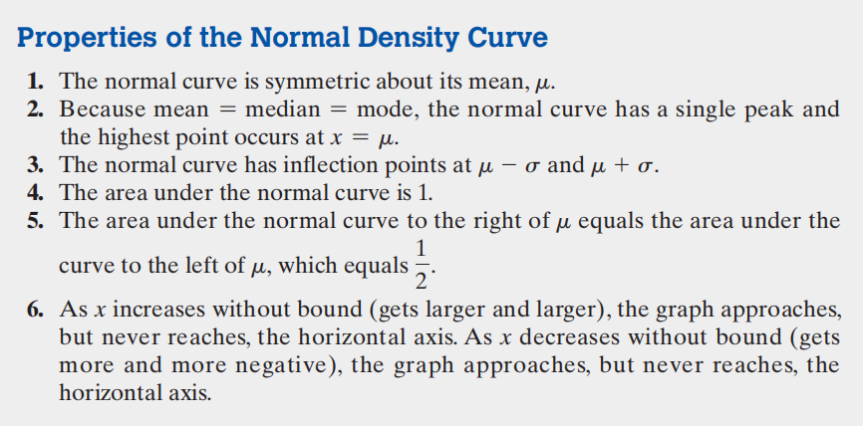
Ch7.1 Normal Distribution
Normal Distribution:
- A continuous random variable is normally distributed, or has a normal probability distribution, if its relative frequency histogram has the shape of a normal curve. (Approximately a bell-shaped curve)

Slide 3
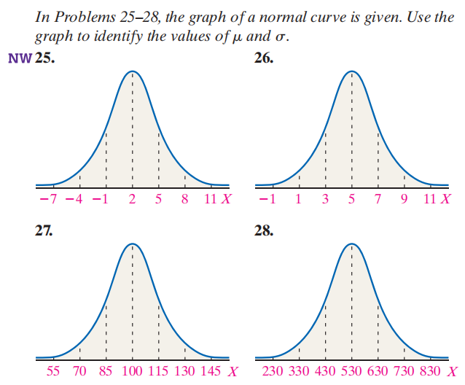
Ch7.1 Normal Distribution
How to specify the mean from the picture?
The peak
How to specify the standard deviation?
The range of X.

Slide 4
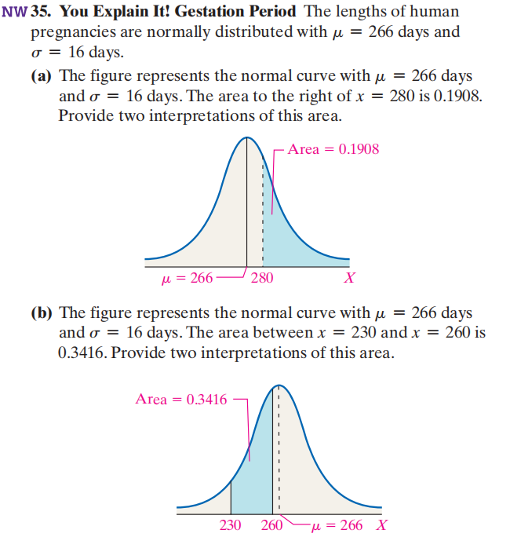
Ch7.1 Normal Distribution
What is the sum of the area under the normal curve?
One
Why does the sum of the area sum to one?
Axiom of probability.
What does certain partition of area under the curve mean?
Probability of x belongs to certain set

Slide 5
Ch7.1 Normal Distribution
How to specify the mean from the picture?
The peak
How to specify the standard deviation?
The range of X.

Slide 6
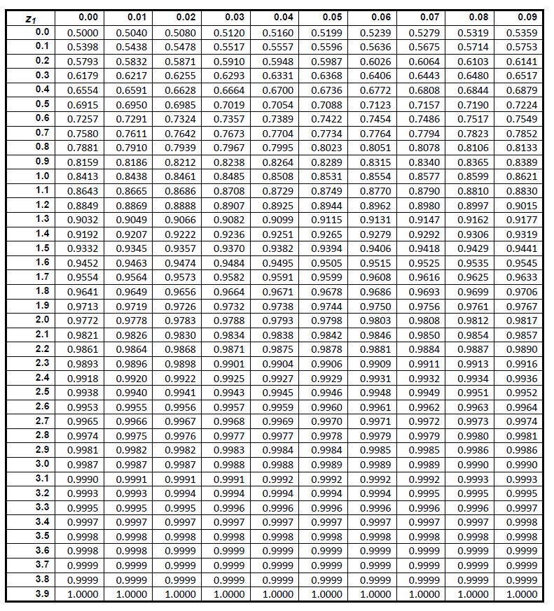
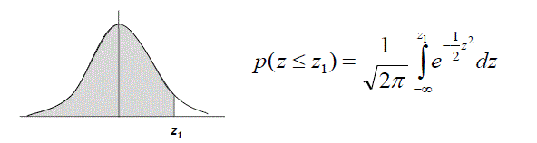
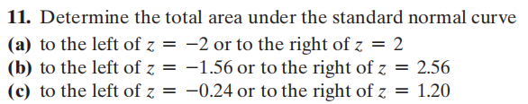
Ch7.2 Application of Normal Distribution
Remember:
All the area under the curve sums to 1.
The distribution is symmetric about the mean.

Slide 7
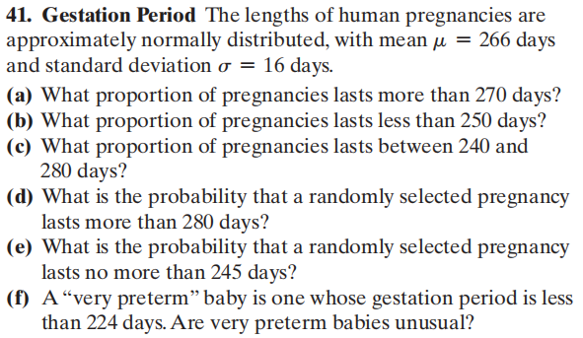
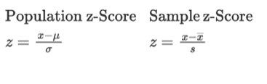
Ch7.2 Application of Normal Distribution
How to calculate when you are only provided standard normal table, but not a table that you want?
Transfer to z-score!
Remember:
z-score follows an approximately standard normal distribution.

Slide 8
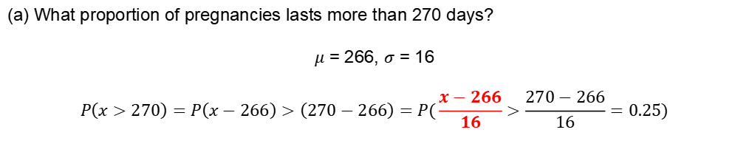
Ch7.2 Application of Normal Distribution
What proportion of pregnancies lasts more than 270 days?
$μ$ = 266, $σ$ = 16
$$P\left(x>270\right)=P\left(x−266\right)>\left(270−266\right)=P(\frac{x−266}{16}>\frac{270−266}{16}=0.25)$$
Check the table again to get the number, or by technical methods.
Other questions similar, leave for your exercise.

Slide 9
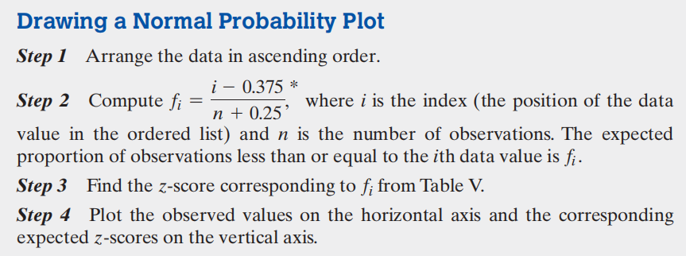
Ch7.3 Assessing Normality
Why do we need to assess normality?
Traditional judgement from common sense is not rigorous enough. Need clear and more scientific method.

Slide 10
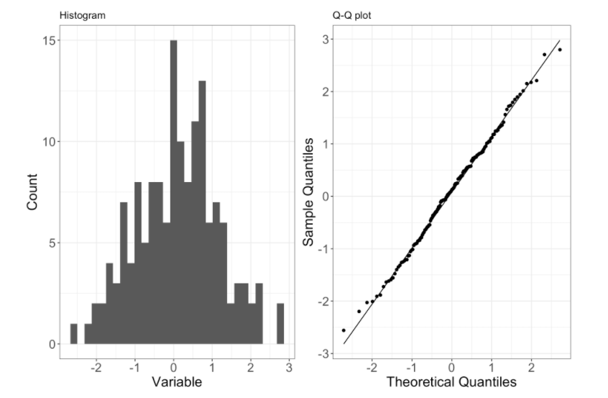
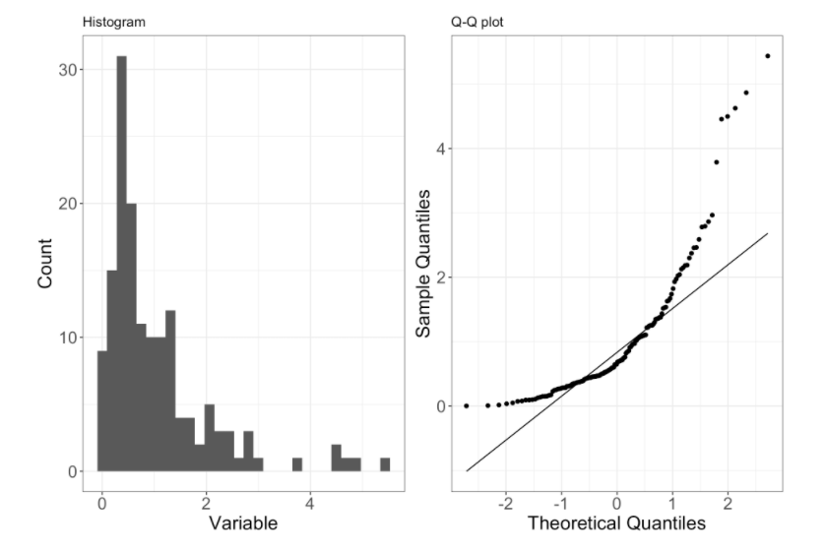
Ch7.3 Assessing Normality
How to judge from the plot?
If the points approximately are on a straight line, the slope is approximately 1 for quantile-quantile plot, then it satisfies perfect normality.

Slide 11
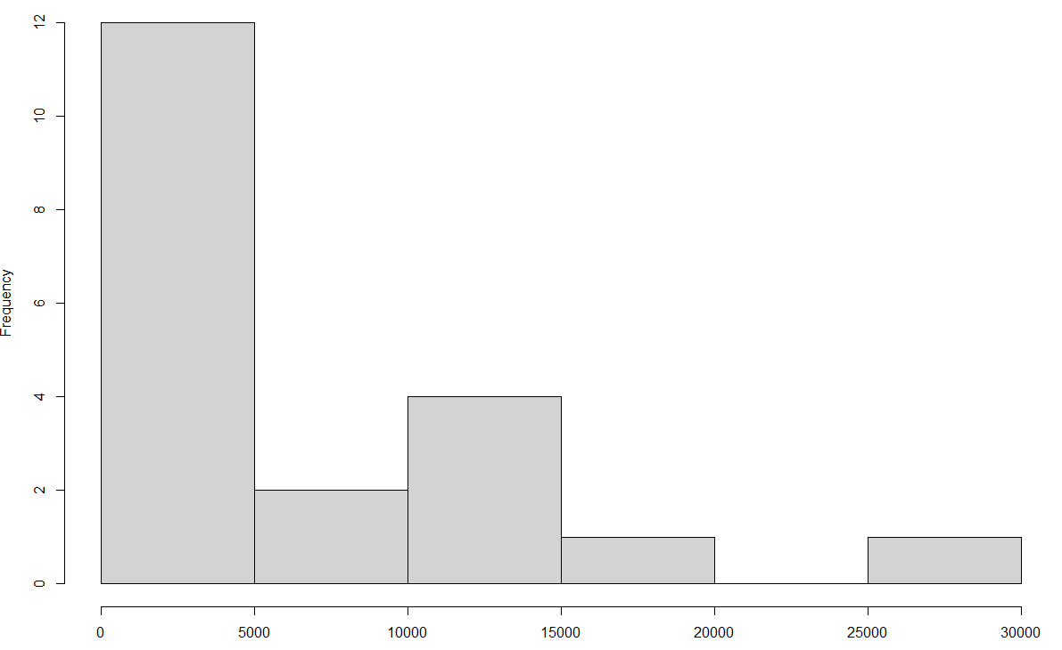
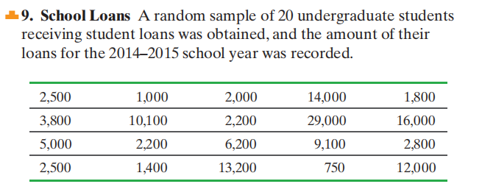
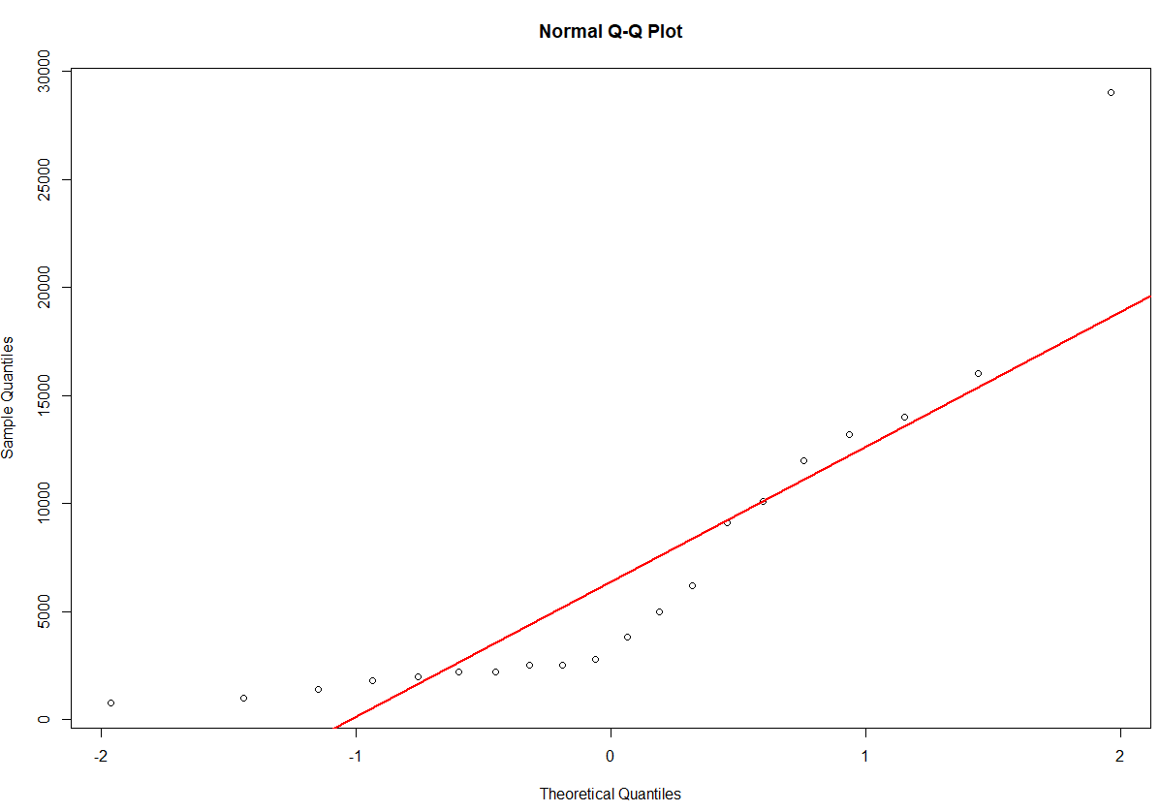
Ch7.3 Assessing Normality
Not normal. Also, we can judge the correlation coefficient (you will learn later) between theoretical and true z-score. If the correlation is greater than 0.951, then we can say it is normally distributed. But the correlation in this case is: 0.88 < 0.951.

Slide 12
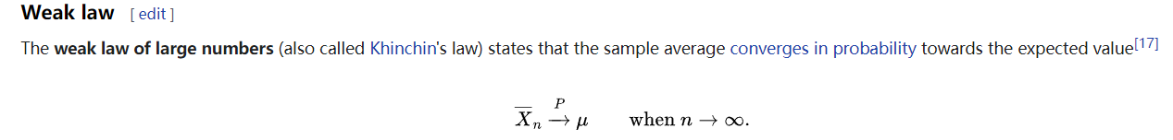
Law of Large Number

Slide 13
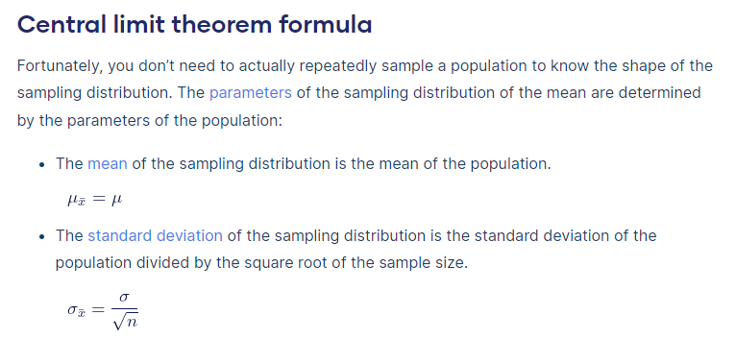

Central Limit Theorem

