Slide 1

STAT7: Discussion Section #9
Mar 6, 2022

Slide 2
Quiz
Quiz link: https://docs.google.com/forms/d/e/1FAIpQLSdDugcFIkjCI18ss9xWP4tx4ywojAjno9ga5ngJX1ikDAQztw/viewform?usp=sf_link
Prepare the standard normal distribution table and t- distribution table table.
Open book, Open note
You MAY use your textbook / note / or even internet search.
Rubric
If you get more than 1 complete answers (with trials for all problems): 100
If you make 1 or 0 complete answer (with full trials): 90
If you have no correct answer (without full trials): 80
Late submission: 70
No submission: 0

Slide 3
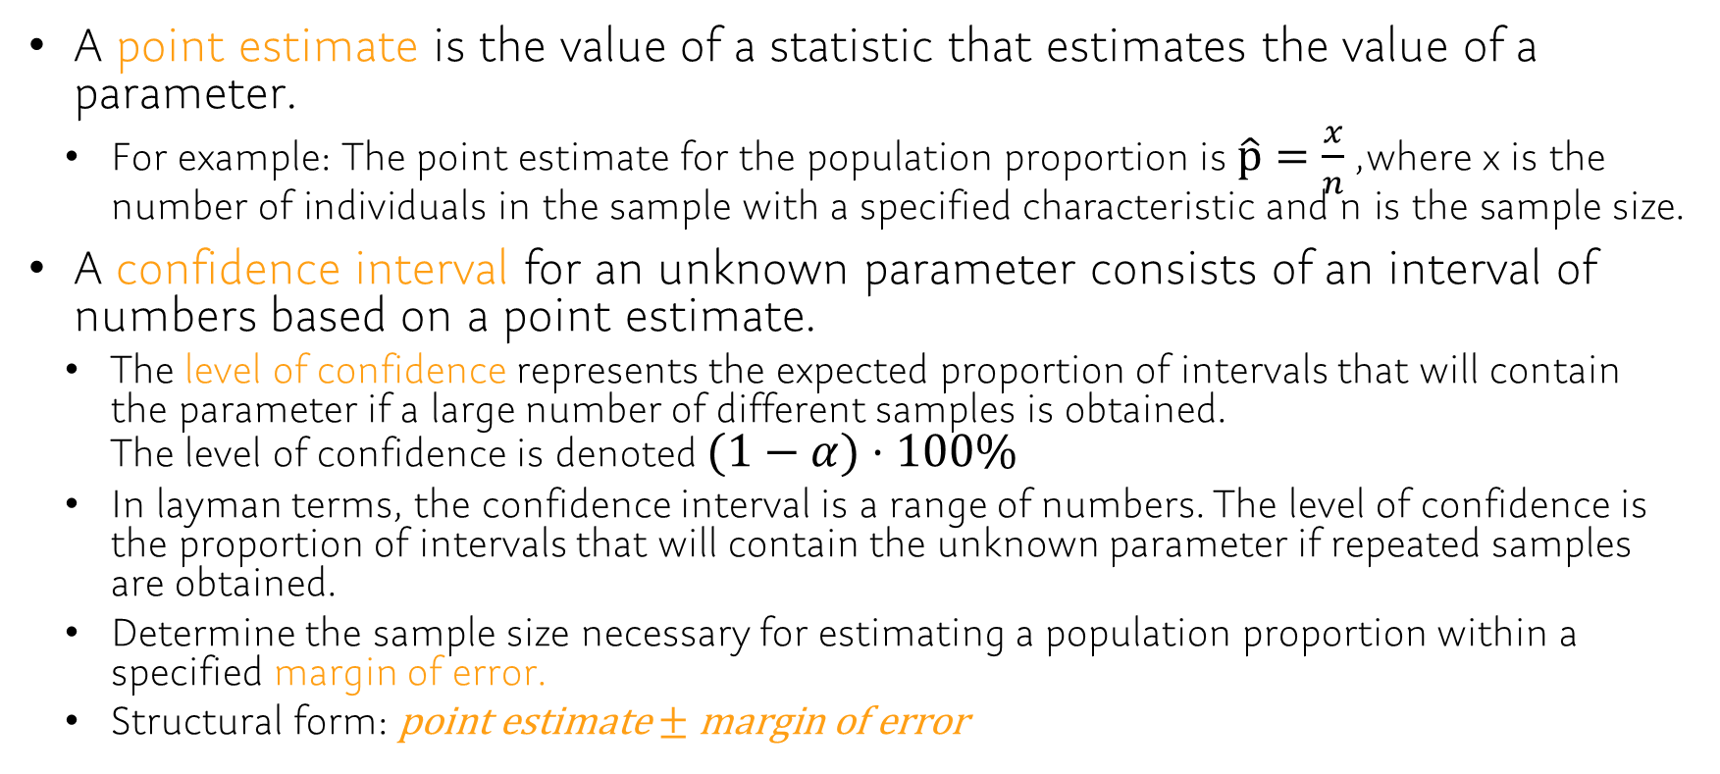
Chap9
A point estimate is the value of a statistic that estimates the value of a parameter.
For example: The point estimate for the population proportion is $\hat{p}=\frac{x}{n}$, where x is the number of individuals in the sample with a specified characteristic and n is the sample size.
A confidence interval for an unknown parameter consists of an interval of numbers based on a point estimate.
The level of confidence represents the expected proportion of intervals that will contain the parameter if a large number of different samples is obtained. The level of confidence is denoted $(1−α)⋅100\%$
In layman terms, the confidence interval is a range of numbers. The level of confidence is the proportion of intervals that will contain the unknown parameter if repeated samples are obtained.
Determine the sample size necessary for estimating a population proportion within a specified margin of error.
Structural form: $\text{point} \text{estimate}±\text{margin} \text{of} \text{error}$

Slide 4
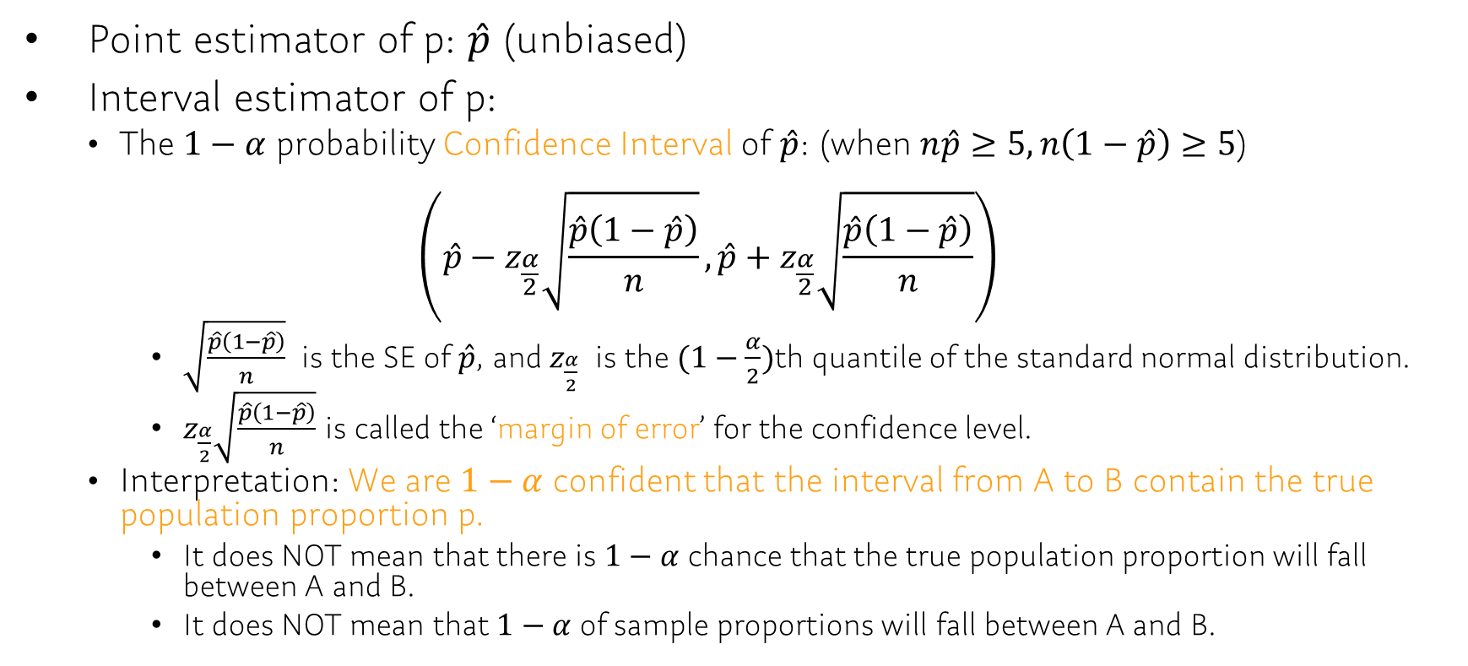
Ch9.1 Estimating a Population Proportion
Point estimator of p: $\hat{p}$ (unbiased)
Interval estimator of p:
The $1−α$ probability Confidence Interval of $\hat{p}$: (when $n\hat{p}≥5, n\left(1−\hat{p}\right)≥5$)
$$\left(\hat{p}−z_{\frac{α}{2}}\sqrt{\frac{\hat{p}\left(1−\hat{p}\right)}{n}},\hat{p}+z_{\frac{α}{2}}\sqrt{\frac{\hat{p}\left(1−\hat{p}\right)}{n}}\right)$$
$\sqrt{\frac{\hat{p}\left(1−\hat{p}\right)}{n}}$ is the SE of $\hat{p}$, and $z_{\frac{α}{2}}$ is the $(1−\frac{α}{2})$th quantile of the standard normal distribution.
$z_{\frac{α}{2}}\sqrt{\frac{\hat{p}\left(1−\hat{p}\right)}{n}}$ is called the ‘margin of error’ for the confidence level.
Interpretation: We are $1−α$ confident that the interval from A to B contain the true population proportion p.
It does NOT mean that there is $1−α$ chance that the true population proportion will fall between A and B.
It does NOT mean that $1−α$ of sample proportions will fall between A and B.

Slide 5
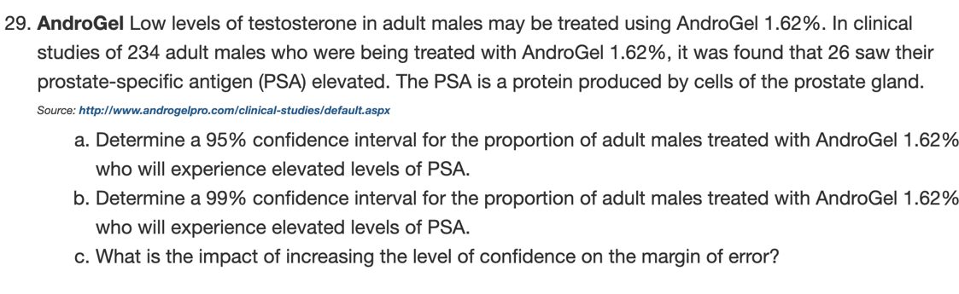
Ch9.1: Example
STAT7 Discussion Section
Notes:
p_hat=26/234 = 0.111
-> p_hat +- z*sqrt(p_hat(1-p_hat)/n) = 0.111 +- z*0.02053546
For 95% conf.interval, z=qnorm(0.975)=1.96 => interval: 0.111 +- 0.0402495
For 99% conf.interval, z=qnorm(0.995)=2.58 => interval: 0.111 +- 0.05298149

Slide 6
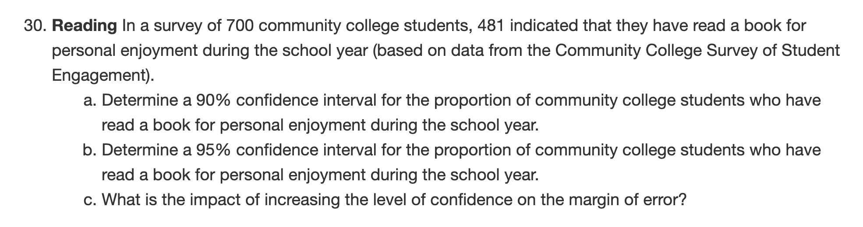
Ch9.1
STAT7 Discussion Section

Slide 7
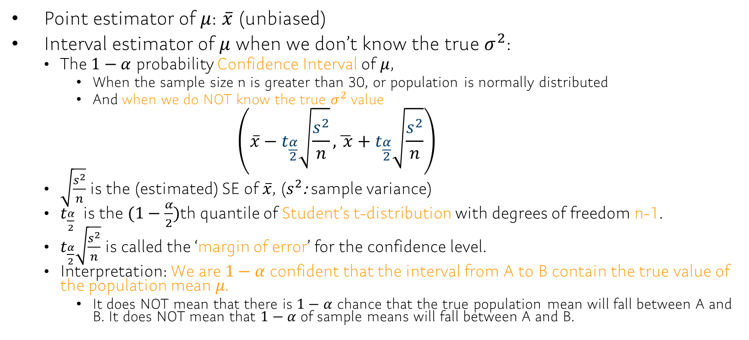
Ch9.2 Estimating a Population Mean
Point estimator of $μ$: $\overline{x}$ (unbiased)
Interval estimator of $μ$ when we don’t know the true $σ^{2}$:
The $1−α$ probability Confidence Interval of $μ$,
When the sample size n is greater than 30, or population is normally distributed
And when we do NOT know the true $σ^{2}$value $\left(\overline{x}−t_{\frac{α}{2}}\sqrt{\frac{s^{2}}{n}},\overline{ x}+t_{\frac{α}{2}}\sqrt{\frac{s^{2}}{n}}\right)$
$\sqrt{\frac{s^{2}}{n}}$is the (estimated) SE of $\overline{x}$, ($s^{2}$: sample variance)
$t_{\frac{α}{2}}$ is the $(1−\frac{α}{2})$th quantile of Student’s t-distribution with degrees of freedom n-1.
$t_{\frac{α}{2}}\sqrt{\frac{s^{2}}{n}}$ is called the ‘margin of error’ for the confidence level.
Interpretation: We are $1−α$ confident that the interval from A to B contain the true value of the population mean 𝜇.
It does NOT mean that there is $1−α$ chance that the true population mean will fall between A and B. It does NOT mean that $1−α$ of sample means will fall between A and B.

Slide 8
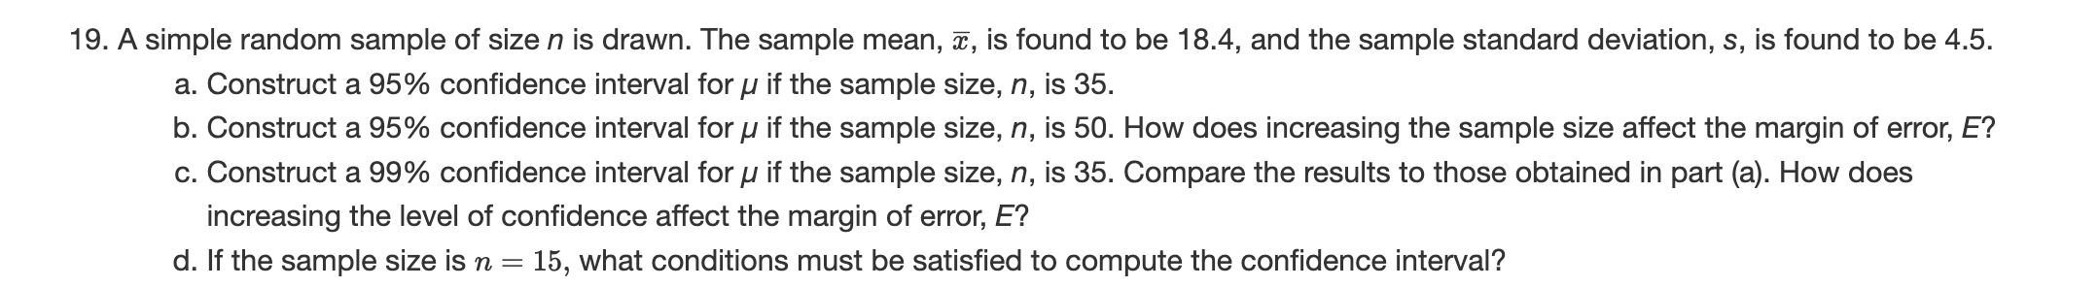
Ch9.2 Example
STAT7 Discussion Section
Notes:
X_bar +- t * s/sqrt(n)
18.4 +- qt(0.975,34) * 4.5 / sqrt(35) = 18.4 +- 2.032245 * 4.5 / 5.91608 = 18.4 +- 1.545804
18.4 +- qt(0.975,49) * 4.5 / sqrt(50) = 18.4 +- 2.009575 * 4.5 / 7.071068 = 18.4 +- 1.278886
18.4 +- qt(0.995,34) * 4.5 / sqrt(35) = 18.4 +- 2.728394 * 4.5 / 5.91608 = 18.4 +- 2.075323
Population should be normal (we can apply CLT)

Slide 9
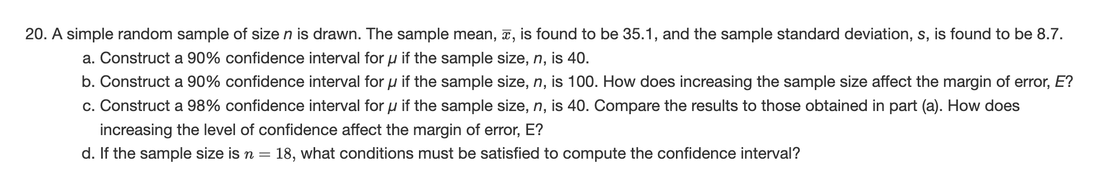
Ch9.2
STAT7 Discussion Section

Slide 10
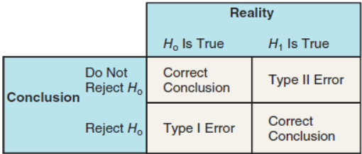
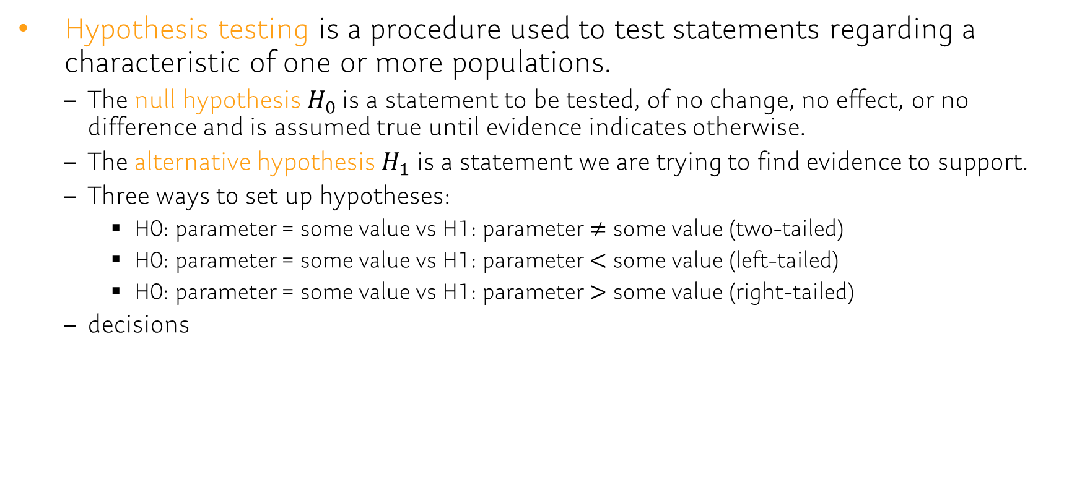
Ch 10.1 The Language of Hypothesis Testing
Hypothesis testing is a procedure used to test statements regarding a characteristic of one or more populations.
The null hypothesis$H_{0}$ is a statement to be tested, of no change, no effect, or no difference and is assumed true until evidence indicates otherwise.
The alternative hypothesis $H_{1}$ is a statement we are trying to find evidence to support.
Three ways to set up hypotheses:
H0: parameter = some value vs H1: parameter $≠$ some value (two-tailed)
H0: parameter = some value vs H1: parameter $<$ some value (left-tailed)
H0: parameter = some value vs H1: parameter $>$ some value (right-tailed)
decisions

Slide 11
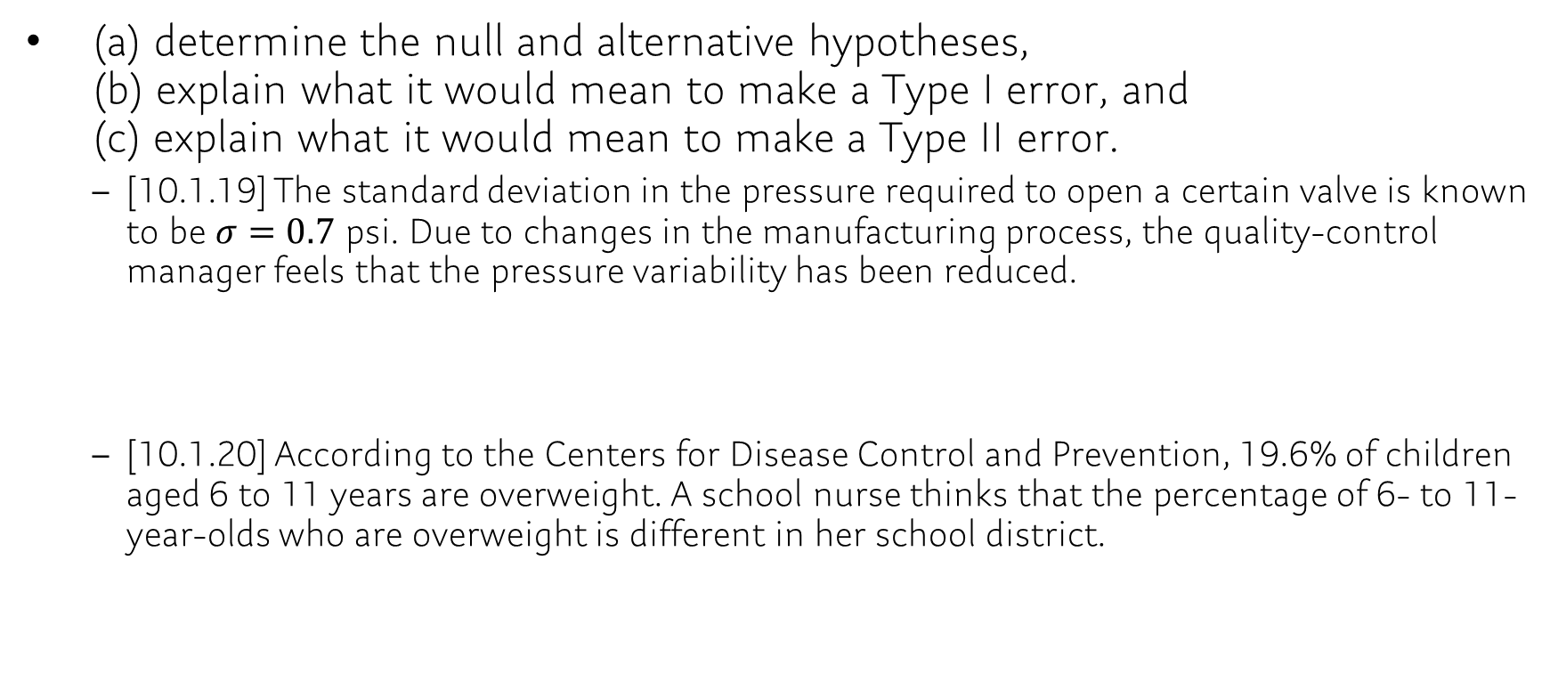
Ch 10.1
(a) determine the null and alternative hypotheses, (b) explain what it would mean to make a Type I error, and (c) explain what it would mean to make a Type II error.
[10.1.19] The standard deviation in the pressure required to open a certain valve is known to be $σ=0.7$ psi. Due to changes in the manufacturing process, the quality-control manager feels that the pressure variability has been reduced.
[10.1.20] According to the Centers for Disease Control and Prevention, 19.6% of children aged 6 to 11 years are overweight. A school nurse thinks that the percentage of 6- to 11-year-olds who are overweight is different in her school district.
Notes:
H0: σ = 0.7 psi, H1: σ < 0.7 psi
The quality-control manager rejects the hypothesis that the variability in the pressure required is 0.7 psi, when the true variability is 0.7 psi.
The quality-control manager fails to reject that the variability in the pressure required is 0.7 psi, when the variability is less than 0.7 psi.

Slide 12
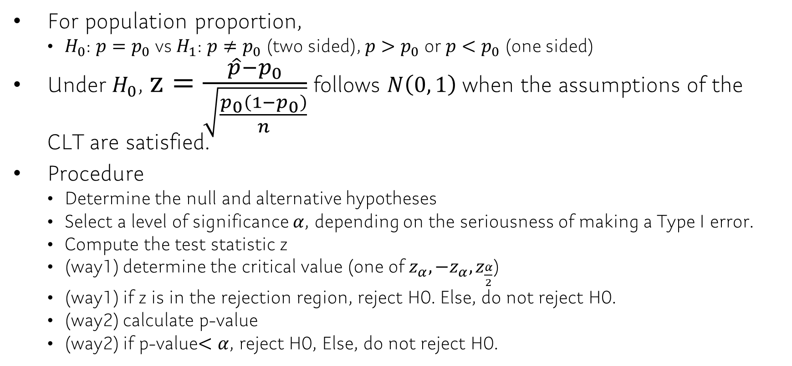
Ch 10.2 Hypothesis Tests for a Population Proportion
For population proportion,
$H_{0}$: $p=p_{0}$ vs $H_{1}$: $p≠p_{0}$ (two sided), $p>p_{0}$ or $p<p_{0}$ (one sided)
Under $H_{0}$, $z=\frac{\hat{p}−p_{0}}{\sqrt{\frac{p_{0}\left(1−p_{0}\right)}{n}}}$ follows $N\left(0, 1\right)$ when the assumptions of the CLT are satisfied.
Procedure
Determine the null and alternative hypotheses
Select a level of significance $α$, depending on the seriousness of making a Type I error.
Compute the test statistic z
(way1) determine the critical value (one of $z_{α},{−z}_{α}, z_{\frac{α}{2}}$)
(way1) if z is in the rejection region, reject H0. Else, do not reject H0.
(way2) calculate p-value
(way2) if p-value$<α$, reject H0, Else, do not reject H0.

Slide 13

Ch 10.2: Example
[10.2.17] The drug Lipitor is meant to reduce cholesterol and LDL cholesterol. In clinical trials, 19 out of 863 patients taking 10 mg of Lipitor daily complained of flulike symptoms. Suppose that it is known that 1.9% of patients taking competing drugs complain of flulike symptoms. Is there evidence to conclude that more than 1.9% of Lipitor users experience flulike symptoms as a side effect at the $α=0.01$ level of significance?
Notes:
np₀(1 − p₀) = 16.1 > 10 and n ≤ 0.05 N.
Hypotheses: H₀: p = 0.019, H₁: p > 0.019
Classical approach: z₀ = 0.65 < z_{0.01} = 2.33; do not reject the null hypothesis.
P-value approach: P-value 0.2578 [Tech: 0.2582] > α = 0.01; do not reject the null hypothesis.
There is not sufficient evidence at the α = 0.01 level of significance to conclude that more than 1.9% of Lipitor users experience flulike symptoms as a side effect.

Slide 14
Ch 10.2
[10.2.18] Nexium is a drug that can be used to reduce the acid produced by the body and heal damage to the esophagus due to acid reflux. The manufacturer of Nexium claims that more than 94% of patients taking Nexium are healed within 8 weeks. In clinical trials, 213 of 224 patients suffering from acid reflux disease were healed after 8 weeks. Test the manufacturer’s claim at the level of significance.

Slide 15
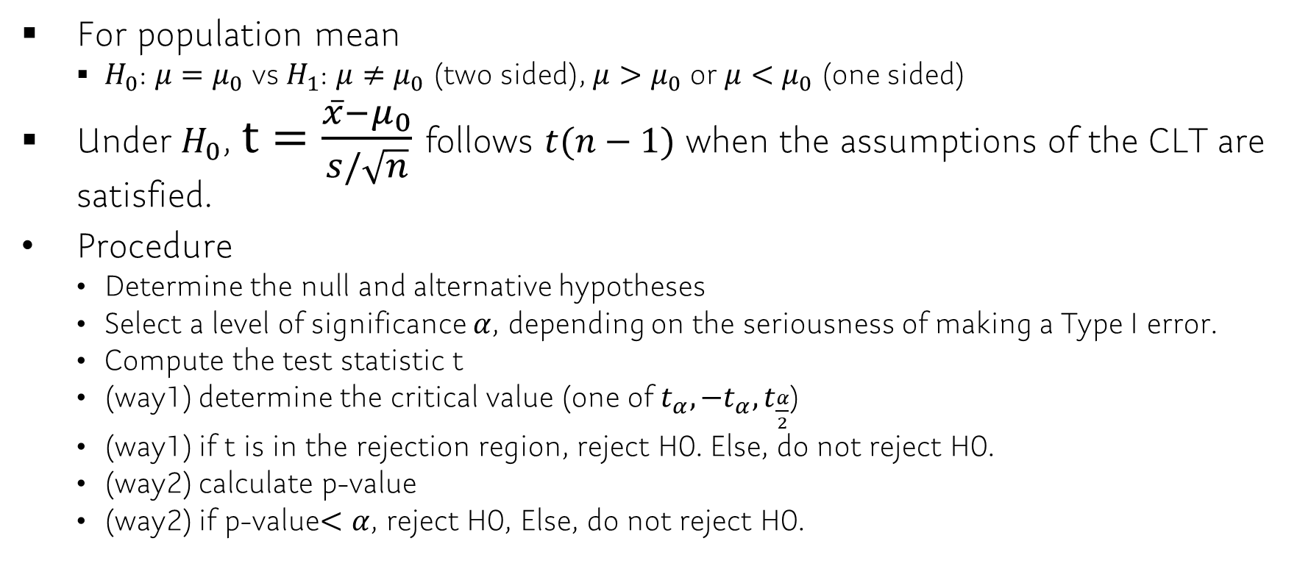
Ch 10.3 Hypothesis Test for a Population Mean
For population mean
$H_{0}$: $μ=μ_{0}$ vs $H_{1}$: $μ≠μ_{0}$ (two sided), $μ>μ_{0}$ or $μ<μ_{0}$ (one sided)
Under $H_{0}$, $t=\frac{\overline{x}−μ_{0}}{s/\sqrt{n}}$ follows $t(n−1)$ when the assumptions of the CLT are satisfied.
Procedure
Determine the null and alternative hypotheses
Select a level of significance $α$, depending on the seriousness of making a Type I error.
Compute the test statistic t
(way1) determine the critical value (one of $t_{α},{−t}_{α}, t_{\frac{α}{2}}$)
(way1) if t is in the rejection region, reject H0. Else, do not reject H0.
(way2) calculate p-value
(way2) if p-value$<α$, reject H0, Else, do not reject H0.

Slide 16
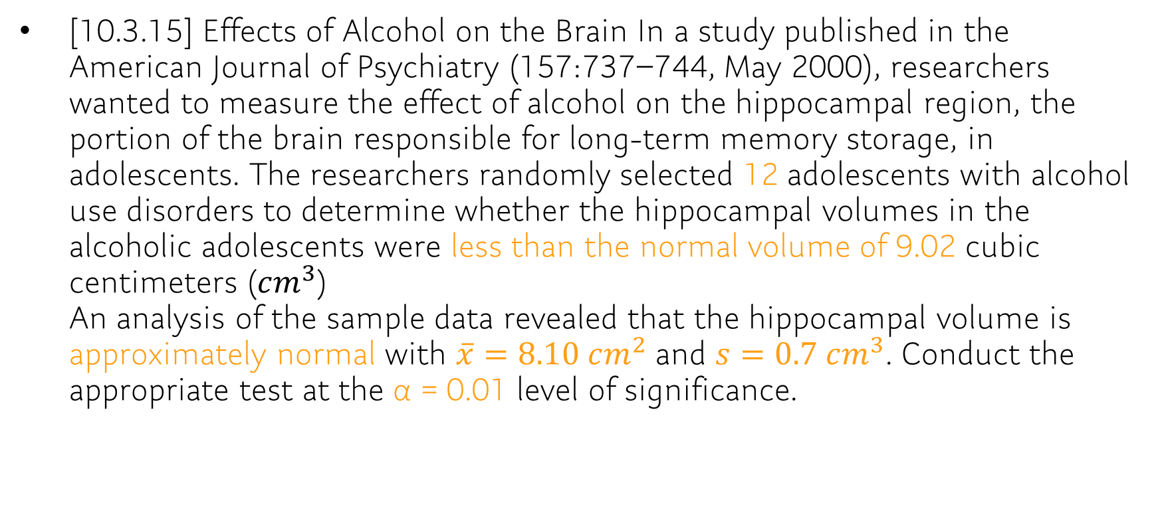
Ch 10.3: Example
[10.3.15] Effects of Alcohol on the Brain In a study published in the American Journal of Psychiatry (157:737–744, May 2000), researchers wanted to measure the effect of alcohol on the hippocampal region, the portion of the brain responsible for long-term memory storage, in adolescents. The researchers randomly selected 12 adolescents with alcohol use disorders to determine whether the hippocampal volumes in the alcoholic adolescents were less than the normal volume of 9.02 cubic centimeters ($cm^{3}$) An analysis of the sample data revealed that the hippocampal volume is approximately normal with $\overline{x}=8.10 cm^{2}$ and $s=0.7 cm^{3}$. Conduct the appropriate test at the α = 0.01 level of significance.
Notes:
Hypotheses: H₀: μ = 9.02 cm³, H₁: μ < 9.02 cm³.
Classical approach: t₀ = −4.553 < −t_{0.01} = −2.718 cm²; reject the null hypothesis.
P-value approach: P-value < 0.0005 [Tech: P-value = 0.0004] < α = 0.01;
reject the null hypothesis. There is sufficient evidence to conclude that the mean hippocampal volume in alcoholic adolescents is less than the normal mean volume of 9.02 cm³.

Slide 17
Ch 10.3
[10.3.16] Para-nonylphenol is found in polyvinyl chloride (PVC) used in the food processing and packaging industries. Researchers wanted to determine the effect this substance had on the organ weight of first-generation mice when both parents were exposed to 50 micrograms per liter (μg/L) of para-nonylphenol in drinking water for 4 weeks. After 4 weeks, the mice were bred. After 100 days, the offspring of the exposed parents were sacrificed and the kidney weights were determined. The mean kidney weight of the 12 offspring was found to be 396.9 milligrams (mg), with a standard deviation of 45.4 mg. Is there significant evidence to conclude that the kidney weight of the offspring whose parents were exposed to 50 μg/L of para-nonylphenol in drinking water for 4 weeks is greater than 355.7 mg, the mean weight of kidneys in normal 100-day-old mice at the α = 0.05 level of significance?

Slide 18
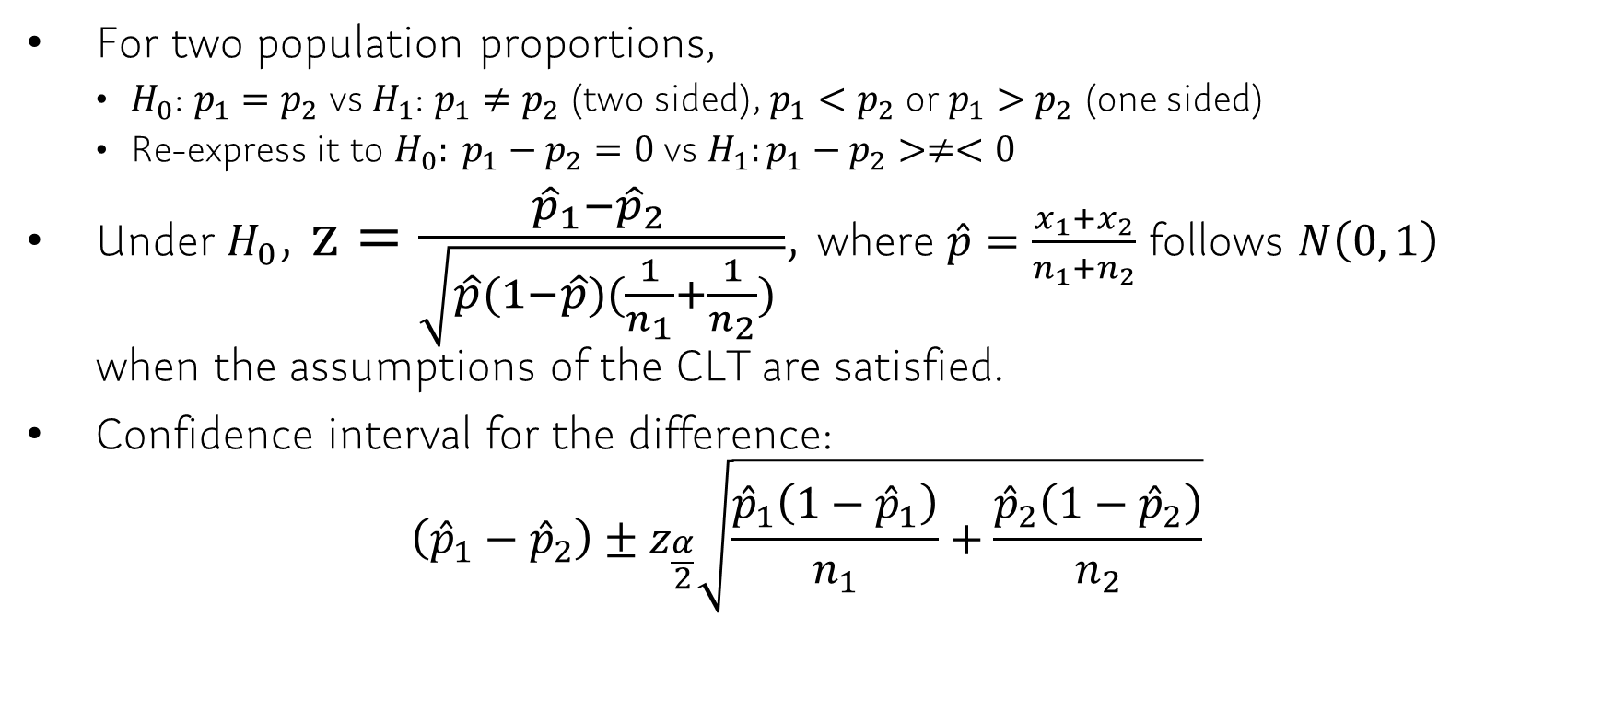
Ch 11.1 Inference about Two Population Proportions
For two population proportions,
$H_{0}$: $p_{1}=p_{2}$ vs $H_{1}$: $p_{1}≠p_{2}$ (two sided), $p_{1}<p_{2}$ or $p_{1}>p_{2}$ (one sided)
Re-express it to $H_{0}: p_{1}−p_{2}=0$ vs $H_{1}:p_{1}−p_{2}>≠<0$
Under $H_{0}$, $z=\frac{{\hat{p}}_{1}−{\hat{p}}_{2 }}{\sqrt{\hat{p}(1−\hat{p})(\frac{1}{n_{1}}+\frac{1}{n_{2}}) }}$, where $\hat{p}=\frac{x_{1}+x_{2}}{n_{1}+n_{2}}$ follows $N\left(0, 1\right)$ when the assumptions of the CLT are satisfied.
Confidence interval for the difference: $\left({\hat{p}}_{1}−{\hat{p}}_{2}\right)±z_{\frac{α}{2}}\sqrt{\frac{{\hat{p}}_{1}\left(1−{\hat{p}}_{1}\right)}{n_{1}}+\frac{{\hat{p}}_{2}\left(1−{\hat{p}}_{2}\right)}{n_{2}}}$

Slide 19
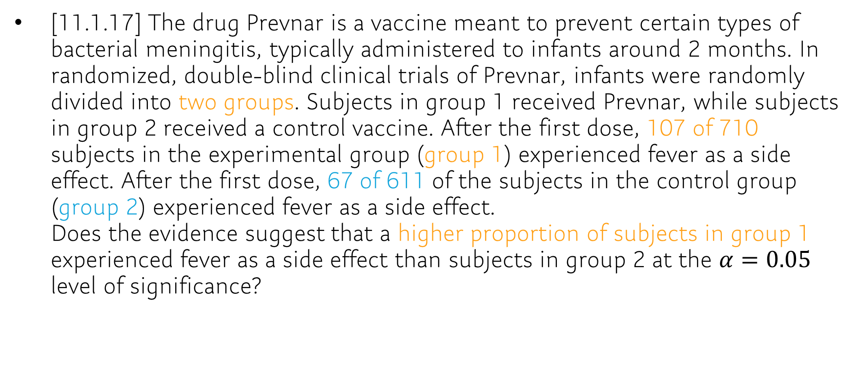
Ch 11.1: Example
[11.1.17] The drug Prevnar is a vaccine meant to prevent certain types of bacterial meningitis, typically administered to infants around 2 months. In randomized, double-blind clinical trials of Prevnar, infants were randomly divided into two groups. Subjects in group 1 received Prevnar, while subjects in group 2 received a control vaccine. After the first dose, 107 of 710 subjects in the experimental group (group 1) experienced fever as a side effect. After the first dose, 67 of 611 of the subjects in the control group (group 2) experienced fever as a side effect. Does the evidence suggest that a higher proportion of subjects in group 1 experienced fever as a side effect than subjects in group 2 at the $α=0.05$ level of significance?
Notes:
Each sample is the result of a completely randomized design experiment; the response variable is qualitative with two outcomes.
n1p^(1−p^1)=91≥10 and n2p^2(1−p^2)=60≥10; and each sample is less than 5% of the population size.
H₀: p₁ = p₂: H₁: p₁ > p₂.
Classical approach: z₀ = 2.20 > z_{0.05} = 1.645; reject H₀. P-value approach:
P-value = 0.0139 < α = 0.05; reject H₀.
There is sufficient evidence at the α = 0.05 level of significance to conclude that a higher proportion of subjects in the treatment group (taking Prevnar) experienced fever as a side effect than in the control (placebo) group.

Slide 20
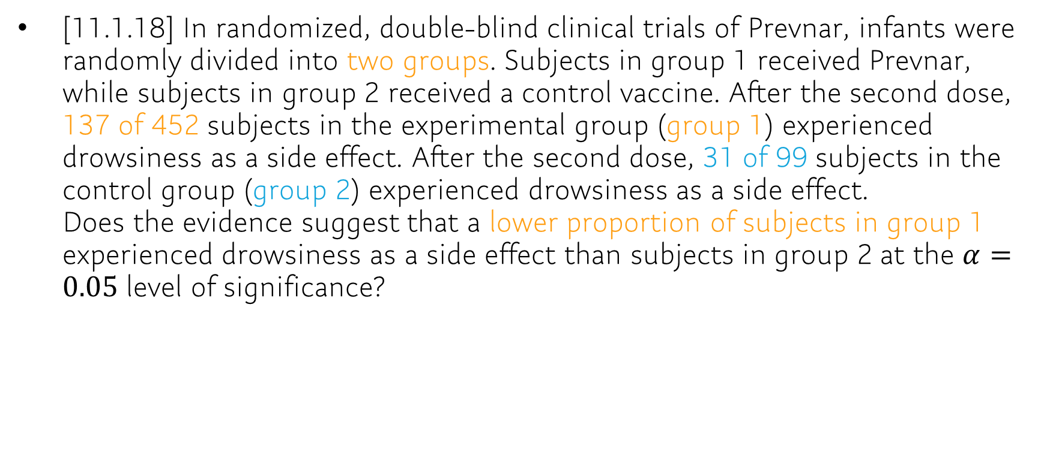
Ch 11.1
[11.1.18] In randomized, double-blind clinical trials of Prevnar, infants were randomly divided into two groups. Subjects in group 1 received Prevnar, while subjects in group 2 received a control vaccine. After the second dose, 137 of 452 subjects in the experimental group (group 1) experienced drowsiness as a side effect. After the second dose, 31 of 99 subjects in the control group (group 2) experienced drowsiness as a side effect. Does the evidence suggest that a lower proportion of subjects in group 1 experienced drowsiness as a side effect than subjects in group 2 at the $α=0.05$ level of significance?

Slide 21
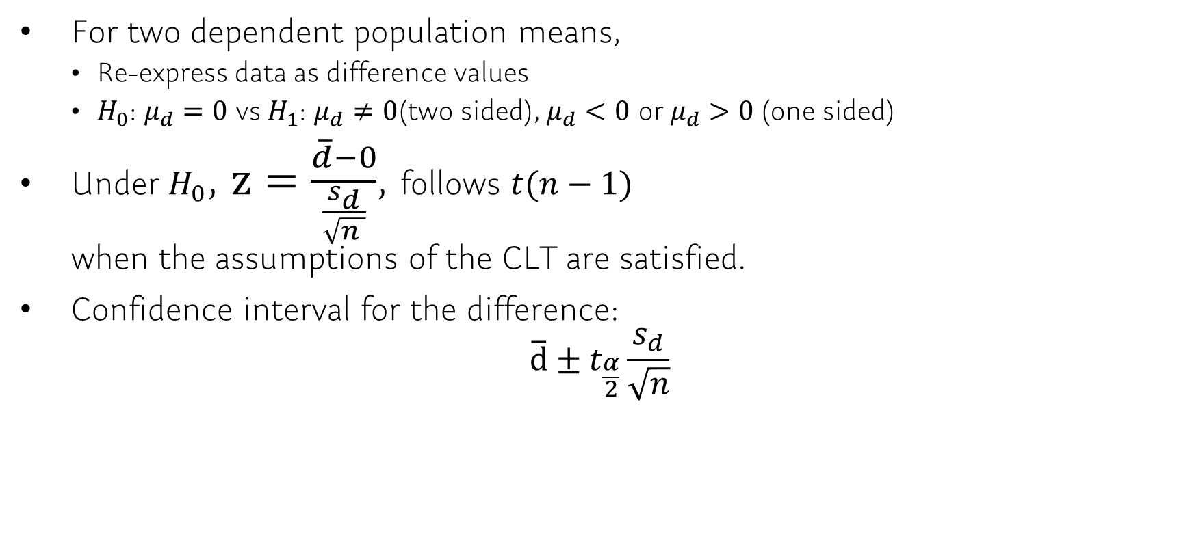
Ch 11.2 Inference about Two Means: Dependent Samples
For two dependent population means,
Re-express data as difference values
$H_{0}$: $μ_{d}=0$ vs $H_{1}$: $μ_{d}≠0$(two sided), $μ_{d}<0$ or$μ_{d}>0$ (one sided)
Under $H_{0}$, $z=\frac{\overline{d}−0}{\frac{s_{d}}{\sqrt{n }}}$, follows $t(n−1)$ when the assumptions of the CLT are satisfied.
Confidence interval for the difference: $\overline{d}±t_{\frac{α}{2}}\frac{s_{d}}{\sqrt{n}}$

Slide 22
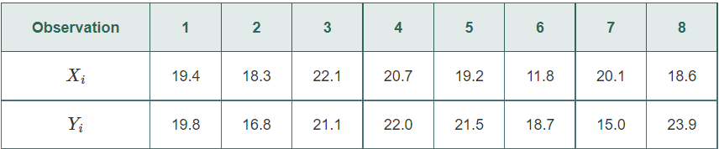

Ch 11.2: Example
[11.2.4] assume that the differences are normally distributed.
Determine for each pair of data.
Compute $\overline{d}$ and $s_{d}$.
Test if $μ_{d}≠0$ at the $α=0.01$ level of significance.
Compute a 99% confidence interval about the population mean difference $μ_{d}$.
Notes:
X-Y = -0.4 1.5 1.0 -1.3 -2.3 -6.9 5.1 -5.3
Diff.mean: -1.075
Diff.sd : 3.833219
Alpha_0.005 = -2.575829
Test statistic for test : -0.7932129, qt(0.005,7) = -3.499483, p-value:0.226848*2=0.453696
Margin of error : 4.742667
CI = -1.075 +- 4.742667

Slide 23
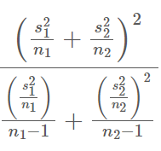
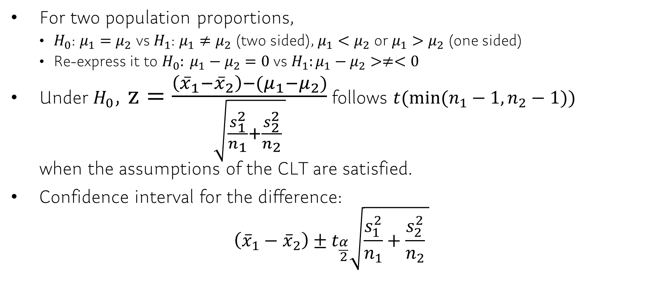
Ch 11.3 Inference about Two Means: Independent Samples
For two population proportions,
$H_{0}$: $μ_{1}=μ_{2}$ vs $H_{1}$: $μ_{1}≠μ_{2}$ (two sided), $μ_{1}<μ_{2}$ or $μ_{1}>μ_{2}$ (one sided)
Re-express it to $H_{0}: μ_{1}−μ_{2}=0$ vs $H_{1}:μ_{1}−μ_{2}>≠<0$
Under $H_{0}$, $z=\frac{\left({\overline{x}}_{1}−{\overline{x}}_{2}\right)−(μ_{1}−μ_{2})}{\sqrt{\frac{s_{1}^{2}}{n_{1}}+\frac{s_{2}^{2}}{n_{2}} }}$ follows $t(min⁡(n_{1}−1, n_{2}−1))$ when the assumptions of the CLT are satisfied.
Confidence interval for the difference: $\left({\overline{x}}_{1}−{\overline{x}}_{2}\right)±t_{\frac{α}{2}}\sqrt{\frac{s_{1}^{2}}{n_{1}}+\frac{s_{2}^{2}}{n_{2}} }$

Slide 24
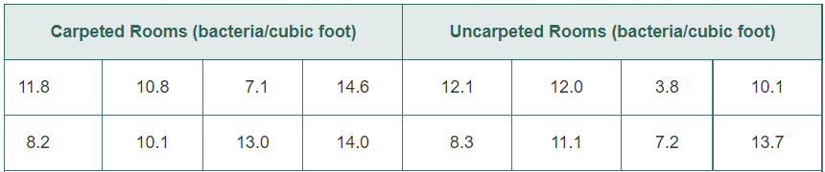
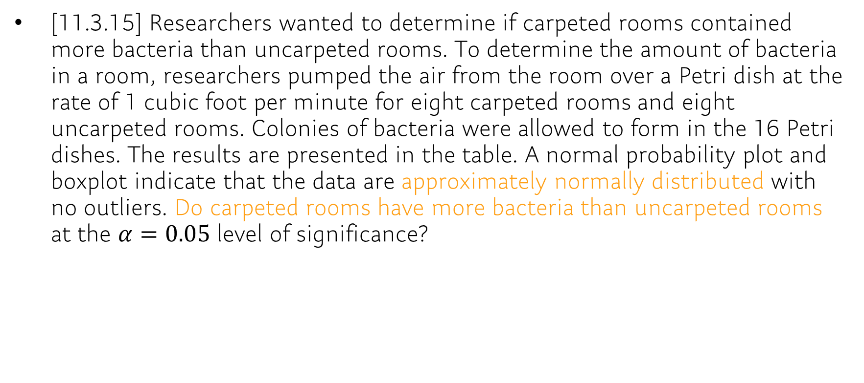
Ch 11.3: Example
[11.3.15] Researchers wanted to determine if carpeted rooms contained more bacteria than uncarpeted rooms. To determine the amount of bacteria in a room, researchers pumped the air from the room over a Petri dish at the rate of 1 cubic foot per minute for eight carpeted rooms and eight uncarpeted rooms. Colonies of bacteria were allowed to form in the 16 Petri dishes. The results are presented in the table. A normal probability plot and boxplot indicate that the data are approximately normally distributed with no outliers. Do carpeted rooms have more bacteria than uncarpeted rooms at the $α=0.05$ level of significance?
Source: William G. Walter and Angie Stober. “Microbial Air Sampling in a Carpeted Hospital.” Journal of Environmental Health, 30 (1968), p. 405.
Notes:
H₀: μ_{carpet} = μ_{no carpet}, H₁: μ_{carpet} > μ_{no carpet}.
carpeted – mean 11.2, sd 2.677419
Uncarpeted – mean 9.7875, sd 3.210001
Using t(7),
Classical approach: t₀ = 0.956 < t_{0.05} = 1.895; do not reject H₀.
P-value approach: 0.20 > P-value > 0.15 [Tech: P-value = 0.1780] > α = 0.05; do not reject H₀.
There is not sufficient evidence at the α = 0.05 level of significance to conclude that carpeted rooms have more bacteria than uncarpeted rooms.

Slide 25
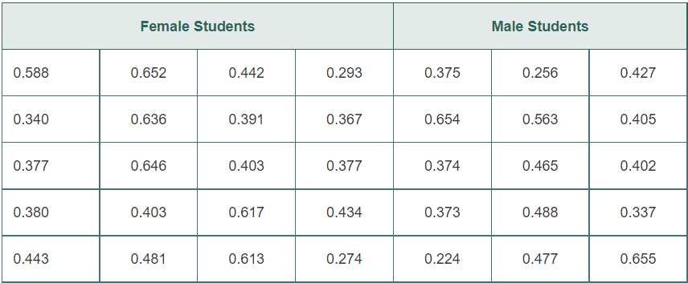
Ch 11.3
[11.3.14] Researchers wanted to determine whether the reaction time (in seconds) of males differed from that of females to a go/no go stimulus. The researchers randomly selected 20 females and 15 males to participate in the study. The go/no go stimulus required the student to respond to a particular stimulus and not to respond to other stimuli. The results are as follows:
- Test whether there is a difference in the reaction times of males and females at the α=0.05 level of significance.
Source: PsychExperiments at the University of Mississippi

Slide 26
Q&A / Announcement
Thank you for a quarter!
Survey: https://docs.google.com/forms/d/e/1FAIpQLScOSxLzJw0W3941U58RWsOaGA6cteXL6riBHYxjr4qMUIq-JQ/viewform?usp=sf_link

