Slide 1
Weekly Report Apr. 12 – Apr. 19
Qi Wang

Slide 2
Primary Achievements
Rebuild the basis function generator of Nychka function.
Finished the Chen’s 1-d Simulation, everything goes okay but DNN seems strange.
Finished the Chen’s 2-d Simulation, but things goes a little strange.
Read the introduction of NSF data set instruction and finished data cleaning.
(Try spNNGP on road accidents data set)

Slide 3
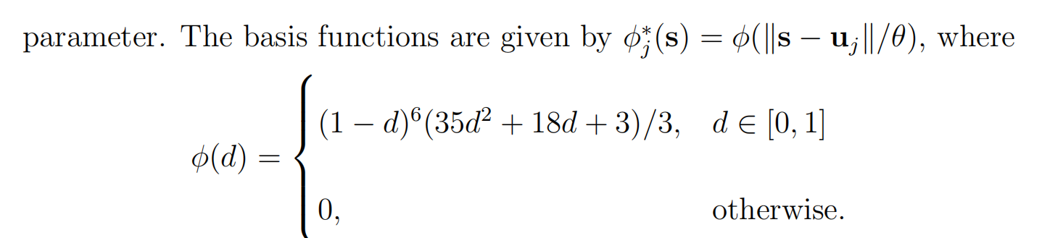
Nychka Basis Function
Instead of the FRK function used in previous steps, I tried to wrote a function used in Chen’s paper, proposed by Nychka as follows:
2.5 times of the distance between basis knots

Slide 4
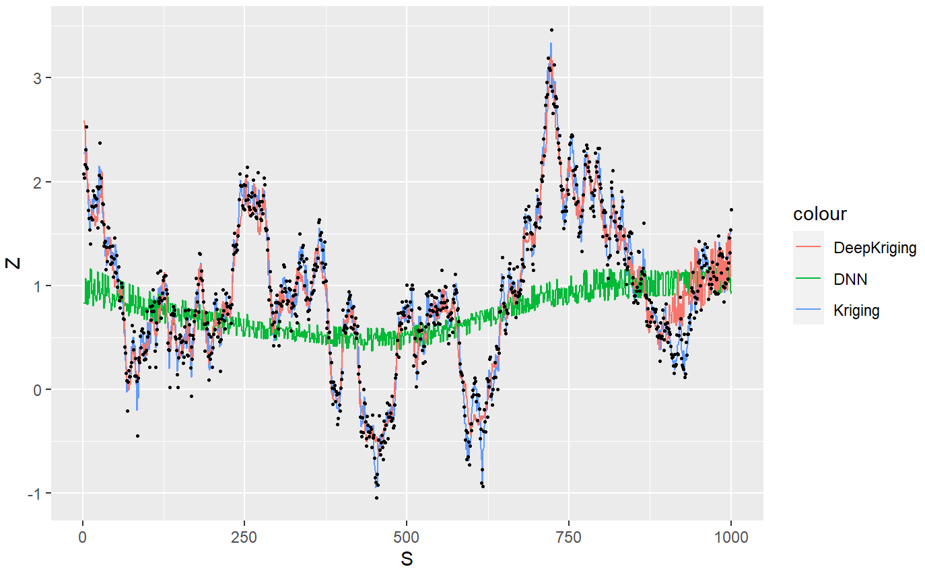
Chen’s 1-d Simulation
The series is generated by an exponential kernel GP added by a noise. And the “Kriging” here means Kriging with the true parameters. It definitely behaves better than the others, but the DNN seems strange. The MSE seems very large and the trend is not fully specified. But the DeepKriging behaves well with Nychka function.

Slide 5
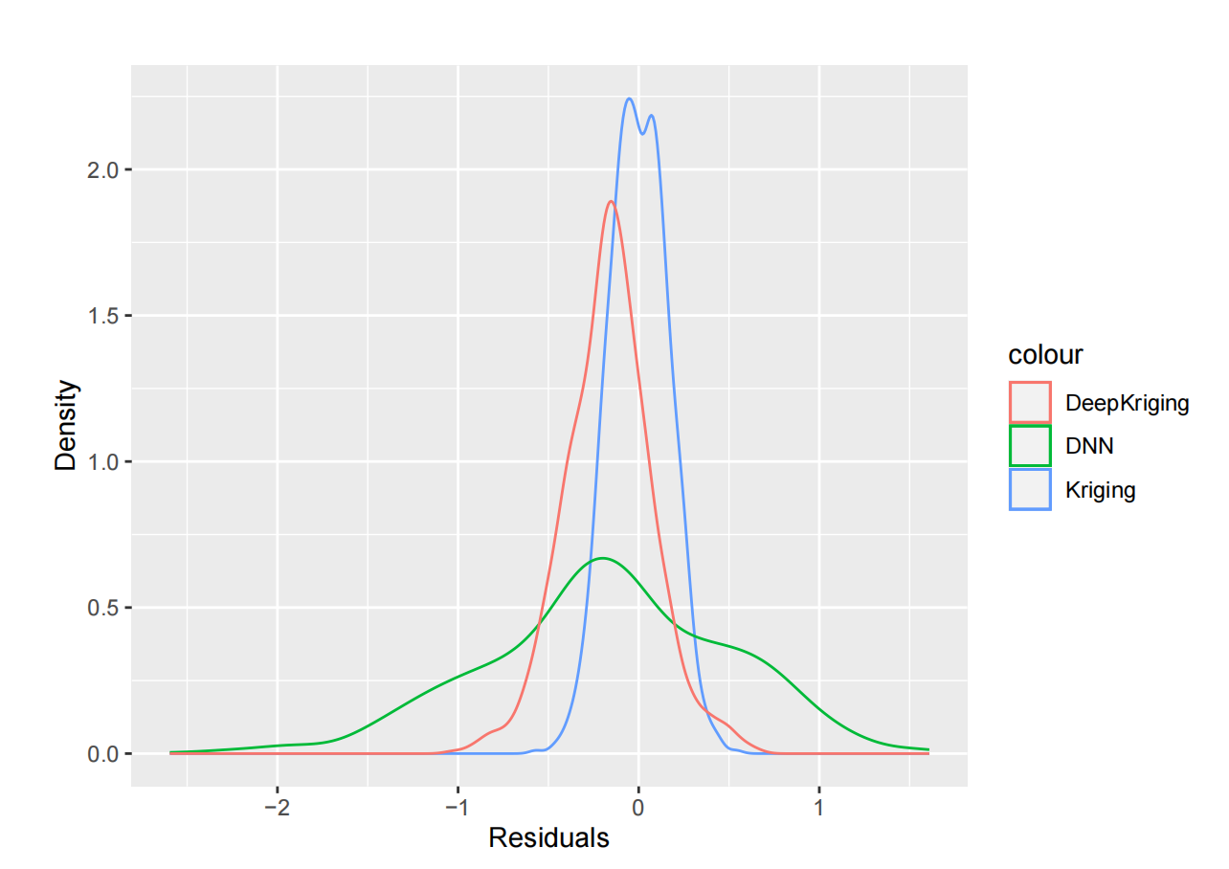
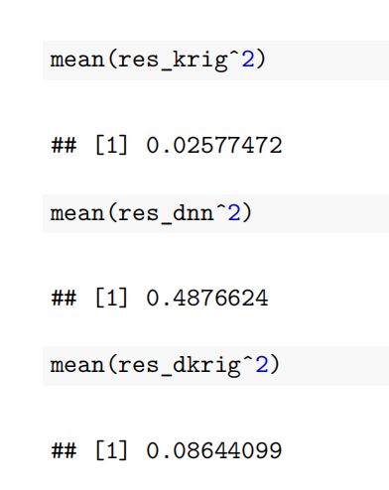
Chen’s 1-d Simulation
Here is the histogram of the residuals, seems like a bias in the DeepKriging? And DNN is also having the bias, making the estimation smaller than the true value, seems not so correct, and the MSE is as follows:

Slide 6
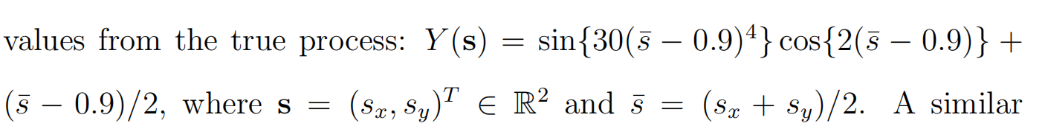
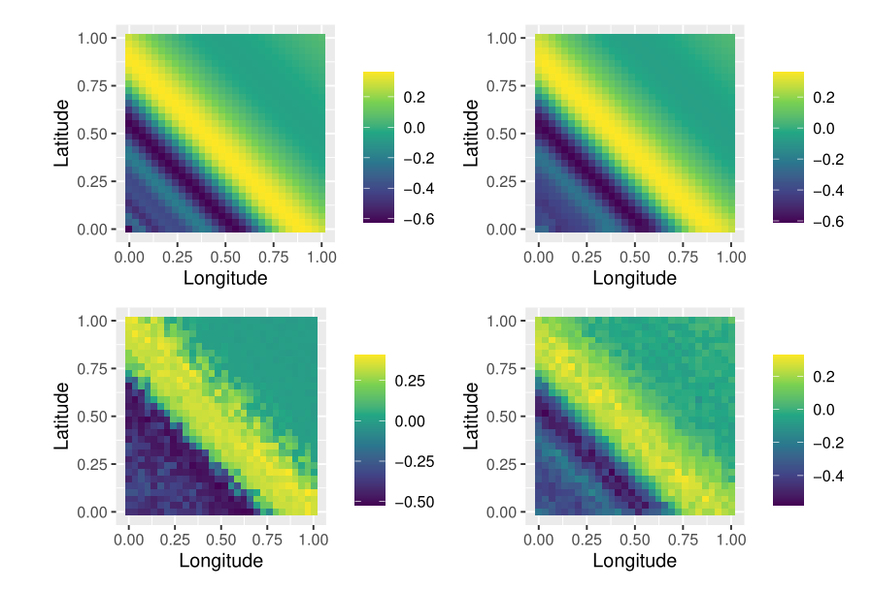
Chen’s 2-d Simulation
Observed
Kriging
Still, I used the Nychka basis function but I don’t know why they performs not as good as Kriging.
We are using MLE of range parameter, smoothness parameter of Matern kernel, the sill effect, nugget effect and intercept.
DeepKriging
DNN

Slide 7
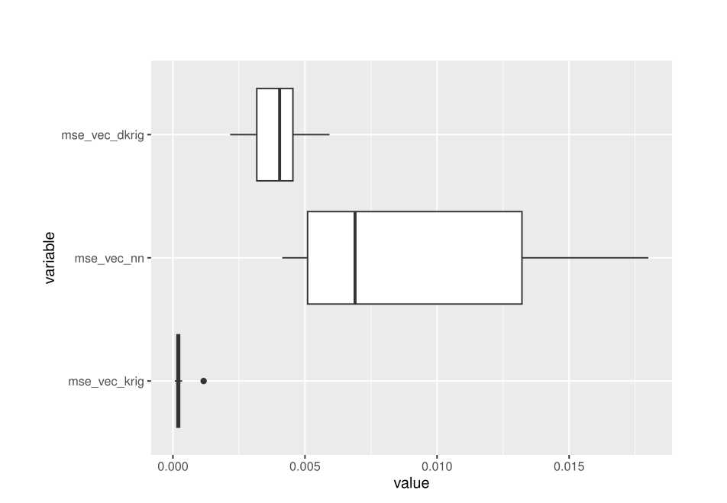
Chen’s 2-d Simulation
Theoratically, Kriging performs the worst, then DNN, and DeepKriging. But with the MLE of the parameters of Matern kernel of this non-stationary correlation function, it actually performs still better than the DeepKriging and the DNN. But the advantage of DeepKriging over DNN is verified here.

Slide 8
Comments on Simulation
1. The DNN performs always so bad, is that wrong?
2. Why Kriging performs still better than DeepKriging in the non-stationary setting?
3. Maybe my deep learning models are wrong, didn’t find the best?
4. The paper didn’t mention what kernel and what parameter they used for their Kriging...
5. Source code is written in python, do I need to reproduce again?

Slide 9
NSF Data Cleaning
The dataset has 12905 observations and 292 covariates. But no longitude and latitude are included here. Luckily, it has a record of the UNITID of the insitution, which we can use to trace the location of the institution by checking the other file on my GitHub path.
The raw location data is so large so I just picked up the longitude, latitude and UNITID of them and combine as a new data frame to avoid GitHub crash.

Slide 10
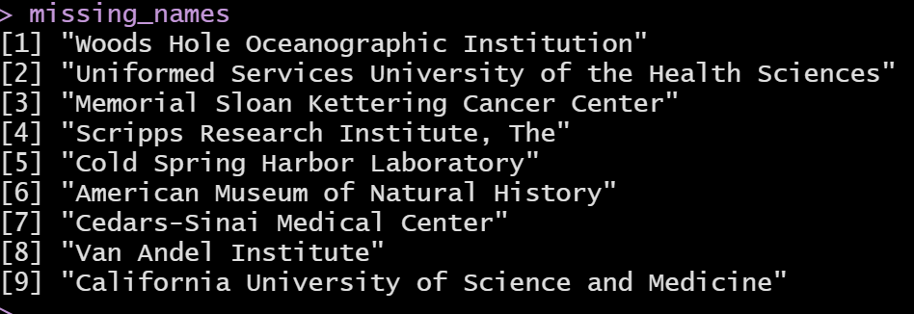
NSF Data Cleaning - Solution 1
Strangely, some institution does not have record even in the scorecards : https://collegescorecard.ed.gov/data/
Solution 1: Simply delete them.

Slide 11
NSF Data Cleaning - Solution 2
Strangely, some institution does not have record even in the scorecards : https://collegescorecard.ed.gov/data/
Solution 2: Manually find the location of them and rejoin the tables.
But, not completely manually...

Slide 12

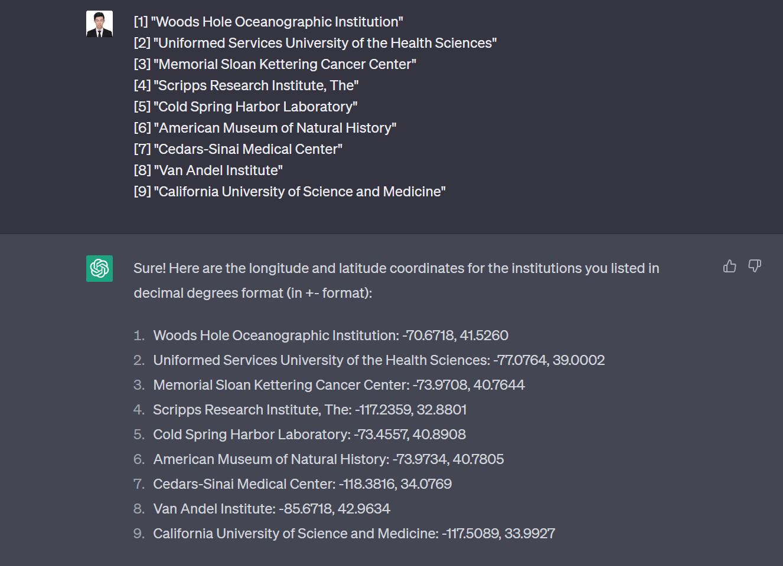
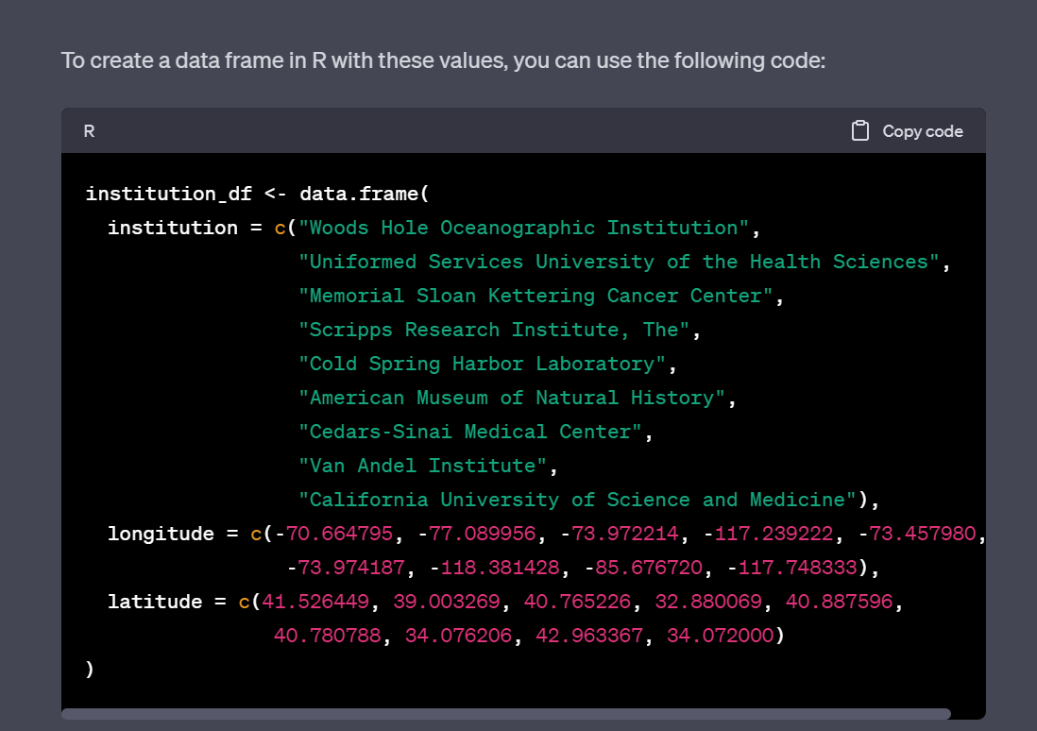
NSF Data Cleaning - Solution 2

Slide 13
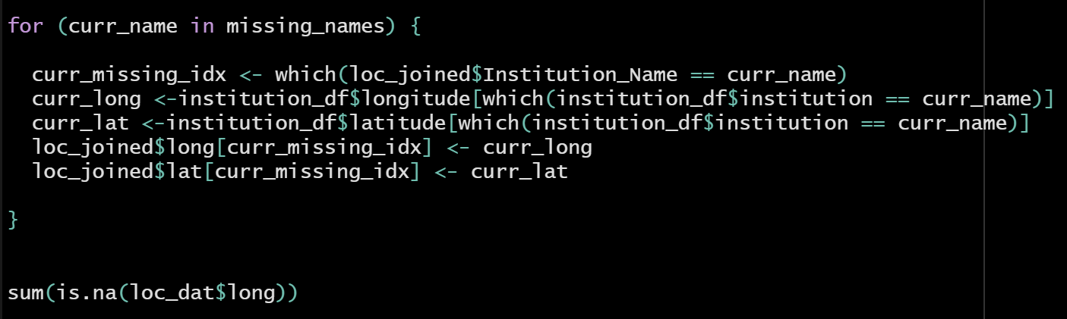
NSF Data Cleaning - Solution 2
And it returns 0. So all joins finished.

Slide 14
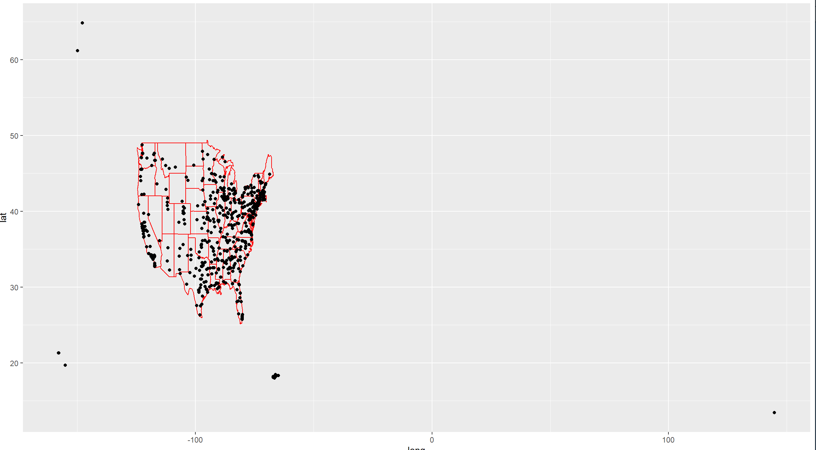
NSF Data Visualization
University of Alaska Fairbanks
University of Guam
Do I need to include other universities outiside of US main land?
Hawaii Pacific University

