Slide 1
Quantify Music Tasts
An Analysis of Spotify Playlists

Slide 2
Contents
Motivation
My Datasets
Analysis Results
Implications and Further Exploration

Slide 3
Motivation
“There are no sad music. Only sad stories. ”

Slide 4

My dataset
Spotify: Million Playlist Dataset(2017)
Kaggle: multi-genre playlists data (also from spotify, but more recent)
Each has audio features used by spotify to describe different features of songs
Continuous (>=0, <1)
Categorical(I treated them as categorical)

Slide 5



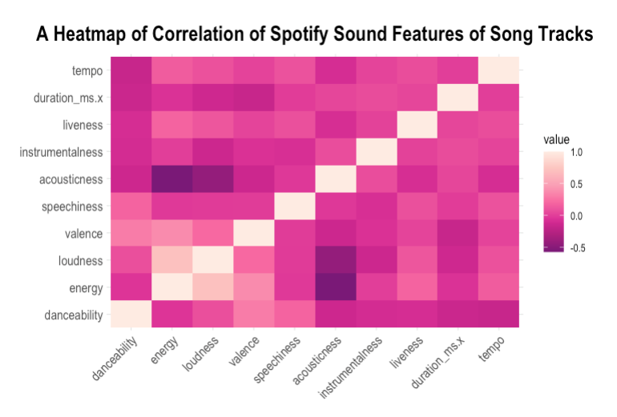
A Study of Technicalities
How do I choose and assess the Myriad of different features provided by Spotify?

Slide 6
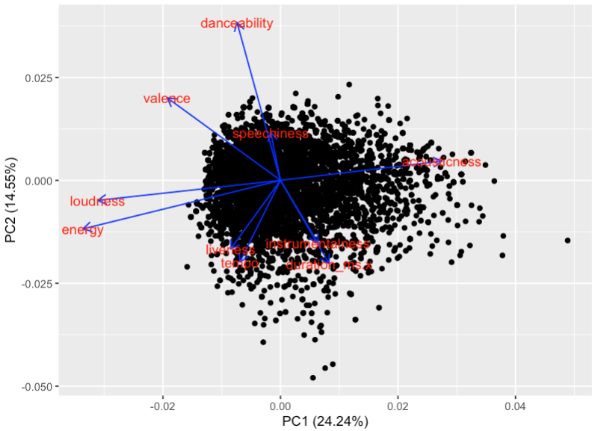
Principal Component Analysis of 10 Features
Features that are closely correlated and point to the same direction:
Loudness/Energy
Danceability/Speechiness
Liveness/Tempo
Instrumentalness/Duration
Features with negative correlations:
Loudness/energy and accousticness
Longer arrows indidate stronger influence on the two principal components.

Slide 7
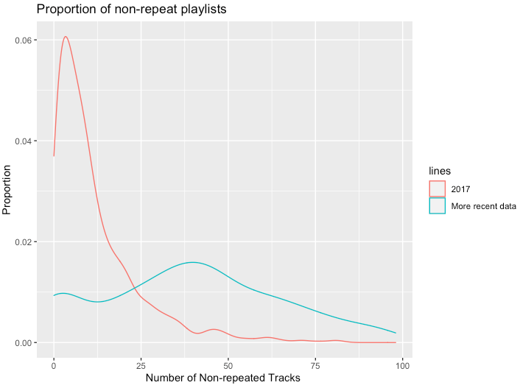
A Study of Features of a Playlists
The Diversity of consumption of music as measured by the number of unique songs in playlists.
Notes:
Implications to designs of recommendation systems

Slide 8
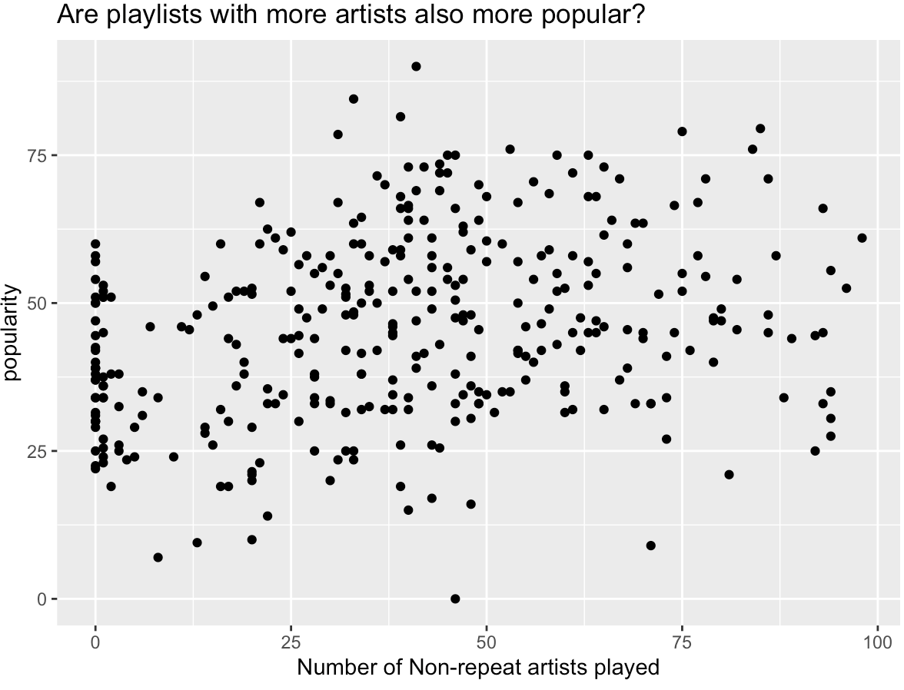
The association between popularity of songs in a playlist with many artists?
It seems there is some pattern but a linear relationship is not strong!

Slide 9
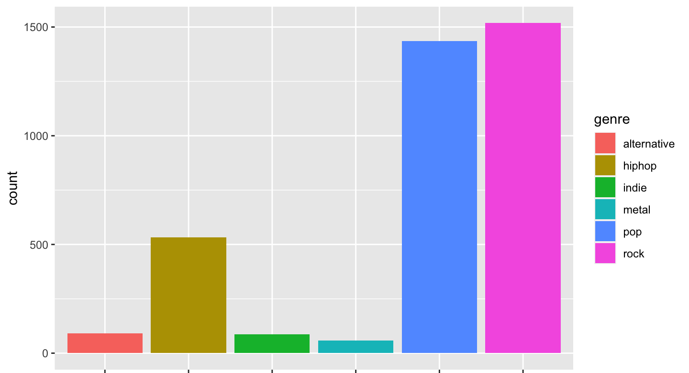
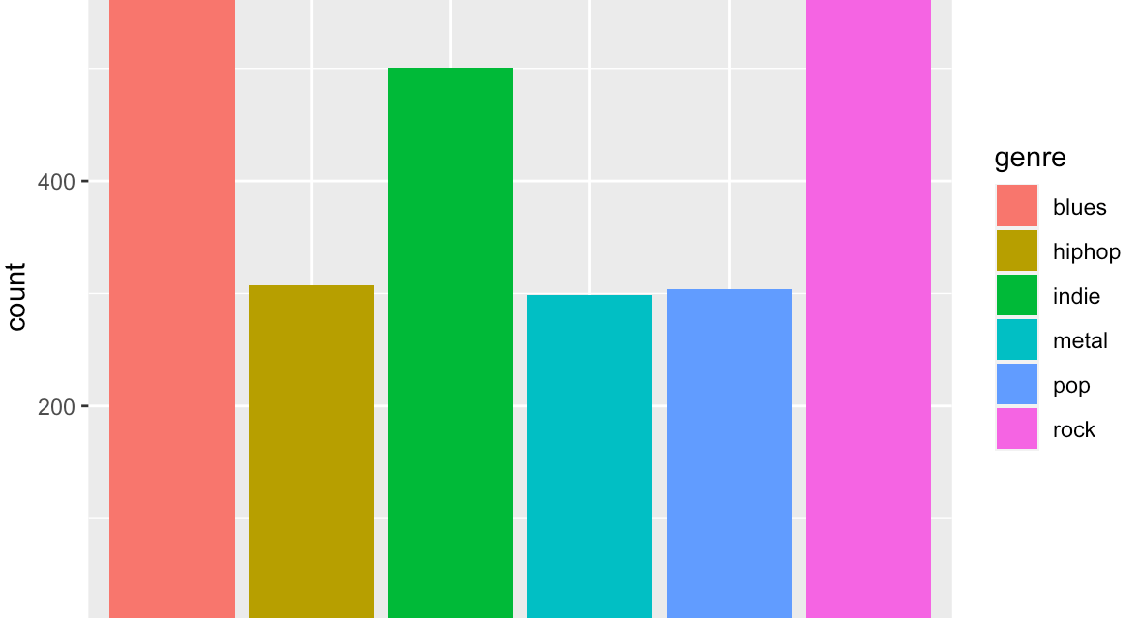
Genres and Popularity
Distribution of Genres in the top most popular Playlists
Rock
z
Distribution of Genres in the lest popular playlists

Slide 10
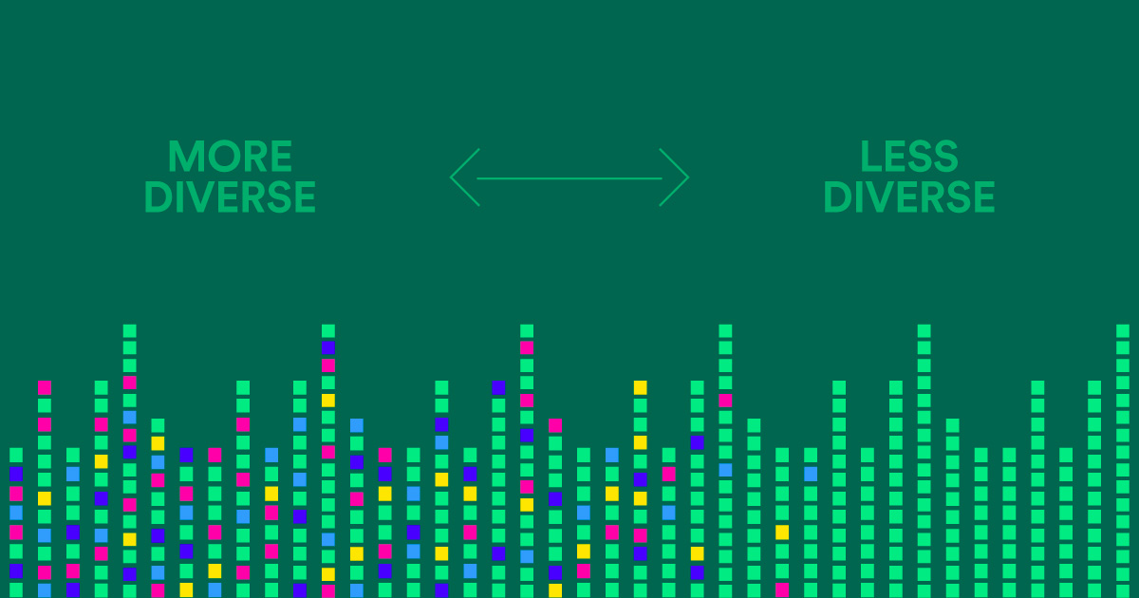
My methods were inspired by …
Spotify R&D

Slide 11
Further Exploration of Data
Experiment with other measurements of playlist diversity
More on features of popular genres.

