Slide 1
University of Illinois Faculty’s Salary Survey
Shuyi Liu
Qiwen Wang
Wendy Wong
http://uiuc-salary-viz.herokuapp.com/

Slide 2
Project Description
Aim: Assist postgraduate students seeking jobs and faculty members looking for mobility to understand the salary variation in different universities
Method: Provide an overview of salary variation across the campuses in the University of Illinois (UI) system by data visualization
Data: Salary of faculty members in 2013/14 – 2017/18
Three campuses in UI system:
Chicago
Springfield
Urbana-Champaign
Notes:
postgraduate students seeking for jobs and faculty members looking for mobility can have their career planned accordingly.

Slide 3
Procedure
Data Collection
1
Data Cleaning
2
Data Visualization
3

Slide 4
1
Data Collection
Data collection:
- From UI Gray Book (The Board of Trustees Office)
Time span of data:
- 2013/14 – 2017/18
College
Campus
Department
Employee
Job Title
Tenure
Employment Class
Salary

Slide 5
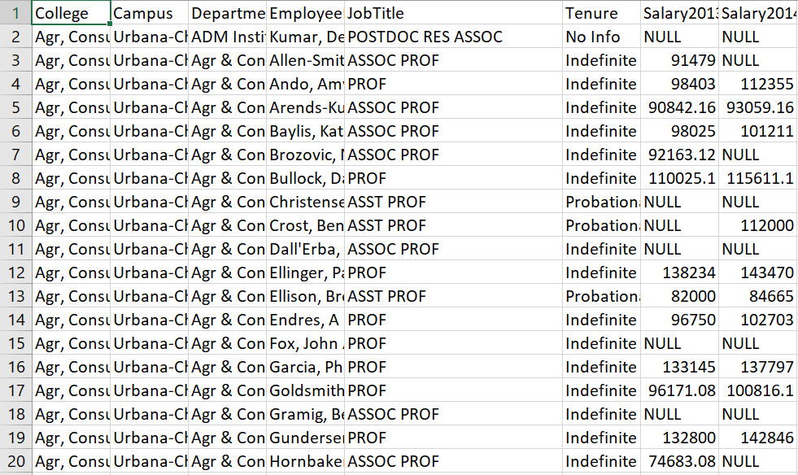
2
Data Cleaning
Data retrieved include:
- Academic positions
- Administrative staffs
→ Data cleaned for studying the salary distribution of academic staffs only

Slide 6
3
Data Visualization
Data Analysis
Visualization
Web Page
Python
Plotly
Dash
Heroku

Slide 7
3
Data Visualization
Bar chart
Pie chart
Line graph
Box plot

Slide 8
Outcome
Faculty’s Salary Range Distribution (By Department)
Faculty’s Salary Distribution over 5 Years (By Department)
Comparison of Faculty’s Salary Range (By Department)
Population of Faculty and Comparison of the Median Salary (By a Common Department across Campuses)
Departments with Top Ten Median Salary (By Campus)
Departments with Top Ten Median Salary (By Position)

Slide 9
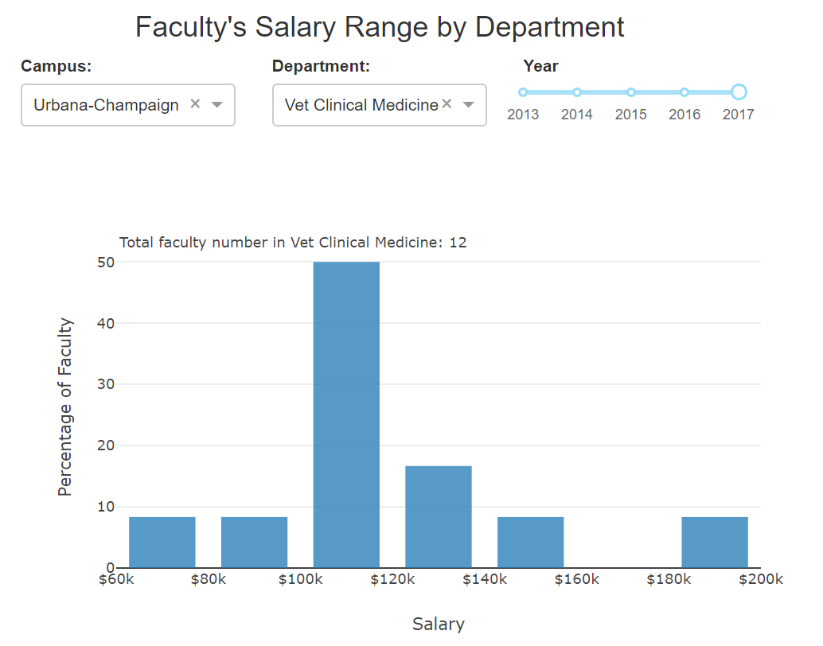
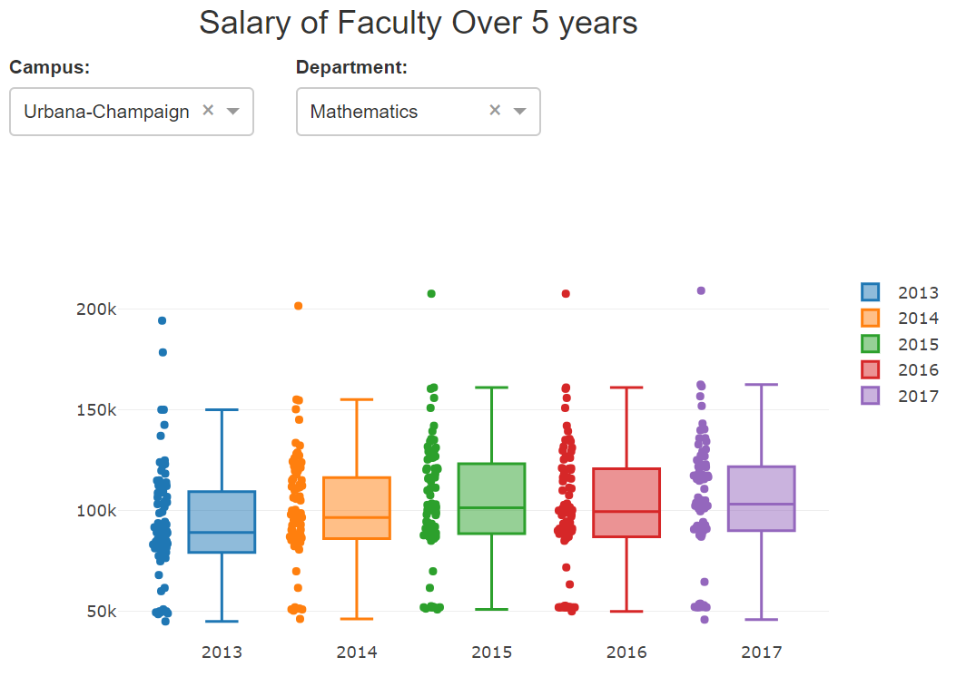
Sample Graphs

Slide 10
Challenges
Not easy to collect a set of data which is substantial but workable in three weeks
Visualization skills
Time limitation

Slide 11
Future Plan
Improving the visualization
Data analysis
Extend the data to other universities in Illinois and in the States

