Slide 1
IBM Capstone Project –
The Battle of Neighborhoods
Submitter：Yang Zhipeng

Slide 2
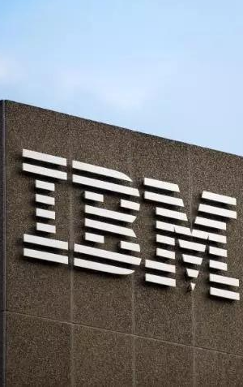
01
Introduction
02
Methodology
03
Dataset
catalog
04
Data preparation
05
Analysis
06
Result

Slide 3

Introduction
I am a Chinese student studying in Vancouver, Canada. I like the scenery and the humanities here. I enjoy my life here. However, I am not really used to eating local food. I want to do a project. Go to find some Chinese restaurants and go to meet up with my Chinese friends.
Notes:
随着无人机性能的提升，无人机将在未来空战中扮演更加重要的角色，其在空战上发挥的作用将不单单是战场侦查与监视，也应该包括执行对敌机动追踪、决策博弈任务，逐步完成从常规的侦察平台到作战平台的转换。为此，需要提高无人机群的自行调整能力和自主决策能力，使得无人机群在多变的空战环境当中，能够具有一定的“自我意识”以迅速适应战场状况和调整自我行动。

Slide 4
Methodology
Find out relevant data
Data cleaning and preparation
Analysis
Result

Slide 5
Dataset
A csv file named "information_week4.csv" that contains the postal code, borough, neighborbood, Latitude, and Longitude.
Foursquare API location data to get information about restaurants and their ratings.

Slide 6
Data preparation and cleaning
Load the csv into python dataframe
Use Foursquare API to get all the data, append into rows then create a dataframe
Remove unnecessary columns or rows
Merge the two dataset together

Slide 7
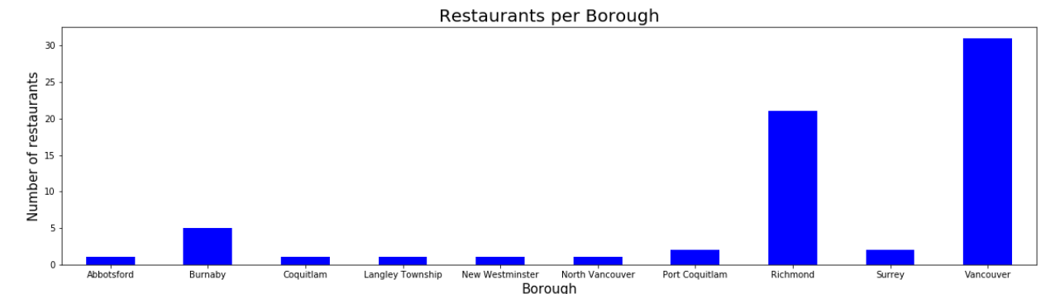
Analysis
Use the visualization library ‘matplotlib’ to present data information

Slide 8
Result
Vancouver has the highest number of restaurants in Greater Vancouver Area, then Richmond and Burnaby. From the bar graph, we can also see most of the Chinese restaurants are located in one of these three boroughs. In conclusion, when I meet my friends and want to find a Chinese restaurant, we should stay in either Burnaby, Richmond, or Vancouver.

Slide 9
THANK YOU ！

