Slide 1
Smart Park Monitoring System
AI-powered crowd and activity analytics for urban parks
Internship Project – Yuvaan Educative LLP (2026)

Slide 2
Why This Project Matters
Manual monitoring is inconsistent and not scalable
Authorities need measurable evidence of crowd load and behavior
Goal: Convert raw surveillance videos into actionable insights

Slide 3
What The System Delivers
People count trends over time
Activity summary (walking, sitting, high activity)
Congestion alerts when crowd stays high
Interactive dashboard for decision-making

Slide 4
System Pipeline
Video INPUT
↓
Motion extraction (OpenCV MOG2)
↓
YOLOv8n people detection (1 FPS)
↓
Feature merge (motion + people_count)
↓
Random Forest activity classification
↓
Statistics + Congestion + Dashboard

Slide 5
Dataset & Coverage
Videos analyzed: 23
Prediction rows generated: 919
Overall average crowd: 8.03
Maximum observed peak: 20 people

Slide 6
Modeling Approach
Detection: YOLOv8n (person class)
Motion: Background subtraction + per-second aggregation
Features: avg_motion_ratio, motion_std, people_count
Classifier: RandomForest (150 trees, balanced classes)
Accuracy achieved: 81%

Slide 7
Congestion Detection Logic
Rule: people_count ≥ 10
Duration: ≥ 10 consecutive seconds
Detected 5 congestion events across 5 videos
Filters short spikes for meaningful alerts

Slide 8
Key Findings
Most crowded videos: park2_07, park2_08, park2_14
Dominant activity: Walking
5 congestion windows detected
Dashboard prioritizes high-load zones quickly

Slide 9
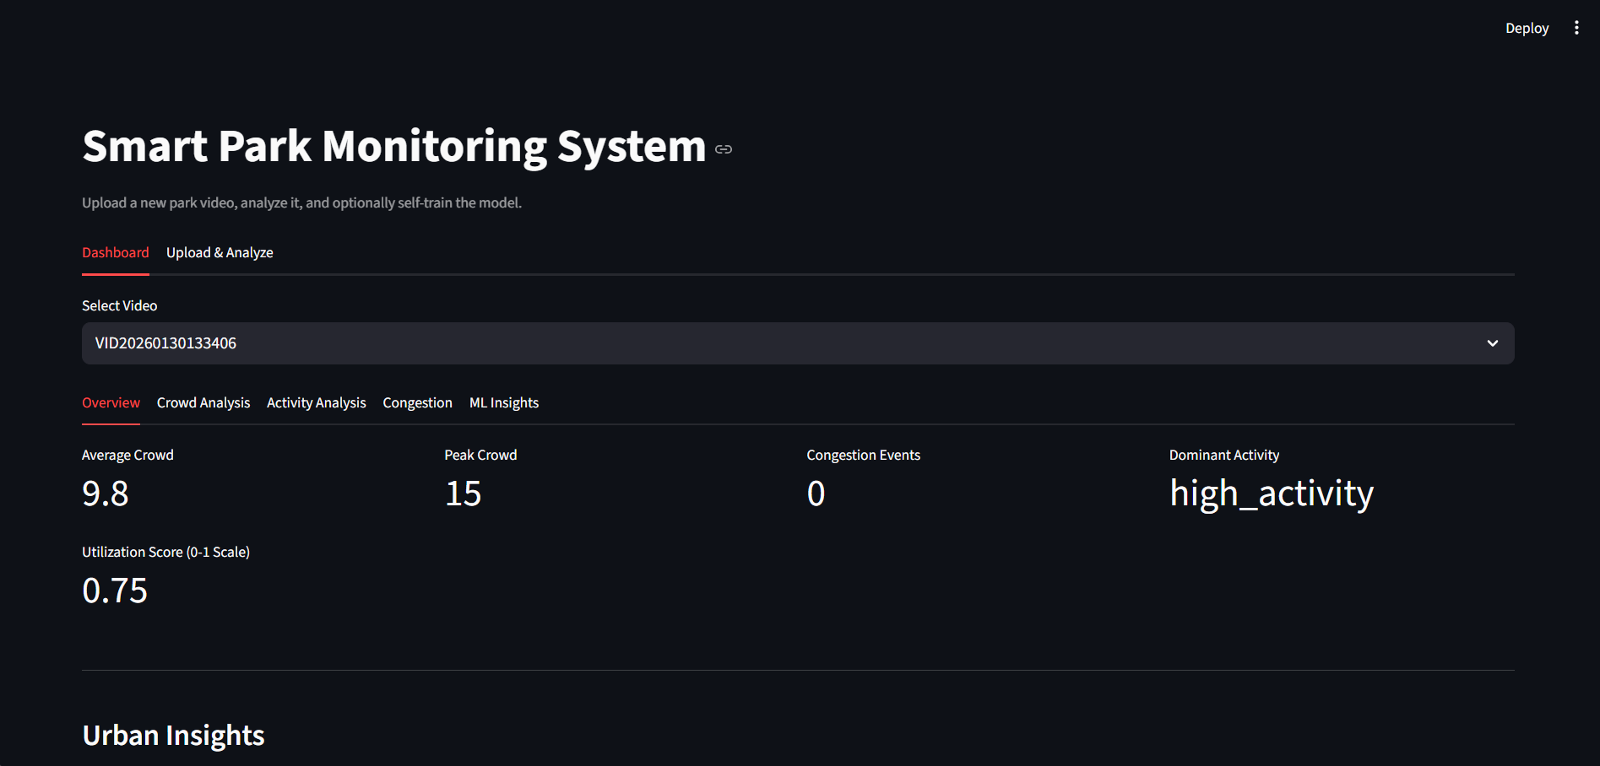
Dashboard Snapshot

Slide 10
Current Limitations
No live stream monitoring (batch processing)
1 FPS sampling may miss very short spikes
No person tracking or spatial heatmaps yet
Class imbalance affects minority activity classes

Slide 11
Future Improvements
CNN-LSTM / 3D CNN with larger dataset
Person tracking (SORT/DeepSORT)
Zone-based spatial heatmaps
Dynamic congestion thresholds
Active learning for better labeling

Slide 12
Conclusion
Delivered an end-to-end AI analytics pipeline
Modular, reproducible, and deployment-ready
Strong foundation for smart-city integration

Slide 13
Thank You

