Slide 1
WorkDay FMS Implementation
SunRISE Training

Slide 2
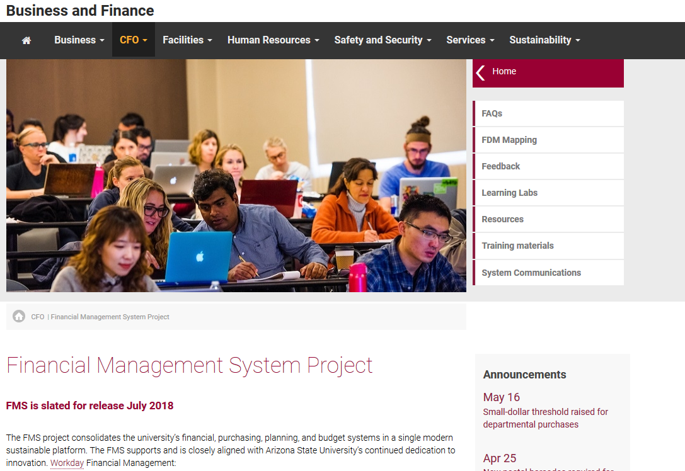
Extensive information regarding WorkDay can be found at the following web address:
https://cfo.asu.edu/fms
This site should be utilized to access the latest information, updates and impacts. There is also extensive information to aid customers through the transition. Blackboard courses have been developed and are available for any ASU affiliate to view.
Financial Management Services help:
(480) 965-2334
FMS@asu.edu

Slide 3
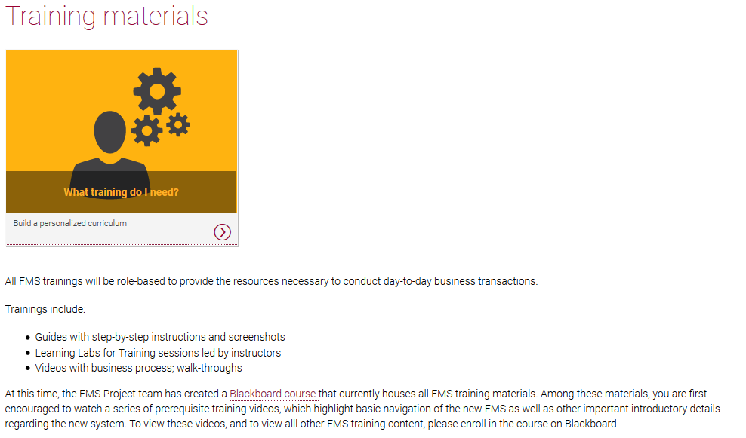
TRAINING INFORMATION
Follow the instructions for self-registration in the Blackboard system.
To view the full video pertaining to purchasing in WorkDay, select Procurement, Departmental Training Materials and Purchasing in Workday Video.
To view the full ASU produced PDF overview on the purchasing process, including SunRISE order processing, select: > Suppliers > Departmental Training Materials > Department Data Entry Specialist – Spend PowerPoint Presentation
The materials contained on that site are a high-level overview of the material contained therein, targeted at the SunRISE procurement process.

Slide 4
AFTER TRAINING AND BEFORE BEGINNING TO ORDER PLEASE NOTE:
Accessing WorkDay
https://www.myworkday.com/asu/d/home.htmld
You will be prompted to login utilizing your ASURite Username and Password.
Software and Computer Purchases – in part or in whole
All software and computer purchases (in part or in whole) must first be reviewed and coordinated with SEMTE IT. Please contact them at asksemte.it@asu.edu for your hardware and software needs.
Chemicals
ALL chemical must be purchased via Workday. Please contact SEMTE.Purchasing@asu.edu if you need help.
Additional information and instruction
https://cfo.asu.edu/purchasing-sunrise
https://www.asu.edu/purchasing/pdf/amazon-registration-instruction.pdf

Slide 5
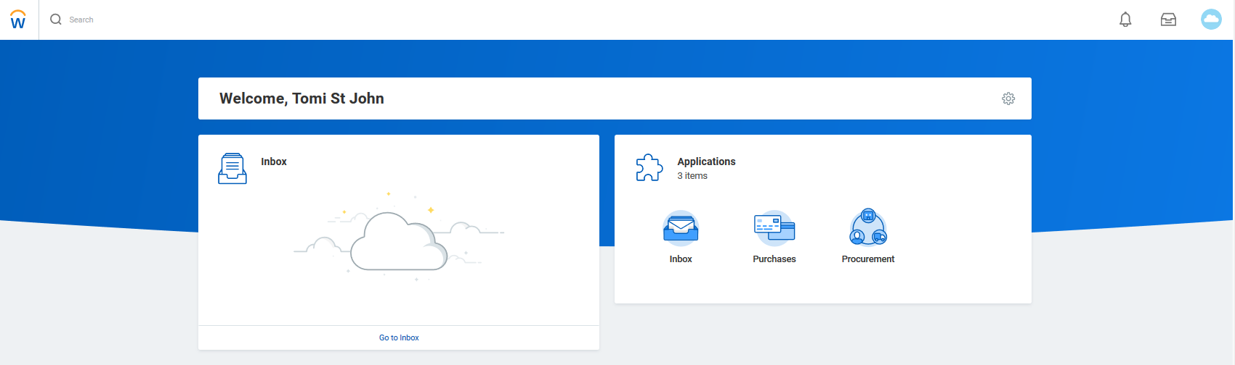
WELCOME TO WORKDAY
You will be logged into the WorkDay tenant. From this home screen you can see several pieces of information:
Home/ASU icon
Search bar
Your Inbox
Purchases worklet

Slide 6
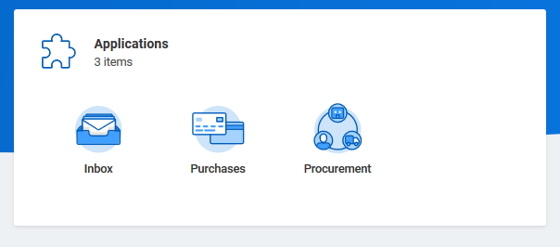
NAVIGATE TO SunRISE IN WORKDAY
Select the Purchases worklet

Slide 7
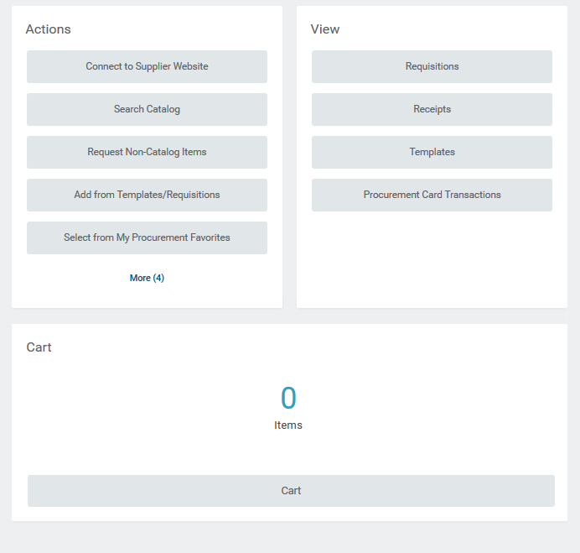
Select: Connect to Supplier Website

Slide 8
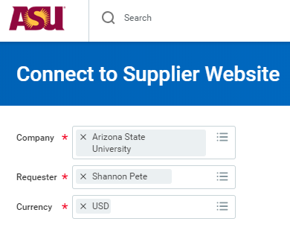

DO NOT CHANGE THE SYSTEM DEFAULTS
Click: OK

Slide 9
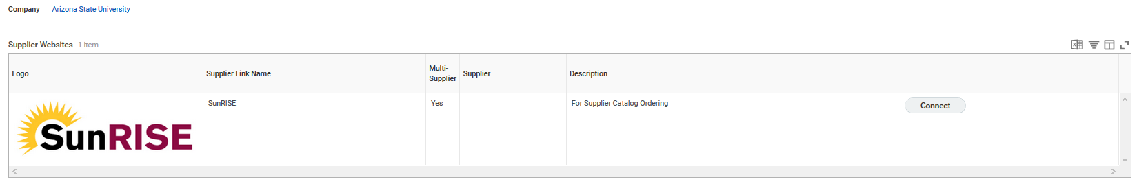
Click: Connect
ASU Policy EHS 408 requires that chemicals be purchased through the ASU designated chemical purchasing system. Specialty items that do not appear in Sunrise should be coordinated with the business office for help with purchasing.
All chemical orders must be coded with the ASU laboratory registration number which corresponds to the purchasing laboratory or shop. Chemical orders will only be approved with complete information. The delivery location entered shall match the registration number.
https://cfo.asu.edu/webform/ehs-chemical-purchase-and-transfer-form (online form for transferring chemicals to another lab).

Slide 10
AMAZON PURCHASING
Amazon.com ordering is now incorporated into the Arizona State University Sunrise system. ASU departments that would like to order from Amazon can choose to have an Amazon Business account for their shopping and ordering needs via Sunrise.
Account registration is required for Amazon purchasing. For more information on registration, benefits and shopping Amazon Business, reference the online ASU Amazon Business Account registration scenarios and set up instructions.
ASU’s new Amazon Business account offers the familiar Amazon open-market user experience and business-specific benefits:
- Access to ASU’s central payment method.
- Business pricing and quantity discounts on millions of items.
- Connection with a specialized business-only customer service team.
- Direct interface to SunRISE for checkout, requisition approval and payment processing.
- Unlimited free 2-day shipping on Prime-eligible items, regardless of the order size.
NOTE: ASU no longer allows a P-card or personal card as a valid form of payment for Amazon purchases. All Amazon purchases will be completed via purchase order through the Sunrise Workday system.
If you have any questions, please check Amazon Business Account FAQ'S or email ASU Procurement

Slide 11
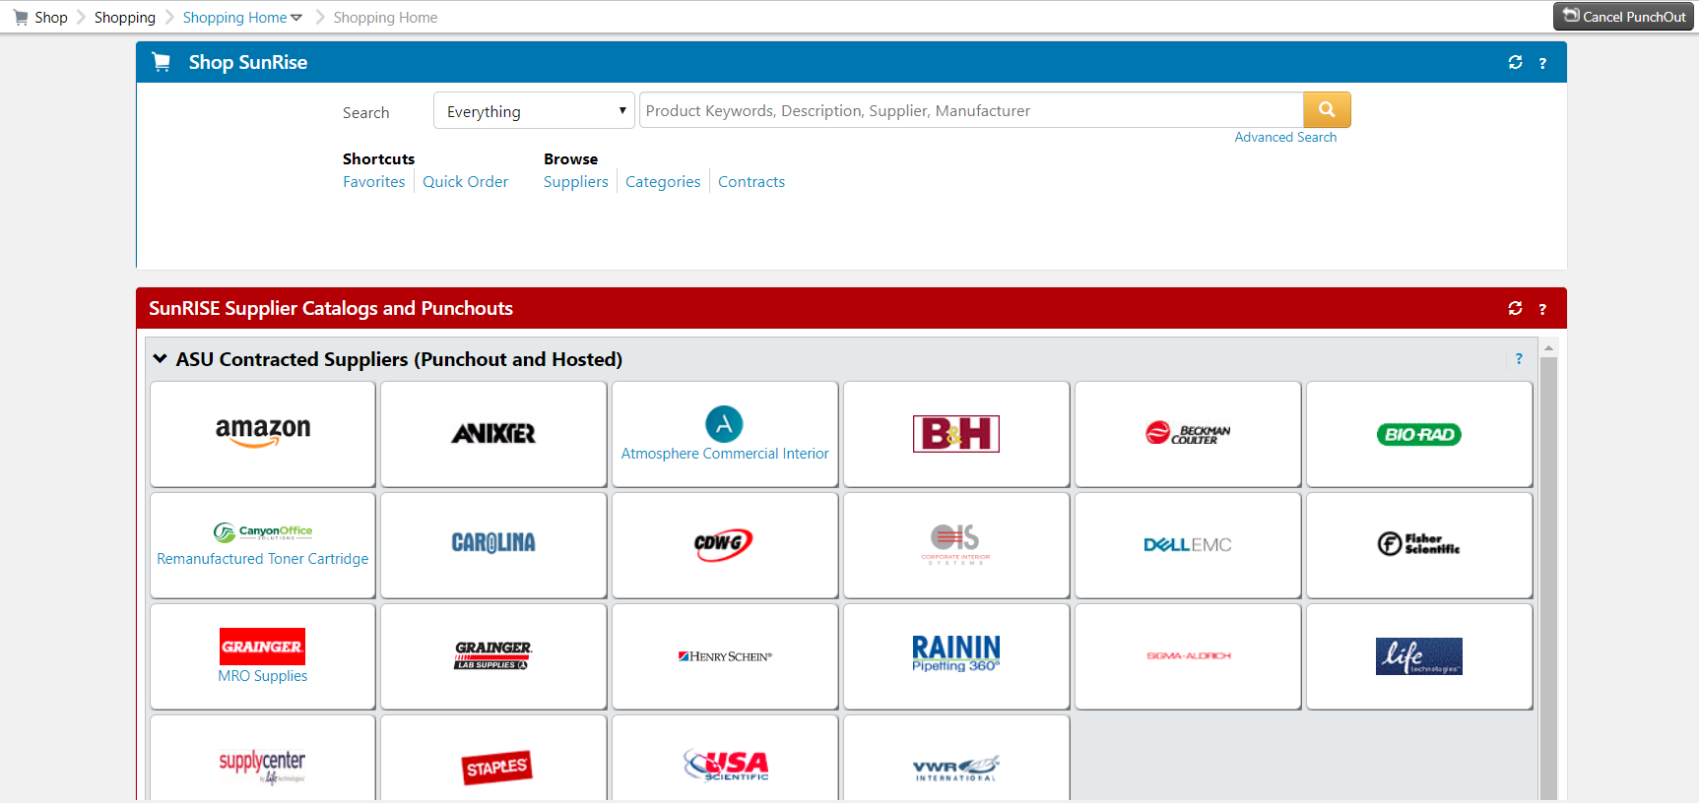
PURCHASING IN SunRISE
Once in SunRISE, access vendor portals as normal. Please be sure to review your items carefully for accuracy.
NOTE!!: DO NOT change the address in the Amazon punchout. Please leave the address as the system default. Changing this will cause in error in the order and it will not be placed.

Slide 12
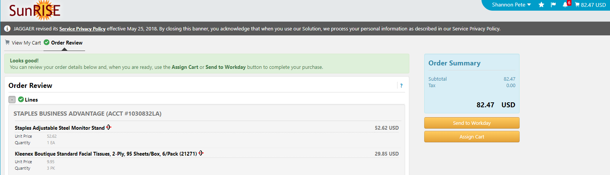
PUNCH BACK INTO WORKDAY
Please take this opportunity to grab a screenshot of your cart contents and email it along with a complete business purpose to your PI for their approval AND account number. You will need to add a copy of the complete email approval to your order later in the workday system. When your order is complete, click the Send To Workday button.
NOTE: You may submit a unique order for each vendor, however it is not necessary. You would continue to shop until you are done. Orders from ASU gas services cannot be combined with an order with other vendors. Also, we recommend submitting separate orders for chemicals or gases, so the correct shipping addresses are entered.

Slide 13
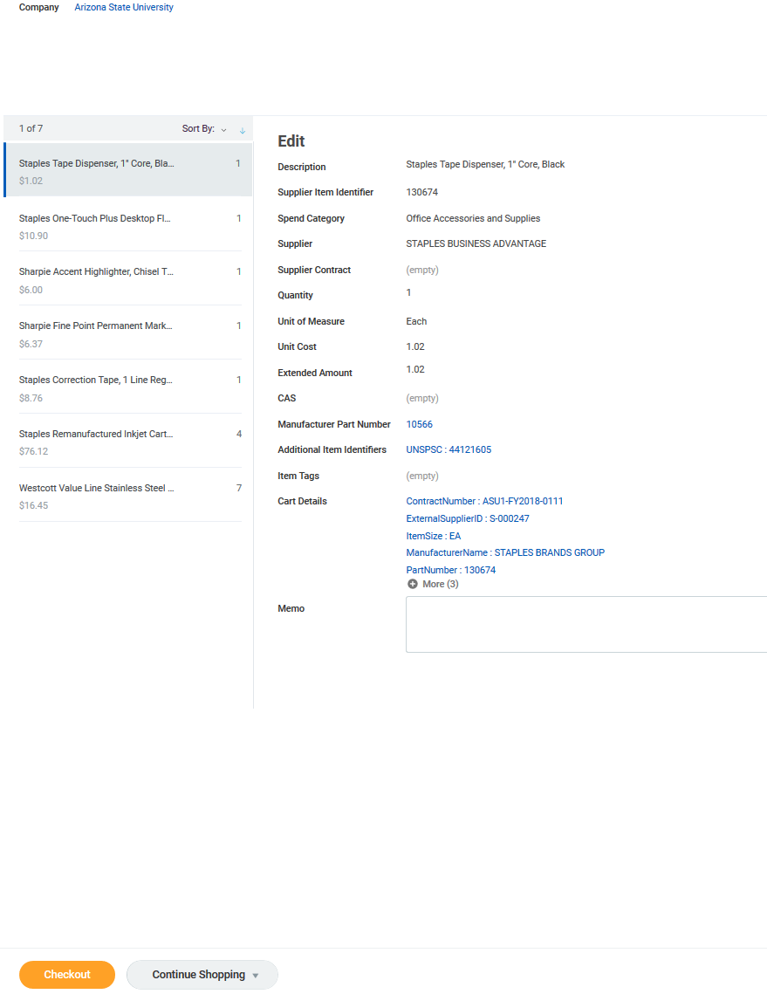
COMPLETING WORKDAY STEPS
Click the Checkout button

Slide 14
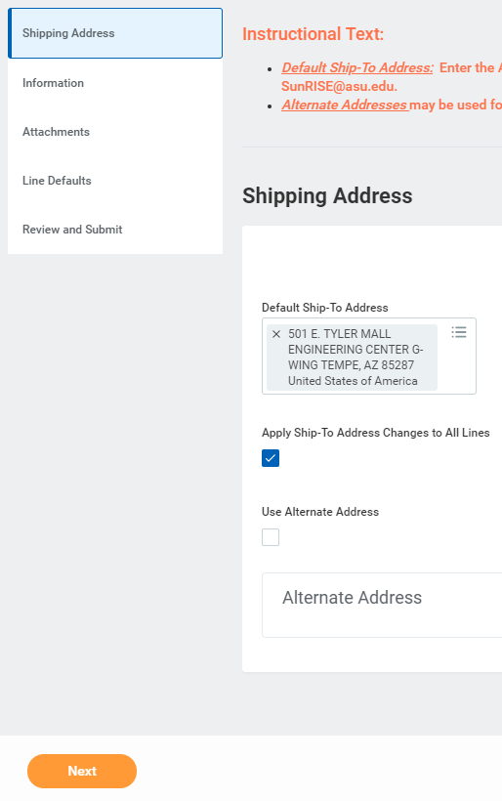
SHIPPING ADDRESSES
501 E. Tyler Mall Engineering Center G-Wing Tempe, AZ 85287 (for all non-chemical orders)
G301_ECG
551 E University Dr. Bateman Chemical Storage Bldg G Tempe, AZ 85287 United States (for all chemical orders)
PSG_G106
Bldg / Room# are required later in the order process.
Then click: Next

Slide 15
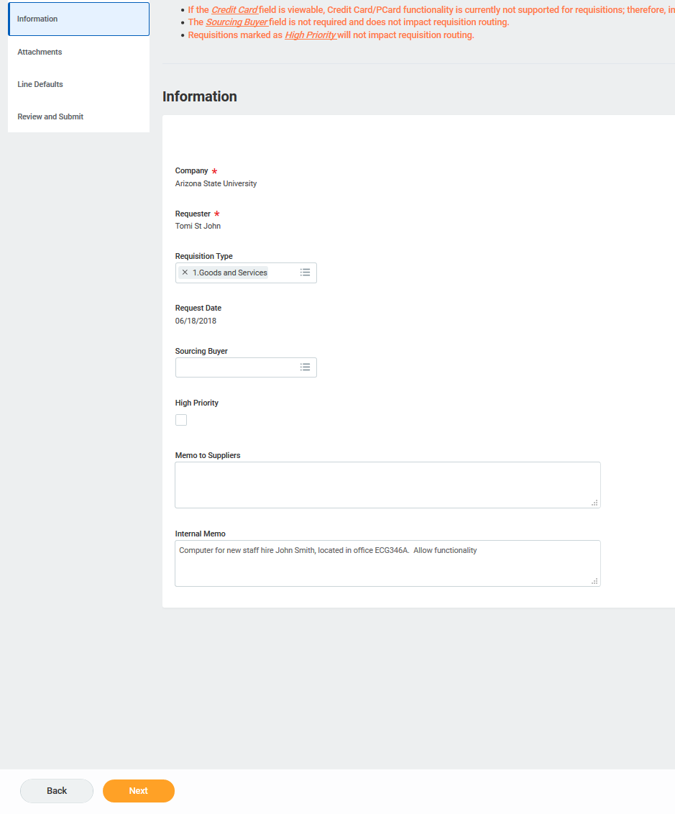
INFORMATION
Under Requisition Type always select Goods and Services
Leave the following blank:
Sourcing Buyer
High Priority
Memo to Suppliers
Under Internal Memo provide the same business justification as approved to the PI for this order. Remember that a good business justification covers:
WHO
WHAT
WHERE
WHEN
WHY
IS GRANT SPECIFIC
Click Next

Slide 16
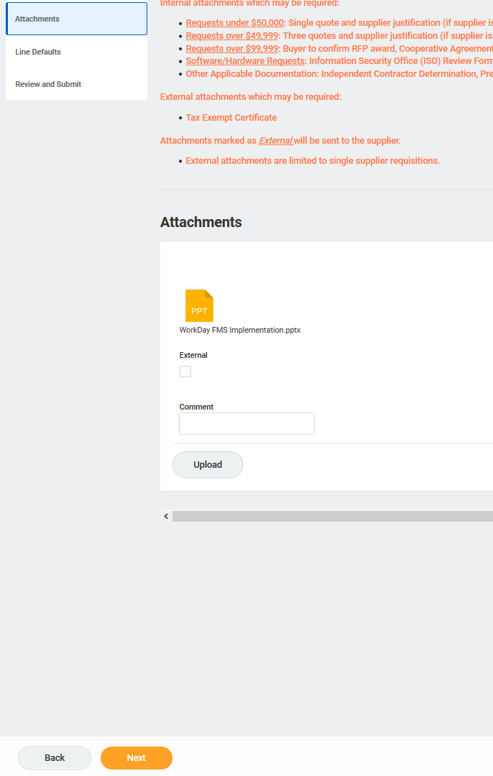
ATTACHMENTS
PI Approval CANNOT be applied in the SunRISE system. Please attach a pdf copy of the complete email approval you received from your PI. The approval must include the business purpose, account and list, screen shot or copy of items you are ordering. Requisitions that do not have the PI attached will be returned to the requestor.
Click Select files
Select the approval and Upload into the WorkDay system
Do not click the External box
Hit the Upload button
Click Next

Slide 17
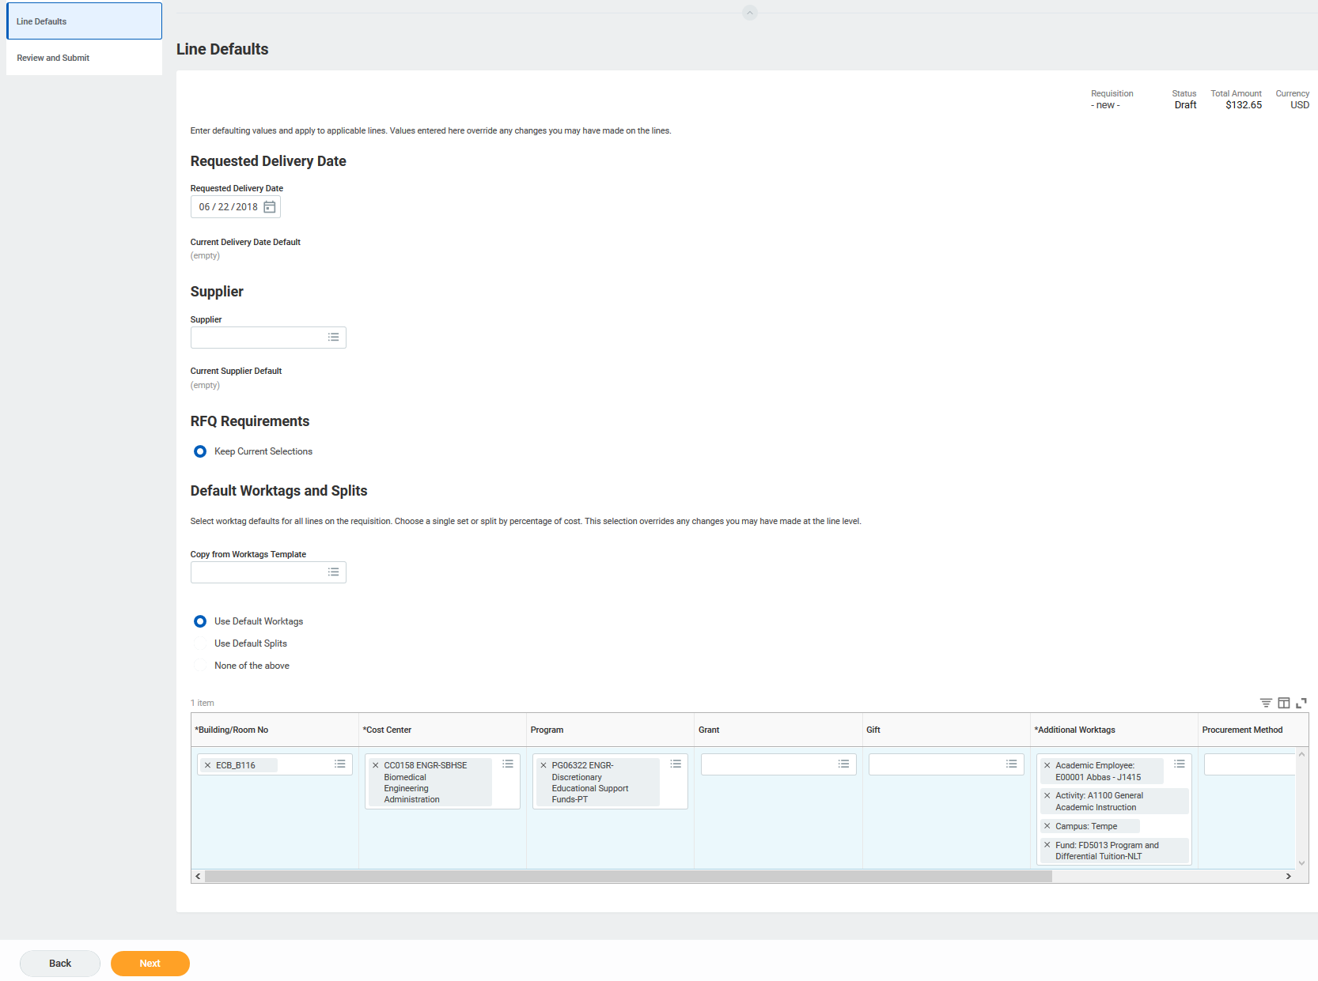
LINE DEFAULTS
Requested Delivery Date
Select a date in the future
THIS DOES NOT MEAN THE PRODUCT WILL BE DELIVERED BY THIS DATE.
Leave the following blank or as system defaults:
Supplier
RFQ Requirements
Select the Use Default Worktags radial
Input AT LEAST
Building/Room No (required!)
Cost Center
Program, Grant or Gift Code
Additional Worktag – this info will auto-populate. If you are ordering chemicals add your lab location here.
Click Next

Slide 18
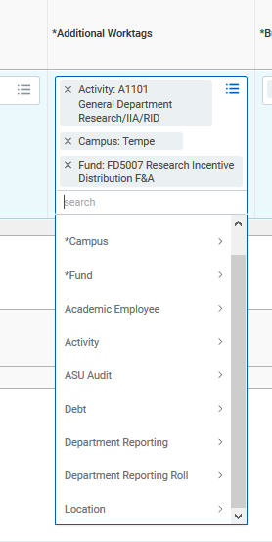
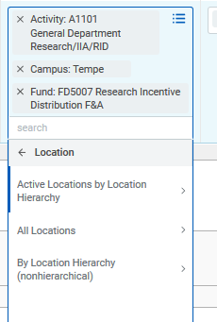
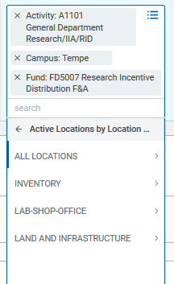
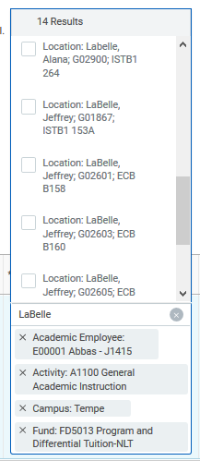
LINE DEFAULTS – CON’T: sample, adding lab location for chemical order
NOTE: Search by Faculty Last Name then select the appropriate lab location.

Slide 19
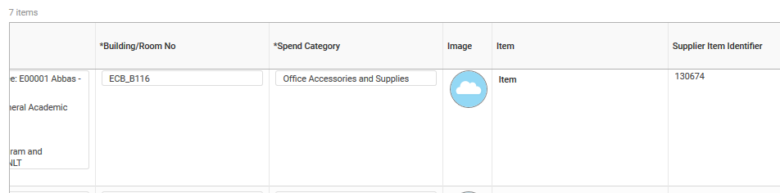
REVIEW AND SUBMIT Spend categories are system references to the items being purchased. These will default, so you do not need to change. The business office will advise if something is miscoded by the system and ask you to update.

Slide 20
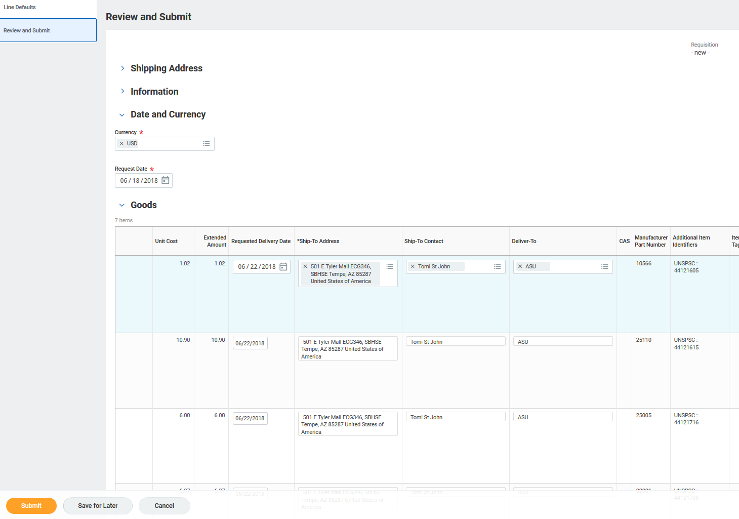
REVIEW AND SUBMIT or SAVE FOR LATER:
While you can SEE information from the other sections of the order, information can only be updated in its corresponding section. Toggle back to that section to update the needed information, if necessary.
Data regarding the following fields defaults in from other sections:
Cost Center, Program, Gift, Grant, Additional Worktags, building/room no, requested delivery date, ship-to address.
Update these fields in the corresponding section if needed
If all fields are accurate, click Submit
If you need more time for this order click Save For Later

Slide 21
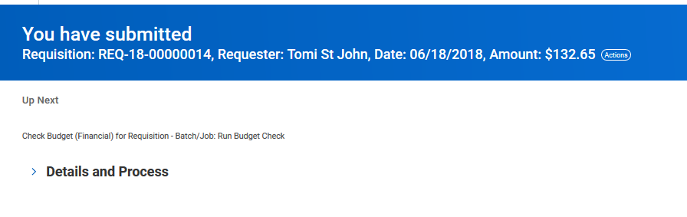
SUCCESSFUL SUBMISSION
A successful submission will return a “You have Submitted” message as well as the order requisition number.
Click: Done

Slide 22
TO ORDER GAS CYLINERS
Select the Search Catalog option

Slide 23
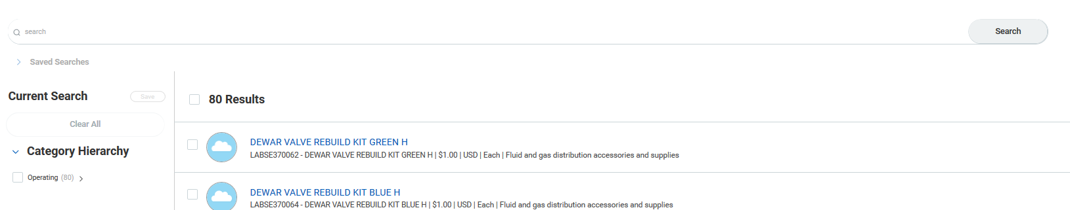
SEARCH THE CATALOG
Search the catalog for the gas needed and select from the options.

Slide 24
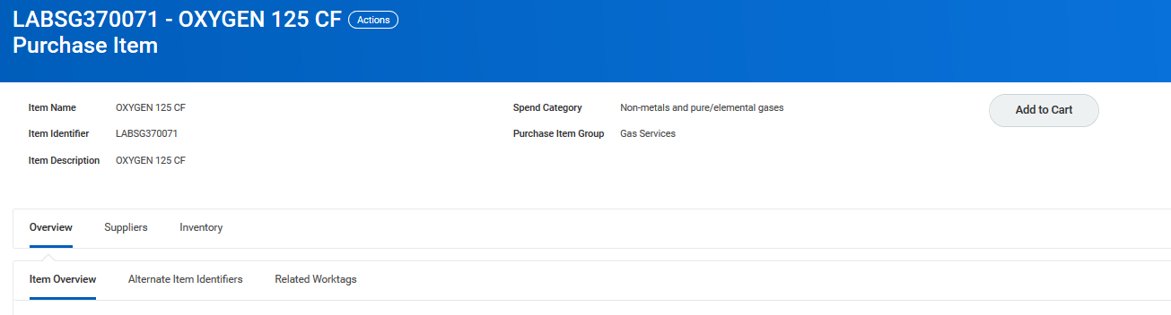
SELECTING PRODUCT
After selecting the line item to see additional product details and verify the product, click Add to Cart

Slide 25
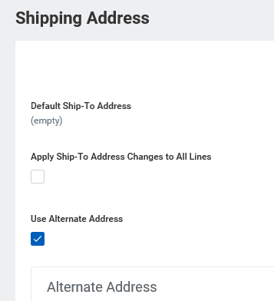
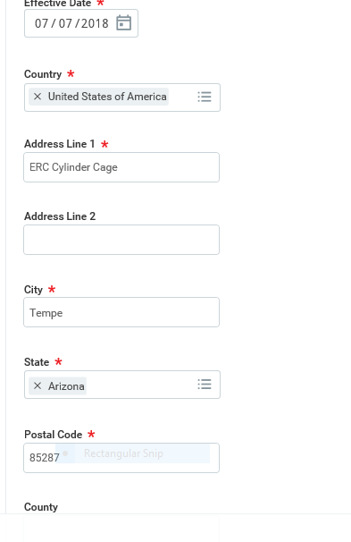
CHOOSE
Use alternate shipping address for cylinders to a Cylinder Cage or if lab is not listed.
Bldg / Room# are required later in the order process.
ASU Policy EHS 408 requires that chemicals be purchased through the ASU designated chemical purchasing system. Specialty items which are ordered outside the designated system must be reported to EHS using the specialty chemical purchase form.
All chemical orders must be coded with the ASU laboratory registration number which corresponds to the purchasing laboratory or shop. Chemical orders will only be approved with complete information. The delivery location entered shall match the registration number.
https://cfo.asu.edu/webform/ehs-chemical-purchase-and-transfer-form (form for transferring chemicals to another lab or submitting back up for Pcard orders).

Slide 26
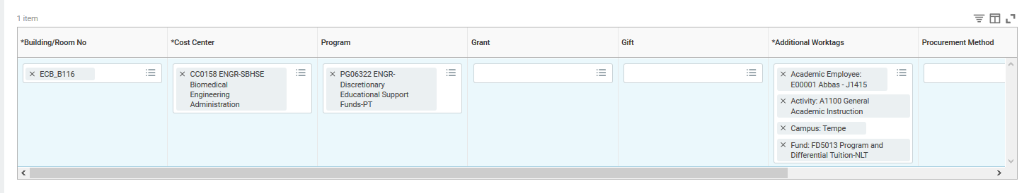
LINE DEFAULTS: example

Slide 27
LINE DEFAULTS – CON’T. – sample:
NOTE: Search by Faculty Last Name then select the appropriate lab location.

Slide 28
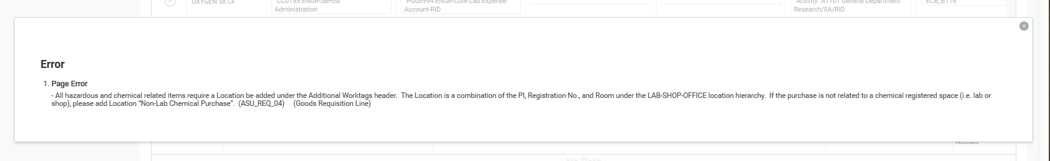
LINE DEFAULTS – CON’T.
NOTE: For any chemical and/or hazardous substances, the lab location is required as an additional worktag.

Slide 29
REVIEW AND SUBMIT or SAVE FOR LATER
While you can SEE information from the other sections of the order, information can only be updated in its corresponding section. Toggle back to that section to update the needed information, if necessary.
Data regarding the following fields defaults in from other sections:
Cost Center, Program, Gift, Grant, Additional Worktags, building/room no, requested delivery date, ship-to address.
Update these fields in the corresponding section
If all fields are accurate, click ‘Submit’

Slide 30
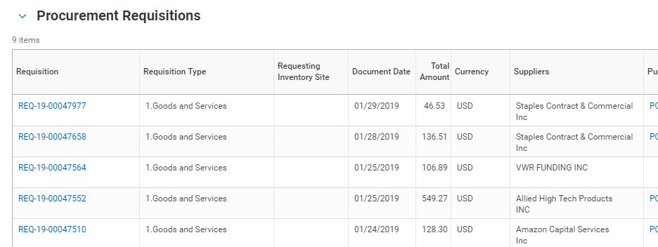
HELPFUL WORKDAY TIPS
To see orders you have submitted, navigate to the Purchases worklet then click Requisitions
Select your requisition from the list to see high level information about that order

Slide 31

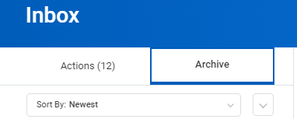
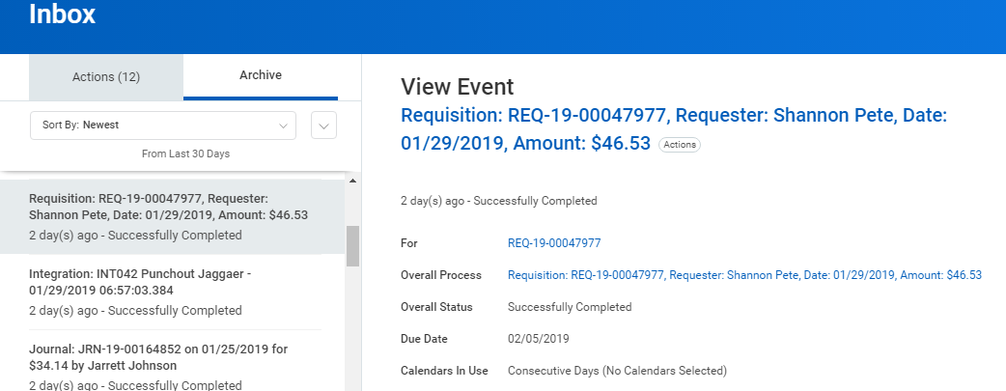
HELPFUL WORKDAY TIPS – CON’T.
You can also view a list of your requisitions in your archive folder.
Click the Inbox
Then click the Archive tab on the next page
A list of your requisitions will appear on the left. Select the one you want to view.
The details will populate the center screen where you can view the status and all other details.

Slide 32
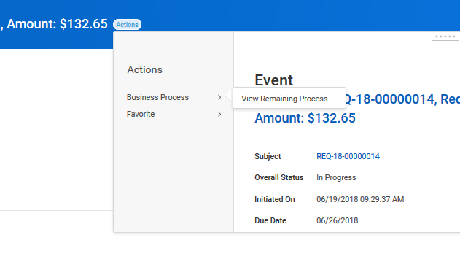
HELPFUL WORKDAY TIPS – CON’T.
To see the submission status of an order, select the Actions button and drill into Business Process, then View Remaining Processes

Slide 33

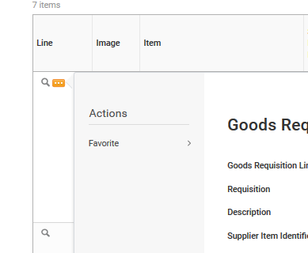
HELPFUL WORKDAY TIPS – CON’T.
Use this icon to re-arrange your column order when entering cost centers, programs, etc.
The ‘…’ always allows you to access additional information for the action that it is attached to

Slide 34
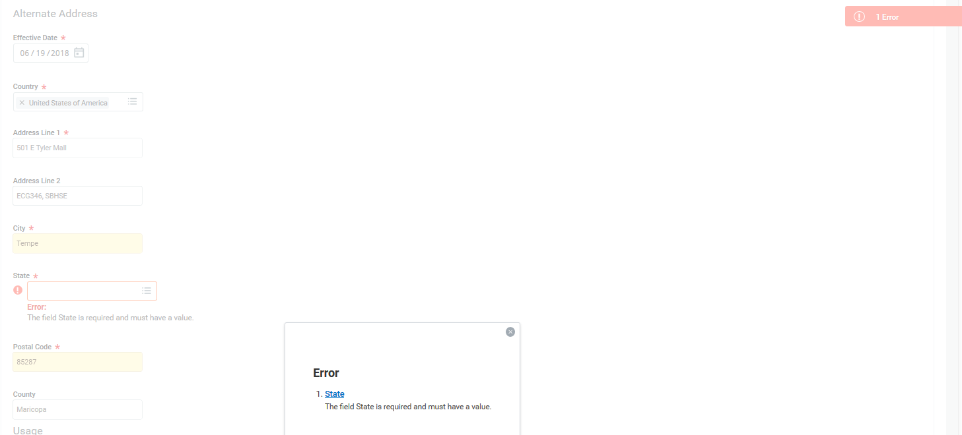
HELPFUL WORKDAY TIPS – CON’T.
Errors:
Click on the red ‘Error’ box and a message will appear
Click on the blue hyperlink to be taken directly to the field that is presenting the error

Slide 35
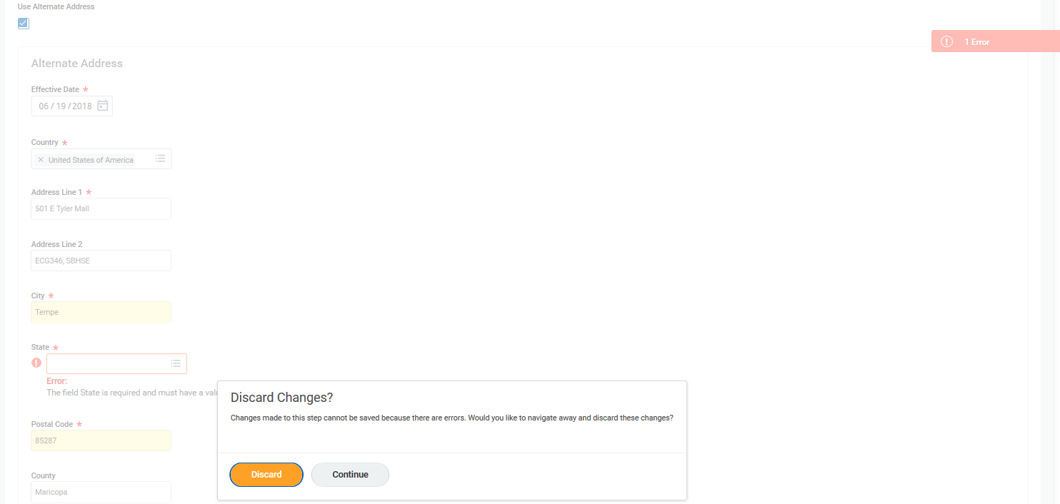
HELPFUL WORKDAY TIPS – CON’T.
Errors:
Click on ‘Continue’ and correct errors. If you hit “Discard” your request will be deleted.

Slide 36
THANK YOU!
SEMTE Business Office Contact
semte.purchasing@asu.edu
(480) 965-9710
FMS Contact
fms@asu.edu
(480) 965-2334

