Slide 1
Artificial Intelligence 人工智慧 Dynamic Programming VS. Ant Colony Optimization (TSP) Computer Science and Information Engineering National Taipei University of Technology

Slide 2
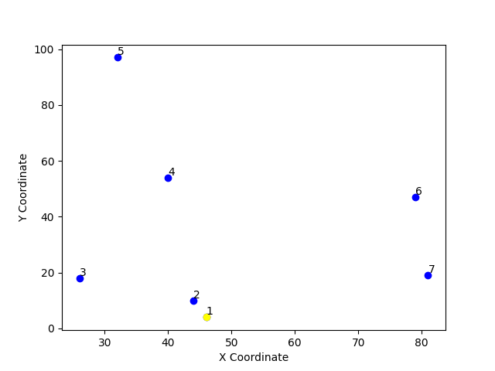
Exercise: Traveling Salesman Problem
City Coordinates
1 | 2 | 3 | 4 | 5 | 6 | 7
(46, 4) | (44, 10) | (32, 97) | (40, 54) | (81, 19) | (79, 47) | (26, 18)

Slide 3
Exercise: Traveling Salesman Problem
Suppose we have a TSP problem with 7 cities
The distance between cities is given by the following matrix
What is the min cost and best path in Dynamic Programming and Ant Colony Optimization?
Compare the differences between these two algorithms
 | 1 | 2 | 3 | 4 | 5 | 6 | 7
1 | 0 | 6 | 94 | 50 | 38 | 54 | 24
2 | 6 | 0 | 87 | 44 | 38 | 50 | 19
3 | 94 | 87 | 0 | 43 | 92 | 68 | 79
4 | 50 | 44 | 43 | 0 | 53 | 39 | 38
5 | 38 | 38 | 92 | 53 | 0 | 28 | 55
6 | 54 | 50 | 68 | 39 | 28 | 0 | 60
7 | 24 | 19 | 79 | 38 | 55 | 60 | 0

Slide 4
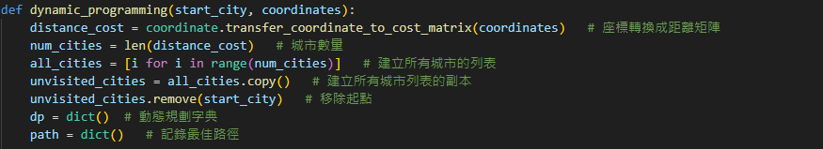
Sample Code: Dynamic Programming
Initialization
Determine the optimal path and cost

Slide 5
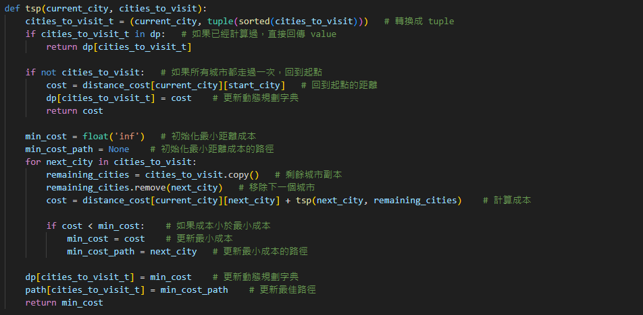
Sample Code: Dynamic Programming
Visit all cities and determine the minimum cost

Slide 6
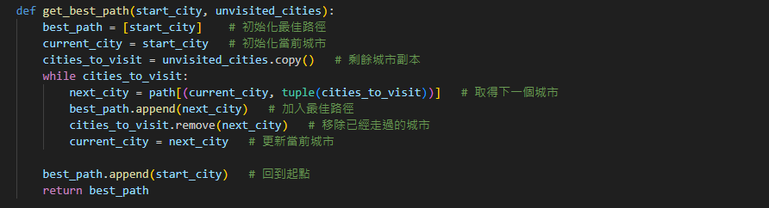
Sample Code: Dynamic Programming
Visit all cities and determine the optimal route

Slide 7
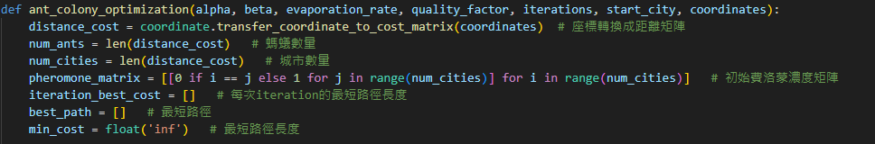
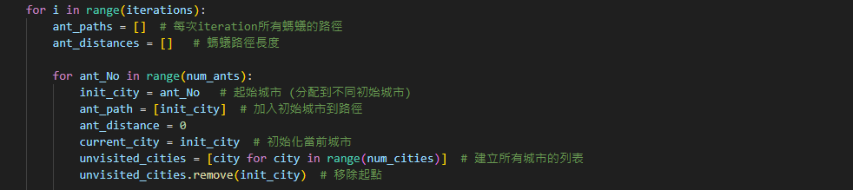
Sample Code: Ant Colony Optimization
Initialization
Define the variables utilized in each iteration

Slide 8
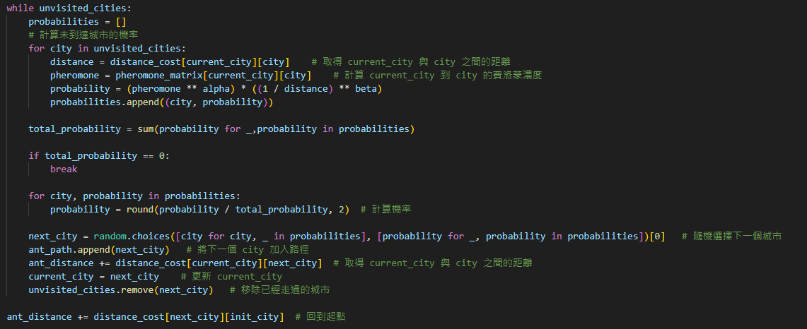
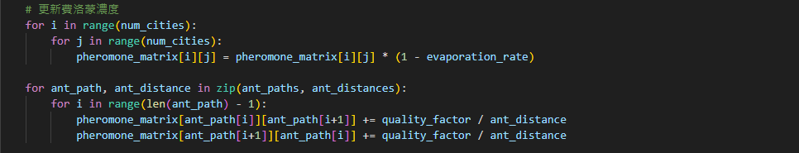
Sample Code: Ant Colony Optimization
Visit all cities and determine the optimal route

Slide 9
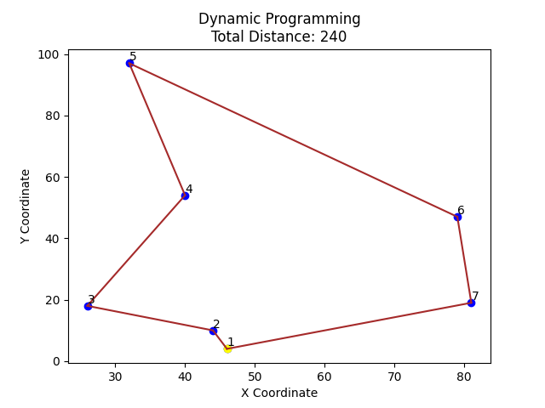
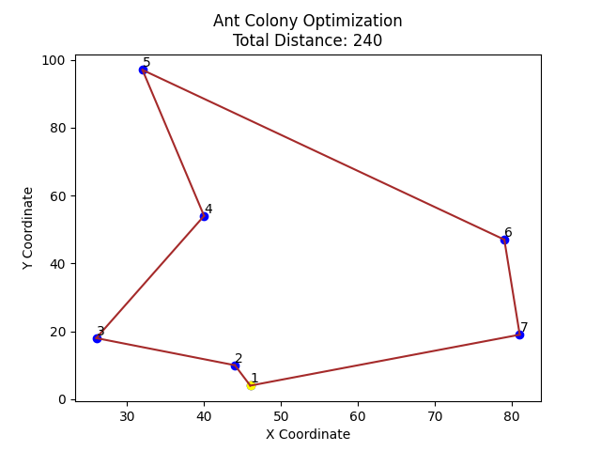
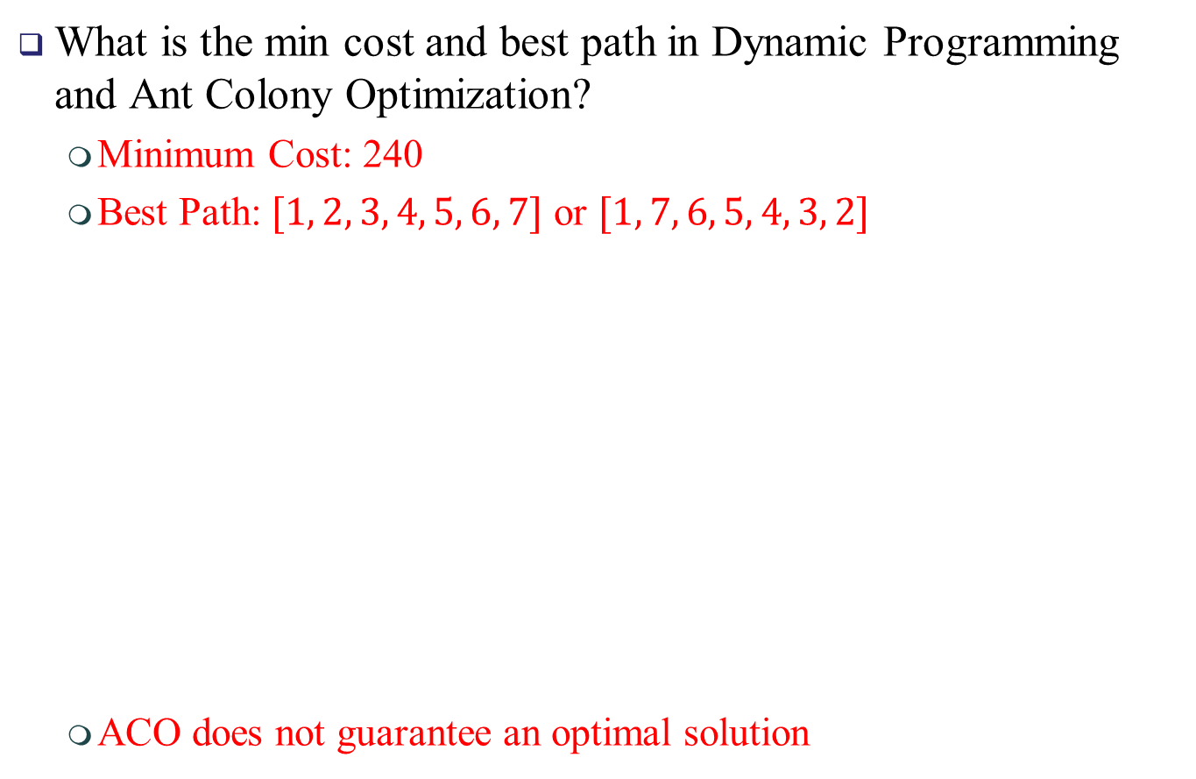
Exercise: Traveling Salesman Problem
What is the min cost and best path in Dynamic Programming and Ant Colony Optimization?
Minimum Cost: 240
Best Path: $[1, 2, 3, 4, 5, 6, 7]$ or $[1, 7, 6, 5, 4, 3, 2]$
ACO does not guarantee an optimal solution

Slide 10
Exercise: Traveling Salesman Problem
Compare the differences between these two algorithms
Dynamic Programming
Exact Algorithm
Guarantees an optimal solution
Inefficient for large problems due to exponential complexity
Typically used for problems with overlapping subproblems
Ant Colony Optimization
Heuristic Algorithm
Finds a good solution, but not guarantee to be optimal
Performs better for large, complex problems
Suitable for complex optimization problems

Slide 11
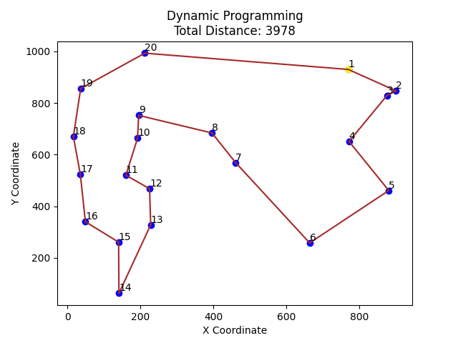
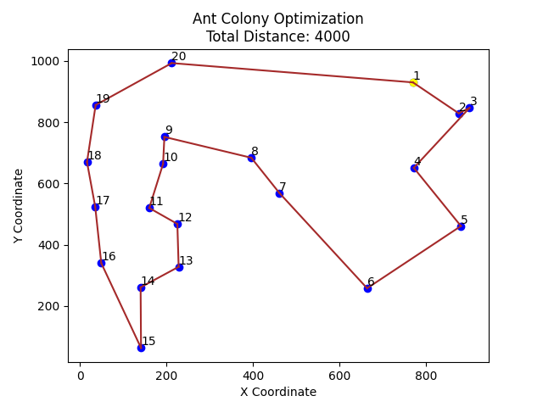
Exercise: Traveling Salesman Problem
Compare the differences between these two algorithms
Dynamic programming guarantees the optimal solution, whereas Ant Colony Optimization may not, particularly when the number of cities increases, but it still provides a good solution

Slide 12
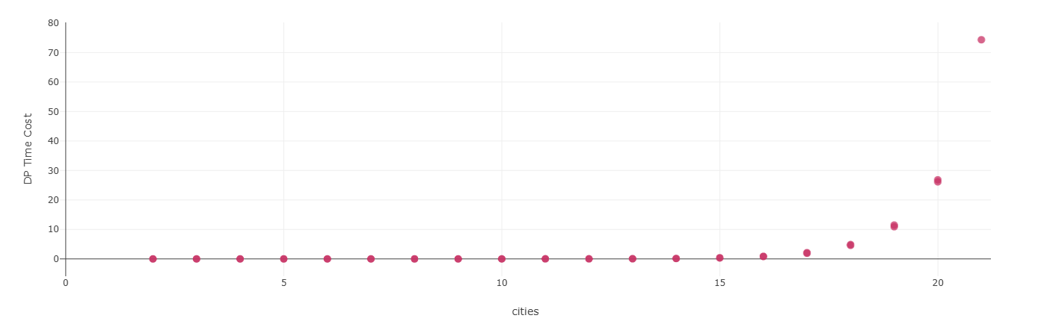
Exercise: Traveling Salesman Problem
Scatter Plot
X-axis (Cities)
Y-axis (Dynamic Programming Time Cost)

Slide 13
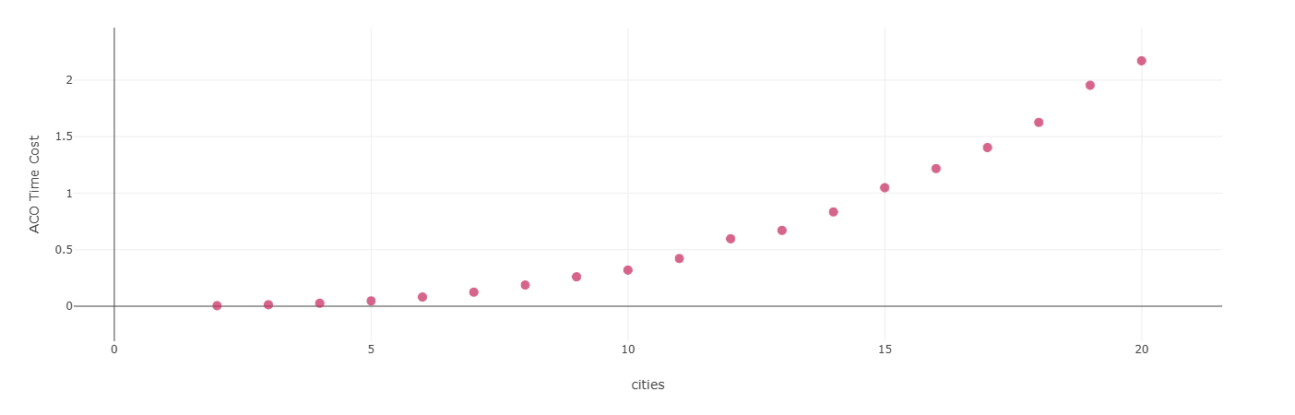
Exercise: Traveling Salesman Problem
Scatter Plot
X-axis (Cities)
Y-axis (Ant Colony Optimization Time Cost)

Slide 14
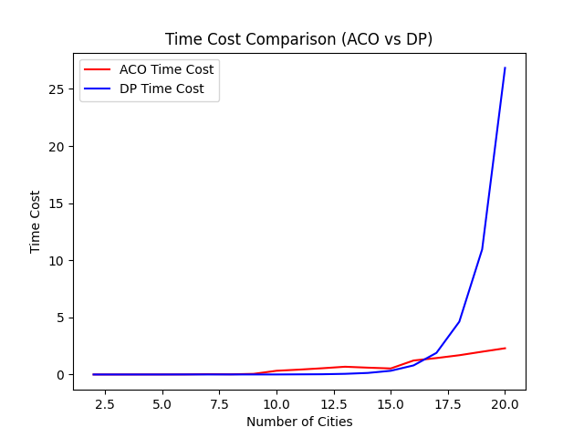

Exercise: Traveling Salesman Problem
Compare the differences between these two algorithms
When $n=17$, the time required for DP exceeds that of ACO

