Slide 1
Artificial Intelligence 人工智慧 Dynamic Programming VS. Ant Colony Optimization (TSP) Computer Science and Information Engineering National Taipei University of Technology

Slide 2
Algorithm
Exact Algorithm
Problem-solving method without approximate or error
Heuristic Algorithm
Problem-solving method to produce approximate solutions
Select the best solution within an acceptable time and cost
Obtain a certain trade-off in complexity and quality of resolution
Most are based on an imitation of natural algorithms
e.g., Ant Colony Algorithm (ACO), Genetic Algorithm (GA), etc.

Slide 3
Dynamic Programming (DP)
Dynamic Programming (DP) is a general algorithm design technique for solving problems defined by recurrences with overlapping subproblems
Main idea
Set up a recurrence relating a solution to a larger instance to solutions of some smaller instances
Solve smaller instances once
Record solutions in a table
Extract solution to the initial instance from that table

Slide 4
Divide-and-Conquer
Divide
Break down the original problem into smaller subproblems
Each subproblem should represent a part of the overall problem
Conquer
If the subproblem is small enough, solve it directly; otherwise, break the subproblem down recursively
Combine
Combine the sub-problems to get the final solution of the whole problem

Slide 5
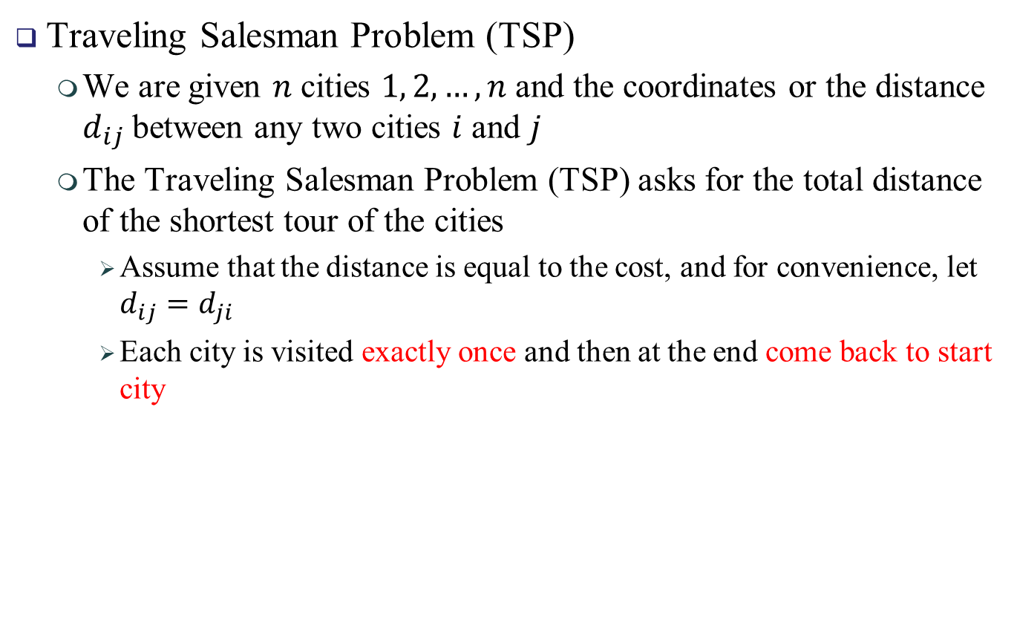
Traveling Salesman Problem
Traveling Salesman Problem (TSP)
We are given $n$ cities $1, 2, …, n$and the coordinates or the distance $d_{ij}$between any two cities $i$ and $j$
The Traveling Salesman Problem (TSP) asks for the total distance of the shortest tour of the cities
Assume that the distance is equal to the cost, and for convenience, let $d_{ij}=d_{ji}$
Each city is visited exactly once and then at the end come back to start city

Slide 6

DP: Traveling Salesman Problem
Let $g(i, S)$ be the length of a shortest path starting at vertex $i$, going through all vertices in $S$ and terminating at vertex $i$.
$$g\left(i, S\right)=⁡\left\{\begin{aligned}\min_{k∈S}\left\{C_{ik}+g\left(k, S−\left\{k\right\}\right)\right\} if S≠∅, \\ C_{is} otherwise, \end{aligned}\right.$$
$g(i, S)$ represents the minimum total cost of traveling from city $i$ while visiting all unvisited cities in set $S$.
$S$ is the set of unvisited cities
$C_{ik}$ is the cost of traveling from city $i$ to city $k$
$C_{is}$ is the cost of traveling from city $i$ to start city $s$

Slide 7
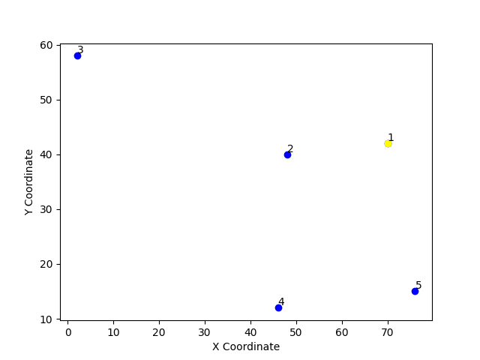

DP: Traveling Salesman Problem
Cities $n = 5$

Slide 8

DP: Traveling Salesman Problem
City Coordinates
Distance $d_{ij}$between any two cities $i$ and $j$
$d_{ij}​=Round(d_{ij}​,0)$
1 | 2 | 3 | 4 | 5
(70, 42) | (48, 40) | (2, 58) | (46, 12) | (76, 15)
 | 1 | 2 | 3 | 4 | 5
1 | 0 | 22 | 69 | 38 | 27
2 | 22 | 0 | 49 | 28 | 37
3 | 69 | 49 | 0 | 63 | 85
4 | 38 | 28 | 63 | 0 | 30
5 | 27 | 37 | 85 | 30 | 0

Slide 9

DP: Traveling Salesman Problem
$i = 1, S = \{ 2, 3, 4, 5 \}$
$$g\left(1, \{2, 3, 4, 5\}\right)$$
$g\left(2, \left\{3, 4, 5\right\}\right) g\left(3, \left\{2, 4, 5\right\}\right)$ $g\left(4, \left\{2, 3, 5\right\}\right) g\left(5, \left\{2, 3, 4\right\}\right)$

Slide 10
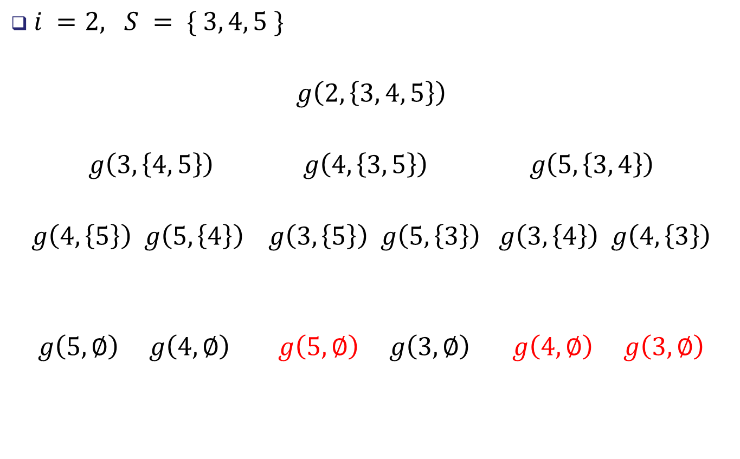
DP: Traveling Salesman Problem
$i =2, S = \{ 3, 4, 5 \}$
$g\left(2, \left\{3, 4, 5\right\}\right)$
$$g\left(3, \left\{4, 5\right\}\right) g\left(4, \left\{3, 5\right\}\right) g\left(5, \left\{3, 4\right\}\right)$$
$$g\left(4, \left\{5\right\}\right) g\left(5, \left\{4\right\}\right) g\left(3, \left\{5\right\}\right) g\left(5, \left\{3\right\}\right) g\left(3, \left\{4\right\}\right) g\left(4, \left\{3\right\}\right)$$
$$g\left(5, ∅\right) g\left(4,∅\right) g\left(5,∅\right) g\left(3,∅\right) g\left(4,∅\right) g\left(3,∅\right)$$

Slide 11
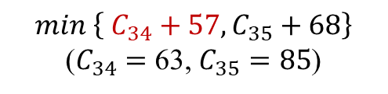
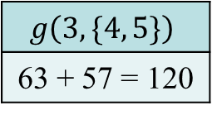
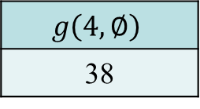

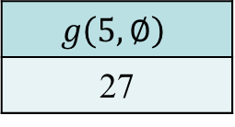
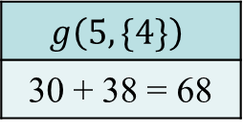

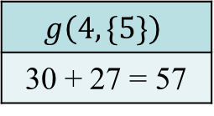

DP: Traveling Salesman Problem
$i =3, S = \left\{ 4, 5 \right\}$
$$g\left(3,\{4, 5\}\right)$$
63 + 57 = 120
$\min\left\{ C_{34}+57, C_{35}+68\right\}$
($C_{34}=$ 63, $C_{35}=85$)
$$g\left(4, \{5\}\right)$$
30 + 27 = 57
$$g\left(5,\{4\}\right)$$
30 + 38 = 68
$$\min\left\{ C_{45}+27 \right\}$$
$$\min\left\{ C_{54}+38 \right\}$$
$$g\left(5, ∅\right)$$
27
$$g\left(4,∅\right)$$
38

Slide 12
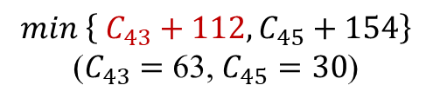
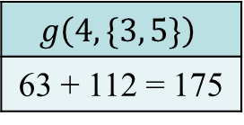
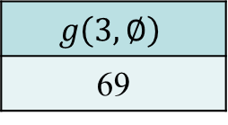

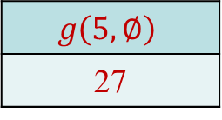
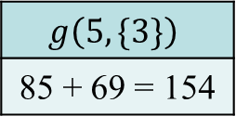

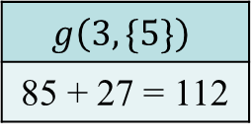

DP: Traveling Salesman Problem
$i =4, S = \left\{ 3, 5 \right\}$
$$g\left(4,\{3, 5\}\right)$$
63 + 112 = 175
$\min\left\{ C_{43}+112, C_{45}+154\right\}$
($C_{43}=$ 63, $C_{45}=30$)
$$g\left(3, \{5\}\right)$$
85 + 27 = 112
$$g\left(5,\{3\}\right)$$
85 + 69 = 154
$$\min\left\{ C_{35}+27 \right\}$$
$$\min\left\{ C_{53}+69 \right\}$$
$$g\left(5, ∅\right)$$
27
$$g\left(3,∅\right)$$
69

Slide 13
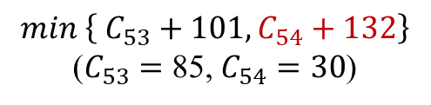
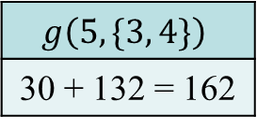
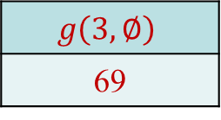

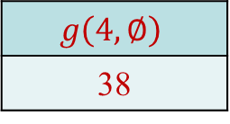
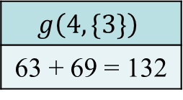

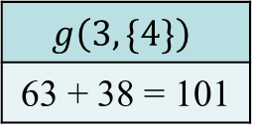

DP: Traveling Salesman Problem
$i =5, S = \left\{ 3, 4 \right\}$
$$g\left(5,\{3, 4\}\right)$$
30 + 132 = 162
$\min\left\{ C_{53}+101, C_{54}+132\right\}$
($C_{53}=$ 85, $C_{54}=30$)
$$g\left(3, \{4\}\right)$$
63 + 38 = 101
$$g\left(4,\{3\}\right)$$
63 + 69 = 132
$$\min\left\{ C_{34}+38 \right\}$$
$$\min\left\{ C_{43}+69 \right\}$$
$$g\left(4, ∅\right)$$
38
$$g\left(3,∅\right)$$
69

Slide 14
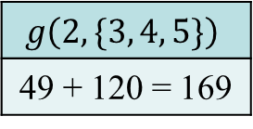
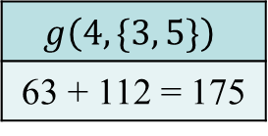

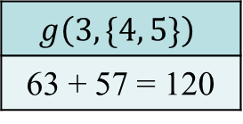
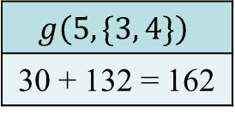
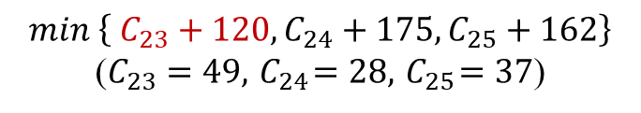
DP: Traveling Salesman Problem
$i =2, S = \left\{ 3, 4, 5 \right\}$
$$g\left(2,\{3, 4, 5\}\right)$$
49 + 120 = 169
$\min\left\{ C_{23}+120, C_{24}+175,C_{25}+162\right\}$
($C_{23}=$ $49, { C}_{24}=28,{ C}_{25}=37$)
$$g\left(3,\{4, 5\}\right)$$
63 + 57 = 120
$$g\left(4,\{3, 5\}\right)$$
63 + 112 = 175
$$g\left(5,\{3, 4\}\right)$$
30 + 132 = 162

Slide 15
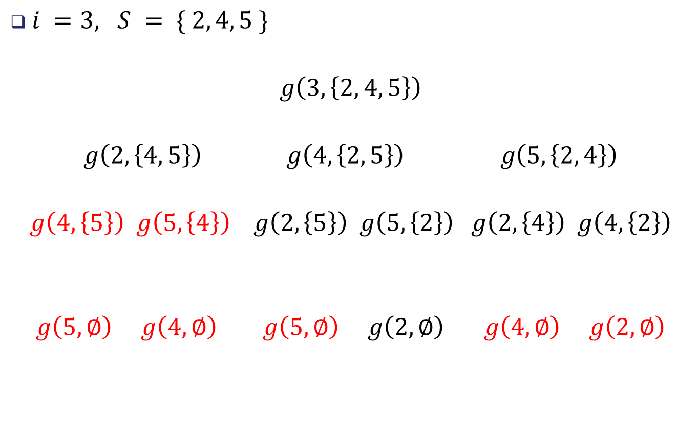
DP: Traveling Salesman Problem
$i =3, S = \{ 2, 4, 5 \}$
$g\left(3, \left\{2, 4, 5\right\}\right)$
$$g\left(2, \left\{4, 5\right\}\right) g\left(4, \left\{2, 5\right\}\right) g\left(5, \left\{2, 4\right\}\right)$$
$$g\left(4, \left\{5\right\}\right) g\left(5, \left\{4\right\}\right) g\left(2, \left\{5\right\}\right) g\left(5, \left\{2\right\}\right) g\left(2, \left\{4\right\}\right) g\left(4, \left\{2\right\}\right)$$
$$g\left(5, ∅\right) g\left(4,∅\right) g\left(5,∅\right) g\left(2,∅\right) g\left(4,∅\right) g\left(2,∅\right)$$

Slide 16
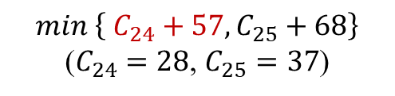
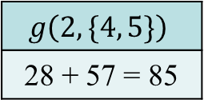
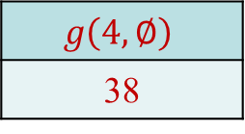

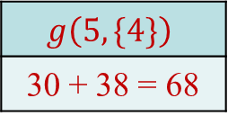
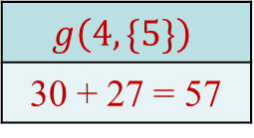
DP: Traveling Salesman Problem
$i =2, S = \left\{ 4, 5 \right\}$
$$g\left(2,\{4, 5\}\right)$$
28 + 57 = 85
$\min\left\{ C_{24}+57, C_{25}+68\right\}$
($C_{24}=$ $28$, $C_{25}=37$)
$$g\left(4, \{5\}\right)$$
30 + 27 = 57
$$g\left(5,\{4\}\right)$$
30 + 38 = 68
$$\min\left\{ C_{45}+27 \right\}$$
$$\min\left\{ C_{54}+38 \right\}$$
$$g\left(5, ∅\right)$$
27
$$g\left(4,∅\right)$$
38

Slide 17
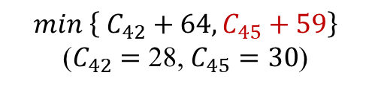
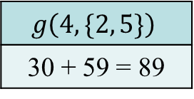
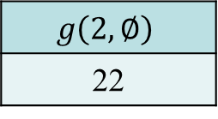

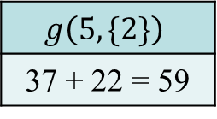

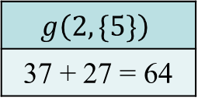

DP: Traveling Salesman Problem
$i =4, S = \left\{ 2, 5 \right\}$
$$g\left(4,\{2, 5\}\right)$$
30 + 59 = 89
$\min\left\{ C_{42}+64, C_{45}+59\right\}$
($C_{42}=$ 28, $C_{45}=30$)
$$g\left(2, \{5\}\right)$$
37 + 27 = 64
$$g\left(5,\{2\}\right)$$
37 + 22 = 59
$$\min\left\{ C_{25}+27 \right\}$$
$$\min\left\{ C_{52}+22 \right\}$$
$$g\left(5, ∅\right)$$
27
$$g\left(2,∅\right)$$
22

Slide 18

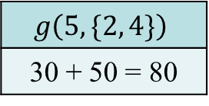
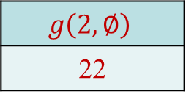

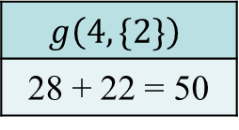

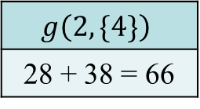

DP: Traveling Salesman Problem
$i =5, S = \left\{ 2, 4 \right\}$
$$g\left(5,\{2, 4\}\right)$$
30 + 50 = 80
$\min\left\{ C_{52}+66, C_{54}+50\right\}$
($C_{52}=$ 37, $C_{54}=30$)
$$g\left(2, \{4\}\right)$$
28 + 38 = 66
$$g\left(4,\{2\}\right)$$
28 + 22 = 50
$$\min\left\{ C_{24}+38 \right\}$$
$$\min\left\{ C_{42}+22 \right\}$$
$$g\left(4, ∅\right)$$
38
$$g\left(2,∅\right)$$
22

Slide 19
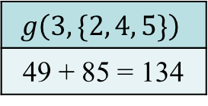
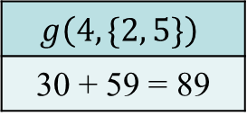

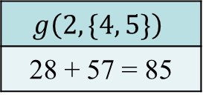

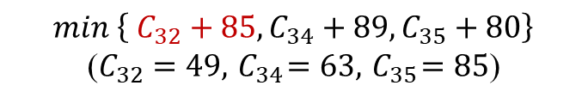
DP: Traveling Salesman Problem
$i =3, S = \left\{ 2, 4, 5 \right\}$
$$g\left(3,\{2, 4, 5\}\right)$$
49 + 85 = 134
$\min\left\{ C_{32}+85, C_{34}+89,C_{35}+80\right\}$
($C_{32}=$ $49, { C}_{34}=63,{ C}_{35}=85$)
$$g\left(2,\{4, 5\}\right)$$
28 + 57 = 85
$$g\left(4,\{2, 5\}\right)$$
30 + 59 = 89
$$g\left(5,\{2, 4\}\right)$$
30 + 50 = 80

Slide 20

DP: Traveling Salesman Problem
$i =4, S = \{ 2, 3, 5 \}$
$g\left(4, \left\{2, 3, 5\right\}\right)$
$$g\left(2, \left\{3, 5\right\}\right) g\left(3, \left\{2, 5\right\}\right) g\left(5, \left\{2, 3\right\}\right)$$
$$g\left(3, \left\{5\right\}\right) g\left(5, \left\{3\right\}\right) g\left(2, \left\{5\right\}\right) g\left(5, \left\{2\right\}\right) g\left(2, \left\{3\right\}\right) g\left(3, \left\{2\right\}\right)$$
$$g\left(5, ∅\right) g\left(3,∅\right) g\left(5,∅\right) g\left(2,∅\right) g\left(3,∅\right) g\left(2,∅\right)$$

Slide 21





DP: Traveling Salesman Problem
$i =2, S = \left\{ 3, 5 \right\}$
$$g\left(2,\{3, 5\}\right)$$
49 + 112 = 162
$\min\left\{ C_{23}+112, C_{25}+154\right\}$
($C_{23}=$ $49$, $C_{25}=37$)
$$g\left(3, \{5\}\right)$$
85 + 27 = 112
$$g\left(5,\{3\}\right)$$
85 + 69 = 154
$$\min\left\{ C_{35}+27 \right\}$$
$$\min\left\{ C_{53}+69 \right\}$$
$$g\left(5, ∅\right)$$
27
$$g\left(3,∅\right)$$
69

Slide 22





DP: Traveling Salesman Problem
$i =3, S = \left\{ 2, 5 \right\}$
$$g\left(3,\{2, 5\}\right)$$
49 + 64 = 113
$\min\left\{ C_{32}+64, C_{35}+59\right\}$
($C_{32}=$ $49$, $C_{35}=85$)
$$g\left(2, \{5\}\right)$$
37 + 27 = 64
$$g\left(5,\{2\}\right)$$
37 + 22 = 59
$$\min\left\{ C_{25}+27 \right\}$$
$$\min\left\{ C_{52}+22 \right\}$$
$$g\left(5, ∅\right)$$
27
$$g\left(2,∅\right)$$
22

Slide 23








DP: Traveling Salesman Problem
$i =5, S = \left\{ 2, 3 \right\}$
$$g\left(5,\{2, 3\}\right)$$
37 + 118 = 155
$\min\left\{ C_{52}+118, C_{53}+71\right\}$
($C_{52}=$ $37$, $C_{53}=85$)
$$g\left(2, \{3\}\right)$$
49 + 69 = 118
$$g\left(3,\{2\}\right)$$
49 + 22 = 71
$$\min\left\{ C_{23}+69 \right\}$$
$$\min\left\{ C_{32}+22 \right\}$$
$$g\left(3, ∅\right)$$
69
$$g\left(2,∅\right)$$
22

Slide 24






DP: Traveling Salesman Problem
$i =4, S = \left\{ 2, 3, 5 \right\}$
$$g\left(4,\{2, 3, 5\}\right)$$
63 + 113 = 176
$\min\left\{ C_{42}+162, C_{43}+113,C_{45}+155\right\}$
($C_{42}=$ $28, { C}_{43}=63,{ C}_{45}=30$)
$$g\left(2,\{3, 5\}\right)$$
49 + 112 = 162
$$g\left(3,\{2, 5\}\right)$$
49 + 64 = 113
$$g\left(5,\{2, 3\}\right)$$
37 + 118 = 155

Slide 25

DP: Traveling Salesman Problem
$i =5, S = \{ 2, 3, 4 \}$
$g\left(5, \left\{2, 3, 4\right\}\right)$
$$g\left(2, \left\{3, 4\right\}\right) g\left(3, \left\{2, 4\right\}\right) g\left(4, \left\{2, 3\right\}\right)$$
$$g\left(3, \left\{4\right\}\right) g\left(4, \left\{3\right\}\right) g\left(2, \left\{4\right\}\right) g\left(4, \left\{2\right\}\right) g\left(2, \left\{3\right\}\right) g\left(3, \left\{2\right\}\right)$$
$$g\left(4, ∅\right) g\left(3,∅\right) g\left(4,∅\right) g\left(2,∅\right) g\left(3,∅\right) g\left(2,∅\right)$$

Slide 26





DP: Traveling Salesman Problem
$i =2, S = \left\{ 3, 4 \right\}$
$$g\left(2,\{3, 4\}\right)$$
49 + 101 = 150
$\min\left\{ C_{23}+101, C_{24}+129\right\}$
($C_{23}=$ $49$, $C_{24}=28$)
$$g\left(3, \{4\}\right)$$
63 + 38 = 101
$$g\left(4,\{3\}\right)$$
63 + 69 = 129
$$\min\left\{ C_{34}+38 \right\}$$
$$\min\left\{ C_{43}+69 \right\}$$
$$g\left(4, ∅\right)$$
38
$$g\left(3,∅\right)$$
69

Slide 27





DP: Traveling Salesman Problem
$i =3, S = \left\{ 2, 4 \right\}$
$$g\left(3,\{2, 4\}\right)$$
63 + 50 = 113
$\min\left\{ C_{32}+66, C_{34}+50\right\}$
($C_{32}=$ $49$, $C_{34}=63$)
$$g\left(2, \{4\}\right)$$
28 + 38 = 66
$$g\left(4,\{2\}\right)$$
28 + 22 = 50
$$\min\left\{ C_{24}+38 \right\}$$
$$\min\left\{ C_{42}+22 \right\}$$
$$g\left(4, ∅\right)$$
38
$$g\left(2,∅\right)$$
22

Slide 28





DP: Traveling Salesman Problem
$i =4, S = \left\{ 2, 3 \right\}$
$$g\left(4,\{2, 3\}\right)$$
71 + 63 = 134
$\min\left\{ C_{42}+118, C_{43}+71\right\}$
($C_{42}=$ $28$, $C_{43}=63$)
$$g\left(2, \{3\}\right)$$
49 + 69 = 118
$$g\left(3,\{2\}\right)$$
49 + 22 = 71
$$\min\left\{ C_{23}+69 \right\}$$
$$\min\left\{ C_{32}+22 \right\}$$
$$g\left(3, ∅\right)$$
69
$$g\left(2,∅\right)$$
22

Slide 29






DP: Traveling Salesman Problem
$i =5, S = \left\{ 2, 3, 4 \right\}$
$$g\left(5,\{2, 3, 4\}\right)$$
30 + 134 = 164
$\min\left\{ C_{52}+150, C_{53}+113,C_{54}+134\right\}$
($C_{52}=$ $37, { C}_{53}=85,{ C}_{54}=30$)
$$g\left(2,\{3, 4\}\right)$$
49 + 101 = 150
$$g\left(3,\{2, 4\}\right)$$
63 + 50 = 113
$$g\left(4,\{2, 3\}\right)$$
71 + 63 = 134

Slide 30






DP: Traveling Salesman Problem
$i =1, S = \left\{ 2, 3, 4, 5 \right\}$
Minimum Cost: 191
Best Path: $[1, 2, 3, 4, 5] or [1, 5, 4, 3, 2]$
$$g\left(1,\{2, 3, 4, 5\}\right)$$
22 + 169 = 191 or 27 + 164 = 191
$$g\left(2,\{3, 4, 5\}\right)$$
49 + 120 = 169
$$g\left(3,\{2, 4, 5\}\right)$$
49 + 85 = 134
$$g\left(4,\{2, 3, 5\}\right)$$
63 + 113 = 176
$$g\left(5,\{2, 3, 4\}\right)$$
30 + 134 = 164
$\min\left\{ C_{12}+169, C_{13}+134,C_{14}+176, C_{15}+164\right\}$
($C_{12}=$ $22, { C}_{13}=69, { C}_{14}=38,{ C}_{15}=27$)

Slide 31

Traveling Salesman Problem
Dynamic Programming

Slide 32
Ant Colony Algorithm (ACO)
Ant colony optimization (ACO) takes inspiration from the foraging behavior (覓食行為) of some ant species.
These ants deposit pheromone (費洛蒙) on the ground in order to mark some favorable path that should be followed by other members of the colony.

Slide 33
Biological Inspiration
Stigmergy
Stigmergy is an indirect, non-symbolic form of communication mediated by the environment
Stigmergic information is local: it can only be accessed by those insects that visit the locus in which it was released

Slide 34

Double Bridge Experiment
Branches have equal lengths
Each ant randomly chooses one of the two bridges
Ants start to explore the surrounding of the nest
Ants deposit pheromones along their path
One of the two bridges presents a higher concentration of pheromone than the other, therefore, attracts more ants
After some time the whole colony converges toward the use of the same bridge

Slide 35

Double Bridge Experiment
Branches have different lengths
The short bridge are the first to reach the nest
Pheromone earlier than the long one and this fact increases the probability
Further ants select the short one instead of the long one

Slide 36

Ant Colony Optimization Algorithms
Several ACO algorithms have been proposed in the literature.
e.g., Ants, Hyper-Cube AS, Rank-Based AS, etc.
Main ACO Algorithms
Ant System (AS)
Variants
$Max−Min$ Ant System ($MM$AS)
Ant Colony System (ACS)

Slide 37
Ant System (AS)
ACO for Traveling Salesman Problem (TSP)
Find the shortest tour
Iterative algorithm
Simulate a number of ants moving on a graph
Allow each city to be visited once and only once
Stochastically among the previously unvisited ones
Stochastic mechanism biased by the pheromone
Pheromone can be read and modified by ants
At the end of an iteration, pheromone values are modified to bias ants in future iterations

Slide 38
Ant System(AS)
Basic Concept
Assign Initial Positions for Ants
Each ant is assigned to a unique starting city to promote diverse initial exploration and avoid getting stuck in local optimum
Sequentially Calculate Transition Probabilities
At each step, each ant calculates the transition probabilities for potential next cities and sequentially selects the next city to visit
Complete the Tour and Calculate Path Length
After visiting all cities, the total path length for each ant’s tour is computed
Update Pheromone Concentrations
After all ants complete their tours, pheromone updates based on path quality, length and evaporation rate

Slide 39

Ant System (AS)
Flowchart

Slide 40
Ant System (AS)
Proper Nouns
Pheromone (費洛蒙)
Evaporation Mechanism (揮發機制)
Heuristic Information (啟發訊息)
Transition Probability (轉移機率)

Slide 41

Ant System (AS)
Pheromone
At each iteration, the pheromone values are updated by all the $m$ ants that have built a solution in the iteration itself.
The pheromone $τ_{ij}$ associated with the edge joining cities $i$ and $j.$
$ρ$ is the evaporation rate, $m$ is the number of ants, and $τ_{ij}^{k}$ is the quantity of pheromone laid on $edge\left(i, j\right)$ by ant $k$.
$$τ_{ij}(t+1)←\left(1−ρ\right)⋅τ_{ij}(t)+\sum_{k=1}^{m}{{Δτ}_{ij}^{k}}$$

Slide 42

Ant System (AS)
Pheromone
Q is a constant related to the quantity of trail laid by ants, and $L_{k}$ is the length of the tour constructed by ant $k$.
$${Δτ}_{ij}^{k}= \left\{\begin{aligned} Q/L_{k} \\ 0\end{aligned}\right.{ if ant k used edge\left(i,j\right) in its tour, \atop otherwise, }$$

Slide 43

Ant System (AS)
Heuristic Information
Heuristic information $η_{ij}$associated with the edge joining cities $i$ and $j$which is given by:
$$η_{ij}= \frac{1}{d_{ij}}$$
$d_{ij}$ is the distance between cities $i$ and $j$.
$$d_{ij}={\left[{\left(x_{i}−x_{j}\right)}^{2}+{\left(y_{i}−y_{j}\right)}^{2}\right]}^{\frac{1}{2}}$$

Slide 44

Ant System (AS)
Transition Probability
$N(s^{p})$is the set of feasible components; that is, $l$ is a city not yet visited by the ant $k$.
Ant $k$ is in city $i$ and has so far constructed the partial solution $s^{p}$ , the probability of going to city $j$ is given by:
$$p_{ij}^{k}=\left\{\begin{aligned}\frac{τ_{ij}^{α}{ ⋅η}_{ij}^{β}}{\sum_{c_{il} ∈ N(s^{p})}{τ_{il}^{α}{ ⋅η}_{il}^{β}}} if c_{ij}∈N\left(s^{p}\right), \\ 0 otherwise, \end{aligned}\right.$$
The parameters $α$ and $β$ control the relative importance of the pheromone.

Slide 45


Ant System (AS)
Transition Probability
An ant in city $i$ chooses the next city to visit
Cities $g, j, k$has not been previously visited

Slide 46


Variants: $MM$AS
$Max−Min$ Ant System ($MM$AS)
The value of the pheromone is bound
Only best ant updates the pheromone trails
${ τ}_{max}$ and $τ_{min}$ are respectively the upper and lower bounds imposed on the pheromone
$τ_{ij}(t+1)$ $←$ ${\left[\left(1−ρ\right)⋅τ_{ij}(t)+{Δτ}_{ij}^{best}\right]}_{τ_{min}}^{τ_{max}}$
The operator ${\left[x\right]}_{b}^{a}$ is defined as:
${\left[x\right]}_{b}^{a}$ = $\left\{\begin{aligned}a if x>a, \\ b if x<b, \\ x otherwise;\end{aligned}\right.$

Slide 47

Variants: $MM$AS
$Max−Min$ Ant System ($MM$AS)
${Δτ}_{ij}^{best}$ $=\left\{\begin{aligned}\frac{1}{L_{best}} if \left(i,j\right) belongs to the best tour, \\ &x otherwise, \end{aligned}\right.$
$L_{best}$ is the length of the tour of the best ant.
$L_{best}$ may be $L_{ib}−$iteration-best, $L_{bs}−$ best-so-far or a combination of both
$L_{ib}$ is the best tour found in the current iteration
$L_{bs}$ is the best solution found since the start of the algorithm

Slide 48

Variants: ACS
Ant Colony System (ACS)
Local pheromone update
Performed by all the ants after each construction step
Each ant applies it only to the last edge traversed
$τ_{ij}(t+1)$ $=$ (1 $−$ $φ$)$⋅$ $τ_{ij}(t)+φ⋅τ_{0}$ ， $φ∈$ $\left(0, 1] \right.$
$φ$is the pheromone decay coefficient
$τ_{0}$ is the initial value of the pheromone

Slide 49

Variants: ACS
Ant Colony System (ACS)
Offline pheromone update
Similarly to $MM$AS is applied at the end of iteration by only one ant
$L_{best}$ can be either the $L_{ib}$ or the $L_{bs}$
$$τ_{ij}(t+1)←\left\{\begin{aligned}\left(1−ρ\right)⋅τ_{ij}(t) +ρ⋅Δτ_{ij} if \left(i,j\right) belongs to best tour, \\ &{\left(1−ρ\right)⋅τ}_{ij}(t) otherwise, \end{aligned}\right.$$
Pseudorandom Proportional rule
The probability for an ant to move from city $i$ to city $j$ depends on a random variable $q$ uniformly distributed over $\left[0, 1\right]$
if $q ≤ q0$, then $j = arg⁡\max_{c_{il}∈N(s^{p})}\left\{{τ_{il}η}_{il}^{β}\right\}$, otherwise original Equation is used

Slide 50
ACO: Traveling Salesman Problem
City Coordinates
Distance $d_{ij}$between any two cities $i$ and $j$
$d_{ij}​=Round(d_{ij}​,0)$
1 | 2 | 3 | 4 | 5
(70, 42) | (48, 40) | (2, 58) | (46, 12) | (76, 15)
 | 1 | 2 | 3 | 4 | 5
1 | 0 | 22 | 69 | 38 | 27
2 | 22 | 0 | 49 | 28 | 37
3 | 69 | 49 | 0 | 63 | 85
4 | 38 | 28 | 63 | 0 | 30
5 | 27 | 37 | 85 | 30 | 0

Slide 51

ACO: Traveling Salesman Problem
Parameters
$α=1, β=1, ρ=0.5, Q=100, Start City=1$
Pheromone Matrix
For every edge($i,j$) set an initial value $τ_{ij}=1$
 | 1 | 2 | 3 | 4 | 5
1 | 0 | 1 | 1 | 1 | 1
2 | 1 | 0 | 1 | 1 | 1
3 | 1 | 1 | 0 | 1 | 1
4 | 1 | 1 | 1 | 0 | 1
5 | 1 | 1 | 1 | 1 | 0

Slide 52


ACO: Traveling Salesman Problem
$Iteration=1$
$k=1, s^{p}=\left\{ 1 \right\}, N\left(s^{p}\right)=\left\{ 2, 3, 4, 5 \right\}, Selected=C_{1→5}$
$$C_{i→j}$$ | $$d_{ij}$$ | $$τ_{ij}$$ | $$P_{ij}^{k}$$
$$C_{1→2}$$ | 22 | 1 | $$\frac{1^{1}⋅{\left(\frac{1}{22}\right)}^{1}}{1^{1}⋅{\left(\frac{1}{22}\right)}^{1}+1^{1}⋅{\left(\frac{1}{69}\right)}^{1}+1^{1}⋅{\left(\frac{1}{38}\right)}^{1}+1^{1}⋅{\left(\frac{1}{27}\right)}^{1}}=0.37$$
$$C_{1→3}$$ | 69 | 1 | $$\frac{1^{1}⋅{\left(\frac{1}{69}\right)}^{1}}{1^{1}⋅{\left(\frac{1}{22}\right)}^{1}+1^{1}⋅{\left(\frac{1}{69}\right)}^{1}+1^{1}⋅{\left(\frac{1}{38}\right)}^{1}+1^{1}⋅{\left(\frac{1}{27}\right)}^{1}}=0.12$$
$$C_{1→4}$$ | 38 | 1 | $$\frac{1^{1}⋅{\left(\frac{1}{38}\right)}^{1}}{1^{1}⋅{\left(\frac{1}{22}\right)}^{1}+1^{1}⋅{\left(\frac{1}{69}\right)}^{1}+1^{1}⋅{\left(\frac{1}{38}\right)}^{1}+1^{1}⋅{\left(\frac{1}{27}\right)}^{1}}=0.21$$
$$C_{1→5}$$ | 27 | 1 | $$\frac{1^{1}⋅{\left(\frac{1}{27}\right)}^{1}}{1^{1}⋅{\left(\frac{1}{22}\right)}^{1}+1^{1}⋅{\left(\frac{1}{69}\right)}^{1}+1^{1}⋅{\left(\frac{1}{38}\right)}^{1}+1^{1}⋅{\left(\frac{1}{27}\right)}^{1}}=0.30$$

Slide 53


ACO: Traveling Salesman Problem
$Iteration=1$
$k=1, s^{p}=\left\{ 1, 5 \right\}, N\left(s^{p}\right)=\left\{ 2, 3, 4 \right\}, Selected=C_{5→2}$
$$C_{i→j}$$ | $$d_{ij}$$ | $$τ_{ij}$$ | $$P_{ij}^{k}$$
$$C_{5→2}$$ | 37 | 1 | $$\frac{1^{1}⋅{\left(\frac{1}{37}\right)}^{1}}{1^{1}⋅{\left(\frac{1}{37}\right)}^{1}+1^{1}⋅{\left(\frac{1}{85}\right)}^{1}+1^{1}⋅{\left(\frac{1}{30}\right)}^{1}}=0.38$$
$$C_{5→3}$$ | 85 | 1 | $$\frac{1^{1}⋅{\left(\frac{1}{85}\right)}^{1}}{1^{1}⋅{\left(\frac{1}{37}\right)}^{1}+1^{1}⋅{\left(\frac{1}{85}\right)}^{1}+1^{1}⋅{\left(\frac{1}{30}\right)}^{1}}=0.16$$
$$C_{5→4}$$ | 30 | 1 | $$\frac{1^{1}⋅{\left(\frac{1}{30}\right)}^{1}}{1^{1}⋅{\left(\frac{1}{37}\right)}^{1}+1^{1}⋅{\left(\frac{1}{85}\right)}^{1}+1^{1}⋅{\left(\frac{1}{30}\right)}^{1}}=0.46$$

Slide 54


ACO: Traveling Salesman Problem
$Iteration=1$
$k=1, s^{p}=\left\{ 1, 5, 2 \right\}, N\left(s^{p}\right)=\left\{ 3, 4 \right\}$ $, Selected=C_{2→4}$
$$C_{i→j}$$ | $$d_{ij}$$ | $$τ_{ij}$$ | $$P_{ij}^{k}$$
$$C_{2→3}$$ | 49 | 1 | $$\frac{1^{1}⋅{\left(\frac{1}{49}\right)}^{1}}{1^{1}⋅{\left(\frac{1}{49}\right)}^{1}+1^{1}⋅{\left(\frac{1}{28}\right)}^{1}}=0.36$$
$$C_{2→4}$$ | 28 | 1 | $$\frac{1^{1}⋅{\left(\frac{1}{28}\right)}^{1}}{1^{1}⋅{\left(\frac{1}{49}\right)}^{1}+1^{1}⋅{\left(\frac{1}{28}\right)}^{1}}=0.64$$

Slide 55


ACO: Traveling Salesman Problem
$Iteration=1$
$k=1, s^{p}=\left\{ 1, 5, 2, 4 \right\}, N\left(s^{p}\right)=\left\{ 3 \right\}, Selected=C_{4→3}$
$k=1, s^{p}=\left\{ 1, 5, 2, 4, 3 \right\}, N\left(s^{p}\right)=∅$
$s=\left\{ 1, 5, 2, 4, 3 \right\}$
$L_{1}=224,$
${Δτ}_{ij}^{1}=\frac{Q}{L_{1}}=\frac{100}{224}=0.45$
$$C_{i→j}$$ | $$d_{ij}$$ | $$τ_{ij}$$ | $$P_{ij}^{k}$$
$$C_{4→3}$$ | 49 | 1 | $$\frac{1^{1}⋅{\left(\frac{1}{63}\right)}^{1}}{1^{1}⋅{\left(\frac{1}{63}\right)}^{1}}=1$$

Slide 56

ACO: Traveling Salesman Problem
$Iteration=1$
$k=1, s^{p}=\left\{ 1, 5, 2, 4, 3 \right\}, N\left(s^{p}\right)=∅$
$s=\left\{ 1, 5, 2, 4, 3 \right\}, L_{1}=224, {Δτ}_{ij}^{1}=\frac{Q}{L_{1}}=\frac{100}{224}=0.45$
$k=2, s^{p}=\left\{ 2, 5, 1, 4, 3 \right\}, N\left(s^{p}\right)=∅$
$s=\left\{ 1, 4, 3, 2, 5 \right\}, L_{2}=214, {Δτ}_{ij}^{2}=\frac{Q}{L_{2}}=\frac{100}{214}=0.47$
$k=3, s^{p}=\left\{ 3, 5, 2, 4, 1 \right\}, N\left(s^{p}\right)=∅$
$s=\left\{ 1, 3, 5, 2, 4 \right\}, L_{3}=257, {Δτ}_{ij}^{3}=\frac{Q}{L_{3}}=\frac{100}{257}=0.39$
$k=4, s^{p}=\left\{ 4, 5, 2, 1 3 \right\}, N\left(s^{p}\right)=∅$
$s=\left\{ 1, 3, 4, 5, 2 \right\}, L_{4}=221, {Δτ}_{ij}^{4}=\frac{Q}{L_{4}}=\frac{100}{221}=0.45$
$k=5, s^{p}=\left\{ 5, 1, 2, 4, 3 \right\}, N\left(s^{p}\right)=∅$
$s=\left\{ 1, 2, 4, 3, 5 \right\}, L_{5}=225, {Δτ}_{ij}^{5}=\frac{Q}{L_{5}}=\frac{100}{225}=0.44$

Slide 57


ACO: Traveling Salesman Problem
$Iteration=1$
$s_{best}=∅, L_{best}= inf$
$$ant_{k}$$ | $$L_{k}$$ | $$s_{k}$$ | $$L_{best}$$ | $$s_{best}$$
$$ant_{1}$$ | 224 | $$\left\{ 1, 5, 2, 4, 3 \right\}$$ | 224 | $$\left\{ 1, 5, 2, 4, 3 \right\}$$
$$ant_{2}$$ | 214 | $$\left\{ 1, 4, 3, 2, 5 \right\}$$ | 214 | $$\left\{ 1, 4, 3, 2, 5 \right\}$$
$$ant_{3}$$ | 257 | $$\left\{ 1, 3, 5, 2, 4 \right\}$$ | 214 | $$\left\{ 1, 4, 3, 2, 5 \right\}$$
$$ant_{4}$$ | 221 | $$\left\{ 1, 3, 4, 5, 2 \right\}$$ | 214 | $$\left\{ 1, 4, 3, 2, 5 \right\}$$
$$ant_{5}$$ | 225 | $$\left\{ 1, 2, 4, 3, 5 \right\}$$ | 214 | $$\left\{ 1, 4, 3, 2, 5 \right\}$$

Slide 58


ACO: Traveling Salesman Problem
$Iteration=1$
Pheromone Evaporation
 | 1 | 2 | 3 | 4 | 5
1 | $$0$$ | $1⋅($1-$ρ)=0.5$ | $1⋅($1-$ρ)=0.5$ | $1⋅($1-$ρ)=0.5$ | $1⋅($1-$ρ)=0.5$
2 | $1⋅($1-$ρ)=0.5$ | $$0$$ | $1⋅($1-$ρ)=0.5$ | $1⋅($1-$ρ)=0.5$ | $1⋅($1-$ρ)=0.5$
3 | $1⋅($1-$ρ)=0.5$ | $1⋅($1-$ρ)=0.5$ | $$0$$ | $1⋅($1-$ρ)=0.5$ | $1⋅($1-$ρ)=0.5$
4 | $1⋅($1-$ρ)=0.5$ | $1⋅($1-$ρ)=0.5$ | $1⋅($1-$ρ)=0.5$ | $$0$$ | $1⋅($1-$ρ)=0.5$
5 | $1⋅($1-$ρ)=0.5$ | $1⋅($1-$ρ)=0.5$ | $1⋅($1-$ρ)=0.5$ | $1⋅($1-$ρ)=0.5$ | $$0$$

Slide 59


ACO: Traveling Salesman Problem
$Iteration=1$
$k=1, s=\left\{ 1, 5, 2, 4, 3 \right\}, L_{1}=224, {Δτ}_{ij}^{1}=0.45$
 | 1 | 2 | 3 | 4 | 5
1 | 0 | 0.5 | $$0.5+{Δτ}_{ij}^{1}$$ | 0.5 | $$0.5+{Δτ}_{ij}^{1}$$
2 | 0.5 | 0 | 0.5 | $$0.5+{Δτ}_{ij}^{1}$$ | $$0.5+{Δτ}_{ij}^{1}$$
3 | $$0.5+{Δτ}_{ij}^{1}$$ | 0.5 | 0 | $$0.5+{Δτ}_{ij}^{1}$$ | 0.5
4 | 0.5 | $$0.5+{Δτ}_{ij}^{1}$$ | $$0.5+{Δτ}_{ij}^{1}$$ | 0 | 0.5
5 | $$0.5+{Δτ}_{ij}^{1}$$ | $$0.5+{Δτ}_{ij}^{1}$$ | 0.5 | 0.5 | 0

Slide 60


ACO: Traveling Salesman Problem
$Iteration=1$
$k=2, s=\left\{ 1, 4, 3, 2, 5 \right\}, L_{2}=214, {Δτ}_{ij}^{2}=0.47$
 | 1 | 2 | 3 | 4 | 5
1 | 0 | 0.5 | $$\text{0.95}$$ | $$0.5+{Δτ}_{ij}^{2}$$ | $$0.95+{Δτ}_{ij}^{2}$$
2 | 0.5 | 0 | $$0.5+{Δτ}_{ij}^{2}$$ | $$\text{0.95}$$ | $$0.95+{Δτ}_{ij}^{2}$$
3 | 0.95 | $$0.5+{Δτ}_{ij}^{2}$$ | 0 | $$0.95+{Δτ}_{ij}^{2}$$ | 0.5
4 | $$0.5+{Δτ}_{ij}^{2}$$ | 0.95 | $$0.95+{Δτ}_{ij}^{2}$$ | 0 | 0.5
5 | $$0.95+{Δτ}_{ij}^{2}$$ | $$0.95+{Δτ}_{ij}^{2}$$ | 0.5 | 0.5 | 0

Slide 61


ACO: Traveling Salesman Problem
$Iteration=1$
$k=3, s=\left\{ 1, 3, 5, 2, 4 \right\}, L_{3}=257, {Δτ}_{ij}^{3}=0.39$
 | 1 | 2 | 3 | 4 | 5
1 | 0 | 0.5 | $$0.95+{Δτ}_{ij}^{3}$$ | $$0.97+{Δτ}_{ij}^{3}$$ | $$\text{1.42}$$
2 | 0.5 | 0 | $$\text{0.97}$$ | $$0.95+{Δτ}_{ij}^{3}$$ | $$1.42+{Δτ}_{ij}^{3}$$
3 | $$0.95+{Δτ}_{ij}^{3}$$ | $$\text{0.97}$$ | 0 | $$\text{1.42}$$ | $$0.5+{Δτ}_{ij}^{3}$$
4 | $$0.97+{Δτ}_{ij}^{3}$$ | $$0.95+{Δτ}_{ij}^{3}$$ | $$\text{1.42}$$ | 0 | 0.5
5 | 1.42 | $$1.42+{Δτ}_{ij}^{3}$$ | $$0.5+{Δτ}_{ij}^{3}$$ | 0.5 | 0

Slide 62


ACO: Traveling Salesman Problem
$Iteration=1$
$k=4, s=\left\{ 1, 3, 4, 5, 2 \right\}, L_{4}=221, {Δτ}_{ij}^{4}=0.45$
 | 1 | 2 | 3 | 4 | 5
1 | 0 | $$0.5+{Δτ}_{ij}^{4}$$ | $$1.34+{Δτ}_{ij}^{4}$$ | $$\text{1.36}$$ | $$\text{1.42}$$
2 | $$0.5+{Δτ}_{ij}^{4}$$ | 0 | $$\text{0.97}$$ | $$\text{1.34}$$ | $$1.81+{Δτ}_{ij}^{4}$$
3 | $$1.34+{Δτ}_{ij}^{4}$$ | $$\text{0.97}$$ | 0 | $$\text{1}\text{.}42+{Δτ}_{ij}^{4}$$ | $$\text{0.89}$$
4 | 1.36 | $$\text{1.34}$$ | $$\text{1}\text{.}42+{Δτ}_{ij}^{4}$$ | 0 | $$0.5+{Δτ}_{ij}^{4}$$
5 | 1.42 | $$1.81+{Δτ}_{ij}^{4}$$ | 0.89 | $$0.5+{Δτ}_{ij}^{4}$$ | 0

Slide 63


ACO: Traveling Salesman Problem
$Iteration=1$
$k=5, s=\left\{ 1, 2, 4, 3, 5 \right\}, L_{5}=225, {Δτ}_{ij}^{5}=0.44$
 | 1 | 2 | 3 | 4 | 5
1 | 0 | $$\text{0.95}+{Δτ}_{ij}^{5}$$ | $$\text{1.79}$$ | $$\text{1.36}$$ | $$\text{1.42}+{Δτ}_{ij}^{5}$$
2 | $$\text{0.95}+{Δτ}_{ij}^{5}$$ | 0 | $$\text{0.97}$$ | $$\text{1.34}+{Δτ}_{ij}^{5}$$ | $$\text{2.26}$$
3 | 1.79 | $$\text{0.97}$$ | 0 | $$\text{1.}87+{Δτ}_{ij}^{5}$$ | $$\text{0.89}+{Δτ}_{ij}^{5}$$
4 | 1.36 | $$\text{1.34}+{Δτ}_{ij}^{5}$$ | $$\text{1.}87+{Δτ}_{ij}^{5}$$ | 0 | 0.95
5 | $$\text{1.42}+{Δτ}_{ij}^{5}$$ | 2.26 | $$\text{0.89}+{Δτ}_{ij}^{5}$$ | $$\text{0.95}$$ | 0

Slide 64


ACO: Traveling Salesman Problem
$Iteration=1$
Pheromone Matrix
Current Minimum Cost: 214
Best Path So Far: $\left[1, 4, 3, 2, 5\right]$
 | 1 | 2 | 3 | 4 | 5
1 | 0 | $$\text{1.39}$$ | $$\text{1.79}$$ | $$\text{1.36}$$ | $$\text{1.86}$$
2 | 1.39 | 0 | $$\text{0.97}$$ | $$\text{1.78}$$ | $$\text{2.26}$$
3 | 1.79 | 0.97 | 0 | $$\text{2.31}$$ | 1.33
4 | 1.36 | 1.78 | 2.31 | 0 | 0.95
5 | 1.86 | 2.26 | 1.33 | $$\text{0.95}$$ | 0

Slide 65

ACO: Traveling Salesman Problem
In the next iteration
Replace the current best path with a new one if its cost is lower than the original path
Repeat the steps until the end criteria are met
The maximum number of iteration is achieved
The value repeats more than the allowed number of times
Result
Minimum Cost: 191
Best Path: $[1, 2, 3, 4, 5] or [1, 5, 4, 3, 2]$
ACO do not promise an optimal solution to the problem

Slide 66

ACO: Traveling Salesman Problem
Ant Colony Optimization

Slide 67

Exercise: Traveling Salesman Problem
City Coordinates
1 | 2 | 3 | 4 | 5 | 6 | 7
(46, 4) | (44, 10) | (32, 97) | (40, 54) | (81, 19) | (79, 47) | (26, 18)

Slide 68
Exercise: Traveling Salesman Problem
Suppose we have a TSP problem with 7 cities
The distance between cities is given by the following matrix
What is the min cost and best path in Dynamic Programming and Ant Colony Optimization?
Compare the differences between these two algorithm
 | 1 | 2 | 3 | 4 | 5 | 6 | 7
1 | 0 | 6 | 94 | 50 | 38 | 54 | 24
2 | 6 | 0 | 87 | 44 | 38 | 50 | 19
3 | 94 | 87 | 0 | 43 | 92 | 68 | 79
4 | 50 | 44 | 43 | 0 | 53 | 39 | 38
5 | 38 | 38 | 92 | 53 | 0 | 28 | 55
6 | 54 | 50 | 68 | 39 | 28 | 0 | 60
7 | 24 | 19 | 79 | 38 | 55 | 60 | 0

Slide 69
ACO: Traveling Salesman Problem
Why heuristic algorithms cannot guarantee the optimal solution?

Slide 70


Comparison
When $n=17$, the time required for DP exceeds that of ACO

Slide 71

ACO: Traveling Salesman Problem
$Iteration=1s_{best}=∅, L_{best}=infinite$
$s_{best}=∅, L_{best}=infinite$
$k=1, s=\left\{ 1, 5, 2, 4, 3 \right\}, L_{1}=224$
$s_{best}=\left\{ 1, 5, 2, 4, 3 \right\}, L_{best}=224$
$k=2, s=\left\{ 1, 5, 2, 4, 3 \right\}, L_{1}=224$
$s_{best}=\left\{ 1, 4, 3, 2, 5 \right\}, L_{best}=214$
$k=3, s=\left\{ 1, 3, 5, 2, 4 \right\}, L_{1}=257$
$s_{best}=\left\{ 1, 4, 3, 2, 5 \right\}, L_{best}=214$
$k=4, s=\left\{1, 3, 4, 5, 2\right\}, L_{4}=221$
$s_{best}=\left\{ 1, 4, 3, 2, 5 \right\}, L_{best}=214$
$k=5,$ $s=\left\{ 1, 2, 4, 3, 5 \right\}, L_{5}=225$
$s_{best}=\left\{ 1, 4, 3, 2, 5 \right\}, L_{best}=214$

Slide 72


Slide 73


Slide 74
補充內容
TSP內容
Conclude for the optimization route (是否有辦法達到最佳化)
Stagnation behavior (End Criteria)
為什麼會需要揮發機制?沒有會有什麼問題
怎麼進行參數調整
1 | 2 | 3 | 4 | 5 | 6 | 7
(46, 4) | (44, 10) | (32, 97) | (40, 54) | (81, 19) | (79, 47) | (26, 18)

