Slide 1
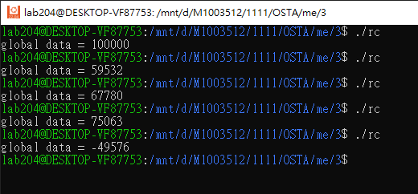
Lab3-1 Race Condition
2個threads，分別對global data做
加法與減法100,000次

Slide 2
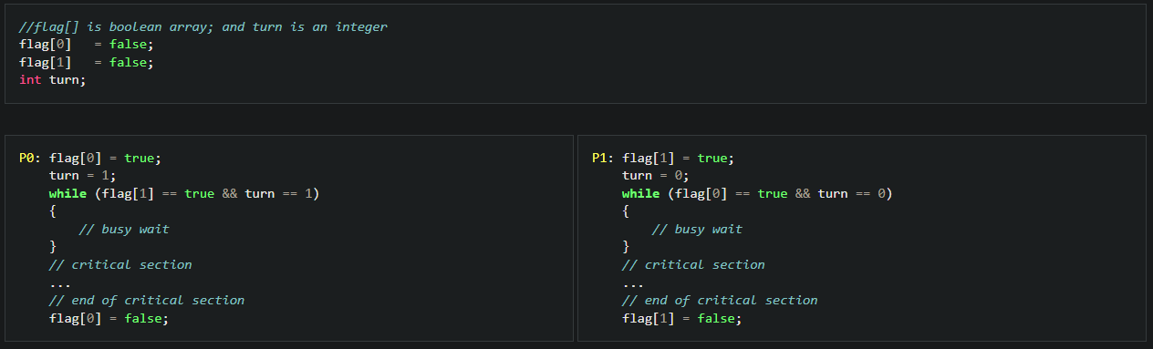
Lab3-2 Peterson

Slide 3
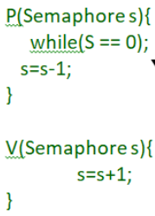
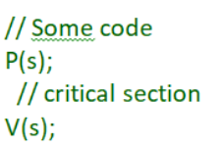
wait
Lab3-3 Semaphore
signal

