Slide 1
X. Other Applications of Time-Frequency Analysis
Applications
(1) Finding Instantaneous Frequency
(2) Signal Decomposition
(3) Filter Design
(4) Sampling Theory
(5) Modulation and Multiplexing
(6) Electromagnetic Wave Propagation
(7) Optics
(8) Radar System Analysis
(9) Random Process Analysis
(10) Music Signal Analysis
(11) Biomedical Engineering
(12) Accelerometer Signal Analysis
(13) Acoustics
(14) Data Compression
(15) Spread Spectrum Analysis
(16) System Modeling
(17) Image Processing
(18) Economic Data Analysis
(19) Signal Representation
(20) Seismology
(21) Geology
(22) Astronomy
(23) Oceanography

Slide 2
10-1 Sampling Theory
Number of sampling points == Sum of areas of time frequency distributions
+ the number of extra parameters
How to make the area of time-frequency smaller?
(1) Divide into several components.
(2) Use chirp multiplications, chirp convolutions, fractional Fourier transforms, or linear canonical transforms to reduce the area.
[Ref] X. G. Xia, “On bandlimited signals with fractional Fourier transform,” IEEE Signal Processing Letters, vol. 3, no. 3, pp. 72-74, March 1996.
[Ref] J. J. Ding, S. C. Pei, and T. Y. Ko, “Higher order modulation and the efficient sampling algorithm for time variant signal,” European Signal Processing Conference, pp. 2143-2147, Bucharest, Romania, Aug. 2012.

Slide 3
Analytic Signal Conversion
Shearing
shearing
Area

Slide 4
Step 1 Analytic Signal Conversion
Step 2 Separate the components
(a) (b)
+
Step 3 Use shearing or rotation to minimize the “area” to each component
Step 4 Use the conventional sampling theory to sample each components

Slide 5
傳統的取樣方式
重建：
新的取樣方式
Hilbert transform of x(t)
(1)
(2)
(3)
k = 1, 2, …, K
(4)
k = 1, 2, …, K

Slide 6
重建：
(1)
(2)
(3)
(4)

Slide 7
嚴格來說，沒有一個信號的 時頻分佈的「面積」是有限的。
Theorem:
If x(t) is time limited (x(t) = 0 for t < t₁ and t > t₂)
then it is impossible to be frequency limited
If x(t) is frequency limited (X(f) = 0 for f < f₁ and f > f₂)
then it is impossible to be time limited
但是我們可以選一個 “threshold” Δ
時頻分析 |X (t, f)| > Δ 或 的區域的面積是有限的
實際上，以「面積」來討論取樣點數，是犧牲了一些精確度。

Slide 8
只取 t ∈ [t₁, t₂] and f ∈ [f₁, f₂] 犧牲的能量所佔的比例
X₁(f) = FT[x₁(t)],
x₁(t) = x(t) for t ∈ [t₁, t₂] , x₁(t) = 0 otherwise
• For the Wigner distribution function (WDF)
= energy of x(t).

Slide 9
A
B
C
D
f-axis
D
A
f₂
B
t-axis
t₁
t₂
f₁
C

Slide 10
10-2 Modulation and Multiplexing
With the aid of
the Gabor transform (or the Gabor-Wigner transform)
horizontal and vertical shifting, dilation, shearing, generalized shearing, and rotation.
[Ref] C. Mendlovic and A. W. Lohmann, “Space-bandwidth product adaptation and its application to superresolution: fundamentals,” J. Opt. Soc. Am. A, vol. 14, pp. 558-562, Mar. 1997.
[Ref] S. C. Pei and J. J. Ding, “Relations between Gabor transforms and fractional Fourier transforms and their applications for signal processing,” vol. 55, issue 10, pp. 4839-4850, IEEE Trans. Signal Processing, 2007.

Slide 11
Example
FT
We want to add f(t) into G(u)
(no empty band)

Slide 13
◎ Conventional Modulation Theory
The signals x₁(t), x₂(t), x₃(t), ……., x_{K}(t) can be transmitted successfully if
Allowed Bandwidth ≥
B_{k}: the bandwidth (including the negative frequency part) of x_{k}(t)
◎ Modulation Theory Based on Time-Frequency Analysis
The signals x₁(t), x₂(t), x₃(t), ……., x_{K}(t) can be transmitted successfully if
Allowed Time duration × Allowed Bandwidth ≥
The interference is inevitable.
How to estimate the interference?
A_{k}: the area of the time-frequency distribution of x_{k}(t)

Slide 14
10-3 Electromagnetic Wave Propagation
Time-Frequency analysis can be used for
Wireless Communication
Optical system analysis
Laser
Radar system analysis
Propagation through the free space (Fresnel transform): chirp convolution
Propagation through the lens or the radar disk: chirp multiplication

Slide 15
Fresnel Transform ：描述電磁波在空氣中的傳播 (See page 243)
電磁波包括光波、雷達波、紅外線、紫外線………
Fresnel transform == LCT with parameters
思考： (1) STFT 或 WDF 哪一個比較適合用在電磁波傳播的分析？
(2) 為何波長越短的電磁波，在空氣中散射的情形越少？

Slide 16
(4) Spherical Disk
y-axis
x-axis
direction of wave propagation
R
radius of the disk = R
plane
Disk 相當於 LCT
的情形

Slide 17
R_{A} R_{B} disk A disk B
D
相當於 LCT
的情形

Slide 18
10-4 Music and Acoustic Signal Analysis
Music Signal Analysis
Acoustic
Voiceprint (Speaker) Recognition
Speech Signal ：
(1) 不同的人說話聲音頻譜不同 (聲紋 voiceprint)
(2) 同一個人但不同的字音，頻譜不一樣
(3) 語調 (第一、二、三、四聲和輕聲) 不同，則頻譜 變化的情形也不同
(4) 即使同一個字音，子音和母音的頻譜亦不相同
(5) 雙母音本身就會有頻譜的變化
• 王小川， “語音訊號處理”，第二章，全華出版，台北，民國94年。

Slide 19
large energy
middle energy
small energy
large energy
Typical relations between time and the instantaneous frequencies for (a) the 1st tone, (b) the 2nd tone, (c) the 3rd tone, and (d) the 4th tone in Chinese.
X. X. Chen, C. N. Cai, P. Guo, and Y. Sun, “A hidden Markov model applied to Chinese four-tone recognition,” ICASSP, vol. 12, pp. 797-800, 1987.

Slide 20
ㄚ1, ㄚ2, ㄚ3, ㄚ4

Slide 21
10-5 Accelerometer Signal Analysis
The 3-D Accelerometer (三軸加速規) can be used for identifying the activity of a person.
z-axis
y: 0
z: -9.8
z-axis
y-axis
y-axis
tilted by θ
x-axis
z-axis
y-axis
y: -9.8sinθ
z: -9.8cosθ

Slide 22
Using the 3D accelerometer + time-frequency analysis, one can analyze the activity of a person.
Walk, Run (Pedometer 計步器)
Healthcare for the person suffered from Parkinson’s disease

Slide 23
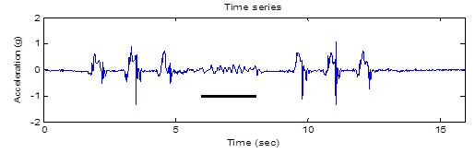
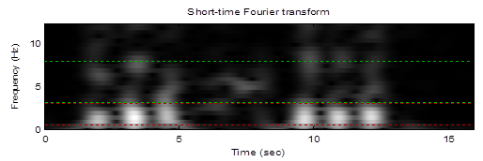
3D accelerometer signal for a person suffering from Parkinson’s disease
The result of the short-time Fourier transform
Y. F. Chang, J. J. Ding, H. Hu, Wen-Chieh Yang, and K. H. Lin, “A real-time detection algorithm for freezing of gait in Parkinson’s disease,” IEEE International Symposium on Circuits and Systems, Melbourne, Australia, pp. 1312-1315, May 2014

Slide 24
10-6 Other Applications
時頻分析適用於頻譜會隨著時間而改變的信號
Biomedical Engineering (心電圖 (ECG), 肌電圖 (EMG), 腦電圖, ……)
Communication and Spread Spectrum Analysis
Economic Data Analysis
Seismology
Geology
Astronomy
Oceanography
Satellite Signal

Slide 25
Short-time Fourier transform of the power signal from a satellite
福爾摩沙衛星三號
C. J. Fong, S. K. Yang, N. L. Yen, T. P. Lee, C. Y. Huang, H. F. Tsai, S. Wang, Y. Wang, and J. J. Ding, “Preliminary studies of the applications of HHT (Hilbert-Huang transform) on FORMOSAT-3/COSMIC GOX payload trending data,” 6th FORMOSAT-3/COSMIC Data Users' Workshop, Boulder, Colorado, USA, Oct. 2012

Slide 26
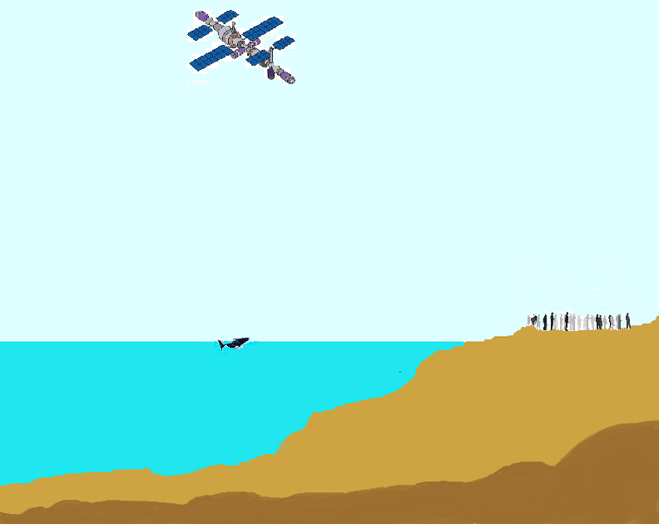
時頻分析的應用範圍
astronomy
satellite
over 700 km
communication
human life
vocal signal, ECG
vocal signal
oceanography
over 1000m
geology
ocean crust

Slide 27
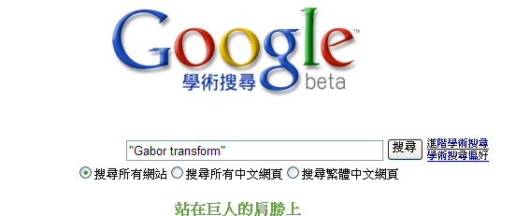
附錄十：幾個常見的資料蒐尋方法
(1) Google 學術搜尋
http://scholar.google.com.tw/
(太重要了，不可以不知道) 只要任何的書籍或論文，在網路上有電子版，都可以用這個功能查得到
再按「搜尋」，就可找到想要的資料
輸入關鍵字，或期刊名，或作者

Slide 28
(2) 尋找 IEEE 的論文
http://ieeexplore.ieee.org/Xplore/guesthome.jsp
(3) Wikipedia
(4) Github (搜尋 code)
(5) 數學的百科網站
http://eqworld.ipmnet.ru/index.htm
有多個 tables，以及對數學定理的介紹
(6) 傳統方法：去圖書館找資料
台大圖書館首頁 http://www.lib.ntu.edu.tw/
或者去 http://www.lib.ntu.edu.tw/tulips

Slide 29
(7) 查詢其他圖書館有沒有我要找的書
「台大圖書館首頁」
「其他圖書館」
(8) 找尋電子書
「台大圖書館首頁」
「電子書」
或「免費電子書」
(9) 查詢一個期刊是否為 SCI
Step 1: 先去 http://scientific.thomson.com/mjl/
Step 2: 在 Search Terms 輸入期刊全名
Search Type 選擇 “Full Journal Title”，再按 “Search”
Step 3: 如果有找到這期刊，那就代表這個期刊的確被收錄在 SCI

Slide 30
(10) 想要對一個東西作入門但較深入的了解:
看 journal papers 或 Wikipedia 會比看 conference papers 適宜
看書會比看 journal papers 或 Wikipedia 適宜
(11) 如果實在沒有適合的書籍，可以看 “review”， “survey”，或
“tutorial” 性質的論文
有了相當基礎之後，再閱讀 journal papers
(以 Paper Title， Abstract， 以及其他 Papers 對這篇文章的描述，
來判斷這篇 journal papers 應該詳讀或大略了解即可)

