Slide 1
XV. Applications of Wavelet Transforms
Wavelet 所適用的 applications，通常有以下兩大特點：
(1) 信號的頻率分佈，會隨著不同的時間(或地點)有較大變異
(2) Multiscale 的分析扮演重要的角色
Larger sampling interval → ignoring the detail
Smaller sampling interval → requiring a lot of data
Wavelet transforms compromise them.
目前，文獻上，80% 以上的應用和 image processing 有關

Slide 2
(1) Image Compression (JPEG 2000)
Quantization Table
JPEG 2000 架構
Discrete Wavelet Transform
Bit Plane Conversion
Image
RGB to YCbCr
4:2:0
Quantization
JPEG 2000 file
Tier 2 Encoder
Binary arithmetic coding
Fractional
Bit-plane coding
檔頭
(Tier 1)
Tier 1: zero coding, sign coding, magnitude refinement coding, run length coding
Tier 2: 用以控制檔案大小 (例如只取比較重要的地方編碼)
註：感謝 2010年修課的潘冠臣同學幫忙整理

Slide 3
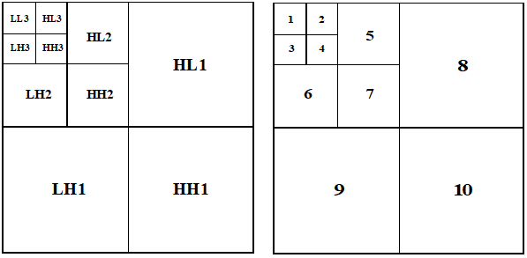
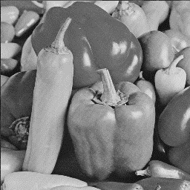
The subbands of the discrete wavelet transform (DWT)

Slide 4
比較：傳統 JPEG 架構
Image
RGB to YCbCr
DCT
量子化
AC係數
Zigzag Scan
Huffman Coding
JPEG file
4:2:0
8 × 8
量子化表
DC係數
差分 編碼
Huffman Coding
檔頭
問題：由於 8 × 8 的切割，在高壓縮率時會造成 blocking effect

Slide 5



DCT-based image compression
Wavelet-based image compression
Original image
CR = 53.4333
CR = 51.3806
CR: compression ratio
註：感謝 2006年修課的黃俊德同學

Slide 6
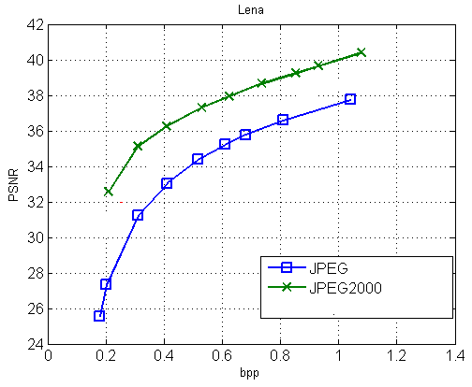
bpp: bit per pixel (每一點平均需要多少個 bits)
PSNR: peak signal to noise ratio (PSNR), see page 480

Slide 7
使用 JPEG 2000 做影像壓縮的優點：
(1)
(2)
(3)
所以，在高壓縮率之下，重建的影像仍有不錯的品質
Question:
Why JPEG 2000 has not replaced the status of JPEG now?
參考資料
C. Christopoulos, A. Skodras, and T. Ebrahimi, “The JPEG2000 still image coding system: An overview,” IEEE Trans. Consumer Electronics, vol. 46, no. 4, pp.1103-1127, Nov. 2000.

Slide 8
Another Compression Algorithm: SPIHT
Using the correlation among high frequency parts in different layers
B.J. Kim, Z. Xiong, and W.A. Pearlman. “Low bit-rate scalable video coding with 3-D set partitioning in hierarchical trees (3-D SPIHT),” IEEE Trans. Circuits Syst. Video Technol., vol. 10, pp. 1374-1387, 2000.

Slide 9
(2) Edge and Corner Detection
(3) Pattern recognition
(a) Feature extraction
(Using the wavelet features)
(b) Computation Time 和縮小的 pattern 互相比較 (節省運算)
(4) 強調前景，壓縮背景

Slide 10
(5) Filter Design
如何不傷到 edge，又能夠將 noise 去除掉？

Slide 11
One-stage wavelet filter
a₁[n]
analysis
synthesis
g[n]
↓ 2
x_{1,L}[n]
↑ 2
h₁[n]
x[n]
a₂[n]
x₀[n]
h[n]
↓ 2
x_{1,H}[n]
↑ 2
g₁[n]
做 filter design 時，可以令
a₁[n] = 1,
a₂[n] = 0 for non-edge region
a₂[n] = 1 for edge region
以 x_{1,H}[n] 的 amplitude 來區分
必要時可使用 two-stage 以上的 wavelet filter

Slide 12
x_{2,L}[n]
(2nd stage, lowpass)
x_{2,H}[n]
(2nd stage, highpass)
x_{1,H}[n]
(1st stage, highpass)

Slide 13
原信號
使用one-stage 的 wavelet filter
使用two-stage 的 wavelet filter

Slide 14
(6) Music
音樂當中，音每高一個音階，頻率就增為二倍
音樂 每一音階有12個半音，增加一個半音，頻率增加 2^{1/12} 倍
(等比級數)
 | Do | 升Do | Re | 升Re | Me | Fa | 升Fa | So | 升So | La | 升La | Si
Hz | 270 | 286 | 303 | 321 | 340 | 360 | 382 | 405 | 429 | 454 | 481 | 510
Hz | 540 | 572 | 606 | 642 | 680 | 721 | 764 | 810 | 857 | 908 | 962 | 1019
(7) Acoustics

Slide 15
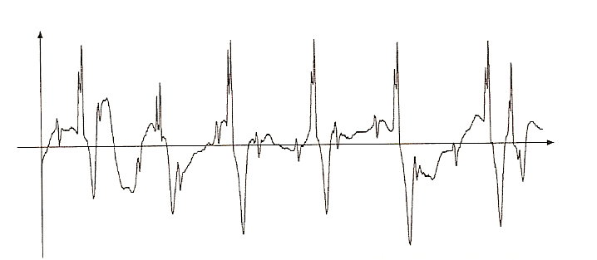
(8) Analyzing the Electrocardiogram (ECG)
Is the rhythm of the cardiac valve in synchronization with that of the heart muscle?
Does the heart muscle relax between beats?
From: A. K. Louis, P. Maab, and A. Rieder, “Wavelets Theory and Applications”, John Wiley & Sons, Chichester, 1997.

Slide 16
(9) 「短期因素」和「長期因素」的分析
population
economical data
temperature
(10) 其他奇奇怪怪的應用
指紋的辦識
羊毛質料的辦識

Slide 17
Time-frequency Analysis 和Wavelet 在應用上的異同處
相同：都能夠處理一個信號的頻率分佈會隨時間而改變的情形
不同：Time frequency analysis 對於瞬間頻率的分析比較精確
Wavelet 可作「巨觀」和「微觀」的分析
由於 memory requirement 較少，適合 2D 的 image analysis 和 3D 的 video analysis

Slide 18
附錄十五 希臘字母大小寫與發音一覽表
大寫 | Α | Β | Γ | Δ | Ｅ | Ζ | Η | Θ
小寫 | α | β | γ | δ | ε | ζ | η | θ
英文拚法 | alpha | beta | gamma | delta | epsilon | zeta | eta | theta
KK 音標 | ˋælfə | ˋbetə | ˋgæmə | ˋdɛltə | ˋɛpsələn | ˋzetə | ˋitə | ˋθitə
大寫 | Ι | Κ | Λ | Μ | Ν | Ξ | Ο | Π
小寫 | ι | κ | λ | μ | ν | ξ | ο | π
英文拚法 | iota | kappa | lambda | mu | nu | xi | omicron | pi
KK 音標 | aɪˋotə | ˋkæpə | ˋlæmdə | mju | nu | ksɪ | ˋɑmɪkrɑn | paɪ

Slide 19
大寫 | Ρ | Σ | Τ | Υ | Φ | Χ | Ψ | Ω
小寫 | ρ | σ | τ | υ | φ, φ | χ | ψ | ϖ, ω
英文拚法 | rho | sigma | tau | upsilon | phi | chi | psi | omega
KK 音標 | ro | ˋsɪgmə | taʊ | ˋjupsəlɑn | faɪ | kaɪ | saɪ | ˋomɪgə

Slide 20
附錄十六 Generalization for the Wavelet Transforms
1. Directional Form 2-D Wavelet Transforms
一般的 2-D wavelet transform，其實可分解成沿著 x-axis 以及沿著 y-axis 的 1-D wavelet transforms 的組合
其實，2-D wavelet transform 不一定要沿著 x-axis ， y-axis 來做
Directional 2-D wavelet transforms:
• curvelet
contourlet
bandlet
shearlet
• Fresnelet
• wedgelet
• brushlet

Slide 21
• Curvelet (ridgelet)
rotation
比較：原本的 1-D wavelet
E. Candès and D. Donoho, "Curvelets – a surprisingly effective nonadaptive representation for objects with edges." In: A. Cohen, C. Rabut and L. Schumaker, Editors, Curves and Surface Fitting: Saint-Malo 1999, Vanderbilt University Press, Nashville (2000), pp. 105–120.

Slide 22

input
the curvelet transform of the input
results with different φ
(four direction for the high-frequency part)

Slide 23
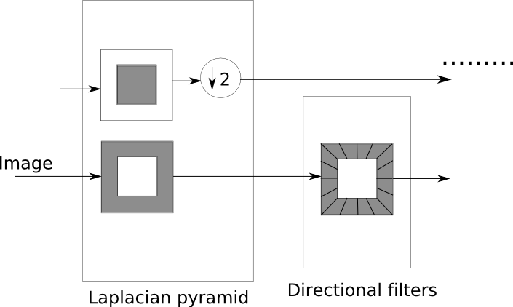
• Contourlet
masks in the frequency domain
低頻部分 沒有分成不同的方向
高頻部分 分成各種不同的方向
M. Do and M. Vetterli, "The contourlet transform: An efficient directional multiresolution image representation," IEEE Trans. Image Processing, vol.14, no.12, pp.2091–2106, Dec. 2005.

Slide 24
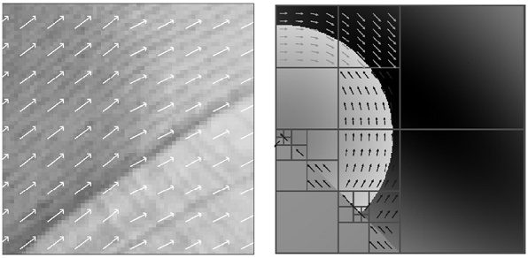
• Bandlet
根據物體的紋理或邊界，來調整 wavelet transforms 的方向
Stephane Mallet and Gabriel Peyre, "A review of Bandlet methods for geometrical image representation," Numerical Algorithms, Apr. 2002.

Slide 25
2. Stationary Wavelet Transforms
…..
g₃[n]
x_{3,L}[n]
g₂[n]
x_{2,L}[n]
…..
g₁[n]
x_{1,L}[n]
h₃[n]
x_{3,H}[n]
x[n]
h₂[n]
x_{2,H}[n]
h₁[n]
x_{1,H}[n]
其中
g_{j}[n]
↑2
g_{j+1}[n]
h_{j}[n]
↑2
h_{j+1}[n]
Q: 和原本 discrete wavelet transform 不一樣的地方在哪裡？
G. P. Nason and B. W. Silverman, “The stationary wavelet transform and some statistical applications,” Lecture Notes in Statistics, available in http://citeseerx.ist.psu.edu/viewdoc/download?doi=10.1.1.49.2662&rep=rep1&type=pdf

Slide 26
3. Bandwidth Form Wavelet Transforms
A little modification for g[n] and h[n]
4. Multi-Band Wavelet Transforms
Instead of only two outputs

Slide 27
Happy New Year!
祝各位期末考順利，寒假愉快！

