Slide 1
VI. Other Time Frequency Distributions
Main Reference
[Ref] S. Qian and D. Chen, Joint Time-Frequency Analysis: Methods and Applications, Chap. 6, Prentice Hall, N.J., 1996.
Requirements for time-frequency analysis:
(1) higher clarity (2) avoid cross-term
(3) less computation time (4) good mathematical properties
tradeoff

Slide 2
VI-A Cohen’s Class Distribution
VI-A-1 Ambiguity Function
(1) If

Slide 3
WDF and AF for the signal with only 1 term
WDF
AF
f
t

Slide 4
(2) If
x₁(t)
x₂(t)

Slide 5
When α₁ = α₂
When α₁ ≠ α₂

Slide 6
WDF and AF for the signal with 2 terms
f
auto term
|WDF|
(t₁, f₁)
cross terms
(t_{μ} , f_{μ})
t
(t₂, f₂)
|AF|
cross term
auto term
(t_{d} , f_{d})
auto terms
(0, 0)
cross term
(-t_{d} , -f_{d})

Slide 7
For the ambiguity function
The auto term is always near to the origin
The cross-term is always far from the origin

Slide 8
VI-A-2 Definition of Cohen’s Class Distribution
The Cohen’s Class distribution is a further generalization of the Wigner distribution function
where
is the ambiguity function (AF).
Φ(η, τ) = 1 → WDF
where

Slide 9
How does the Cohen’s class distribution avoid the cross term?
Chose Φ(τ, η) low pass function.
Φ(τ, η) ≈ 1 for small |η |, | τ |
Φ(τ, η) ≈ 0 for large |η |, | τ |
[Ref] L. Cohen, “Generalized phase-space distribution functions,” J. Math. Phys., vol. 7, pp. 781-806, 1966.
[Ref] L. Cohen, Time-Frequency Analysis, Prentice-Hall, New York, 1995.

Slide 10
VI-A-3 Several Types of Cohen’s Class Distribution
Choi-Williams Distribution (One of the Cohen’s class distribution)
[Ref] H. Choi and W. J. Williams, “Improved time-frequency representation of multicomponent signals using exponential kernels,” IEEE. Trans. Acoustics, Speech, Signal Processing, vol. 37, no. 6, pp. 862-871, June 1989.

Slide 11
Cone-Shape Distribution (One of the Cohen’s class distribution)
[Ref] Y. Zhao, L. E. Atlas, and R. J. Marks, “The use of cone-shape kernels for generalized time-frequency representations of nonstationary signals,” IEEE Trans. Acoustics, Speech, Signal Processing, vol. 38, no. 7, pp. 1084-1091, July 1990.

Slide 12
Cone-Shape distribution for the example on pages 83, 125
α = 1

Slide 13
Distributions | Φ(τ, η)
Wigner | 1
Cohen (circular) | Φ(τ, η) = 1 for Φ(τ, η) = 0 otherwise
Cohen (rectangular) | Φ(τ, η) = 1 for Φ(τ, η) = 0 otherwise
Choi-Williams
Cone-Shape
Page
Levin (Margenau-Hill)
Born-Jordan
註：感謝 2007年修課的王文阜同學

Slide 14
VI-A-4 Advantages and Disadvantages of Cohen’s Class Distributions
The Cohen’s class distribution may avoid the cross term and has higher clarity.
However, it requires more computation time and lacks of well mathematical properties.
Moreover, there is a tradeoff between the quality of the auto term and the ability of removing the cross terms.

Slide 15
VI-A-5 Implementation for the Cohen’s Class Distribution
簡化法 1：不是所有的 A_{x}(η, τ) 的值都需要算出
If for |η| > B or |τ| > C

Slide 16
簡化法 2：注意，η 這個參數和input 及output 都無關
由於 和 input 無關，可事先算出，所以只剩 2 個積分式

Slide 17
VI-B Modified Wigner Distribution Function
where X(f) = FT[x(t)]
Modified Form I
Modified Form II

Slide 18
Modified Form III (Pseudo L-Wigner Distribution)
增加 L 可以減少 cross term 的影響 (但是不會完全消除)
[Ref] L. J. Stankovic, S. Stankovic, and E. Fakultet, “An analysis of instantaneous frequency representation using time frequency distributions-generalized Wigner distribution,” IEEE Trans. on Signal Processing, pp. 549-552, vol. 43, no. 2, Feb. 1995
P.S.: 感謝2006年修課的林政豪同學

Slide 19
Modified Form IV (Polynomial Wigner Distribution Function)
When q = 2 and d₁ = d₋₁ = 0.5, it becomes the original Wigner distribution function.
It can avoid the cross term when the order of phase of the exponential function is no larger than q/2 + 1.
However, the cross term between two components cannot be removed.
[Ref] B. Boashash and P. O’Shea, “Polynomial Wigner-Ville distributions & their relationship to time-varying higher order spectra,” IEEE Trans. Signal Processing, vol. 42, pp. 216–220, Jan. 1994.
[Ref] J. J. Ding, S. C. Pei, and Y. F. Chang, “Generalized polynomial Wigner spectrogram for high-resolution time-frequency analysis,” APSIPA ASC, Kaohsiung, Taiwan, Oct. 2013.

Slide 20
d_{l} should be chosen properly such that
when
then

Slide 21
when q = 2

Slide 22
When q = 4

Slide 23
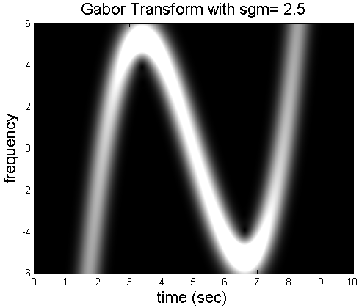
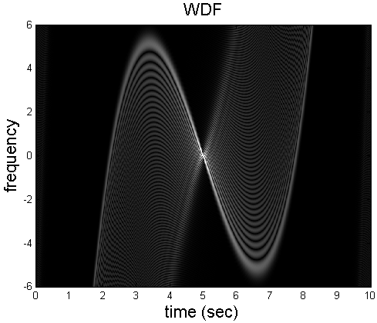
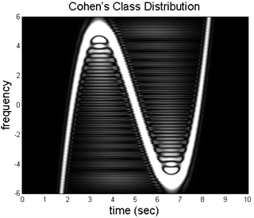
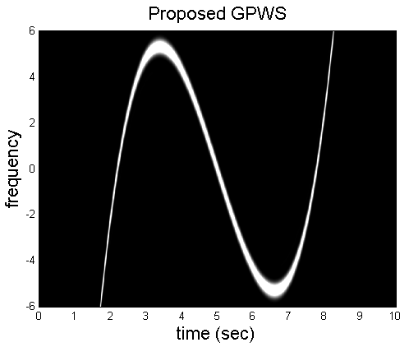
q = ?

Slide 24
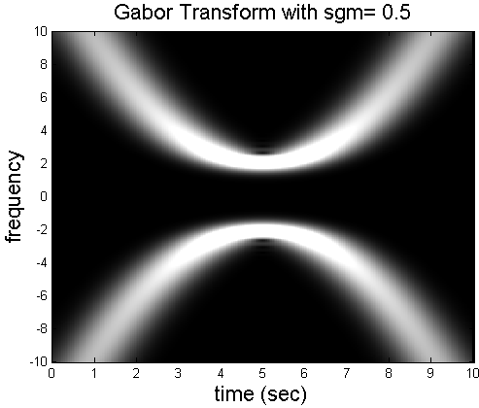
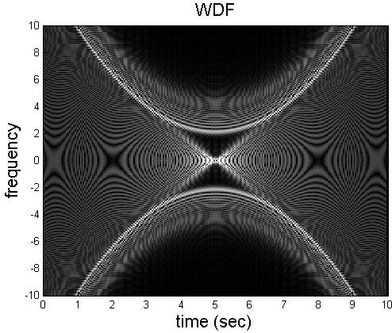
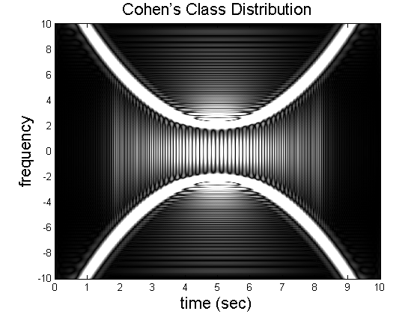
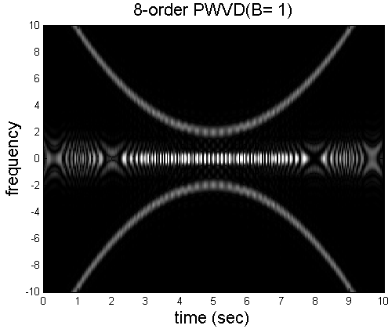

Slide 25
VI-C Gabor-Wigner Transform
[Ref] S. C. Pei and J. J. Ding, “Relations between Gabor transforms and fractional
Fourier transforms and their applications for signal processing,” IEEE Trans.
Signal Processing, vol. 55, no. 10, pp. 4839-4850, Oct. 2007.
Advantages:
combine the advantage of the WDF and the Gabor transform
advantage of the WDF → higher clarity
advantage of the Gabor transform → no cross-term

Slide 26
x(t) = cos(2πt)
(a)
(b)
(c)
(d)

Slide 27
(a) (b)
(c)
(d)
(b)、(c) are real

Slide 28
思考：
(1) Which type of the Gabor-Wigner transform is better?
(2) Can we further generalize the results?

Slide 29
Implementation of the Gabor-Wigner Transform ：簡化技巧
(1) When G_{x}(t, f) ≈ 0,
先算 G_{x}(t, f)
W_{x}(t, f) 只需算 G_{x}(t, f) 不近似於 0 的地方
(2) When x(t) is real，對 Gabor transform 而言
if x(t) is real, where X(f) = FT[x(t)]

Slide 30
附錄六： Fourier Transform 常用的性質
(1) Recovery (inverse Fourier transform)
(2) Integration
(3) Modulation
(4) Time Shifting
(5) Scaling
(6) Time Reverse

Slide 31
(7) Real / Imaginary Input | If x(t) is real, then X(f) = X*(−f); If x(t) is pure imaginary, then X(f) = −X*(−f)
(8) Even / Odd Input | If x(t) = x(−t), then X(f) = X(−f); If x(t) = −x(−t), then X(f) = −X(−f);
(9) Conjugation
(10) Differentiation
(11) Multiplication by t
(12) Division by t
(13) Parseval’s Theorem (Energy Preservation)
(14) Generalized Parseval’s Theorem

Slide 32
(15) Linearity
(16) Convolution | If then
(17) Multiplication | If , then
(18) Correlation | If then
(19) Two Times of Fourier Transforms
(20) Four Times of Fourier Transforms

