Slide 1
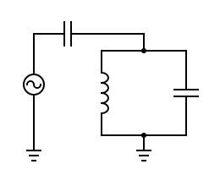
$V=V_{0}cos\left(ω_{01}t\right)$
$L$
$C$
$H=\frac{Q^{2}}{2C}+\frac{φ^{2}}{2L}$
$ω_{01}=1\sqrt{LC}$

