Slide 1
This is test-example
powerpoint presentation and free slide/object
VANXY
PPT
nine8007

Slide 2

Agenda
Example for the agenda slide
Insert Sub-Title
Insert Sub-Title
Insert Sub-Title
Insert Sub-Title
Insert Sub-Title
Insert Sub-Title
Insert Sub-Title

Slide 3
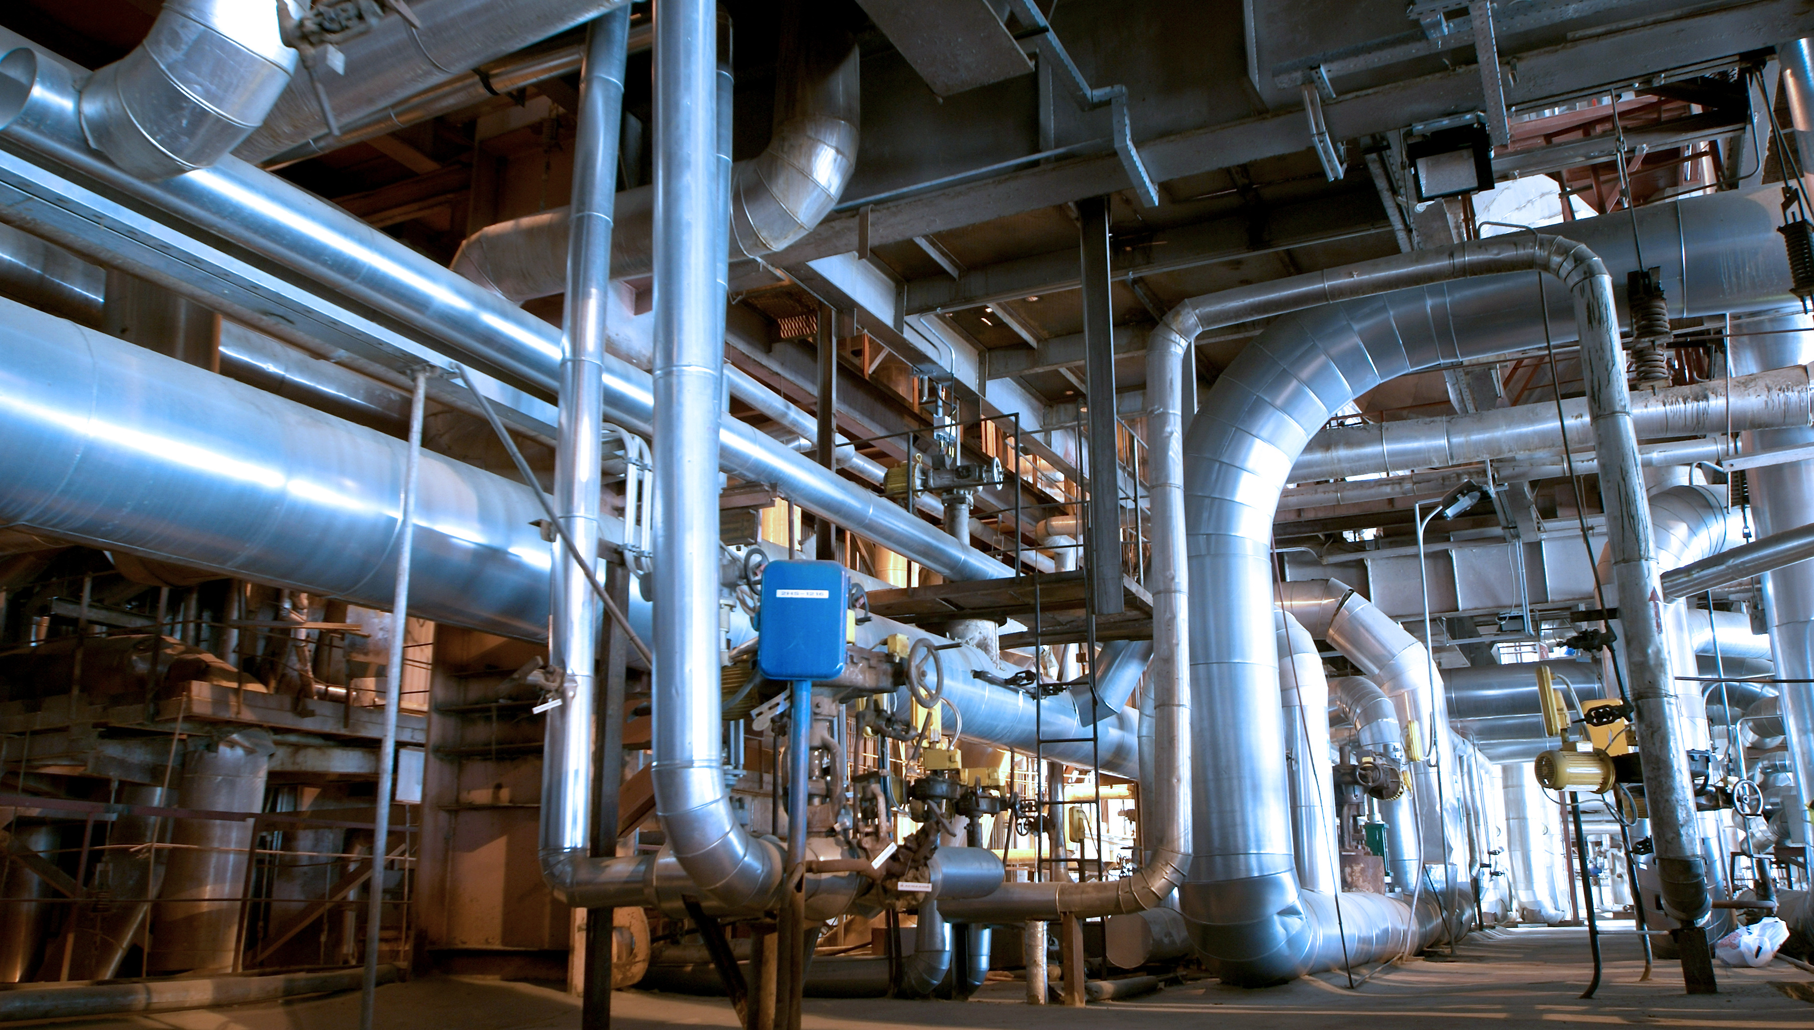





Insert Sub-Title
This sub-title is example slide
Social Media
Program
Contents
Photography
Movies
If a picture paints a thousand words,then why can`t I paint you
If a picture paints a thousand words,then why can`t I paint you
If a picture paints a thousand words,then why can`t I paint you
If a picture paints a thousand words,then why can`t I paint you
If a picture paints a thousand words,then why can`t I paint you
If a picture paints a thousand words, then why can`t I paint you The words will never show the you I`ve come to know if a face could launch a thousand ships, then where am I to go There`s no one home but you You`re all that`s left me too And when my love for life is running dry, you come and pour yourself on me If a man could be two places at one time I`d be with you Tomorrow and today, beside you all the way If the world should stop revolving spinning slowly down to die, I`d spend the end with you And when the world was through, Then one by one the stars would all go out and you and I would simply fly away

Slide 4





Insert Sub-Title
This sub-title is example slide
Social Media
Photography
If a picture paints a thousand words, then why can`t I paint you The words will never show the you I`ve come to know if a face could launch a thousand ships, then where am I to go There`s no one home but you
If a picture paints a thousand words, then why can`t I paint you The words will never show the you I`ve come to know if a face could launch a thousand ships, then where am I to go There`s no one home but you
Program
Movies
If a picture paints a thousand words, then why can`t I paint you The words will never show the you I`ve come to know if a face could launch a thousand ships, then where am I to go There`s no one home but you
If a picture paints a thousand words, then why can`t I paint you The words will never show the you I`ve come to know if a face could launch a thousand ships, then where am I to go There`s no one home but you
Contents
If a picture paints a thousand words, then why can`t I paint you The words will never show the you I`ve come to know if a face could launch a thousand ships, then where am I to go There`s no one home but you

Slide 5
Insert Sub-Title
This sub-title is example slide
01
02
03
Social Media
Photography
Program
If a picture paints a thousand words, then why can`t I paint you The words will never show the you I`ve come to know if a face
If a picture paints a thousand words, then why can`t I paint you The words will never show the you I`ve come to know if a face
If a picture paints a thousand words, then why can`t I paint you The words will never show the you I`ve come to know if a face
04
05
Movies
Contents
If a picture paints a thousand words, then why can`t I paint you The words will never show the you I`ve come to know if a face
If a picture paints a thousand words, then why can`t I paint you The words will never show the you I`ve come to know if a face
If a picture paints a thousand words, then why can`t I paint you The words will never show the you I`ve come to know if a face could launch a thousand ships, then where am I to go There`s no one home but you You`re all that`s left me too And when my love for life
is running dry, you come and pour yourself on me If a man could be two places at one time I`d be with you Tomorrow and today, beside you all the way If the world should stop revolving spinning slowly down to die, I`d spend the end with you And when the world was through, Then one by one the stars would all go out and you and I would simply fly away

Slide 6

Short Company History
This sub-title is example slide
Asia-Pacific No1
We turn Global
ASIA AWARD
This Award is example
GROWTH
We Born
03’ Sales-Up
06’ Max Gross-Profit
01’
03’
09’
11’
14’
If a picture paints a thousand words, then why can`t I paint you The words will never show the you I`ve come to know if a face could launch a thousand ships, then where am I to go There`s no one home but you You`re all that`s left me too And when my love for life
is running dry, you come and pour yourself on me If a man could be two places at one time I`d be with you Tomorrow and today, beside you all the way If the world should stop revolving spinning slowly down to die, I`d spend the end with you And when the world was through, Then one by one the stars would all go out and you and I would simply fly away

Slide 7




Insert Sub-Title
This sub-title is example slide
If a picture paints a housand words, then why can`t I aint you The words will never how the you I`ve come to know if a face could launch
02
If a picture paints a housand words, then why can`t I aint you The words will never how the you I`ve come to know if a face could launch
04
analysis & investigation
Organize and Plan
Related Documents
Sales and Market
01
If a picture paints a housand words, then why can`t I aint you The words will never how the you I`ve come to know if a face could launch
03
If a picture paints a housand words, then why can`t I aint you The words will never how the you I`ve come to know if a face could launch

Slide 8
Insert Sub-Title
This sub-title is example slide
01
If a picture paints a thousand words, then why can`t I paint you The words will never show the you I`ve come to know if a face could launch a thousand ships, then where am I to go There`s no one home but you You`re all that`s left me too And when my love for life is running dry
02
If a picture paints a thousand words, then why can`t I paint you The words will never show the you I`ve come to know if a face could launch a thousand ships, then where am I to go There`s no one home but you You`re all that`s left me too And when my love for life is running dry
03
If a picture paints a thousand words, then why can`t I paint you The words will never show the you I`ve come to know if a face could launch a thousand ships, then where am I to go There`s no one home but you You`re all that`s left me too And when my love for life is running dry
04
If a picture paints a thousand words, then why can`t I paint you The words will never show the you I`ve come to know if a face could launch a thousand ships, then where am I to go There`s no one home but you You`re all that`s left me too And when my love for life is running dry

Slide 9
Insert Sub-Title
This sub-title is example slide

Slide 10




Insert Sub-Title
This sub-title is example slide
Description
Description
If a picture paints a thousand words, then why can`t I paint you The words will never show the you I`ve come to know if a face could launch a thousand ships, then where am I to go There`s
Description
Description
If a picture paints a thousand words, then why can`t I paint you The words will never show the you I`ve come to know if a face could launch a thousand ships, then where am I to go There`s
Description
Description
If a picture paints a thousand words, then why can`t I paint you The words will never show the you I`ve come to know if a face could launch a thousand ships, then where am I to go There`s
Description
Description
If a picture paints a thousand words, then why can`t I paint you The words will never show the you I`ve come to know if a face could launch a thousand ships, then where am I to go There`s

Slide 11
Insert Sub-Title
This sub-title is example slide
$ 12,500
$ 20,000
$ 1,500
$ 51,900
$ 33,800
If a picture paints a thousand words, then why can`t I paint you The words will never show the you I`ve come to know if a face could launch a thousand ships, then where am I to go There`s no one home but you You`re all that`s left me too And when my love for life is running dry, you come and pour yourself on me If a man could be two places at one time I`d be with you Tomorrow and today, beside you all the way If the world should stop revolving spinning slowly down to die, I`d spend the end with you And when the world was through, Then one by one the stars would all go out and you and I would simply fly away

