Slide 1
AlphaVault
Decentralized Quantitative
Portfolio Management
Risk-controlled rebalancing on Sepolia
Du zhuotong | SC6113
AlphaVault / Du zhuotong / 1 of 12
Notes:
0–20 seconds. Welcome to AlphaVault, a quantitative portfolio management and risk controlled rebalancing application by Du zhuotong. This ten minute demonstration explains the problem, system design, actual application workflow, and measured results. The project uses mock assets on a local chain and the Sepolia test network.
Source: Technical report pp. 1–2.

Slide 2
Problem and stakeholders
Delegate allocation while preserving policy checks and investor exit.
Stakeholder | Need | Tension
Investor | Traceable holdings and exit | Manager discretion vs protection
Manager | Allocation changes | Return seeking vs exposure caps
Risk officer | Policy and emergency controls | Protection vs trading flexibility
Keeper / admin | Execution / permissions | Availability and central authority
Design scenario; organizational time savings have not been measured.
AlphaVault / Du zhuotong / 2 of 12
Notes:
20–65 seconds. Consider a small token treasury that delegates allocation decisions to a manager. Contributors want to see where assets are held, understand who can change the rules, and retain an exit when trading is paused. A spreadsheet can describe an allocation, but it cannot enforce that allocation during a transfer. AlphaVault separates the investor, strategy manager, risk officer, and Keeper. Their incentives can conflict: the manager may seek exposure while the risk officer limits it. The design makes those permissions inspectable. This is a prototype scenario, not a completed user study. Reduced operating effort remains a future research question rather than a measured benefit.
Source: Technical report p. 2.

Slide 3
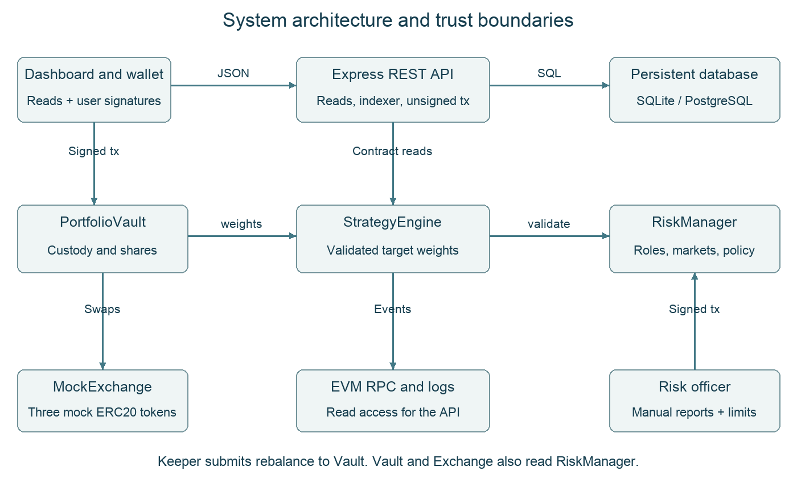
System architecture
AlphaVault / Du zhuotong / 3 of 12
Notes:
65–105 seconds. The dashboard reads portfolio data through a same origin REST API. For public transactions, the API prepares unsigned calldata and MetaMask signs with the user's account. The hosted server does not hold a signing key. PortfolioVault holds tokens, StrategyEngine calculates target weights, and RiskManager enforces policy. MockExchange performs test token swaps. An off chain Keeper can submit an eligible rebalance, but all contract checks still apply. The backend indexes blockchain events into PostgreSQL in the public deployment, or SQLite locally. The database provides observations and evidence; the chain remains authoritative for custody.
Source: Technical report p. 3; contracts/ and server/.

Slide 4
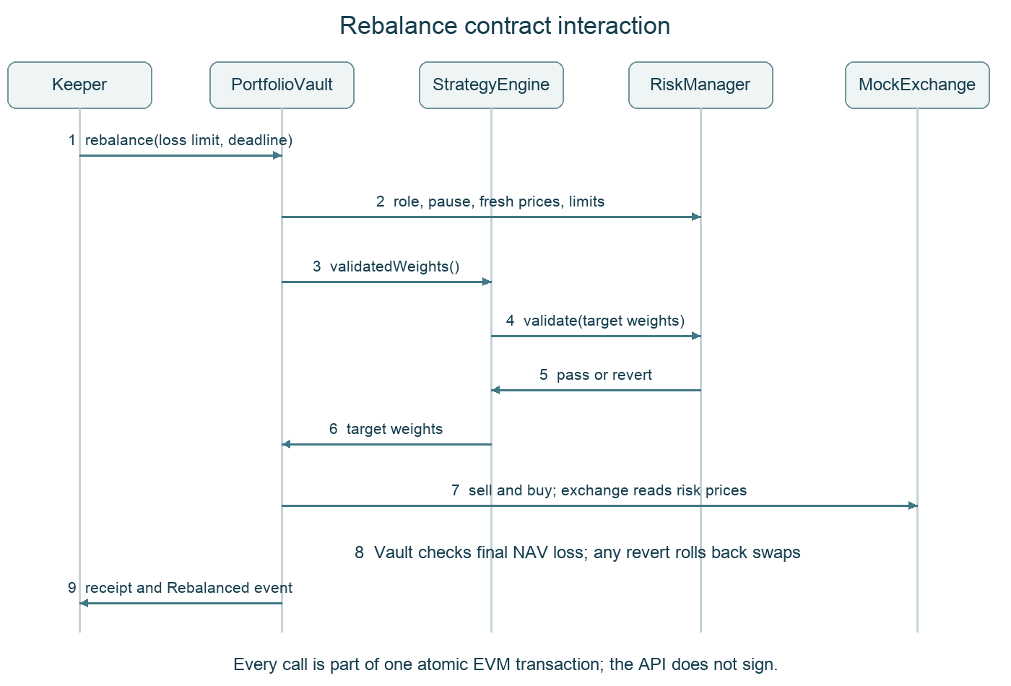
Contract interaction
AlphaVault / Du zhuotong / 4 of 12
Notes:
105–140 seconds. A rebalance starts with an authorized Keeper request. The vault checks roles, pause state, fresh prices, timing and bounds. It then asks StrategyEngine for validated weights. The strategy calls RiskManager before returning those weights. The vault sells risky holdings to mock cash, buys the target assets, and checks the final loss in net asset value. These operations share one atomic transaction. If a bound fails, the swaps and timestamp roll back together. A failed gas estimate is not a successful on chain transaction and is not included in the evidence count.
Source: Technical report p. 5; PortfolioVault.rebalance.

Slide 5
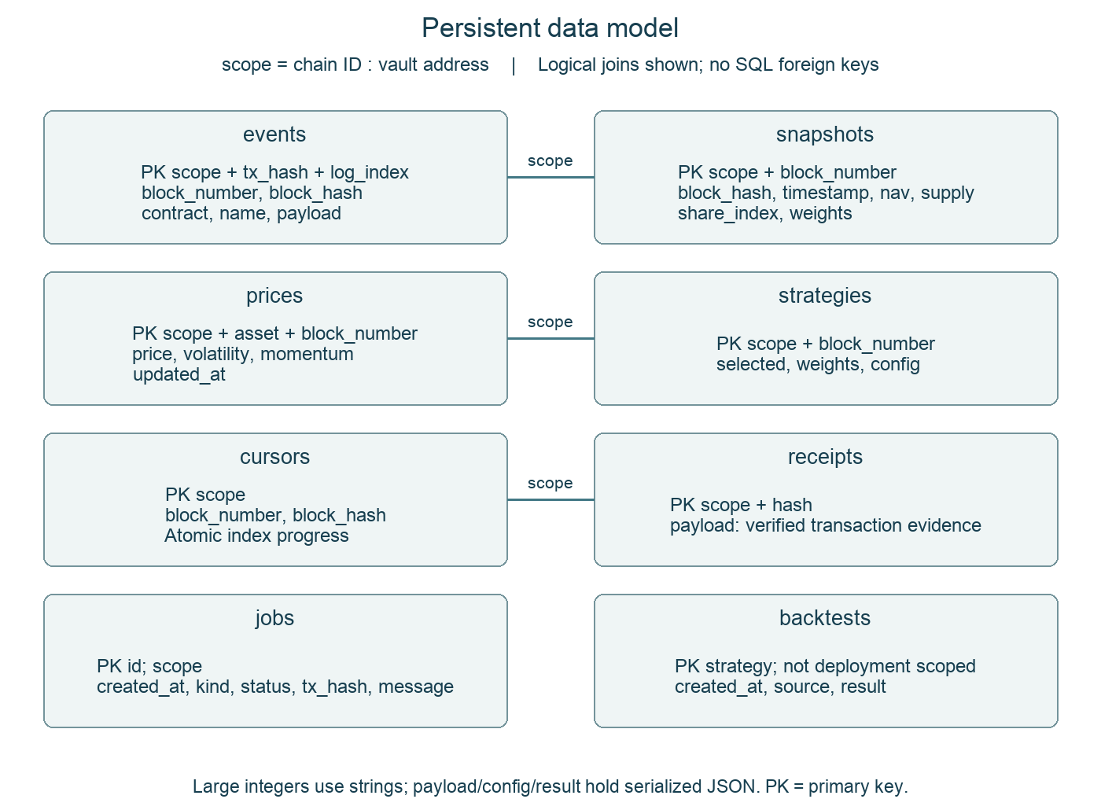
Persistent data model
AlphaVault / Du zhuotong / 5 of 12
Notes:
140–175 seconds. Eight tables support the application. Events are identified by deployment scope, transaction hash and log index. Snapshots store observed portfolio values, while prices and strategies retain per block observations. Cursors store index progress and block hashes so the service can detect a chain rollback. Receipts hold verified evidence, and jobs track execution outcomes. Backtests are keyed by strategy and identify their synthetic source. Deployment scope combines chain ID and vault address. These are logical relationships, not SQL foreign key constraints. Large on chain amounts are stored as strings to avoid numeric precision loss.
Source: Technical report p. 7; server/store.mjs, postgres-store.mjs.

Slide 6
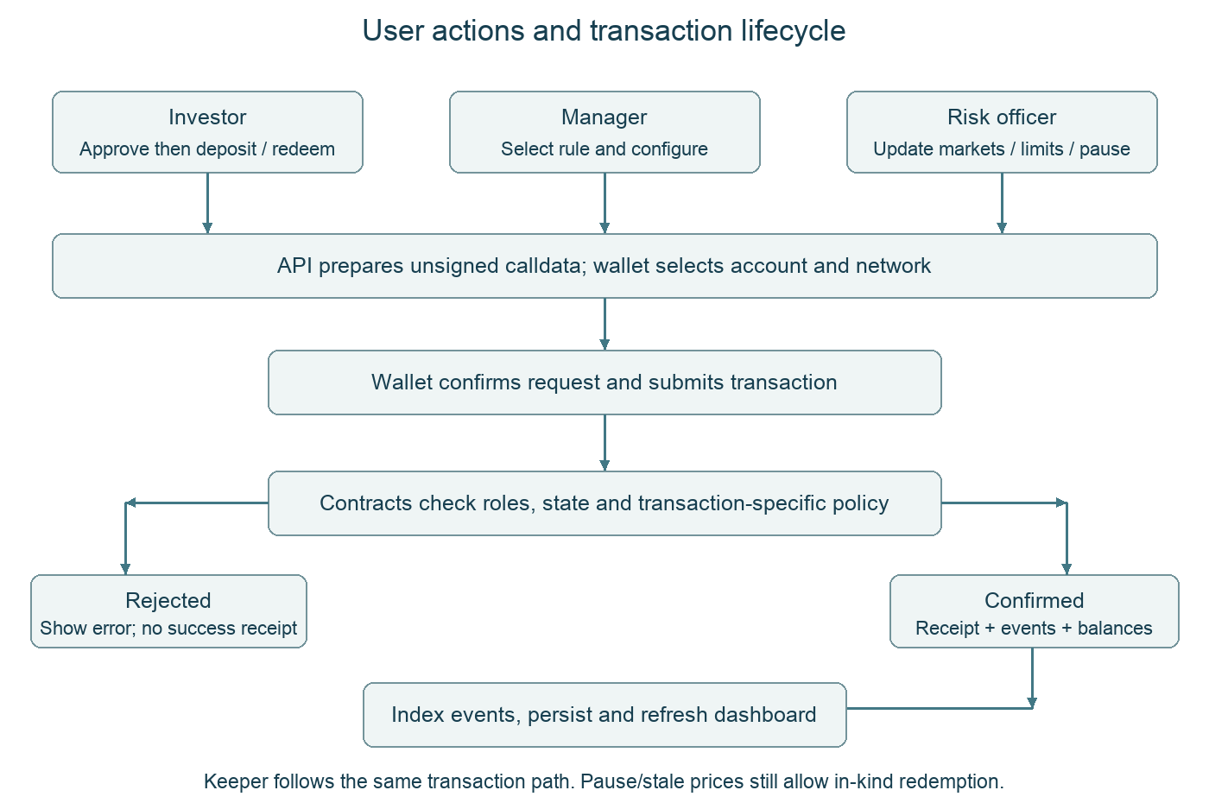
Process flow
AlphaVault / Du zhuotong / 6 of 12
Notes:
175–205 seconds. The user chooses an action, the API prepares calldata, and the wallet asks for confirmation. Smart contracts then enforce the account's authority and the relevant state checks. After success, the service indexes events and refreshes the dashboard. Approval and deposit are separate transactions. Selecting a strategy does not execute a trade. Rebalancing needs a separate Keeper request. A pause blocks deposits and trading, but investors can still redeem their proportional asset basket. That exit does not depend on fresh market prices.
Source: Technical report p. 8; public/app.js and server/actions.mjs.

Slide 7
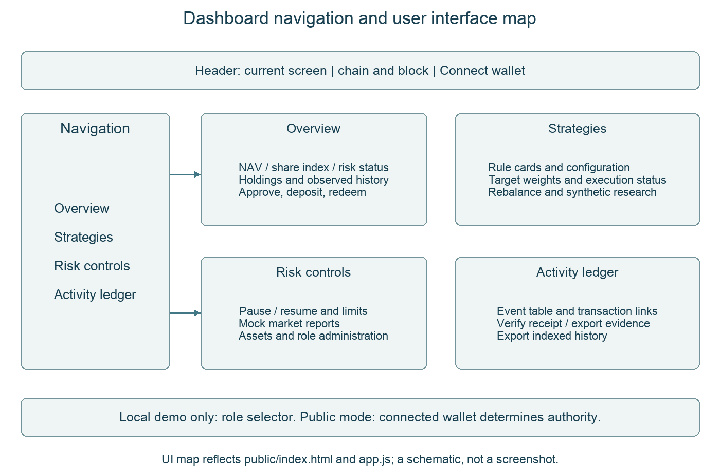
Dashboard guide
AlphaVault / Du zhuotong / 7 of 12
Notes:
205–230 seconds. Overview shows portfolio value and investor actions. Strategies separates allocation choice from execution. Risk controls contains policy and emergency pause. Activity ledger links actions to evidence. The local role selector chooses test accounts. In public mode, the connected wallet determines authority. We now move to the recorded workflow.
Source: Technical report p. 9; public/index.html and app.js.

Slide 8
Recorded application workflow
Local demonstration | Public historical evidence
Approve and deposit 1,000 mUSD | Sepolia dashboard and stale-price disclosure
Select Momentum and rebalance | NAV 748.80 mUSD; share index 99.84
Pause and redeem 25% in kind | 10 method types, including ERC20 approve
Inspect ledger and synthetic research | No new public signatures in the recording
Recorded application workflow: 3 min 23 sec within the ten-minute presentation.
AlphaVault / Du zhuotong / 8 of 12
Notes:
230–433 seconds. Show the recorded workflow from local approval and deposit through public Sepolia evidence. Local figures are distinct from public figures.
Source: evidence/video-recording.json; recorded local actions and public historical state.

Slide 9
Measured impact
Maximum drawdown
Equal Weight 9.04%
Volatility Target 5.82%
Difference 3.22 pp
Both returns are negative.
Synthetic fixture only.
Functional evidence: six selected unauthorized calls rejected; paused exit succeeds.
AlphaVault / Du zhuotong / 9 of 12
Notes:
433–478 seconds. The strategy experiment compares rules on the same deterministic price fixture and fee assumptions. Volatility Target has a maximum drawdown of five point eight two percent, compared with nine point zero four percent for Equal Weight. That is about three point two two percentage points lower. Annualized volatility is also lower, but both returns remain negative. These results do not establish real market profitability. Functional evidence is separate: six selected unauthorized privileged calls were rejected in the tests, and a public redemption succeeded while trading was paused. The public rebalance cost one point six zero mock dollars in exchange fees, with network gas paid separately.
Source: Technical report pp. 10–12; evidence/backtests.json; test/contracts.test.mjs.

Slide 10
Tests and persistent hosting
Check | Observed result
Latest full suite | 64 passed / 0 failed
Public API acceptance | Wallet mode / PostgreSQL / expected Sepolia vault
Public transaction evidence | 12 successful receipts / 10 distinct types
Earlier restart experiment | Non-chain jobs sentinel retained
Interpretation | Specific tested scenarios; no uptime or audit guarantee
AlphaVault / Du zhuotong / 10 of 12
Notes:
478–528 seconds. The latest full automated run passes sixty four tests with zero failures. Tests cover contract permissions, accounting, rollback, price freshness, pause behavior, API preparation and persistence. A new public acceptance check also passes: the service is in wallet mode, uses PostgreSQL, points to the expected Sepolia vault, and exposes ten verified transaction types. The earlier restart experiment provides a stronger storage check than event replay alone. A non chain jobs record remained identical after the Render service restarted. Because that record is not reconstructed from blockchain events, its retention demonstrates persistence across that observed restart. This is a specific acceptance result, not an uptime guarantee. The free service can still sleep.
Source: evidence/current-tests.tap, submission-hosted-check.json, hosted-jobs-*.json.

Slide 11
Limits and contribution record
Current boundary | Next engineering step
Manual prices and mock exchange | Independent oracle and execution integration
Synthetic fixture only | Real out-of-sample data and realistic costs
Central role administration | Stronger governance and external review
Unattended Keeper tested locally | Reliable authorized operational deployment
Contribution record maps responsibilities to artifacts and Git checkpoints.
AlphaVault / Du zhuotong / 11 of 12
Notes:
528–573 seconds. The project delivers contracts, a REST service, persistent storage, a wallet capable dashboard, tests, deployment evidence and submission materials. The individual contribution report maps those responsibilities to artifacts and meaningful Git checkpoints. Several engineering boundaries remain. Prices are manually reported, assets and the exchange are simulated, and the administrator can reassign roles. There is no external security audit or field usability study. Unattended Keeper execution was tested locally; the public rebalance was manually signed. Explorer source verification is separate from deployment receipt checks. These limits guide the next development priorities and the interpretation of the evidence.
Source: Technical report pp. 6, 12–14; Individual contribution report.

Slide 12
Submission and conclusion
Delivered
14-page report with five diagrams
User manual and individual contribution report
Source, tests, deployment evidence and ten-minute video
https://alphavault-sepolia.onrender.com
https://github.com/qwekker/alphavault-sc6113
Public repository: source code and contribution history are accessible.
AlphaVault / Du zhuotong / 12 of 12
Notes:
573–600 seconds. The submission contains a fourteen page technical report with five diagrams, a user manual, an individual contribution report, slides, source code and this ten minute demonstration. The report connects the problem and stakeholder needs to measured prototype results. The repository and public deployment links are shown here. AlphaVault demonstrates constrained, traceable portfolio operations with an explicit investor exit path. Thank you for watching.
Source: docs/SUBMISSION_MAP.md and submission/ deliverables.

