Slide 1
Distributed Sorting
20170123 최지훈
20210979 손정호

Slide 2
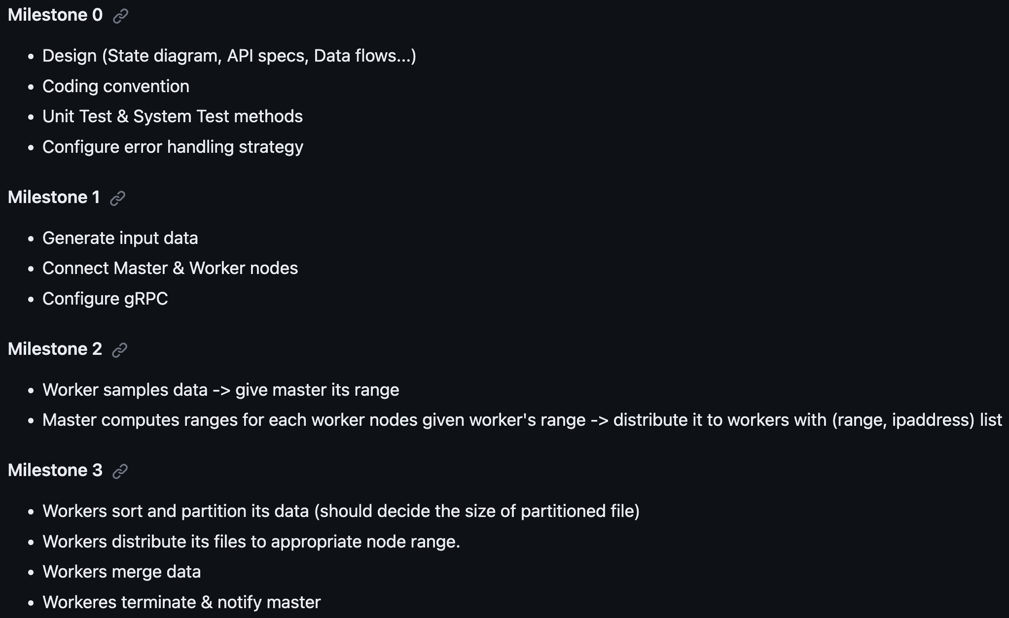
MileStones

Slide 3
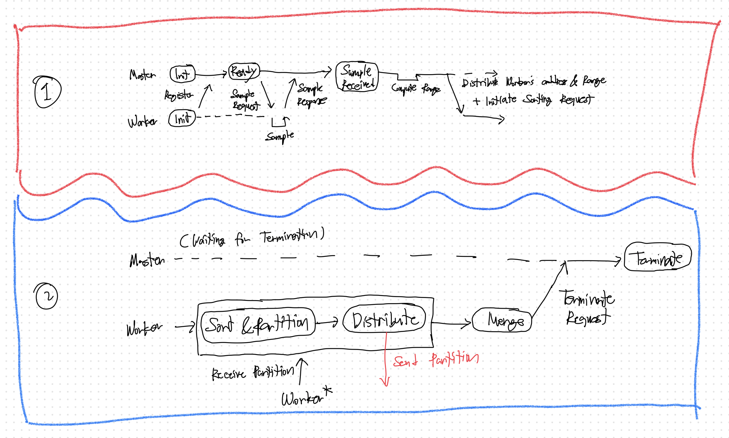
Dataflow Diagram
How master and worker will communicate

Slide 4
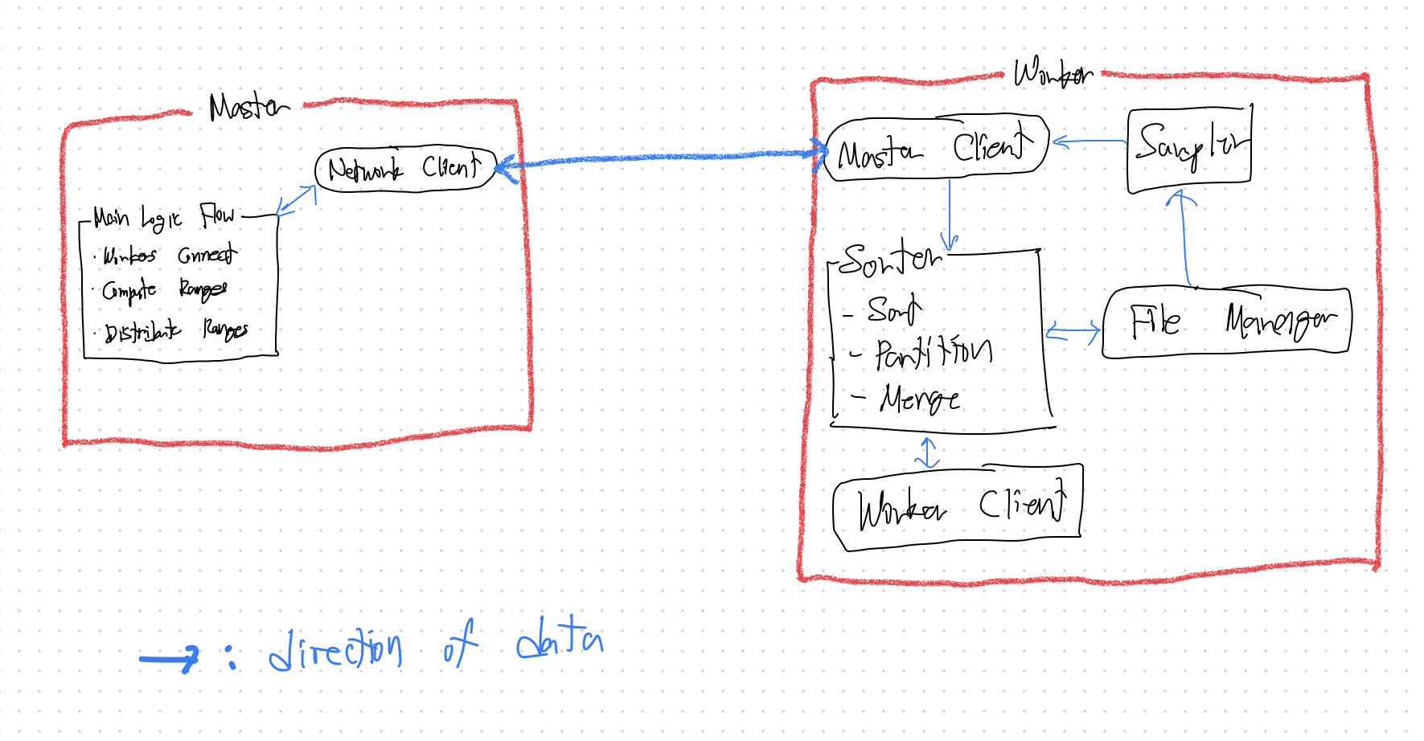
Module Design

Slide 5
Things To Consider
How to communicate using gRpc
How to send data, Request/Response, …
Plan to implement communication by this week
How worker will distribute each partition
Worker connecting directly to worker?
When should we start sending the partition?

