Slide 1
What is an “Effect” (or a “Side Effect”)?
Main Job: Render UI & React to User Input
Side Effects: Anything Else
Evaluate & Render JSX Manage State & Props
React to (User) Events & Input
Re-evaluate Component upon State & Prop Changes
Store Data in Browser Storage
Send Http Requests to Backend Servers Set & Manage Timers
…
This all is “baked into” React via the “tools” and features covered in this course (i.e.
useState() Hook, Props etc).
These tasks must happen outside of the normal component evaluation and render cycle – especially since they might block/
delay rendering (e.g. Http requests)

Slide 2
Handling Side Effects with the useEffect() Hook
useEffect(() => { … }, [ dependencies ]);
A function that should be executed AFTER every component evaluation IF the specified dependencies changed
Dependencies of this effect – the function only runs if the dependencies changed
Your side effect code goes into this function.
Specify your dependencies of your function here

Slide 3
Introducing useReducer() for State Management
Sometimes, you have more complex state – for example if it got multiple states, multiple ways of changing it or dependencies to other states
useState() then often becomes hard or error-prone to use – it’s easy to write bad, inefficient or buggy code in such scenarios
useReducer() can be used as a replacement for useState() if you need “more powerful state management”

Slide 4
Understanding useReducer()
const [state, dispatchFn] = useReducer(reducerFn, initialState, initFn);
The state snapshot used in the component re-
render/ re- evaluation cycle
A function that can be used to
dispatch a new
action (i.e. trigger an update of the state)
The initial state
A function to set the initial state
programmatically
(prevState, action) => newState
A function that is triggered automatically once an action is dispatched (via dispatchFn()) – it receives the latest state snapshot and should return the new, updated state.

Slide 5
useState() vs useReducer()
Generally, you’ll know when you need useReducer() (➔ when using useState() becomes cumbersome or you’re getting a lot of bugs/ unintended behaviors)
useState()
useReducer()
The main state management “tool”
Great if you need “more power”
Great for independent pieces of state/ data
Should be considered if you have related pieces of state/ data
Can be helpful if you have more complex state updates
Great if state updates are easy and limited to a few kinds of updates

Slide 6
컴포넌트의 트리구조와 의존성관계
Props와 함수만으로 데이터를 전달할
경우
<App />
<Auth />
<Shop />
<Cart />
<LoginForm />
Login
<Products />
<Product />
Add to Cart
접근불가
접근불가

Slide 7
컨텍스트로 해결
모든 컴포넌트가 접근할 수 있는 전역 저장소 생성
<App />
<Auth />
<Shop />
<Cart />
<LoginForm />
Login
<Products />
<Product />
Add to Cart
접근불가
접근불가

Slide 8
Context Limitations
React Context is NOT optimized for high frequency changes!
We’ll explore a better tool for that, later
React Context also shouldn’t be used to replace ALL component communications and props
Component should still be configurable via props and short “prop chains” might not need any replacement

Slide 9
Rules of Hooks
Only call React Hooks in React Functions
Only call React Hooks at the Top Level
React Component Functions
Custom Hooks (covered later!)
Don’t call them in nested
functions
Don’t call them in any block statements
+ extra, unofficial Rule for useEffect(): ALWAYS add everything you refer to inside of useEffect() as a dependency!

Slide 10
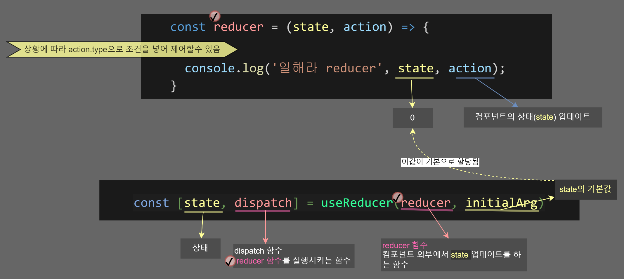

Slide 11
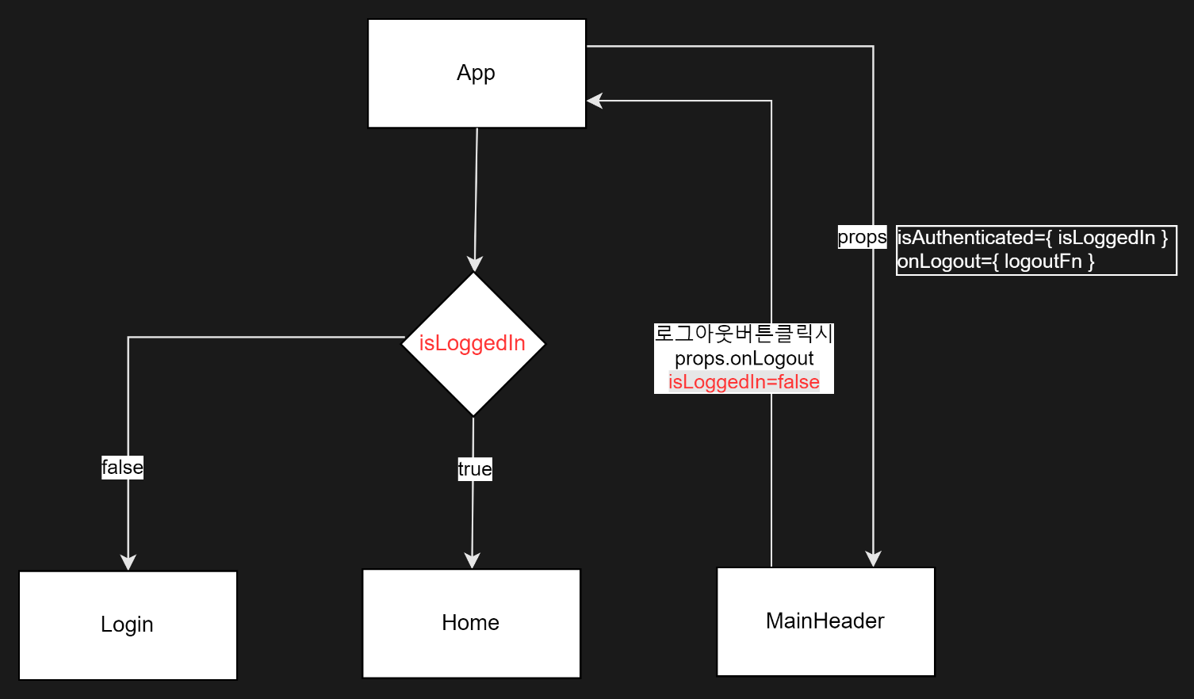
App의 구조

Slide 12
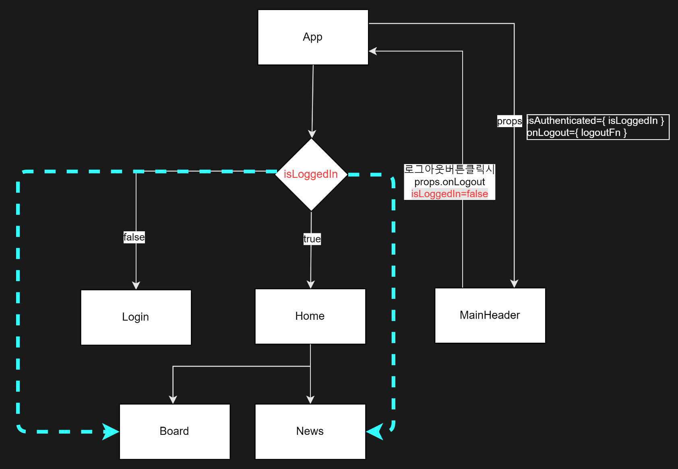
App의 구조

