Slide 1

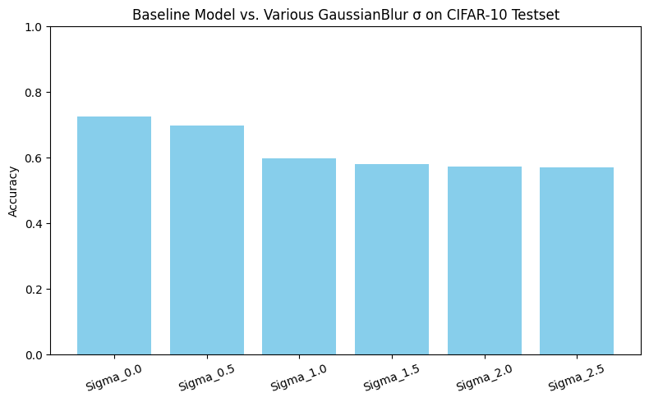
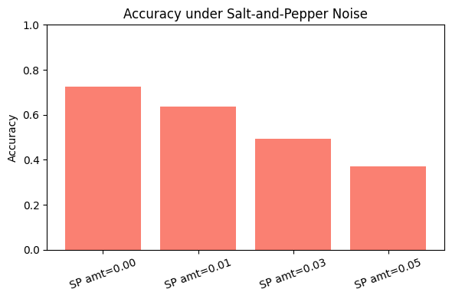
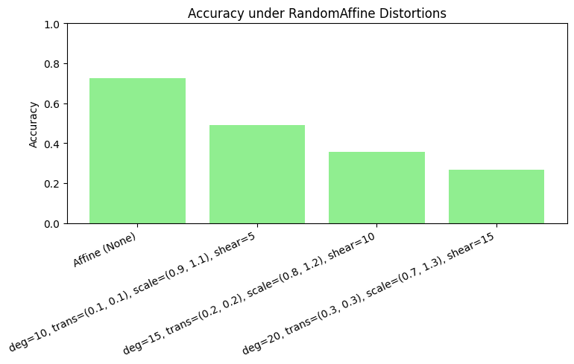


Evaluating the Input Perturbation Robustness of CIFAR-10 Classifiers:
A Comparison of Blur, Salt-and-Pepper Noise, and Geometric Distortions
Kyeonghwan Kim
Computer Science and Engineering, Seoul National University
qwerq123456@snu.ac.kr
Backgrounds
Deep learning-based image classification models are often exposed to various types of noise or distortions in real-world applications. Assessing a model’s robustness to input perturbations is therefore crucial
We use the CIFAR-10 dataset to train a Simple CNN model and have previously examined how Gaussian blur (varying σ) affects its performance
However, Gaussian blur is only one possible perturbation. Other forms such as Salt=and pepper noise (random pixel corruption) and geometric distortions (Random Affine) can also significantly degrade classification accuracy.
Research Goals
Experiments
Compare classifier performance under multiple perturbation types
In addition to prior Gaussian blur experiments, measure how Salt-and-Pepper noise and Random Affine distortions (with varying strengths) impact accuracy.
Identify vulnerabilities by noise type
Determine which perturbation the model is most sensitive to and investigate any class-specific misclassification patterns.
Lay groundwork for mitigation strategies
Provide baseline robustness data that can inform future efforts to apply robust loss functions, data augmentation, or other defenses against corrupted inputs.
Gaussian Blur
As σ increases from 0.0 to 2.5, accuracy steadily drops from 72.53% to 57.02%
Salt-and-Pepper Noise
As noise increase from 0 to 5%, accuracy drops from 72.53% to 37.24%.
Even a small amount of Salt-and-Pepper noise causes a sharp drop in accuracy.
Random Affine Distortion
Increasing geometric distortion leads to greater performance degradation: a 26.60% accuracy at the strongest set of parameters versus 72.53% with no transform.
Methodology
Data and Model
Dataset : CIFAR-10 (50,000 training images, 10,000 test images).
Model architecture : Simple CNN
Training
Apply only ToTensor – Normalize to all training images
Evaluation (perturbed Testsets)
Load the. Retrained model and evaluate on test sets with various perturbations.
Perturbation types and strengths
Gaussian Blur: σ = 0.0, 0.5, 1.0, 1.5
Salt-and-Pepper Noise : amount = 0.00, 0.01, 0.03, 0.05
RandomAffine Distortion : degrees = 10, 15, 20
Evaluation procedure
For each perturbation setting, build a Dataloader that applies the specified transform to every test image.
Compute overall test accuracy (number of correct predictions / total images).
Record the accuracy for each noise/parameter combination.
Concluding Remarks
Our experiments demonstrate that even a simple CNN trained on clean CIFAR-10 data is highly vulnerable to a range of input perturbations. Gaussian blur, salt-and-pepper noise, and geometric distortions each caused significant accuracy degradation compared to the 72.53% baseline.
Salt-and-Pepper noise proved especially damaging: only 1% pixel corruption dropped accuracy from 72.53% down to 63.80% and 5% corruption drove it below 40%. This indicates that sparse, high-magnitude pixel errors are harder for the network to ignore than mild blurring.
Random Affine distortions likewise inflicted severe performance drops as transformation parameters intensified. With moderate translation, rotation, scale, and shear, accuracy fell to 35.51%. Under the strongest affine settings, it sank to 26.60%. This highlights that spatial feature shifts and warping critically impair the learned representations.
Gaussian blur produces a more gradual decline from 72.53% to 57.02%. But nonetheless confirms that smoothing out high-frequency details also limits classification ability.
Future work (1)integrating these perturbations into the training pipeline. (2) Using more advanced architectures to. Valuate whether deeper feature hierarchies confer greater resilience

