Slide 1
Coverless Image Steganography Based on Optical Mark Recognition and Rule Based Machine Learning
ADITH SHETTY
2021MTIS-02 CS&IoT

Slide 2
ABSTRACT
Security is the most important factor to be considered during private information transmission through the internet.
So, to keep this data from unauthorized access during transmission, steganography is used. Steganography is the scheme of securing sensitive information by concealing it within carriers such as digital images, videos, audio, text, etc.
To solve this problem, this paper, proposes a novel, highly robust coverless image steganography method based on optical mark recognition (OMR) and rule-based machine learning (RBML).

Slide 3
INTRODUCTION
Communicating and storing sensitive and confidential information has become part of day-to-day life.
Information transmission has increased exponentially.
Thus, secure transmission and storage of private information have received many researchers attention.
As such, many techniques for hiding private and sensitive information in digital carriers have been developed. Hiding this information in images, text, videos, and audio is termed steganography.

Slide 4
IMAGE STEGANOGRAPHY
Steganography is a method to secure messages during transmission by concealing them within a carrier such as an image, video, text, or audio, which results in stego media.
By using steganography, the secret message format does not change, and the actual data are maintained.
The objectives are to provide end-to-end secure data communication and personal data protection.
The cover medium chosen for embedding must have two features: it should be familiar, and the modifications should be invisible to a third party.
Digital images are the most famous carrier in steganography because they contain significant amounts of redundant data and can conceal sensitive data without any visible effects.
So, in image steganography, confidential information is exclusively hidden in images.

Slide 5
GENERAL IMAGE STEGANOGRAPHY PROCEDURE
The primary goal of digital image steganography is the unnoticeable concealment of private or secret data inside a cover image.
The secret message type may be image, bits, text, or video files.
The embedded data hidden in a carrier image are termed a ‘secret message’ or ‘payload,’ and the result is a ‘stego-image.’
Then stego-image is shared through an insecure channel.
For better security, security systems may use an encryption algorithm and optional key throughout the embedding process. This key may contain data such as embedding coefficients, the password used in the encryption process, etc.

Slide 6
It must be shared between the sender and recipient.
So, image steganography terms are :
Secret message (payload): sensitive information that is embedded in the carrier image,
Cover image (carrier): an original image that is used as the medium to hold the payload,
Stego-image: resultant image after hiding the payload within the carrier image, and
Stego-key: optional additional information that is used for embedding and extracting the payload
The image steganography system comprises two phases: embedding and extracting the secret message.
In the embedding phase, the secret message or payload is hidden in locations selected within the carrier image, depending on the steganography method. Then stego-image is submitted to the recipient.

Slide 7
IMAGE STEGANOGRAPHY REQUIREMENTS
Any image steganography system has four essential properties: robustness, capacity, imperceptibility, and security to test its effectiveness.
Robustness: Robustness is the ability to embed and extract the hidden payload from a stego-image even if it is damaged/modified during transmission or by some third party.
Payload Capacity: Payload capacity is the maximum amount of data that can be hidden inside the carrier image.
Imperceptibility (Undetectability): Imperceptibility or undetectability, means how much the stego-image is indistinguishable from the carrier image i.e. they should look identical.
Security: Security means how stego-images can resist different steganalysis attacks. Another critical requirement of any image steganography system is the secure transmission of the payload.

Slide 8
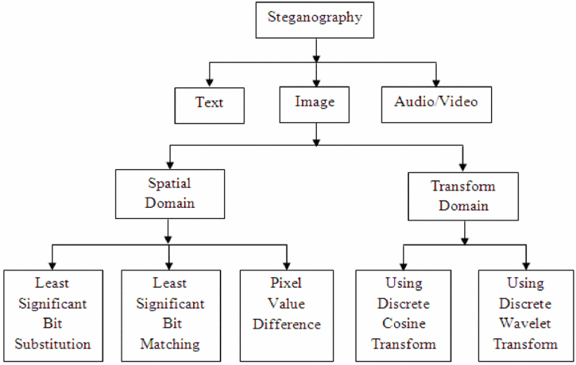
IMAGE STEGANOGRAPHY CLASSIFICATIONS
The image steganography can be categorized into two domains such as Transform and Spatial domains.

Slide 9
COVERLESS IMAGE STEGANOGRAPHY
In almost all traditional image steganography methods, the payload is embedded into cover image pixels, because of which the pixels of the cover image get changed.
In these methods, the stego-images may be detected by any image steganalysis tool, and due to this, security cannot be guaranteed. To address this issue, a coverless data hiding concept has been proposed.
Coverless data hiding was proposed to resist existing steganalysis tools.
Compared with traditional steganography, coverless steganography does not change the cover pixels, such as LSB, etc.
Therefore, the security of coverless steganography methods is higher than traditional steganography methods.
Coverless information hiding does not mean that a cover is not required.
However, compared with traditional steganography, coverless steganography directly uses the contents of the cover itself to represent the payload.

Slide 10
OPTICAL MARK RECOGNITION (OMR)
OMR is an electronic method used to gather marked data by identifying specific markings on a bubble sheet document.
Usually, this process is achieved with the aid of a special scanner that checks light reflection through the sheet; marked bubbles/circles reflect less light than the blank bubbles/circles, resulting in less reflectivity.
Currently, the OMR process is widely used in different types of exams. This technology involves collecting data from fill-in-the-bubble sheets like tests, surveys, multiple-choice questions (MCQ) sheets, and true/false (T/F) sheets.

Slide 11
OMR enables the answerer to choose the answer of a question by filling in a bubble or circle associated with the correct answer.
Collecting data using OMR is more precise than handwriting answers’ recognition.
Although OMR is not a new technology, it has evolved; conventional OMR systems require preprinted forms and special scanners.
Although OMR is a promising technology, it is expensive and limited to very high volume applications.

Slide 12
RULE-BASED MACHINE LEARNING
RBML algorithms describe data using relational rules. This system can be contrasted from ML systems that create a model that can be generally applied to all the incoming data.
Simply put, these systems are straightforward: If A is input data, perform B.
The main contribution of this study is to propose a novel and highly robust coverless image steganography method using the bubble sheet as a cover based on an OMR system and RBML in order to enhance coverless image steganography security, robustness, and capacity.

Slide 13
PROPOSED METHOD
According to different hiding methods, the commonly used image steganography schemes, leave modifications to the stego-image that are detectable by any detection algorithm.
Coverless information hiding has been proposed to resist the existing steganalysis tools. Steganalysis can be classified into passive and active methods.
For passive methods, the absence or existence of secret data can be identified, whereas active steganalysis can recover, modify, or tamper with the hidden message so that the recipient is unable to extract it.
Another unsolved problem in image steganography is the artifacts that could destroy the stego image, such as network transmission errors or image manipulations, such as image filtering, scaling, conversion of file format, digital to analog format conversion, noise, and data compression.

Slide 14
Another unsolved problem in image steganography is that the stego image may get destroyed due to various reasons, such as network transmission errors or image manipulations, image filtering, scaling, conversion of file format, digital to analog format conversion, noise, and data compression.
The current coverless image steganography methods are similar to image retrieval. These methods use images retrieved from the image library (i.e., a pre-defined local database created at the sender and receiver; both ends) to represent the payload.
These techniques are not very robust, as they can resist some steganalysis tools or algorithms, but not all.
Also, they cannot overcome issues due to network transmission errors or image manipulations.

Slide 15
Another challenge with the coverless image steganography methods is that these techniques have low embedding capacity.
Any steganography system must be secure and robust against manipulations by an active attacker that could result in secret message loss, such as network transmission errors or image manipulations.
Thus, the following properties of coverless image steganography techniques need to be improved: security and robustness against these attacks, overcoming challenges stated above, and greater capacity than the few bits/cover provided in the previously proposed coverless methods.
So, to address these problems, a novel coverless image steganography method that is based on OMR and RBML is proposed here.

Slide 16
PROPOSED METHOD COMPONENTS
The components of the proposed method are as follows:
Bubble sheet: Corresponds to the cover image in traditional steganography methods. It is a generated answer/bubble sheet that is used as a carrier.
Secret message (payload): Sensitive information mapped to the bubble sheet (bubble sheet answers).
Answered/mapped bubble sheet: Corresponds to stego-image—the bubble sheet obtained after answering/mapping the secret message.
Mapping algorithm: The embedding algorithm used to answer the bubble sheet based on secret message bits.
Detection algorithm: The extraction algorithm used to collect and detect the answers from the answered bubble sheet to obtain and form the secret message.

Slide 17
MAPPING PHASE
Before the mapping phase, a bubble-sheet template (True/False answer sheet) must be generated only once at the sender side using any free OMR software.
The generated bubble sheet and the secret message are fed as inputs to the mapping algorithm. Then, the secret message is divided into characters and converted into binary stream 0’s and 1’s. After that, this bitstream is divided into blocks, each block’s length is equal to the number of columns of each row in the generated sheet.
Secondly, the algorithm is now created and it performs the following tasks: detect and count the number of rows in the bubble sheet, detect all circles found in the generated bubble sheet row by row, calculate the bubble sheet full capacity as each byte (i.e., 8 bits) and mapping the secret data by marking and answering the bubbles/circles in the bubble sheet.

Slide 18
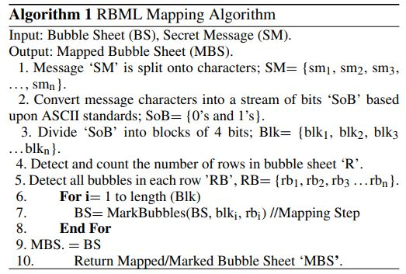

Slide 19
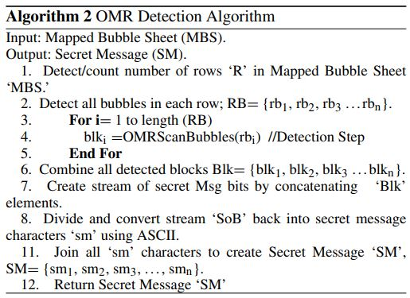
DETECTION PHASE
The detection phase works same as the mapping phase but in reverse order, as shown in the OMR detection algorithm. Firstly, the answered/mapped bubble-sheet is scanned row by row, and the circles are detected for each row. Then, answers are collected, and secret bits are obtained and concatenated to form the bitstream. After, the bitstream is represented by 8 bits blocks, and these blocks are converted into characters using ASCII. Finally, these obtained characters are joined together, forming the secret message.

Slide 20
EVALUATION AND COMPARISONS
Upgrading the properties of coverless image steganography, such as enhancing capacity, security, imperceptibility, and robustness, is this paper’s main contribution.
So, the proposed method was experimentally evaluated based on these four essential properties to assess its effectiveness and to verify and evaluate its efficiency.
The results were used to compare the effectiveness of the proposed method with existing coverless image steganography methods.

Slide 21
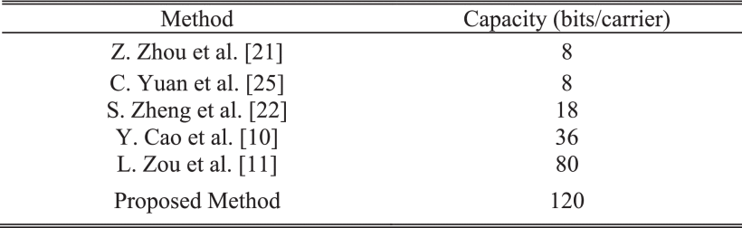
CAPACITY
The proposed method’s hiding capacity is the highest amongst the available methods. Notably, the proposed method capacity is not limited to 120 bits/cover, as more bubbles can be added until the sheet capacity according to the actual needs.

Slide 22

ROBUSTNESS
Robustness is the steganography method’s ability to resist attacks. The robustness of the coverless proposed method was tested, evaluated, and verified through experiments and comparisons.
First, a bit error rate (BER) must be defined. BER is a robustness measure of the steganography algorithm in the communication process, calculated as follows:
If BER = 0, no errors were found, and the secret bits were successfully extracted with 100% accuracy, which means that the method is 100% robust to this attack. Otherwise, if BER > 0, an error rate exists in the extracted secret bits after the attack (i.e., some secret bits have been changed/damaged), which means the method is not 100% robust to this attack.

Slide 23
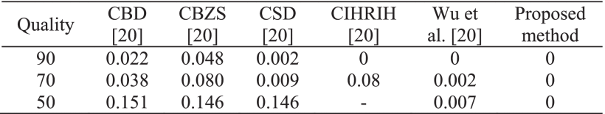
JPEG COMPRESSION ATTACK
JPEG is the compression standard for still images and is the most popular method. JPEG is a lossy compression that allows data to be lost and applied to images before/during transmission. The stego-image is modified/damaged through transmission if it is compressed. The proposed method robustness (BER) was measured against the JPEG attack.

Slide 24
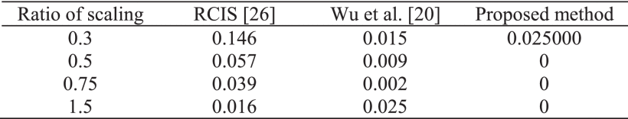
SCALING ATTACK
Stego-image scaling can destroy the extracted secret message. The results showed that at a 0.3 scaling ratio, the proposed method has three error bits out of the 120 bits. The BER was 0.02500. This error was due to the tiny size of the circles that the ML algorithm could not detect the circles. The BER of the proposed method at the 0.5, 0.75, and 1.5 scales was 0, which means the method is 100% robust, and the message was fully detected successfully.

Slide 25
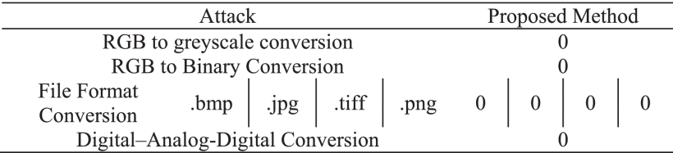
OTHER ATTACKS
The results of applying some attacks that are hard to resist by almost all image steganography methods, including color space conversion (i.e., red, green, blue (RGB) to greyscale conversion), thresholding (i.e., RGB to binary image conversion), conversion of file format, and digital into analog format conversion (i.e., print and scan stego-image).
The proposed method succeeded in resisting the above attacks, and the BER was 0, which means 100% robust to these types of attacks.

Slide 26
SECURITY
In the proposed method, there is no hidden message and no stego-image; it is only a bubble-sheet, which is not suspicious.
Data hiding methods should resist various steganalysis attacks. Unfortunately, almost all the existing image steganography methods are detectable by steganalysis tools that use the pixel bits changes resulting from the hiding operations applied in steganography methods.
However, these tools cannot efficiently detect coverless steganography methods because without employing a cover image for embedding the secret data, the proposed method directly finds the circle and marks it to map the secret bits. Notably, OMR sheets are not suspicious as they are used in exams and surveys, and they have not been previously used as cover images.
Thus, the proposed method provides a high-security level, and is hard for an attacker to detect the payload.

Slide 27
CONCLUSION
In this paper, a highly robust, highly secure, and highly embedding capacity coverless image steganography method based on OMR and RBML was proposed.
Finally, the proposed coverless steganography method has some advantages compared to current coverless methods:
No database is required. No database is needed for cover images, neither at the sender side nor the receiver side, compared with previously reported coverless methods.
No secret information sharing required. No information has to be shared between the sender and receiver, such as databases, labels, bit locations, etc.
No time wasted in searching. Almost all previous methods have to search within a database for the required image. Searching for images in databases can be slow, depending on the size of the database.
Very high capacity. The proposed method has the highest embedding capacity among the previously proposed methods. Also, embedding capacity can be increased as required.

Slide 28
Very high robustness.
Very high security as bubble sheets are not suspicious and have not been previously used as a cover file.
In the OMR phase, no special or expensive tools are required.

Slide 29
THANK YOU

