Slide 1
Legal Document Summarization using Transformers
Course:-Machine Learning(CS3103)
Group Number: 25RC36
Roll Numbers
2301AI08
2301AI29
2301AI34
2302CS02

Slide 2
Roles And Responsibilities
Name | Role | Responsibilities
Dheeraj (2301AI08) | Team Lead | Title, abstract, intro, conclusion, scope, QA, repo management
Sathvik (2301AI34) | Data Lead | Literature survey, dataset sourcing, cleaning, preprocessing, EDA
Tanuj (2301AI29) | Implementation Lead | Extraction and Assignment, Implementation
Koushik (2302CS02) | Inference Lead | fine-tune BART, Inference, Evaluation

Slide 3
Introduction
Problem Statement:-
Legal documents such as court judgments, statutes, and government orders are often extremely long, unstructured, and written in dense legal terminology. Manual summarization of such documents is time-consuming and requires domain expertise.
Existing transformer-based summarization models struggle due to:
1.)Input length limitations (512–1024 tokens), leading to truncation of long judgments.
2.)Scarcity of domain-specific summarization datasets, especially for Indian legal documents.
This project aims to address these challenges by developing an automated legal document summarization system that combines an Extract-then-Assign (ETA) dataset generation strategy with a fine-tuned BART( model to generate concise, coherent, and legally faithful summaries.

Slide 4
Motivation:-
Legal professionals, law students, and researchers spend significant time reading lengthy judgments to extract relevant information.
With thousands of judgments produced every month, manual analysis becomes inefficient.
Furthermore, Indian legal judgments are lengthy (5,000–20,000+ tokens) and public datasets with high-quality summaries are limited.
The motivation for this work arises from the need for:
*Efficient retrieval and understanding of legal documents.
*Automated summarization tools that can handle long documents.
*Domain-adapted models that overcome data scarcity and input-length barriers.

Slide 5
Objectives:-
The key objectives of the project are:
To build a high-quality training dataset for legal summarization using the ETA strategy.
To preprocess and chunk long Indian legal documents into model-friendly units.
To fine-tune a BART model on the generated dataset for abstractive summarization.
To evaluate the model using ROUGE and BERT Score metrics.

Slide 6
Literature Review
Key prior works:
Transformer-based seq2seq models and adaptations for summarization; long-document transformers; dataset augmentation strategies for low-resource summarization.
• T5 (Text-to-Text Transfer Transformer)—a unified encoder-decoder pretraining approach for many NLP tasks including summarization [2].
• BART and denoising autoencoders for abstractive summarization [3].
• Long-document transformers (BigBird, LED) using sparse attention to handle long inputs [4, 5].
• Summarization of Lengthy Legal Documents — the extract-then-assign paradigm for long legal texts to create multiple manageable document-summary pairs and augment training data [1].

Slide 7
Literature Review
Gaps Identified:
From existing literature, three major gaps remain:
Lack of high-quality annotated datasets for Indian legal summarization.
Difficulty in processing long documents due to token limits.
Limited adoption of hybrid extractive–abstractive strategies for dataset generation.
Although BART performs well on abstractive summarization, fine-tuning it on long legal documents is expensive, motivating the use of PEFT–LoRA to reduce training cost while maintaining performance..

Slide 8
Methodology:
Dataset & Preprocessing :-
We combine two sources:
• Rishiai dataset—structured Indian legal judgment summaries containing pairs of judgments and short summaries in English
• FIRE Dataset from an external source.
Preprocessing included:
Handling Broken words using regex.
Removing Noise.

Slide 9
Proposed Method
Extractive Summaries Generation
For each document, we generate k = 7 extractive summaries using:
TextRank
LexRank
LSA
KL-Sum
LUHN
SumBasic
Legal-SBERT based scoring
Each extractive summary is constrained to ≤ 512 tokens.
Extract-then-Assign (ETA) Data Generation
Given each extractive summary chunk and ground-truth summary sentences, we:
1.Compute similarity using ROUGE Score.
2.Assign each summary sentence to the most similar extractive chunk.
3.Enforce length constraints to avoid overflows.
4.Generate up to 7 document–summary pairs per original sample.
This multiplies the available training samples by 7×.

Slide 10
Proposed Method
Finetuning using BART:-
We fine-tune BART-Large using PEFT LoRA (Low Rank Adaptation) for efficient parameter-reduced training. LoRA updates only small low-rank matrices reducing number of training parameters, enabling fast, low-cost fine-tuning while still retaining strong abstractive summarization performance on legal document chunks.
As machine learning models become larger and more complex, fine-tuning them often requires substantial computational power and memory. LoRA addresses this issue by reducing the number of trainable parameters which makes the fine-tuning process faster and less demanding.

Slide 11
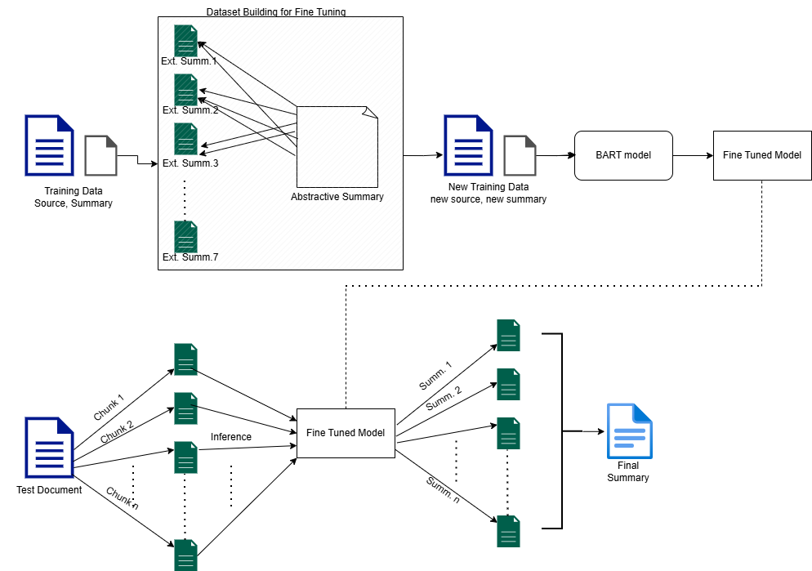
Block Diagram

Slide 12
Results and Discussions
After fine-tuning BART-Large using PEFT LoRA on the ETA-generated dataset, we evaluate the summarization quality on the held-out test set using ROUGE and BERTScore. The results are as follows:
Evaluation Metrics:-
Key Observations:
High semantic fidelity (BERTScore 0.8493) shows the model captures legal meaning well.
Good bigram retention (ROUGE-2 0.3547) suggests the summaries preserve key phrases from judgments.
Slightly lower ROUGE-L indicates room for improvement in capturing long-span logical flow across sentences.
The approach generalizes well to unseen test samples, validating the ETA + LoRA pipeline.
ROUGE Scores:
ROUGE-1: 0.5723
ROUGE-2: 0.3547
ROUGE-L: 0.3169
BERTScore:
Precision: 0.8453
Recall: 0.8535
F1 Score: 0.8493

Slide 13
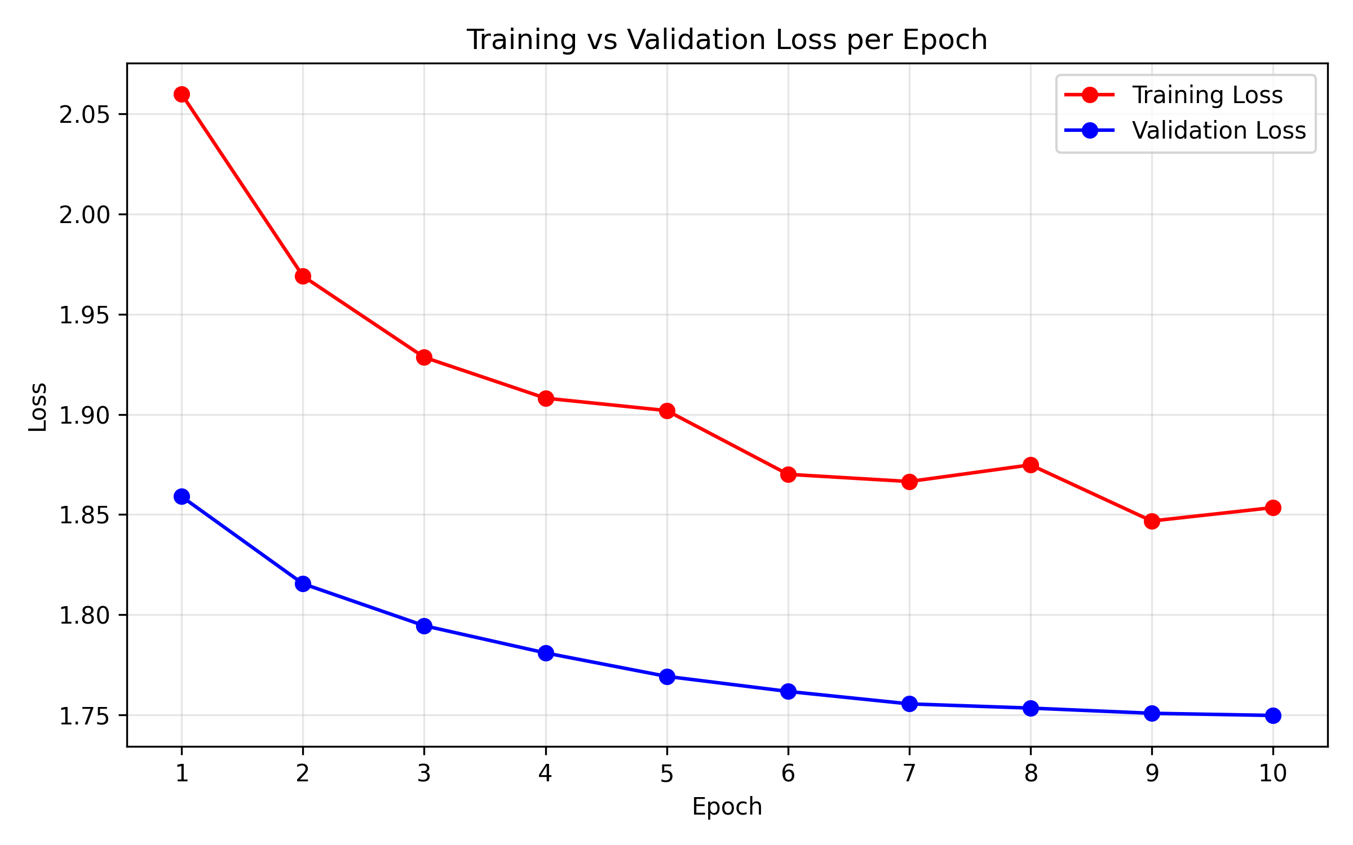
Loss Curve

Slide 14
Conclusions
We overcame the twin challenges of input length limits and data scarcity in legal summarization by employing the Extract-then-Assign (ETA) dataset generation strategy. This approach successfully created a high-quality, large training dataset from existing legal documents.
The BART-Large model was efficiently adapted for this domain using PEFT LoRA. This method minimized training cost while ensuring strong abstractive summarization performance on document chunks.
The final model demonstrated strong performance, achieving a BERTScore F1 of 0.8493 (high semantic fidelity) and a ROUGE-2 score of 0.3547 (good phrase retention). This validates the ETA + LoRA pipeline for generating concise, legally faithful summaries.

Slide 15

Future Work:
Use advanced long-document transformers (Longformer-Encoder-Decoder (LED), BigBird Pegasus, or Pegasus-X).
Expansion to Multilingual Indian Legal Documents.
Use RAG (Retrieval-Augmented Generation) to bring external legal knowledge into summaries.

Slide 16
References:
[1] D. Jain, M. D. Borah, and A. Biswas, “Summarization of lengthy legal documents via abstractive dataset building: An extract-then-assign approach,” Expert Systems with Applications, vol. 237, p. 121571, 2024.
[2] C. Raffel, N. Shazeer, A. Roberts, K. Lee, S. Narang, M. Matena, Y. Zhou, W. Li, and P. J. Liu, “Exploring the limits of transfer learning with a unified text-to-text transformer,” Journal of Machine Learning Research, vol. 21, no. 140, pp. 1–67, 2020.
[3] M. Lewis, Y. Liu, N. Goyal, M. Ghazvininejad, A. Mohammad, O. Zettlemoyer, and L. Zettlemoyer, “Bart: Denoising sequence-to-sequence pre-training for natural language generation, translation, and comprehension,” in Proceedings of ACL, 2019.
[4] M. Zaheer, S. Gao, L. A. Dalvi, J. Li, and A. Smola, “Big bird: Transformers for longer sequences,” in Advances in Neural Information Processing Systems, 2020.
[5] I. Beltagy, M. E. Peters, and A. Cohan, “Longformer: The long-document transformer,” arXiv preprint arXiv:2004.05150, 2020

