Slide 1

Military Security and Defense University of the Republic of Uzbekistan
Institute of Information and Communication Technologies and Military Communications
Cyber Forensics and Ethical Hacking
Topic 2. Linux OS
Lesson 2. Working in Linux OS
THEORY: working with the terminal
Practical lesson · 4 hours
Kali Linux · zsh · bash
Tashkent · 2026

Slide 2

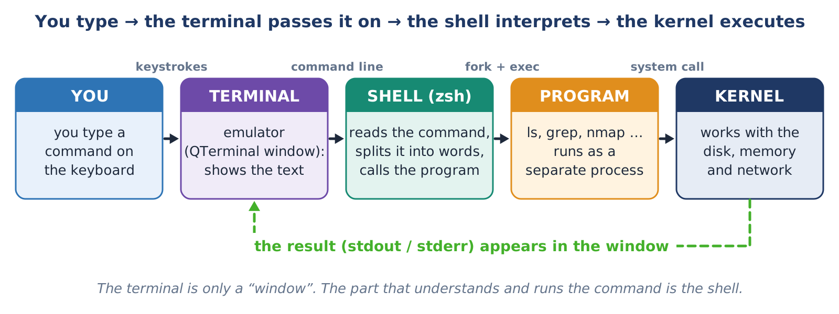

1.1 · TERMINAL, CONSOLE, SHELL
Terminal, console and shell: who does what?
Key ideas
▸ Terminal – the window where you type (Kali: QTerminal)
▸ Shell – the program that understands commands (Kali: zsh, servers: bash)
▸ Console (TTY) – a full-screen text mode, no graphics
▸ CLI – working with typed commands
Figure 2. The path of a command: from the keyboard to the kernel and back
The terminal is only a window. The shell is the “translator” that understands and runs the command.
Cyber Forensics & Ethical Hacking · Topic 2 · Linux OS · Lesson 2 · Theory
2

Slide 3
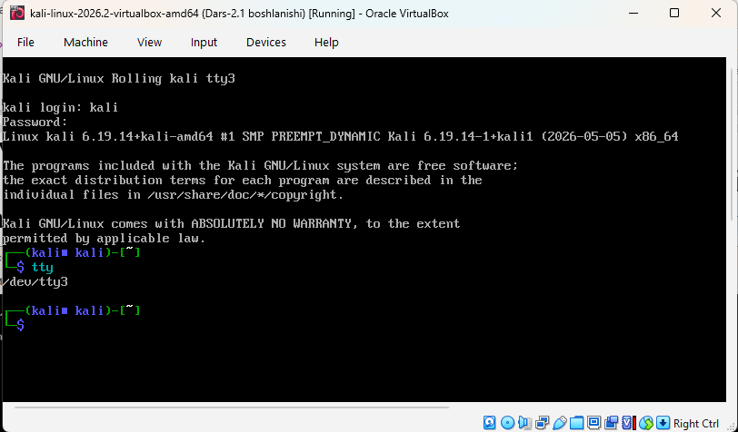
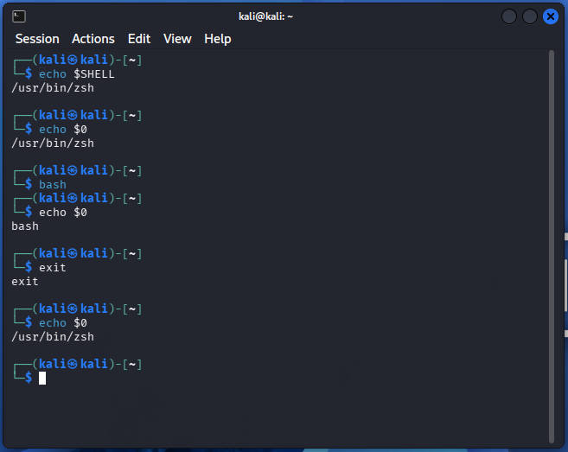

1.1 · TERMINAL, CONSOLE, SHELL
In practice: which console and which shell?
Figure 4. Console (TTY3): tty shows /dev/tty3
Figure 5. Finding the shell: echo $SHELL, echo $0, bash
To the console: Host + F3 ; back: Host + F7 . Leave with exit.
bash starts bash, exit returns to zsh.
Cyber Forensics & Ethical Hacking · Topic 2 · Linux OS · Lesson 2 · Theory
3

Slide 4
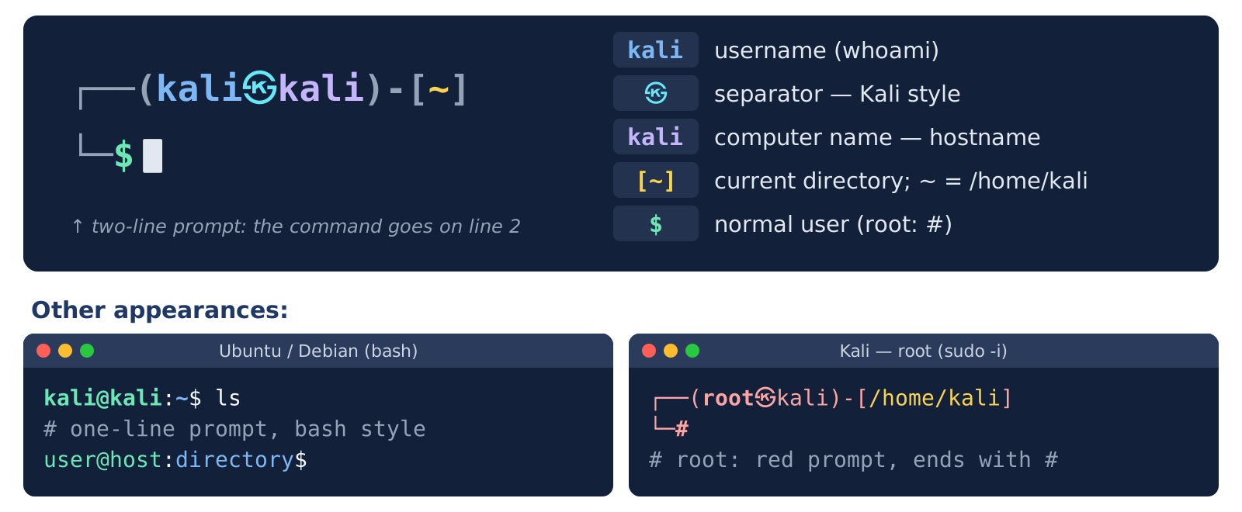
1.2 · THE PROMPT
The prompt: the shell says “I am ready”
Key ideas
▸ Two lines: info on top, the command below
▸ kali㉿kali – who, on which computer
▸ [~] – current directory
▸ $ = normal user, # = root
zsh helpers: grey suggestion ( → accepts it); a valid command is green, a wrong one is red.
Figure 6. Structure of the Kali prompt
Cyber Forensics & Ethical Hacking · Topic 2 · Linux OS · Lesson 2 · Theory
4

Slide 5
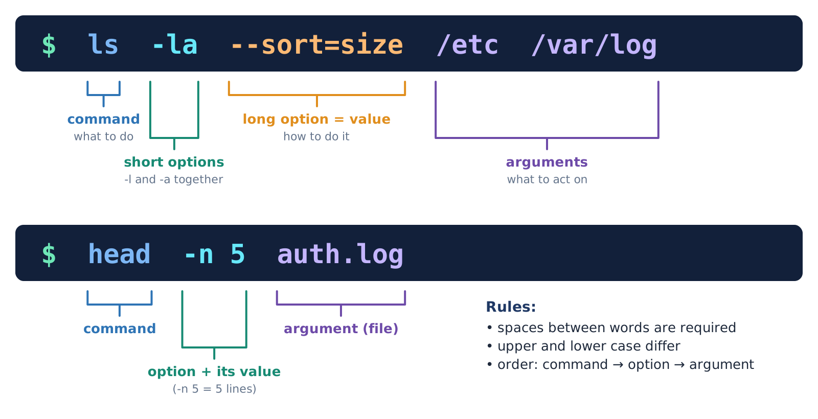
1.3 · COMMAND SYNTAX
A command = command + option + argument
Key ideas
▸ Command – what to do: ls
▸ Option – how to do it: short -l, long --all
▸ Argument – what to act on: /etc
▸ Short options combine: ls -la
Case matters: ls -r and ls -R are different options.
Figure 8. Parts of a command line
Cyber Forensics & Ethical Hacking · Topic 2 · Linux OS · Lesson 2 · Theory
5

Slide 6
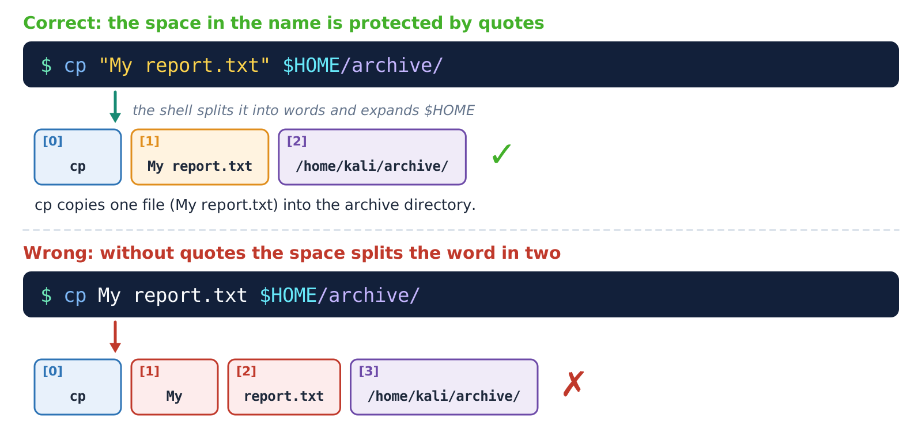

1.3 · COMMAND SYNTAX
Quotes and the -- sign
Key ideas
▸ A space separates words – put a name with a space in quotes
▸ Inside “ ” a variable expands: $USER
▸ Inside ‘ ’ everything is literal
▸ -- means “options end here”: rm -- -file.txt
When in doubt, use double quotes.
Figure 9. How the shell splits a line into words
Cyber Forensics & Ethical Hacking · Topic 2 · Linux OS · Lesson 2 · Theory
6

Slide 7
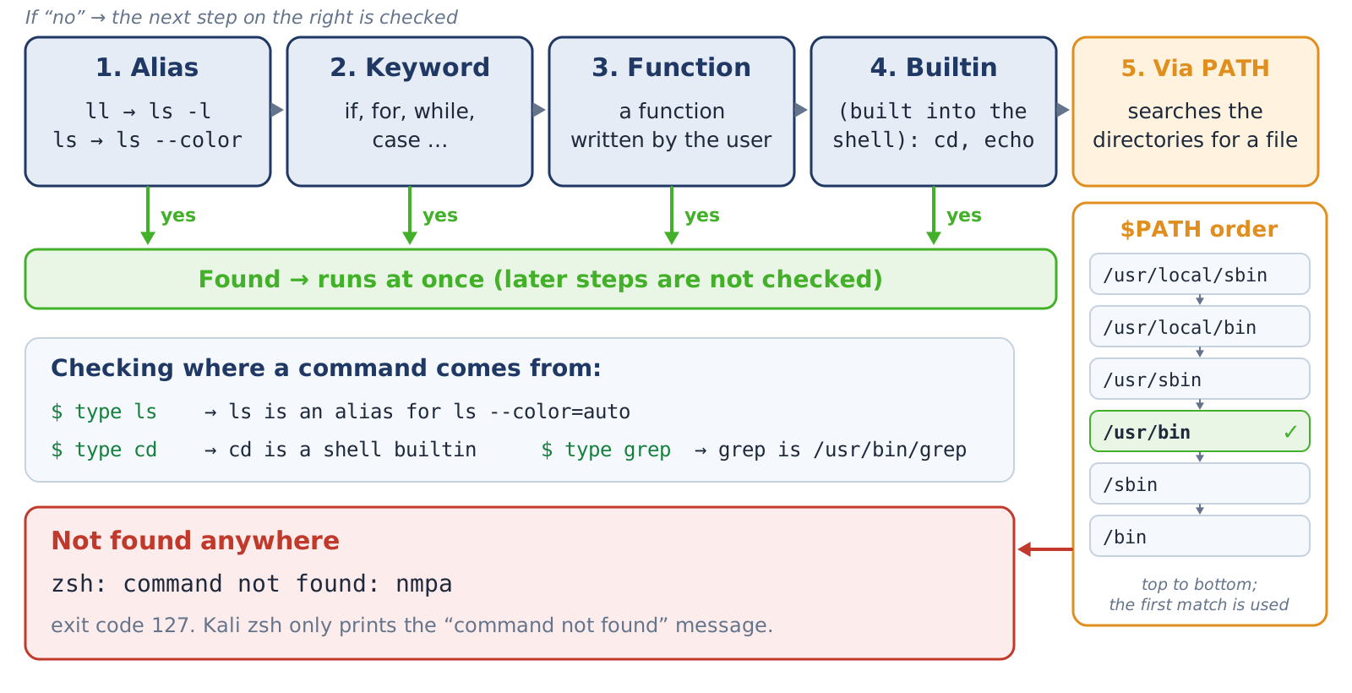
1.4 · COMMAND TYPES AND PATH
Where is a command found?
Key ideas
▸ Order: alias → keyword → function → builtin → program file
▸ PATH – a list of directories (split by :), left to right
▸ Not found: command not found (code 127)
▸ type -a ls shows the source
Add a directory: export PATH="$PATH:$HOME/lab22/bin". Never add the current directory . to PATH!
Figure 10. Search order and PATH directories
Cyber Forensics & Ethical Hacking · Topic 2 · Linux OS · Lesson 2 · Theory
7

Slide 8
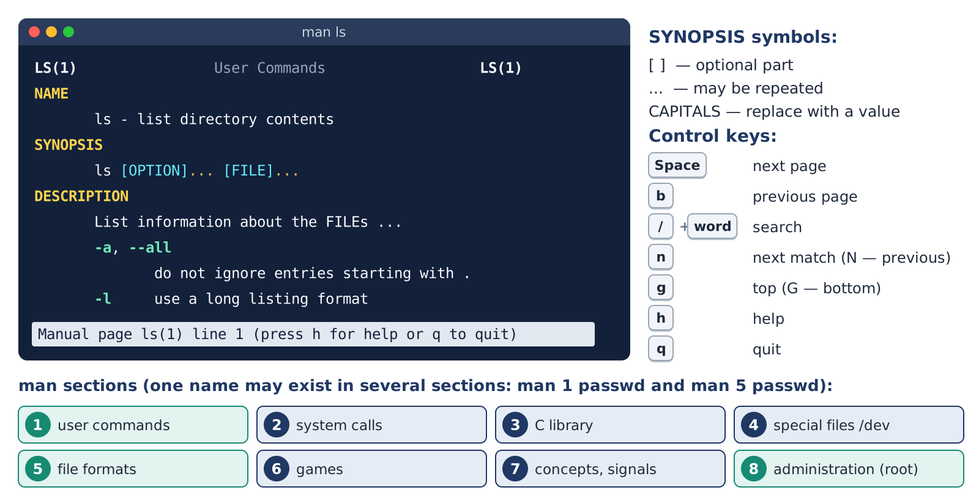
1.5 · GETTING HELP
No need to memorise – just know how to look up
Key ideas
▸ man grep – the full manual
▸ ls --help – a short reminder
▸ man -k word – if you don’t know the name
▸ Inside man: / search, q quit
Start every new tool by reading its manual.
Figure 11. The man page: structure, keys, sections
Cyber Forensics & Ethical Hacking · Topic 2 · Linux OS · Lesson 2 · Theory
8

Slide 9
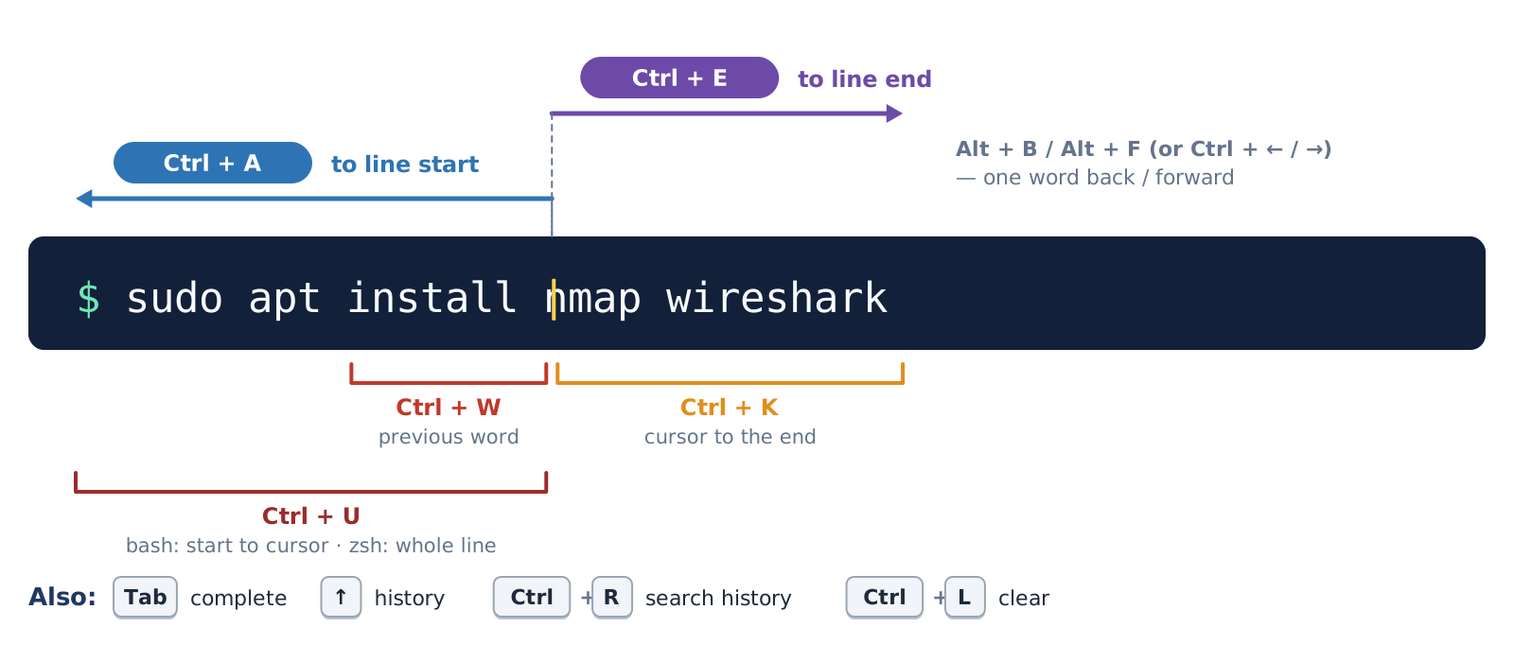
1.6 · WORKING FAST
Tab, history and shortcuts: type less
Key ideas
▸ Tab – completes a name
▸ ↑ – previous command; history – the list
▸ Ctrl + R – search the history
▸ Ctrl + C – stops (NOT copy)
Never type a password in a command – it stays in the history.
Figure 12. Line-editing keys
Cyber Forensics & Ethical Hacking · Topic 2 · Linux OS · Lesson 2 · Theory
9

Slide 10
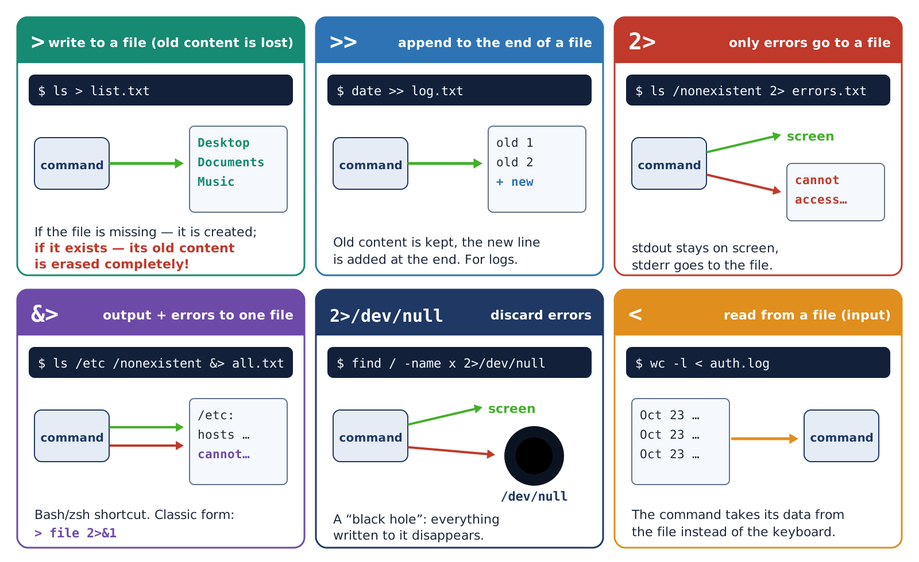
1.7 · STREAMS AND REDIRECTION
Sending output from the screen to a file
Key ideas
▸ Three streams: stdin 0 (input), stdout 1 (output), stderr 2 (errors)
▸ > writes to a file, >> appends
▸ 2> redirects only errors
▸ 2>/dev/null discards errors
> erases the old content of a file – be careful!
Figure 14. Redirection operators
Cyber Forensics & Ethical Hacking · Topic 2 · Linux OS · Lesson 2 · Theory
10

Slide 11
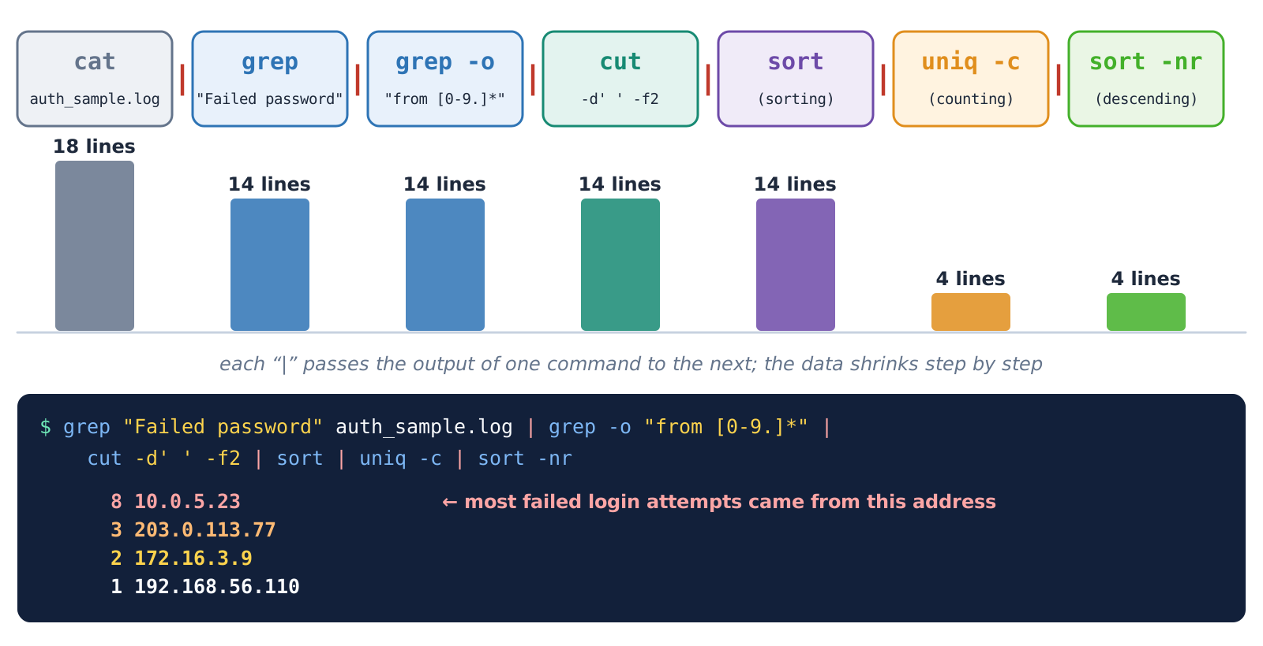
1.8 · PIPE AND FILTERS
Chaining small commands together
Key ideas
▸ | – passes one command’s output to the next
▸ Filters: grep, sort, uniq -c, cut, wc -l
▸ Build the chain one step at a time and check each result
sort | uniq -c | sort -nr answers “how many times did each thing occur?”
Figure 15. A pipeline: the data shrinks at each step
Cyber Forensics & Ethical Hacking · Topic 2 · Linux OS · Lesson 2 · Theory
11

Slide 12
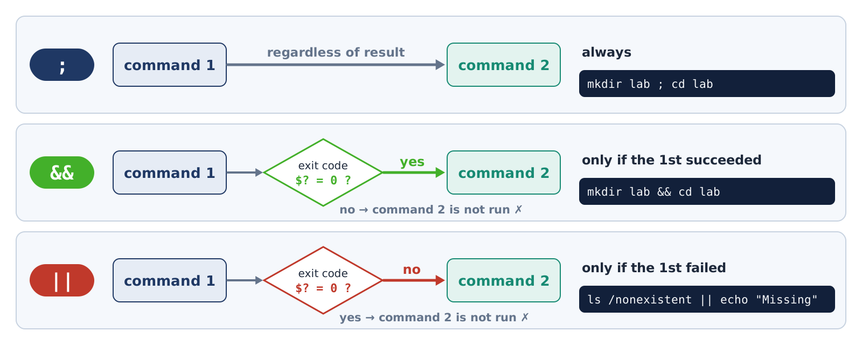
1.9 · COMBINING COMMANDS
; && || and the exit code
Key ideas
▸ ; – always runs the next one
▸ && – only if the previous one succeeded
▸ || – only if the previous one failed
▸ Exit code $?: 0 = fine, other number = error
Figure 16. The ;, && and || operators
cd dir && rm -r * is safer than using ;.
Cyber Forensics & Ethical Hacking · Topic 2 · Linux OS · Lesson 2 · Theory
12

Slide 13
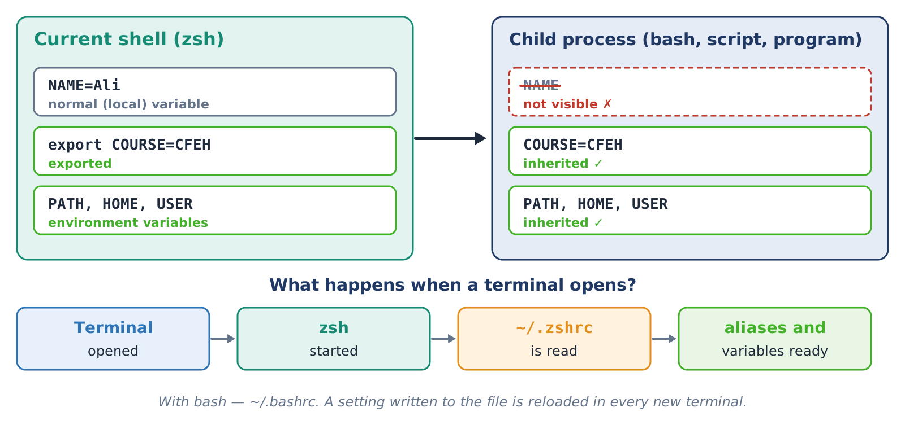
1.10 · VARIABLES, ALIASES, CONFIG
Variables and aliases
Key ideas
▸ NAME=value (no spaces), read it with $NAME
▸ export – passes it to child processes
▸ alias ll='ls -l' – a short name
▸ To keep it: write it into ~/.zshrc
Write to ~/.zshrc only with >> – > erases the whole file.
Figure 17. A plain and an exported variable
Cyber Forensics & Ethical Hacking · Topic 2 · Linux OS · Lesson 2 · Theory
13

Slide 14
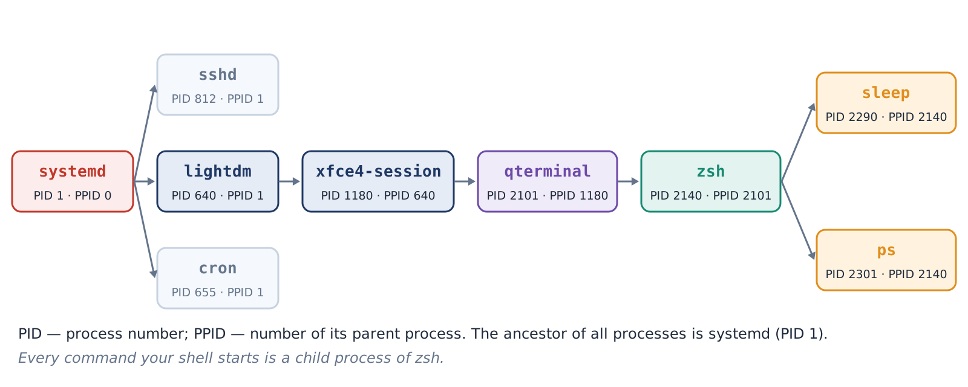
1.11 · PROCESSES AND SIGNALS
A process is a running program
Key ideas
▸ Every process has a number: PID; its parent: PPID
▸ View: ps aux, top, pgrep
▸ kill PID – polite; kill -9 – last resort
▸ Background: &, Ctrl + Z , bg, fg
Figure 18. The process tree: PID and PPID
If the terminal closes, its background jobs stop too.
Cyber Forensics & Ethical Hacking · Topic 2 · Linux OS · Lesson 2 · Theory
14

Slide 15
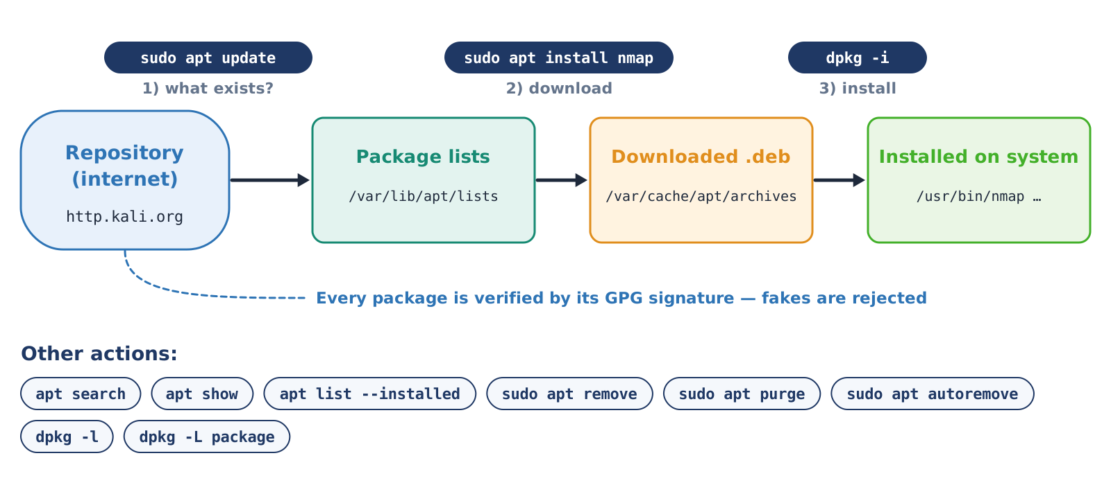
1.12 · PACKAGES: APT AND DPKG
Installing programs with the package manager
Key ideas
▸ sudo apt update – refreshes the list
▸ sudo apt install nmap – installs
▸ apt remove / apt purge – removes
▸ dpkg -S file – which package owns a file
Install only from the official repository. sudo asks for your own password.
Figure 20. apt: from the repository to the system
Cyber Forensics & Ethical Hacking · Topic 2 · Linux OS · Lesson 2 · Theory
15

Slide 16
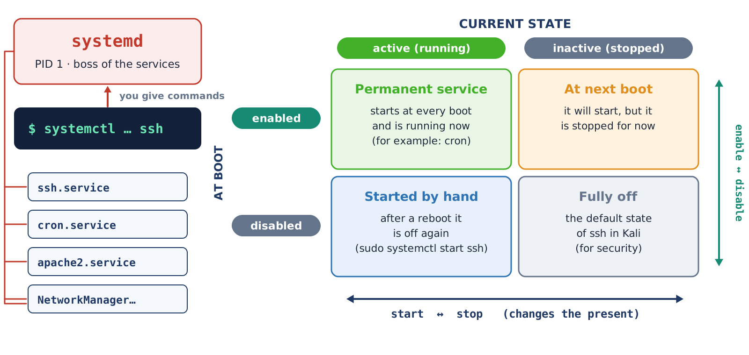
1.13 · SERVICES: SYSTEMD
A service is a program that runs in the background
Key ideas
▸ systemctl status ssh – see the state
▸ start / stop – the current state
▸ enable / disable – the boot-time state
▸ journalctl -u ssh – the service log
SSH is off by default in Kali. Leave it off after the lesson.
Figure 21. Current state and boot-time state
Cyber Forensics & Ethical Hacking · Topic 2 · Linux OS · Lesson 2 · Theory
16

Slide 17
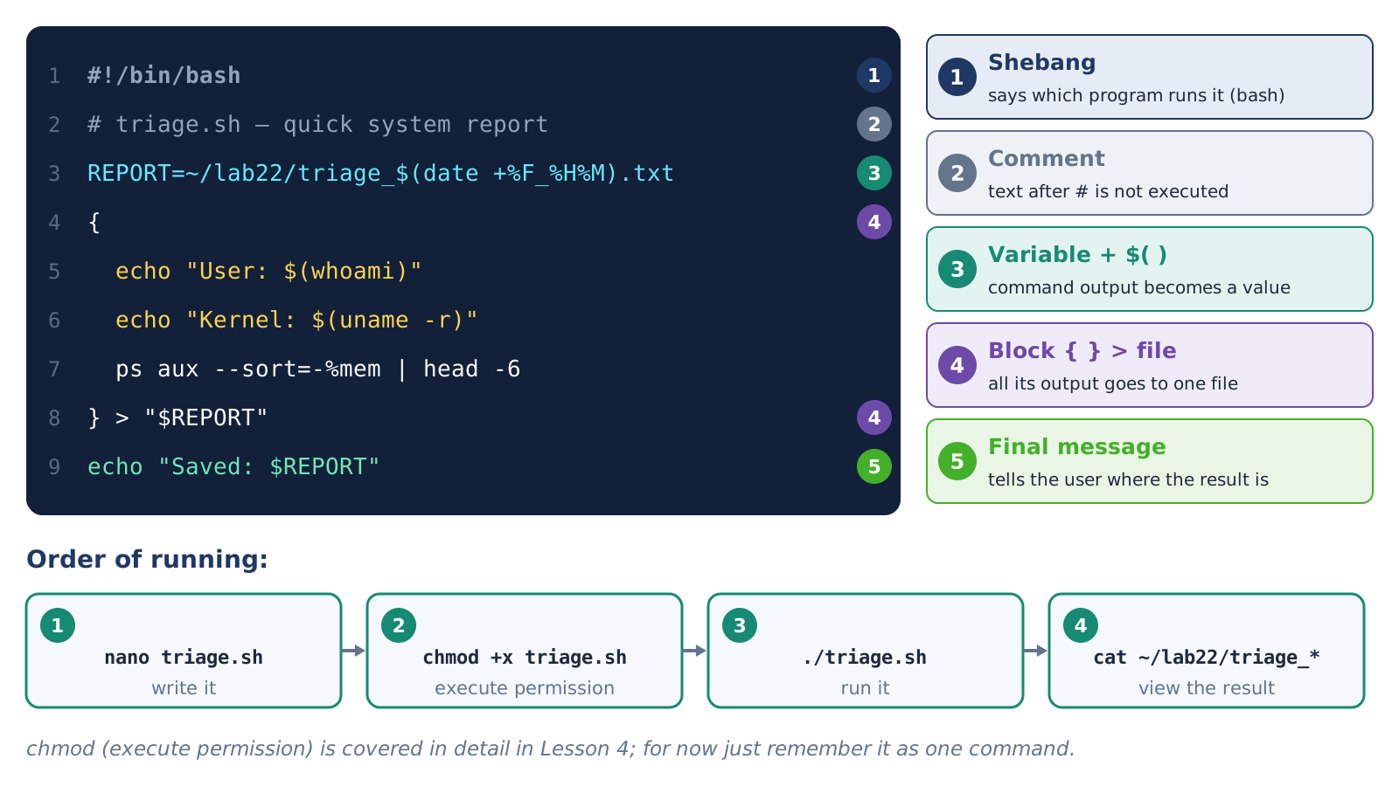
1.14 · BASH SCRIPT
A script is a file of saved commands
Key ideas
▸ First line: #!/bin/bash (shebang)
▸ bash triage.sh – no special permission needed
▸ chmod +x triage.sh → ./triage.sh
▸ $1 – an argument, $? – the exit code
Write it once – run it as many times as you like.
Figure 22. Script structure and how to run it
Cyber Forensics & Ethical Hacking · Topic 2 · Linux OS · Lesson 2 · Theory
17

Slide 18

THANK YOU FOR YOUR ATTENTION!
Now the practice: 13 tasks on the Kali Linux VM

