Slide 1

Military Security and Defense University of the Republic of Uzbekistan
Institute of Information and Communication Technologies and Military Communications
Cyber Forensics and Ethical Hacking
Topic 2. Linux OS
Lesson 3. Working in Linux OS
THEORY: recon actions and network tools
Practical lesson · 4 hours
Kali Linux · Metasploitable
Tashkent · 2026

Slide 2


LESSON CARD
The lesson at a glance
Item | Details
Subject | Cyber Forensics and Ethical Hacking
Topic | 2. Linux OS
Lesson | 3. Working in Linux OS
Type and time | Practical · 4 hours = 2 sessions × 80 min
Learning questions | 1. Recon actions in Linux OS 2. Nmap, Netcat, Traceroute, whois, dig
Laboratory | Kali Linux (you) and Metasploitable (target)
Prior knowledge | 2.2: terminal, |, >, grep, apt
By the end of the lesson you will:
▸ tell passive from active recon;
▸ find domain and IP info with whois and dig;
▸ see a packet’s path with traceroute;
▸ find open ports, services and versions with nmap;
▸ grab a banner with nc;
▸ save results to a file and write a report.
Today we learn five tools for gathering information about a target.
Theory block: 20 min (start of session 1)
Theory
20 min
Tasks 1–2
40 min
Tasks 3–6
60 min
Cyber Forensics & Ethical Hacking · Topic 2 · Linux OS · Lesson 3 · Theory
2

Slide 3
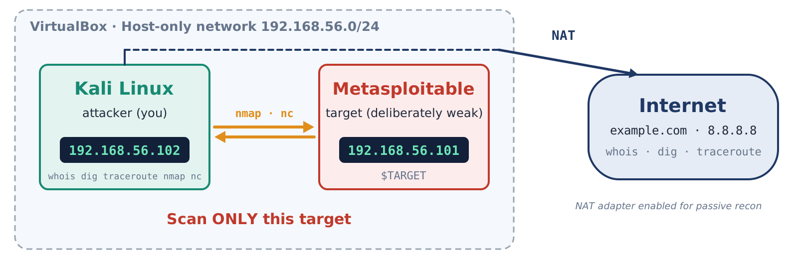

LABORATORY
Two virtual machines, one closed network
Figure 1. Lab layout
The most important rule: scan only your own lab target. Scanning another network without the owner’s written permission may be a crime; never connect Metasploitable to the internet.
Cyber Forensics & Ethical Hacking · Topic 2 · Linux OS · Lesson 3 · Theory
3

Slide 4




THEORY OUTLINE
5 items – 3 blocks
A. Recon basics
B. Path and ports
C. Service and rules
▸ 1.1 Recon: passive and active
▸ 1.2 whois and DNS: dig
▸ 1.3 traceroute: packet path
▸ 1.4 nmap: ports and services
▸ 1.5 netcat: connecting to a port
▸ 3.2 Scanning leaves traces
Each item: diagram → rule → example. Every practical task carries a “Theory: 1.x” reference.
Cyber Forensics & Ethical Hacking · Topic 2 · Linux OS · Lesson 3 · Theory
4

Slide 5

I. THEORY
Recon actions and network tools
How information about a target is gathered: passive first, then active methods

Slide 6
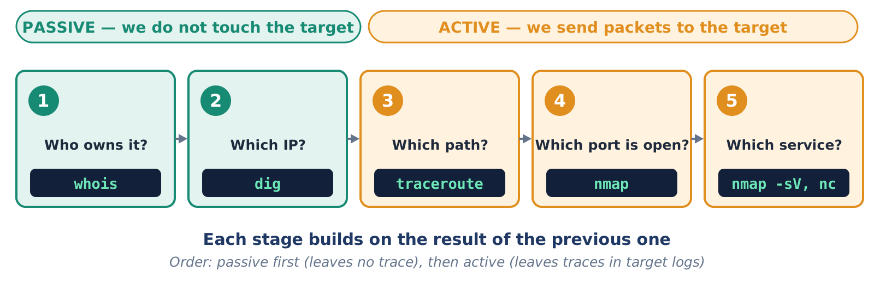
1.1 · RECON: PASSIVE AND ACTIVE
Recon is the first stage: gathering information about a target
Figure 2. Recon stages and tools
Passive – does not touch the target (whois, dig). Active – sends packets, leaves traces in the target’s logs (traceroute, nmap, nc).
Cyber Forensics & Ethical Hacking · Topic 2 · Linux OS · Lesson 3 · Theory
6

Slide 7
1.1 · RECON: PASSIVE AND ACTIVE
Five tools – five questions
Tool | Question it answers | Type
whois | Who owns the domain or IP? | Passive
dig | Which IP does it have? Mail and name servers? | Passive
traceroute | Which path does a packet take? | Active
nmap | Which hosts are up? Which ports are open? Which service and version? | Active
nc | How does a service introduce itself on connection? | Active
Order: passive first (leaves no trace), then active.
Cyber Forensics & Ethical Hacking · Topic 2 · Linux OS · Lesson 3 · Theory
7

Slide 8
1.2 · WHOIS & DIG
whois and DNS: dig
whois
Record | Meaning
A | IPv4 address
AAAA | IPv6 address
NS | name servers
MX | mail servers
TXT | text record
PTR | reverse: IP → name
▸ domain owner, registration date, name servers
▸ for an IP: which organization owns it
dig · DNS
▸ DNS turns a domain name into an IP – “the phone book”
▸ the record type says what you want
terminal
$ whois example.com | head -20
$ dig +short example.com A
$ dig +short gmail.com MX
$ dig -x 8.8.8.8 +short
? DNS
“REDACTED FOR PRIVACY” is normal.
Cyber Forensics & Ethical Hacking · Topic 2 · Linux OS · Lesson 3 · Theory
8

Slide 9
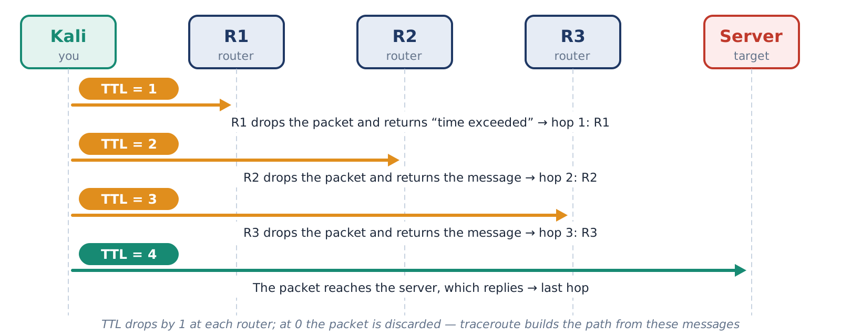
1.3 · TRACEROUTE
traceroute: the path of a packet
Reading the output
▸ * * * – no reply from this hop (firewall); the path is not necessarily broken
▸ The hop count may vary
▸ Same network – usually 1 hop
Each router lowers TTL by 1; at 0 it drops the packet and sends a message back.
Figure 3. Finding the path with TTL
terminal
$ traceroute -n example.com
$ ping -c 2 -t 1 example.com # TTL=1
$ traceroute -n $TARGET # one hop
? TTL
Cyber Forensics & Ethical Hacking · Topic 2 · Linux OS · Lesson 3 · Theory
9

Slide 10
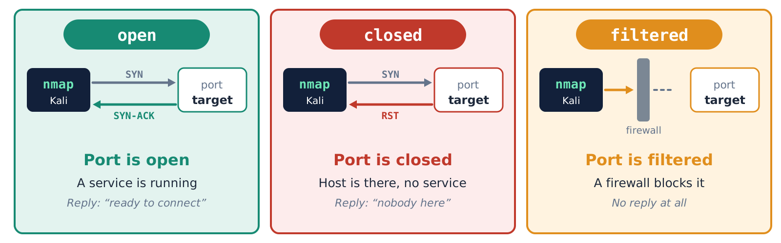
1.4 · NMAP
nmap: the three port states
Figure 4. open, closed and filtered
A port is a service’s “door” on a computer (0–65535). An open port is a running service – a door into the target.
? port
Cyber Forensics & Ethical Hacking · Topic 2 · Linux OS · Lesson 3 · Theory
10

Slide 11
1.4 · NMAP
The most common ports
Port | Service | Port | Service
21 | FTP | 80 | HTTP
22 | SSH | 443 | HTTPS
23 | Telnet | 445 | SMB
25 | SMTP | 3306 | MySQL
53 | DNS | 3389 | RDP
Remember
▸ 21 – FTP, 22 – SSH, 80 – HTTP
▸ 23 Telnet – old, insecure
▸ 445 – Windows file sharing
With no options nmap checks the 1000 most popular ports.
A port number hints at the service, but -sV gives the real answer.
Cyber Forensics & Ethical Hacking · Topic 2 · Linux OS · Lesson 3 · Theory
11

Slide 12
1.4 · NMAP
Main options and reading the output
Option | What it does
-sn | live hosts only
-p 21,80 / -p- | listed / all ports
-F | fast scan (100 ports)
-sV | service and version
-O | OS guess (sudo)
--open | open ports only
-oN file | save result to a file
-Pn | skip the ping check
$ nmap -sV --open $TARGET
PORT STATE SERVICE VERSION
21/tcp open ftp vsftpd 2.3.4
22/tcp open ssh OpenSSH 4.7p1
80/tcp open http Apache httpd 2.2.8
1
PORT – number and protocol
2
STATE – open / closed / filtered
3
VERSION – goes into the report
An old version can signal known vulnerabilities.
? port
Cyber Forensics & Ethical Hacking · Topic 2 · Linux OS · Lesson 3 · Theory
12

Slide 13
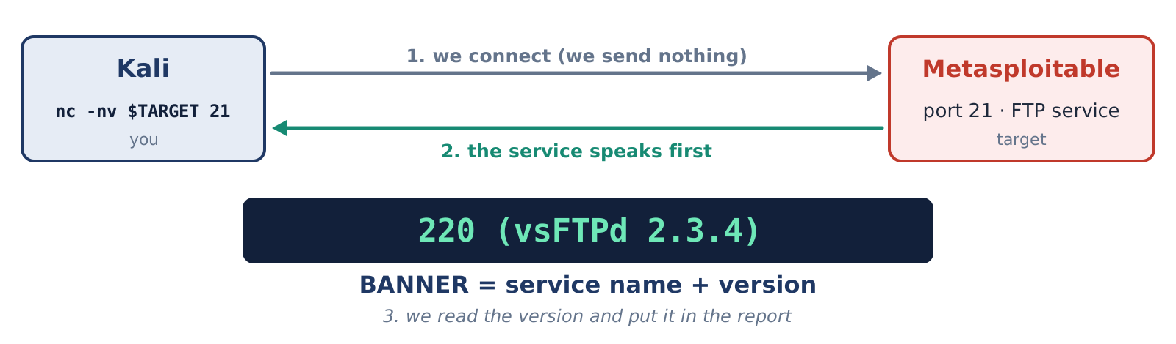
1.5 · NETCAT
netcat (nc): connecting to a port by hand
Option | What it does
-z | only checks
-v | verbose
-n | no DNS
-w 3 | waits 3 s
-l | listens
-p | port number
Figure 5. Grabbing a banner
terminal
$ nc -zv $TARGET 21 22 80
$ nc -nv $TARGET 21 # FTP banner
$ nc -lvnp 4444 # listen
nc versions differ in Kali: nc -h. If -p errors: nc -lvn 4444.
A banner is the text a service sends when you connect.
? banner
Cyber Forensics & Ethical Hacking · Topic 2 · Linux OS · Lesson 3 · Theory
13

Slide 14






RULES
Scanning: 6 rules
Only your own target
Permission first
Keep the weak system isolated
Scan only the lab’s Metasploitable.
Any other network – only with the owner’s written permission.
Never connect Metasploitable to the internet; shut it down when idle.
Active recon leaves traces
Save results with a timestamp
Take a snapshot
nmap, nc, traceroute show up in the target’s logs.
-oN file and date – for the report and as evidence.
Snapshot before you start; restore when finished.
Cyber Forensics & Ethical Hacking · Topic 2 · Linux OS · Lesson 3 · Theory
14

Slide 15



SUMMARY
What to remember from the theory
Recon: passive first (whois, dig), then active
DNS records: A, NS, MX, TXT, PTR
traceroute: TTL=1, 2, 3 … – routers on the path
Port states: open, closed, filtered
nmap -sV – service and version; -oN – save
nc – grab a banner and talk over a port
Active recon leaves traces in the target’s logs
Scan only your own lab target
Cyber Forensics & Ethical Hacking · Topic 2 · Linux OS · Lesson 3 · Theory
15

Slide 16
REVIEW QUESTIONS
Test yourself
What is recon? Passive vs active recon?
What are whois and dig for? Why passive?
1
2
What do the DNS A, NS, MX records mean?
How does traceroute work? What is TTL?
3
4
How do open, closed, filtered differ?
What do -sn, -F, -p-, -sV, -O do?
5
6
What is a banner? How do you get one with nc?
Why scan only authorized targets?
7
8
Cyber Forensics & Ethical Hacking · Topic 2 · Linux OS · Lesson 3 · Theory
16

Slide 17

THANK YOU FOR YOUR ATTENTION!
Now the practice: 6 tasks on Kali and Metasploitable

Slide 18
GLOSSARY
Tricky terms, explained simply
Buttons marked “?” in the slides jump here

Slide 19
GLOSSARY
Glossary index
1
DNS
2
TTL
the domain → IP “phone book”
a packet’s time to live
Open →
Open →
3
Port
4
Banner
a service’s “door”
a service’s introduction text
Open →
Open →
Cyber Forensics & Ethical Hacking · Topic 2 · Linux OS · Lesson 3 · Theory
19

Slide 20
GLOSSARY · 1
DNS: the phone book of the internet
In plain words
example.com
name
People remember names (example.com); computers use numbers (IPs). DNS links the two.
Analogy
DNS server
dig
A phone book: look up a number by name.
Example
$ dig +short example.com A
$ dig -x 8.8.8.8 +short # reverse
93.184.216.34
IP address (A)
← Back to the topic
Cyber Forensics & Ethical Hacking · Topic 2 · Linux OS · Lesson 3 · Theory
20

Slide 21
GLOSSARY · 2
TTL: a packet’s time to live
In plain words
A packet carries a number. Each router lowers it by 1. At 0 the packet is dropped and a message goes back to the sender.
3
TTL
2
TTL
1
TTL
0
TTL
Analogy
A letter: one stamp is used at every stop; when stamps run out the letter is returned.
R1
R2
R3
✗
At TTL=0 the router drops the packet and says “time exceeded” (ICMP) – traceroute relies on exactly that.
Example
$ ping -c 2 -t 1 example.com
Time to live exceeded # the expected result
← Back to the topic
Cyber Forensics & Ethical Hacking · Topic 2 · Linux OS · Lesson 3 · Theory
21

Slide 22
GLOSSARY · 3
Port: a service’s door
In plain words
192.168.56.101
IP – the building
Many services run on one IP address. The port number says which service to connect to (0–65535).
21
FTP
22
SSH
80
HTTP
Analogy
A building and its rooms: the IP is the street address, the port is the room number.
Example
Open port = running service = a door you can reach
$ nmap -p 21,22,80 $TARGET
$ nmap -p- --open $TARGET # all ports
← Back to the topic
Cyber Forensics & Ethical Hacking · Topic 2 · Linux OS · Lesson 3 · Theory
22

Slide 23
GLOSSARY · 4
Banner: a service’s introduction
In plain words
Some services, when you connect, send their own name and version. That text is the banner.
Kali
nc
Service
port 21
Analogy
Picking up the phone: “Hello, this is vsFTPd 2.3.4”.
220 (vsFTPd 2.3.4)
Example
$ nc -nv $TARGET 21
220 (vsFTPd 2.3.4)
Know the version – and you can look up known vulnerabilities
← Back to the topic
Cyber Forensics & Ethical Hacking · Topic 2 · Linux OS · Lesson 3 · Theory
23

