Slide 1


COURSE: “CYBER FORENSICS AND ETHICAL HACKING”
TOPIC 1
WINDOWS OS
SECURITY
Lesson 2 · Windows OS Services | Seminar, 2 hours
REPUBLIC OF UZBEKISTAN
UNIVERSITY OF MILITARY SECURITY AND DEFENSE
Institute of ICT and Military Communications · Cybersecurity Department
Lecturer: Senior Lecturer, Cybersecurity Department — Captain M. Isakov

Slide 2





TOPIC 1 · WINDOWS OS SECURITY
Lesson 2: Windows OS Services (Seminar)
Topic
Session type
Duration
Windows OS security
Seminar
2 hours
Learning questions
Link to Lesson 1
1
User Account Control, AppLocker and SmartScreen security systems
▸ AppLocker works only if the Application Identity service is running.
▸ Defender and Firewall are themselves services (WinDefend, MpsSvc).
▸ Today: the tools that stop an attack before and after it starts.
2
Defender and Firewall security systems
KKvaEH · Topic 1 · Windows OS Security
5

Slide 3

QUESTION 1
UAC, AppLocker and SmartScreen security systems
6

Slide 4





QUESTION 1 · USER ACCOUNT CONTROL
UAC — why it was introduced and what it does
The problem (Windows XP)
The solution (since Windows Vista)
▸ Users worked with administrator rights all the time.
▸ Any malware they launched got full admin rights instantly.
▸ Even an admin works with reduced (standard) rights.
▸ Admin rights are used only after an explicit “Yes”.
What UAC asks for — depends on who you are:
Administrator → Consent prompt
Standard user → Credential prompt
Secure Desktop
Just click “Yes” or “No”.
An administrator’s user name and password must be entered.
The screen dims — malware cannot click a fake “Yes” button.
Where to open: Start → type “User Account Control” → Change User Account Control settings
KKvaEH · Topic 1 · Windows OS Security
7

Slide 5
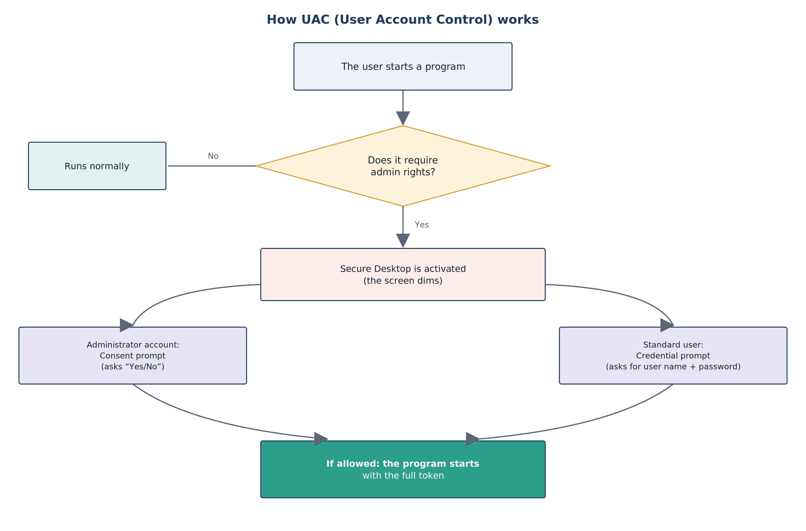
QUESTION 1 · USER ACCOUNT CONTROL
How UAC works — step by step
1
A program starts — with the ordinary (filtered) token.
2
Needs admin rights? — No → runs normally. Yes → go on.
3
Secure Desktop — the screen dims, only the prompt is active.
4
Prompt — Admin: Yes/No. Standard user: password.
5
Allowed — the program runs with the full token.
Terms (click for explanation):
? Secure Desktop
? Access token
Fig. 1. How UAC (User Account Control) works
KKvaEH · Topic 1 · Windows OS Security
8

Slide 6
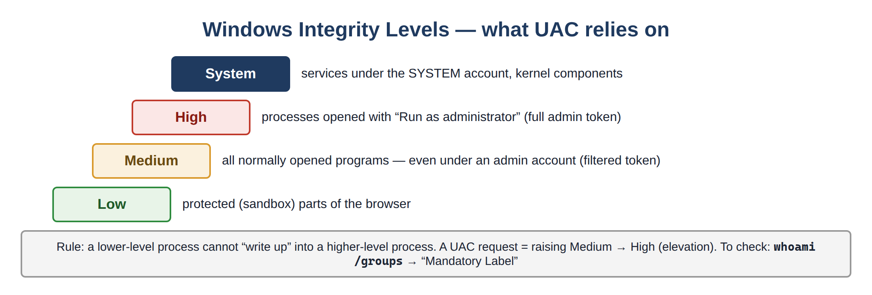
QUESTION 1 · USER ACCOUNT CONTROL
Two tokens and integrity levels — what UAC is built on
Login (Administrator)
FILTERED TOKEN
standard rights
everyday work
FULL ADMIN TOKEN
all rights
only after UAC “Yes”
Admin Approval Mode: an administrator receives two tokens at sign-in. Everyday programs get the filtered one; the full one is activated only for the confirmed program.
This is least privilege in practice.
Fig. 2. Windows Integrity Levels
> whoami /groups → Mandatory Label\Medium / High
Terms:
? Integrity level
? Access token
KKvaEH · Topic 1 · Windows OS Security
9

Slide 7
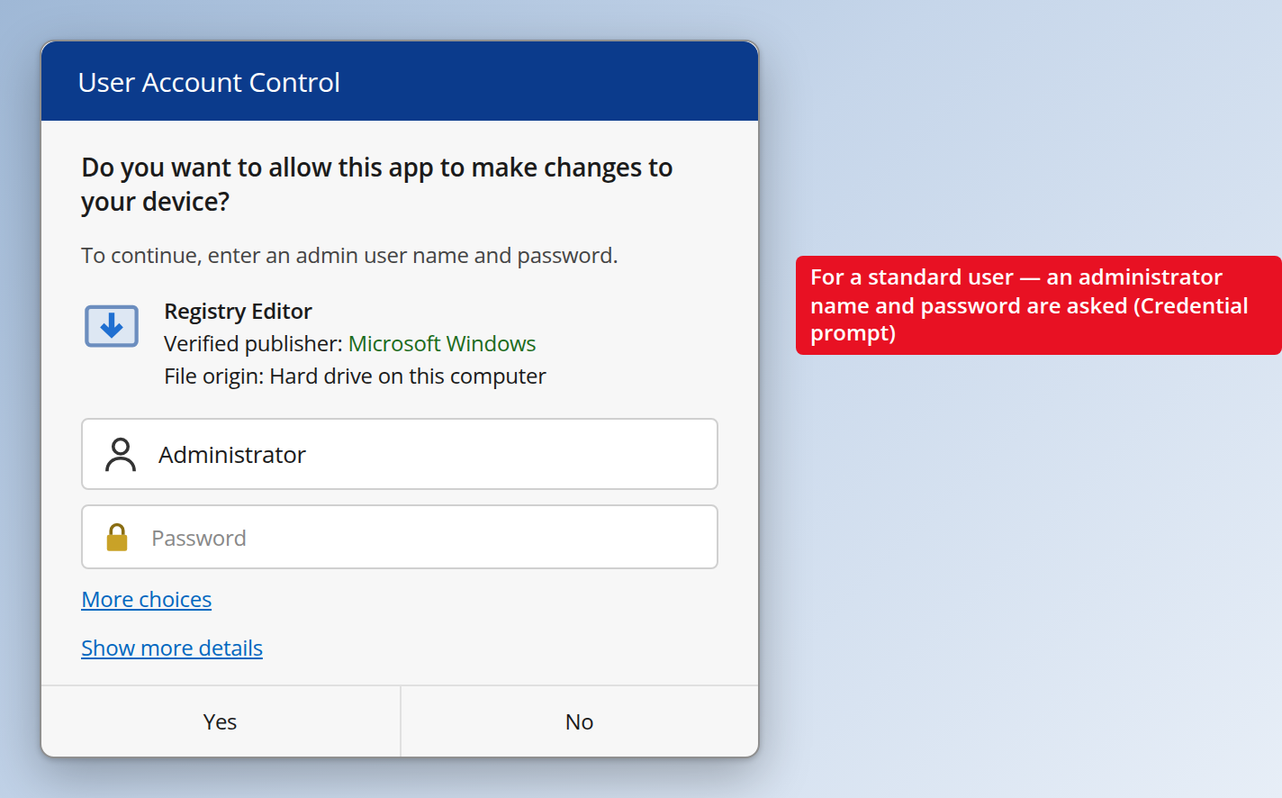
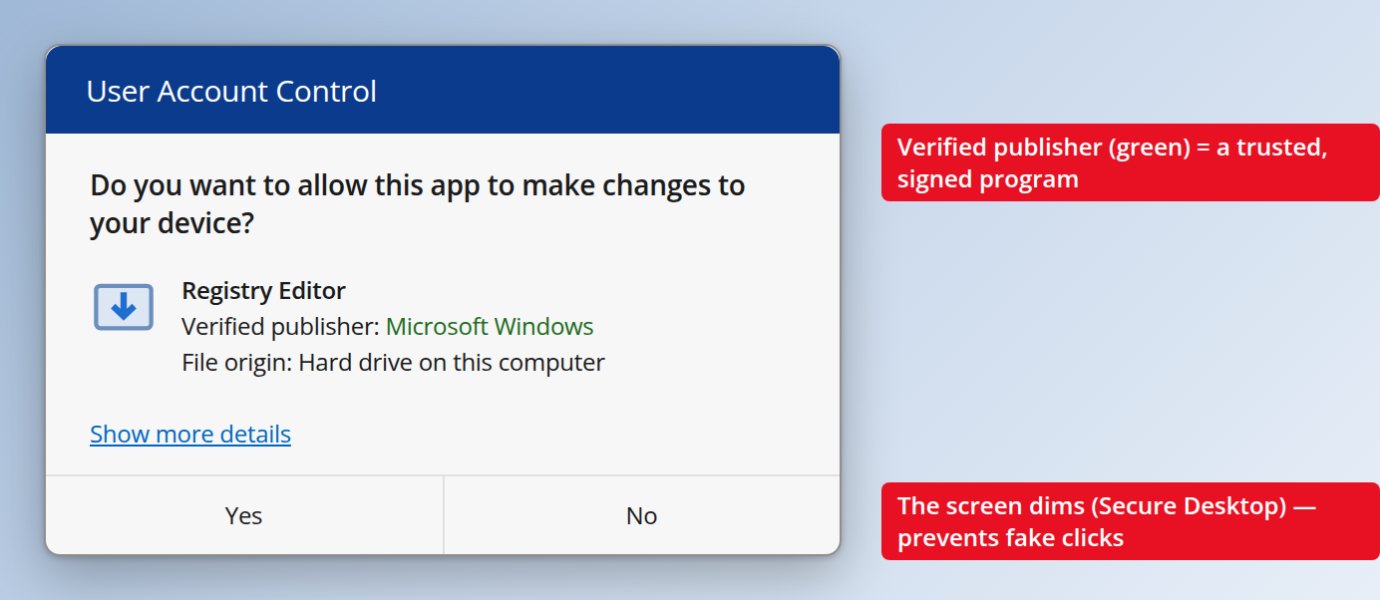
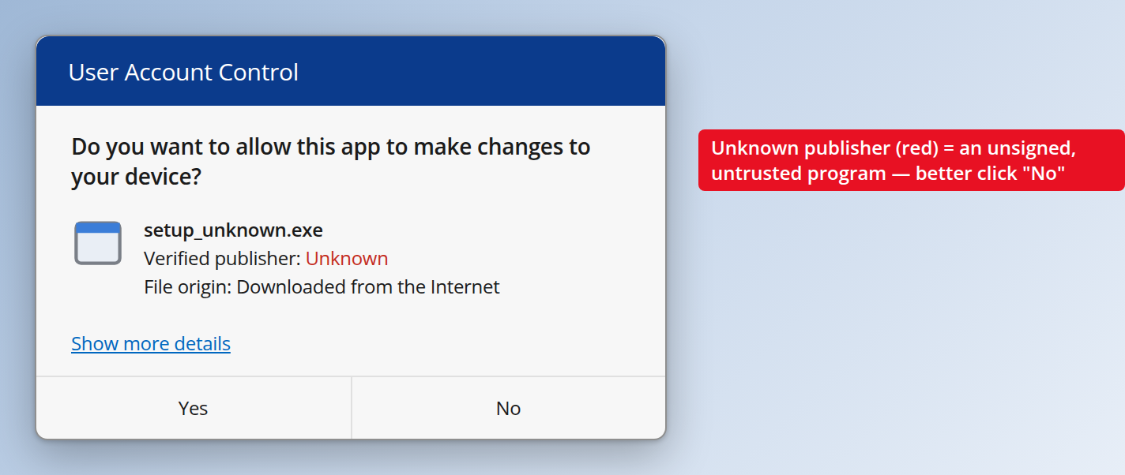

QUESTION 1 · USER ACCOUNT CONTROL
What the UAC prompt looks like — learn to read it
Fig. 3. Signed program — Verified publisher (green)
Fig. 4. Unsigned program — Unknown publisher (red)
Fig. 5. Standard user — Credential prompt
Trusted: Microsoft Windows
Warning sign → click “No”
Admin name + password needed
Three lines to read before clicking “Yes”:
Program name
is it the program you started yourself?
Verified publisher
green name = signed; red “Unknown” = unsigned
File origin
“Downloaded from the Internet” needs extra care
KKvaEH · Topic 1 · Windows OS Security
10

Slide 8
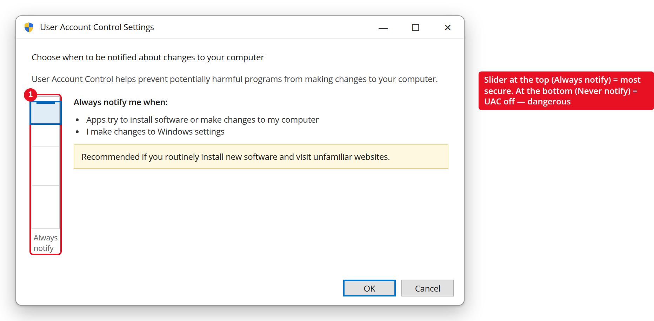
QUESTION 1 · USER ACCOUNT CONTROL
UAC levels — the slider and what it changes
Always notify
Military / government networks
Warns on every change, even Windows settings. Uses Secure Desktop.
Notify when apps change (default)
Most users
Warns only for programs. Uses Secure Desktop.
Notify — do not dim
Not recommended
Fig. 6. UAC settings window — slider at “Always notify”
Same, but without Secure Desktop — weaker.
Registry: HKLM\...\Policies\System
EnableLUA = 1 → UAC on
ConsentPromptBehaviorAdmin = 2 always · 5 default · 0 never
PromptOnSecureDesktop = 1 dim · 0 no dim
Never notify
Never use
UAC is effectively off — very dangerous.
KKvaEH · Topic 1 · Windows OS Security
11

Slide 9



QUESTION 1 · APPLOCKER
AppLocker — “only allowed programs may run”
UAC controls who may do what; AppLocker controls which programs may run at all. The administrator lists what is allowed (whitelist) — everything else is blocked, even if the user says “Yes”.
5 rule collections — by file type:
Executable
Windows Installer
Script
Packaged app
DLL
.exe .com
.msi .msp
.ps1 .vbs .js .bat
UWP apps
.dll .ocx
Each rule uses one of 3 conditions:
Publisher — by digital signature
Most flexible — survives updates
Path — by file location
e.g. only C:\Program Files
File hash — by the file’s fingerprint
Strictest — breaks on every update
? Whitelist
? File hash
KKvaEH · Topic 1 · Windows OS Security
12

Slide 10
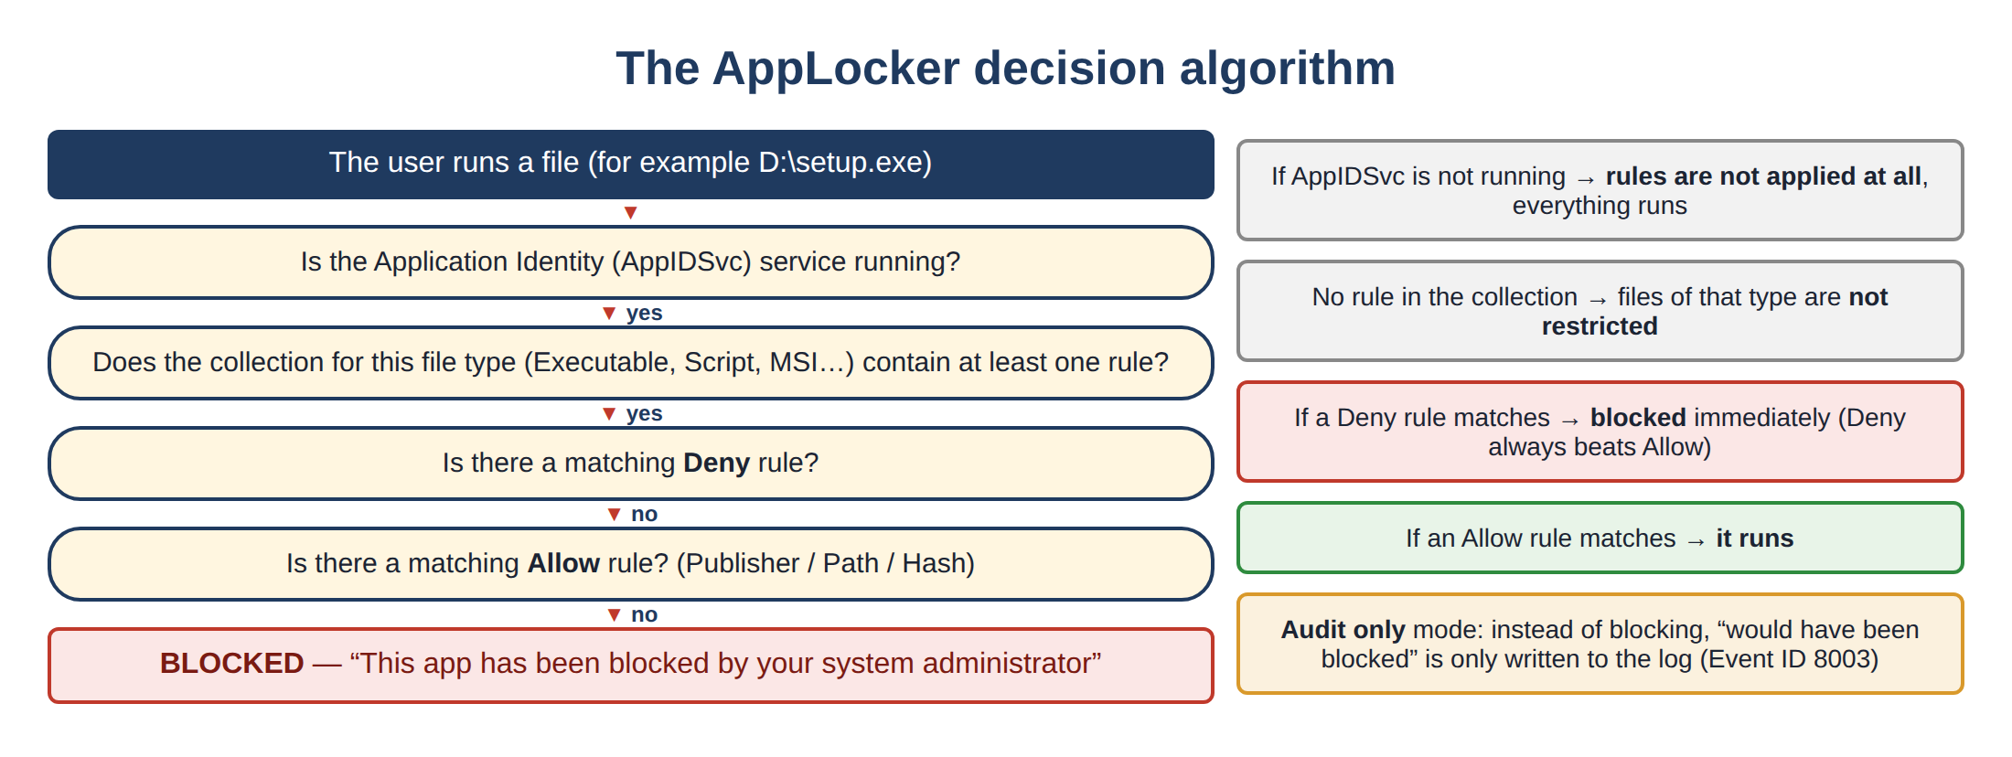
QUESTION 1 · APPLOCKER
How AppLocker decides: run or block?
Important
▸ Application Identity (AppIDSvc) must be running.
▸ Full support: Enterprise / Education / Server only.
Two modes:
▸ Enforce rules — really blocks.
▸ Audit only — only logs “would be blocked” (Event ID 8003). Use it to test rules first.
Fig. 7. The AppLocker decision algorithm
KKvaEH · Topic 1 · Windows OS Security
13

Slide 11
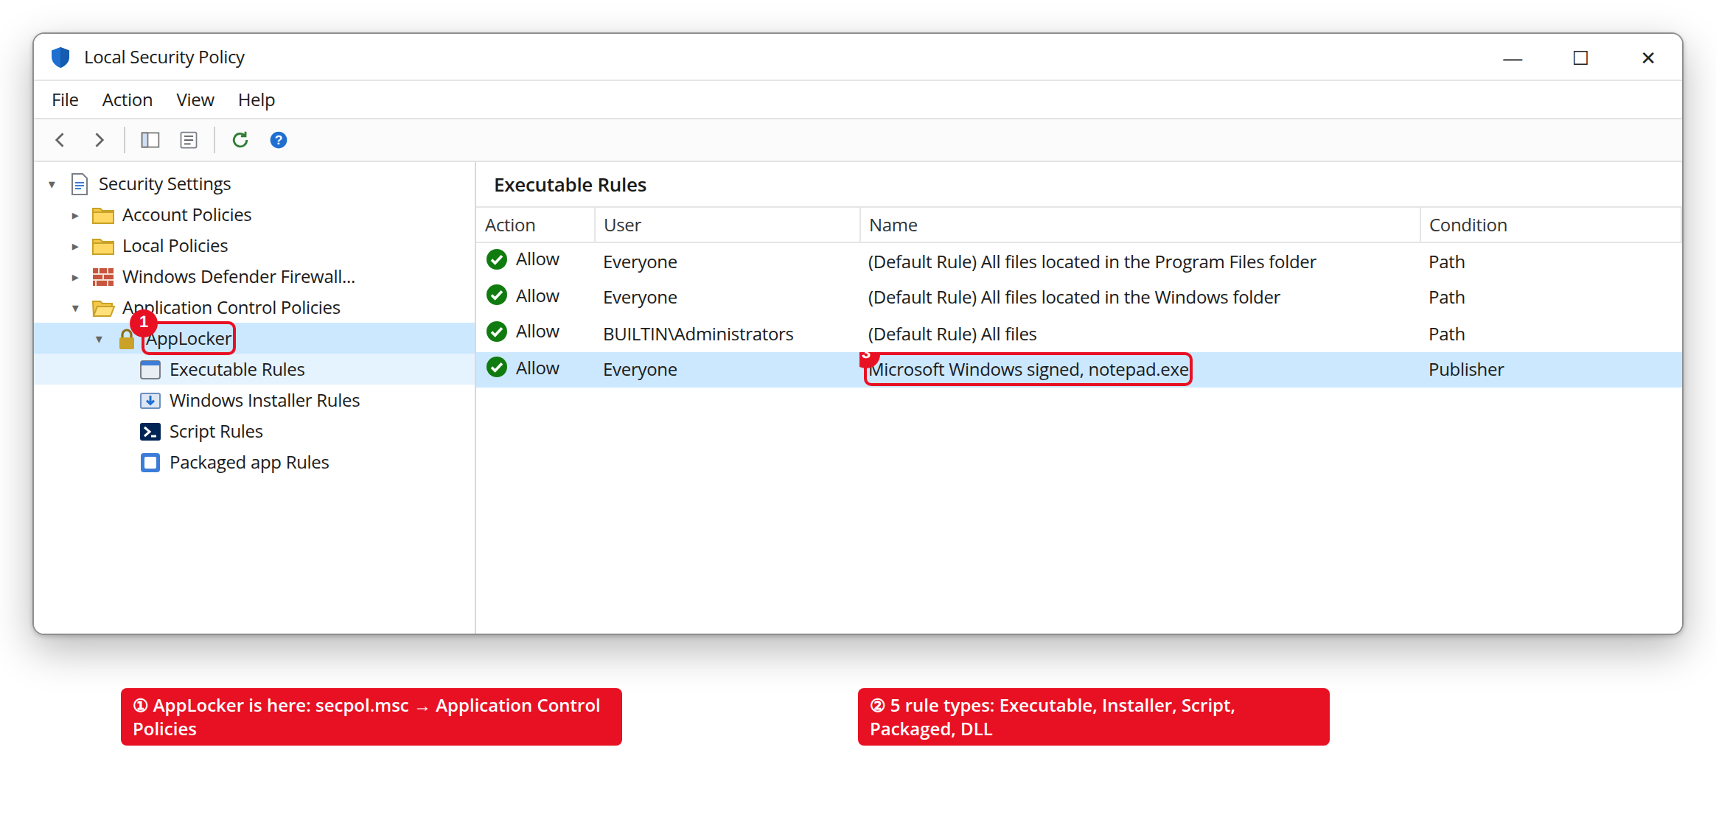
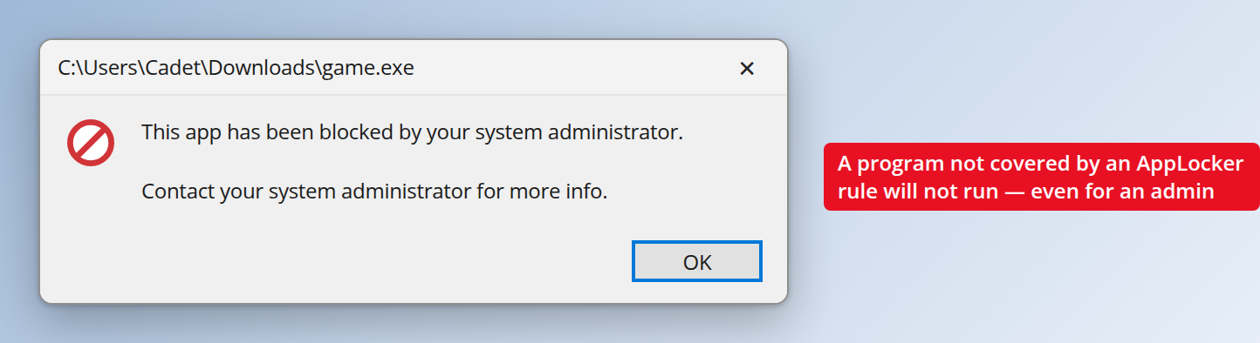

QUESTION 1 · APPLOCKER
Where AppLocker lives and what the user sees
Fig. 9. A program blocked by AppLocker
Open: Win + R → secpol.msc
→ Application Control Policies → AppLocker
(or gpedit.msc → Computer Configuration → … )
Fig. 8. secpol.msc → Application Control Policies → AppLocker
Practical example: a Path rule allows programs only from C:\Windows and C:\Program Files. Any .exe from Downloads or a USB flash drive is blocked automatically — even for an administrator.
KKvaEH · Topic 1 · Windows OS Security
14

Slide 12
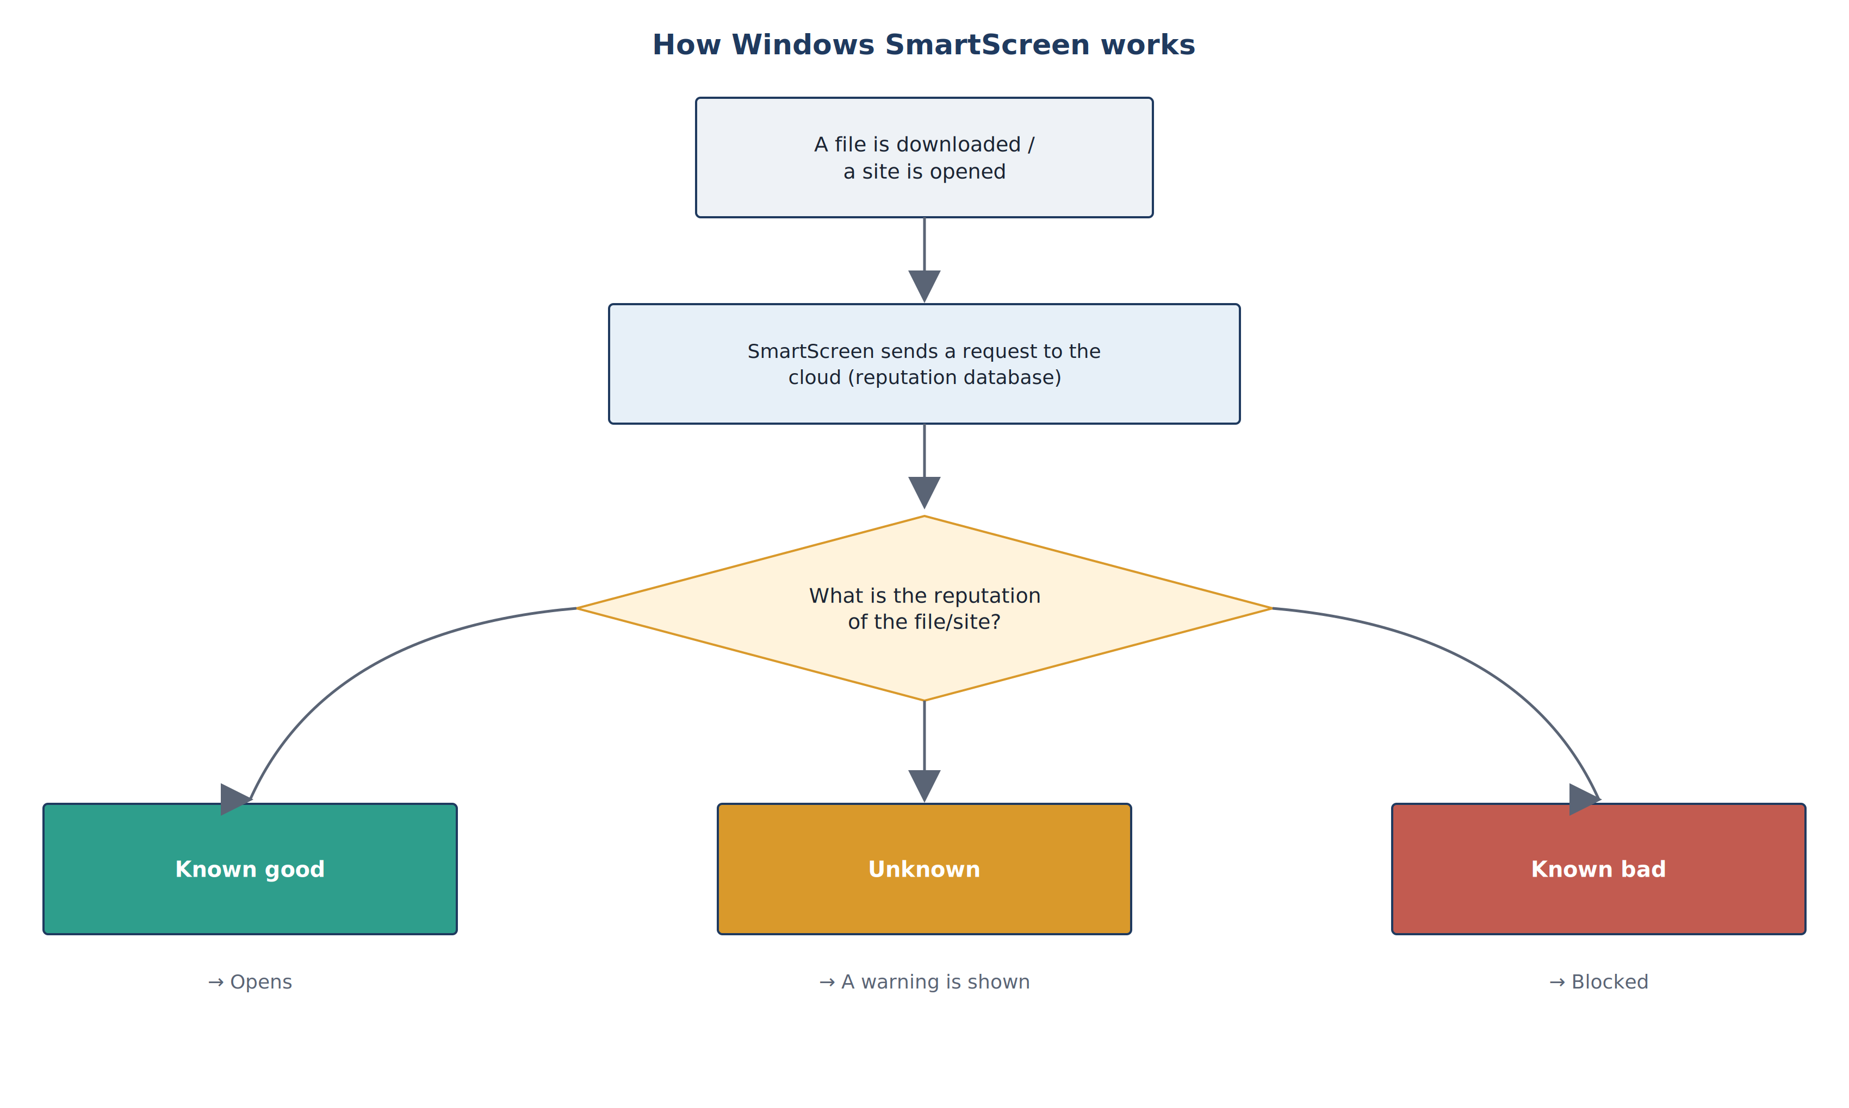

QUESTION 1 · SMARTSCREEN
SmartScreen — checking reputation before a file runs
Cloud reputation
▸ Microsoft keeps the “reputation” of millions of files and sites.
▸ New or rarely downloaded files are treated as risky.
Why it is effective
▸ Catches phishing sites and brand-new malware —
▸ even when no antivirus signature exists yet.
Fig. 10. How Windows SmartScreen works
AppLocker controls programs on the system; SmartScreen checks what comes from the internet.
KKvaEH · Topic 1 · Windows OS Security
15

Slide 13
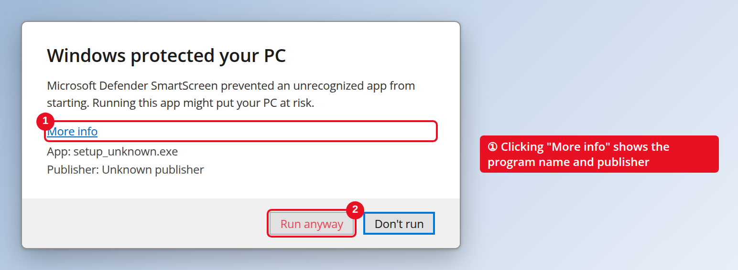
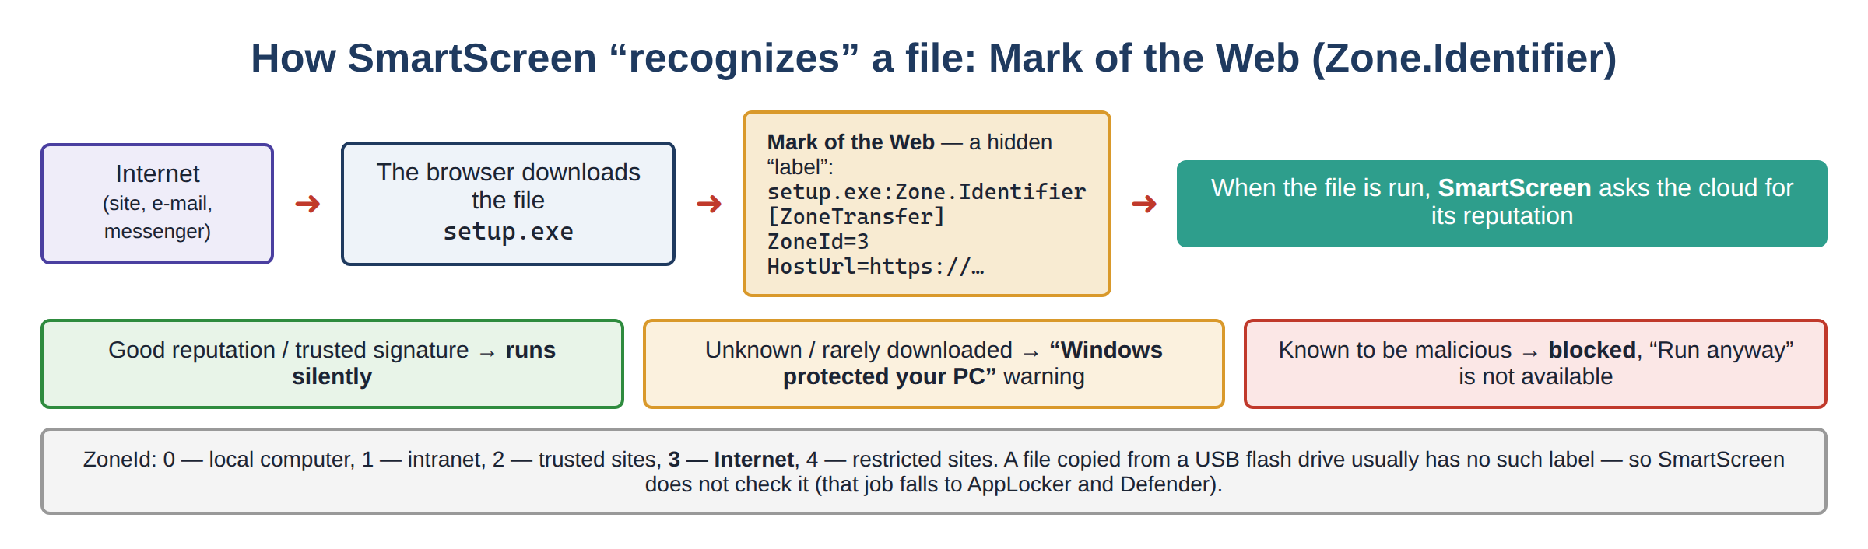


QUESTION 1 · SMARTSCREEN
The SmartScreen warning and the Mark of the Web
Fig. 11. “Windows protected your PC” — More info / Run anyway
Fig. 12. Mark of the Web (Zone.Identifier)
“More info” — shows the file name and publisher.
“Run anyway” — continue at your own risk — makes the user stop and think.
ZoneId = 3 — the file came from the Internet → SmartScreen checks it.
Settings: Windows Security → App & browser control → Reputation-based protection
? Mark of the Web
KKvaEH · Topic 1 · Windows OS Security
16

Slide 14
QUESTION 1 · PRACTICAL SIGNIFICANCE
UAC vs AppLocker vs SmartScreen — who stops what?
 | UAC | AppLocker | SmartScreen
Question it asks | May this program get admin rights? | May this program run at all? | Is this file/site trusted?
When it acts | When admin rights are requested | Every time a file starts | When a downloaded file runs / a site opens
Can the user override? | Yes — click “Yes” (or give a password) | No — only the administrator | Yes — “More info → Run anyway”
Where to configure | Control Panel → User Accounts | secpol.msc / gpedit.msc | Windows Security → App & browser
Editions | All | Enterprise / Education / Server | All
Seminar task: a user downloaded game.exe from a website. Which of the three tools reacts first, second, third — and why?
KKvaEH · Topic 1 · Windows OS Security
17

Slide 15
QUESTION 2
Defender and Firewall security systems
18

Slide 16
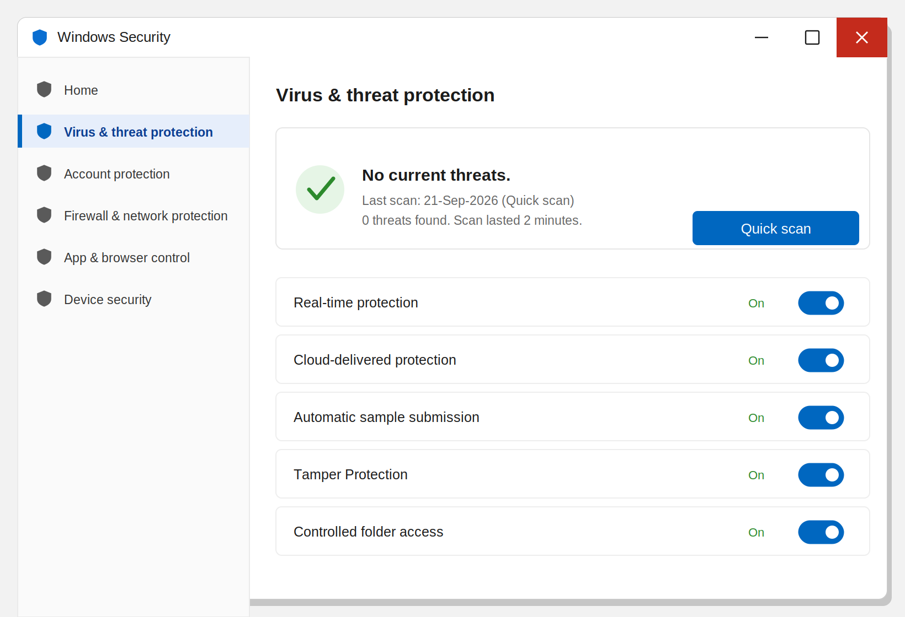

QUESTION 2 · MICROSOFT DEFENDER
Windows Defender — the built-in antivirus
UAC, AppLocker and SmartScreen block in advance. Defender scans files that already exist or are running, and detects malicious behaviour.
Real-time protection — checks each file as it is opened, downloaded or run
Cloud-delivered protection — recognizes new threats using the cloud database
Automatic sample submission — sends suspicious unknown files to Microsoft
Tamper Protection — malware cannot switch Defender off
Fig. 13. Windows Security → Virus & threat protection
Controlled folder access — protects Documents/Pictures from ransomware
PS> Get-MpComputerStatus
RealTimeProtectionEnabled : True
KKvaEH · Topic 1 · Windows OS Security
19

Slide 17





QUESTION 2 · WINDOWS FIREWALL
Windows Firewall — directions and network profiles
Inbound
traffic coming INTO the computer — blocked by default unless a rule allows it
Outbound
traffic LEAVING the computer — allowed by default unless a rule blocks it
Each rule: port, program or protocol → Allow or Block. Three profiles — three rule sets:
Domain
Private
Public
Computer is joined to a corporate domain (Active Directory)
Home or trusted private network
Café, airport, hotel — unknown networks
Medium — the internal network is trusted more
Medium — e.g. file sharing allowed
Strictest — most incoming connections blocked
? Firewall profile
KKvaEH · Topic 1 · Windows OS Security
20

Slide 18
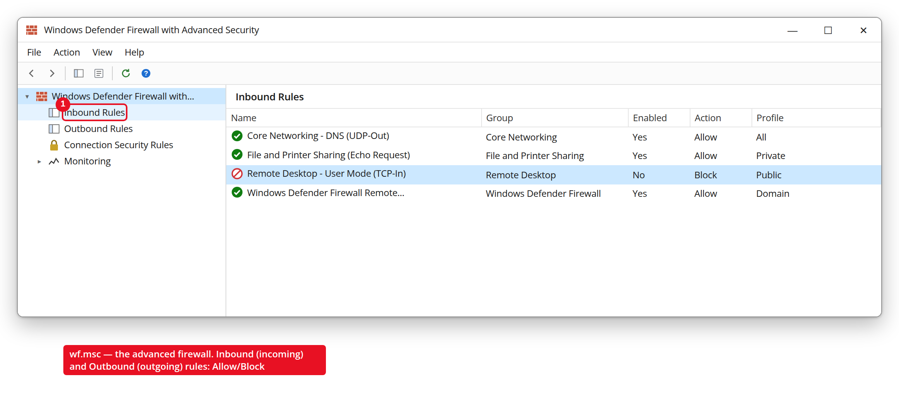
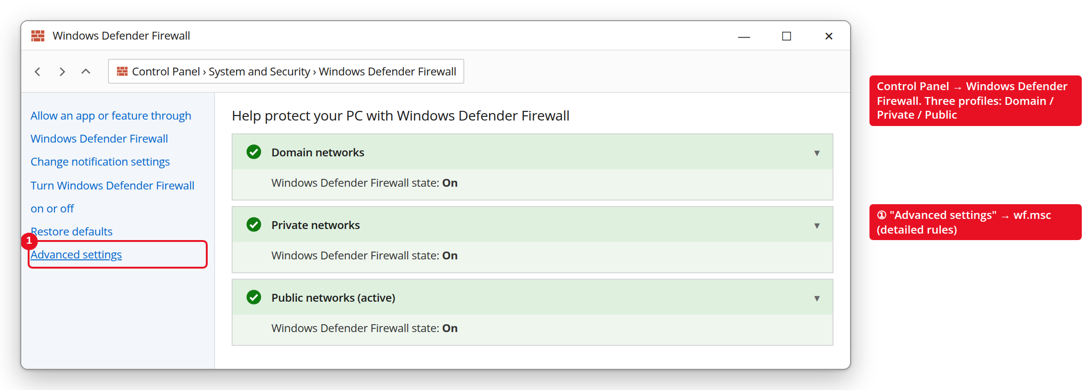
QUESTION 2 · WINDOWS FIREWALL
Where the Firewall is configured
Fig. 14. Control Panel → Windows Defender Firewall — three profiles
Fig. 15. wf.msc — Inbound rules (Allow / Block)
Quick view
Windows Security → Firewall & network protection
Classic
Win + R → control → Windows Defender Firewall
Advanced rules
Win + R → wf.msc (or “Advanced settings”)
PowerShell
Get-NetFirewallProfile | Select Name, Enabled
KKvaEH · Topic 1 · Windows OS Security
21

Slide 19

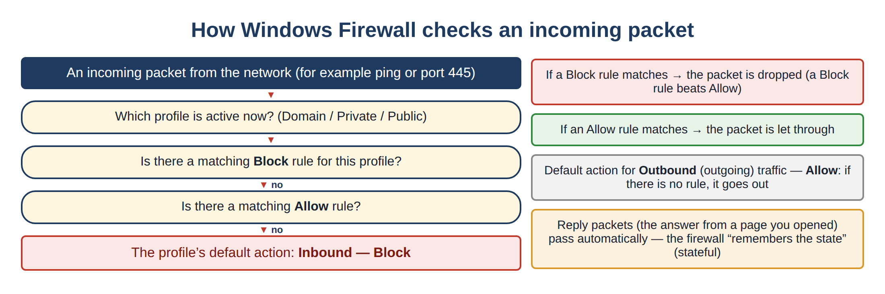

QUESTION 2 · WINDOWS FIREWALL
How the Firewall decides about an incoming packet
Block beats Allow
if both rules match, the packet is dropped
Stateful
replies to your own requests pass automatically
Public = strictest
unknown networks get the tightest rules
Fig. 16. Windows Firewall — checking an incoming packet
KKvaEH · Topic 1 · Windows OS Security
22

Slide 20
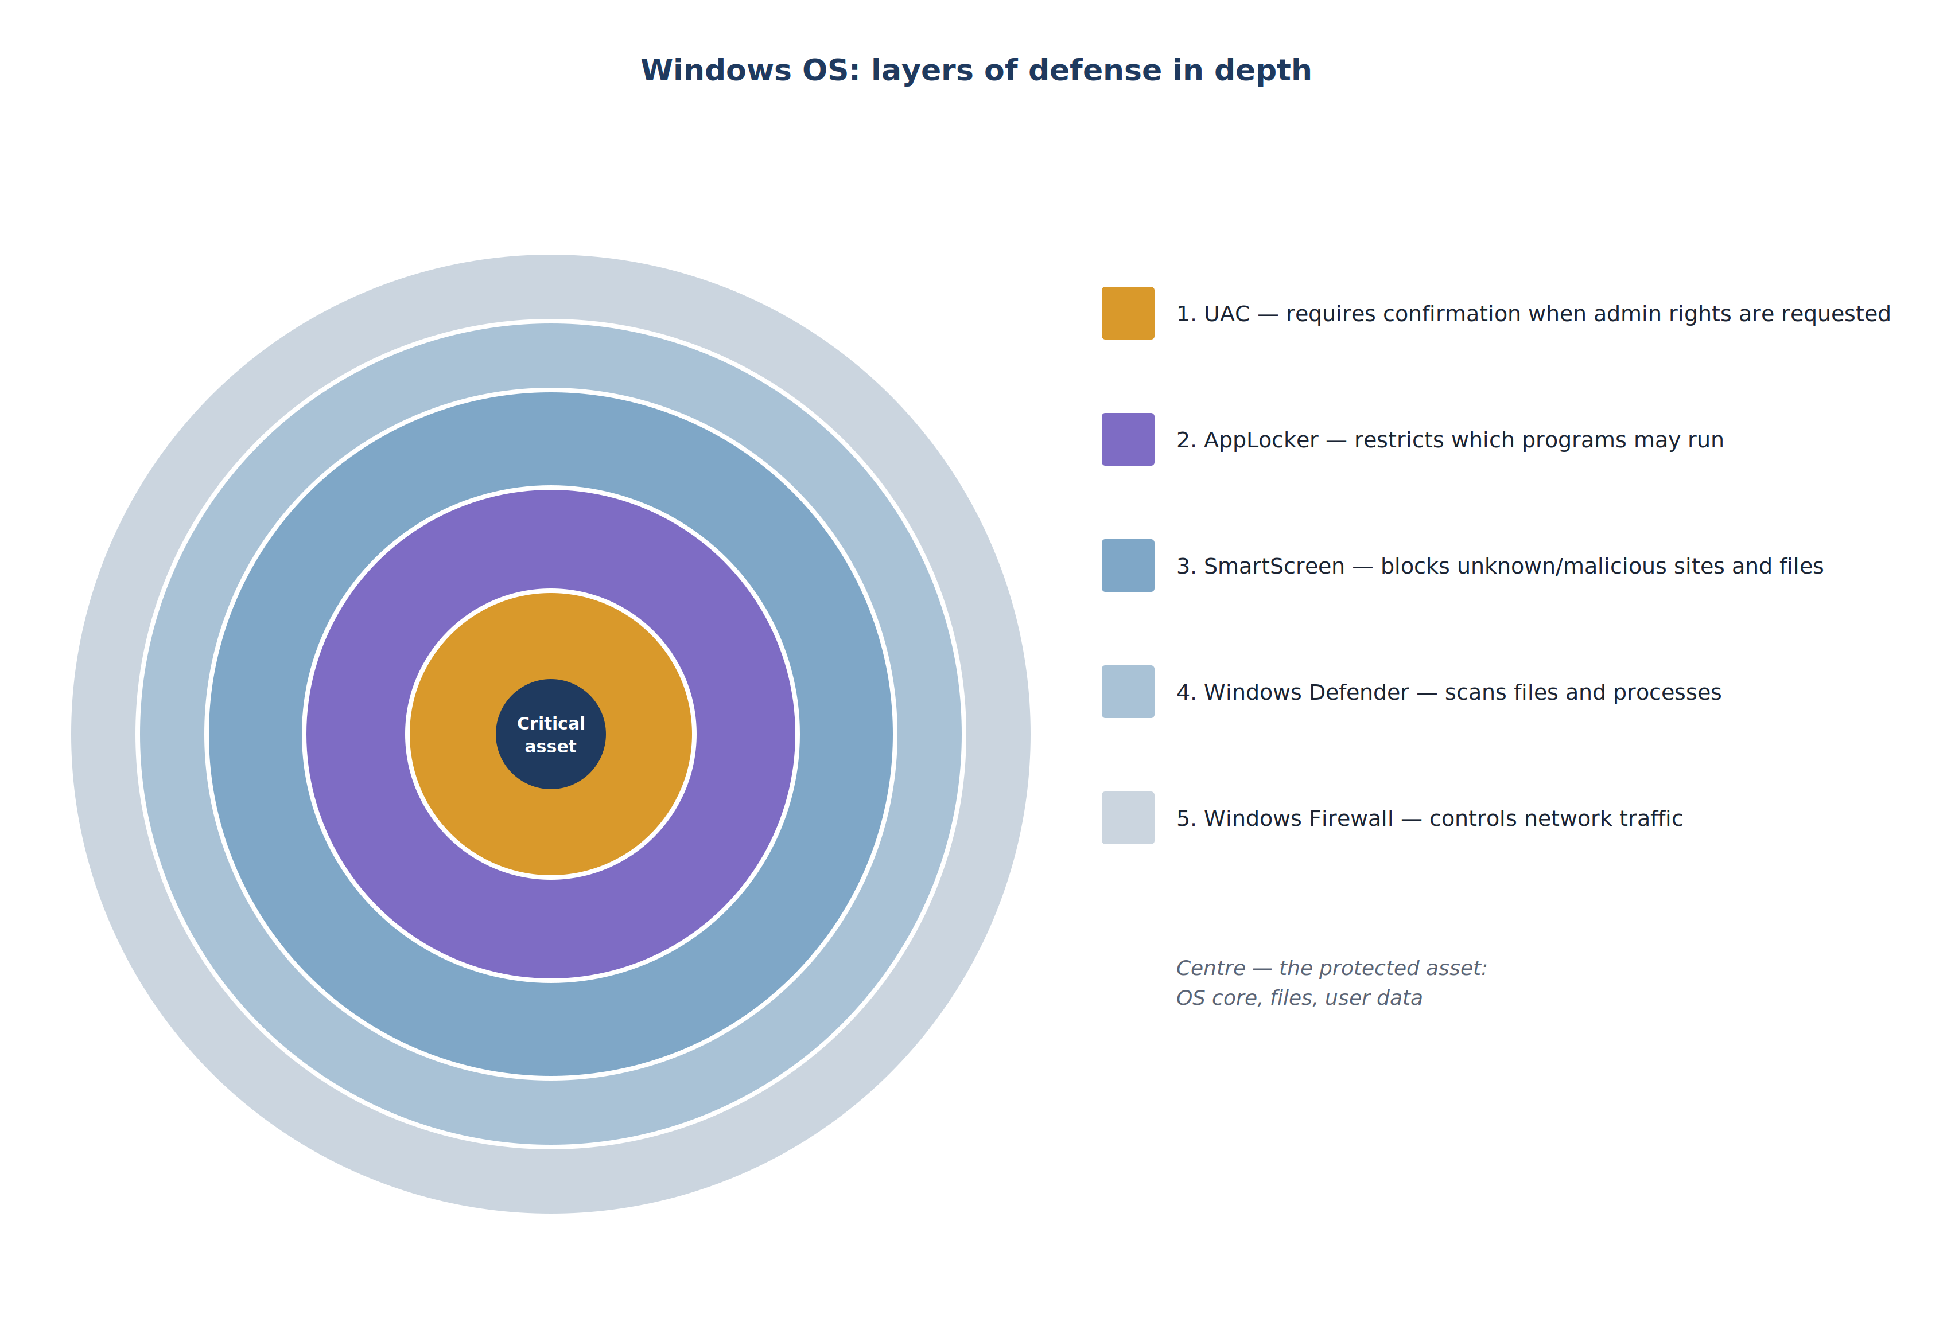
QUESTION 2 · ADDITIONAL IMPORTANT INFORMATION
All tools together — defense in depth
What each layer mainly protects against:
UAC
admin rights used without the user knowing
AppLocker
unauthorized / unknown programs running
SmartScreen
malicious downloads and phishing sites
Defender
malicious code already on the computer
Firewall
unauthorized network connections
Fig. 17. Windows OS: layers of defense in depth
Idea: if an attacker gets past one layer, the next one stops them.
? Defense in depth
KKvaEH · Topic 1 · Windows OS Security
23

Slide 21


QUESTION 2 · PRACTICAL SIGNIFICANCE
One attack — several layers of protection
›
›
›
›
›
›
File from USB / Internet
SmartScreen
AppLocker
Defender
UAC
Firewall
Event Log
A cadet downloads crack.exe. SmartScreen warns “unknown publisher”; the user clicks “Run anyway”.
AppLocker: the file is in Downloads — no Allow rule → blocked.
1
2
Without AppLocker → Defender detects the malicious code by signature or behaviour.
If it slips past Defender and asks for admin rights → UAC stops it.
3
4
Even if it runs, the Firewall restricts its connection to the attacker’s server.
Every step is written to the Event Log → the forensic investigator reconstructs the attack.
5
6
KKvaEH · Topic 1 · Windows OS Security
24

Slide 22
WRAP-UP
Summary
UAC — admin rights only after an explicit confirmation; even an administrator works with a filtered token.
AppLocker — only allowed programs may run (Publisher / Path / File hash); needs the AppIDSvc service.
SmartScreen — checks the reputation of files and sites from the internet (Mark of the Web).
Defender — scans existing and running files; Tamper Protection and Controlled folder access protect it and your data.
Firewall — Inbound/Outbound rules in Domain, Private and Public profiles; together all five form defense in depth.
KKvaEH · Topic 1 · Windows OS Security
25

Slide 23
WRAP-UP
Review questions — Lesson 2
Why was UAC introduced and what problem does it solve?
Against which types of threats is SmartScreen especially effective?
1
5
What is the difference between the Consent prompt and the Credential prompt?
What does Defender’s Controlled folder access protect against?
2
6
Why are the filtered token and the full admin token needed?
Explain the difference between the Domain, Private and Public profiles.
3
7
Explain AppLocker’s three rule conditions (Publisher, Path, File Hash).
What does the “defense in depth” principle mean?
4
8
KKvaEH · Topic 1 · Windows OS Security
26

Slide 24

THANK YOU FOR YOUR ATTENTION!
Questions are welcome.
Next section — glossary of terms

Slide 25

GLOSSARY
Glossary — this section explains the following
Integrity level
Secure Desktop
Access token
Whitelist
Low / Medium / High / System
the dimmed, protected screen
a program’s “ID card”
the “allowed” list
File hash
Mark of the Web
Firewall profile
Defense in depth
a file’s fingerprint
the “from the Internet” label
Domain / Private / Public
several layers of protection
Each term is explained in beginner-friendly language, with an example and a diagram.
KKvaEH · Topic 1 · Windows OS Security
28

Slide 26
GLOSSARY · TERM EXPLAINED
29
Integrity level (trust level of a process)
In plain terms:
System
services, kernel
Every running program gets a trust label: Low, Medium, High or System. A program with a lower level cannot change a program with a higher level.
High
Run as administrator
Medium
normal programs
Why it matters:
UAC is exactly the jump from Medium to High. Your browser runs at Medium (its sandbox even at Low), so a hacked web page cannot touch system files.
Check it: whoami /groups → “Mandatory Label”.
Low
browser sandbox
▲ higher = more trusted
← Back to lesson

Slide 27
GLOSSARY · TERM EXPLAINED
30
Secure Desktop
In plain terms:
normal desktop — dimmed, “frozen”
When UAC asks “Do you want to allow…?”, Windows switches to a separate, protected desktop: the screen behind it dims and only the prompt can be clicked. Ordinary programs cannot see or control it.
User Account Control
Do you want to allow this app to make changes?
Why it matters:
Yes
No
Without it, malware could draw a fake window or “click” the Yes button by itself. On the Secure Desktop, only a real person with the mouse/keyboard can answer.
only this window is active
← Back to lesson

Slide 28
GLOSSARY · TERM EXPLAINED
31
Access token (filtered and full)
In plain terms:
Sign-in as Administrator
An access token is a program’s “ID card”: it lists who you are (your SID), your groups and your privileges. Windows checks this card every time the program opens a file or changes a setting.
FILTERED TOKEN
user SID · groups
standard rights
→ Medium
FULL TOKEN
user SID · groups
all admin rights
→ High
Why it matters:
An administrator gets two cards at sign-in: a filtered one for everyday work and a full one that is used only after the UAC “Yes”. This is how UAC protects even admins.
UAC “Yes” = switching from the filtered token to the full one
← Back to lesson

Slide 29


GLOSSARY · TERM EXPLAINED
32
Whitelist (allow list)
In plain terms:
notepad.exe (Microsoft, signed)
A whitelist is a list of what is allowed. Anything not on the list is forbidden by default. The opposite is a blacklist: everything is allowed except what is listed.
C:\Program Files\*
game.exe (Downloads)
Why it matters:
New malware is never on any blacklist yet — but it is also not on the whitelist, so it is blocked. That is why AppLocker (a whitelist) is so strong in military and corporate networks.
crack.exe (USB drive)
green = on the list · red = not on the list → blocked
← Back to lesson

Slide 30
GLOSSARY · TERM EXPLAINED
33
File hash (a file’s fingerprint)
In plain terms:
setup.exe v1.0
→
3F9A…C21B
A hash function turns a whole file into a short, fixed-length code (for example SHA-256). The same file always gives the same hash; change even one byte and the hash becomes completely different.
setup.exe v1.1
→
A04D…77E9
Why it matters:
One small change → a new hash → the old AppLocker rule no longer matches. Check a hash: Get-FileHash setup.exe
An AppLocker File hash rule allows exactly one version of one file. It is the strictest condition — but after every update the hash changes and the rule must be rewritten.
← Back to lesson

Slide 31
GLOSSARY · TERM EXPLAINED
34
Mark of the Web (Zone.Identifier)
In plain terms:
PS> Get-Content .\setup.exe -Stream Zone.Identifier
[ZoneTransfer]
ZoneId=3
HostUrl=https://example.com/setup.exe
When a browser saves a file from the internet, Windows quietly attaches a hidden label to it — the Zone.Identifier stream. It says where the file came from (ZoneId=3 means “Internet”).
Why it matters:
0
1
2
3
4
SmartScreen and Office look at this label: a file “from the Internet” is checked and may open in protected mode. A file copied from a USB drive usually has no label — so SmartScreen does not check it.
this computer
intranet
trusted sites
Internet
restricted sites
← Back to lesson

Slide 32
GLOSSARY · TERM EXPLAINED
35
Firewall profile (Domain / Private / Public)
In plain terms:
Domain
office, Active Directory
A profile is a set of firewall rules tied to the type of network. Windows picks the profile automatically when you connect: domain network → Domain; you said “private” → Private; otherwise → Public.
Private
home, trusted
Why it matters:
The same laptop needs different protection at the office and in a café. On Public, almost all incoming connections are blocked, so strangers on the same Wi-Fi cannot reach your shared folders.
Check: Get-NetConnectionProfile
Public
café, airport — strictest
← Back to lesson

Slide 33
GLOSSARY · TERM EXPLAINED
36
Defense in depth
In plain terms:
Firewall
Instead of trusting one strong wall, you build several independent layers. Each layer can fail — but an attacker must defeat all of them to succeed.
Defender
SmartScreen
AppLocker
UAC
data
Why it matters:
No single tool is perfect: users click “Run anyway”, new malware has no signature yet. With five layers (SmartScreen, AppLocker, Defender, UAC, Firewall) one mistake does not mean a compromised system.
← Back to lesson

