Slide 1


FAN: “KIBER KRIMINALISTIKA VA ETIKAL HAKING”
1-MAVZU
WINDOWS OT
XAVFSIZLIGI
3-mashg‘ulot · Windows OT servislari | Amaliy, 4 soat
O‘ZBEKISTON RESPUBLIKASI
HARBIY XAVFSIZLIK VA MUDOFAA UNIVERSITETI
Axborot-kommunikatsiya texnologiyalari va harbiy aloqa instituti · Kiberxavfsizlik kafedrasi
Ma’ruzachi: Kiberxavfsizlik kafedrasi katta o‘qituvchisi — kapitan M. Isakov

Slide 2





1-MAVZU · WINDOWS OT XAVFSIZLIGI
3-mashg‘ulot: Windows OT servislari (amaliy)
Mavzu
Mashg‘ulot turi
Davomiyligi
Windows OT xavfsizligi
Amaliy (laboratoriya)
4 soat
O‘quv savollari
Boshlashdan oldin
1
User Account Control (UAC) — amalda sozlash
▸ Windows 11 Pro / Enterprise virtual mashinasi (Home emas).
▸ Ishni boshlashdan oldin snapshot oling.
▸ Administrators guruhidagi oddiy hisob bilan kiring (built-in Administrator emas).
▸ Hech qachon ish yoki shaxsiy kompyuterda mashq qilmang.
daraja · registr · ikki token · integrity level
2
AppLocker va SmartScreen xavfsizlik tizimlari — amalda sozlash
qoidalar · A–E mashqlar · SmartScreen sinovi · Mark of the Web
KKvaEH · 1-mavzu · Windows OT xavfsizligi
2

Slide 3
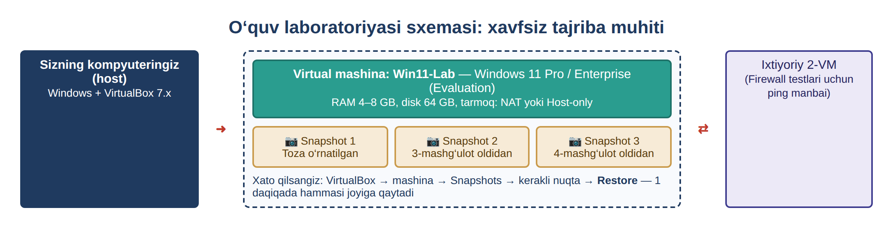

AMALIY MASHG‘ULOT · TASHKIL ETISH
4 soatlik laboratoriya rejasi va laboratoriya muhiti
1.1
UAC darajasini o‘zgartirish va sinab ko‘rish (msconfig)
15 daq
1.2
UACni PowerShell orqali tekshirish (EnableLUA)
10 daq
1.3
Ikki token va integrity level’ni amalda ko‘rish
15 daq
1.4
Slayderning to‘rt holati va registr qiymatlari
15 daq
1-rasm. O‘quv laboratoriyasi tuzilishi: virtual mashina va snapshotlar
Xavfsizlik qoidalari: faqat VMda ishlang · har bir topshiriqdan oldin snapshot oling · biror narsa buzilsa — tizimni “tuzatish” o‘rniga snapshotni Restore qiling. Mashqlar oxirida laboratoriyani avvalgi holatga qaytaring.
2.1
AppLocker: servis → qoidalar → sinov + A–E mashqlar
75 daq
2.2
SmartScreen: 5 ta sozlama va xavfsiz sinov sayti
25 daq
2.3
Mark of the Web: o‘qish, olib tashlash, sinash
20 daq
Jami: 240 daqiqa — 215 daqiqa laboratoriya ishi + 25 daqiqa kirish, takrorlash va yakun. Har bir topshiriq oxirida “Natija” qutisi: nima qildik va nimaga erishdik.
Lab
Yakuniy topshiriq + skrinshotli hisobot
45 daq
? Snapshot
3
KKvaEH · 1-mavzu · Windows OT xavfsizligi

Slide 4

1-SAVOL
User Account Control (UAC) — amalda sozlash
4

Slide 5
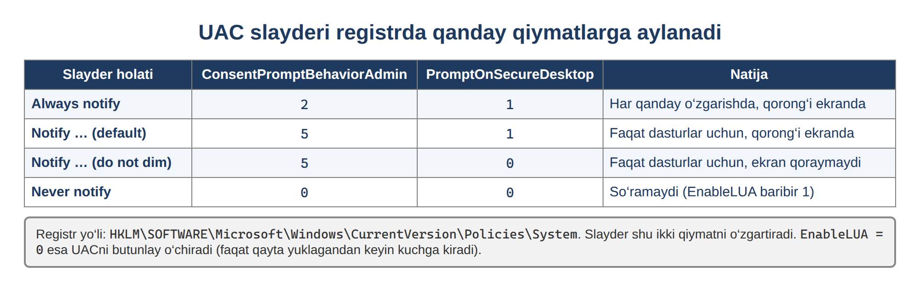

1-SAVOL · 2-MASHG‘ULOTDAN QISQA TAKRORLASH
Nimani o‘zgartiramiz — UAC darajalari
Always notify — eng xavfsiz — harbiy tarmoqlarda ishlating
Notify… (default) — faqat dasturlar uchun ogohlantiradi
Do not dim — Secure Desktop yo‘q — kuchsizroq
Never notify — so‘ramaydi — hech qachon ishlatmang
2-rasm. UAC slayderi holatlari va ularning registrdagi qiymatlari
Bugungi maqsad: slayderni suring, natijani ekranda ko‘ring (msconfig), so‘ng uni PowerShell yordamida registrda isbotlang, oxirida esa ikki token va integrity level’ni o‘z ko‘zingiz bilan ko‘ring.
? Registry value
? Integrity level
5
KKvaEH · 1-mavzu · Windows OT xavfsizligi

Slide 6
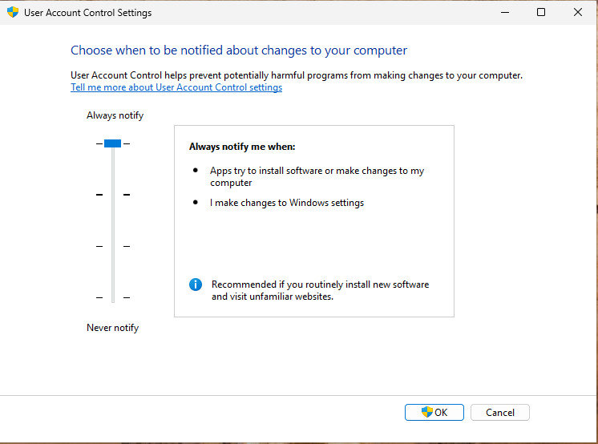
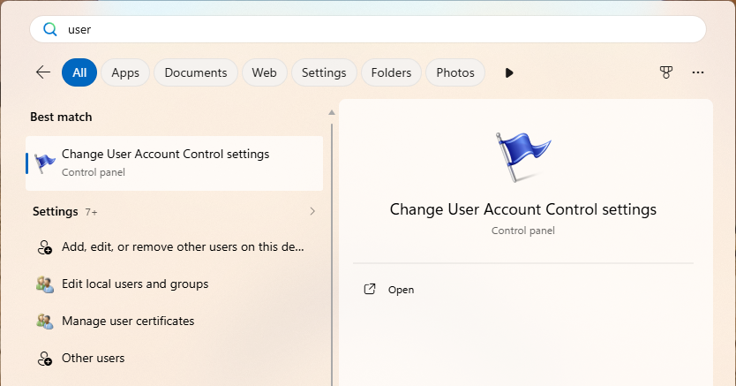

1-SAVOL · AMALIY TOPSHIRIQ 1.1
1.1-topshiriq — UACni “Always notify” holatiga o‘rnatish
Start menyusi qidiruviga User Account Control deb yozing.
1
Change User Account Control settings bo‘limini oching.
2
Oynada slayder bor — u to‘rtta darajani ko‘rsatadi.
3
Slayderni eng yuqoriga — Always notify holatiga suring va OK ni bosing.
3-rasm. Start menyusida UAC sozlamasini qidirish
4-rasm. Slayder “Always notify” holatida
4
Tez yo‘llar: Win + R → UserAccountControlSettings (eng tez) yoki Win + R → control → User Accounts → User Accounts → “Change User Account Control settings”.
Tizimning o‘zi tasdiq so‘raydi — Yes (“Ha”) deb javob bering.
5
Kutilayotgan natija: oyna qayta ochilganda ham slayder eng yuqorida turadi; o‘zgartirishning o‘zi ham UAC tasdig‘ini talab qildi.
KKvaEH · 1-mavzu · Windows OT xavfsizligi
6

Slide 7
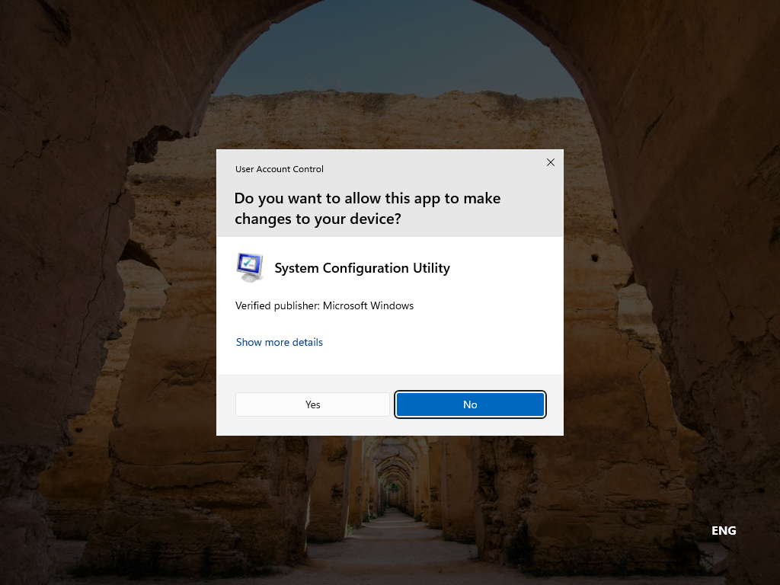
1-SAVOL · AMALIY TOPSHIRIQ 1.1
1.1-topshiriq — yangi darajani msconfig bilan sinash, so‘ng qaytarish
Win + R oynasida msconfig buyrug‘ini kiriting.
1
Kuzating: standart darajada bu oyna so‘rovsiz ochilar edi — endi Windowsning o‘z dasturi uchun ham UAC tasdiq so‘rayapti.
2
So‘rovni o‘qing: dastur nomi (System Configuration Utility), nashriyotchi — Microsoft Windows.
3
Slayderni standart holatga qaytaring (“Notify only when apps try to make changes”).
4
msconfig ni qayta ishga tushiring — endi oyna so‘rovsiz ochiladi.
5
5-rasm. “Always notify” holatida msconfig uchun ham tasdiq so‘ralmoqda
Natija: “Always notify” darajasida Windows hatto o‘z sozlama dasturlari uchun ham tasdiq so‘raydi. Slayder qanchalik yuqori bo‘lsa, nazorat shunchalik qattiq.
KKvaEH · 1-mavzu · Windows OT xavfsizligi
7

Slide 8
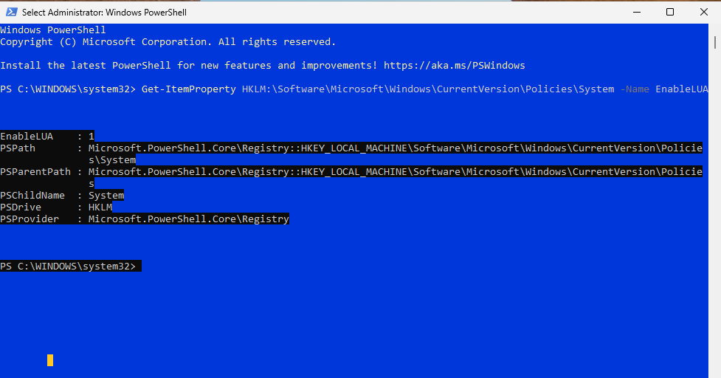
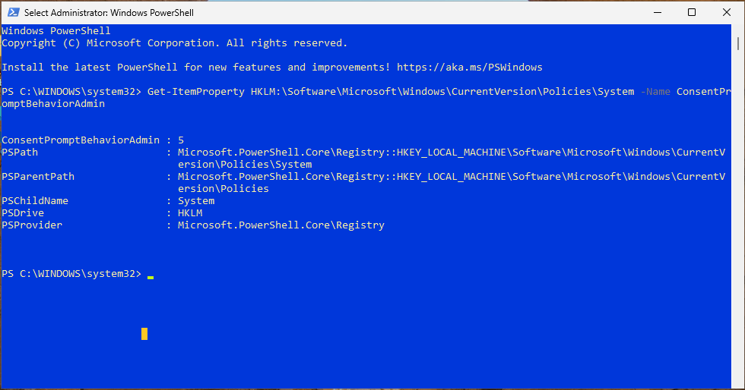
1-SAVOL · AMALIY TOPSHIRIQ 1.2
1.2-topshiriq — UACni PowerShell orqali tekshirish
PowerShellni administrator huquqida oching (o‘ng tugma → Run as administrator).
1
Bajaring: Get-ItemProperty HKLM:\Software\Microsoft\Windows\CurrentVersion\Policies\System -Name EnableLUA
2
6-rasm. PowerShell — UAC holatini (EnableLUA) tekshirish natijasi
EnableLUA : 1 — UAC yoqilgan; 0 bo‘lsa — o‘chirilgan (jiddiy kamchilik).
3
Xuddi shunday -Name ConsentPromptBehaviorAdmin ni o‘qing — administrator uchun so‘rov turi.
4
7-rasm. PowerShell — ConsentPromptBehaviorAdmin qiymati
Kutilayotgan natija: EnableLUA : 1 va ConsentPromptBehaviorAdmin : 5 (standart) — GUI slayderi aslida shu registr qiymatlarini o‘zgartiradi.
? Registry value
8
KKvaEH · 1-mavzu · Windows OT xavfsizligi

Slide 9


1-SAVOL · AMALIY TOPSHIRIQ 1.2
Qiymatlarni qanday o‘qish kerak
ConsentPromptBehaviorAdmin qiymatlari:
Standart foydalanuvchi uchun alohida qiymat
0
Elevate without prompting — xavfli — admin huquqi jimgina beriladi
ConsentPromptBehaviorUser:
3 (sukut bo‘yicha) — administrator login va paroli so‘raladi (Credential prompt);
0 — huquq talab qiladigan amal so‘rovsiz rad etiladi.
Bu qiymatni ham yuqoridagi buyruq bilan o‘qib ko‘ring.
1
Ask for credentials on the Secure Desktop — juda qat’iy
2
Ask for consent on the Secure Desktop — = “Always notify”
3
Ask for credentials — qat’iy, ekran xiralashmaydi
Kriminalistik tekshiruv
4
Ask for consent — ekran xiralashmaydi
Tekshirilayotgan kompyuterda EnableLUA = 0 yoki ConsentPromptBehaviorAdmin = 0 topilsa — bu kimdir (ko‘pincha zararli dastur) himoyani ataylab pasaytirgani belgisi bo‘lishi mumkin. Registr qiymatlarini GUI bilan solishtiring: ular doim bir xil narsani ko‘rsatishi kerak.
5
Consent for non-Windows programs — = standart
KKvaEH · 1-mavzu · Windows OT xavfsizligi
9

Slide 10
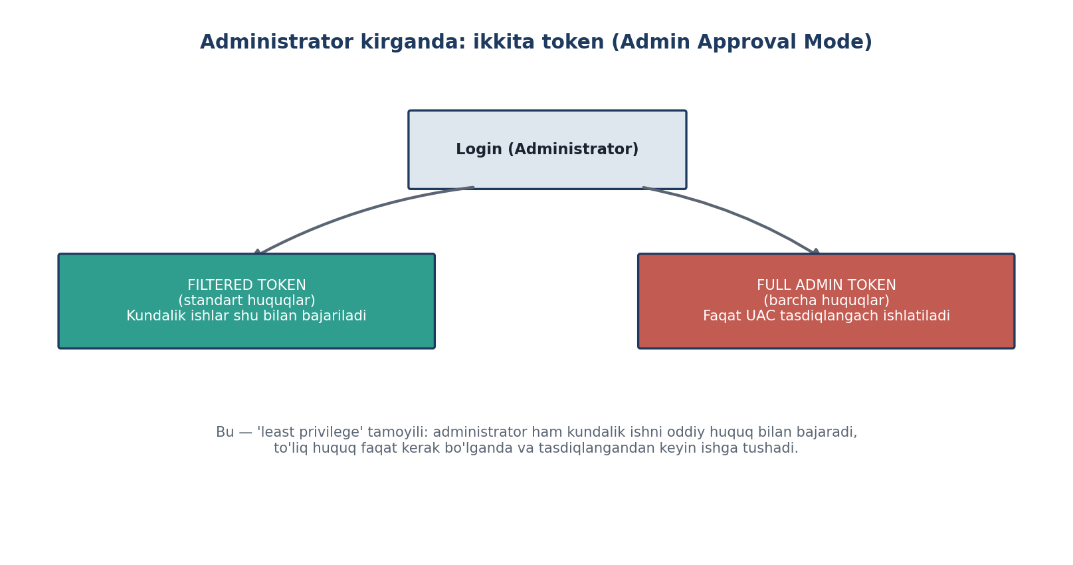
1-SAVOL · AMALIY TOPSHIRIQ 1.3
1.3-topshiriq — ikki token va integrity level’ni amalda ko‘rish
Windows PowerShellni oddiy usulda oching (Run as administrator emas).
Tekshiruv | Oddiy oyna | Administrator oynasi
Mandatory Level | Medium | High
BUILTIN\Administrators | Group used for deny only | Enabled group
net session | Access is denied | OK
Task Manager → Elevated | No | Yes
Token | filtrlangan (oddiy) | to‘liq (full)
1
Bajaring: whoami /groups | findstr /i "Mandatory" va … "BUILTIN\Administrators"
2
Endi PowerShellni Run as administrator bilan oching, UACni tasdiqlang va xuddi shu buyruqlarni bajaring.
3
Ikkala oynada: net session — oddiy oynada Access is denied, admin oynada ishlaydi.
4
Ctrl + Shift + Esc → Details → ustunlar → Elevated: bitta powershell.exe — No, ikkinchisi — Yes.
5
8-rasm. Administrator kirganda ikkita token (Admin Approval Mode)
Kutilayotgan natija: bir hisobning ikkita oynasi turli huquq bilan ishlaydi: kundalik oyna — Medium (filtrlangan token), tasdiqlangan oyna — High (to‘liq token).
? Integrity level
10
KKvaEH · 1-mavzu · Windows OT xavfsizligi

Slide 11
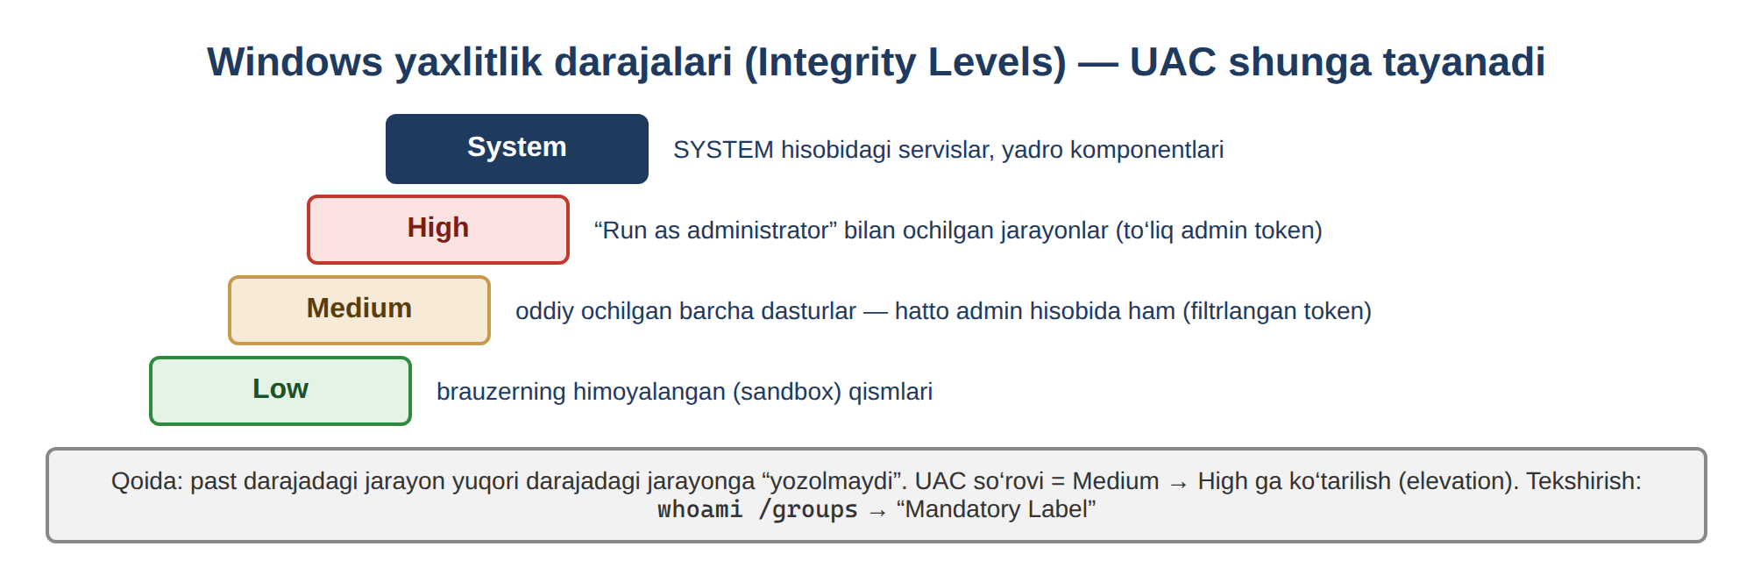


1-SAVOL · AMALIY TOPSHIRIQ 1.3 — NATIJA
Nimani ko‘rdik — va nega bu muhim
E’tibor bering — built-in Administrator
O‘rnatilgan Administrator hisobida (SID oxiri -500) Admin Approval Mode sukut bo‘yicha o‘chiq: hamma oyna darhol High darajada ishlaydi va UAC so‘rovi chiqmaydi. Shuning uchun mashqlarni Administrators guruhidagi oddiy hisobda bajaring. Tekshirish: whoami /user.
9-rasm. Windows yaxlitlik darajalari (Integrity Levels)
Natija — nimani ko‘rdik?
Keyingi mashqlar uchun
Administrator bo‘lib kirgan foydalanuvchining kundalik oynalari Medium darajada ishlaydi, Administrators guruhi esa ulardan “o‘chirilgan” (deny only). To‘liq huquq faqat UAC tasdig‘idan keyin, faqat shu bitta jarayon uchun beriladi (High). Zararli dastur oddiy oynadan ishga tushsa, u ham Medium darajada qoladi — UACning butun foydasi shunda.
Bu bilim AppLocker mashqida yana kerak bo‘ladi: AppLocker ham aynan shu tokenga qarab qaror qiladi (A mashq — “Run as administrator” bilan nega ochiladi?).
KKvaEH · 1-mavzu · Windows OT xavfsizligi
11

Slide 12
1-SAVOL · AMALIY TOPSHIRIQ 1.4
1.4-topshiriq — slayderning to‘rt holati va registr qiymatlari
Slayder aslida registrdagi uchta qiymatni o‘zgartiradi. Slayderni har bir holatga qo‘yib, administrator oynasida buyruqni bajaring va jadvalni to‘ldiring:
Natija — jadvaldan xulosa
PS> Get-ItemProperty HKLM:\Software\Microsoft\Windows\CurrentVersion\Policies\System |
Select-Object EnableLUA, ConsentPromptBehaviorAdmin, PromptOnSecureDesktop
ConsentPromptBehaviorAdmin — so‘rov qanday ko‘rsatiladi: 2 har doim so‘raydi, 5 faqat boshqa dasturlar uchun, 0 umuman so‘ramaydi.
PromptOnSecureDesktop — ekran qorayishi (Secure Desktop): 1 yoqilgan, 0 o‘chirilgan.
Diqqat: “Never notify” holatida ham EnableLUA = 1 bo‘lib qoladi. UAC butunlay faqat EnableLUA = 0 orqali o‘chiriladi va buning uchun kompyuter qayta yuklanadi.
Kriminalistik ahamiyati: ConsentPromptBehaviorAdmin = 0 yoki EnableLUA = 0 — himoya ataylab pasaytirilganining belgisi bo‘lishi mumkin.
Slayder holati | ConsentPrompt…Admin | PromptOnSecure… | EnableLUA
Always notify (eng yuqori) | 2 | 1 | 1
Notify only when apps try… (standart) | 5 | 1 | 1
Notify… (do not dim my desktop) | 5 | 0 | 1
Never notify (eng past) | 0 | 0 | 1
KKvaEH · 1-mavzu · Windows OT xavfsizligi
12

Slide 13
2-SAVOL
AppLocker va SmartScreen — amalda sozlash
13

Slide 14





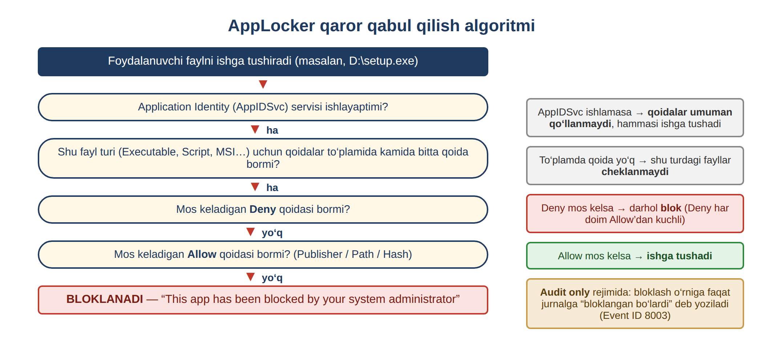
2-SAVOL · AMALIY TOPSHIRIQ 2.1
AppLocker laboratoriyasi — butun yo‘l 7 qadamda
1
2
3
4
5
6
7
›
›
›
›
›
›
AppIDSvcni yoqish
Siyosatni ochish
Standart qoidalar
O‘z qoidangiz
Qo‘llash
Sinov
Jurnal
sc config / sc start
gpedit / secpol
Create Default Rules
Publisher: notepad.exe
gpupdate /force
bloklandi / ruxsat
Hodisa 8004
Boshlashdan oldin
▸ AppLocker Pro, Enterprise, Education va Server nashrlarida ishlaydi; Homeda yo‘q (winver bilan tekshiring).
▸ Qoidalarni Application Identity servisi qo‘llaydi — u ishlamasa, qoidalar kuchga kirmaydi.
▸ Doimo avval Default rules, keyin o‘z qoidangiz.
▸ Avval snapshot — noto‘g‘ri qoida butun tizimni bloklashi mumkin.
10-rasm. AppLocker qaror qabul qilish algoritmi
? Default rules
? Implicit deny
14
KKvaEH · 1-mavzu · Windows OT xavfsizligi

Slide 15
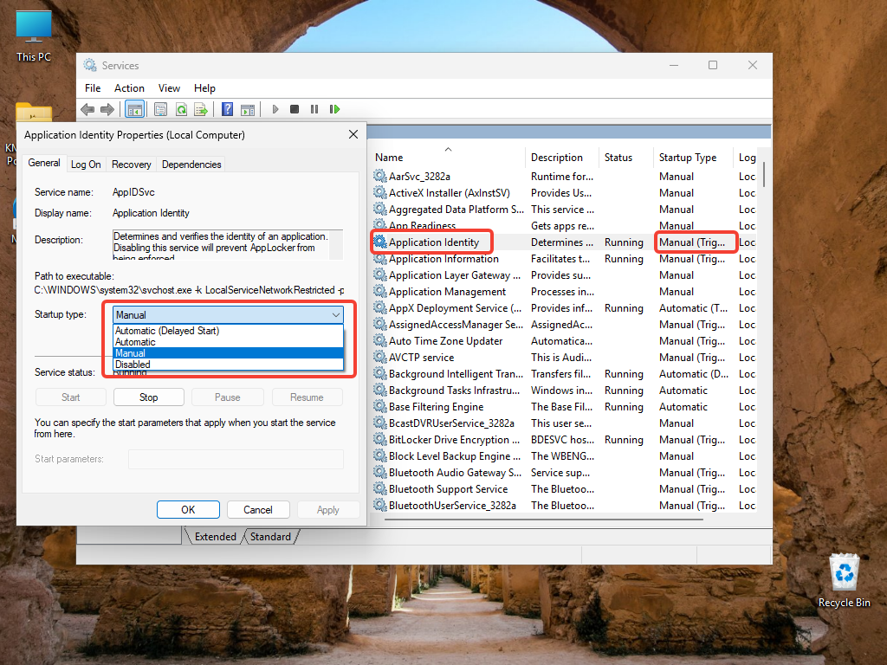
2-SAVOL · 2.1-TOPSHIRIQ — A QADAM
A qadam — Application Identity (AppIDSvc) servisini ishga tushirish
1
Win + R → services.msc → Application Identity ni toping.
2
Himoyalangan servis: Startup type maydoni kulrang — bu yerdan sozlab bo‘lmaydi.
3
Buyruq qatorini administrator sifatida oching.
4
Bajaring: sc config appidsvc start= auto va sc start appidsvc
11-rasm. services.msc — “Application Identity” (AppIDSvc) servisi
5
Tekshiring: sc query appidsvc → STATE : 4 RUNNING bo‘lishi kerak.
“Access denied” bo‘lsa: gpedit.msc → Computer Configuration → Windows Settings → Security Settings → System Services → Application Identity → Automatic, so‘ng gpupdate /force.
Kutilayotgan natija: AppIDSvc = Running, Automatic. Bu — 1-mashg‘ulotda o‘rgangan sc buyrug‘ining amaliy qo‘llanishi. Usiz AppLocker qoidalari e’tiborga olinmaydi.
KKvaEH · 1-mavzu · Windows OT xavfsizligi
15

Slide 16
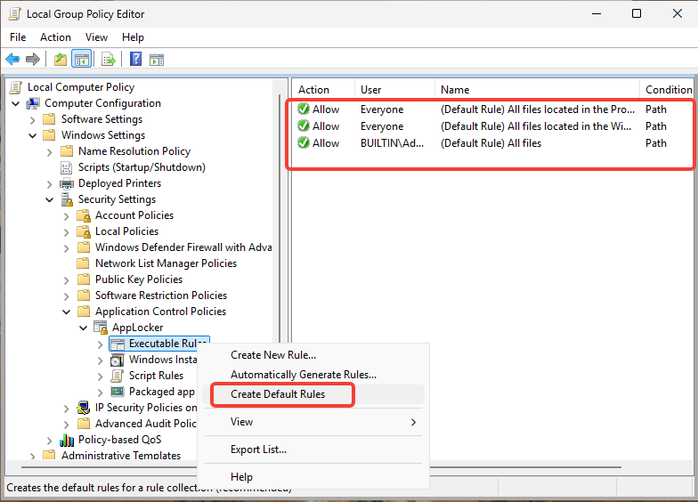
2-SAVOL · 2.1-TOPSHIRIQ — B QADAM
B qadam — siyosatni ochish va standart qoidalarni yaratish
Win + R → gpedit.msc (Local Group Policy Editor; faqat Pro/Enterprise).
1
Yo‘l: Computer Configuration → Windows Settings → Security Settings → Application Control Policies → AppLocker.
2
Executable Rules ustida o‘ng tugma → Create Default Rules.
3
Uchta qoida paydo bo‘ladi: Program Files, Windows (Everyone) va Administrators uchun barcha fayllar.
4
12-rasm. gpedit.msc — “Create Default Rules” buyrug‘i (kontekst menyu)
Kutilayotgan natija: Executable Rules ichida uchta standart Allow qoidasi — Windowsning o‘zi ishlashda davom etadi. Ulardan tashqaridagi hamma narsa endi implicit deny ostida.
? Default rules
? Implicit deny
16
KKvaEH · 1-mavzu · Windows OT xavfsizligi

Slide 17
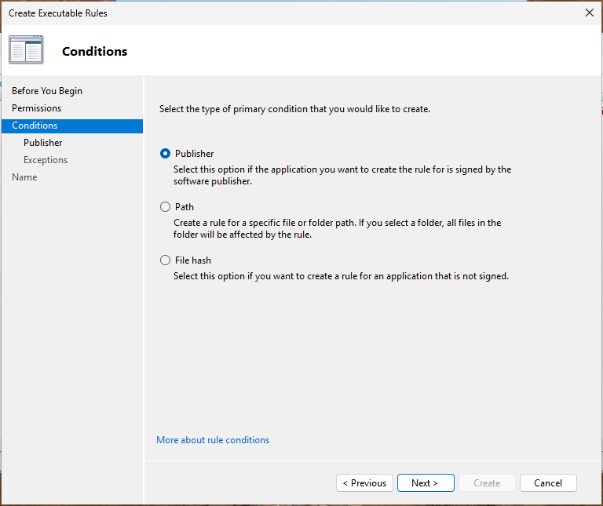
2-SAVOL · 2.1-TOPSHIRIQ — C QADAM
C qadam — o‘z qoidangizni yaratish (Publisher sharti)
1
Executable Rules ustida o‘ng tugma → Create New Rule… → “Before You Begin” → Next.
2
Permissions: Action = Allow, User or group = Everyone → Next.
3
Conditions: Publisher shartini tanlang → Next.
4
Browse… → imzolangan fayl: C:\Windows\System32\notepad.exe. Slayderni o‘zgartirmang → Next.
5
Exceptions’ni o‘tkazib yuboring, qoidaga nom bering → Create.
13-rasm. AppLocker — yangi qoida yaratish ustasi (Publisher sharti)
Kutilayotgan natija: ro‘yxatda notepad.exe uchun yangi Publisher qoidasi paydo bo‘ladi — u dastur yangilansa ham ishlayveradi (imzo o‘zgarmaguncha).
KKvaEH · 1-mavzu · Windows OT xavfsizligi
17

Slide 18
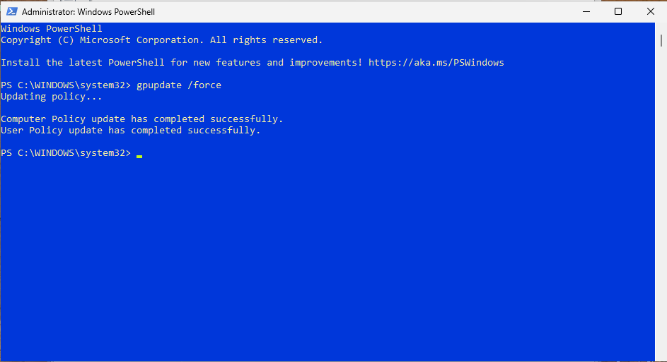
2-SAVOL · 2.1-TOPSHIRIQ — D QADAM
D qadam — siyosatni qo‘llash va qoidani sinash
1
Administrator PowerShellda: gpupdate /force.
2
“Computer Policy update has completed successfully” xabarini kuting.
3
Qoidada ko‘rsatilmagan dasturni ishga tushiring (Ish stoli yoki Downloads’dagi .exe — A mashqqa qarang).
“This app has been blocked by your system administrator” — hatto administrator bo‘lsangiz ham.
14-rasm. PowerShell — “gpupdate /force” bilan siyosatni kuchga kiritish
4
Natija — nima sodir bo‘ldi?
Qayerdan tekshiriladi? eventvwr.msc → Applications and Services Logs → Microsoft → Windows → AppLocker → EXE and DLL.
8004 — bloklandi (Enforce) · 8003 — bloklangan bo‘lardi (Audit only) · 8002 — ruxsat berildi.
Ruxsat ro‘yxatiga tushmagan dasturni AppLocker bloklaydi. Sabab — implicit deny: to‘plamda kamida bitta qoida paydo bo‘lsa, ochiq ruxsat berilmagan hamma narsa avtomatik taqiqlanadi.
? Group Policy refresh
? Event log
? Implicit deny
18
KKvaEH · 1-mavzu · Windows OT xavfsizligi

Slide 19
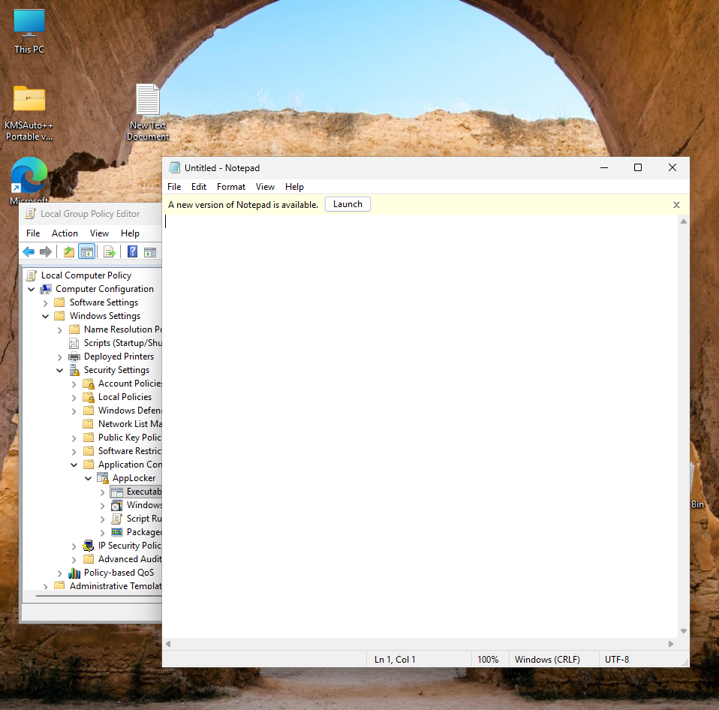
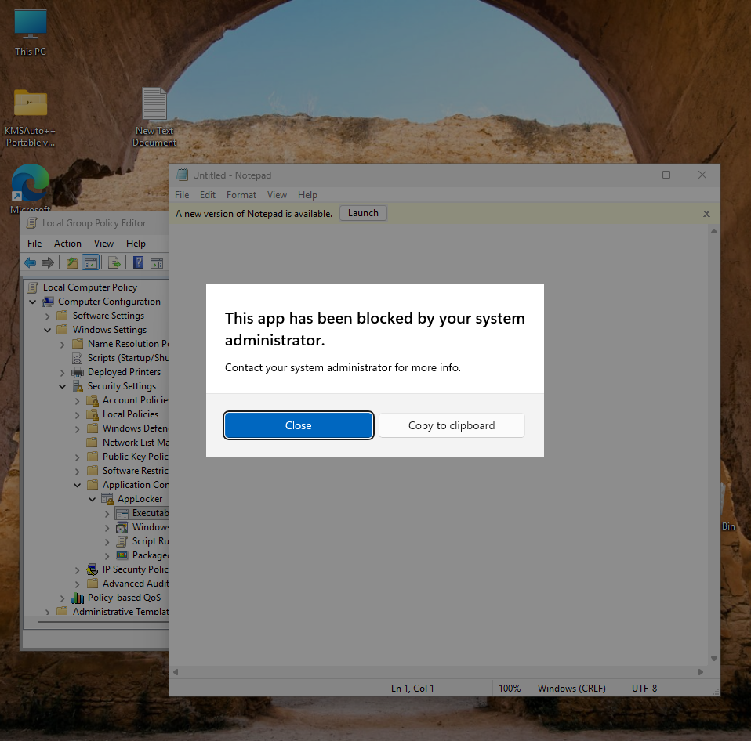
2-SAVOL · 2.1-TOPSHIRIQ — MUHIM NYUANS
Windows 11 da ikkita Notepad — sinovni to‘g‘ri bajarish
Muammo
Eski Notepad — C:\Windows\System32 da.
Yangi Notepad — Microsoft Store ilovasi, boshqa papkada.
Windows sukut bo‘yicha yangisini ochadi, bizning qoida esa faqat eskisiga ruxsat beradi → yangi Notepad bloklanadi.
1
Settings → Apps → Advanced app settings → App execution aliases.
2
Ro‘yxatdan Notepad ni toping va Off qiling.
3
Notepadni qayta oching — endi eski Notepad ishga tushadi va qoida unga ruxsat beradi.
15-rasm. Ruxsat etilgan dastur — eski Notepad ochildi
16-rasm. AppLocker tomonidan bloklangan dastur oynasi
Kutilayotgan natija: bitta qoida — ikki xil natija: eski Notepad (qoidadagi fayl) ochiladi, yangisi bloklanadi. Qoida aynan qaysi faylga yozilganiga doim e’tibor bering.
KKvaEH · 1-mavzu · Windows OT xavfsizligi
19

Slide 20
2-SAVOL · QO‘SHIMCHA MASHQLAR — A
A mashq — ruxsat berilmagan joydan dasturni ishga tushirish
# oddiy PowerShell — ikki zararsiz test fayl
Copy-Item C:\Windows\System32\cmd.exe "$env:USERPROFILE\Desktop\test_cmd.exe"
Copy-Item C:\Windows\System32\charmap.exe "$env:USERPROFILE\Desktop\charmap.exe"
Oddiy oyna
filtrlangan token · Administrators = deny only
→ faqat Everyone qoidalari (Windows, Program Files)
BLOKLANDI
Ish stolidagi test_cmd.exe ni ikki marta bosing → “This app has been blocked…”. C:\Windows ichida ishlardi, Ish stolida — yo‘q.
1
Run as administrator
to‘liq token · Administrators faol
→ BUILTIN\Administrators — (All files) qoidasi
RUXSAT
Shu fayl: o‘ng tugma → Run as administrator → UACni tasdiqlang → dastur ochiladi!
2
Natija — nega administrator sifatida ochildi?
Default rules ichida BUILTIN\Administrators — (All files) qoidasi bor. Oddiy oynada token filtrlangan (1.3-topshiriq), shuning uchun bu qoida ishlamaydi. UAC tasdig‘idan keyin to‘liq token bilan u kuchga kiradi. Xulosa: AppLocker (Default rules bilan) birinchi navbatda oddiy foydalanuvchilarni himoya qiladi — kundalik ish standart hisobda bajarilishi kerak.
KKvaEH · 1-mavzu · Windows OT xavfsizligi
20

Slide 21



2-SAVOL · QO‘SHIMCHA MASHQLAR — B
B mashq — File hash, Path va Publisher qoidalari farqi
Executable Rules → Create New Rule… → Allow, Everyone → Conditions: File hash → Browse Files… → Ish stolidagi test_cmd.exe → Create → gpupdate /force.
Path — “fayl QAYERDA?”
1
Faylni ruxsat berilgan papkadan ko‘chirsangiz — qoida ishlamay qoladi.
test_cmd.exe ni oddiy usulda ishga tushiring — endi ochiladi.
2
Publisher — “KIM imzolagan?”
Faylni abc.exe deb qayta nomlang va Documents ga ko‘chiring — baribir ochiladi.
3
Dastur yangilansa ham, imzo o‘zgarmasa — ishlayveradi.
Ish stolidagi charmap.exe ni ishga tushiring — bloklanadi: unga Allow qoidasi yo‘q.
4
File hash — “AYNAN QAYSI fayl?”
Nomi va joyi ahamiyatsiz; bitta bayt o‘zgarsa — qoidani qayta yaratish kerak.
Natija: uch xil qoida uch xil savolga javob beradi — vaziyatga qarab tanlang.
KKvaEH · 1-mavzu · Windows OT xavfsizligi
21

Slide 22
2-SAVOL · QO‘SHIMCHA MASHQLAR — C
C mashq — Deny qoidasi Allow qoidasidan ustun turadi
Create New Rule… → Action: Deny, User: Everyone → Conditions: Path → Browse Files… → C:\Windows\regedit.exe → Create.
Allow · Everyone
%WINDIR%\*
1
regedit.exe
BLOKLANDI
(Deny ustun)
→
Qo‘llang: gpupdate /force.
Allow · Administrators
* (All files)
2
Deny · Everyone
C:\Windows\regedit.exe
Win + R → regedit → UACni tasdiqlang → Registry Editor bloklanadi — hatto administrator sifatida ham.
3
Natija — nima uchun bloklandi?
Mashqdan keyin — albatta!
regedit.exe C:\Windows ichida (Everyone uchun Allow) va administratorlar uchun “All files” qoidasi ham bor. Shunga qaramay bloklandi: bitta faylga Allow ham, Deny ham to‘g‘ri kelsa — Deny har doim ustun. Tashkilotlarda regedit, cmd, powershell kabi vositalar aynan shunday taqiqlanadi.
Shu Deny qoidasini o‘chiring: qoida ustida o‘ng tugma → Delete → gpupdate /force. Aks holda registr muharririni umuman ocha olmaysiz.
KKvaEH · 1-mavzu · Windows OT xavfsizligi
22

Slide 23
2-SAVOL · QO‘SHIMCHA MASHQLAR — D
D mashq — Audit only rejimi va AppLocker jurnali
AppLocker ustida o‘ng tugma → Properties → Enforcement → Executable rules: Configured + Audit only → OK → gpupdate /force.
# jurnalni PowerShelldan o‘qish
Get-WinEvent -LogName "Microsoft-Windows-AppLocker/EXE and DLL" `
-MaxEvents 5 | Format-Table TimeCreated, Id, Message -Wrap
1
Ish stolidagi charmap.exe ni ishga tushiring — endi ochiladi (Audit rejimida hech narsa bloklanmaydi).
2
Hodisa kodi | Ma’nosi
8002 | Dasturga ruxsat berildi (Allow qoidasiga tushdi)
8003 | Audit only: bloklangan bo‘lardi, lekin ruxsat berildi
8004 | Enforce rules: dastur bloklandi
eventvwr.msc → … → AppLocker → EXE and DLL → yangi 8003 hodisasi: “…would have been prevented from running…”.
3
Rejimni Enforce rules ga qaytaring → gpupdate /force → charmap.exe yana bloklanadi, jurnalga 8004 yoziladi.
4
Natija: Audit only — “xavfsiz sinov”: qoidalar hech kimga xalaqit bermay, nimani bloklashi mumkinligini jurnal orqali ko‘rsatadi.
? Audit only mode
? Event log
23
KKvaEH · 1-mavzu · Windows OT xavfsizligi

Slide 24


2-SAVOL · 2.1-TOPSHIRIQ — AMALIY AHAMIYATI
Audit only → Enforce: real tashkilotlarda qanday amalga oshiriladi
Audit only
Enforce rules
▸ Hech narsa bloklanmaydi.
▸ Har bir “bloklangan bo‘lardi” holati jurnalga yoziladi — 8003 hodisasi.
▸ Maqsad: foydalanuvchilar zarar ko‘rishidan OLDIN qoidalar nimani unutganini topish.
▸ Ruxsat berilmagan hamma narsa bloklanadi.
▸ Bloklangan ishga tushirishlar jurnalga yoziladi — 8004 hodisasi.
▸ Faqat audit jurnali “toza” bo‘lgandan keyingina yoqing.
1
2
3
4
5
Qoidalar + Audit only
1–2 hafta: 8003 hodisalarini o‘qish
Yetishmayotgan Allow qoidalarini qo‘shish
Enforce ga o‘tish
8004 hodisalarini kuzatish
Nega avval Audit only? Qoidalar birdaniga Enforce qilinsa, xodimlarning ish dasturlari to‘satdan bloklanib qolishi mumkin. Laboratoriyada buni daqiqalarga qisqartiramiz — lekin tartib o‘sha-o‘sha.
KKvaEH · 1-mavzu · Windows OT xavfsizligi
24

Slide 25
2-SAVOL · QO‘SHIMCHA MASHQLAR — E
E mashq — qoidani buyruq qatoridan oldindan sinash
Faylni ishga tushirmasdan turib, siyosat unga ruxsat beradimi — Test-AppLockerPolicy bilan tekshiriladi:
PS> $p = Get-AppLockerPolicy -Effective
PS> $p | Test-AppLockerPolicy -Path "$env:USERPROFILE\Desktop\charmap.exe" -User Everyone
PS> $p | Test-AppLockerPolicy -Path C:\Windows\System32\notepad.exe -User Everyone
Allowed
ruxsat bor
Denied
aniq Deny qoidasi
DeniedByDefault
hech qaysi Allow’ga tushmadi — implicit deny
PolicyDecision ustuni qarorni, MatchingRule ustuni esa qaysi qoida ishlaganini ko‘rsatadi.
Siyosatni faylga zaxiralash (import yoki tekshiruv uchun):
PS> Get-AppLockerPolicy -Local -Xml | Out-File "$env:USERPROFILE\Desktop\applocker_backup.xml"
Natija: qoidani foydalanuvchiga zarar yetkazmasdan oldindan sinash va siyosatni hujjatlashtirish mumkin — auditorlar va administratorlar uchun qulay usul.
? Implicit deny
25
KKvaEH · 1-mavzu · Windows OT xavfsizligi

Slide 26

2-SAVOL · 2.1-TOPSHIRIQ — YAKUN
Laboratoriyani avvalgi holatga qaytarish
1
secpol.msc → Application Control Policies → AppLocker: barcha to‘plamlardagi qoidalarni belgilab Delete.
Eng oson yo‘l
2
AppLocker → Properties → barcha to‘plamlarda Configured belgisini olib tashlang.
Amaliyot virtual mashinada bajarilgan bo‘lsa — oldin olingan snapshotga qaytish (Restore). Hammasi bir daqiqada avvalgi holatiga qaytadi.
3
Administrator PowerShellda: gpupdate /force.
4
Servisni qaytaring (ixtiyoriy): sc config appidsvc start= demand · sc stop appidsvc
Nega muhim?
5
App execution aliases oynasida Notepadni yana On qiling.
Qoidalar o‘chirilgach, AppLocker hech narsani bloklamaydi. Unutilgan Deny yoki Default rules keyingi mashg‘ulotlarda kutilmagan bloklashlarga olib kelishi mumkin. Ishonch uchun kompyuterni bir marta qayta yuklash ham mumkin.
6
Test fayllarni o‘chiring: test_cmd.exe, charmap.exe (Ish stoli), abc.exe (Documents).
? Snapshot
26
KKvaEH · 1-mavzu · Windows OT xavfsizligi

Slide 27
2-SAVOL · 2.1-TOPSHIRIQ — NOSOZLIKLARNI BARTARAF ETISH
AppLocker ishlamayaptimi? — avval shularni tekshiring
Belgi | Ehtimoliy sabab | Yechim
Qoida bor, lekin dastur baribir ishga tushyapti | Application Identity servisi to‘xtatilgan | sc start appidsvc → gpupdate /force
Umuman hech narsa bloklanmayapti | Rejim “Audit only” | Enforcement → Enforce rules → gpupdate /force
Qoidalardan keyin Windows ilovalari ishlamay qoldi | Standart qoidalar yaratilmagan | Create Default Rules; kerak bo‘lsa snapshotni tiklang
O‘zgarishlar qo‘llanmayapti | Siyosat yangilanmagan | gpupdate /force yoki tizimdan chiqib, qayta kiring
Ruxsat berilgan Notepad bloklanyapti | Windows yangi (Store) Notepadni ochmoqda | App execution aliases → Notepad = Off
“Run as administrator” bilan bloklangan dastur ochildi | Administrators — (All files) qoidasi | Kutilgan holat: kundalik ishni standart hisobda bajaring
AppLocker umuman yo‘q | Home nashri | Pro / Enterprise / Education VMdan foydalaning
KKvaEH · 1-mavzu · Windows OT xavfsizligi
27

Slide 28
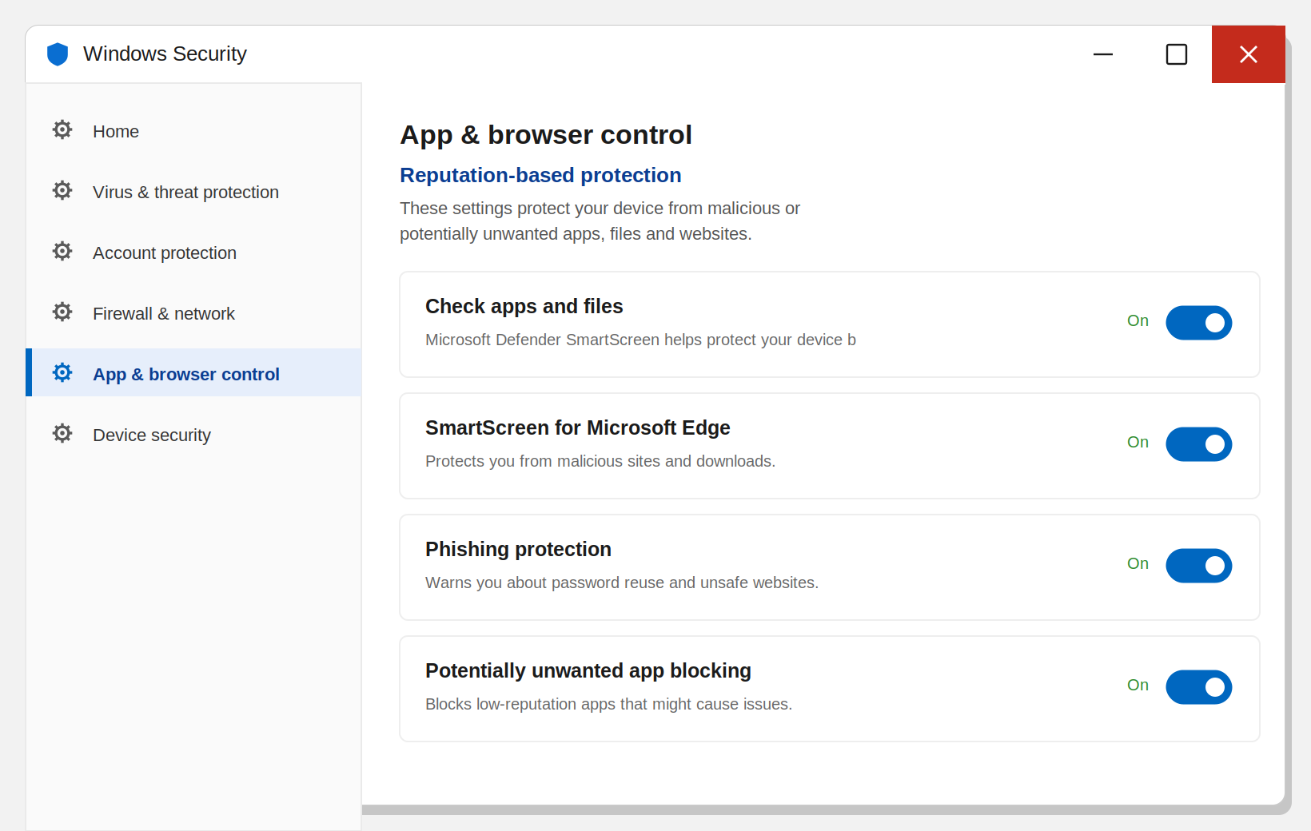
2-SAVOL · AMALIY TOPSHIRIQ 2.2
2.2-topshiriq — SmartScreen sozlamalari: beshta parametr
1
Start → Windows Security → oching.
Check apps and files — yuklangan faylni ishga tushishdan oldin tekshiradi (kam tanilgan setup.exe ni to‘xtatadi)
On
2
App & browser control bo‘limiga o‘ting.
SmartScreen for Microsoft Edge — Edge’da xavfli sayt va yuklamalarni bloklaydi
On
3
Reputation-based protection settings havolasini bosing.
Phishing protection — Windows parolini soxta saytga yozsangiz ogohlantiradi
On
Potentially unwanted app blocking — reklama/keraksiz ilovalar (PUA): Block apps + Block downloads
On
SmartScreen for Microsoft Store apps — Store ilovalari ochadigan veb-manzillarni tekshiradi
On
SmartScreen nimani tekshiradi? Faqat internetdan yuklangan fayllarni — brauzer ularga yashirin Mark of the Web belgisini qo‘yadi. Fleshkadan nusxalangan faylda bu belgi yo‘q.
17-rasm. “App & browser control” — Reputation-based protection
? Mark of the Web
28
KKvaEH · 1-mavzu · Windows OT xavfsizligi

Slide 29
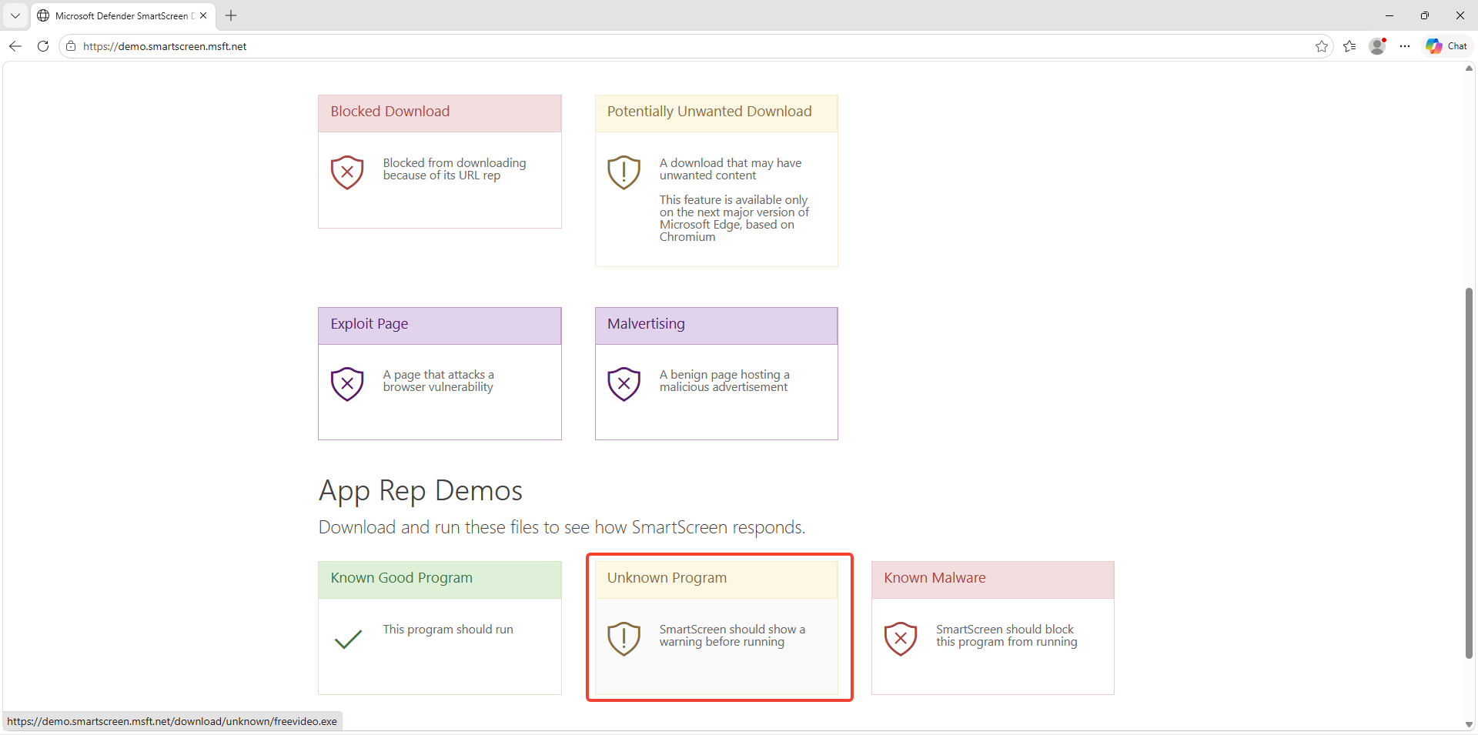
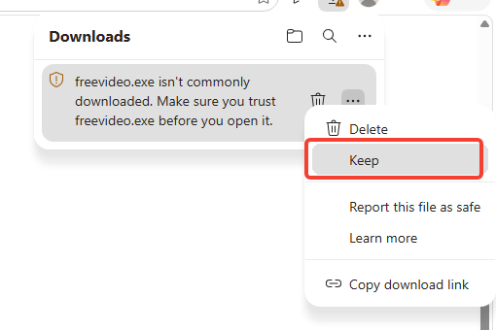
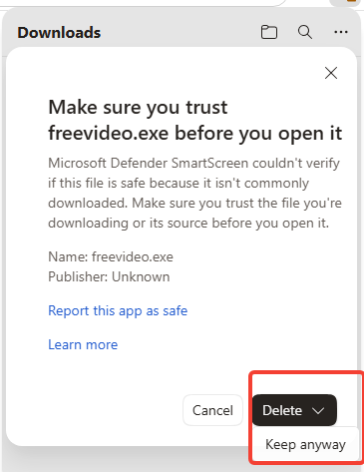

2-SAVOL · AMALIY TOPSHIRIQ 2.2 — SINOV
Sinov: SmartScreen’ni xavfsiz tekshirish (demo.smartscreen.msft.net)
Microsoft Edge’da https://demo.smartscreen.msft.net ni oching — haqiqiy virus yo‘q, faqat demo fayllar.
1
Unknown Program havolasini bosing. Edge: “isn’t commonly downloaded” → Keep.
2
SmartScreen yana so‘raydi — Keep anyway bilan davom eting.
3
18-rasm. demo.smartscreen.msft.net — SmartScreen sinov sayti
Natija — nega ogohlantirdi?
Edge faylni “zararli” demadi, balki kam tanilgan / obro‘si past dedi. Bu — SmartScreen’ning obro‘ tekshiruvi: fayl yangi bo‘lgani uchun Microsoft bazasida yetarli “ishonch” yo‘q. Solishtiring: Known Malicious yoki Phishing Page havolalarini Edge umuman ochmaydi — qizil ogohlantirish.
19-rasm. Yuklab olishda ogohlantirish — “Keep”
20-rasm. “Keep anyway” bilan davom ettirish
KKvaEH · 1-mavzu · Windows OT xavfsizligi
29

Slide 30
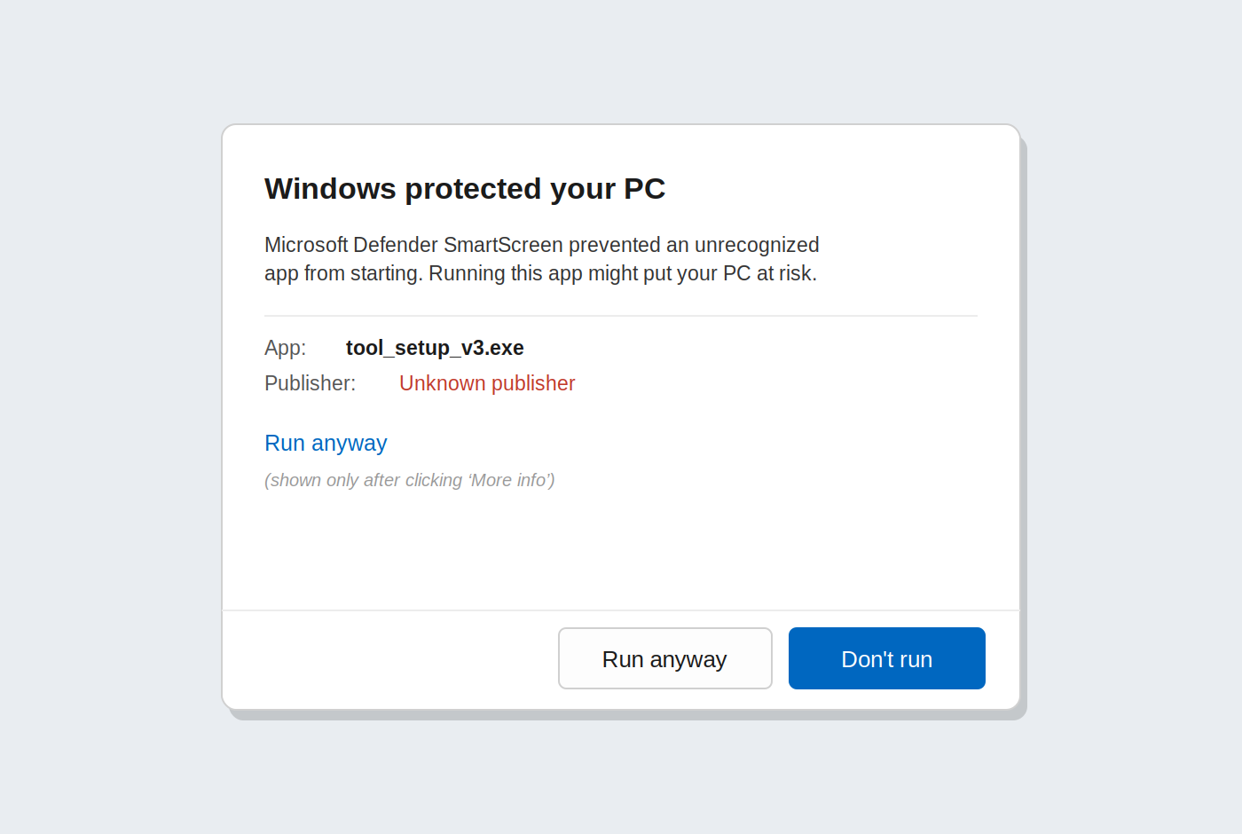
2-SAVOL · AMALIY TOPSHIRIQ 2.2 — SINOV
“Windows protected your PC” — SmartScreen ogohlantirishi
Yuklangan faylni ishga tushiring → ko‘k “Windows protected your PC” oynasi.
1
More info ni bosing: App — fayl nomi, Publisher: Unknown — fayl imzosiz.
2
Shundagina Run anyway paydo bo‘ladi — uni bosmang, Don’t run bilan yoping.
3
Qo‘shimcha: Potentially Unwanted Application havolasi — PUA blocking yoqilgan bo‘lsa, Edge yuklamani bloklaydi.
4
21-rasm. SmartScreen ogohlantirishi va “More info → Run anyway”
Natija: SmartScreen dastur ishga tushishidan OLDIN to‘xtatadi va foydalanuvchini o‘ylashga majbur qiladi.
Adashtirmang!
Oyna chiqmasdan dastur ochilsa: (1) MOTW yo‘q; (2) avval “Run anyway” bosilgan — SmartScreen eslab qoladi; (3) Check apps and files o‘chiq.
KKvaEH · 1-mavzu · Windows OT xavfsizligi
30

Slide 31
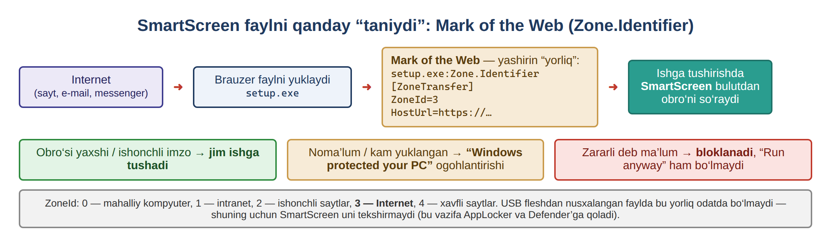
2-SAVOL · AMALIY TOPSHIRIQ 2.3
2.3-topshiriq — Mark of the Web: yuklangan fayl belgisini o‘qish
Belgi faylning ichida emas, NTFS’dagi yashirin Zone.Identifier oqimida (alternate data stream) saqlanadi. A mashq: 2.2-topshiriqda yuklangan fayl oqimlarini ko‘ring:
ZoneId | Zona | Ma’nosi
0 | Local computer | Shu kompyuterda yaratilgan
1 | Local intranet | Ichki tarmoq
2 | Trusted sites | Ishonchli saytlar
3 | Internet | Internetdan — SmartScreen tekshiradi
4 | Restricted sites | Xavfli deb belgilangan
PS> cd $env:USERPROFILE\Downloads
PS> Get-Item .\freevideo.exe -Stream *
PS> Get-Content .\freevideo.exe -Stream Zone.Identifier
[ZoneTransfer]
ZoneId=3
ReferrerUrl=https://demo.smartscreen.msft.net/
HostUrl=https://.../freevideo.exe
Natija: HostUrl — fayl qayerdan yuklanganini, ReferrerUrl — qaysi sahifadan havola bosilganini ko‘rsatadi. Kriminalist birinchi bo‘lib shu belgini o‘qiydi.
22-rasm. SmartScreen va Mark of the Web (Zone.Identifier)
? Mark of the Web
31
KKvaEH · 1-mavzu · Windows OT xavfsizligi

Slide 32
2-SAVOL · AMALIY TOPSHIRIQ 2.3
B va C mashqlar — belgini olib tashlash va o‘z test faylingiz bilan sinash
B mashq — Unblock
sstest.exe ni ikki marta bosing — ogohlantirishsiz ochiladi (MOTW yo‘q).
Fayl → Properties → General pastida: “This file came from another computer…” + Unblock — bu MOTWning grafik ko‘rinishi. Buyruq bilan:
2
Belgini qo‘shing (kod, 3-qadam) va yana bosing — “Windows protected your PC”, Publisher: Unknown.
PS> Unblock-File .\freevideo.exe
PS> Get-Item .\freevideo.exe -Stream * # faqat :$DATA qoladi
3
Unblock-File bilan belgini olib tashlang — ogohlantirish yo‘qoladi. Oxirida faylni o‘chiring.
C mashq — o‘zingiz yaratgan test fayl
4
# 1) Windows PowerShell 5.1 — zararsiz test dastur
$src = 'public class T { public static void Main() {'
$src += ' System.Console.WriteLine("SmartScreen test"); System.Console.ReadLine(); } }'
Add-Type -TypeDefinition $src -OutputType ConsoleApplication `
-OutputAssembly "$env:USERPROFILE\Desktop\sstest.exe"
# 3) “internetdan kelgan” belgisini qo‘lda qo‘shish
Set-Content "$env:USERPROFILE\Desktop\sstest.exe" -Stream Zone.Identifier `
-Value "[ZoneTransfer]`r`nZoneId=3"
Muhim nyuanslar
-OutputType ConsoleApplication faqat Windows PowerShell 5.1 da ishlaydi.
SmartScreen faylni Explorer orqali ochilganda tekshiradi; .\sstest.exe dan odatda ogohlantirish chiqmaydi.
Hujumchilar MOTWni yo‘qotishga urinadi (arxiv / disk obrazi ichida yuborish).
KKvaEH · 1-mavzu · Windows OT xavfsizligi
32

Slide 33
YAKUNIY AMALIY TOPSHIRIQ
Laboratoriya topshirig‘i — mustaqil bajaring va hisobot topshiring
UAC: “Always notify” holatiga o‘tkazing — sozlamalar oynasi skrinshoti + ConsentPromptBehaviorAdmin = 2 ni ko‘rsatuvchi PowerShell natijasi.
Hisobot quyidagilarni o‘z ichiga olishi kerak
▸ Titul varag‘i: F.I.Sh., guruh, sana
▸ Har bir topshiriq uchun izohli skrinshot
▸ 1–2 gap: nima qildingiz va nimani ko‘rdingiz
▸ Laboratoriya avvalgi holatga qaytarilgani haqida qayd
▸ O‘zingiz tanlagan 2 ta nazorat savoliga javob
AppLocker — qoida: faqat C:\Windows va C:\Program Files dan ishga tushishga ruxsat beruvchi Path qoidasini yarating.
AppLocker — sinov: qoidadan tashqaridagi istalgan .exe ni ishga tushiring — bloklanganini skrinshot bilan tasdiqlang (+ 8004).
SmartScreen: noma’lum manbadan kelgan faylni yuklab, ogohlantirish oynasini skrinshot qiling.
Baholash: UAC — 20% · AppLocker qoidasi — 30% · AppLocker sinovi + jurnal — 30% · SmartScreen — 10% · hisobot sifati — 10%
KKvaEH · 1-mavzu · Windows OT xavfsizligi
33

Slide 34


YAKUNLASH
Xulosa
UAC darajasi slayder bilan o‘rnatiladi; “Always notify” — eng xavfsizi. GUI va registr (EnableLUA, ConsentPromptBehaviorAdmin, PromptOnSecureDesktop) doim mos kelishi kerak.
Administrator ham kundalik ishni Medium (filtrlangan token) bilan bajaradi; High faqat UAC tasdig‘idan keyin.
AppLocker faqat Application Identity servisi ishlaganda ishlaydi; avval Default rules, keyin Publisher / Path / File hash qoidalari.
Implicit deny; Deny har doim ustun; Default rules bilan administrator “Run as administrator” orqali o‘tib keta oladi.
Audit only (8003) → Enforce (8004), gpupdate /force bilan qo‘llang; Test-AppLockerPolicy bilan oldindan sinang.
SmartScreen — 5 ta sozlama; tekshiruvni Mark of the Web (ZoneId=3) ishga tushiradi; belgi Unblock-File bilan olib tashlanadi.
KKvaEH · 1-mavzu · Windows OT xavfsizligi
34

Slide 35
YAKUNLASH
Nazorat savollari — 3-mashg‘ulot
AppLocker ishlashi uchun qaysi servis ishga tushirilgan bo‘lishi kerak?
Nega Ish stolidagi dastur oddiy usulda bloklanadi, “Run as administrator” bilan esa ishga tushadi?
1
6
“Audit only” va “Enforce Rules” rejimlari orasidagi farq nima?
Path, Publisher va File hash qoidalari fayl qayta nomlanganda yoki ko‘chirilganda qanday ishlaydi?
2
7
UAC darajasini o‘zgartirish uchun qaysi buyruq qatori vositasidan foydalanish mumkin?
Bitta faylga ham Allow, ham Deny qoidasi to‘g‘ri kelsa, qaysi biri ustun turadi?
3
8
SmartScreen ogohlantirishi chiqqanda foydalanuvchi qanday qo‘shimcha ma’lumot ko‘rishi mumkin?
Mark of the Web nima, u qayerda saqlanadi va uni qanday o‘qish mumkin?
4
9
Nima uchun Default Rules yaratmasdan turib maxsus qoida qo‘shish tavsiya etilmaydi?
Oddiy va administrator PowerShell oynasining integrity level’i qanday farq qiladi va buni qanday tekshirasiz?
5
10
KKvaEH · 1-mavzu · Windows OT xavfsizligi
35

Slide 36

E’TIBORINGIZ UCHUN RAHMAT!
Savollaringiz bo‘lsa, marhamat.
Keyingi bo‘lim — atamalar lug‘ati

Slide 37


LUG‘AT
Lug‘at — ushbu bo‘limda quyidagilar tushuntiriladi
Snapshot
Registry value
Integrity level
VMning saqlangan holati
registrdagi nomlangan sozlama
jarayonning ishonch darajasi
Default rules
Implicit deny
Audit only mode
AppLockerning “xavfsizlik to‘ri”
ruxsat berilmagan — taqiqlangan
jurnalga yozadi, bloklamaydi
Group Policy refresh
Event log
Mark of the Web
gpupdate /force
tizimning “qora qutisi”
“internetdan kelgan” belgisi
Har bir atama boshlang‘ich darajaga mos tilda, misol va diagramma bilan tushuntiriladi. Kartochkani bosing — izohga o‘tasiz.
KKvaEH · 1-mavzu · Windows OT xavfsizligi
37

Slide 38
LUG‘AT · ATAMA IZOHI
38
Snapshot (virtual mashina)
Oddiy qilib aytganda:
Snapshot 1 — toza o‘rnatish
Snapshot — ma’lum bir paytdagi butun virtual mashinaning saqlangan “surati” — disk, sozlamalar va hatto xotira. Keyinchalik aynan o‘sha holatga bitta bosish bilan qaytish mumkin (Restore).
Snapshot 2 — 3-mashg‘ulotdan oldin
Lab: qoidalar, tajribalar…
Nima uchun muhim:
Xavfsizlik laboratoriyalarida biz ataylab narsalarni buzamiz: dasturlarni bloklaymiz, UACni o‘zgartiramiz. Snapshot istalgan xatoni bir daqiqada bekor qilish imkonini beradi.
VirtualBox: Machine → Snapshots → Take / Restore.
Nimadir buzildi → Restore
← Mavzuga qaytish

Slide 39
LUG‘AT · ATAMA IZOHI
39
Registry value (masalan, EnableLUA)
Oddiy qilib aytganda:
Kalit:
HKLM\SOFTWARE\Microsoft\Windows\
CurrentVersion\Policies\System
Windows registri — papkalar (kalitlar — keys) kabi tuzilgan katta sozlamalar bazasi. Kalit ichida qiymatlar (values) bor: nomi, turi va ma’lumoti. Masalan, EnableLUA = 1.
EnableLUA REG_DWORD 1
ConsentPromptBehaviorAdmin REG_DWORD 5
Nima uchun muhim:
Har bir GUI kaliti (masalan, UAC slayderi) aslida shunchaki registr qiymatidir. Qiymatlarni PowerShell bilan o‘qish sozlamani tez, ko‘plab kompyuterlarda va kriminalistik tahlil paytida tekshirish imkonini beradi.
PromptOnSecureDesktop REG_DWORD 1
← Mavzuga qaytish

Slide 40
LUG‘AT · ATAMA IZOHI
40
Integrity level (Medium / High)
Oddiy qilib aytganda:
System
yadro, SYSTEM servislari
Har bir jarayonning ishonch darajasi bor: Low, Medium, High, System. Past darajadagi jarayon yuqori darajadagisiga “yoza olmaydi”. Oddiy oyna — Medium, “Run as administrator” — High.
High
Run as administrator (to‘liq token)
Medium
oddiy dasturlar (filtrlangan token)
Nima uchun muhim:
UAC aynan shu darajalarga tayanadi: zararli dastur oddiy oynadan ishga tushsa, u Medium’da qoladi va tizimni o‘zgartira olmaydi. Tekshirish: whoami /groups → “Mandatory Label”.
Low
brauzer “sandbox”i
← Mavzuga qaytish

Slide 41
LUG‘AT · ATAMA IZOHI
41
AppLocker standart qoidalari (default rules)
Oddiy qilib aytganda:
Allow · Everyone
%PROGRAMFILES%\*
Create Default Rules ni bosganingizda AppLocker uchta Allow qoidasini qo‘shadi: C:\Program Files dagi hamma narsa, C:\Windows dagi hamma narsa va Administrators guruhi uchun barcha fayllar.
Allow · Everyone
%WINDIR%\*
Allow · Administrators
* (barcha fayllar)
Nima uchun muhim:
AppLocker ruxsat berilmagan hamma narsani bloklaydi. Bu qoidalarsiz hatto Explorer va Start menyusi ham bloklanishi mumkin. Ular — qoidalaringiz ostidagi “xavfsizlik to‘ri”. (Administrators qoidasi sabab “Run as administrator” bilan bloklangan dastur ochilishi mumkin — A mashq.)
Qolgan hammasi → bloklanadi (Enforce rejimida)
← Mavzuga qaytish

Slide 42
LUG‘AT · ATAMA IZOHI
42
Implicit deny
Oddiy qilib aytganda:
Allow
qoidaga mos → ishga tushadi
To‘plamda (masalan, Executable Rules) kamida bitta qoida paydo bo‘lishi bilan AppLocker “ruxsat ro‘yxati” rejimiga o‘tadi: ochiq ruxsat berilmagan hamma narsa avtomatik taqiqlanadi.
Deny
aniq taqiq → har doim ustun
Nima uchun muhim:
DeniedByDefault
hech qaysi Allow’ga tushmadi → bloklandi
Shuning uchun Ish stolidagi yoki Downloads’dagi noma’lum .exe hech qanday Deny qoidasisiz ham bloklanadi. Test-AppLockerPolicy bunday holatni DeniedByDefault deb ko‘rsatadi.
← Mavzuga qaytish

Slide 43
LUG‘AT · ATAMA IZOHI
43
Audit only mode
Oddiy qilib aytganda:
Audit only
dastur ishlaydi · 8003 “bloklangan bo‘lardi”
Audit only rejimida AppLocker hech narsani bloklamaydi. U faqat nimani bloklagan bo‘lardi — shuni jurnalga yozadi (8003 hodisasi).
Enforce rules
dastur bloklandi · 8004
Nima uchun muhim:
Qoidalarda xato qilish oson. Avval audit qilish qoidalaringiz qaysi qonuniy dasturlarni unutganini ko‘rsatadi — shunda Enforce ga o‘tganingizda (8004) foydalanuvchilar ishi to‘xtab qolmaydi.
← Mavzuga qaytish

Slide 44
LUG‘AT · ATAMA IZOHI
44
Group Policy refresh (gpupdate /force)
Oddiy qilib aytganda:
PS> gpupdate /force
Updating policy...
# Computer Policy update has completed successfully.
# User Policy update has completed successfully.
Windows siyosatlarini ishga tushishda va taxminan har 90 daqiqada avtomatik qayta o‘qiydi. gpupdate /force esa barcha siyosatlarni darhol qayta o‘qib, qo‘llashga majbur qiladi.
Nima qo‘llanganini tekshirish: gpresult /r
Nima uchun muhim:
AppLocker yoki xavfsizlik sozlamalarini o‘zgartirgandan keyin kutish yoki qayta ishga tushirish shart emas — gpupdate o‘zgarishni darhol qo‘llaydi, shuning uchun uni o‘sha zahoti sinab ko‘rishingiz mumkin.
← Mavzuga qaytish

Slide 45
LUG‘AT · ATAMA IZOHI
45
Event log (Event Viewer)
Oddiy qilib aytganda:
8002
AppLocker: dasturga ruxsat berildi
Windows muhim hodisalarni jurnallarga yozadi — xuddi samolyotning “qora qutisi” kabi. Har bir hodisaning manbasi, vaqti va Event ID raqami bor. Ularni eventvwr.msc da o‘qiysiz.
8003
AppLocker: bloklangan bo‘lardi (audit)
8004
AppLocker: dastur bloklandi
Nima uchun muhim:
Jurnallar himoya ishlaganini isbotlaydi (AppLocker 8004) va hujumchi nima qilganini ko‘rsatadi. Ular kiber kriminalistikada asosiy dalil hisoblanadi.
4625
Security: muvaffaqiyatsiz kirish (4-mashg‘ulot)
← Mavzuga qaytish

Slide 46
LUG‘AT · ATAMA IZOHI
46
Mark of the Web (Zone.Identifier)
Oddiy qilib aytganda:
file.exe:Zone.Identifier
[ZoneTransfer]
ZoneId=3
ReferrerUrl=https://site/
HostUrl=https://site/file.exe
Brauzer internetdan yuklangan faylga yashirin “internetdan kelgan” belgisini qo‘yadi. U faylning ichida emas, NTFS’dagi Zone.Identifier oqimida saqlanadi: ZoneId=3, HostUrl, ReferrerUrl.
Brauzerdan yuklangan
MOTW bor → SmartScreen tekshiradi
Nima uchun muhim:
SmartScreen aynan shu belgiga qarab tekshiradi: belgi yo‘q — ogohlantirish yo‘q. Kriminalist esa HostUrl dan fayl qaysi saytdan kelganini aniqlaydi. O‘qish: Get-Content file -Stream Zone.Identifier; olib tashlash: Unblock-File.
Fleshkadan / o‘zingiz yaratgan
MOTW yo‘q → ogohlantirish yo‘q
← Mavzuga qaytish

