Slide 1


COURSE: “CYBER FORENSICS AND ETHICAL HACKING”
TOPIC 1
WINDOWS OS
SECURITY
Lesson 3 · Windows OS Services | Practical, 4 hours
REPUBLIC OF UZBEKISTAN
UNIVERSITY OF MILITARY SECURITY AND DEFENSE
Institute of ICT and Military Communications · Cybersecurity Department
Lecturer: Senior Lecturer, Cybersecurity Department — Captain M. Isakov

Slide 2





TOPIC 1 · WINDOWS OS SECURITY
Lesson 3: Windows OS Services (Practical)
Topic
Session type
Duration
Windows OS security
Practical (lab)
4 hours
Learning questions
Before you start
1
User Account Control (UAC) — configuring in practice
▸ A Windows 11 Pro / Enterprise virtual machine (not Home).
▸ Take a snapshot before you begin.
▸ Sign in with an ordinary account in the Administrators group (not the built-in Administrator).
▸ Never practise on a work or personal PC.
level · registry · two tokens · integrity level
2
AppLocker and SmartScreen security systems — configuring in practice
rules · exercises A–E · SmartScreen test · Mark of the Web
KKvaEH · Topic 1 · Windows OS Security
2

Slide 3
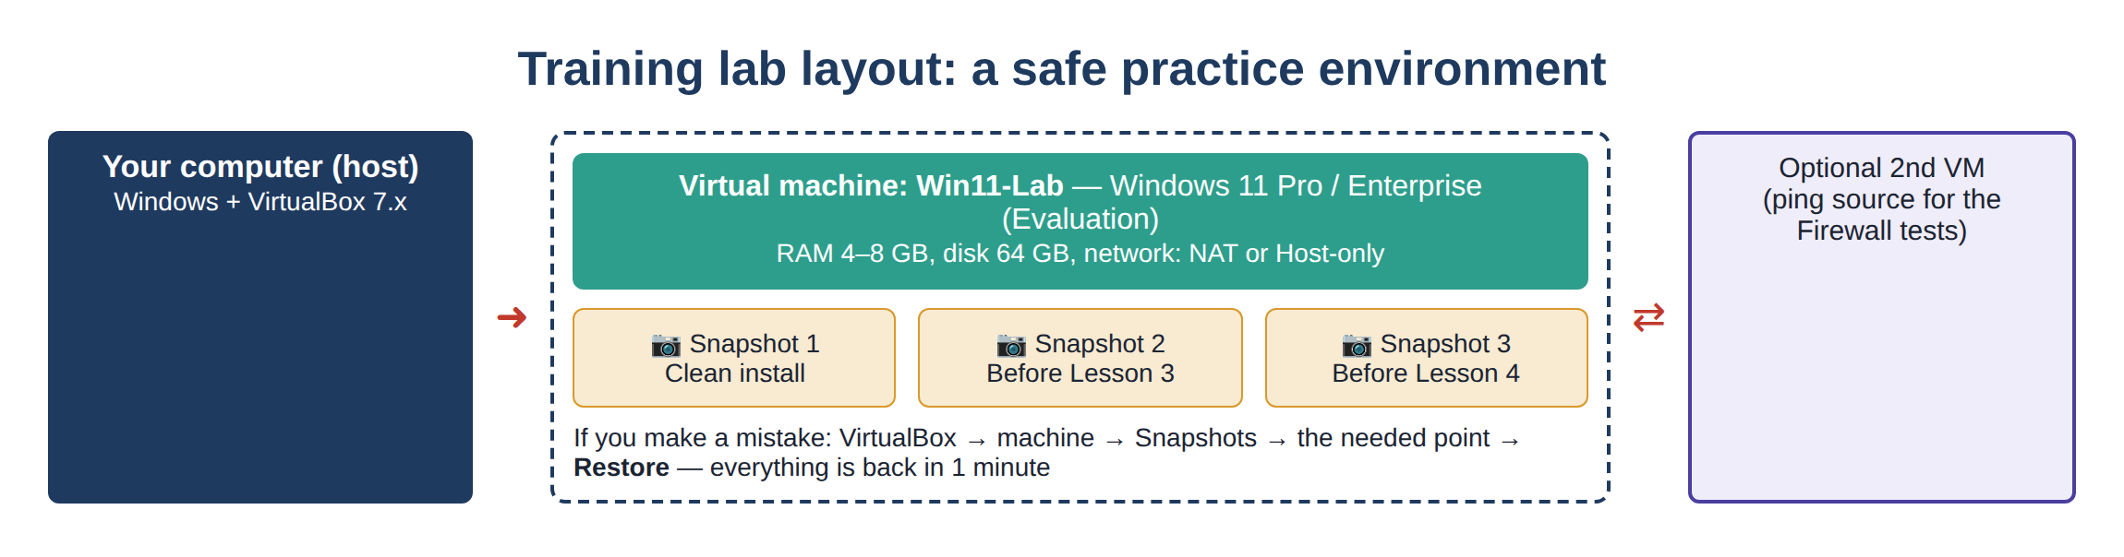

PRACTICAL LESSON · ORGANISATION
Lab plan for 4 hours and the lab environment
1.1
Change the UAC level and test it (msconfig)
15 min
1.2
Check UAC with PowerShell (EnableLUA)
10 min
1.3
See the two tokens and the integrity level
15 min
1.4
The four slider positions and registry values
15 min
Figure 1. Training lab layout: virtual machine and snapshots
Safety rules: work only in the VM · take a snapshot before each task · if something breaks, Restore the snapshot instead of “fixing” the system. At the end of the exercises, restore the lab to its previous state.
2.1
AppLocker: service → rules → test + exercises A–E
75 min
2.2
SmartScreen: 5 settings and the safe test site
25 min
2.3
Mark of the Web: read, remove, test
20 min
Total: 240 minutes — 215 minutes of lab work + 25 minutes for the introduction, review and wrap-up. Every task ends with a “Result” box: what we did and what we achieved.
Lab
Final assignment + report with screenshots
45 min
? Snapshot
3
KKvaEH · Topic 1 · Windows OS Security

Slide 4

QUESTION 1
User Account Control (UAC) — configuring in practice
4

Slide 5
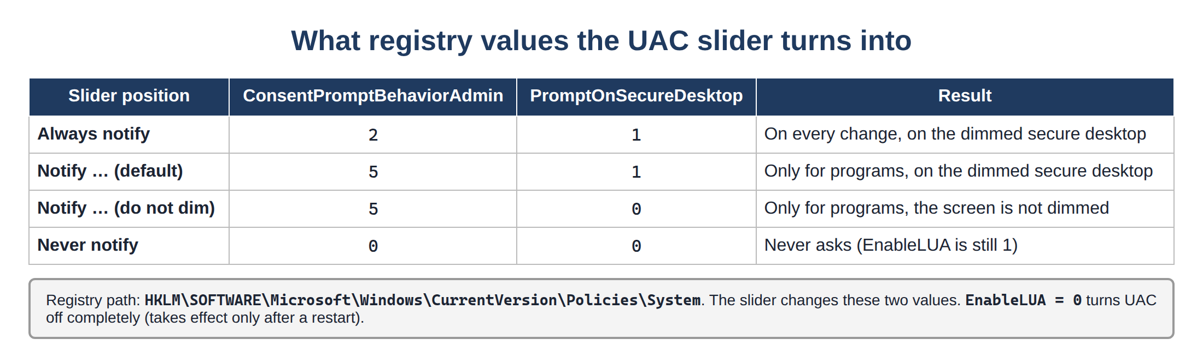

QUESTION 1 · QUICK RECAP FROM LESSON 2
What we change — the UAC levels
Always notify — most secure — use it on military networks
Notify… (default) — warns only for programs
Do not dim — no Secure Desktop — weaker
Never notify — never asks — never use it
Figure 2. UAC slider positions and their registry values
Today’s goal: move the slider, see the result on screen (msconfig), prove it in the registry with PowerShell, and finally see the two tokens and the integrity level with your own eyes.
? Registry value
? Integrity level
5
KKvaEH · Topic 1 · Windows OS Security

Slide 6
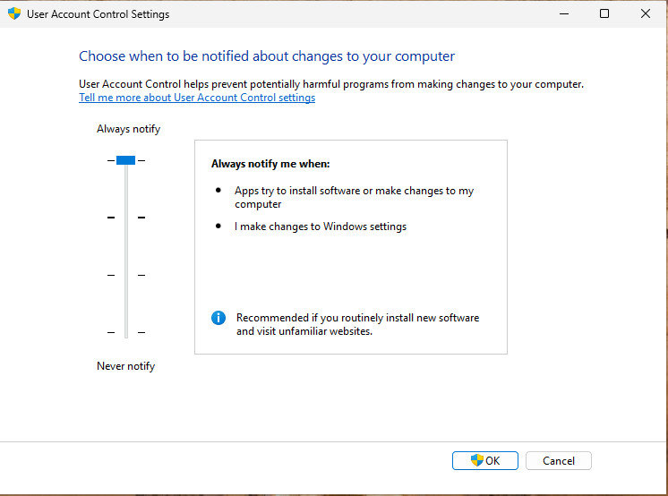
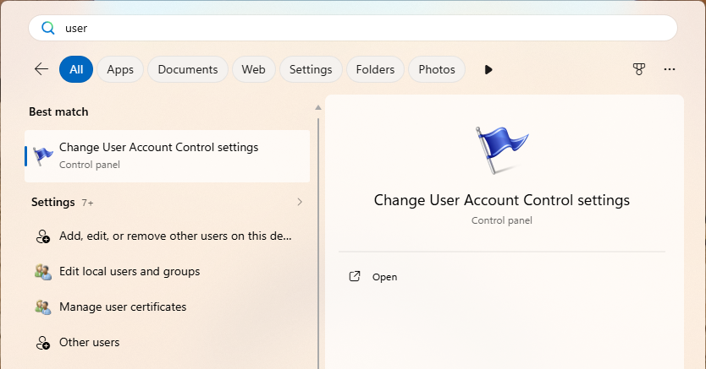

QUESTION 1 · PRACTICAL TASK 1.1
Task 1.1 — set UAC to “Always notify”
In Start menu search, type User Account Control.
1
Open Change User Account Control settings.
2
The window shows a slider — it indicates the four levels.
3
Move the slider to the top — Always notify — and click OK.
Figure 3. Searching for the UAC setting in the Start menu
Figure 4. The slider at “Always notify”
4
Quick ways: Win + R → UserAccountControlSettings (the fastest) or Win + R → control → User Accounts → User Accounts → “Change User Account Control settings”.
The system itself asks for confirmation — answer Yes.
5
Expected result: the slider stays at the top when the window is reopened; the change itself also required UAC confirmation.
KKvaEH · Topic 1 · Windows OS Security
6

Slide 7
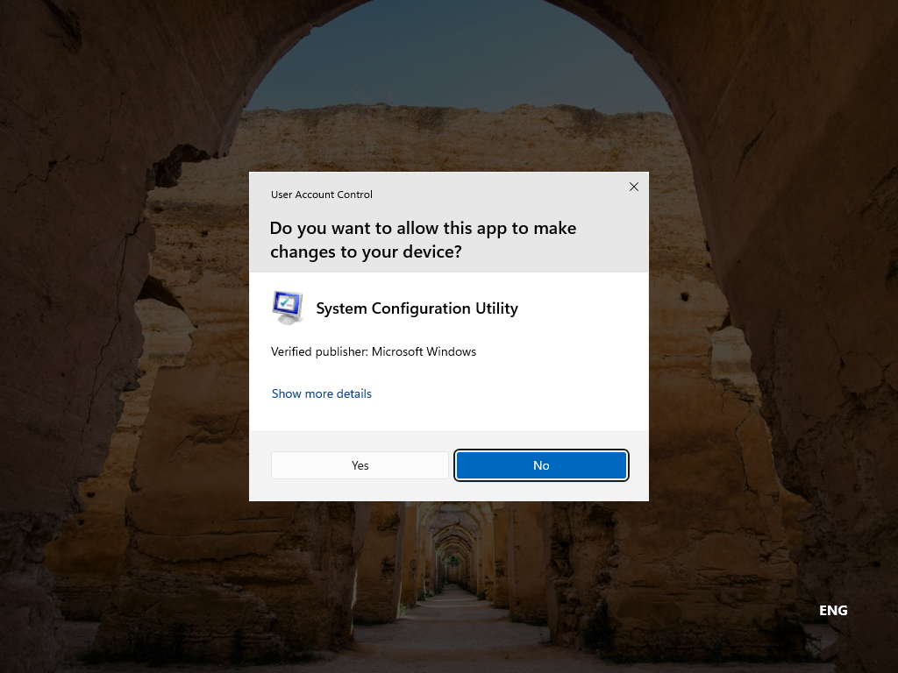
QUESTION 1 · PRACTICAL TASK 1.1
Task 1.1 — test the new level with msconfig, then revert
In the Win + R box, enter msconfig.
1
Observe: at the default level this window opened without a prompt — now UAC asks even for Windows’ own program.
2
Read the prompt: the program name (System Configuration Utility), the publisher — Microsoft Windows.
3
Return the slider to the default level (“Notify only when apps try to make changes”).
4
Run msconfig again — now the window opens without a prompt.
5
Figure 5. At “Always notify” even msconfig asks for confirmation
Result: at “Always notify” Windows asks for confirmation even for its own settings programs. The higher the slider, the stricter the control.
KKvaEH · Topic 1 · Windows OS Security
7

Slide 8
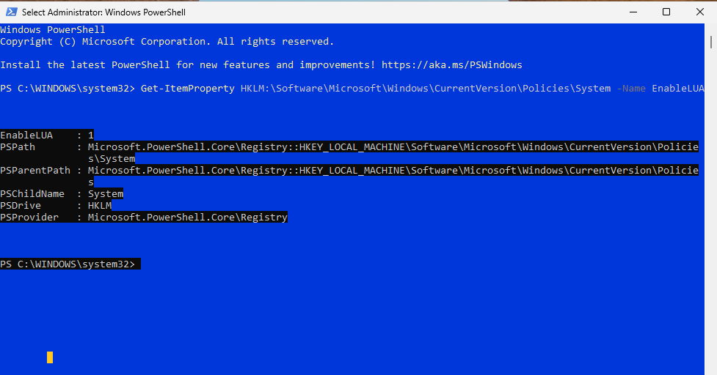
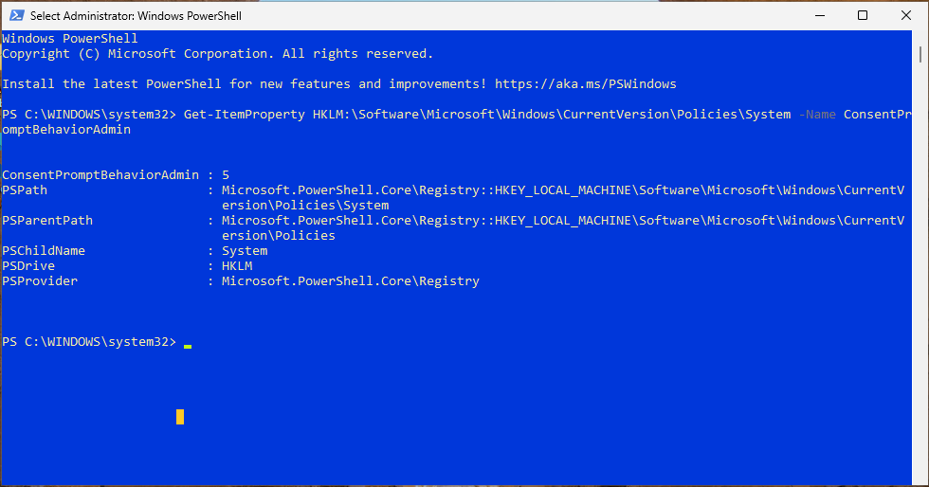
QUESTION 1 · PRACTICAL TASK 1.2
Task 1.2 — check UAC with PowerShell
Open PowerShell with administrator rights (right-click → Run as administrator).
1
Run: Get-ItemProperty HKLM:\Software\Microsoft\Windows\CurrentVersion\Policies\System -Name EnableLUA
2
Figure 6. PowerShell — result of checking the UAC state (EnableLUA)
EnableLUA : 1 — UAC is on; 0 — it is off (a serious weakness).
3
Likewise read -Name ConsentPromptBehaviorAdmin — the prompt type for administrators.
4
Figure 7. PowerShell — the ConsentPromptBehaviorAdmin value
Expected result: EnableLUA : 1 and ConsentPromptBehaviorAdmin : 5 (default) — the GUI slider really changes these registry values.
? Registry value
8
KKvaEH · Topic 1 · Windows OS Security

Slide 9


QUESTION 1 · PRACTICAL TASK 1.2
How to read the values
ConsentPromptBehaviorAdmin values:
A separate value for standard users
0
Elevate without prompting — dangerous — admin rights are given silently
ConsentPromptBehaviorUser:
3 (default) — an administrator user name and password are requested (Credential prompt);
0 — an action that needs rights is denied without a prompt.
Read this value too with the command above.
1
Ask for credentials on the Secure Desktop — very strict
2
Ask for consent on the Secure Desktop — = “Always notify”
3
Ask for credentials — strict, no dimming
Forensic check
4
Ask for consent — no dimming
If EnableLUA = 0 or ConsentPromptBehaviorAdmin = 0 is found on a computer under investigation, it may be a sign that someone (often malware) deliberately weakened the protection. Compare the registry values with the GUI: they must always tell the same story.
5
Consent for non-Windows programs — = default
KKvaEH · Topic 1 · Windows OS Security
9

Slide 10
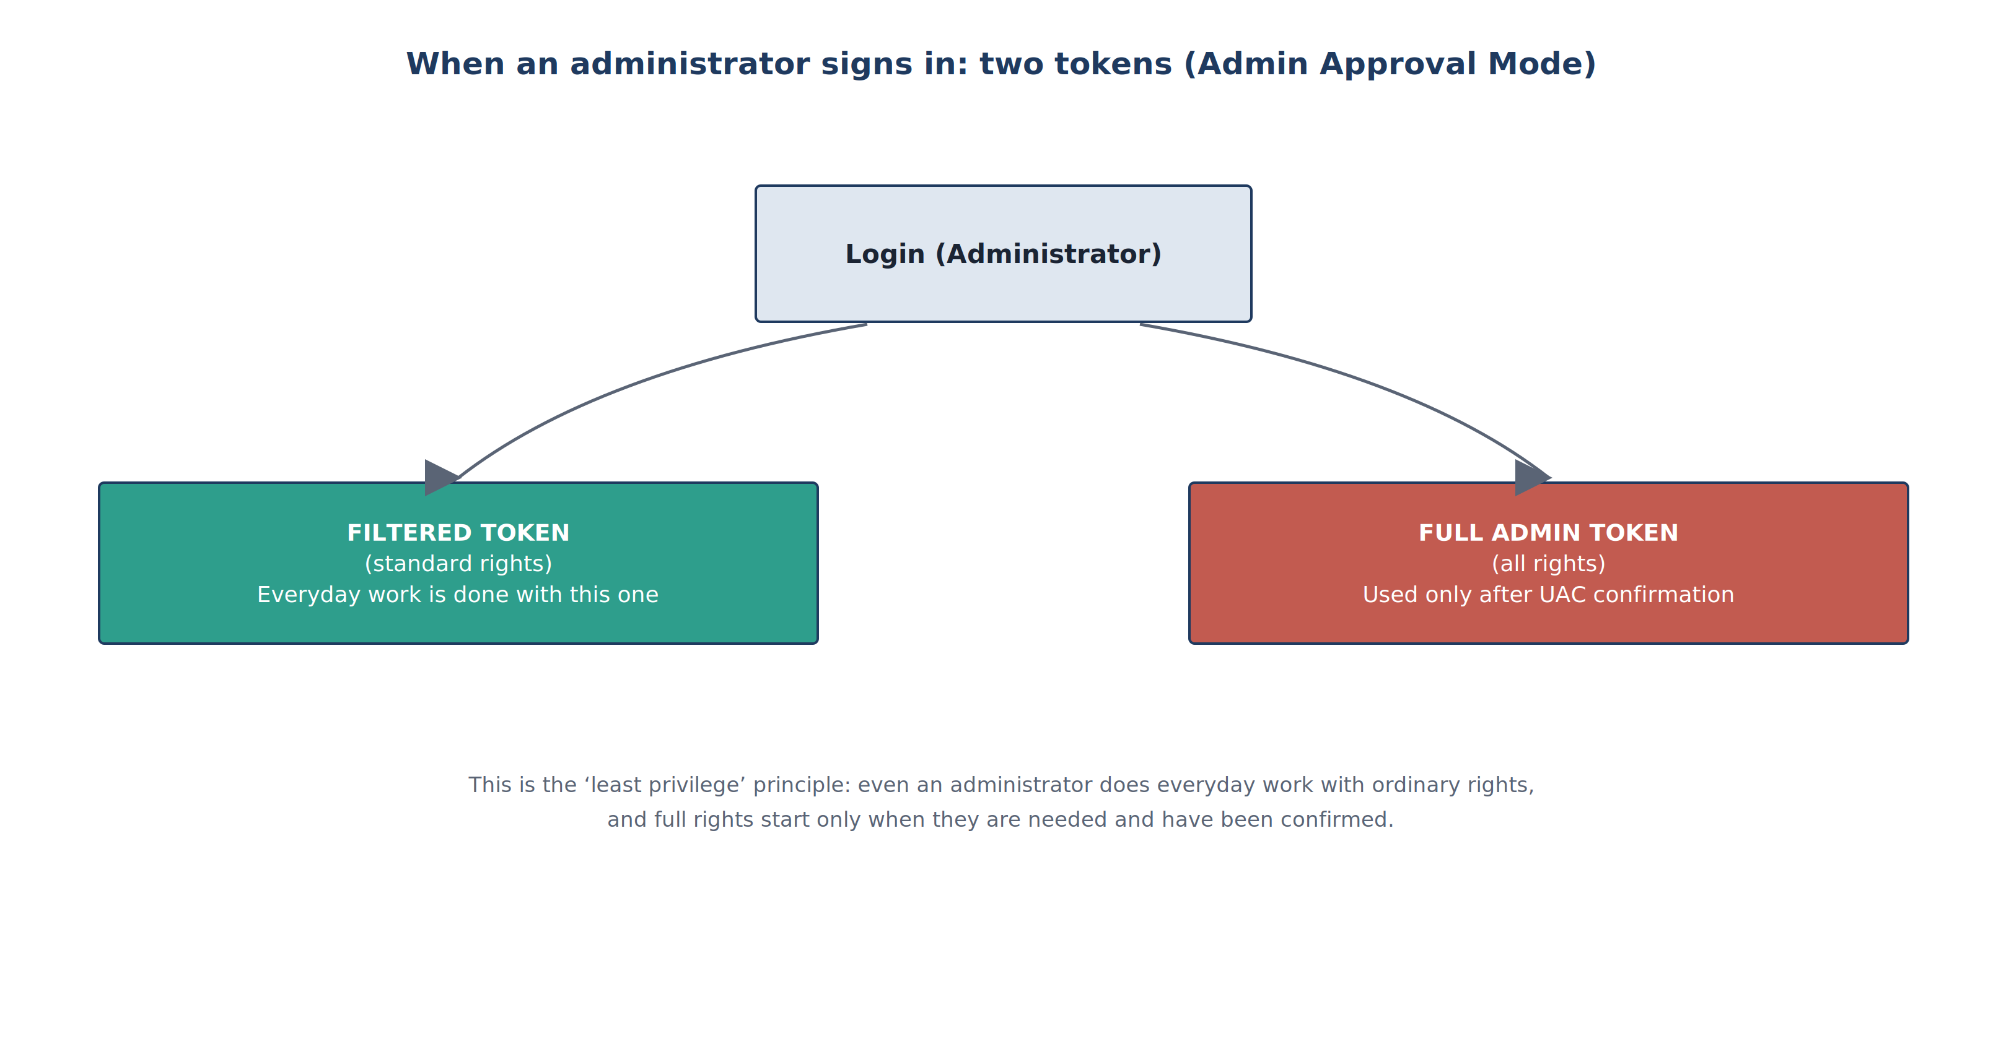
QUESTION 1 · PRACTICAL TASK 1.3
Task 1.3 — see the two tokens and the integrity level
Open Windows PowerShell the ordinary way (not Run as administrator).
Check | Ordinary window | Administrator window
Mandatory Level | Medium | High
BUILTIN\Administrators | Group used for deny only | Enabled group
net session | Access is denied | OK
Task Manager → Elevated | No | Yes
Token | filtered (ordinary) | full
1
Run: whoami /groups | findstr /i "Mandatory" and … "BUILTIN\Administrators"
2
Now open PowerShell with Run as administrator, confirm UAC and run the same commands.
3
In both windows: net session — Access is denied in the ordinary window, works in the admin one.
4
Ctrl + Shift + Esc → Details → columns → Elevated: one powershell.exe shows No, the other Yes.
5
Figure 8. Two tokens when an administrator signs in (Admin Approval Mode)
Expected result: two windows of the same account run with different rights: the everyday window is Medium (filtered token), the confirmed one is High (full token).
? Integrity level
10
KKvaEH · Topic 1 · Windows OS Security

Slide 11
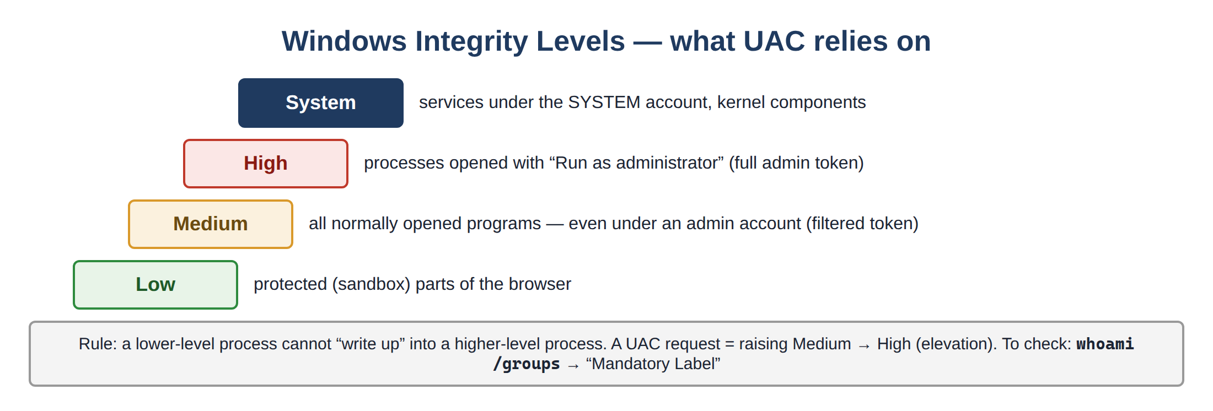


QUESTION 1 · PRACTICAL TASK 1.3 — RESULT
What we saw — and why it matters
Note — the built-in Administrator
In the built-in Administrator account (SID ending in -500) Admin Approval Mode is off by default: every window runs at High at once and no UAC prompt appears. So do the exercises in an ordinary account in the Administrators group. To check: whoami /user.
Figure 9. Windows integrity levels
Result — what did we see?
For the next exercises
The everyday windows of a user signed in as an administrator run at the Medium level, and the Administrators group is “switched off” in them (deny only). Full rights are granted only after UAC confirmation, and only for that one process (High). If malware starts from an ordinary window, it also stays at Medium — that is the whole benefit of UAC.
You will need this again in the AppLocker exercise: AppLocker also decides based on exactly this token (Exercise A — why does it open with “Run as administrator”?).
KKvaEH · Topic 1 · Windows OS Security
11

Slide 12
QUESTION 1 · PRACTICAL TASK 1.4
Task 1.4 — the four slider positions and the registry values
The slider actually changes three values in the registry. Put the slider in each position, run the command in an administrator window and fill in the table:
Result — what the table shows
PS> Get-ItemProperty HKLM:\Software\Microsoft\Windows\CurrentVersion\Policies\System |
Select-Object EnableLUA, ConsentPromptBehaviorAdmin, PromptOnSecureDesktop
ConsentPromptBehaviorAdmin — how the prompt is shown: 2 always asks, 5 only for other programs, 0 never asks.
PromptOnSecureDesktop — screen dimming (Secure Desktop): 1 on, 0 off.
Note: even at “Never notify” EnableLUA stays 1. UAC is turned off completely only through EnableLUA = 0, and that requires a restart.
Forensic significance: ConsentPromptBehaviorAdmin = 0 or EnableLUA = 0 may be a sign that the protection was weakened on purpose.
Slider position | ConsentPrompt…Admin | PromptOnSecure… | EnableLUA
Always notify (highest) | 2 | 1 | 1
Notify only when apps try… (default) | 5 | 1 | 1
Notify… (do not dim my desktop) | 5 | 0 | 1
Never notify (lowest) | 0 | 0 | 1
KKvaEH · Topic 1 · Windows OS Security
12

Slide 13
QUESTION 2
AppLocker and SmartScreen — configuring in practice
13

Slide 14





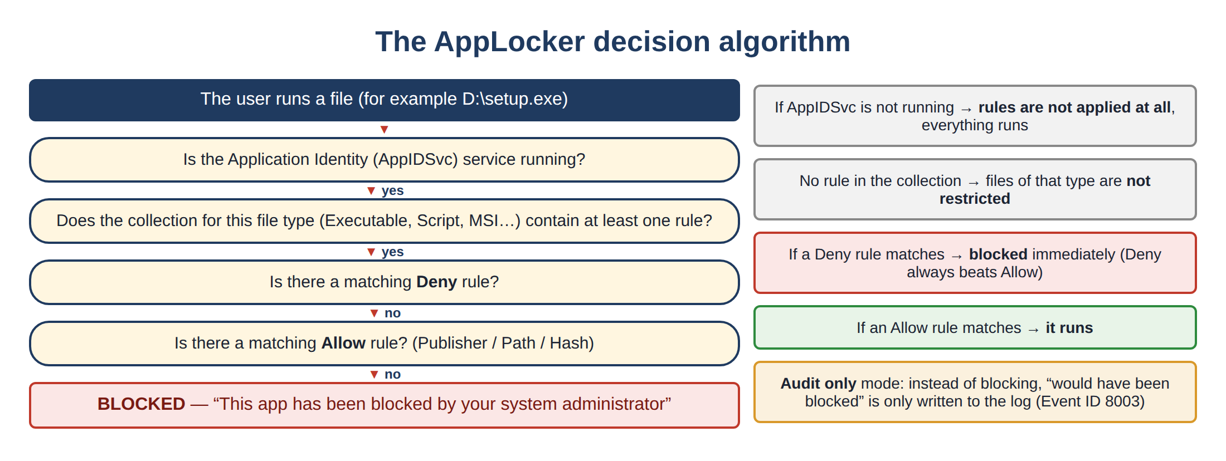
QUESTION 2 · PRACTICAL TASK 2.1
The AppLocker lab — the whole path in 7 steps
1
2
3
4
5
6
7
›
›
›
›
›
›
Start AppIDSvc
Open the policy
Default rules
Your own rule
Apply
Test
Log
sc config / sc start
gpedit / secpol
Create Default Rules
Publisher: notepad.exe
gpupdate /force
blocked / allowed
Event 8004
Before you start
▸ AppLocker works in the Pro, Enterprise, Education and Server editions; Home does not have it (check with winver).
▸ Rules are enforced by the Application Identity service — if it is not running, rules do not take effect.
▸ Always create the Default rules first, then your own rule.
▸ Snapshot first — a wrong rule can block the whole system.
Figure 10. The AppLocker decision algorithm
? Default rules
? Implicit deny
14
KKvaEH · Topic 1 · Windows OS Security

Slide 15
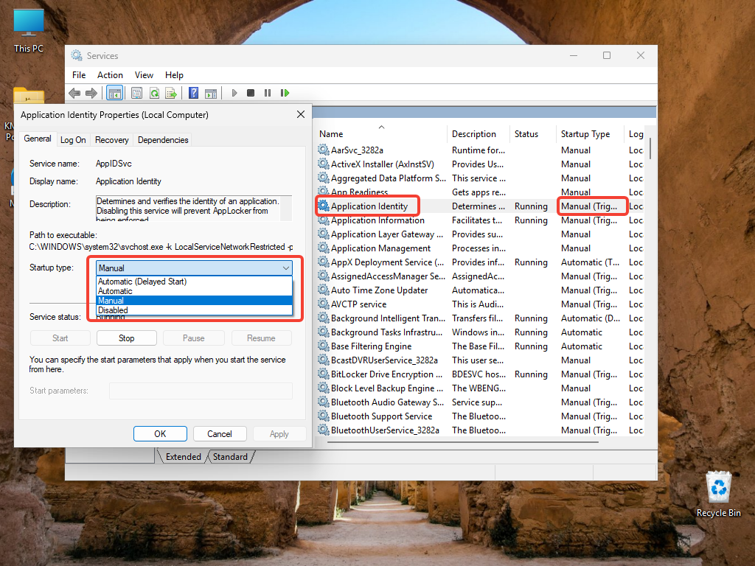
QUESTION 2 · TASK 2.1 — STEP A
Step A — start the Application Identity (AppIDSvc) service
1
Win + R → services.msc → find Application Identity.
2
A protected service: the Startup type field is greyed out — it cannot be configured here.
3
Open the command line as administrator.
4
Run: sc config appidsvc start= auto and sc start appidsvc
Figure 11. services.msc — the “Application Identity” (AppIDSvc) service
5
Check: sc query appidsvc → it should show STATE : 4 RUNNING.
If you get “Access denied”: gpedit.msc → Computer Configuration → Windows Settings → Security Settings → System Services → Application Identity → Automatic, then gpupdate /force.
Expected result: AppIDSvc = Running, Automatic. This is the sc command from Lesson 1 applied in practice. Without it AppLocker rules are ignored.
KKvaEH · Topic 1 · Windows OS Security
15

Slide 16
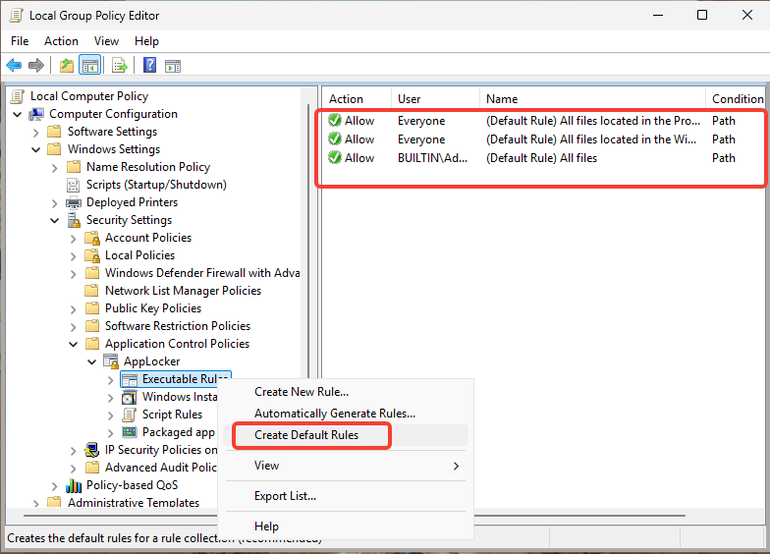
QUESTION 2 · TASK 2.1 — STEP B
Step B — open the policy and create the default rules
Win + R → gpedit.msc (Local Group Policy Editor; Pro/Enterprise only).
1
Path: Computer Configuration → Windows Settings → Security Settings → Application Control Policies → AppLocker.
2
Right-click Executable Rules → Create Default Rules.
3
Three rules appear: Program Files, Windows (Everyone) and all files for Administrators.
4
Figure 12. gpedit.msc — the “Create Default Rules” command (context menu)
Expected result: three default Allow rules in Executable Rules — Windows itself keeps working. Everything outside them now falls under implicit deny.
? Default rules
? Implicit deny
16
KKvaEH · Topic 1 · Windows OS Security

Slide 17
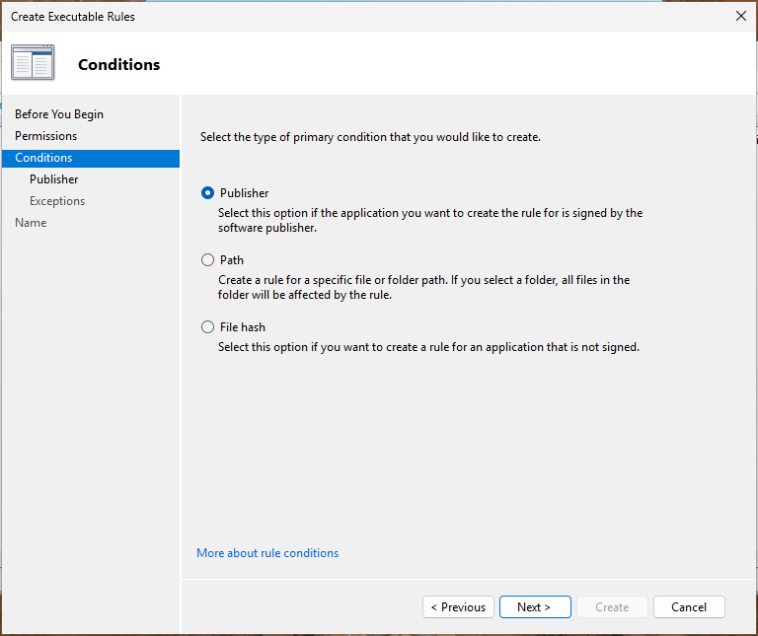
QUESTION 2 · TASK 2.1 — STEP C
Step C — create your own rule (Publisher condition)
1
Right-click Executable Rules → Create New Rule… → “Before You Begin” → Next.
2
Permissions: Action = Allow, User or group = Everyone → Next.
3
Conditions: choose the Publisher condition → Next.
4
Browse… → a signed file: C:\Windows\System32\notepad.exe. Do not change the slider → Next.
5
Skip Exceptions, name the rule → Create.
Figure 13. AppLocker — the new rule wizard (Publisher condition)
Expected result: a new Publisher rule for notepad.exe appears in the list — it keeps working even when the program is updated (as long as the signature stays the same).
KKvaEH · Topic 1 · Windows OS Security
17

Slide 18
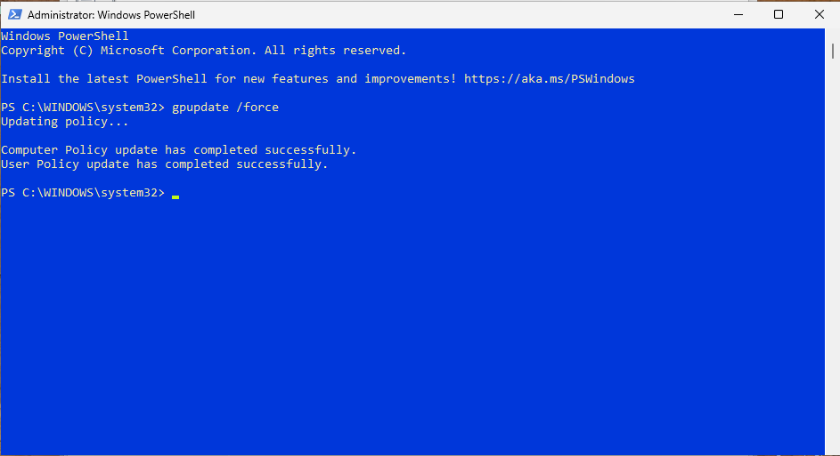
QUESTION 2 · TASK 2.1 — STEP D
Step D — apply the policy and test the rule
1
In an administrator PowerShell: gpupdate /force.
2
Wait for “Computer Policy update has completed successfully”.
3
Run a program that is not covered by the rules (an .exe on the Desktop or in Downloads — see Exercise A).
“This app has been blocked by your system administrator” — even if you are an administrator.
Figure 14. PowerShell — applying the policy with “gpupdate /force”
4
Result — what happened?
Where to check? eventvwr.msc → Applications and Services Logs → Microsoft → Windows → AppLocker → EXE and DLL.
8004 — blocked (Enforce) · 8003 — would have been blocked (Audit only) · 8002 — allowed.
AppLocker blocks a program that is not on the allow list. The reason is implicit deny: as soon as at least one rule appears in a collection, everything not explicitly allowed is automatically forbidden.
? Group Policy refresh
? Event log
? Implicit deny
18
KKvaEH · Topic 1 · Windows OS Security

Slide 19
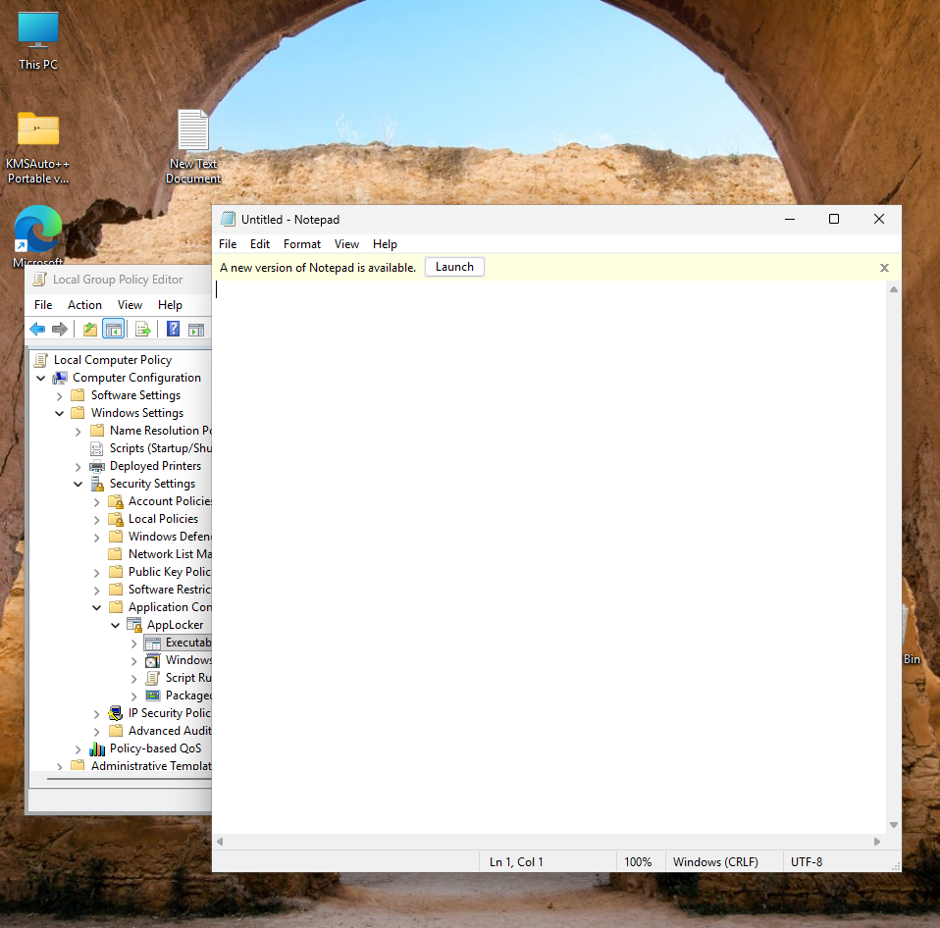
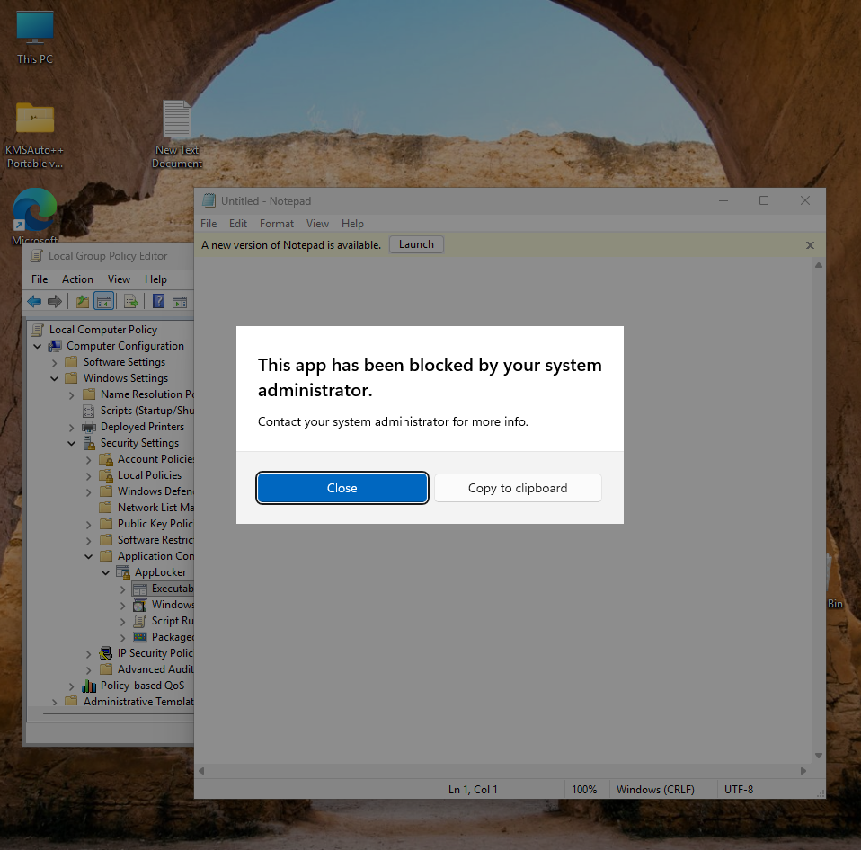
QUESTION 2 · TASK 2.1 — AN IMPORTANT NUANCE
Two Notepads in Windows 11 — doing the test correctly
The problem
The old Notepad is in C:\Windows\System32.
The new Notepad is a Microsoft Store app in a different folder.
Windows opens the new one by default, but our rule allows only the old one → the new Notepad is blocked.
1
Settings → Apps → Advanced app settings → App execution aliases.
2
Find Notepad in the list and turn it Off.
3
Open Notepad again — now the old Notepad starts and the rule allows it.
Figure 15. An allowed program — the old Notepad opened
Figure 16. The window of a program blocked by AppLocker
Expected result: one rule — two outcomes: the old Notepad (the file in the rule) opens, the new one is blocked. Always check exactly which file a rule was written for.
KKvaEH · Topic 1 · Windows OS Security
19

Slide 20
QUESTION 2 · ADDITIONAL EXERCISES — A
Exercise A — running a program from a location that is not allowed
# ordinary PowerShell — two harmless test files
Copy-Item C:\Windows\System32\cmd.exe "$env:USERPROFILE\Desktop\test_cmd.exe"
Copy-Item C:\Windows\System32\charmap.exe "$env:USERPROFILE\Desktop\charmap.exe"
Ordinary window
filtered token · Administrators = deny only
→ only the Everyone rules (Windows, Program Files)
BLOCKED
Double-click test_cmd.exe on the Desktop → “This app has been blocked…”. It ran inside C:\Windows, but not on the Desktop.
1
Run as administrator
full token · Administrators enabled
→ the BUILTIN\Administrators — (All files) rule
ALLOWED
Same file: right-click → Run as administrator → confirm UAC → the program opens!
2
Result — why did it open as administrator?
The Default rules include BUILTIN\Administrators — (All files). In an ordinary window the token is filtered (task 1.3), so this rule does not apply. After UAC confirmation, with the full token, it takes effect. Conclusion: AppLocker (with the Default rules) protects ordinary users first of all — everyday work should be done in a standard account.
KKvaEH · Topic 1 · Windows OS Security
20

Slide 21



QUESTION 2 · ADDITIONAL EXERCISES — B
Exercise B — File hash vs Path vs Publisher rules
Executable Rules → Create New Rule… → Allow, Everyone → Conditions: File hash → Browse Files… → test_cmd.exe on the Desktop → Create → gpupdate /force.
Path — “WHERE is the file?”
1
Move the file out of the allowed folder — the rule stops applying.
Run test_cmd.exe the ordinary way — now it opens.
2
Publisher — “WHO signed it?”
Rename it to abc.exe and move it to Documents — it still opens.
3
Even if the program is updated, it keeps working while the signature is the same.
Run charmap.exe on the Desktop — it is blocked: there is no Allow rule for it.
4
File hash — “EXACTLY WHICH file?”
Name and location do not matter; if one byte changes, the rule must be created again.
Result: three kinds of rule answer three different questions — choose according to the situation.
KKvaEH · Topic 1 · Windows OS Security
21

Slide 22
QUESTION 2 · ADDITIONAL EXERCISES — C
Exercise C — a Deny rule overrides an Allow rule
Create New Rule… → Action: Deny, User: Everyone → Conditions: Path → Browse Files… → C:\Windows\regedit.exe → Create.
Allow · Everyone
%WINDIR%\*
1
regedit.exe
BLOCKED
(Deny wins)
→
Apply: gpupdate /force.
Allow · Administrators
* (All files)
2
Deny · Everyone
C:\Windows\regedit.exe
Win + R → regedit → confirm UAC → Registry Editor is blocked — even as administrator.
3
Result — why was it blocked?
After the exercise — always!
regedit.exe is inside C:\Windows (Allow for Everyone) and there is also the “All files” rule for administrators. It was blocked anyway: when both Allow and Deny match one file, Deny always wins. This is exactly how organizations forbid tools such as regedit, cmd and powershell.
Delete this Deny rule: right-click the rule → Delete → gpupdate /force. Otherwise you will not be able to open the registry editor at all.
KKvaEH · Topic 1 · Windows OS Security
22

Slide 23
QUESTION 2 · ADDITIONAL EXERCISES — D
Exercise D — Audit only mode and the AppLocker log
Right-click AppLocker → Properties → Enforcement → Executable rules: Configured + Audit only → OK → gpupdate /force.
# read the log from PowerShell
Get-WinEvent -LogName "Microsoft-Windows-AppLocker/EXE and DLL" `
-MaxEvents 5 | Format-Table TimeCreated, Id, Message -Wrap
1
Run charmap.exe on the Desktop — now it opens (nothing is blocked in Audit mode).
2
Event code | Meaning
8002 | The program was allowed (matched an Allow rule)
8003 | Audit only: would have been blocked, but was allowed
8004 | Enforce rules: the program was blocked
eventvwr.msc → … → AppLocker → EXE and DLL → the new 8003 event: “…would have been prevented from running…”.
3
Switch back to Enforce rules → gpupdate /force → charmap.exe is blocked again and 8004 is logged.
4
Result: Audit only is a “safe rehearsal”: the log shows what the rules would block without getting in anyone’s way.
? Audit only mode
? Event log
23
KKvaEH · Topic 1 · Windows OS Security

Slide 24


QUESTION 2 · TASK 2.1 — PRACTICAL SIGNIFICANCE
Audit only → Enforce: how it is done in real organizations
Audit only
Enforce rules
▸ Nothing is blocked.
▸ Every “would be blocked” start is logged — event 8003.
▸ Goal: find what the rules forget BEFORE users suffer.
▸ Everything not allowed is blocked.
▸ Blocked starts are logged — event 8004.
▸ Turn it on only after the audit log is clean.
1
2
3
4
5
Rules + Audit only
1–2 weeks: read the 8003 events
Add the missing Allow rules
Switch to Enforce
Monitor the 8004 events
Why Audit only first? If the rules are enforced all at once, employees’ work programs can suddenly be blocked. In the lab we shorten this to minutes — but the order is the same.
KKvaEH · Topic 1 · Windows OS Security
24

Slide 25
QUESTION 2 · ADDITIONAL EXERCISES — E
Exercise E — testing a rule in advance from the command line
Whether the policy allows a file can be checked without running it — with Test-AppLockerPolicy:
PS> $p = Get-AppLockerPolicy -Effective
PS> $p | Test-AppLockerPolicy -Path "$env:USERPROFILE\Desktop\charmap.exe" -User Everyone
PS> $p | Test-AppLockerPolicy -Path C:\Windows\System32\notepad.exe -User Everyone
Allowed
allowed
Denied
an explicit Deny rule
DeniedByDefault
matched no Allow rule — implicit deny
The PolicyDecision column shows the decision, and the MatchingRule column shows which rule applied.
Back up the policy to a file (for import or an audit):
PS> Get-AppLockerPolicy -Local -Xml | Out-File "$env:USERPROFILE\Desktop\applocker_backup.xml"
Result: a rule can be tested in advance without harming users and the policy can be documented — a convenient method for auditors and administrators.
? Implicit deny
25
KKvaEH · Topic 1 · Windows OS Security

Slide 26

QUESTION 2 · TASK 2.1 — WRAP-UP
Restoring the lab to its previous state
1
secpol.msc → Application Control Policies → AppLocker: select the rules in all collections → Delete.
The easiest way
2
AppLocker → Properties → clear Configured for all collections.
If the practical was done in a virtual machine — revert to the snapshot taken earlier (Restore). Everything is back in a minute.
3
In an administrator PowerShell: gpupdate /force.
4
Return the service (optional): sc config appidsvc start= demand · sc stop appidsvc
Why does it matter?
5
In App execution aliases, turn Notepad On again.
Once the rules are deleted, AppLocker blocks nothing. A forgotten Deny rule or Default rules can cause unexpected blocks in later lessons. To be sure, you can also restart the computer once.
6
Delete the test files: test_cmd.exe, charmap.exe (Desktop), abc.exe (Documents).
? Snapshot
26
KKvaEH · Topic 1 · Windows OS Security

Slide 27
QUESTION 2 · TASK 2.1 — TROUBLESHOOTING
AppLocker not working? — check these first
Symptom | Likely cause | Fix
There is a rule, but the program still runs | The Application Identity service is stopped | sc start appidsvc → gpupdate /force
Nothing is blocked at all | The mode is “Audit only” | Enforcement → Enforce rules → gpupdate /force
Windows apps stopped working after the rules | The default rules were not created | Create Default Rules; restore the snapshot if needed
Changes are not applied | The policy was not refreshed | gpupdate /force or sign out and back in
The allowed Notepad is blocked | Windows opens the new (Store) Notepad | App execution aliases → Notepad = Off
A blocked program opened with “Run as administrator” | The Administrators — (All files) rule | Expected: do everyday work in a standard account
There is no AppLocker at all | Home edition | Use a Pro / Enterprise / Education VM
KKvaEH · Topic 1 · Windows OS Security
27

Slide 28
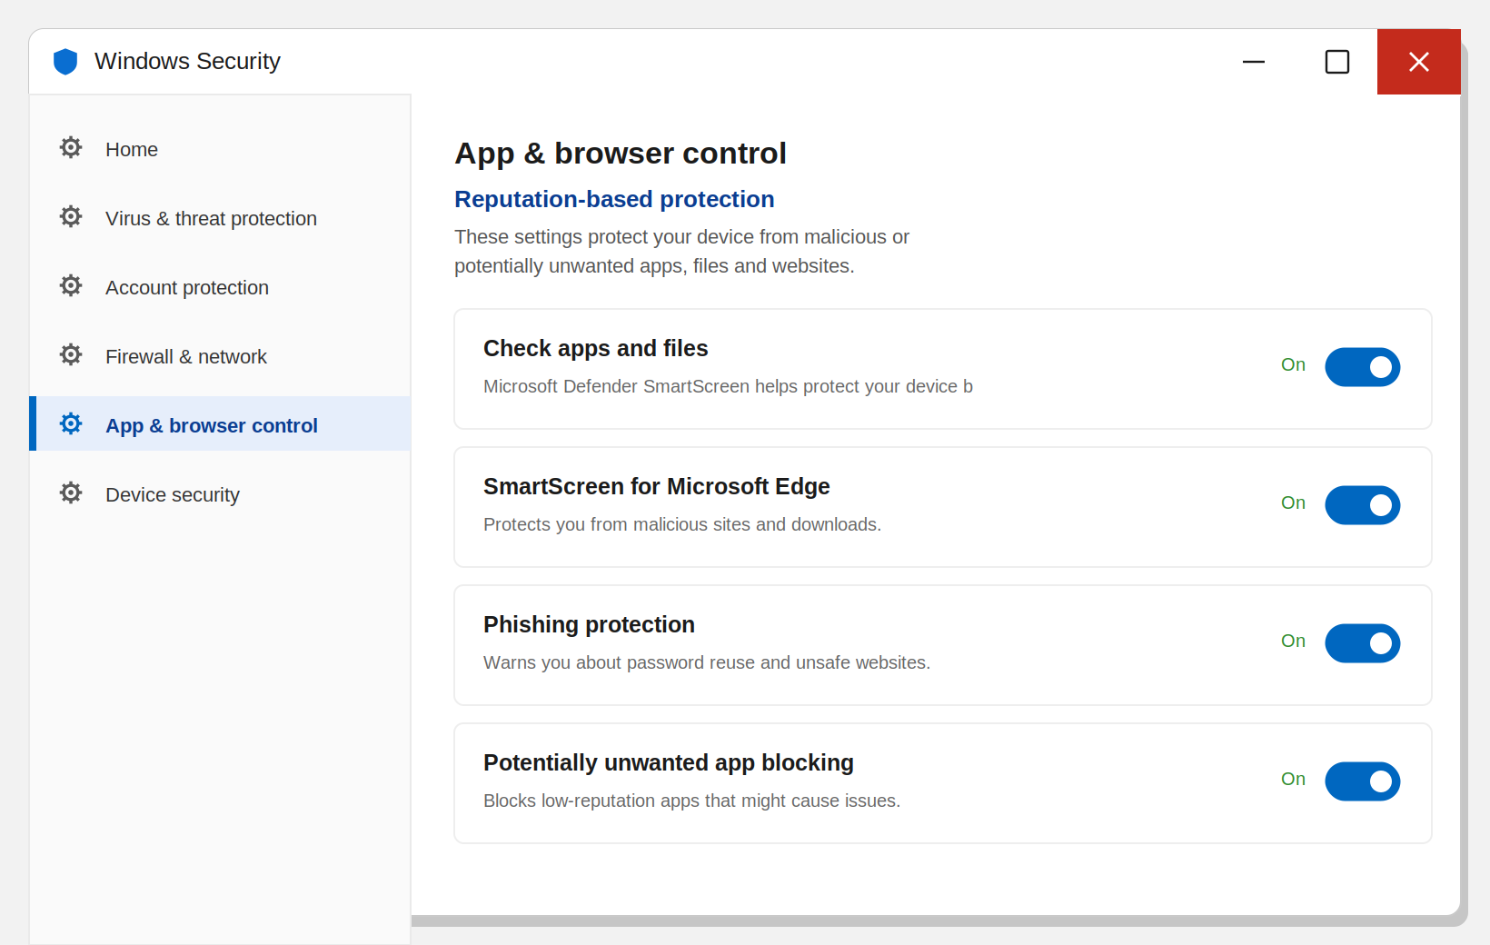
QUESTION 2 · PRACTICAL TASK 2.2
Task 2.2 — SmartScreen settings: five options
1
Start → Windows Security → open it.
Check apps and files — checks a downloaded file before it runs (stops a little-known setup.exe)
On
2
Go to App & browser control.
SmartScreen for Microsoft Edge — blocks dangerous sites and downloads in Edge
On
3
Click Reputation-based protection settings.
Phishing protection — warns if you type your Windows password into a fake site
On
Potentially unwanted app blocking — adware/unwanted apps (PUA): Block apps + Block downloads
On
SmartScreen for Microsoft Store apps — checks web addresses opened by Store apps
On
What does SmartScreen check? Only files downloaded from the internet — the browser puts a hidden Mark of the Web on them. A file copied from a flash drive has no such mark.
Figure 17. “App & browser control” — Reputation-based protection
? Mark of the Web
28
KKvaEH · Topic 1 · Windows OS Security

Slide 29
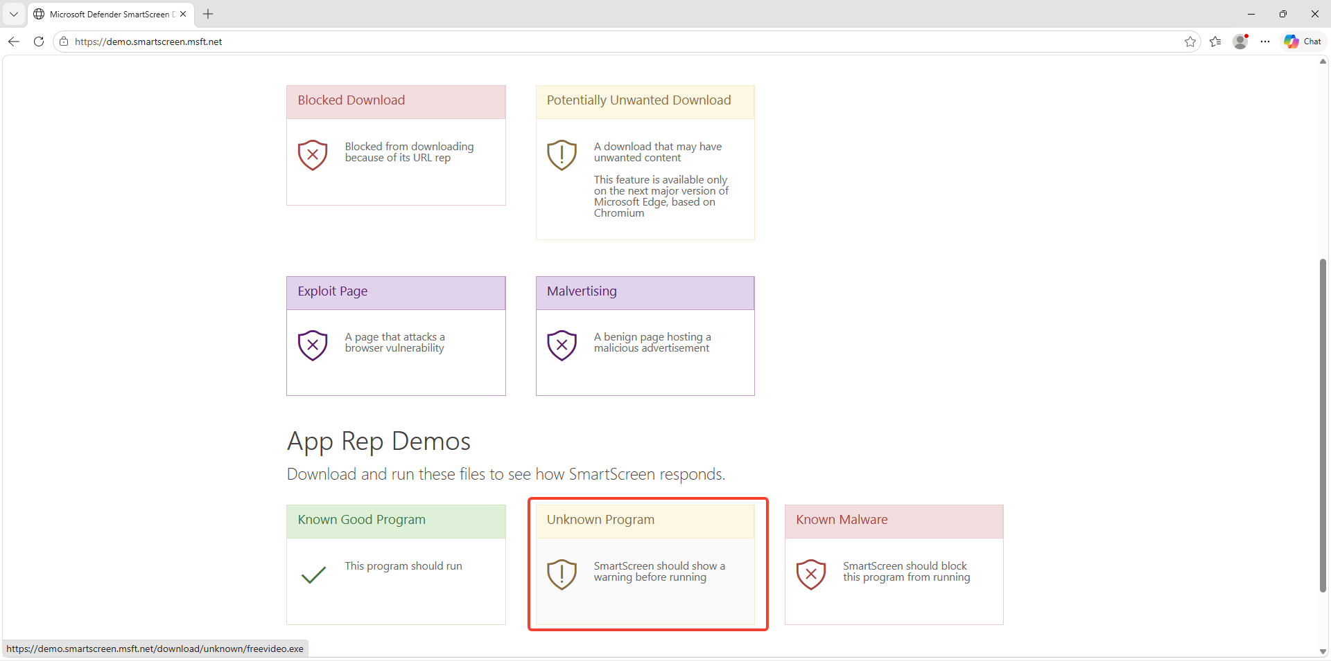
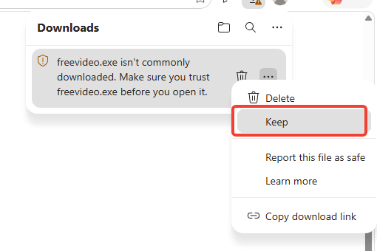
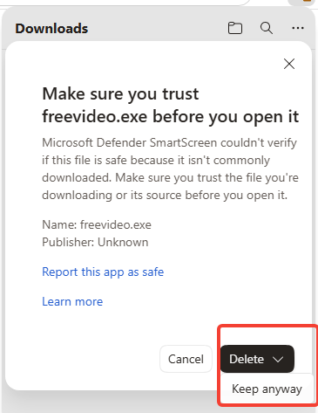

QUESTION 2 · PRACTICAL TASK 2.2 — TEST
Test: checking SmartScreen safely (demo.smartscreen.msft.net)
In Microsoft Edge, open https://demo.smartscreen.msft.net — no real viruses, only demo files.
1
Click Unknown Program. Edge: “isn’t commonly downloaded” → Keep.
2
SmartScreen asks again — continue with Keep anyway.
3
Figure 18. demo.smartscreen.msft.net — the SmartScreen test site
Result — why did it warn?
Edge did not say the file was “malicious”; it said it was little-known / low-reputation. That is SmartScreen’s reputation check: the file is new, so there is not enough “trust” for it in Microsoft’s database. Compare: Edge does not open the Known Malicious or Phishing Page links at all — a red warning.
Figure 19. The download warning — “Keep”
Figure 20. Continuing with “Keep anyway”
KKvaEH · Topic 1 · Windows OS Security
29

Slide 30
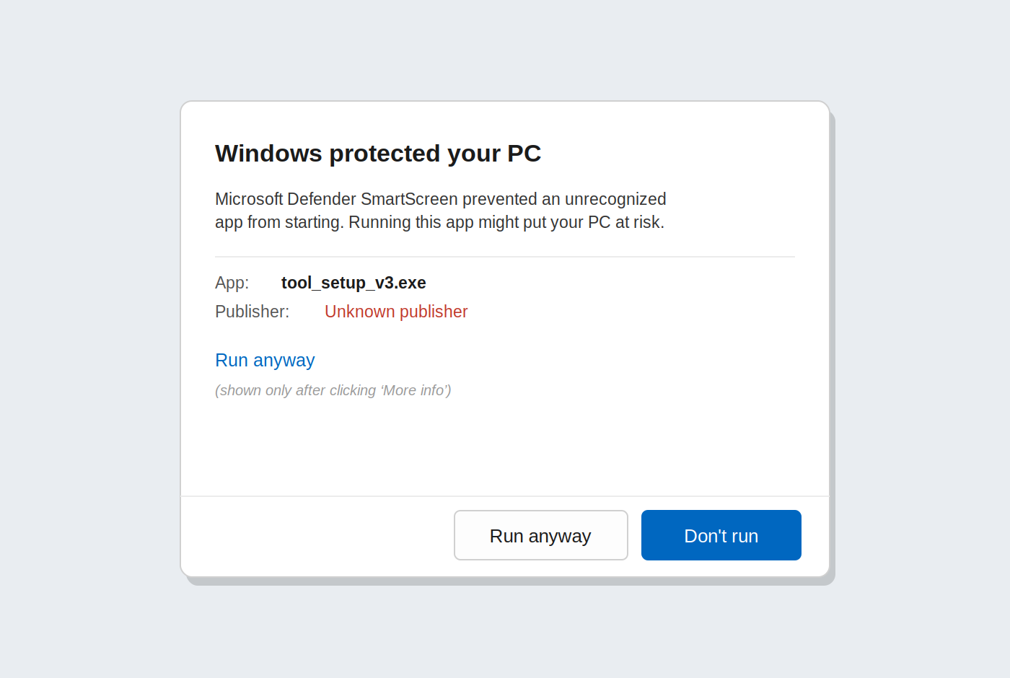
QUESTION 2 · PRACTICAL TASK 2.2 — TEST
“Windows protected your PC” — the SmartScreen warning
Run the downloaded file → the blue “Windows protected your PC” window.
1
Click More info: App — the file name, Publisher: Unknown — the file is unsigned.
2
Only now does Run anyway appear — do not click it; close with Don’t run.
3
Extra: the Potentially Unwanted Application link — if PUA blocking is on, Edge blocks the download.
4
Figure 21. SmartScreen warning and “More info → Run anyway”
Result: SmartScreen stops the program BEFORE it starts and makes the user think.
Do not confuse!
If the program opens without this window: (1) no MOTW; (2) “Run anyway” was clicked before — SmartScreen remembers; (3) Check apps and files is off.
KKvaEH · Topic 1 · Windows OS Security
30

Slide 31
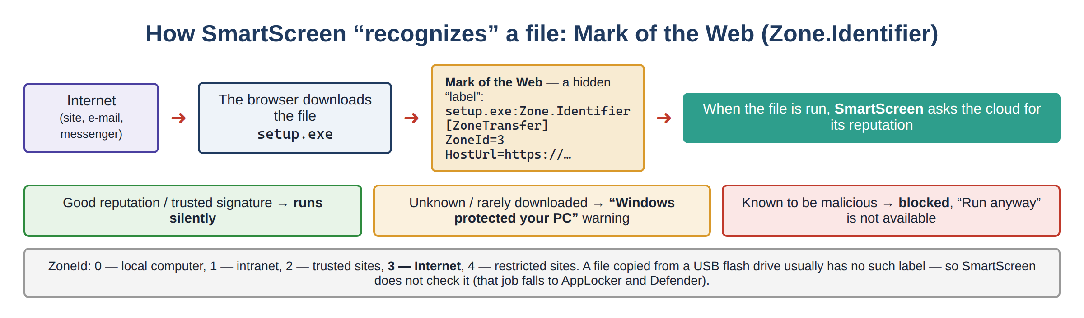
QUESTION 2 · PRACTICAL TASK 2.3
Task 2.3 — Mark of the Web: reading the mark of a downloaded file
The mark is stored not inside the file but in a hidden NTFS Zone.Identifier stream (alternate data stream). Exercise A: look at the streams of the file downloaded in task 2.2:
ZoneId | Zone | Meaning
0 | Local computer | Created on this computer
1 | Local intranet | Internal network
2 | Trusted sites | Trusted sites list
3 | Internet | From the internet — SmartScreen checks it
4 | Restricted sites | Marked as dangerous
PS> cd $env:USERPROFILE\Downloads
PS> Get-Item .\freevideo.exe -Stream *
PS> Get-Content .\freevideo.exe -Stream Zone.Identifier
[ZoneTransfer]
ZoneId=3
ReferrerUrl=https://demo.smartscreen.msft.net/
HostUrl=https://.../freevideo.exe
Result: HostUrl shows where the file was downloaded from, ReferrerUrl — which page the link was clicked on. A forensic investigator reads this mark first.
Figure 22. SmartScreen and the Mark of the Web (Zone.Identifier)
? Mark of the Web
31
KKvaEH · Topic 1 · Windows OS Security

Slide 32
QUESTION 2 · PRACTICAL TASK 2.3
Exercises B and C — removing the mark and testing with your own file
Exercise B — Unblock
Double-click sstest.exe — it opens without a warning (no MOTW).
File → Properties → at the bottom of General: “This file came from another computer…” + Unblock — the graphical form of the MOTW. With a command:
2
Add the mark (code, step 3) and double-click again — “Windows protected your PC”, Publisher: Unknown.
PS> Unblock-File .\freevideo.exe
PS> Get-Item .\freevideo.exe -Stream * # only :$DATA remains
3
Remove the mark with Unblock-File — the warning disappears. Delete the file at the end.
Exercise C — a test file you create
4
# 1) Windows PowerShell 5.1 — a harmless test program
$src = 'public class T { public static void Main() {'
$src += ' System.Console.WriteLine("SmartScreen test"); System.Console.ReadLine(); } }'
Add-Type -TypeDefinition $src -OutputType ConsoleApplication `
-OutputAssembly "$env:USERPROFILE\Desktop\sstest.exe"
# 3) add the “came from the internet” mark by hand
Set-Content "$env:USERPROFILE\Desktop\sstest.exe" -Stream Zone.Identifier `
-Value "[ZoneTransfer]`r`nZoneId=3"
Important nuances
-OutputType ConsoleApplication works only in Windows PowerShell 5.1.
SmartScreen checks a file opened through Explorer; .\sstest.exe usually shows no warning.
Attackers try to strip the MOTW (sending files inside archives / disk images).
KKvaEH · Topic 1 · Windows OS Security
32

Slide 33
FINAL PRACTICAL ASSIGNMENT
Lab assignment — do it on your own and hand in a report
UAC: set “Always notify” — screenshot of the settings window + PowerShell output showing ConsentPromptBehaviorAdmin = 2.
The report must include
▸ Title page: name, group, date
▸ A captioned screenshot for each task
▸ 1–2 sentences: what you did and what you saw
▸ A note that the lab was restored to its previous state
▸ Answers to 2 review questions of your choice
AppLocker — rule: create a Path rule that allows programs to run only from C:\Windows and C:\Program Files.
AppLocker — test: run any .exe outside this rule — confirm the block with a screenshot (+ 8004).
SmartScreen: download a file from an unknown source and take a screenshot of the warning window.
Assessment: UAC — 20% · AppLocker rule — 30% · AppLocker test + log — 30% · SmartScreen — 10% · report quality — 10%
KKvaEH · Topic 1 · Windows OS Security
33

Slide 34


WRAP-UP
Conclusion
The UAC level is set with the slider; “Always notify” is the most secure. The GUI and the registry (EnableLUA, ConsentPromptBehaviorAdmin, PromptOnSecureDesktop) must always match.
Even an administrator works day to day at Medium (filtered token); High only after UAC confirmation.
AppLocker works only while the Application Identity service runs; Default rules first, then Publisher / Path / File hash rules.
Implicit deny; Deny always wins; with the Default rules an administrator can get through via “Run as administrator”.
Audit only (8003) → Enforce (8004), apply with gpupdate /force; test in advance with Test-AppLockerPolicy.
SmartScreen has 5 settings; the check is triggered by the Mark of the Web (ZoneId=3); the mark is removed with Unblock-File.
KKvaEH · Topic 1 · Windows OS Security
34

Slide 35
WRAP-UP
Review questions — Lesson 3
Which service must be running for AppLocker to work?
Why is a program on the Desktop blocked normally but runs with “Run as administrator”?
1
6
What is the difference between the “Audit only” and “Enforce Rules” modes?
How do Path, Publisher and File hash rules behave when a file is renamed or moved?
2
7
Which command-line tool can be used to change the UAC level?
If both an Allow and a Deny rule match one file, which one wins?
3
8
What additional information can the user see when a SmartScreen warning appears?
What is the Mark of the Web, where is it stored and how can it be read?
4
9
Why is adding a custom rule without first creating the Default Rules not recommended?
How does the integrity level of an ordinary and an administrator PowerShell window differ, and how do you check it?
5
10
KKvaEH · Topic 1 · Windows OS Security
35

Slide 36

THANK YOU FOR YOUR ATTENTION!
Questions are welcome.
Next section — glossary of terms

Slide 37


GLOSSARY
Glossary — this section explains the following
Snapshot
Registry value
Integrity level
a saved state of the VM
a named setting in the registry
the trust level of a process
Default rules
Implicit deny
Audit only mode
AppLocker’s “safety net”
not allowed = forbidden
logs, does not block
Group Policy refresh
Event log
Mark of the Web
gpupdate /force
the system’s “black box”
the “came from the internet” mark
Each term is explained in beginner-friendly language, with an example and a diagram. Click a card to jump to its explanation.
KKvaEH · Topic 1 · Windows OS Security
37

Slide 38
GLOSSARY · TERM EXPLAINED
38
Snapshot (virtual machine)
In plain terms:
Snapshot 1 — clean install
A snapshot is a saved “picture” of the whole virtual machine — disk, settings and even memory — at one moment. Later you can return to that exact moment with one click (Restore).
Snapshot 2 — before Lesson 3
Lab: rules, experiments…
Why it matters:
In security labs we deliberately break things: block programs, change UAC. A snapshot lets you undo any mistake in a minute.
VirtualBox: Machine → Snapshots → Take / Restore.
Something broke → Restore
← Back to lesson

Slide 39
GLOSSARY · TERM EXPLAINED
39
Registry value (e.g. EnableLUA)
In plain terms:
Key:
HKLM\SOFTWARE\Microsoft\Windows\
CurrentVersion\Policies\System
The Windows registry is a big settings database arranged like folders (keys). Inside a key there are values: a name, a type and data. For example EnableLUA = 1.
EnableLUA REG_DWORD 1
ConsentPromptBehaviorAdmin REG_DWORD 5
Why it matters:
Every GUI switch (like the UAC slider) is really just a registry value. Reading values with PowerShell lets you check a setting quickly, on many PCs, and during forensic analysis.
PromptOnSecureDesktop REG_DWORD 1
← Back to lesson

Slide 40
GLOSSARY · TERM EXPLAINED
40
Integrity level (Medium / High)
In plain terms:
System
kernel, SYSTEM services
Every process has a trust level: Low, Medium, High, System. A lower-level process cannot “write up” into a higher one. An ordinary window is Medium, “Run as administrator” is High.
High
Run as administrator (full token)
Medium
ordinary programs (filtered token)
Why it matters:
UAC relies on exactly these levels: if malware starts from an ordinary window, it stays at Medium and cannot change the system. To check: whoami /groups → “Mandatory Label”.
Low
browser sandbox
← Back to lesson

Slide 41
GLOSSARY · TERM EXPLAINED
41
AppLocker default rules
In plain terms:
Allow · Everyone
%PROGRAMFILES%\*
When you click Create Default Rules, AppLocker adds three Allow rules: everything in C:\Program Files, everything in C:\Windows, and all files for the Administrators group.
Allow · Everyone
%WINDIR%\*
Allow · Administrators
* (all files)
Why it matters:
AppLocker blocks everything that is not allowed. Without these rules even Explorer and the Start menu could be blocked. They are the safety net under your own rules. (Because of the Administrators rule, a blocked program can open with “Run as administrator” — Exercise A.)
Everything else → blocked (in Enforce mode)
← Back to lesson

Slide 42
GLOSSARY · TERM EXPLAINED
42
Implicit deny
In plain terms:
Allow
matches a rule → runs
As soon as at least one rule appears in a collection (for example Executable Rules), AppLocker switches to “allow list” mode: everything not explicitly allowed is automatically forbidden.
Deny
explicit ban → always wins
Why it matters:
DeniedByDefault
matched no Allow → blocked
That is why an unknown .exe on the Desktop or in Downloads is blocked even without any Deny rule. Test-AppLockerPolicy reports this case as DeniedByDefault.
← Back to lesson

Slide 43
GLOSSARY · TERM EXPLAINED
43
Audit only mode
In plain terms:
Audit only
the program runs · 8003 “would have been blocked”
In Audit only mode AppLocker does not block anything. It only writes to the log what it would have blocked (event 8003).
Enforce rules
the program is blocked · 8004
Why it matters:
Rules are easy to get wrong. Auditing first shows which legitimate programs your rules forget — so users are not stopped from working when you switch to Enforce (8004).
← Back to lesson

Slide 44
GLOSSARY · TERM EXPLAINED
44
Group Policy refresh (gpupdate /force)
In plain terms:
PS> gpupdate /force
Updating policy...
# Computer Policy update has completed successfully.
# User Policy update has completed successfully.
Windows re-reads its policies automatically at start-up and roughly every 90 minutes. gpupdate /force makes it re-read and apply all policies immediately.
To check what was applied: gpresult /r
Why it matters:
After changing AppLocker or security settings you do not have to wait or restart — gpupdate applies the change at once, so you can test it right away.
← Back to lesson

Slide 45
GLOSSARY · TERM EXPLAINED
45
Event log (Event Viewer)
In plain terms:
8002
AppLocker: the program was allowed
Windows writes important events into logs — like an aircraft’s black box. Each event has a source, a time and an Event ID number. You read them in eventvwr.msc.
8003
AppLocker: would have been blocked (audit)
8004
AppLocker: the program was blocked
Why it matters:
Logs prove that a protection worked (AppLocker 8004) and show what an attacker did. They are the main evidence in cyber forensics.
4625
Security: failed logon (Lesson 4)
← Back to lesson

Slide 46
GLOSSARY · TERM EXPLAINED
46
Mark of the Web (Zone.Identifier)
In plain terms:
file.exe:Zone.Identifier
[ZoneTransfer]
ZoneId=3
ReferrerUrl=https://site/
HostUrl=https://site/file.exe
The browser puts a hidden “came from the internet” mark on a downloaded file. It is stored not inside the file but in the NTFS Zone.Identifier stream: ZoneId=3, HostUrl, ReferrerUrl.
Downloaded by a browser
has MOTW → SmartScreen checks
Why it matters:
SmartScreen checks based on exactly this mark: no mark — no warning. A forensic investigator learns from HostUrl which site the file came from. Read: Get-Content file -Stream Zone.Identifier; remove: Unblock-File.
From a USB drive / self-made
no MOTW → no warning
← Back to lesson

