Slide 1
Festival shift rosters,
solved and scored
OT course project: one evaluator
scores four solvers
Gaurav Choudhury, Ansh Sharma, Harshil
Chukkala, Ishan Alam, Mayookh Ghosh,
Pranay Bansal, Soumya Pathak, Ishan Kumar,
Vineet Arora, Yashashwani dixit

Slide 2





Five CSV files hold the whole fest
Every shift in the fest starts on one hand-filled sheet, which we turn into five files
per case.
File
What it holds
Morning, Evening and a Night duty that runs past midnight
Roll number, group and a weekly hour cap per student
How many people each day, shift and group needs
Shift and day-off wishes, weighted per student
The 7 to 28 day horizon, rest gap, streak limit and the penalty tiers
A case with duplicate IDs, an unknown reference or a hole in the demand grid is rejected before solving.
2

Slide 3
Rest gaps and day limits bound each student
So each case arrives with the limits every roster has to respect.
Rule
One shift a day
Own group only
Rest gap
Weekly cap
Consecutive days
Preferences
What it sets
Hard rule: no student works two shifts on one day
Hard rule: a student covers only their own group
Hours between two shifts, counted across midnight for Night
A student's maximum hours per week
How many days in a row before a streak costs
Each shift or day-off wish carries a weight
The two hard rules are checked before a candidate is accepted; the rest add to the evaluator’s seven costs.
3

Slide 4
A sick call empties one slot
So the morning starts with one slot nobody is assigned to.
01
02
03
04
05
Empty
slot
Patch by
hand
Rest gap
breaks
Hours
pile up
Sick call
One
volunteer
down
No one
assigned
Filled from
the sheet
Someone
else's day
Extra hours
land here
The fix breaks someone else’s rest gap and piles extra hours on one student. It is not ideal or
optimal
4

Slide 5
The sheet fails in three ways
The patched sheet hides three faults.
01
02
03
Compliance
Workload
Dropouts
Rest, hour caps
and consecutive-
day rules get
broken unnoticed.
Students in one
group end up
with uneven
hours.
A manual fix
ripples through
the whole sheet.
5

Slide 6
Can we fix this?
6

Slide 7
Our answer: turn the sheet into an engine
The answer turns a fest from a spreadsheet into a
scored, repairable roster.
Rejected
Five CSVs
Valid case?
Rules and model
two hard rules, seven
costs
One evaluator
Repair
after a sick call
Four solvers
7

Slide 8

Every slot becomes a yes/no decision
We write each slot down as a decision the solver can take.
1 if student s works shift sh on day d.
Hard rule: no student takes two shifts in
a day.
Hard rule: students cover only their own
group.
A weighted sum of seven costs per
roster.
One shift per day
Own group only
Objective
8

Slide 9
Every compromise gets a price
But a legal roster is not a good one, so each compromise
needs a price.
Unfilled
Overwork
Streak
Rest
Preference
Fairness
Isolated
Missing person per slot
Cap breach per rolling window
Day past the limit
Short gap between shifts
Unmet preference
Hour spread in a group
One day off between work days
9

Slide 10
Four groups, four small problems
Then the model splits: no student belongs to two groups.
MPR, CND, Hospitality and Spons share no students
Each group is solved on its own, so the problem stays small
A group’s search never looks at another group’s students
CP-SAT runs the four groups side by side in the harness
10

Slide 11
Four ways to search, simple to exact
So four searches attack the same seven costs, and differ in how
they search.
01 Greedy
02 Local search
Fills the hardest slot first, one student at a
time.
Simulated annealing that starts from the
greedy roster.
03 CP-SAT cold
04 CP-SAT warm
OR-Tools solves each group with no hint.
Gives OR-Tools the greedy roster as a hint.
11

Slide 12
Three test sets, one score
But four solvers need one finish line, so every roster gets
the same evaluator and seed.
What we tested
5 curated cases
100 generated cases
1000 sick-leave repairs
How
60 s per solver, 7 to 28 days
7 to 28 days, 400 solver runs
5 s per repair
Every cost comes from the same evaluator. Each generated case carries a fixed
seed, which makes a run repeat.
12

Slide 13
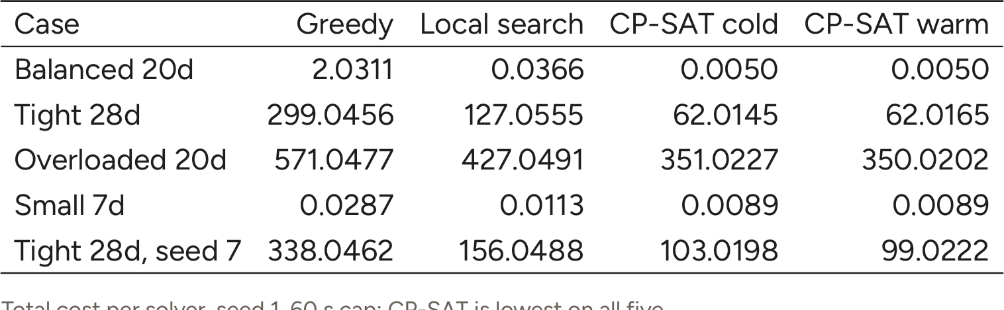
CP-SAT wins every curated case
Then round 1 is clear: the five curated cases rank the solvers by
evaluator cost.
13

Slide 14
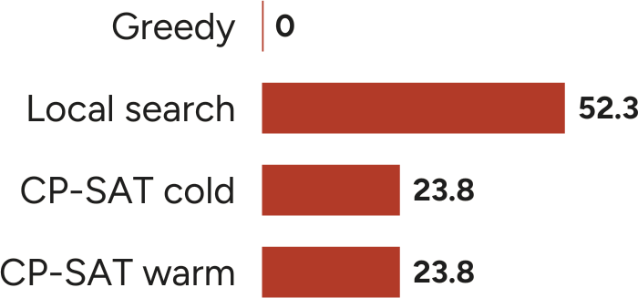
Local search wins 52.3% of 100
But round 2 flips it: local search wins most, so we asked why.
Scenario
Balanced
Gap to best
0.012 / 15.158 /
5.125
0.972 / 27.872 /
Tight
49.244
12.363 / 9.536 /
Overloaded
35.539
Win rate over 100 generated cases of 7 to 28 days, seed 1, 60 s limit, one CP-SAT worker per
group. Gap to the best solver below: local / cold / warm.
14

Slide 15
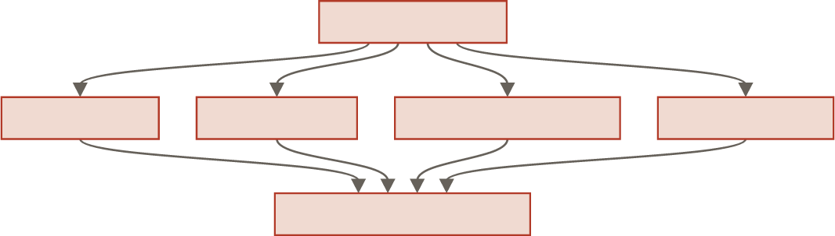
CP-SAT was racing with a handicap
So we looked at the harness itself.
One 60 s limit
MPR group
CND group
Hospitality group
Spons group
CP-SAT, one worker
We suspect the harness: it ran four groups at once and split the limit
CP-SAT stopped at about 21 s, on one search worker
We found the bug and fixed the harness
15

Slide 16
CP-SAT still leads past full load
Then we split the generated cases by load, where a fest
spends its days.
Case
Balanced 7d
Tight 14d
Overloaded 20d
Load
0.847
Local
0.0313
CP-SAT
0.0125
Gap
0.0188
1.000
1.150
24.0489
375.0426
17.0206
330.0211
7.0283
45.0215
Load is demand over capacity. Below full load the gaps are negligible; once demand
reaches capacity they widen.
16

Slide 17
Back to the 7 a.m. sick call
And the morning we started with is now a repair run.
Repair
Local search
CP-SAT
Mean changes
1.68
2.08
A repair moves about two
shifts and leaves the rest
of the sheet alone
No repair run in the
thousand broke a hard
rule
Mean changes per sick event, 1000 repair runs at 5 s each on the same 100 cases. Median
repair time 0.024 s for the annealing repair.
17

Slide 18
The numbers answer all three problems
So each failure we started from gets an answer.
Problem
Compliance
What the runs show
0 hard-rule failures in 400 runs and 1000
repairs
Median group hour spread 12 h with CP-SAT,
Workload
16 h with local search
About 2 changes per sick call: local 1.68, CP-
Dropouts
SAT 2.08
Every cost in these runs comes from the same evaluator, seed 1.
18

Slide 19
Thank you
Festival shift rosters, solved
and scored

