Slide 1
Современный синтез речи
(2023)

Slide 2
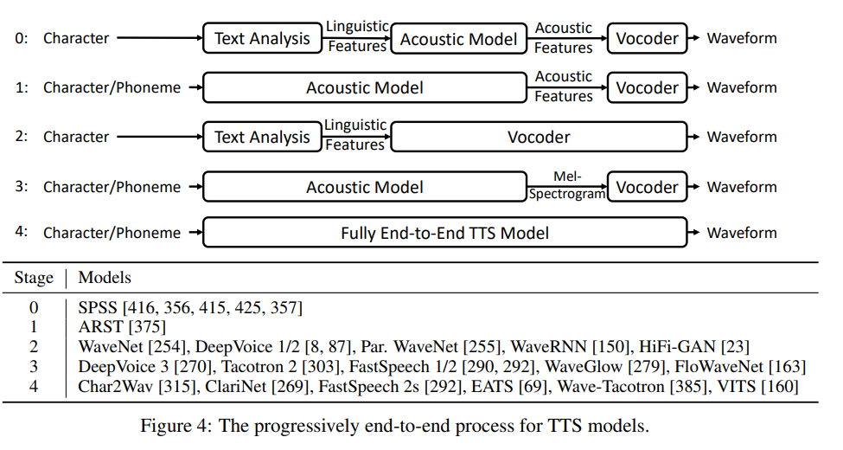

Slide 3
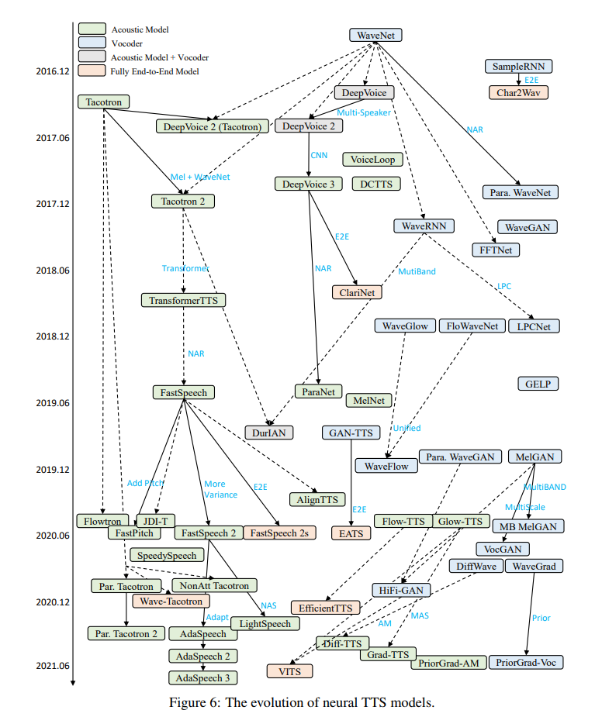

Slide 4
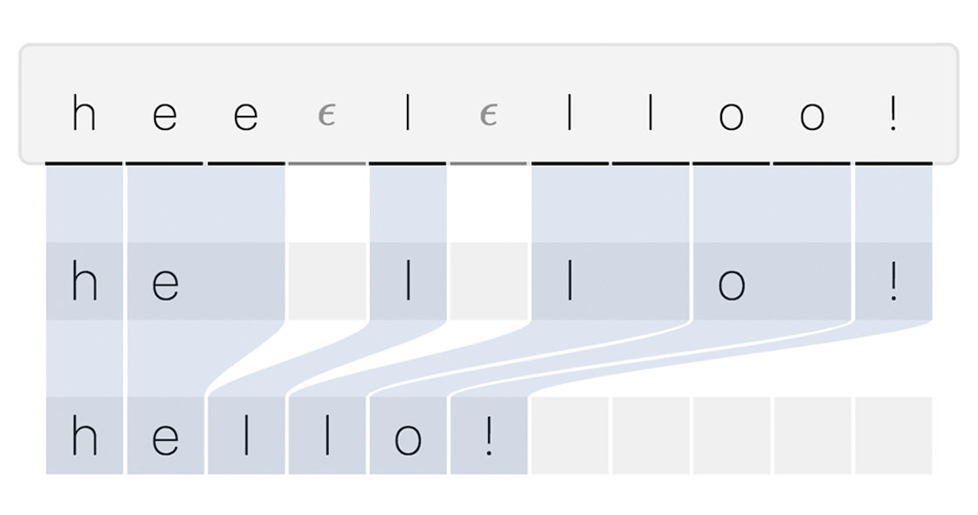
Alignment

Slide 5
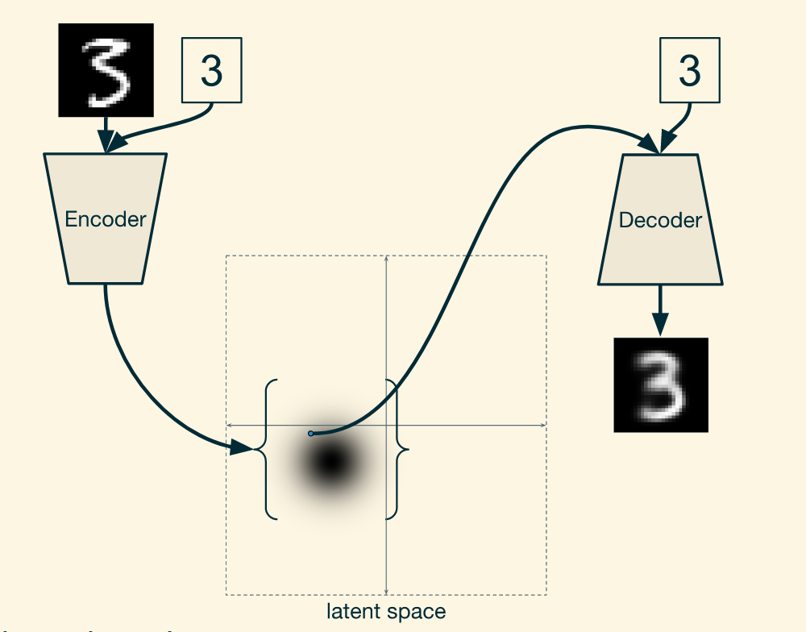
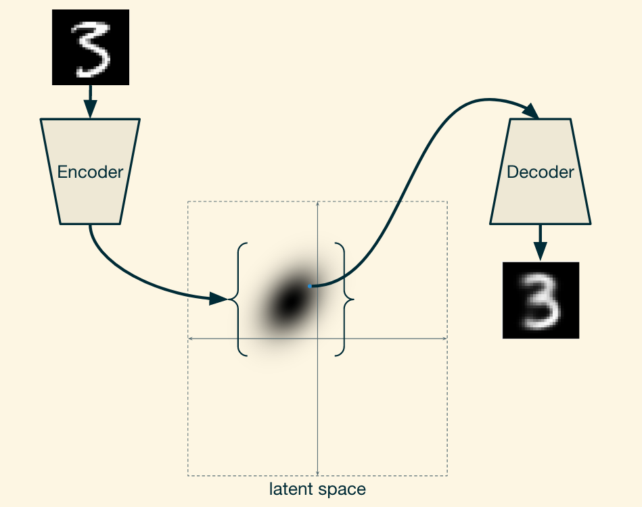
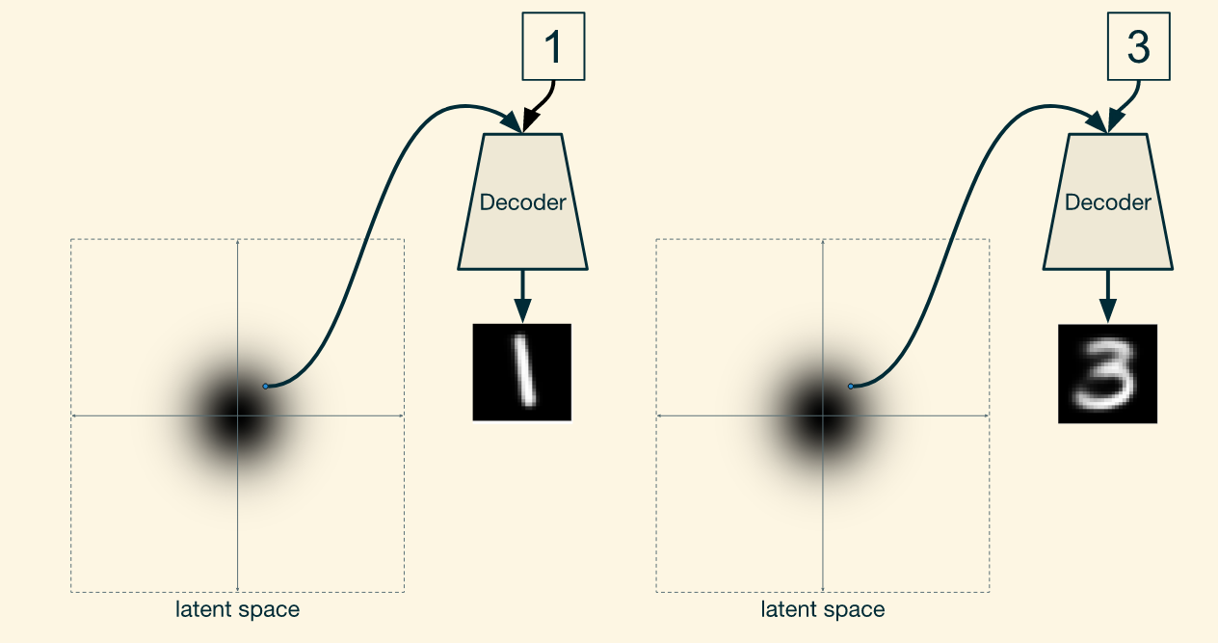
VAE/CVAE
CVAE
training
CVAE
inference
VAE

Slide 6
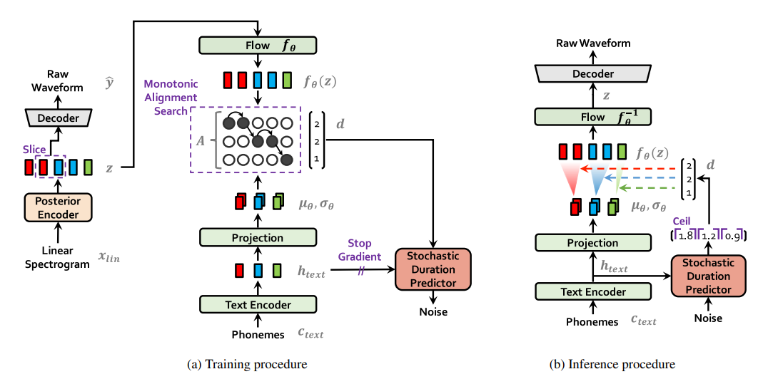
VITS (2021)
HiFi GAN
WaveNet blocks
Transformer Encoder
phoneme → waveform
Conditional Variational Autoencoder with Adversarial Learning for End-to-End Text-to-Speech
https://jaywalnut310.github.io/vits-demo/index.html

Slide 7
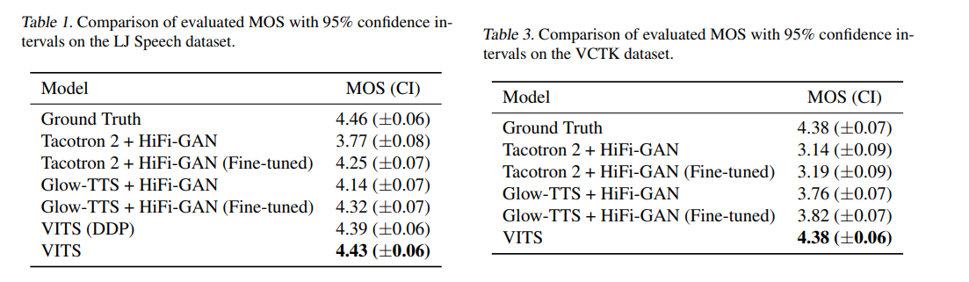
VITS (2021)
https://jaywalnut310.github.io/vits-demo/index.html

Slide 8
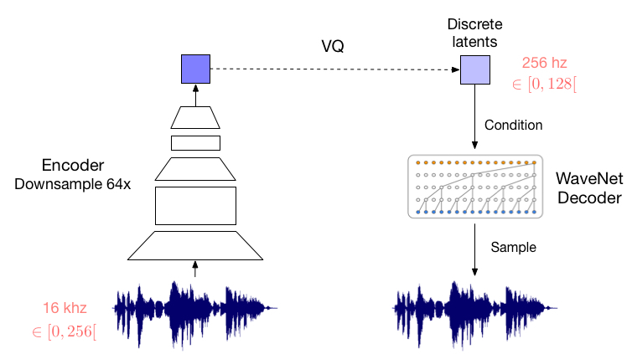
VQ-VAE

Slide 9
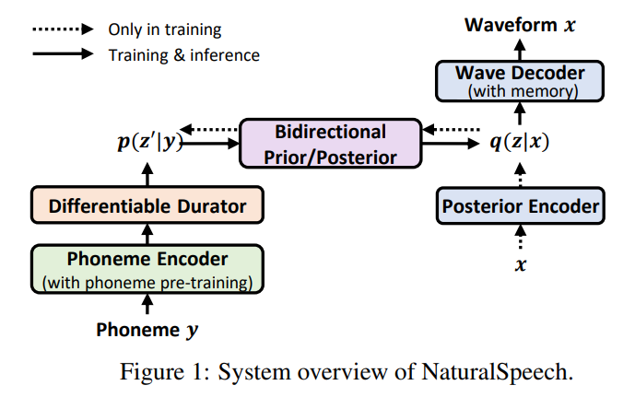
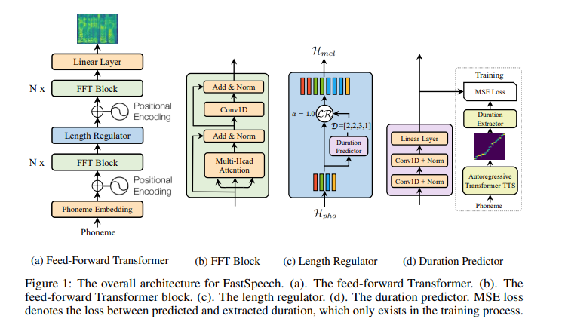
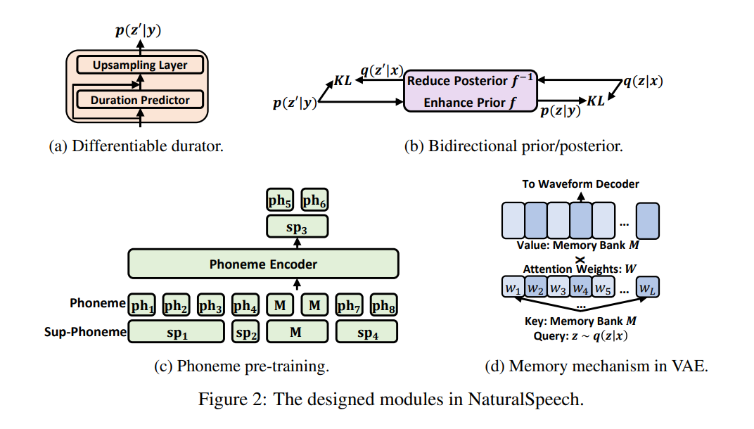
NaturalSpeech (2022)
GAN
Phoneme → waveform
VQ-VAE
WaveNet blocks

Slide 10
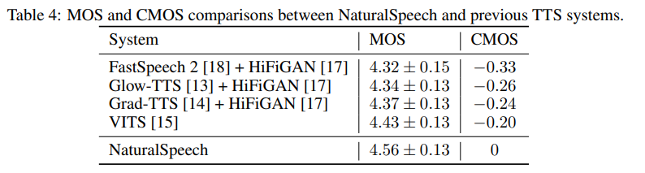
NaturalSpeech (2022)
“which demonstrates no statistically significant difference from human recordings for the first time on this dataset.”
https://speechresearch.github.io/naturalspeech/

Slide 11
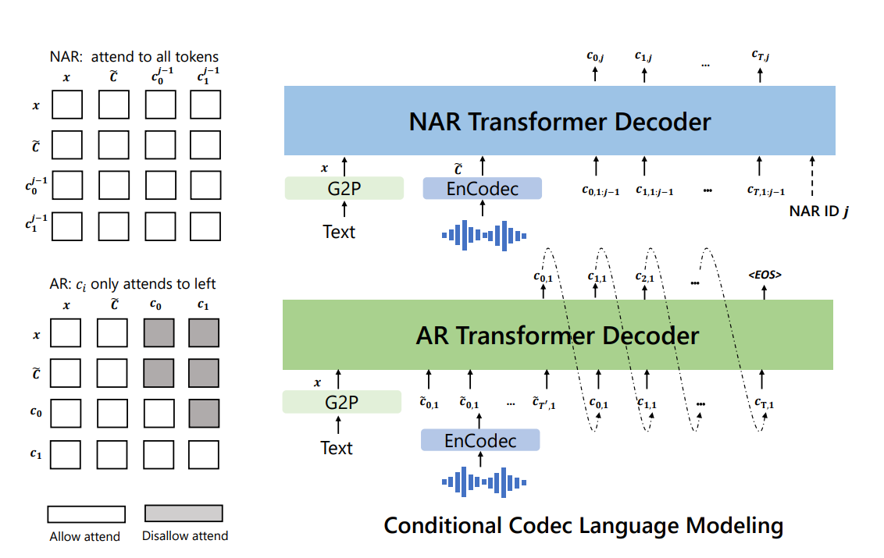
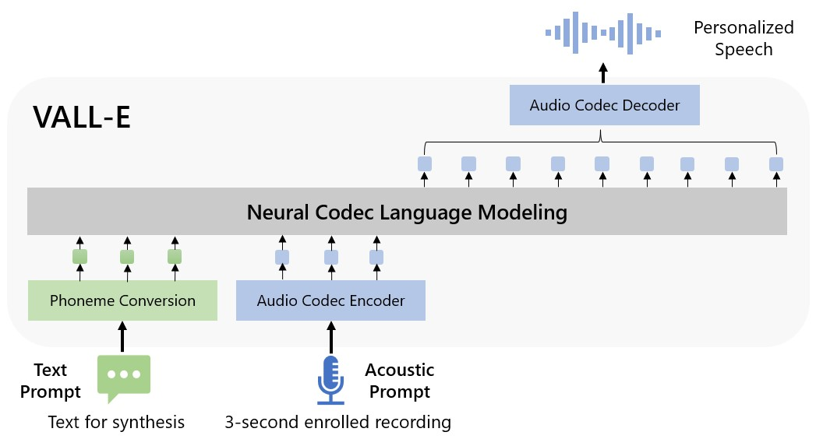
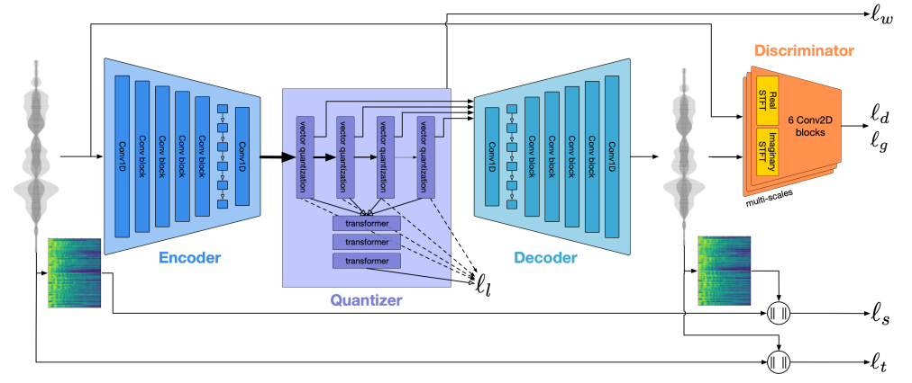
VALL-E (2023)
phoneme → discrete code → waveform
neural codec language model
Pre-training 60k hours

Slide 12
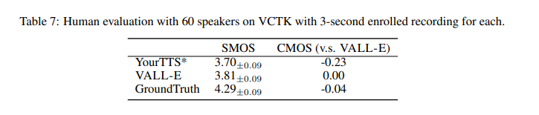
VALL-E (2023)
https://valle-demo.github.io/

Slide 13
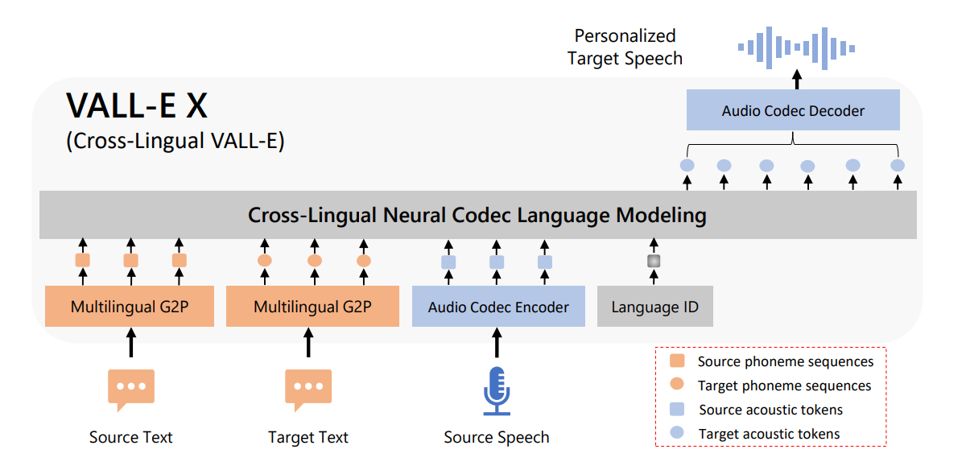
VALL-E X (2023)
https://vallex-demo.github.io/

Slide 14
Список использованной литературы
https://arxiv.org/pdf/2106.15561.pdf
https://arxiv.org/pdf/2106.06103.pdf
https://arxiv.org/pdf/2205.04421.pdf
https://arxiv.org/pdf/2301.02111.pdf

