Slide 1

SMART INDIA HACKATHON 2026
IDEA PRESENTATION | SOFTWARE
BAGHEWALA / WELL-TO-SURFACE DIGITAL TWIN
INTEGRATED CSS + SRP
DECISION SUPPORT
A running prototype that connects reservoir, wellbore and pump-system models for explainable monitoring and what-if analysis.
PROBLEM STATEMENT ID
[ADD EXACT ID FROM SIH PORTAL]
PROBLEM STATEMENT TITLE
Digital Twin for Well-to-Surface Optimization of Cyclic Steam Stimulation (CSS) and Sucker Rod Pump (SRP) Operations for Heavy Oil Wells of Baghewala Field
THEME / CATEGORY
Smart Automation / Software
TEAM ID / REGISTERED TEAM NAME
[ADD TEAM ID] / [ADD REGISTERED TEAM NAME]
LIVE DEMO | SIH-120-FINAL.VERCEL.APP | SIMULATED DATA

Slide 2
IDEA TITLE
[TEAM NAME]
BAGHEWALA DIGITAL TWIN
Integrated CSS + SRP decision support for heavy-oil wells
THE PROBLEM | A COUPLED FAILURE CHAIN
CSS heat
declines
Oil viscosity
rises
Pump / rod
loads shift
Risk, energy loss
& lower recovery
PROPOSED SOLUTION
HOW IT ADDRESSES THE PROBLEM
INNOVATION & UNIQUENESS
One shared well model
From reactive to informed
Integration + explainability
Connect reservoir temperature to estimated viscosity, wellbore conditions, rod/pump loading and production estimates.
Compare CSS and SRP scenarios in one operator workflow.
Surface how reservoir cooling can affect viscous flow and pumping risk.
Show model alerts and compare options before a simulated change.
Cause-to-effect view across reservoir, wellbore and SRP instead of isolated dashboards.
What-if is separated from state-changing demo controls; engineer stays in control.
PROTOTYPE TODAY: simulated telemetry + simplified model + rule-based insights | FIELD AI / AUTO-CONTROL: future, only after data validation and safety approval

Slide 3
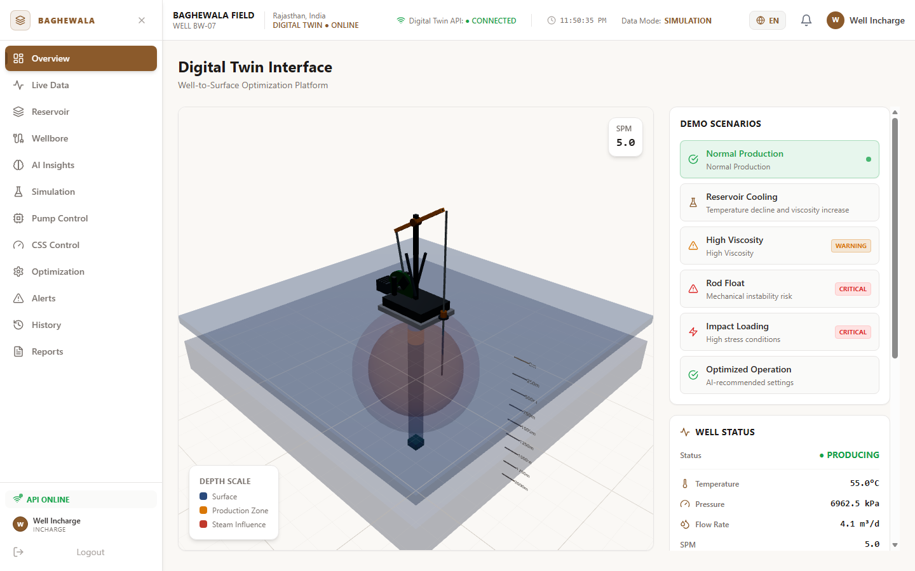
TECHNICAL APPROACH
[TEAM NAME]
METHODOLOGY | THE RUNNING MODEL CHAIN
01
Simulated well state
REST API / scenario preset
02
Thermal + viscosity
Cooling changes estimated viscosity
03
Wellbore profiles
Depth-wise temperature / pressure / viscosity
04
Rod + dynamometer
Load & classifier risk
05
Surface + flow
Power / vibration / Q estimate
06
Decision UI
Charts | alerts | what-if
RUNNING PROTOTYPE | OVERVIEW / DEMO WELL | SIMULATED VALUES
TECHNOLOGIES USED IN THE WORKING PROTOTYPE
React + TypeScript
Three.js
FastAPI + Python
NumPy
REST API
Zustand + Recharts
NEXT VALIDATION GATE
Field historian, calibrated models, shadow-mode advisory AI
Production deployment would require durable storage / streaming; Vercel demo state is not a field historian or control plane.

Slide 4
FEASIBILITY AND VIABILITY
[TEAM NAME]
ANALYSIS OF FEASIBILITY
WORKING NOW
DATA PATH
VIABILITY GATE
Deployable software demo
Field inputs are identified
Advisory before automation
React + FastAPI prototype is live; model, dashboards and what-if endpoints run with simulated state.
PS lists production, CSS, steam, VFD/SRP, failure, completion, reservoir and fluid records.
Start offline, then shadow mode, then operator-approved advisory; no writes until formal safety approval.
POTENTIAL CHALLENGES & RISKS
STRATEGIES TO OVERCOME THEM
Sparse / inconsistent records
Audit units, timestamps, well IDs; quantify missingness.
Heavy-oil model mismatch
Calibrate by well / cycle; validate on held-out periods.
False alerts / operator overload
Tune thresholds; track precision, recall and false alarms.
Cyber / operational safety
Read-only shadow mode; access controls, interlocks, sign-off.
Demo state is not persistent
Add durable database + event stream before field deployment.
VIABILITY PATH | REPLAY HISTORICAL DATA -> CALIBRATE / VALIDATE -> SHADOW MODE -> APPROVED ADVISORY PILOT

Slide 5
IMPACT AND BENEFITS
[TEAM NAME]
POTENTIAL IMPACT ON TARGET AUDIENCE
PETROLEUM / RESERVOIR
ARTIFICIAL LIFT / PRODUCTION
FIELD OPERATORS
MAINTENANCE / ASSET
Understand thermal-fluid context
Compare CSS + SRP decisions
See explainable, reviewable alerts
Track reliability indicators
BENEFITS OF THE SOLUTION | EXPECTED, NOT YET MEASURED
ECONOMIC
OPERATIONAL
Target: lower energy / barrel, fewer unplanned interventions, better value from steam.
Earlier visibility of changing thermal / pump conditions; more consistent decisions.
RELIABILITY
ENVIRONMENTAL
Flag simulated rod-float / impact risk; future validation could support maintenance planning.
If efficiency improves: potential reduction in steam and energy intensity per unit oil.
HOW A FIELD PILOT PROVES VALUE
Oil rate / recovery
SOR
kWh per unit oil
Rod failures / unsets
Downtime
Compare to a verified baseline; publish only measured or validated results. No quantified production, SOR, energy or failure reduction is claimed.

Slide 6
RESEARCH AND REFERENCES
[TEAM NAME]
RESEARCH BASIS | PROBLEM CONTEXT + MODEL FOUNDATIONS
PRIMARY PROBLEM SOURCE
Oil India Limited / SIH 2026 problem statement supplied by the team: heavy-oil Baghewala; CSS + SRP co-optimization; available production, cycle, steam, VFD/SRP, failure and reservoir/fluid data.
CSS THERMAL DESIGN
Boberg, T.C. & Lantz, R.B. (1966). Calculation of the Production Rate of a Thermally Stimulated Well. JPT 18(12), 1613-1623.
Conceptual CSS reference; current prototype uses a simplified thermal model.
SRP DYNAMICS
Gibbs, S.G. (1963). Predicting the Behavior of Sucker-Rod Pumping Systems. JPT 15(7), 769-778.
Reference for rod-system modeling; current model is a simplified demonstration.
PHYSICS-INFORMED ML
Raissi, M., Perdikaris, P. & Karniadakis, G.E. (2019). Physics-informed neural networks. J. Comput. Phys. 378, 686-707. DOI: 10.1016/j.jcp.2018.10.045
Future research direction only; no trained PINN is in the running prototype.
IMPLEMENTATION DOCS
React: react.dev | FastAPI: fastapi.tiangolo.com | Vercel: vercel.com/docs
Frontend / API stack in the deployed demonstration.
REPOSITORY / LIVE DEMO | github.com/qwertypoiuy9/sih-120-final | sih-120-final.vercel.app | Verify SIH portal PS ID and registered team details before submission.

