Slide 1
Movie genre predictopn

Slide 2
Context

Slide 3
Context
Nature of the problem:
Multi-label Classiﬁcation
Problem Statement:
Are we able to predict the labelled set of unseen posters through analyzing training instances with a known labelled set?
Dataset:
Labelled genre movie poster dataset with respective images from Wei-Ta Chu and Hung-Jui Guo
IMDb dataset
Total of 25 genres (-2) with 552 permutations (193 unique)

Slide 4
Implementation

Slide 5
Process
Hamming Loss
Avg. Precision Score
Ranking Loss
Load image
Convert to array
1. Binary
Cross-entropy
Images to Array
Model Selection
Activation Function
Loss Function
Model Evaluation
CNN
VGG16
1. Sigmoid

Slide 6
Breaking It Down - Preprocessing
Images to Array:
Load & resize image
Convert loaded images in PIL format into a Numpy array
Divide by colour range for each channel
Setting up X and y:
X - Images converted to arrays
y - MHE labelled dataset
(Label vector)

Slide 7
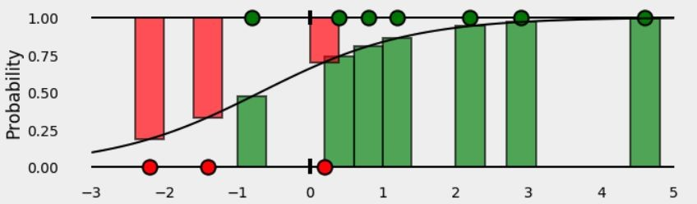
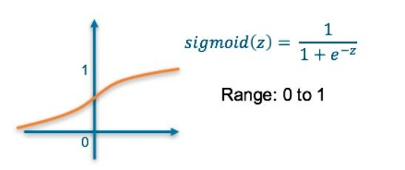
Breaking It Down - Activation & Loss Functions
Loss Function:
Binary Cross-entropy Loss
Activation Function:
Sigmoid
The loss computed for every CNN output vector component is not affected by other component values, it tries to decide for each class whether the example belongs to that class or not
This allows the model to output a number between 0 and 1 for each label independently. This number indicates the probability that the corresponding attribute is present in the image

Slide 8
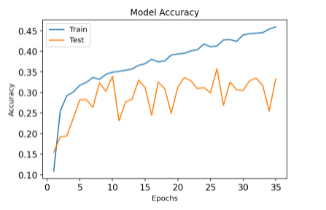
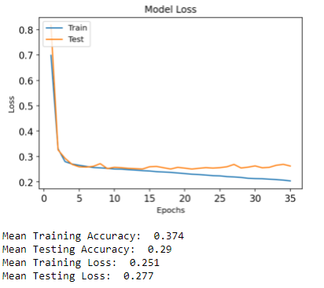
CNN model

Slide 9
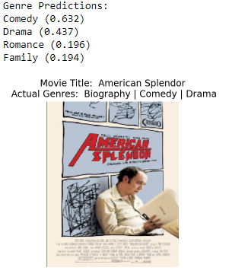
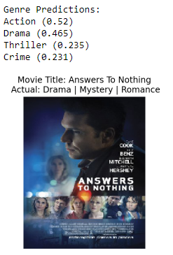
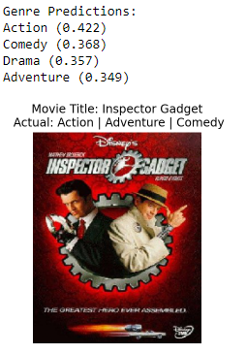
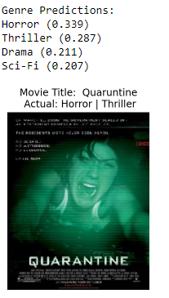
Samples of Model Predictions on Test Images

Slide 10
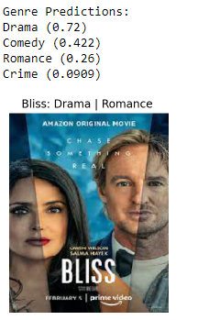
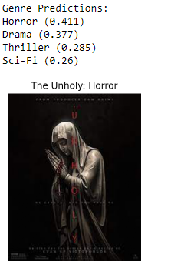
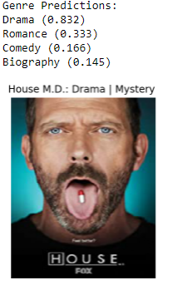
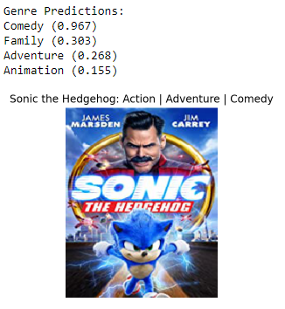
Samples of Model Predictions on Unseen

Slide 11
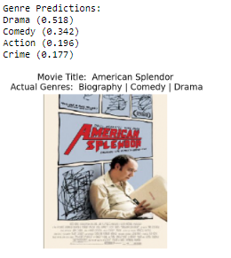
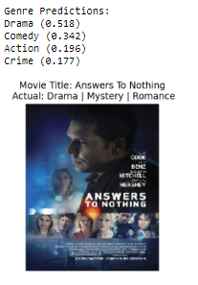
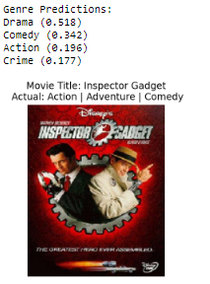
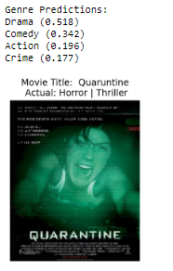
Samples of Model Predictions on Test Images VGG16

Slide 12
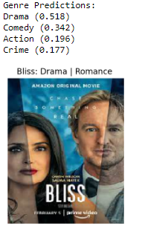
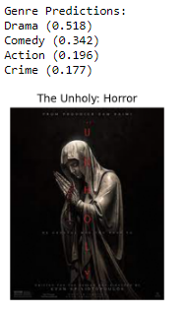
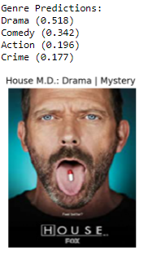
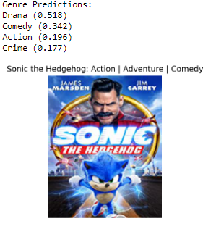
Samples of Model Predictions on Unseen
VGG16

Slide 13
Evaluation

Slide 14
Metrics for CNN Model Evaluation
1) Hamming Loss
2) Avg. Precision
3) Ranking Loss
The fraction of misclassiﬁed labels
Averages the entire ranking of model predictions
The expectation of the mis-rank rate over all possible pairs of labels
0,667
0.195
0,168

Slide 15
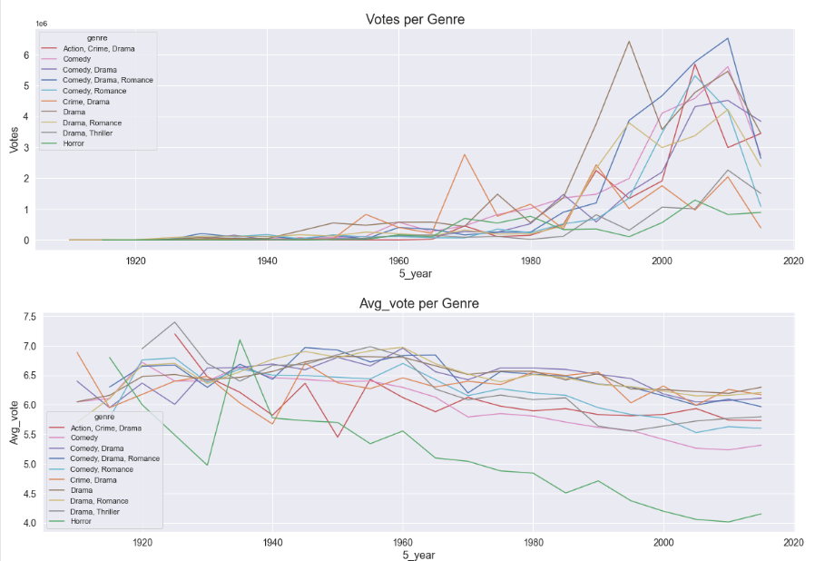

Slide 16
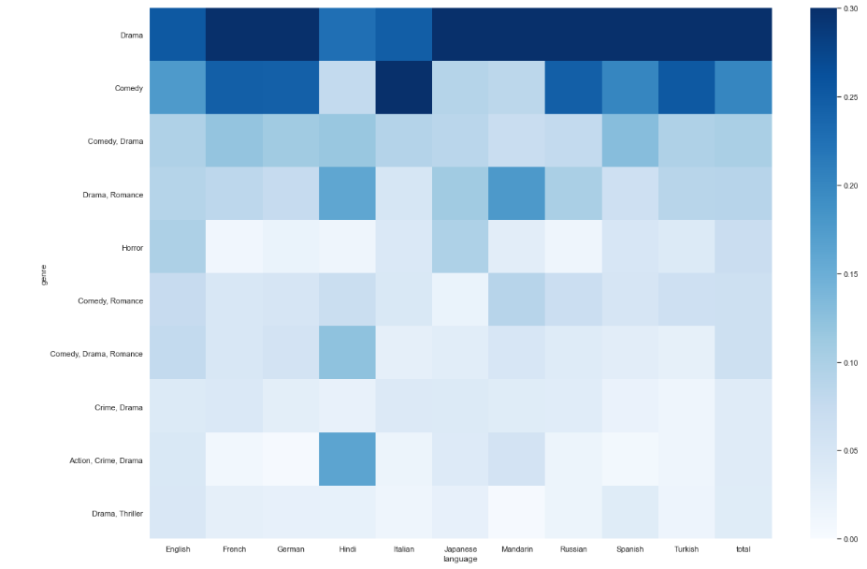

Slide 17
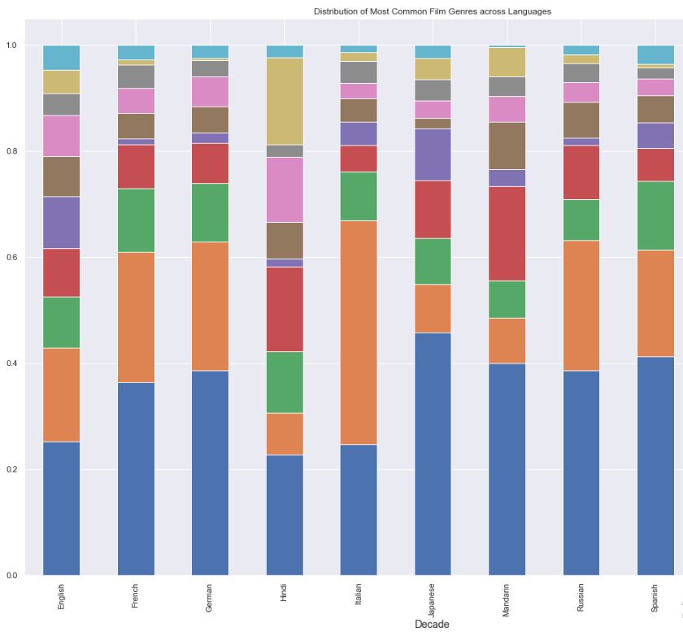
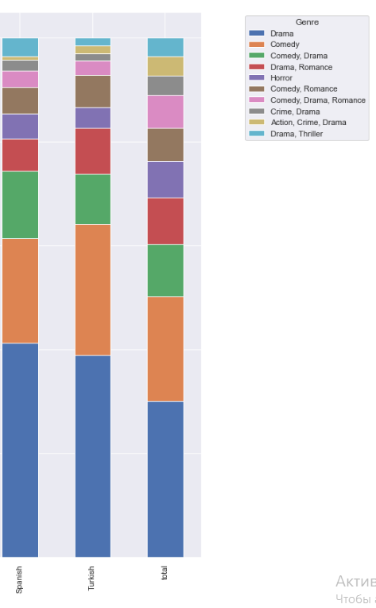

Slide 18
Conclusion

Slide 19
Limitations
The main challenge was data imbalance
Collecting more poster data for under-represented genres will not solve this issue
Subjective movie labelling by IMDb sources & varied posters for release
Limited packages to deal with multi-label classification problems iterative stratification for splitting data effectively, one-error loss etc.

Slide 20
Student: Azamat Orymbekov
Github: https://github.com/rmbziiik/Movie_genre_from_its_poster

