Slide 1


SMART INDIA HACKATHON 2026
TITLE PAGE
Problem Statement ID – SIH26145
Problem Statement Title- AI-Based Detection of Cyber Threats in Unidirectional IP Traffic
Theme- Blockchain & Cybersecurity
PS Category- Software
Team Name- resurrección

Slide 2
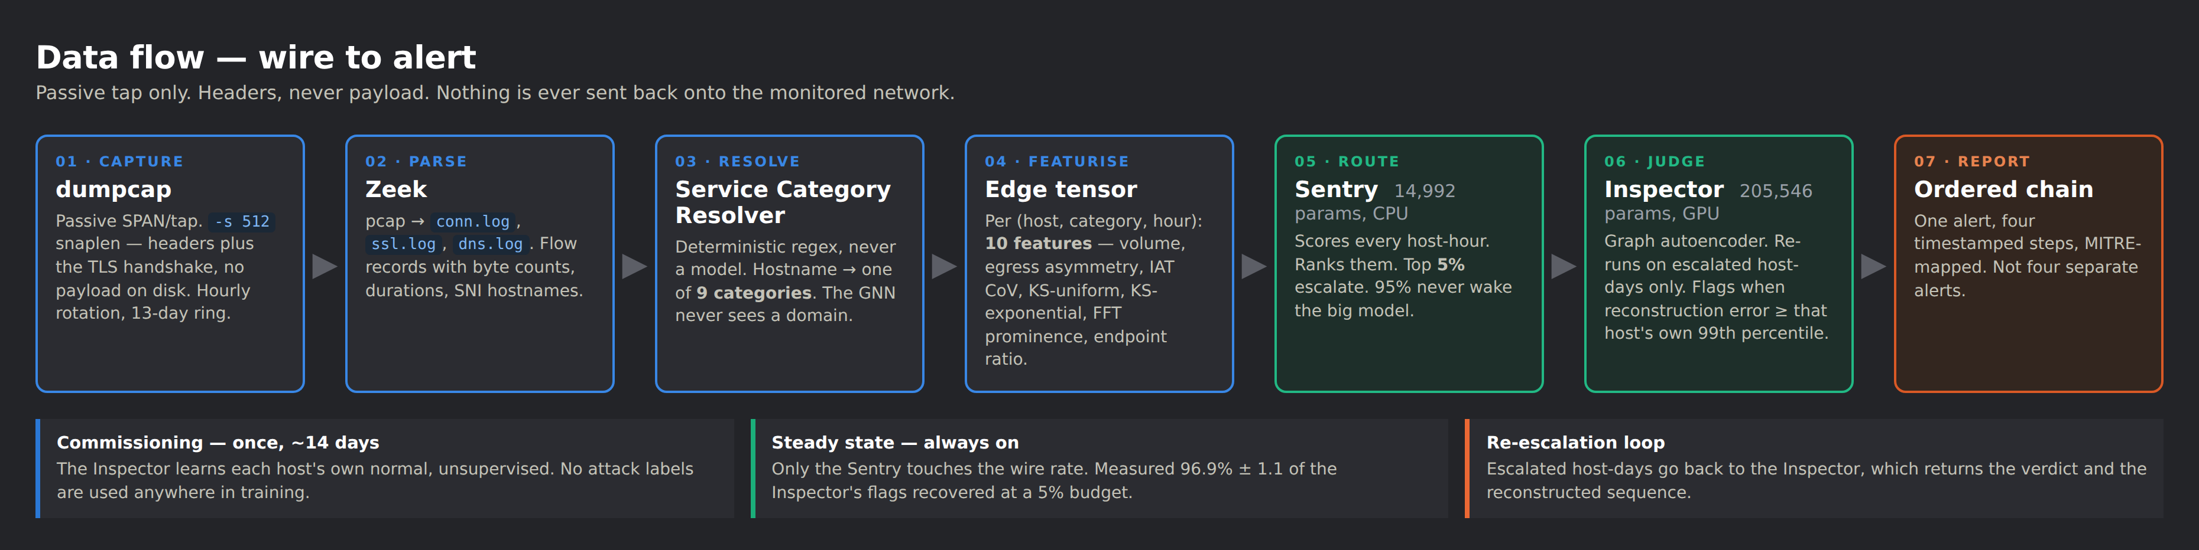
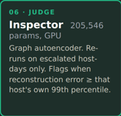
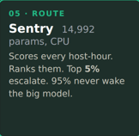
PROPOSED SOLUTION
INNOVATION & UNIQUENESS
Cross-service category-transition sequence semantics: the ORDER of service categories, scored per host, as the detection signal. A 91-study review of graph-based NIDS found no published system doing this. The Inspector architecture itself is prior art (GraphIDS, arXiv:2509.16625) and we say so. What is ours is the agentic orchestration around it — a self-routing seven-stage pipeline that pushes only the top-5% host-days to the heavy model and returns a single, ordered, evidence-backed chain.
THE IDEA
A two-model agentic cascade. The Inspector — a graph autoencoder — learns each host's own normal, unsupervised, during commissioning. The Sentry, 13.7× smaller, runs always-on and decides what deserves the Inspector. Both sit on a Tier-1 pipeline of six ONNX experts whose per-event outputs are auto-routed to the right model and fused into one correlated kill chain — capture → parse → resolve → featurism → route → judge → report, with no human in the loop until the verdict.
WHY NOTHING CATCHES IT TODAY
HOW IT ADDRESSES THE PROBLEM
AND IT ESCALATES BACK
Signature IDS needs a known bad. Domain and DNS filters need a bad domain. DPI needs plaintext — and 61% of encrypted web traffic on our own measured capture was QUIC. EDR needs an agent on the host. A Living-off-Trusted-Sites chain defeats all four at once, because every hop is a legitimate allow-listed service and each request in isolation looks like a developer doing their job. Only an agent that reasons over the sequence across services, not any single request, surfaces the chain — which is exactly what our pipeline is built to do.
No signature, no bad domain, no decryption, no agent on the host. It works behind a data diode where the return channel is invisible, and on IoT/OT/BYOD that cannot run an agent. The intelligence is a passive, self-directed pipeline: it routes each event to the right expert, escalates on its own budget, and correlates — but it never acts on the network. Detection is autonomous; response stays with the analyst.
Host-days the Sentry ranks in the top 5% return to the Inspector, which re-runs on those only and emits ONE alert carrying the four timestamped chain steps — not four disconnected alerts an analyst has to correlate by hand. This closed re-escalation loop is the agentic core: the cheap router decides, the expert confirms, and the pipeline hands back a finished, ordered verdict. Measured: 96.9% ± 1.1 of the Inspector's flags recovered at that 5% budget, over 3 seeds.
GITHUB REPO LINK: https://github.com/qwertyuiopas17/netsentinel
@SIH Idea submission- Template

Slide 3
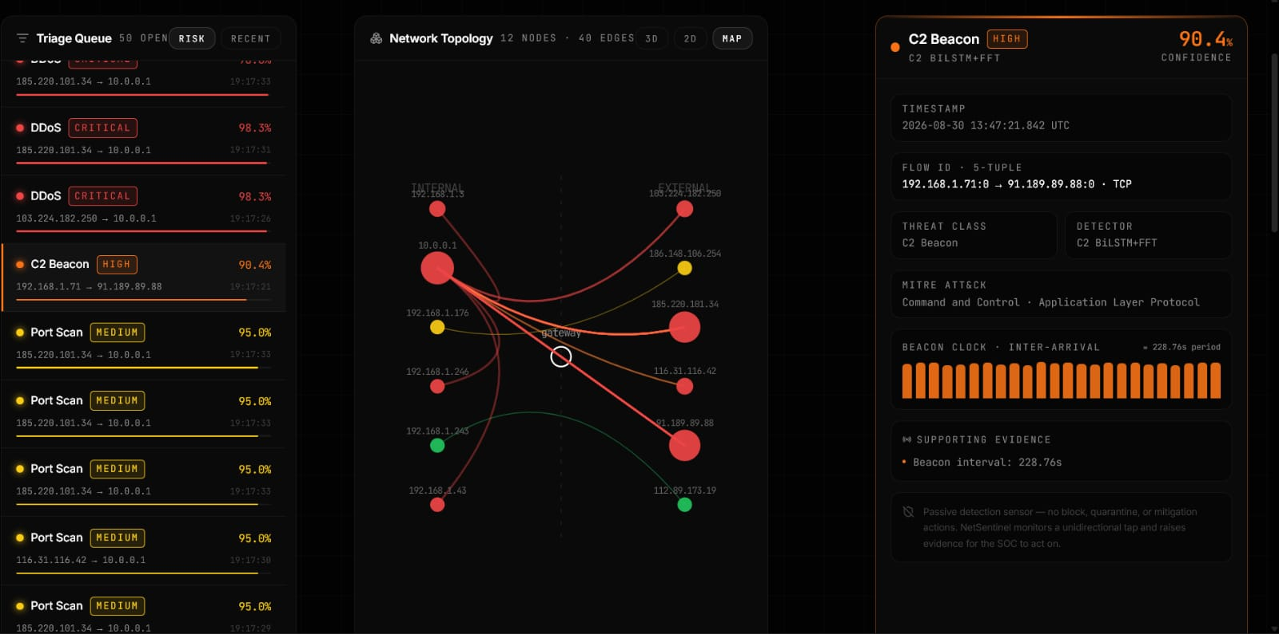
TECHNICAL APPROACH
Net Sentinel is a passive, agentless NIDS for data-diode-protected critical infrastructure. It routes every event to one of six behavioral experts, then fuses their verdicts into a single correlated kill chain — headers only, never payload.
E1 · DDoS Detection: XGBoost (3,000 trees) trained on CIC-DDoS2019 (2.5M flows). Detects volumetric and application-layer floods from flow-rate, timing regularity and TCP-flag asymmetry, with a rate-guard to suppress false positives. F1 99.3%.
E2 · DGA Detection (DGArchive exclusive): CNN-BiLSTM + bigram model trained on DGArchive — a restricted-access, research-only corpus of 137 real malware families (474K domains) that most systems can't obtain. Reads a domain character-by-character to flag algorithmically-generated C2 domains by their high entropy. Evaluated with family-wise holdout (27 families never seen in training) for an honest 0.9787 macro-F1.
INSERT SITE PAGE IMAGE
E3 · Inspector–Sentry Cascade: Our flagship behavioral tier. The Inspector — a graph autoencoder that learns each host's own normal unsupervised during commissioning and flags when reconstruction error crosses that host's 99th percentile. The Sentry — a GRU student (14,992 params, 13.7× smaller, CPU) — runs always-on, ranks every host-hour, and escalates only the top 5% to the Inspector..
E4 · Encrypted Traffic / Malware FT-Transformer (4 layers, 8 heads) on ISCX-VPN (100K flows). Classifies encrypted flows by metadata alone — no decryption — to reveal what applications ride inside a tunnel. Acc 88.0%.
PUT CAPTION
Live Software Running (Pipeline)
E5 · Recon / Port Scan — XGBoost trained multi-dataset (CIC-IDS2017 · LITNET-2020 · UNSW-NB15 · CSE-CIC-IDS2018); catches the reconnaissance phase by fan-out probing across ports/hosts. F1 99.43%.
E6 · Data Exfiltration — VAE + Isolation Forest on CIC-Bell-DNS-EXF-2021; unsupervised scoring of DNS lexical features to catch tunneled exfiltration (dnscat2, iodine, Cobalt Strike DNS). F1 88.1%.
BLOCKCHAIN LEDGER — TAMPER-EVIDENT ALERT AUDIT: Every alert the engine emits is written to an append-only, hash-chained ledger before it reaches the dashboard. Each record stores the alert, and the SHA-256 hash of the previous record — so any edit or deletion breaks the chain and is instantly detectable. This gives critical-infrastructure operators a cryptographically verifiable, non-repudiable audit trail for incident forensics. Implementation: alerts are serialized → SHA-256 hashed → linked (Prev-hash) into a local ledger written alongside the Fast API alert hub; for multi-site deployments this extends to a permissioned chain (Hyperledger Fabric) so no single operator can rewrite history. It is an integrity layer, not a detection layer — it records verdicts, it never makes them.
Document link: https://1drv.ms/w/c/e7784e622ae4d2bd/IQBKv40J2VFuS5Qz89qppSyIAUmAgOKZeacWCUSTfnbM4MI?e=tT2O60
@SIH Idea submission- Template

Slide 4
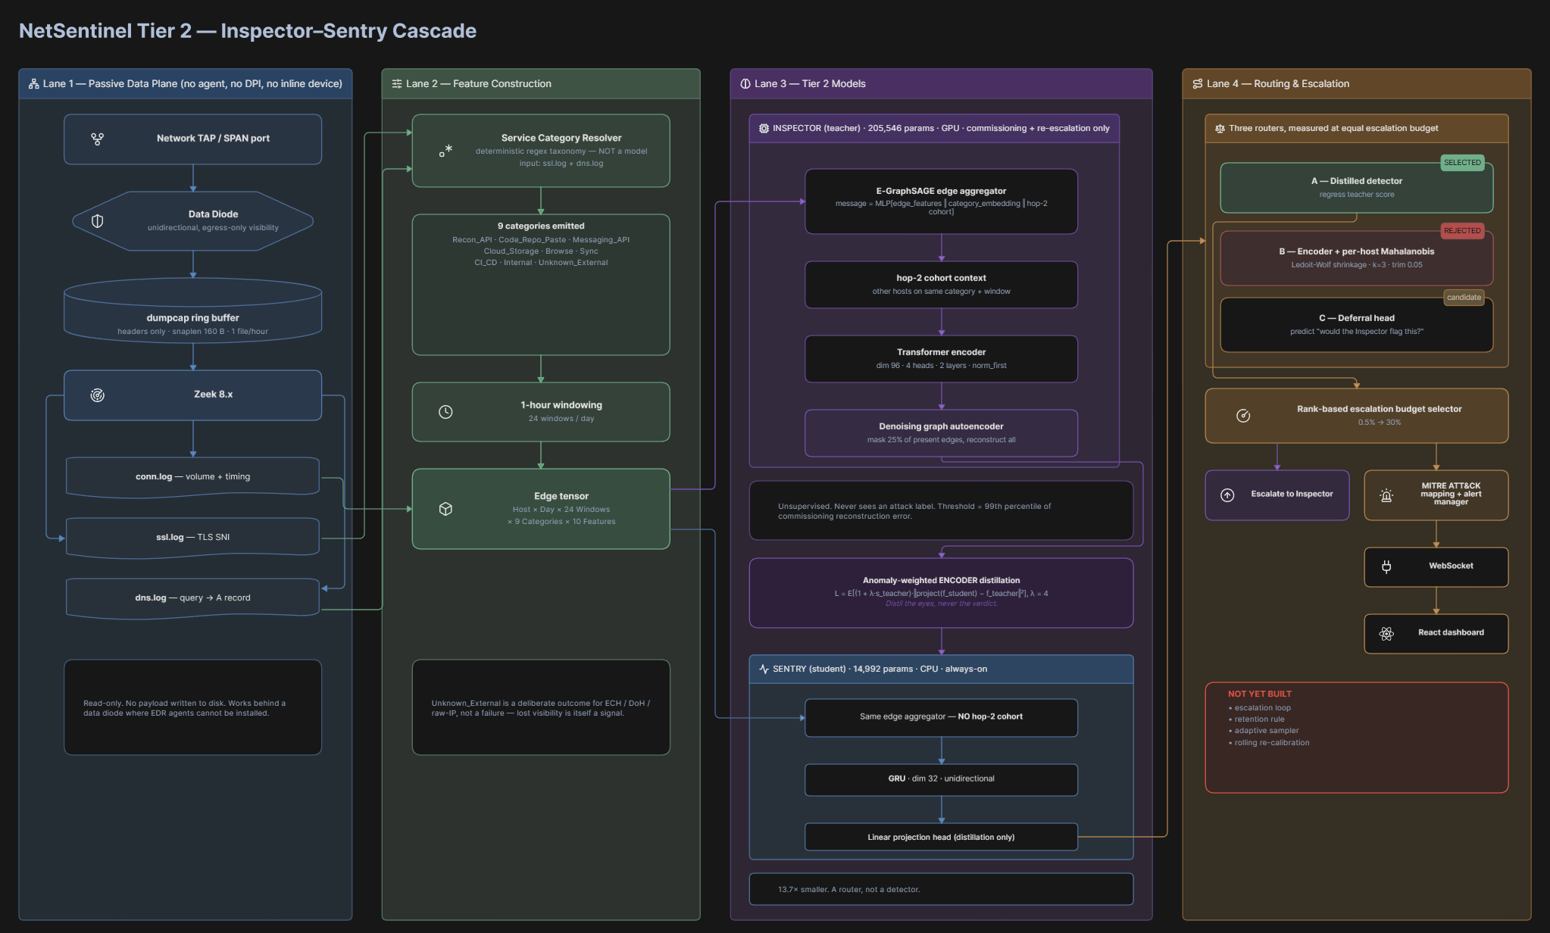
TECHNICAL APPROACH
Agentic pipeline — 1. Ins
CAPTURE & PARSE
dumpcap (snaplen 512) · Zeek 6 · Npcap · hybrid extractor (CICFlowMeter flow stats + Scapy DNS/flow/session events) · scheduled task with ring-buffer pruning and a hostname-coverage audit
MODELS
Tier-1 — six ONNX experts routed per event: DDoS (XGBoost) · DGA (CNN-BiLSTM) · DNS-exfil (VAE) · C2 beacon (BiLSTM+FFT) · encrypted traffic (FT-Transformer) · port scan (XGBoost). Tier-2 — Inspector (E-GraphSAGE + Transformer, 205,546) + GRU Sentry (14,992). PyTorch · ONNX Runtime
SERVING & UI
FastAPI · WebSocket alert hub · React + TypeScript dashboard · force-directed threat graph · MITRE ATT&CK mapping
DATA & EVALUATION
LANL cyber1 (612 hosts, 13 days, 749 real red-team events) · own 12-day multi-host capture · strictly temporal multi-seed protocol
@SIH Idea submission- Template

Slide 5
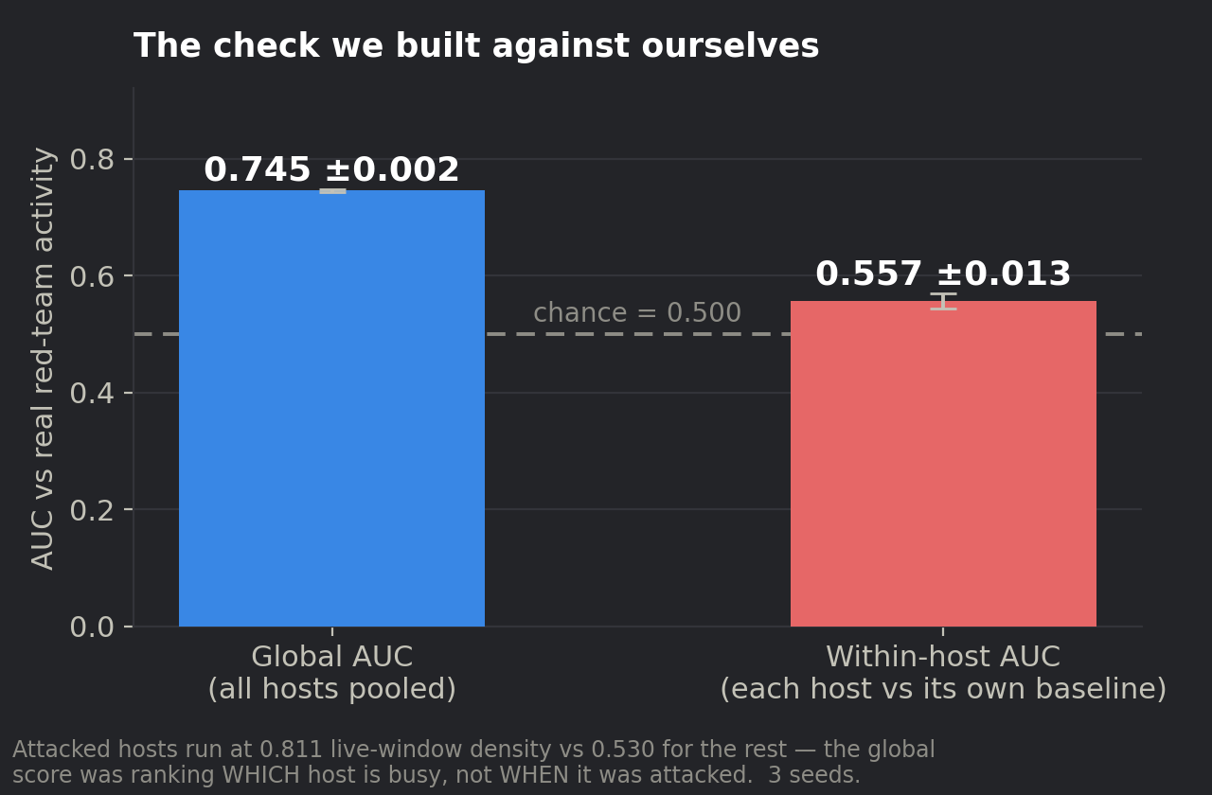
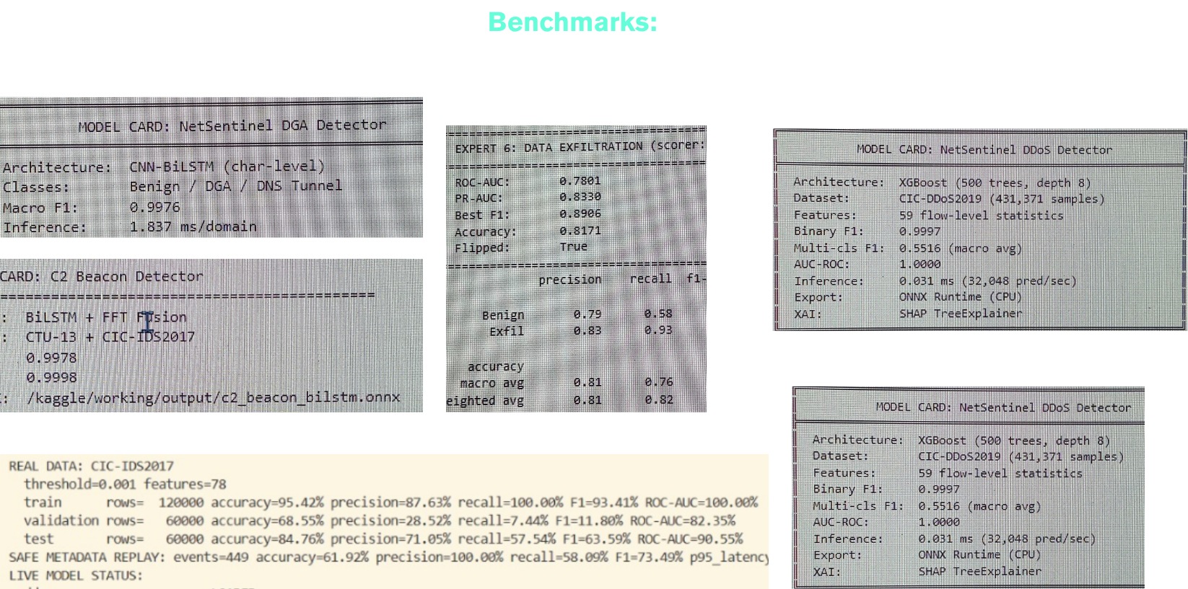
FEASIBILITY AND VIABILITY
Feasibility analysis, the risks we actually found, and how we are handling each one.
IS IT FEASIBLE? — ALREADY BUILT AND MEASURED
The agentic Tier-1 pipeline runs end to end: an 8.8 GB capture is with 23 ms per-event latency in just 280 MB of RAM, auto-routing each event to the right one of six ONNX experts and raising 32,266 correlated alerts. Tier-2 (the Inspector–Sentry cascade) is measured over 3 seeds on real enterprise traffic. Every component is open source — Zeek, PyTorch, ONNX Runtime, FastAPI, React — with no paid API, and commissioning ran on CPU.
SCALABILITY
WHAT THE 36 HOURS ARE FOR
Cost is linear in host-days, and the agentic router is cheap by design: the always-on Sentry is 14,992 parameters at ~250,000 windows/second on one CPU core, deciding per event what deserves the heavy model. Routing and correlation stay on CPU; only the top 5% of host-days reach the GPU-side Inspector — 94.7% less GPU work than inspecting everything at a 1,000-host deployment.
Not the pipeline — that exists. The remaining work is the agentic escalation loop (returning the top-5% host-days to the Inspector for one fused alert), rolling re-calibration, the retention rule, and the analyst evidence panel — plus the injection experiment on our own capture.
Test against LANL Red Team
RISK No public dataset can evaluate this. → Of 124 surveyed datasets, none has multi-day egress traffic with multi-stage campaign labels. We are building the corpus — 6 machines, 12 days — and we audit our own capture with a tool that returns a pass/fail on hostname coverage.
RISK Within-host AUC 0.557 ± 0.013 against the LANL red team — chance. → Attacked hosts were simply busier (0.811 vs 0.530 activity density). LANL has zero external traffic, so the cross-service hypothesis cannot fire there at all. We are capturing our own 12-day egress corpus to test it properly.
RISK The alert threshold decays — across networks and over time. → Our shift test showed the mechanism transfers (AUC −3.3%) but the 99th-percentile threshold does not: it flags 6.3% in a second organisation and 6.8% in its own later test period. Every deployment needs its own calibration window plus rolling re-calibration.
RISK Fusing six signals could invent a kill chain that isn't there (over-correlation) → → Correlation only links events from the same host in valid temporal order, and the service-category step is a deterministic resolver, never a model. One alert carries the four timestamped chain steps as evidence, so an analyst can verify the sequence rather than trust a black box.
Benchmark Data
@SIH Idea submission- Template

Slide 6
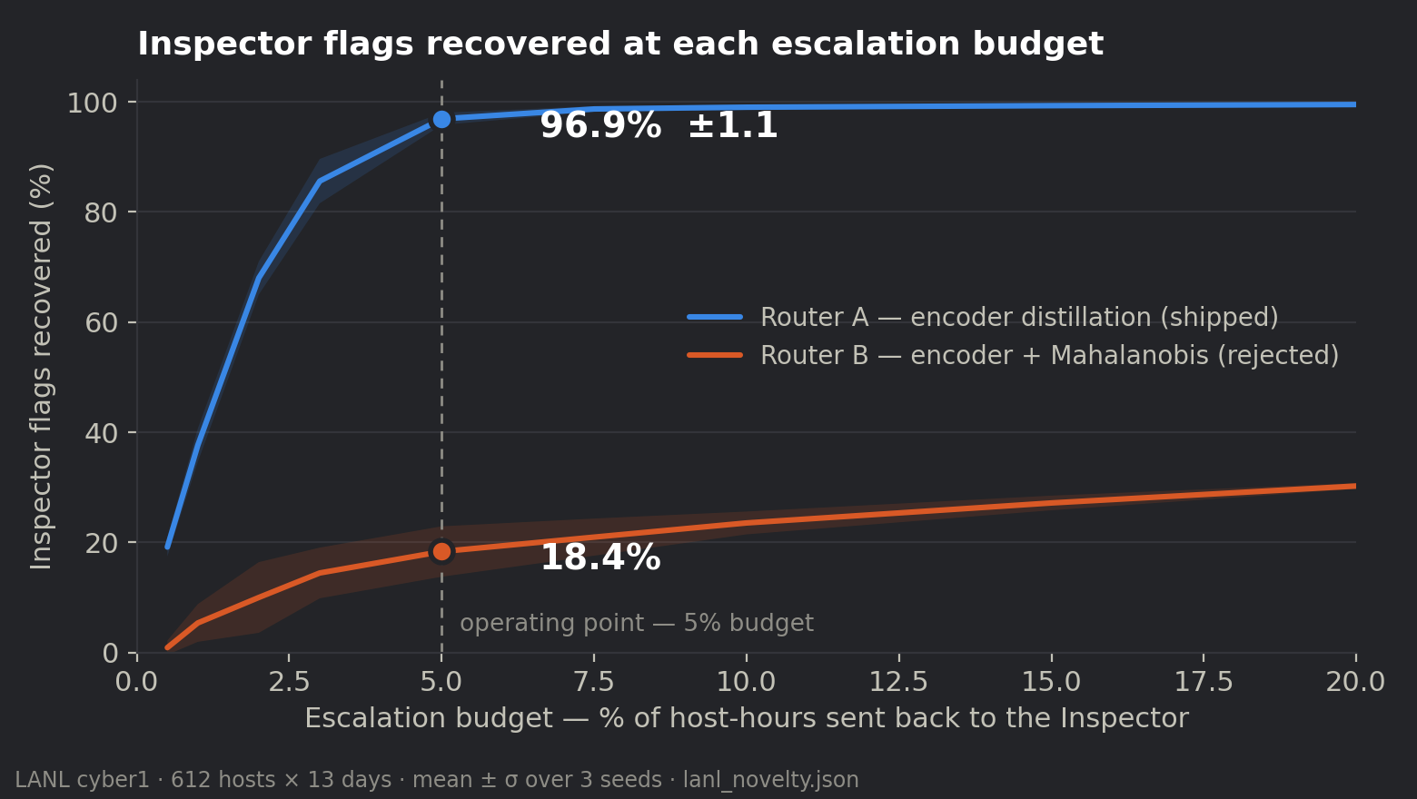
IMPACT AND BENEFITS
Every figure below regenerates from a result file by script. None is typed by hand.
96.9%
13.7×
of the expensive model's flags recovered at a 5% escalation budget (±1.1, 3 seeds)
smaller student model — 205,546 → 14,992 parameters, CPU-only
94.7%
0.992
less GPU work in steady state at a 1,000-host deployment
Sentry–Inspector agreement (AUC) on real enterprise traffic (±0.003)
SOCIAL & STRATEGIC
ECONOMIC
Behavioural egress detection for diode-protected national infrastructure — nuclear, defence, power grid, SCADA — which today has none. Directly supports NCIIPC's Critical Information Infrastructure mandate. SDG 9 and SDG 11.
94.7% less GPU work than inspecting every host-day, so the detection layer runs on CPU-only hardware an OT site already owns. One alert carrying four timestamped chain steps instead of four disconnected alerts also cuts analyst time.
96.9% is AGREEMENT WITH THE TEACHER — an efficiency figure, not a detection rate, and we never present it as one. Our best honest detection result against a real red team is within-host AUC 0.557 ± 0.013.
Industrial & critical-infrastructure use cases:
1. Nuclear & Power Generation: Monitors egress from diode-isolated plant networks where no inline device or endpoint agent is permitted; flags a reactor-control host that starts touching service categories in an order it never has before.
2. Electrical Grid & Substations (SCADA/ICS): Watches IEC-104 / DNP3 control segments passively on a SPAN port — detects the reconnaissance-to-exfiltration chain across substations without adding latency or a single packet to the OT network.
3. Defence & Government Air: Gapped Networks Fully offline, no telemetry, no external resolver — every model, feature and decision boundary is auditable, meeting data-sovereignty rules that rule out CrowdStrike/Darktrace-class cloud tools.
4. Oil, Gas & Pipeline Operations Geographically dispersed RTUs and PLCs behind unidirectional gateways; behavioural detection catches living-off-trusted-services C2 that signature IDS and domain filters miss entirely.
@SIH Idea submission- Template

Slide 7
RESEARCH AND REFERENCES
Inspector architecture — prior art, not ours
GraphIDS: self-supervised graph intrusion detection with edge aggregation — arXiv:2509.16625
The Inspector is GraphIDS-shaped. We say this on stage. The cascade, the distillation and per-entity baselining are all established technique.
Why the router predicts the teacher's flag, not its own uncertainty
Jitkrittum, Gupta, Menon, Narasimhan, Rawat, Kumar — "When does confidence-based cascade deferral suffice?" NeurIPS 2023,
Confidence-based deferral is provably suboptimal. Our router is trained to answer "would the Inspector flag this".
Why we distil the encoder and never the verdict
"Knowledge distillation for anomaly detection" — MDPI Machine Learning & Knowledge Extraction 8(3):60
Distillation transfer is asymmetric: global outliers 78%, isolation 88%, neighbourhood 76%, local outliers only 20%. A LOTS chain is a local outlier.
Real red-team evaluation data
Kent, A. D. — "Comprehensive, Multi-Source Cyber-Security Events", Los Alamos National Laboratory, 2015
612 hosts × 13 days × 749 real red-team events. Also, the source of our honest negative result: within-host AUC 0.557.
Threat model and taxonomy
MITRE ATT&CK T1567 (Exfiltration Over Web Service), T1102 (Web Service C2) · The LOTS Project living-off-trusted-sites domain taxonomy
The nine service categories in our resolver extend the LOTS taxonomy. The resolver is a deterministic lookup, never a model.
Capability | NetSentinel | Wireshark | Snort / Suricata | Commercial (Cisco / CrowdStrike / Darktrace)
Offline / air-gapped operation — no cloud, no telemetry | ✓ Yes | Yes (manual) | Yes | No — cloud-dependent
Passive & agentless — runs behind a data diode | ✓ Yes | Passive but manual | Inline / tap, needs rules | No — needs agents or inline
Detects unknown, zero-day behaviour (no signatures) | ✓ Behavioural, unsupervised | No | No — signatures only | Partial
Cross-service kill-chain correlation — ONE alert, not four | ✓ Unique to us | No | No | No
Encrypted-traffic visibility without decryption | ✓ Headers only | No | Limited | Often needs TLS break
Protection Against Modern Cloud/Telegram/Discord Attacks | ✓ Better results | -- | -- | No
Video link: https://drive.google.com/drive/folders/1PeBuv8mAERw5uahcXovEdzWme7k20iW-?usp=sharing
@SIH Idea submission- Template

