Slide 1

Credit Loan Analysis
Max becker, Michael bowman, lance cannon, & Adrian Williams
Notes:
Lance

Slide 2
Project Overview
Dataset
Data Inspection & Cleanup
Data Analysis
Machine Learning: Decision Tree
Machine Learning: Random Forest
Confusion Matrices
Loan Prediction
Conclusion
Notes:
Lance

Slide 3
Dataset
Sourced from Kaggle:
https://www.kaggle.com/datasets/credit-scoring-data
Contains five demographic fields from approved loans:
Age, Gender, Marital Status, Education Level, and Employment Status
Contains seven fields on factors that influence credit scores:
Credit Utilization Ratio, Payment History, Number of Credit Accounts, Loan Amount, Interest Rate, Loan Term, and Type of Loan
1,000 total records with each representing an individual’s credit profile
Notes:
Adrian

Slide 4
Data Inspection & Cleanup
Ages ranged from 20 – 65, so we added a column that helped bucket these into groups labeled twenties, thirties, forties, fifties, and sixties
Saved this updated file as a new csv file
Inspected the data types and null counts, and updated several column types from strings to integers
Decided that target column would be Loan Type
Notes:
Adrian

Slide 5



Data Analysis
Ran three different analysis to learn the following:
Find the different types of loan count by gender:
Find the average loan amount per education status:
Find the average term length per type of loan:
Notes:
Adrian

Slide 6
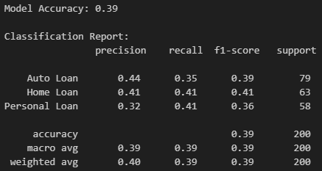
Machine Learning: Decision Tree
Defined our features and target
Encoded categorical features, as well as target column
Split our data into training and testing sets
Trained a Decision Tree Classifier
Predicted on test data
Evaluated the model (39% accuracy)
Notes:
Mike

Slide 7
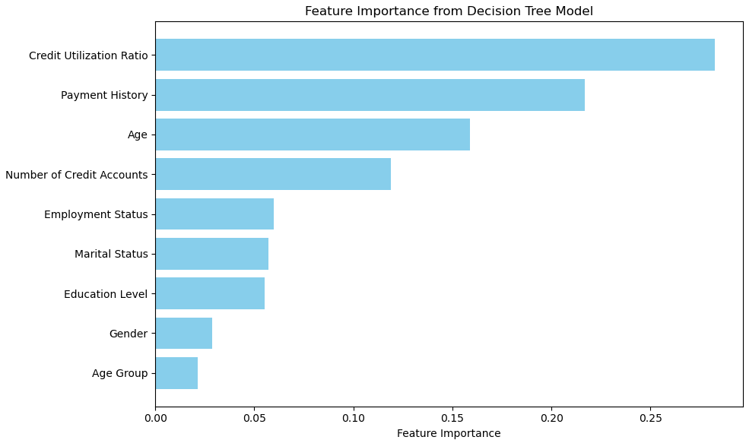
Machine Learning: Decision Tree
Understanding the feature importance from the Decision Tree Model
Notes:
Mike

Slide 8
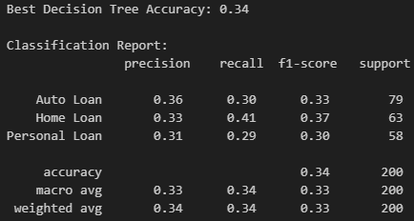
Machine Learning: Decision Tree
Improving the accuracy for the Decision Tree Model
Define parameter grid for tuning
Setup a GridSearchCV
Fit the GridSearchCV to our training data
Select the best model from the GridSearchCV
Predict on our test set
Evaluate the model (34% accuracy)
Notes:
Mike

Slide 9
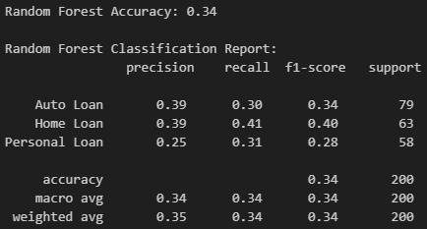
Machine Learning: Random Forest
Train a Random Forest Classifier using similar steps as the Decision Tree Model
Predict on our test data
Evaluate the model (34% accuracy)
Notes:
Max

Slide 10
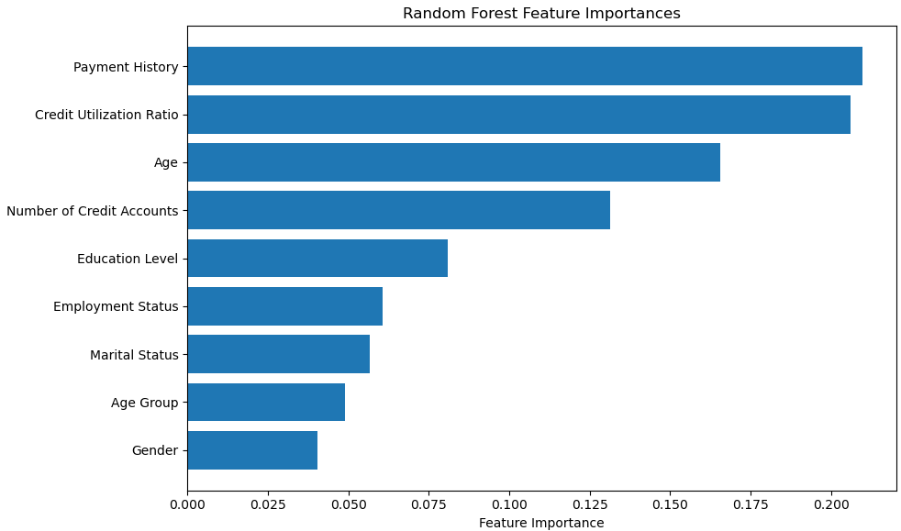
Machine Learning: Random Forest
Understanding the feature importance from the Random Forest Model
Notes:
Max

Slide 11
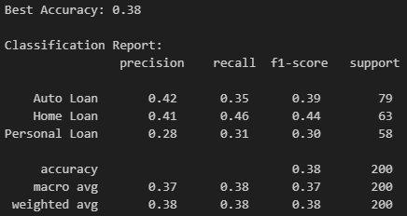
Machine Learning: Random Forest
Improving the accuracy for the Random Forest Model
Define parameter grid for tuning
Setup a GridSearchCV
Fit the GridSearchCV to our training data
Select the best model from the GridSearchCV
Predict on our test set
Evaluate the model (38% accuracy)
Notes:
Max

Slide 12
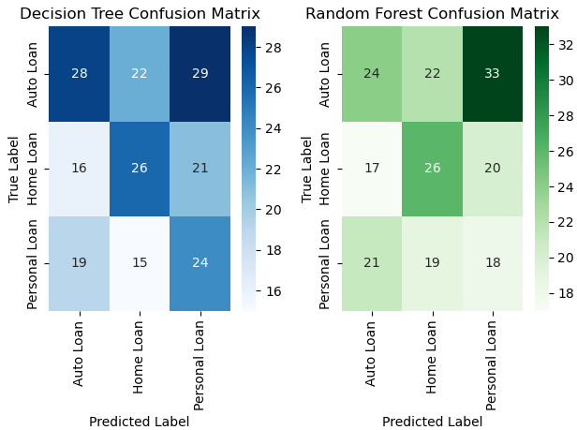
Confusion Matrices
Generate a Confusion Matrix for each model
Define the labels that correspond to each age group
Plot the Confusion Matrices for comparison
Notes:
Max

Slide 13
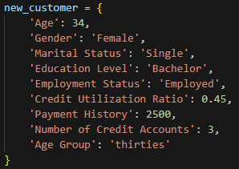
Loan Prediction
Create a new individual’s profile for model testing purposes
Encode categorical fields using the same encoders
Predict the loan type using each model
Decode the prediction for each model
Notes:
Lance

Slide 14
Conclusion
Both models fell below a 40% classification accuracy, indicating that neither was successful in predicting the target variable reliably
Likely due to the data quality being randomly generated, and thus failing to find any real correlation between the demographic fields and an individuals selected loan type
Insights and lessons learned:
Low accuracy doesn’t mean failure, it highlights areas for improvement in feature engineering, preprocessing, or model selection
It’s crucial to analyze confusion matrices and other metrics (e.g., precision, recall) — especially in imbalanced datasets — since accuracy alone can be misleading
Future trials could include:
Experimenting with other Machine Learning Model types such as Logistic Regression, Gradient Boosting, or even Deep Learning approaches
Finding “real” datasets that would almost certainly show relationships between demographic fields and influential credit score factors
Notes:
Adrian / Mike

Slide 15
ANY QUESTIONS?
Thank you!
Notes:
Mike

