Slide 1
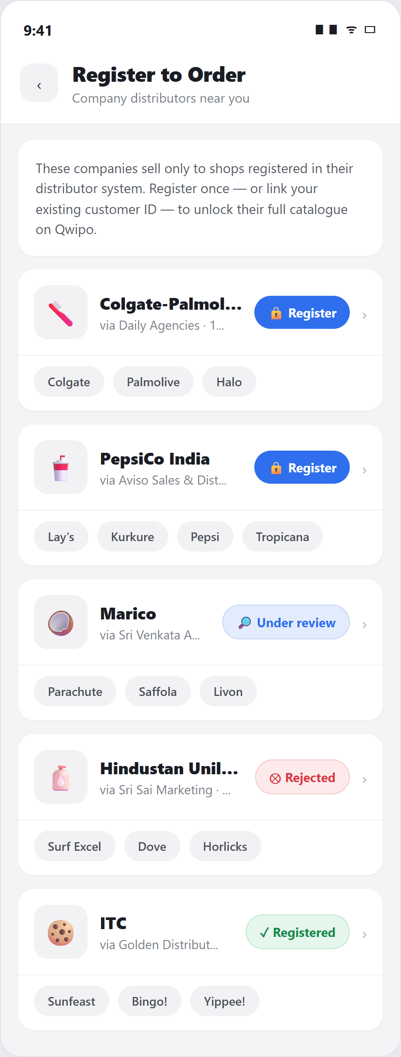
QWIPO B2B · PRODUCT PROPOSAL
Registered-Customer
Purchase
End-to-end DMS registration workflow — from company tagging in the
Super Admin portal, to buyer-app registration, to customer-ID operations
in the Seller Store.
Admin tags company
→
Buyer registers
→
Seller issues ID
→
Catalogue unlocks
Product Team · August 2026

Slide 2
CONTEXT
Why company registration needs a first-class workflow
Companies like Colgate, PepsiCo, HUL and ITC sell only to shops that exist in their distributor-management system (DMS) — a buyer who isn't registered simply cannot be billed.
Each company's DMS issues its own customer ID. A distributor packing ITC, HUL, Colgate and PepsiCo holds four different customer IDs for the same shop.
Today Qwipo has no way to model this: buyers see catalogues they cannot order from, and distributors manage registrations over phone calls and paper KYC.
This proposal closes the loop across all three surfaces — Super Admin, Buyer App and Seller Store — so registration becomes a tracked, self-serve workflow.
1 shop = 4 IDs
one customer ID per company DMS — state is tracked per company link
2 entry paths
link an existing customer ID instantly, or submit pre-filled KYC
24–48 hrs
typical company approval window for a new outlet registration
Qwipo B2B · DMS Registration Proposal
2

Slide 3
PROPOSAL AT A GLANCE
One workflow, three surfaces
1
SUPER ADMIN
2
BUYER APP
3
SELLER STORE
4
BUYER APP
Tag the company
Register or link ID
Review & issue IDs
Catalogue unlocks
While linking a company to a seller in Distributor mode, admin sets Customer Purchase: all customers, or registered customers only.
→
Gated companies show a Register entry point. The buyer links an existing DMS customer ID, or submits KYC pre-filled from their Qwipo profile.
→
Requests land in the new Customers (DMS) module. The seller creates the customer in the company DMS and records the issued ID — singly or in bulk.
→
Once registered, the company's full catalogue opens for that shop. Status is tracked per company: a shop can be live on ITC while HUL is under review.
Wholesaler-mode companies are exempt: wholesale never restricts purchase, so those links need no registration and stay open to every buyer.
Qwipo B2B · DMS Registration Proposal
3

Slide 4
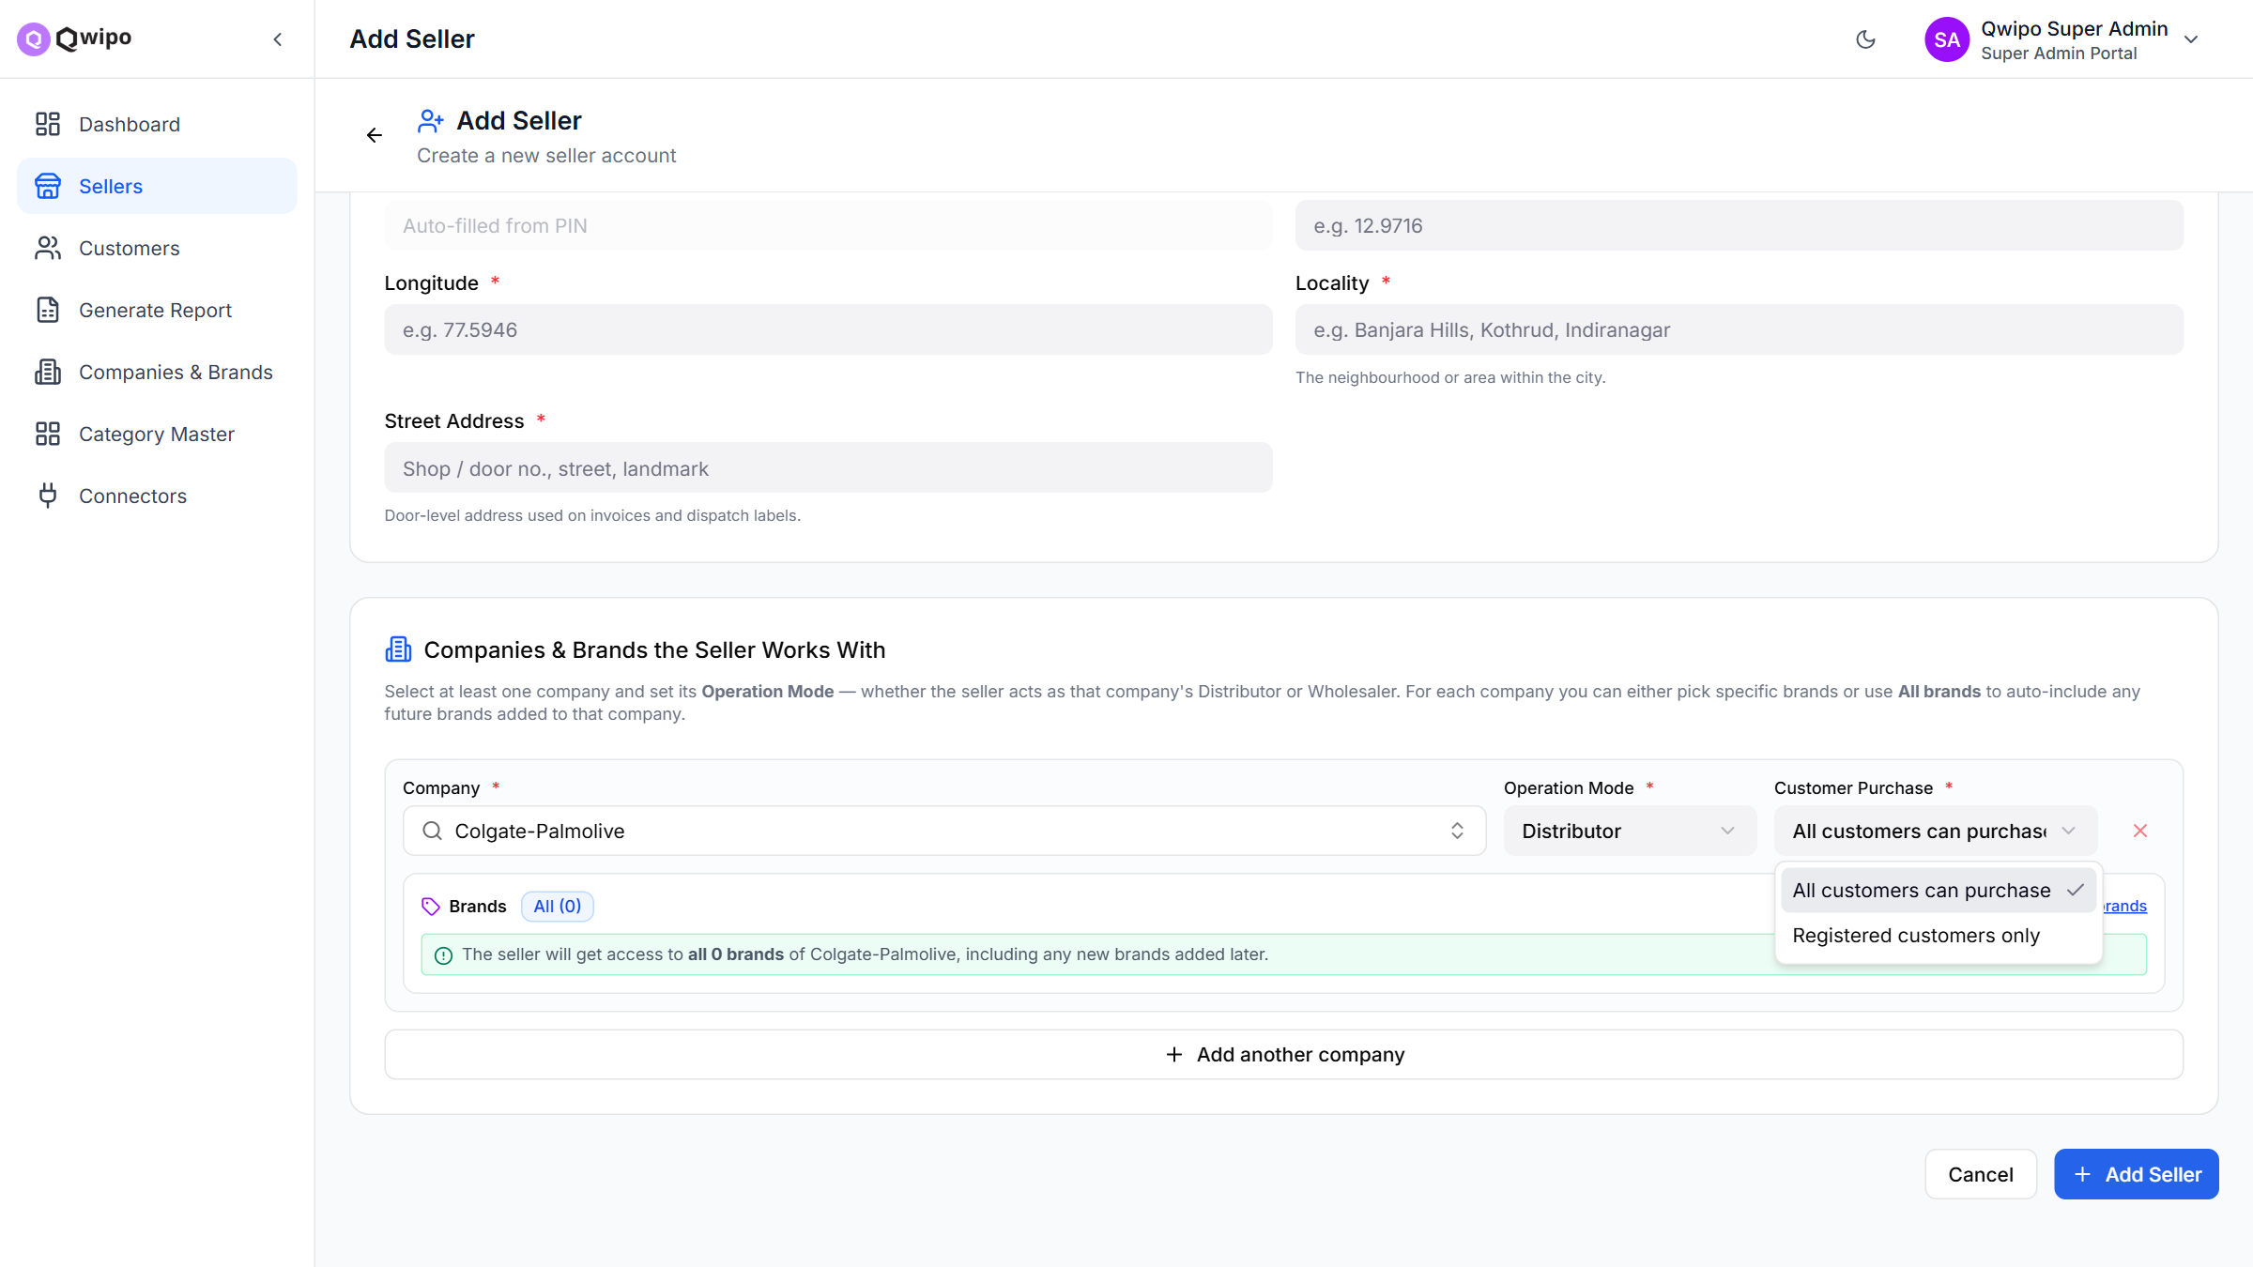
STEP 1 · SUPER ADMIN
Customer tagging while linking a company
1
Add Seller → Companies & Brands
Admin links companies to the seller and sets the Operation Mode per company — Distributor or Wholesaler.
When the mode is Distributor, a mandatory Customer Purchase field appears with two options:
All customers can purchase — open catalogue, today's behaviour (default).
Registered customers only — buyers must hold that company's DMS customer ID before they can order.
Wholesaler rows never show the field — wholesale never restricts.
Add Seller — Customer Purchase dropdown, one setting per linked company
Qwipo B2B · DMS Registration Proposal
4

Slide 5
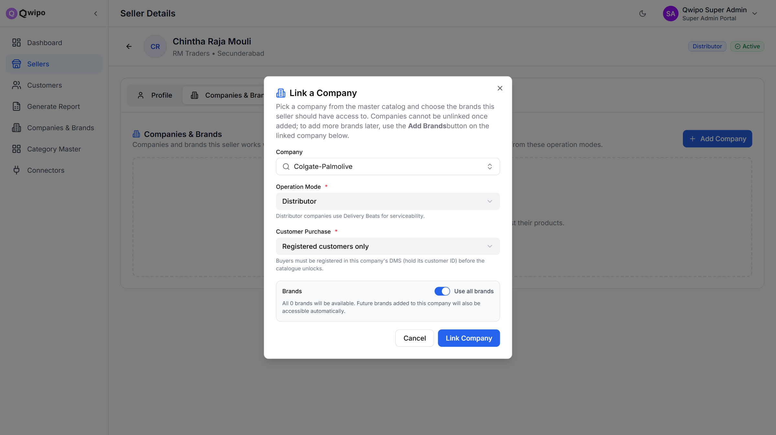
STEP 1 · SUPER ADMIN
Same gate for sellers that already exist
1
Seller Details → Link a Company
The Link a Company dialog on an existing seller carries the identical Customer Purchase choice — the gate is set at tag time, wherever tagging happens.
Inline helper copy spells out the consequence: “Buyers must be registered in this company's DMS (hold its customer ID) before the catalogue unlocks.”
Defaults to the open option, so rolling this out changes nothing for current sellers until a company is deliberately gated.
Link a Company — “Registered customers only” selected
Qwipo B2B · DMS Registration Proposal
5

Slide 6
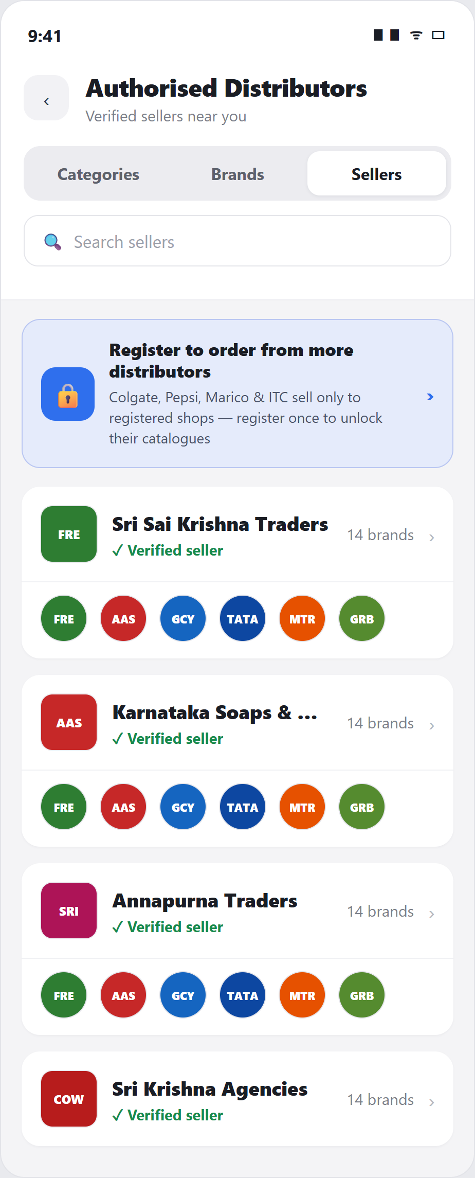
STEP 2 · BUYER APP
Gated companies become a visible, guided entry point
2
Discovery & status at a glance
A Register to order banner sits on the Authorised Distributors screen — buyers learn which companies need registration instead of hitting dead ends.
The Register to Order list shows every gated company nearby, the distributor who serves it, and its brands.
One status chip per company mirrors the seller-side state: Register, Under review, Rejected, Registered.
Registration is per company, not per app — ITC can be live while HUL is still pending.
Entry banner — Authorised Distributors
Register to Order — per-company status
Qwipo B2B · DMS Registration Proposal
6

Slide 7
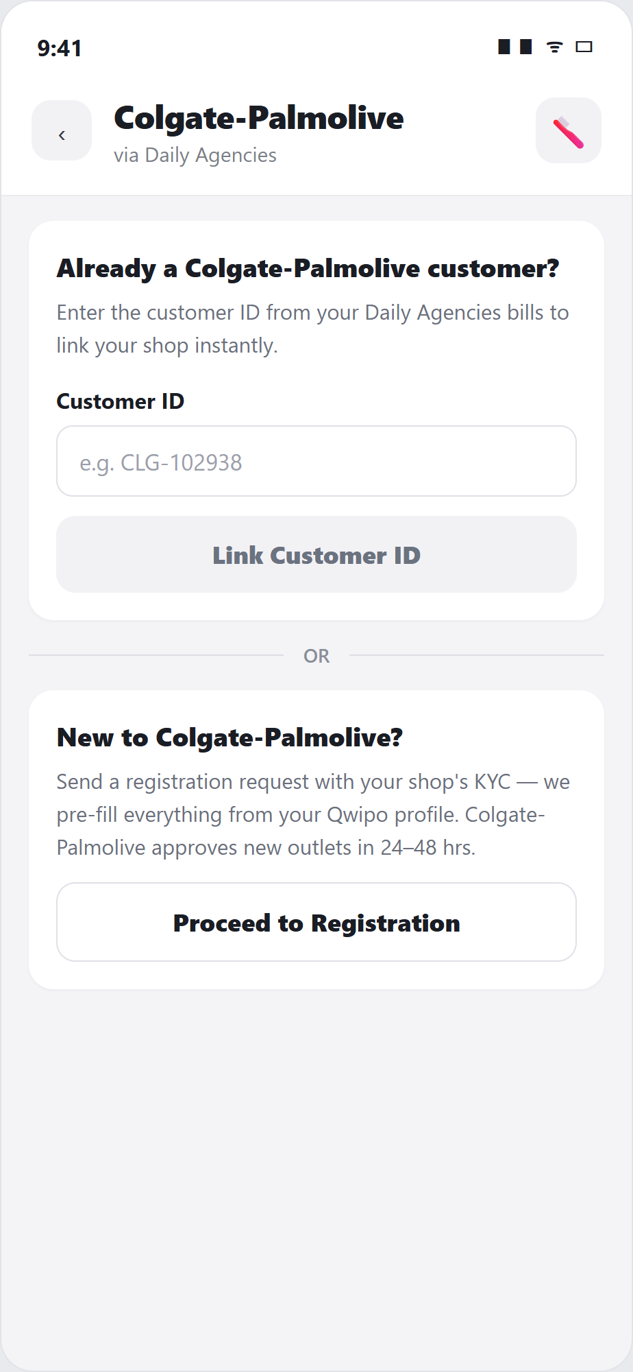
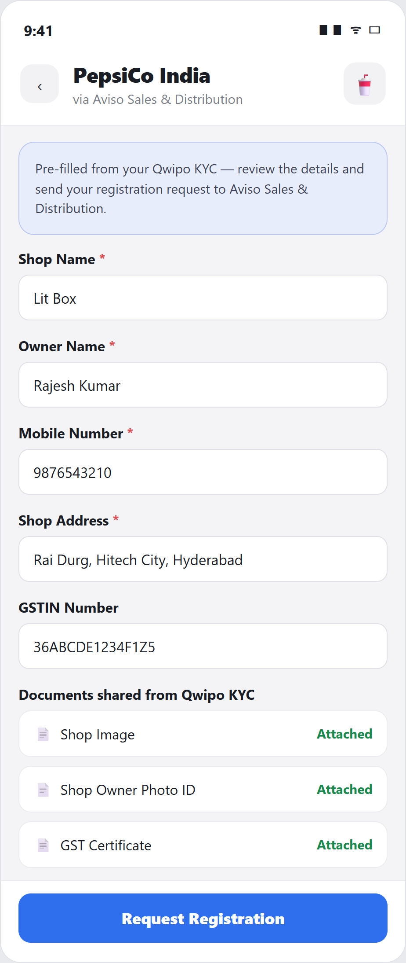
STEP 2 · BUYER APP
Two paths in: link an ID, or register with pre-filled KYC
2
Link Customer ID / New registration
Path 1 — already a customer:
the buyer types the customer ID from their distributor bills and links the shop instantly. No review needed — straight to Registered.
Path 2 — new to the company:
a registration request pre-filled from the buyer's Qwipo KYC — shop, owner, GSTIN and documents attach automatically. Zero re-typing.
The request lands with the distributor; companies typically approve new outlets in 24–48 hours.
Link existing ID — or proceed to registration
KYC pre-filled from the Qwipo profile
Qwipo B2B · DMS Registration Proposal
7

Slide 8
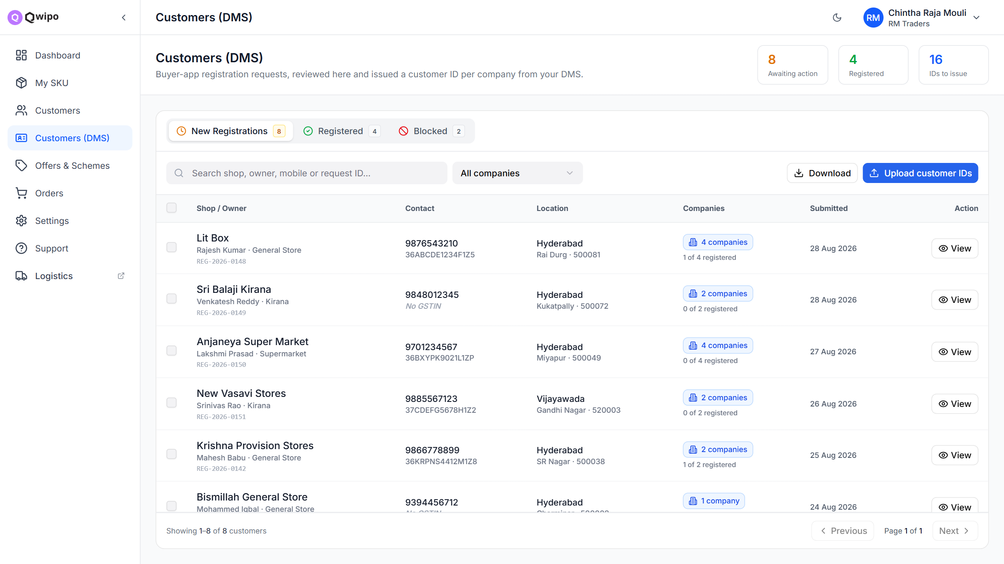
STEP 3 · SELLER STORE
Customers (DMS) — a work queue built for volume
3
New module: Customers (DMS)
Buyer requests land in three single-homed tabs — New Registrations, Registered, Blocked — with headline counts of what's awaiting action.
Each row shows the shop's KYC essentials and how many of its company links are registered (“1 of 4 registered”).
Bulk built in: Download emits a CSV with one customer-ID column per company; the seller fills IDs from the DMS and uploads it back — hundreds of registrations in one pass.
Customers (DMS) — New Registrations queue with bulk download / upload
Qwipo B2B · DMS Registration Proposal
8

Slide 9
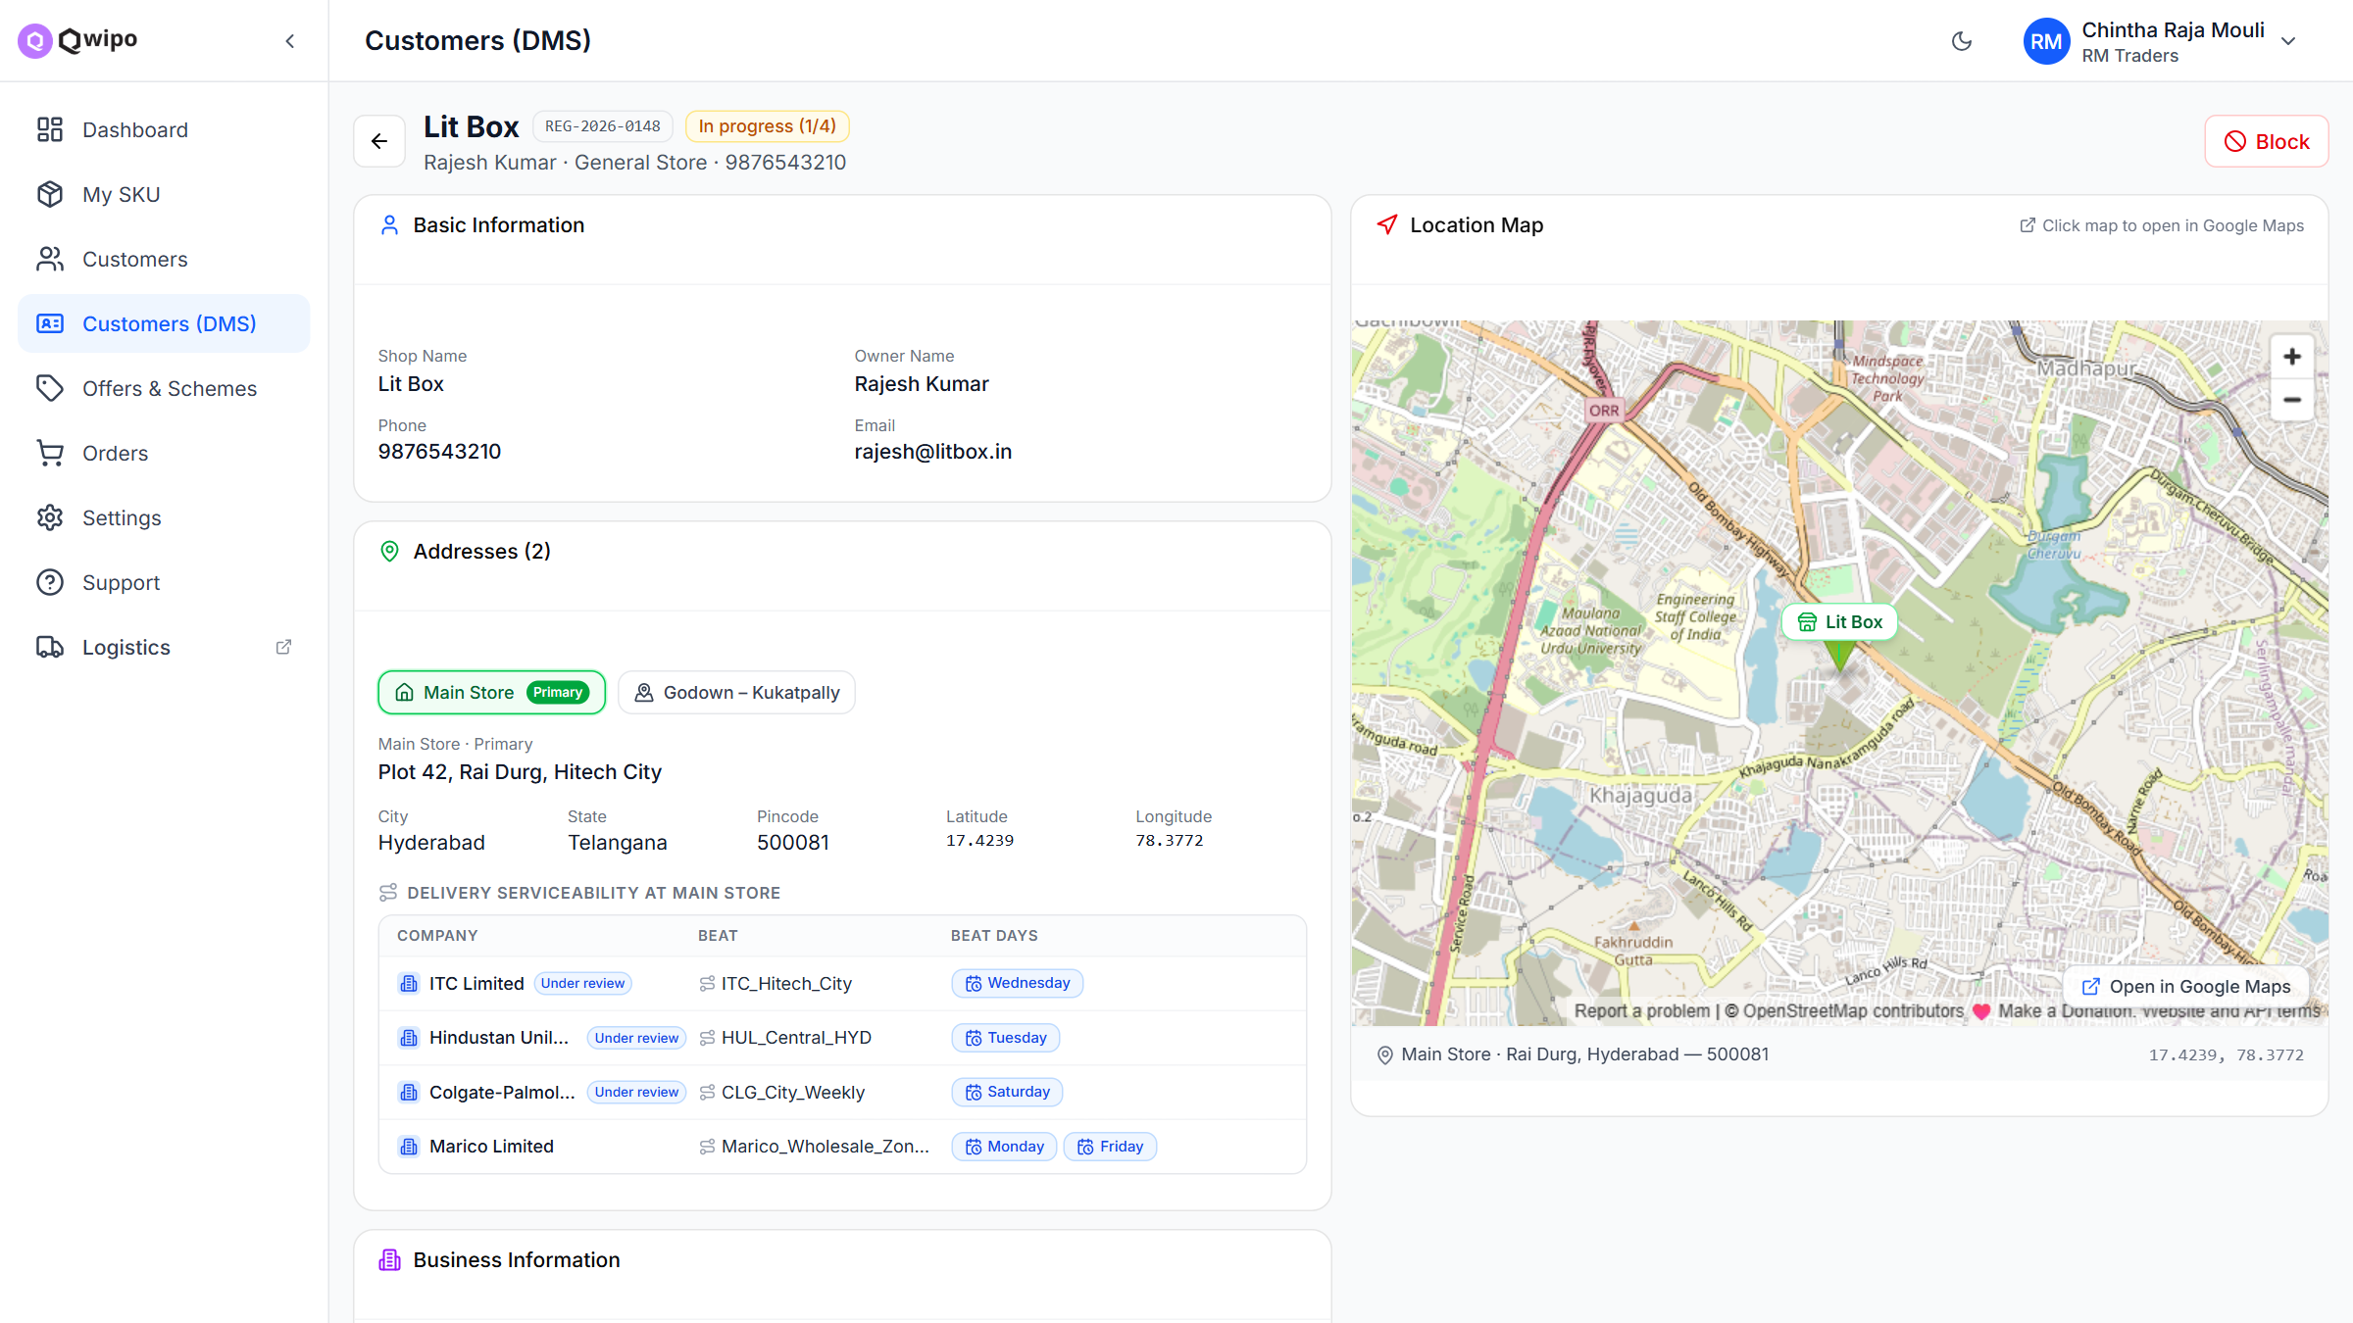
STEP 3 · SELLER STORE
Customer detail — the full picture before issuing an ID
3
Review with serviceability context
The shared KYC pack — shop image, owner photo ID, GST certificate — sits beside basic information, ready to copy into the company DMS.
Every address maps to live Company × Beat × Beat-days serviceability, so the seller knows the shop is coverable before registering it.
Location pin with an open-in-Google-Maps jump for field verification.
Detail — KYC documents, addresses and per-company beat serviceability
Qwipo B2B · DMS Registration Proposal
9

Slide 10
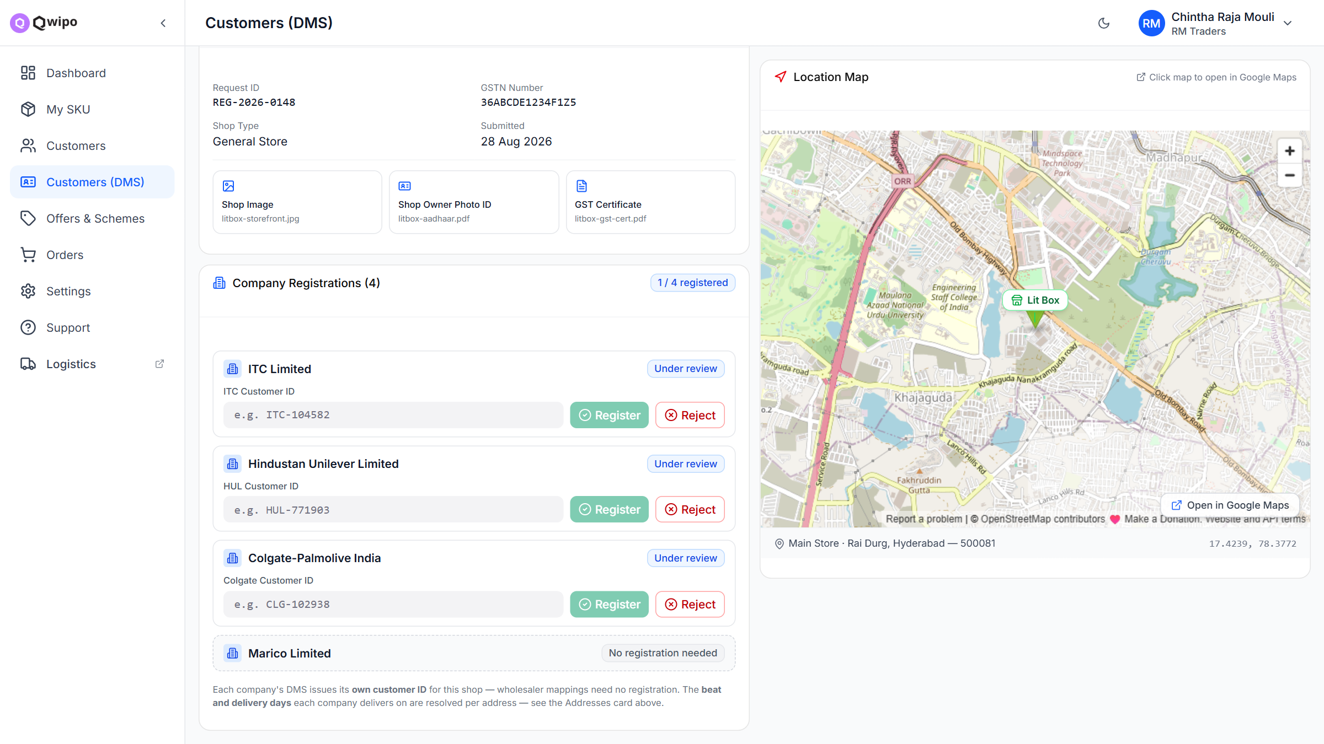
STEP 3 · SELLER STORE
Issue IDs per company — register, reject, or exempt
3
Company Registrations card
One block per linked company, each with its own lifecycle — the “1 / 4 registered” badge tracks progress across companies.
The seller pastes the customer ID issued by that company's DMS (format-hinted per company, e.g. CLG-102938) and hits Register — or rejects with a reason the buyer sees.
Wholesaler companies show “No registration needed” — exempt by design.
Opening a pending customer marks them Under review, so the buyer's chip updates the moment work starts.
Per-company Register / Reject with the company's own ID format
Qwipo B2B · DMS Registration Proposal
10

Slide 11
STATE MODEL
Five statuses, shared verbatim by buyer and seller
Path 1 — buyer already holds the company's customer ID
Link Customer ID
→
Registered ✓
instant — review pipeline skipped
Path 2 — new registration via KYC request
Pending approval
→
Under review
→
Registered ✓
or
Rejected ✕
→ re-apply
Business rules
State lives per company link — one shop tracks four independent lifecycles across four companies.
Rejection always carries a reason, shown to the buyer; a rejected shop can re-apply, returning to Pending approval.
Blocked is seller-initiated and separate from rejection — a blocked shop is frozen across that seller's gated companies.
Qwipo B2B · DMS Registration Proposal
11

Slide 12
FOR DISCUSSION
Search & catalogue visibility for gated companies
When a buyer searches a product from a company they aren't registered with, what should they see?
Option A — Discoverable, but locked RECOMMENDED
Option B — Hidden until registered
Gated products appear in search and browse with a lock badge and a Register to order CTA in place of Add to cart.
Search stays complete — the buyer always finds the product, and every locked result advertises the registration flow.
Turns search demand into registration leads for the company and the distributor.
Price visibility for locked items is a per-company toggle we can add later.
Gated catalogues stay invisible in search and browse until the shop is registered with the company.
Cleanest contractual posture if a company insists its price list must never be exposed to unregistered outlets.
But search feels broken — the buyer can't find Colgate at all, and never learns registration exists.
Could be offered as a stricter per-company setting where a company demands it.
Qwipo B2B · DMS Registration Proposal
12

Slide 13
WHERE WE NEED THE ROOM
Decisions & next steps
Decisions we're asking for
Proposed next steps
Approve the workflow model: per-company Customer Purchase tagging + per-company registration lifecycle.
Pick the search stance for gated companies — discoverable-but-locked (recommended) vs hidden.
Confirm the bulk CSV path as the v1 DMS bridge, with direct DMS API integration as a fast-follow.
Nominate 1–2 anchor companies and distributors for the pilot.
Validate the flow with the pilot distributors against their real DMS registration process.
Freeze buyer-app UX for the two registration paths and the status chips.
Detail stories per surface (Admin, Buyer, Seller Store) and size the build.
Define registration SLAs and the nudges for requests idle beyond 48 hours.
Qwipo B2B · DMS Registration Proposal · August 2026

