Slide 1
QWIPO SELLER PLATFORM
Seller Onboarding to
Buyer App Visibility
The complete workflow — from creating a distributor to their products going live on the customer app.
Steps 1–5 · Admin
Steps 6–10 · Seller
Step 11 · Partner Portal
Step 12 · Automatic
Prepared for the Business Team · Based on the Tech Team's onboarding checklist · Version 2.0 · July 2026

Slide 2
The Onboarding Checklist at a Glance
Twelve steps take a new seller from creation to products visible on the customer app. Admin sets the seller up, the seller readies their catalog, admin syncs the seller to the Partner Portal — then going live is automatic.
1
Create Companies & Brands (if not already in the system)
ADMIN
2
Create a New Seller — Active status, GPS, Companies & Brands tagged
ADMIN
3
Upload Serviceability / GeoJSON per company
ADMIN
4
Add Connector (ONDC — Active)
ADMIN
5
Sync Catalog — per brand, from the seller's Companies & Brands tab
ADMIN
6
Seller logs in with their mobile number
SELLER
7
Upload / review SKUs (Bulk Import for products not in the master catalog)
SELLER
8
Make SKUs ONDC compliant (product image + required fields)
SELLER
9
Update price & inventory (MRP > 0, Selling Price > 0, Stock ON)
SELLER
10
Set up WhatsApp notifications
SELLER
11
Sync the seller to the Partner Portal (Discover → Add Seller)
ADMIN
12
Products go live — visible on the customer app
AUTOMATIC
If any step is missed, the seller's products will not appear on the buyer app — the troubleshooting guide at the end shows what to check.
2

Slide 3
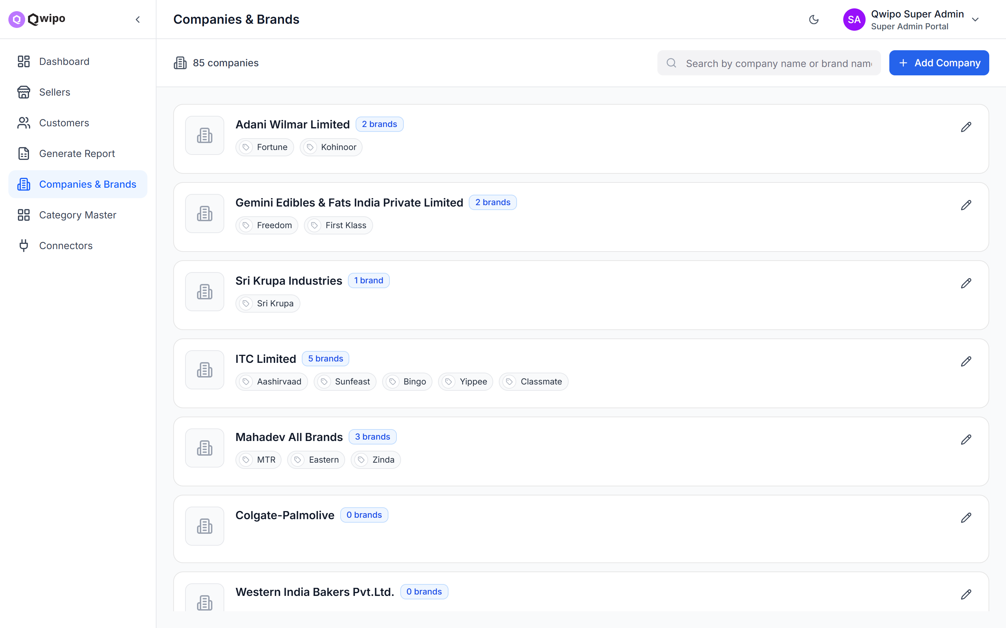
1
Create Companies & Brands
Who: ADMIN
Before creating a seller, every company and brand the seller wants to sell must already exist in the system.
Company and brands already exist? Skip this step.
New company or brand needed? Admin creates it first.
To create a new company
Go to Admin Portal → Companies & Brands
Add the company name (unique across the platform)
Add at least one brand under the company
It is then available for any seller to use
Think of Companies & Brands as a master list maintained by the admin. Sellers pick from this list — they don't create their own.
CHECKLIST
Company name added (unique across platform)
At least one brand added under the company
Company and brands visible in the master list
Admin Portal → Companies & Brands — the master list sellers pick from
3

Slide 4
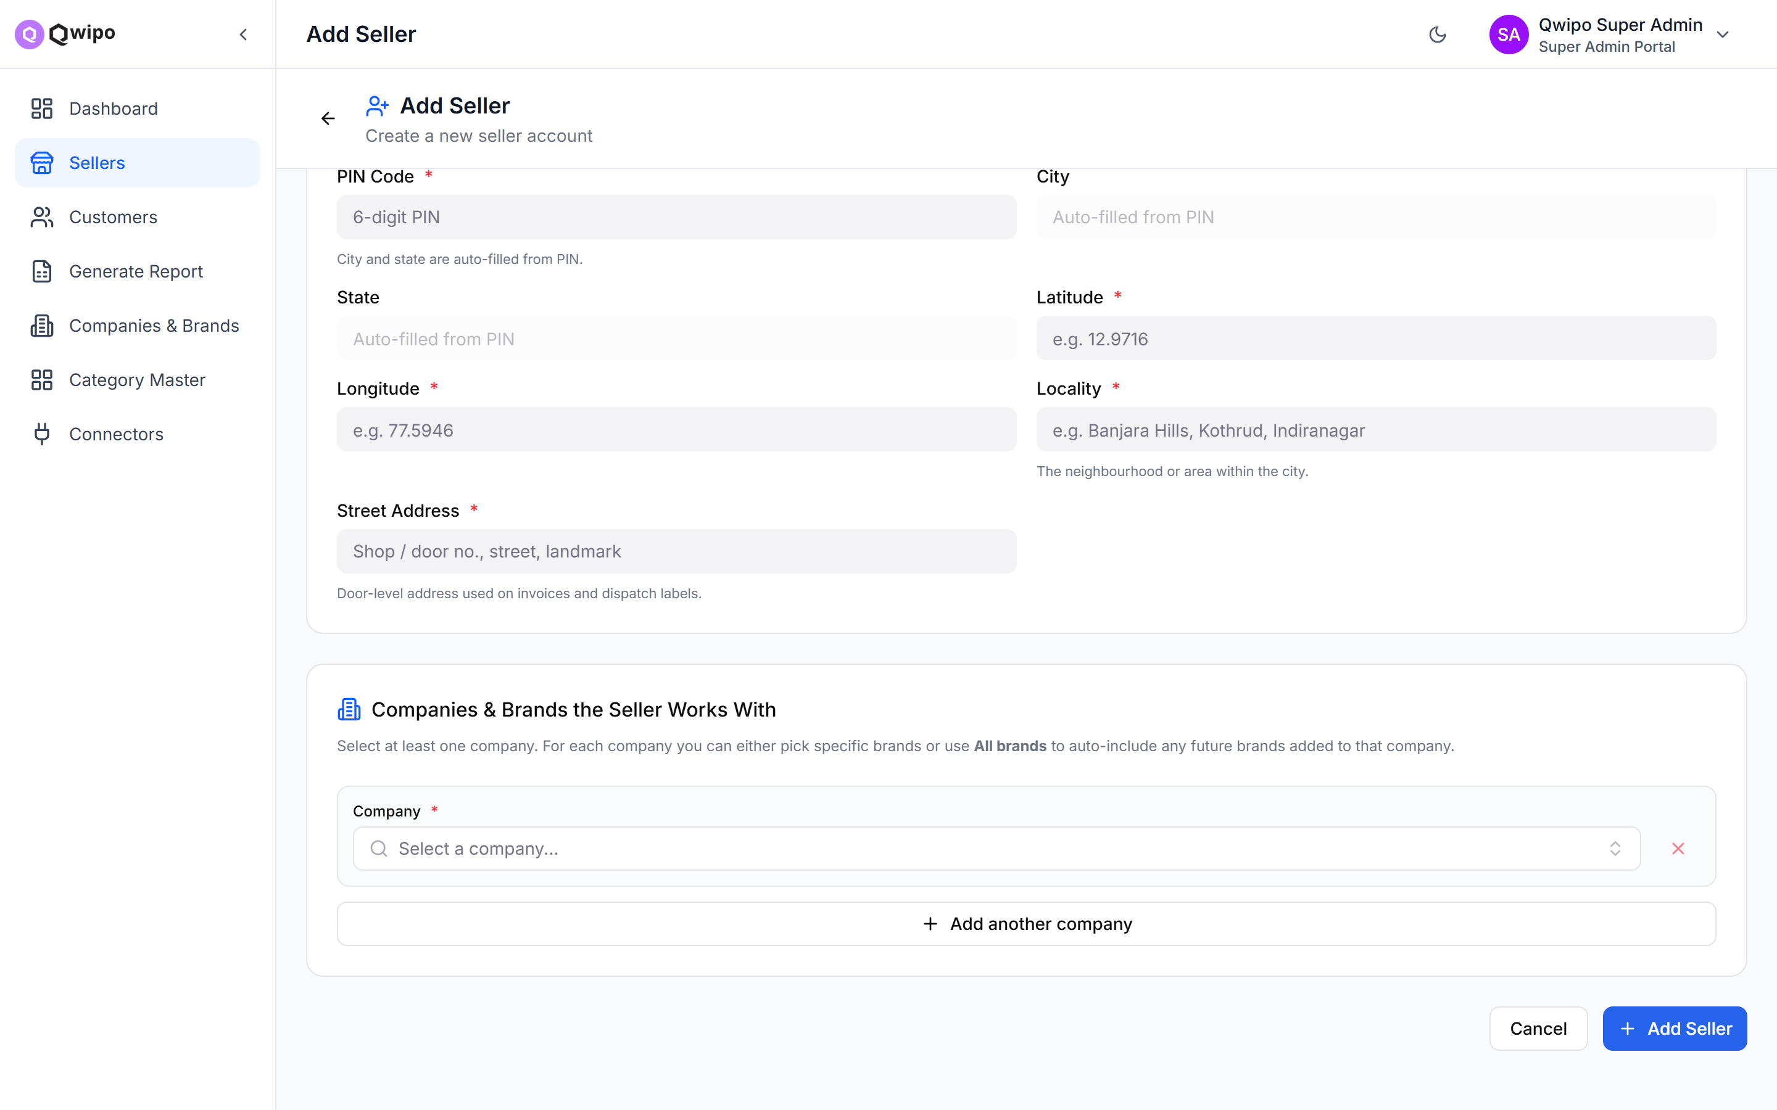
2
Create a New Seller
Who: ADMIN
Fill in the seller's details in the Admin Portal. Three fields decide whether products ever reach the customer app:
GPS coordinates
Copied to the seller's warehouse. Wrong coordinates = wrong delivery area.
Companies
At least one must be selected. The seller can only sell products from their tagged companies.
Brands (under each company)
Pick specific brands to limit the range — or leave empty and all brands are auto-assigned.
⚠ These fields are the #1 cause of “products not showing” issues later. Double-check them at creation.
Add Seller — GPS coordinates and “Companies & Brands the Seller Works With”
4

Slide 5
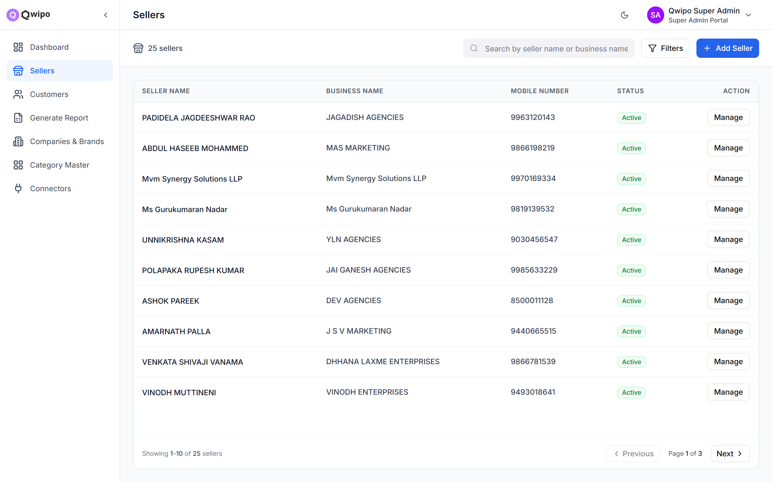
2
What Happens After the Seller Is Created
Who: ADMIN
Automatically on successful creation
Seller account is created in Active status
A login is auto-created using the seller's mobile number
A default warehouse is set up from the seller's address and GPS
Default order settings are applied
⚠ The seller must remain Active. If an admin deactivates the seller, all of their products vanish from the customer app.
CHECKLIST
GPS coordinates entered correctly
At least one company selected
Brands tagged (or left empty for all brands)
Seller status is Active
Login created (mobile number)
Default warehouse has the correct address
Sellers list — every new seller starts in Active status
5

Slide 6
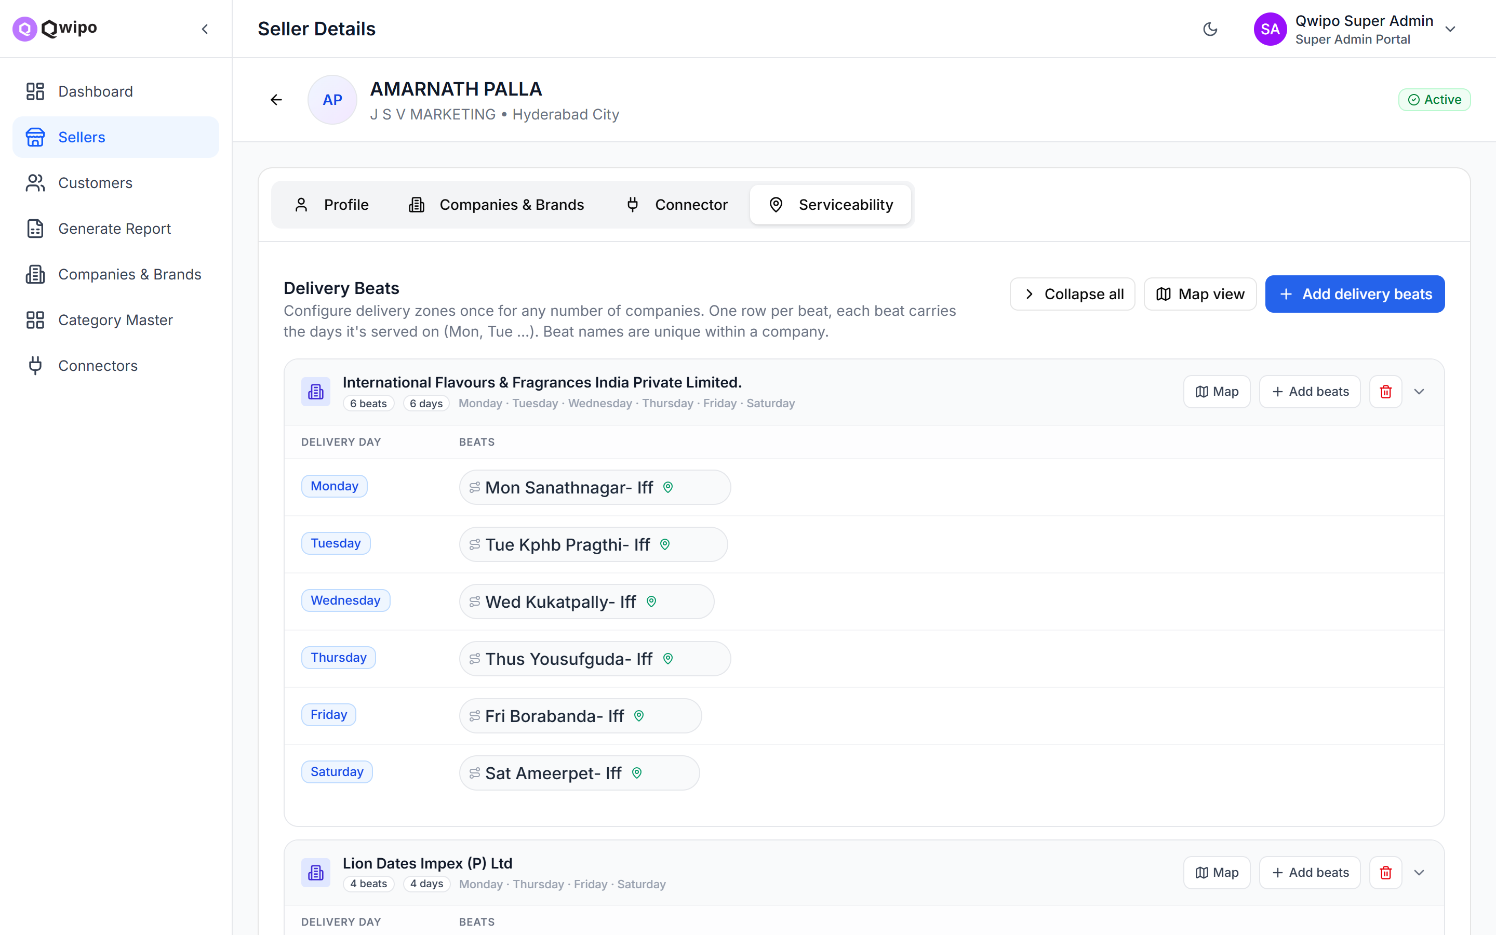
3
Upload Serviceability / GeoJSON
Who: ADMIN
Done from the seller's detail page → Serviceability tab. This defines where the seller can deliver — each company tagged to the seller needs its own delivery area.
Example — one seller, two companies
“ABC Distributors” (Hyderabad) sells HUL and ITC
HUL area uploaded: Madhapur · ITC area: Gachibowli
Madhapur customers see only HUL products
Gachibowli customers see only ITC products
Kukatpally customers see nothing from this seller
⚠ No serviceability rule = no visibility. This is one of the most commonly missed steps.
CHECKLIST
Every tagged company has a serviceability rule
Area covers the intended delivery zone
Polygon verified on the map
Seller Details → Serviceability — delivery beats grouped per company
6

Slide 7
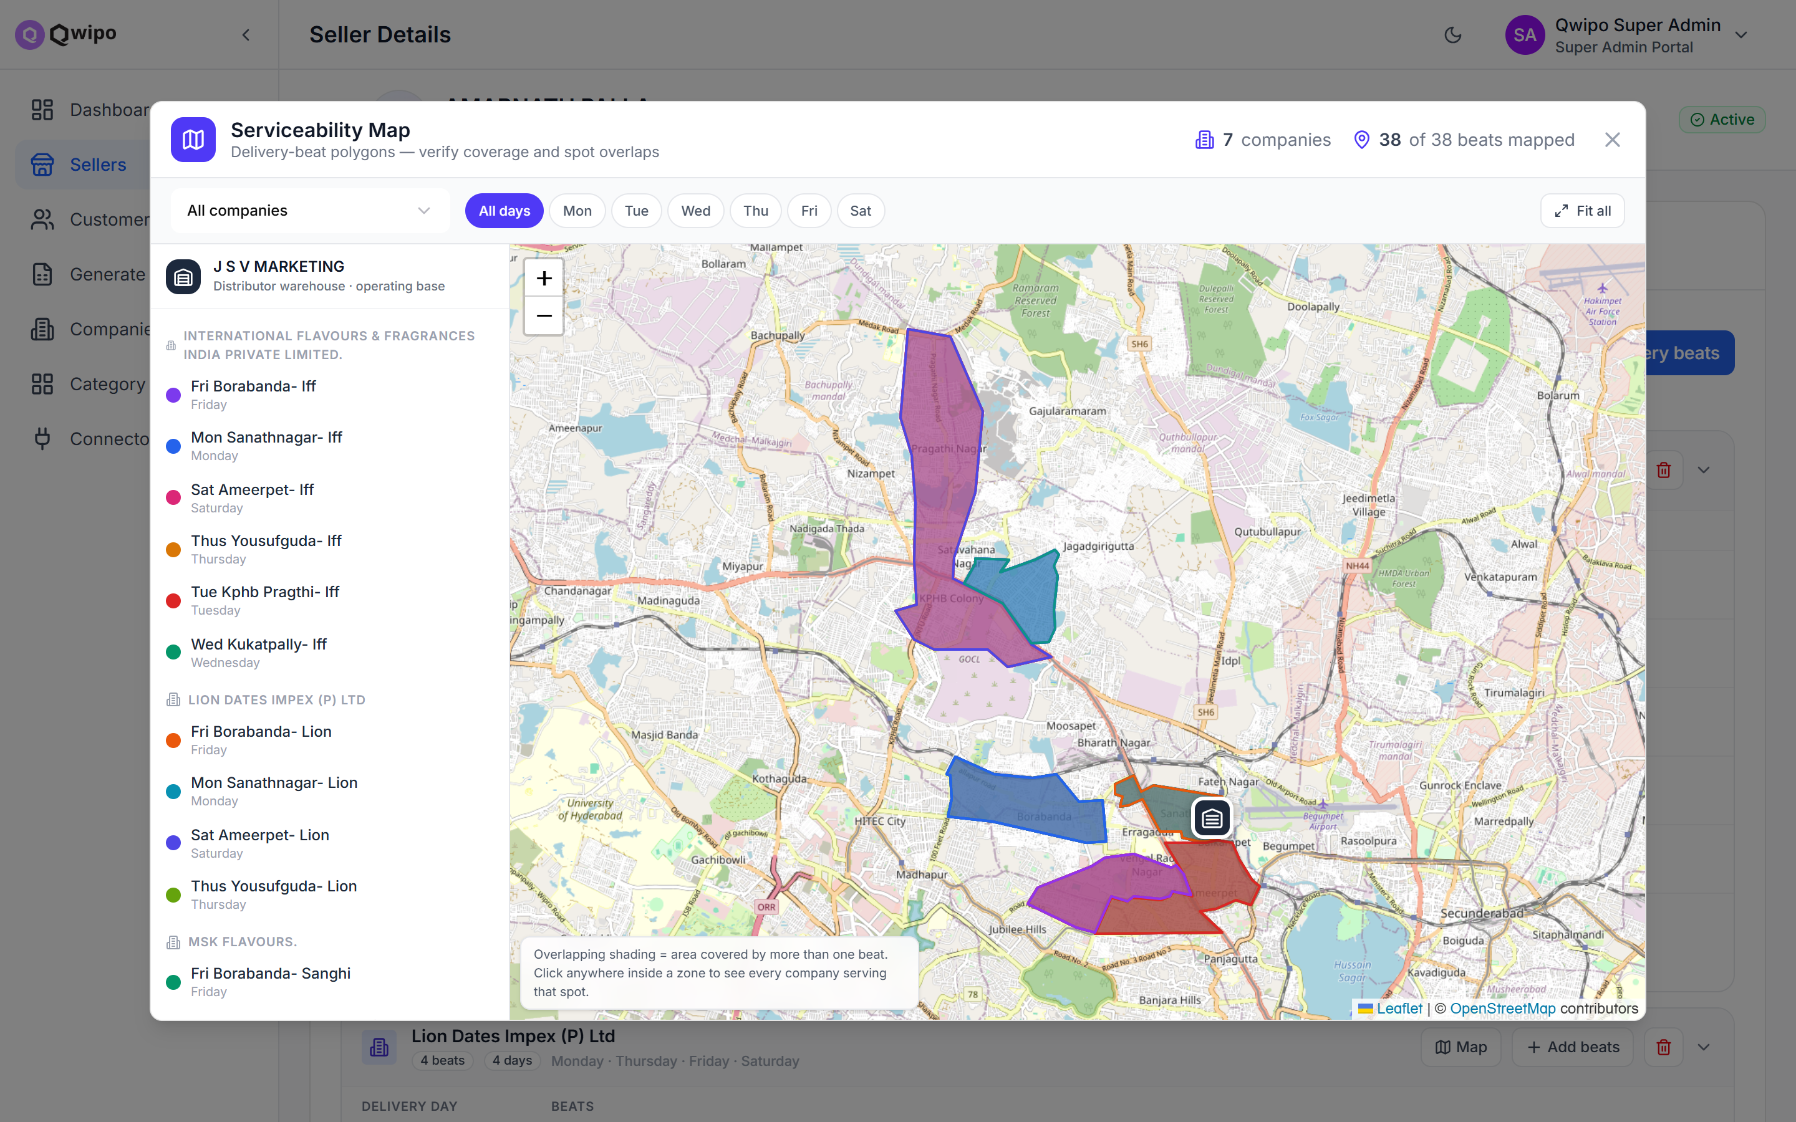
3
Verify Coverage on the Map
Who: ADMIN
Use Map View to confirm every polygon sits where deliveries actually happen.
One colour per beat, grouped by company
Filter by company or delivery day
Overlapping shading = area covered by more than one beat
Click inside a zone to see every company serving that spot
A polygon in the wrong place quietly hides products from real customers — a 30-second map check catches it.
Serviceability Map — 38 delivery beats across 7 companies, verified visually
7

Slide 8
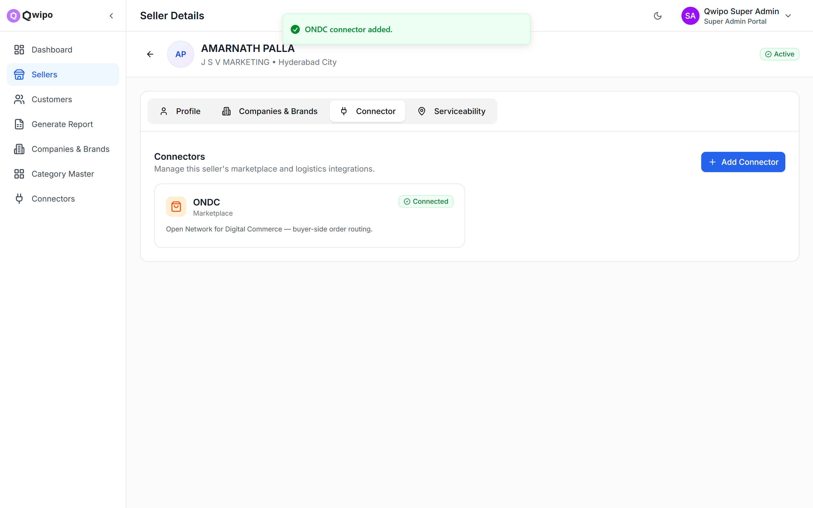
4
Add Connectors
Who: ADMIN
Done from the seller's detail page → Connector tab. A connector links the seller to a marketplace such as ONDC.
How to do it
Click Add Connector and select the marketplace (e.g. ONDC)
Save — the connector is created in Active status
⚠ The seller must have at least one Active connector. Without it, nothing shows up in any customer app.
CHECKLIST
ONDC connector added
Connector status is Active
Connector tab — ONDC connected and Active for this seller
8

Slide 9
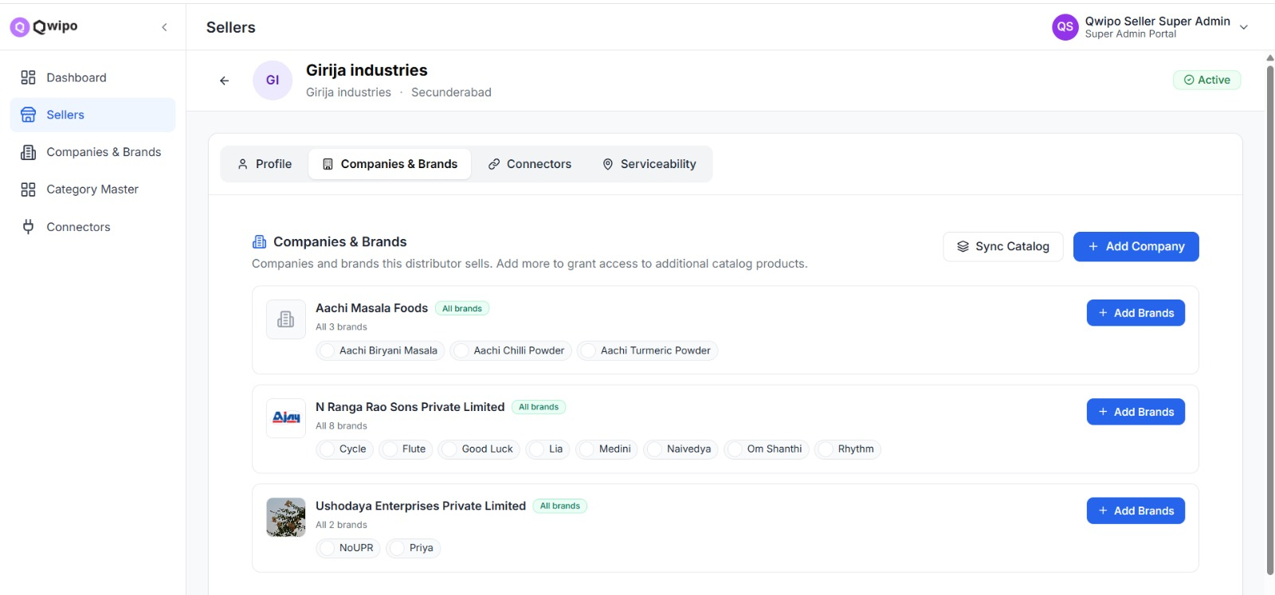
5
Sync Catalog
Who: ADMIN
Done from the seller's detail page → Companies & Brands tab → Sync Catalog. The catalog is synced per brand — matching products are copied from Qwipo's master catalog into the seller's account.
What happens on sync
System reads the seller's tagged companies and brands
Finds all matching products in the master catalog
Copies them, with pricing and schemes, into the seller's list
Re-running is safe — already-synced products are skipped
Product in the master catalog?
Yes → use Sync Catalog (this step)
No → the seller imports it via Bulk Import (Step 7)
Seller Details → Companies & Brands — Sync Catalog pulls the tagged brands' products
CHECKLIST
Sync Catalog run for the seller's brands
Products appeared in the seller's catalog
Pricing and schemes copied along
9

Slide 10
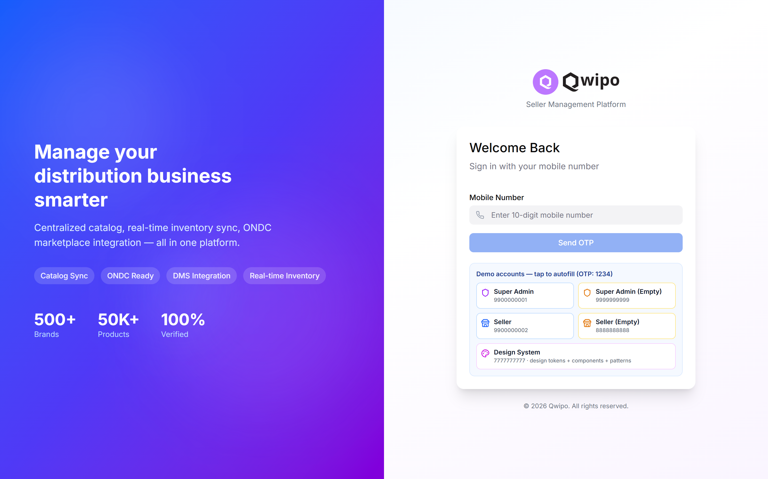
6
Seller Logs In
Who: SELLER
From here the seller takes over. They open the Seller Portal and sign in with the same mobile number the admin registered during creation.
Enter the registered mobile number
Verify with the OTP sent to that number
The Seller Portal dashboard loads
No separate account setup is needed — the login was auto-created in Step 2.
CHECKLIST
Seller can log in with the registered mobile number
Seller Portal dashboard loads successfully
Seller Portal login — mobile number + OTP
10

Slide 11
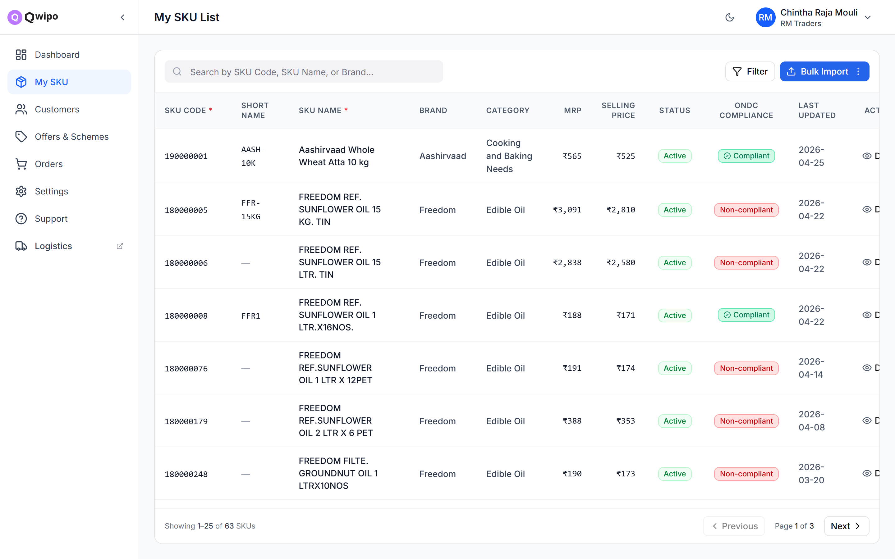
7
Upload / Review SKUs
Who: SELLER
On the My SKU page the seller reviews their product list.
Products synced by the admin (Step 5) are already listed
Products missing from the master catalog are added via Bulk Import (next slide)
⚠ Uploaded products must belong to the companies and brands assigned to the seller — anything else is rejected.
CHECKLIST
Synced products visible in My SKU
Manual upload (if any) completed without errors
Products belong to the seller's tagged companies
My SKU — synced products with price, status and ONDC compliance at a glance
11

Slide 12
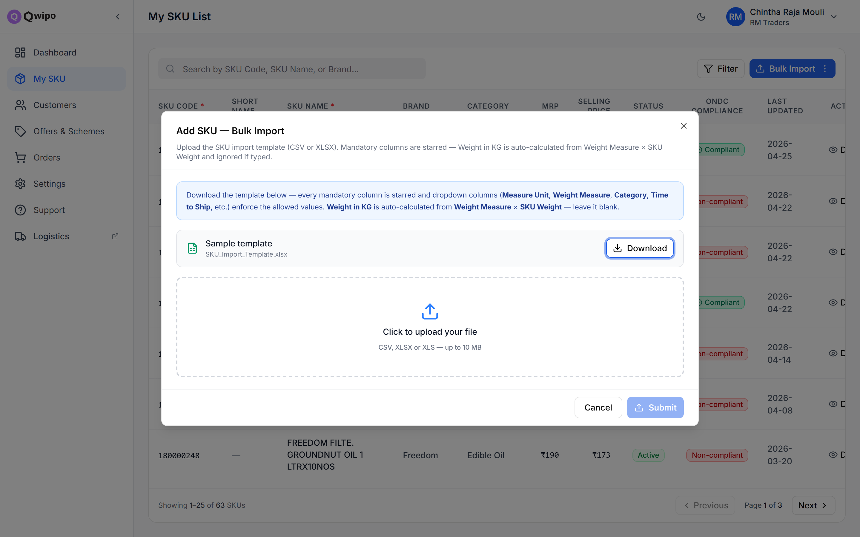
7
Bulk Import — Products Not in the Master Catalog
Who: SELLER
When a product doesn't exist in Qwipo's master catalog, the seller brings it in through the Bulk Import file.
The workflow
My SKU → Bulk Import → Add New SKUs
Download the sample template (CSV or XLSX)
Fill in the products — mandatory columns are starred, dropdown columns enforce the allowed values
Upload the file and Submit
The same menu also offers “Update Price & Stock” — download the existing catalog, edit offline, re-upload.
CHECKLIST
Template downloaded and filled correctly
File uploaded with no validation errors
New SKUs appear in the My SKU list
Bulk Import — download the template, fill it in, upload
12

Slide 13
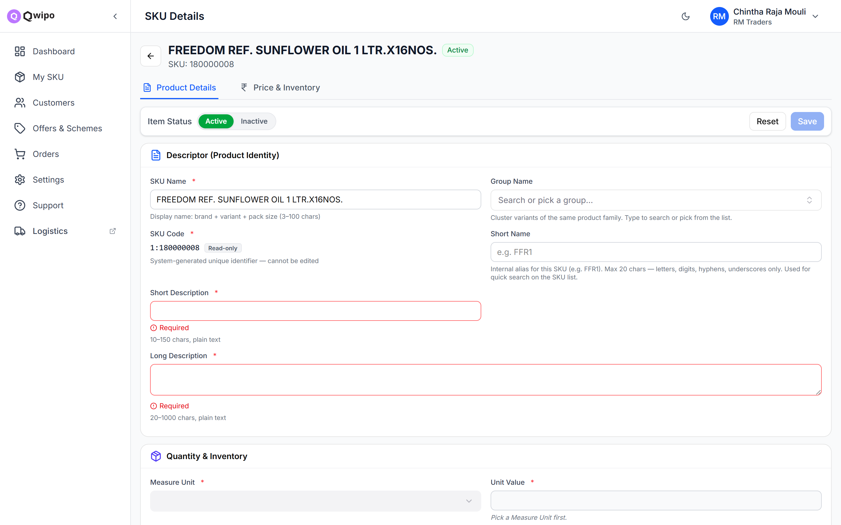
8
Make SKUs ONDC Compliant
Who: SELLER
⚠ Products marked “Non-Compliant” will NOT appear in the customer app.
The most common reason is a missing product image. To fix a product:
Click the product to open its details
Upload the product image
Fill any other missing required fields (descriptions, manufacturer details, …)
Save — status flips to “Compliant” once everything required is filled
CHECKLIST
Product image uploaded for each SKU
Manufacturer details filled
Compliance status shows “Compliant”
SKU Details — required fields are flagged until the SKU is compliant
13

Slide 14
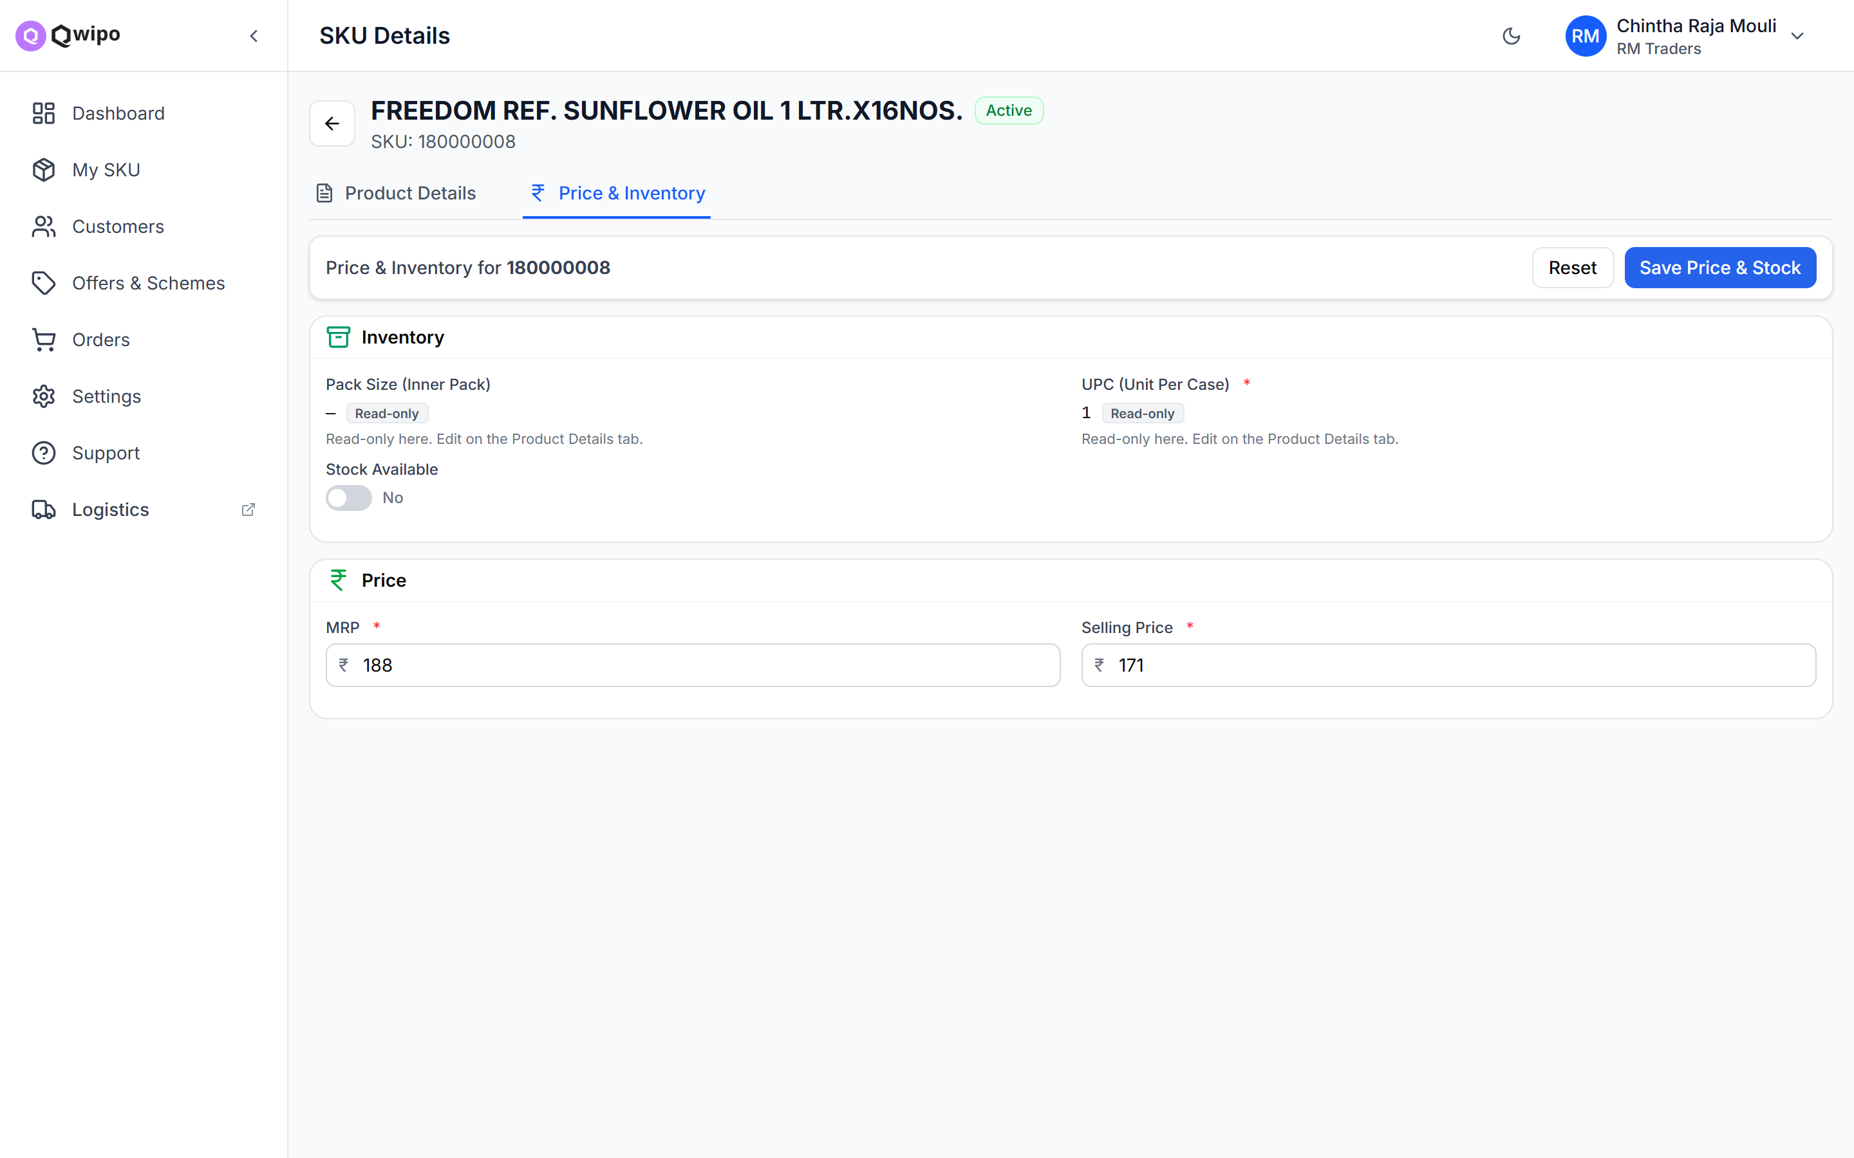
9
Update Price & Inventory
Who: SELLER
From My SKU → Price & Inventory. Three rules decide whether a product can be shown and sold:
MRP must be greater than 0 — zero MRP hides the product
Selling Price must be greater than 0 — zero hides it too. This is what the customer pays; set it below MRP for a discount
Stock Available must be ON — the quick way to show / hide a product
Bulk option: use “Import Prices” to update many products at once via Excel.
CHECKLIST
MRP set and greater than 0 for each SKU
Selling Price set and greater than 0
Stock Available toggled ON
Price & Inventory — MRP, Selling Price and the Stock Available toggle
14

Slide 15
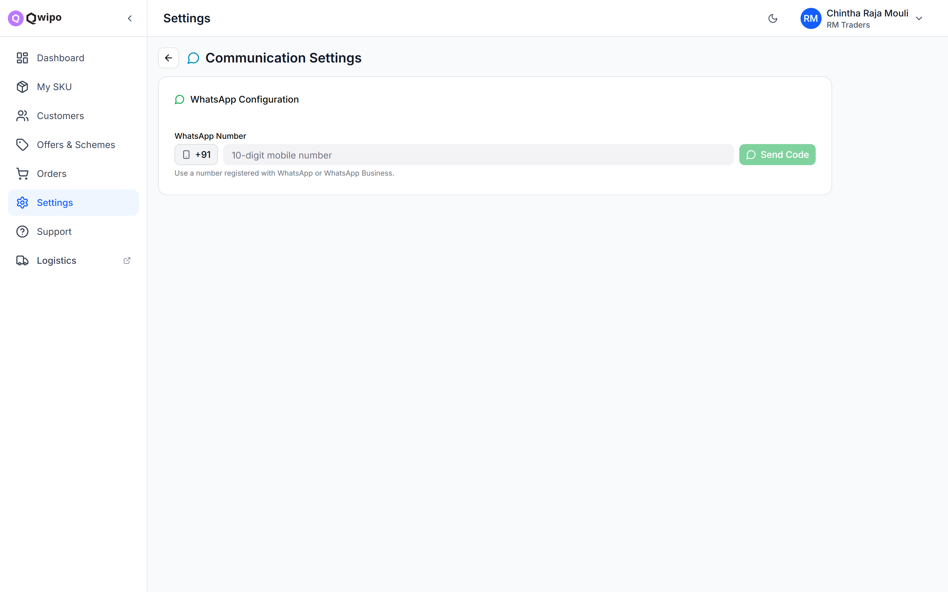
10
Set Up WhatsApp Notifications
Who: SELLER
From Settings → Communication Settings — so the seller never misses an incoming order.
Enter a WhatsApp-enabled mobile number
Verify it with the OTP code
Turn “Notify New Orders” ON
Highly recommended: order notifications land directly on WhatsApp the moment a customer places an order.
CHECKLIST
WhatsApp number entered and verified with OTP
“Notify New Orders” toggle is ON
Settings → Communication — WhatsApp number with OTP verification
15

Slide 16
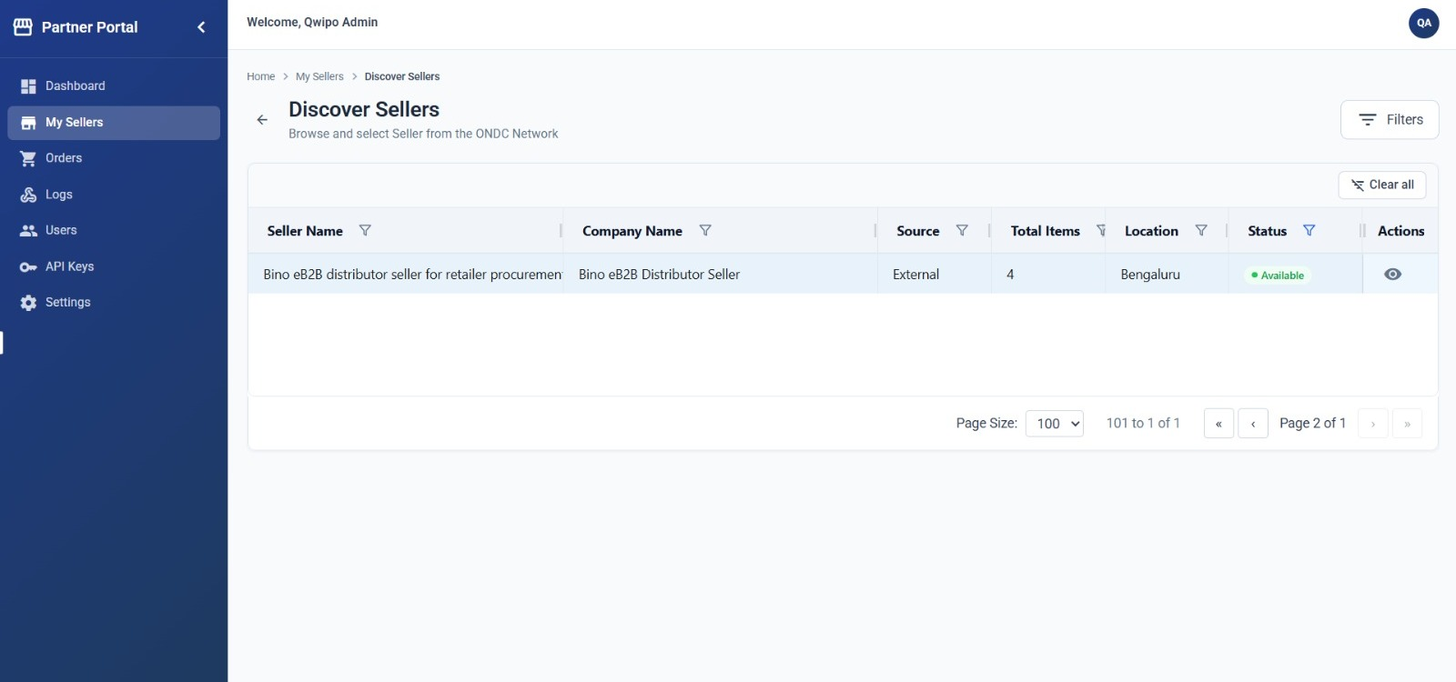
11
Sync the Seller to the Partner Portal
Who: ADMIN
⚠ This step was easy to miss — and without it the distributor never appears in the buyer app.
Everything so far lives in the Seller Store. The Partner Portal is where the seller is published to the buyer side — the admin must sync every new seller across.
Find the new seller
Log in to the Partner Portal
Open My Sellers in the left menu
Click Discover Sellers
Use Filters (e.g. by location) to find the newly created seller
Partner Portal → Discover Sellers — filter to find the newly created seller
CHECKLIST
Partner Portal → My Sellers → Discover Sellers
Filter applied — new seller found in the list
16

Slide 17
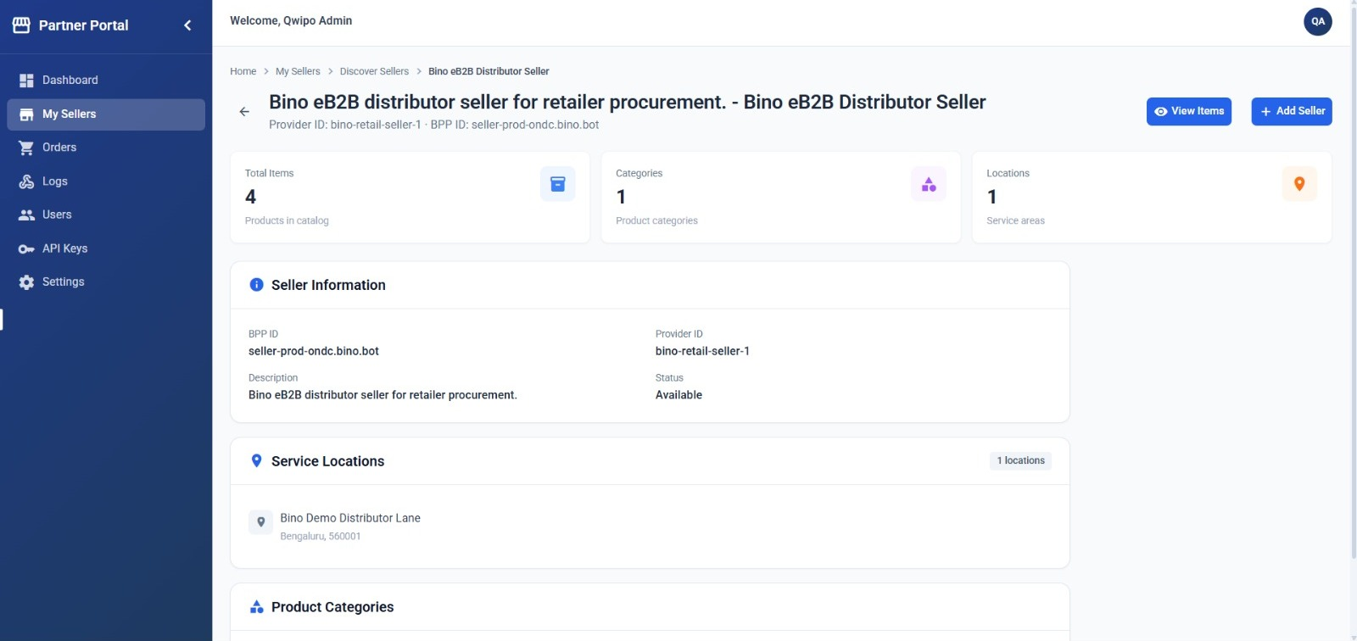
11
Add the Seller
Who: ADMIN
Open the discovered seller to review its details — catalog size, categories and service locations.
Then click Add Seller
The seller is synced into the Partner Portal
It starts appearing in the My Sellers list
Catalog sync status is tracked per seller from there
Review the seller's items with View Items before adding, if you want to sanity-check the catalog.
Discovered seller — review details, then click Add Seller
CHECKLIST
Seller details reviewed
Add Seller clicked
17

Slide 18
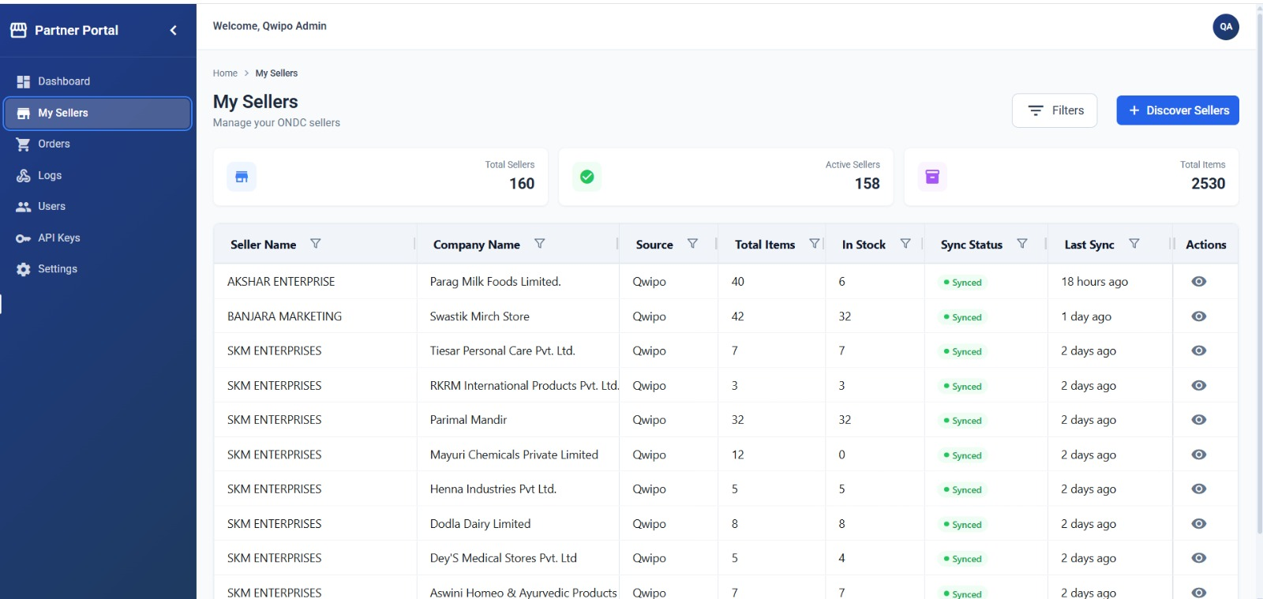
11
Confirm in My Sellers
Who: ADMIN
After Add Seller, the seller shows up in the My Sellers list with its catalog and sync status.
One row per seller + company combination
Total Items and In Stock counts per company
Sync Status shows “Synced” with the last sync time
⚠ Only when the seller appears here is the process complete — and the distributor becomes visible in the buyer mobile application.
My Sellers — the synced seller, per-company items and sync status
CHECKLIST
Seller visible in My Sellers
Sync Status = Synced
Distributor visible in the buyer app
18

Slide 19
12
Products Go Live — Automatically
Who: AUTOMATIC
Once every step is complete, products appear on the customer app on their own. There is no manual “publish” button.
How customers find the products
1
2
3
4
5
Search
City match
Area check
Filters
Order
Customer opens a buyer app and searches for a product
ONDC matches the customer's city with the seller's ONDC City Code
System checks the customer's location is inside the seller's delivery area
Only products that are Active + Compliant + Priced + In Stock are shown
Customer browses the catalog and places the order
✓ Final check: products are visible on the buyer app from inside the delivery area · the right company's products appear for the right location · pricing and stock status are accurate
19

Slide 20
How Updates Reach the Buyer App
Data created in the Seller Store flows to the Partner Portal, and from there to the Buyer application. Two sync mechanisms keep everything up to date — knowing which one applies tells you when a change becomes visible.
Seller Store
→
Partner Portal
→
Buyer Application
Incremental Sync — automatic
On Search — needs a search refresh
Day-to-day changes. Only the modified records are pushed, so updates reach the buyer app quickly — nobody has to do anything.
Structural changes to what is searchable. They appear in the buyer app only after the next search / index refresh is triggered.
Seller Active / Inactive status
Seller serviceability updates
SKU Active / Inactive, SKU information
SKU price and stock (In / Out of Stock)
Schemes & offers
New seller creation
Seller MOV / Non-Beat MOV updates
New SKU creation
Company / brand creation or updates
Any new SKU added under a company or brand
Delivery-area (polygon) changes are different: each customer's location is cached for 30 minutes, so a serviceability change can take up to 30 minutes to show for a given customer.
20

Slide 21
Which Sync Applies? — Quick Reference
Use this to predict when a change becomes visible — automatic within minutes (Incremental), after the next search refresh (On Search), or when the customer's 30-minute location cache expires (Polygons).
Seller Active / Inactive
INCREMENTAL — AUTOMATIC
New seller
ON SEARCH — AFTER REFRESH
Seller serviceability
INCREMENTAL — AUTOMATIC
Seller MOV / Non-Beat MOV
ON SEARCH — AFTER REFRESH
SKU Active / Inactive
INCREMENTAL — AUTOMATIC
New SKU
ON SEARCH — AFTER REFRESH
SKU information
INCREMENTAL — AUTOMATIC
Company / brand create or update
ON SEARCH — AFTER REFRESH
SKU price
INCREMENTAL — AUTOMATIC
SKU added to a company / brand
ON SEARCH — AFTER REFRESH
SKU stock (In / Out of Stock)
INCREMENTAL — AUTOMATIC
Polygon / delivery-area updates
UP TO 30 MIN — CACHE
Schemes & offers
INCREMENTAL — AUTOMATIC
Why it matters: using the right trigger for the type of change prevents stale or inconsistent data from appearing in the buyer application.
Source: Tech Team — “Data Synchronization Guide: Incremental Sync vs. On Search”
21

Slide 22
The Complete Chain
Visibility is a chain — every link must hold.
1
Companies & Brands exist in the system
2
Seller created (Active) with ONDC City Code + GPS
3
Companies & Brands tagged to the seller
4
Serviceability / GeoJSON uploaded per company
⚠
5
At least one Connector is Active
If any step is missing, the product will NOT appear.
6
Catalog synced or SKUs bulk-imported
7
Product image uploaded (ONDC Compliant)
One broken link hides the product for every customer.
8
MRP > 0 and Selling Price > 0
9
Stock Available = ON
10
Seller synced to the Partner Portal (My Sellers)
Product visible on the Customer App
22

Slide 23
Quick Troubleshooting Guide
When products don't show up, work through this list — it covers the failure behind almost every escalation.
PROBLEM
WHAT TO CHECK
Products not showing anywhere
Is the seller Active? Is the connector Active? Is the ONDC City Code set?
Distributor missing from the buyer app
Was the seller added in the Partner Portal? Check My Sellers (Step 11).
Products in the wrong city
Check the ONDC City Code — it may be set incorrectly.
Visible to some customers, not others
Check GeoJSON / serviceability — the customer may be outside the delivery area.
One company's products not showing
Is that company tagged to the seller? Does it have a serviceability rule?
A single product not showing
Is it Active? Compliant? MRP > 0? Selling Price > 0? Stock ON?
Products disappeared after re-upload
“Full Snapshot” mode deactivates products missing from the uploaded file.
Synced products not showing yet
Wait a few minutes for the marketplace sync to complete.
Update made but not visible yet
Check the sync type — On Search changes show after the next search refresh; polygon changes take up to 30 minutes.
Source: Tech Team — “Seller Onboarding to Buyer App Visibility” checklist, v1.0, July 2026 · Partner Portal sync workflow added v2.0
23

