Slide 1

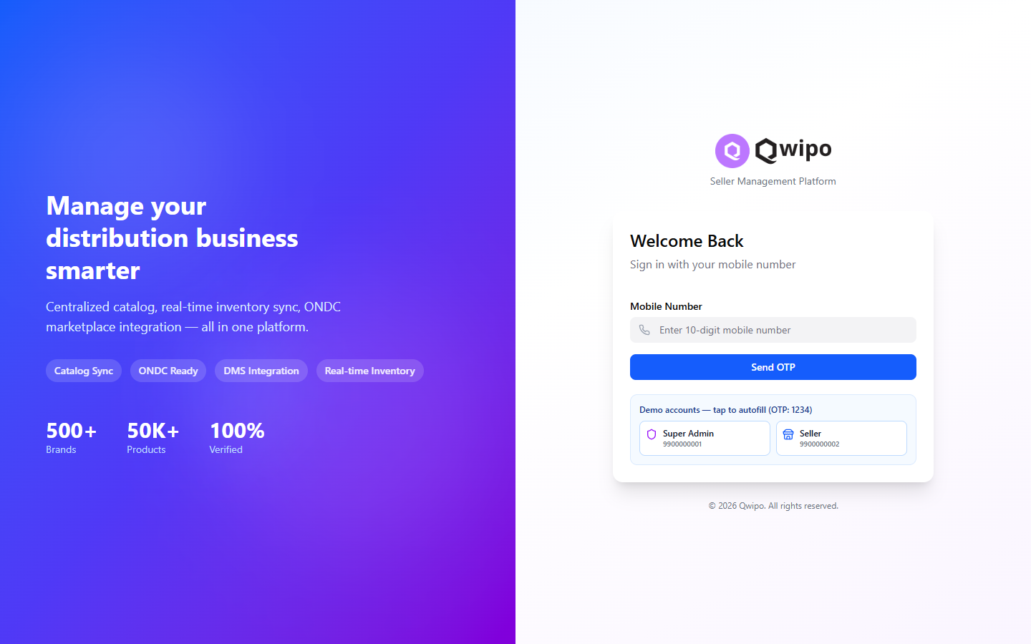
Q
Qwipo
DIGITAL COMMERCE & DISTRIBUTION ENABLEMENT PLATFORM
Qwipo Seller
Store Platform
Empowering Brands, Distributors & Retailers through Digital Commerce
500+
50K+
100%
Brands
Verified SKUs
ONDC-Ready
Live Phase-1 build · Built for FMCG / CPG distribution networks
Notes:
Welcome. Qwipo Seller Store is a digital commerce and distribution enablement platform purpose-built for FMCG/CPG brands, their distributors and retailers. Today I'll show how the platform takes a manufacturer like ITC or HUL from distributor onboarding all the way to delivery and customer notification — with ONDC, logistics and WhatsApp built in. Everything shown is on the live build.

Slide 2






THE PROBLEM
Why FMCG distribution still struggles to go digital
Brands and distributors face the same recurring friction across every market they serve.
Distributor onboarding complexity
Product catalog chaos
Territory conflicts
Slow, manual, paper-heavy setup delays time-to-market for every new distributor.
Inconsistent SKUs, missing attributes and no single source of truth across the network.
Overlapping coverage means distributors compete for the same retailers.
Order processing inefficiency
No logistics visibility
Fragmented commerce stack
Calls, spreadsheets and WhatsApp screenshots create errors and delays.
Once an order ships, brands and retailers lose sight of fulfilment status.
DMS, marketplaces, logistics and messaging live in disconnected silos.
Qwipo Seller Store Platform
02 / 20
Notes:
These six challenges show up in nearly every FMCG distribution network. They aren't technology problems in isolation — they compound. Slow onboarding delays catalog, a messy catalog breaks orders, no territory control creates channel conflict, and a fragmented stack means no end-to-end visibility. Qwipo was designed to solve all six in one connected platform.

Slide 3









PLATFORM OVERVIEW
One platform, the entire distribution value chain
Qwipo Seller Store connects manufacturers, distributors and retailers on a single ONDC-ready commerce layer — with logistics and WhatsApp built in.
Brands & Manufacturers
ITC · HUL · Nestlé · Marico …
End-to-end seller enablement
Onboard, catalog, price, sell, fulfil — in one console.
Qwipo Seller Store Platform
ONDC-ready architecture
Catalog · Serviceability · Orders · Offers
Publish catalog and sync orders on the open network.
Distributor & retailer ecosystem
Manage the full network and its relationships.
Integration Layer
DMS · ONDC · Logistics · WhatsApp
Logistics integration
Assign partners and track every shipment.
WhatsApp-enabled commerce
Distributors → Retailers
Notify and engage retailers where they already are.
Beat-mapped coverage · Last-mile delivery
Qwipo Seller Store Platform
03 / 20
Notes:
At its core, Qwipo is a single layer that sits between the brands at the top and the retailers at the bottom. Manufacturers' master data flows in; the platform handles catalog, serviceability, orders and offers; an integration layer connects DMS, ONDC, logistics and WhatsApp; and distributors serve beat-mapped retailers with last-mile delivery. One platform replaces a stack of disconnected tools.

Slide 4
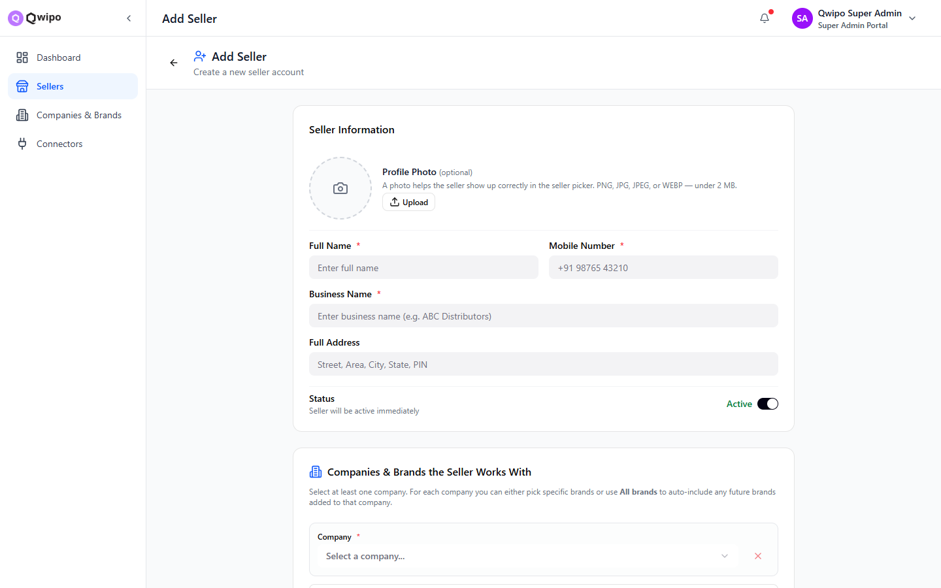
FEATURE · ONBOARDING
Onboard a distributor in minutes, not weeks
1
Create seller
2
Business details
3
Assign brands
4
Activate
Name, mobile, business name
Address, profile, OTP login
Companies + specific or all brands
Live & sign-in ready instantly
WHAT THE SUPER ADMIN CAPTURES
Profile photo, full name and mobile number (OTP-based login)
Business / trading name and full address
Companies the distributor carries — ITC, HUL, Nestlé and more
Specific brands per company, or “All brands” to auto-include future ones
Active-by-default status toggle for instant go-live
BUSINESS BENEFIT
New distributors are live and transacting the same day. A guided, single-form flow removes back-and-forth and shrinks onboarding from weeks of paperwork to a few minutes.
Qwipo Seller Store Platform
04 / 20
Notes:
Onboarding is where most distribution platforms lose weeks. In Qwipo the Super Admin creates a seller in four short steps — identity, business details, brand assignment, and activate. Mobile-number OTP means no password setup. Choosing 'All brands' for a company auto-includes any future brands. The distributor can sign in and transact the same day.

Slide 5
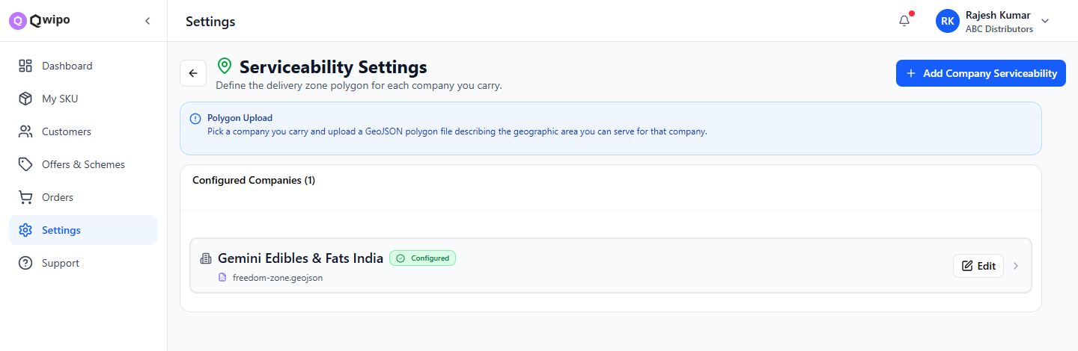
FEATURE · SERVICEABILITY
Define exactly where every company can deliver
State
City
Pincode
Beat
State, city and pincode-level serviceability control
Company-level configuration — each manufacturer's zone is set independently
Multiple beats per company, each with a Beat Name and Delivery Day (Mon–Sun / Next Day)
Optional GeoJSON polygon per beat for precise geo-matching
Distributor coverage and territory boundaries managed in one table
BEAT-WISE SERVICEABILITY
Company
Beat
Delivery Day
Polygon
BUSINESS BENEFIT
ITC Limited
KPHB 4
Monday
GeoJSON
Brands control precisely which areas each distributor serves — preventing overlap and ensuring every retailer is matched to the right distributor and delivery day automatically.
HUL
Madhapur
Wednesday
GeoJSON
Gemini Edibles
Kondapur
Next Day
GeoJSON
Qwipo Seller Store Platform
05 / 20
Notes:
Serviceability is configured per company, down to the pincode and beat. The May-2026 update introduced beat-wise serviceability: each company can have many beats, and every beat carries a name, a delivery day, and an optional GeoJSON polygon. The table you see drives automatic matching of retailers to the correct distributor and delivery day — no manual assignment.

Slide 6
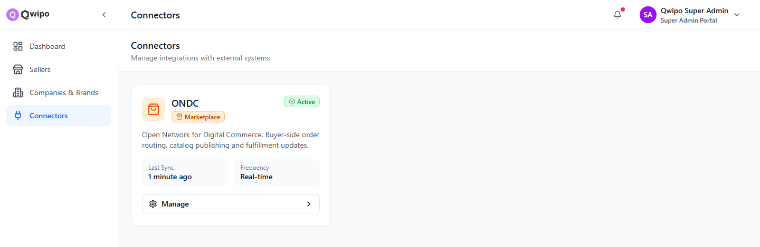


FEATURE · ONDC
Plug distributors into the open network — instantly
ONDC Connector setup with a single, managed configuration
Onboard any seller to ONDC without custom integration work
Publish the seller's catalog to the network, pre-validated for ONDC rules
Real-time order synchronisation — buyer-side orders route straight into Orders
Fulfilment and status updates flow back to the network automatically
BUSINESS BENEFIT
Distributors reach millions of ONDC buyers without building anything. Qwipo handles catalog publishing, order routing and fulfilment updates — turning every distributor into a digital seller out of the box.
Configure
Onboard seller
Publish catalog
Sync orders
ONDC connector
Map to network
Pre-validated SKUs
Real-time, two-way
Qwipo Seller Store Platform
06 / 20
Notes:
ONDC is a first-class connector. Once configured, any distributor is onboarded to the open network, their catalog is published with ONDC validation already applied, and orders sync in real time — buyer-side orders land directly in the Orders queue and fulfilment updates flow back. The connector card shows it live, syncing in real time.

Slide 7





FEATURE · LOGISTICS
Connected fulfilment with full delivery visibility
Logistics connector configuration in the seller console
Delivery-partner integrations alongside in-house / manual delivery
Order-to-fulfilment workflow with clear handover points
Live tracking and delivery status for brand, distributor and retailer
ORDER FULFILMENT WORKFLOW
Order confirmed
Ready to fulfil
Assign delivery
BUSINESS BENEFIT
Beat / manual / 3PL partner
No more blind spots after dispatch. Every shipment — manual or 3PL — is tracked to delivery, so brands and retailers always know where an order is and when it will arrive.
Pickup & dispatch
Shipment created
DELIVERY MODES
In transit — tracked
Beat delivery
Manual / self
3PL partners
Live status visible to all
Delivered & confirmed
POD closes the loop
Qwipo Seller Store Platform
07 / 20
Notes:
Logistics is wired in through a connector just like ONDC. Distributors can fulfil via their own beat delivery, manual/self delivery, or integrated 3PL partners. Whatever the mode, the order moves through a clear workflow — confirmed, assigned, dispatched, tracked in transit, and confirmed delivered — with status visible to the brand, distributor and retailer the whole way.

Slide 8

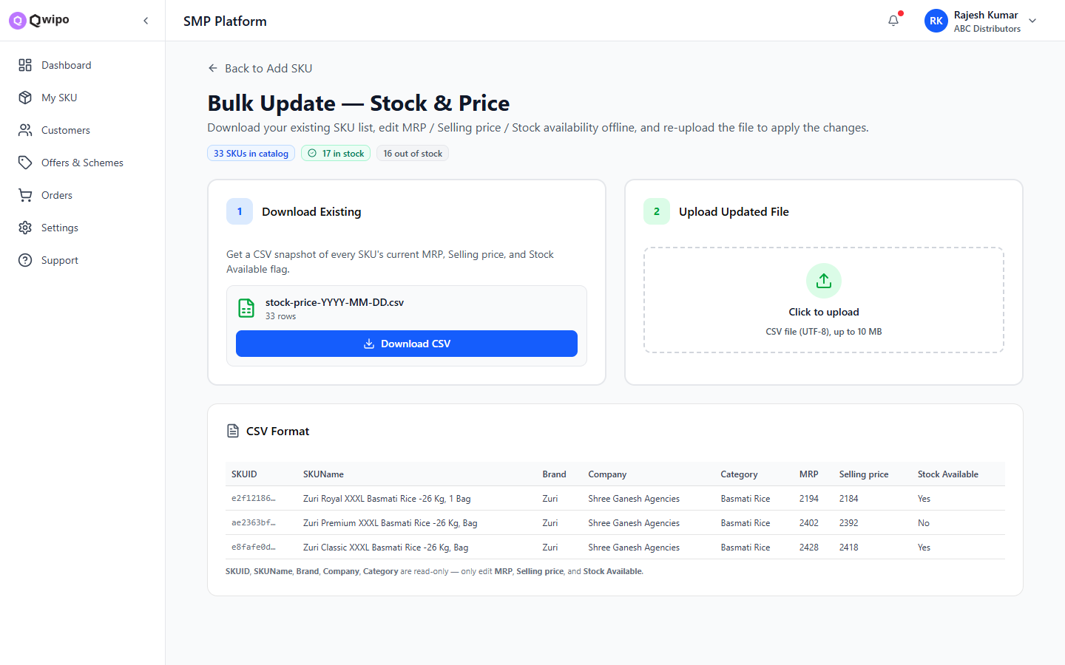

FEATURE · CATALOG
Build a verified catalog in hours, not months
Bulk Excel / CSV import
Upload a template to onboard hundreds of SKUs; a validation report flags ONDC errors before commit.
Central Catalog Sync
Pull pre-validated SKUs from Qwipo's master catalog — 50K+ products, 100% verified.
Manual entry
Full control of identity, pricing, inventory, ONDC fields and media for one-off SKUs.
BUSINESS BENEFIT
Catalog digitisation stops being a project. Bulk upload and central sync turn weeks of manual data entry into a single, validated import.
Qwipo Seller Store Platform
08 / 20
Notes:
Catalog is the other classic bottleneck. Qwipo offers three ways to build it: bulk Excel/CSV import with a validation report that flags ONDC issues before you commit; Central Catalog Sync that pulls pre-validated SKUs from Qwipo's 50,000-plus verified master catalog; and manual entry for full control. The screen shows the bulk stock-and-price flow — download, edit offline, re-upload.

Slide 9



FEATURE · DMS
Sync straight from your Distributor Management System
DMS
Qwipo Connector
Auto SKU + inventory
Seller Catalog
Masters · stock · pricing
Per-seller, scheduled sync
Products created, stock updated
Live & ONDC-ready
WHAT SYNCS AUTOMATICALLY
Product masters
Pricing & MRP
Stock / inventory
Schemes & offers
BUSINESS BENEFIT
One connection eliminates double data entry. Product masters, pricing, stock and schemes flow from the DMS into Qwipo automatically — keeping the digital catalog accurate with near-zero manual effort.
Qwipo Seller Store Platform
09 / 20
Notes:
Most brands already run a DMS. Rather than re-keying everything, Qwipo's connector pulls masters, pricing, stock and schemes directly from the DMS on a per-seller schedule. SKUs are created automatically, inventory stays in sync, and the catalog is instantly ONDC-ready. The result is one source of truth with almost no manual effort.

Slide 10



FEATURE · TERRITORY INTELLIGENCE
Govern who serves whom — down to the polygon
Beat Mapping
Customer Mapping
Customer Tagging
Organise retailers into delivery beats per distributor.
Map each retailer to the right distributor and company.
Segment retailers by type, value and behaviour.
Company-wise Mapping
Geo-fencing
Polygon Creation
Independent coverage rules per manufacturer.
Define serviceable boundaries that drive matching.
Upload GeoJSON polygons for precise territories.
BUSINESS BENEFIT
Prevent distributor conflicts before they happen. Region-specific retailer servicing, clear company-wise boundaries and geo-fenced territories give brands precise market control and clean channel governance.
Qwipo Seller Store Platform
10 / 20
Notes:
Territory intelligence is where Qwipo is genuinely differentiated for FMCG. Brands can map retailers into beats, tie each customer to the right distributor and company, tag and segment them, set independent company-wise coverage, and enforce it with geo-fencing and GeoJSON polygons. This is how you stop two distributors fighting over the same kirana store.

Slide 11
FEATURE · GEO ALLOCATION
Retailers auto-assigned by the polygon they fall in
Polygon-based territory assignment using uploaded GeoJSON zones
Every retailer is matched to the distributor whose polygon contains them
Deterministic matching engine resolves the right beat and delivery day
Overlap detection prevents two distributors claiming the same retailer
A
B
BUSINESS BENEFIT
Allocation becomes automatic and conflict-free. As soon as a retailer's location is known, the platform assigns them to exactly one distributor — eliminating manual mapping and channel disputes.
C
TERRITORY ZONES
Zone A — ABC Distributors
Zone B — Coast Grocers
Zone C — Urban Kirana
Retailers automatically resolved to a single distributor territory
Qwipo Seller Store Platform
11 / 20
Notes:
This is the territory engine in action. Distributors upload GeoJSON polygons describing their zones. When a retailer's location is known, the matching engine determines which polygon contains them and assigns them to exactly one distributor — along with the right beat and delivery day. Overlaps are detected, so no two distributors can claim the same retailer.

Slide 12
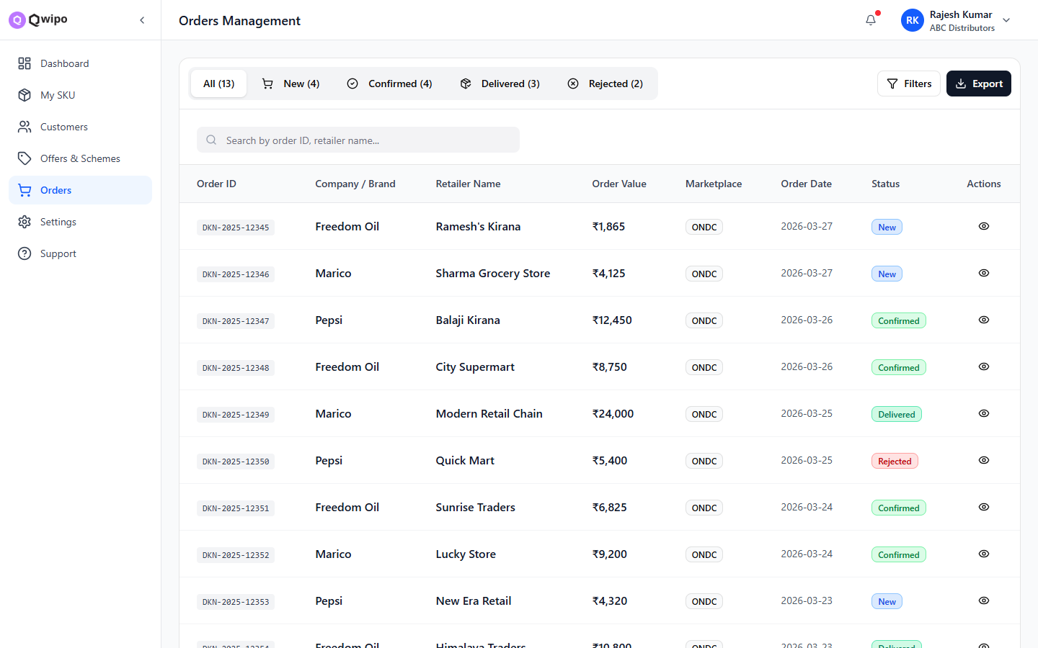
FEATURE · ORDERS
Every order, every channel — one managed queue
Placed
Confirmed
Processing
Shipped
Delivered
Status pipeline with tabs — New, Confirmed, Delivered, Rejected
Channel filter — ONDC, marketplaces and direct orders together
Order detail shows buyer, seller, line items, taxes and QPS savings
Quick actions — accept, confirm, modify items, ship, cancel, invoice
Search by order ID or retailer; one-click export
BUSINESS BENEFIT
Orders from every channel land in one place with a clear approval-to-delivery pipeline — replacing calls and spreadsheets with a single, auditable workflow your team can act on instantly.
Qwipo Seller Store Platform
12 / 20
Notes:
Orders is the operational heart. Whether an order comes from ONDC, a marketplace or directly, it flows into one queue with a clear pipeline — new, confirmed, processing, shipped, delivered, with a rejected branch. The team accepts, confirms, modifies, ships or cancels from here, and every order opens to a full detail view with line items, taxes and quantity-pricing savings.

Slide 13

FEATURE · HANDOVER
A clean handover — manual or partner-led
Manual / Self Delivery
Distributor's own beat or fleet handles last-mile delivery directly.
Shipment Tracking
Live status — visible to brand, distributor & retailer
Order Confirmed
Ready for dispatch
Logistics Partner (3PL)
Assign an integrated delivery partner; shipment created automatically.
Delivery Confirmation
Proof of delivery closes the order loop
TRACKING STATES
Dispatched
In Transit
Out for Delivery
Delivered
Qwipo Seller Store Platform
13 / 20
Notes:
The handover is deliberately simple. A confirmed order goes one of two ways — the distributor delivers it themselves through their beat or fleet, or it's assigned to an integrated 3PL partner that auto-creates the shipment. Both paths converge into the same tracking and delivery-confirmation flow, so regardless of who delivers, everyone sees live status through to proof of delivery.

Slide 14

FEATURE · WHATSAPP COMMERCE
Meet retailers where they already are
New order notifications
Qwipo Seller Store
Instant alert the moment an order is placed.
online
Delivery notifications
🛒 *New Order* #DKN-2025-12345
Balaji Kirana · ₹12,450 placed
Out-for-delivery and delivered updates in real time.
Delay notifications
Proactive heads-up with a revised ETA.
✅ Order *confirmed* & being packed
Retailer communication
Two-way messaging for confirmations and queries.
🚚 *Out for delivery* — arriving today by 6 PM
Distributor communication
Keep distributors looped in on every status change.
⏰ Slight *delay* — revised ETA tomorrow, 11 AM
BUSINESS BENEFIT
📦 *Delivered* — thank you!
Adoption is effortless — no app to install. Retailers transact and stay informed on WhatsApp, driving faster confirmations, fewer support calls and stronger engagement.
Qwipo Seller Store Platform
14 / 20
Notes:
WhatsApp is how Indian retail actually communicates, so commerce happens there. The platform pushes new-order, out-for-delivery, delivered and delay notifications automatically, and supports two-way messaging with both retailers and distributors. There's nothing to install — which is why adoption is so high. The mock on the right shows the real notification flow for a sample ITC order.

Slide 15



FEATURE · AUTOMATION
Events trigger the right message, automatically
EVENTS
CHANNELS
New order placed
WhatsApp
Status changed
SMS
Out for delivery
Automation
Engine
Email
Delay detected
In-app alert
BUSINESS BENEFIT
Real-time alerts run without anyone lifting a finger. Order updates, status changes and customer communication are automated end-to-end — cutting manual follow-ups and keeping every stakeholder informed instantly.
Qwipo Seller Store Platform
15 / 20
Notes:
Behind the notifications is a simple automation model: business events on the left — a new order, a status change, an out-for-delivery, a detected delay — feed an automation engine that fans out to the right channels: WhatsApp, SMS, email and in-app alerts. Templates are configured once in Communication settings and then everything runs automatically and in real time.

Slide 16

THE BIG PICTURE
From manufacturer to delivered — one connected flow
Brand / Manufacturer
Distributor Onboarding
Catalog Creation
Retailer Mapping
Customer Notification
Delivery
Logistics Assignment
Order Placement
One platform · one data model · zero hand-offs between disconnected tools
Notes:
Putting it all together: a brand's data flows in, a distributor is onboarded, the catalog is created, retailers are mapped by territory, orders are placed across channels, logistics is assigned, delivery happens, and the customer is notified — all on one platform with one data model and no hand-offs between disconnected systems. That continuous flow is the entire value proposition in a single slide.

Slide 17


OUTCOMES
What changes for brands and distributors
Faster seller onboarding
Faster catalog digitisation
Reduced distributor conflict
Operational efficiency
Days to minutes
Bulk + central sync
Clean territory rules
Less manual effort
ONDC readiness
Logistics visibility
Better retailer engagement
WhatsApp-powered comms
Out of the box
Tracked to delivery
Right beat, right day
Zero-install reach
Qwipo Seller Store Platform
17 / 20
Notes:
The outcomes map directly back to the challenges from slide two. Onboarding drops from days to minutes, catalog digitisation becomes a single import, territory rules remove distributor conflict, operations get more efficient, ONDC is ready out of the box, logistics is fully visible, retailers are served on the right beat and day, and WhatsApp gives zero-install reach. Every benefit is something we just demonstrated live.

Slide 18


WHY QWIPO
Built for FMCG distribution — not retrofitted to it
ONDC-ready platform
FMCG-focused workflows
Catalog publishing and order sync on the open network, built in.
Beats, schemes, distributor networks — modelled for how FMCG runs.
Rapid deployment
Territory intelligence
Onboard distributors and digitise catalogs in days, not quarters.
Polygon-based geo-fencing and conflict-free retailer allocation.
Logistics integrations
Enterprise scalability
Manual, beat and 3PL fulfilment with end-to-end tracking.
Multi-brand, multi-distributor, multi-channel from day one.
WhatsApp commerce
Zero-install retailer engagement and automated notifications.
Notes:
Why Qwipo over a generic e-commerce or a custom build? Because it's built for FMCG distribution specifically — ONDC-ready, FMCG-native workflows, rapid deployment, territory intelligence, logistics integrations, enterprise scale, and WhatsApp commerce. These aren't add-ons; they're the foundation. That's what lets a brand like ITC or HUL digitise an entire distributor network quickly and cleanly.

Slide 19

VALUE PROPOSITION
The impact, in numbers
< 10 min
50K+
~80%
100%
to onboard a distributor
pre-validated SKUs to draw from
less manual catalog effort
ONDC-ready out of the box
ILLUSTRATIVE: DIGITAL ORDER ADOPTION AFTER GO-LIVE
ALSO IMPROVED
Order processing speed — calls & spreadsheets replaced by one queue
Territory governance — conflict-free, polygon-based allocation
Delivery visibility — every shipment tracked to proof of delivery
Retailer engagement — automated WhatsApp at every step
Figures are illustrative targets based on platform capabilities, not guaranteed results.
Qwipo Seller Store Platform
19 / 20
Notes:
These numbers are illustrative — they show the shape of the impact, not a guarantee. Onboarding in under ten minutes, a 50,000-SKU verified catalog to draw from, roughly 80% less manual catalog work, and ONDC-ready from day one. The chart shows the typical ramp in digital-order share after go-live, and the panel lists the operational gains in processing speed, governance, visibility and engagement.

Slide 20

Q
Qwipo
THANK YOU
Let's digitise your distribution network
Qwipo — Digital Commerce & Distribution Platform
www.qwipo.com
sales@qwipo.com
WhatsApp Commerce enabled
Empowering Brands, Distributors & Retailers through Digital Commerce
Notes:
Thank you. To summarise: Qwipo Seller Store takes an FMCG brand's entire distribution network digital — onboarding, catalog, territory, orders, logistics and WhatsApp — on one ONDC-ready platform. I'd love to set up a working session with your distribution and digital teams to map this to your network. Reach us at the details on screen.

