Slide 1
INTERNAL TRAINING
Qwipo Seller Store
Seller User Guide
A walkthrough for distributor onboarding teams — what every seller-portal screen does and why it exists.
Phase 1 · Version 1.1 · 29 May 2026

Slide 2
ABOUT THIS GUIDE
Who this is for, and why it matters
Who this is for
What you will learn
Onboarding teams setting up new distributors
Customer success teams supporting sellers day-to-day
Sales engineers walking sellers through the portal
Sellers (Distributors) using the portal directly
The 5 modules in Phase 1 and what each one solves
The non-obvious dependencies (Company → SKU, Address → Warehouse)
How to upload a clean SKU catalogue without retries
How to confirm and dispatch orders end-to-end
Why we built this deck
The portal looks simple, but every screen is wired into the ONDC marketplace, the buyer app, and the Super Admin setup behind the scenes. If a seller skips a step — e.g. enters the wrong manufacturer name or saves the wrong warehouse address — orders fail silently downstream. This guide focuses on the why behind every page so trainers can explain it to a first-time user.
Qwipo Seller Store · Seller Training Guide · v1.1 · Internal Use
2 / 33

Slide 3




THE BIG PICTURE
Where the Seller Portal sits in the Qwipo platform
Super Admin Portal
Seller Portal
Buyer App / ONDC
Sets up Companies, Brands, Sellers, and Serviceability. This is the 'foundation' — the seller cannot start without it.
What this guide covers. Upload catalogue, manage orders, configure store, run schemes.
Where retailers actually discover products. Driven by Company + Brand grouping, serviceability, and SKU images.
Why this order matters
A seller logging in for the first time depends on the Super Admin having created the Company, mapped the Brands, and configured Serviceability. If any of those is missing, the SKU upload will fail or the order will never reach the seller — even though the portal looks fine.
Qwipo Seller Store · Seller Training Guide · v1.1 · Internal Use
3 / 33

Slide 4
PREREQUISITES
What must already exist before a seller logs in
1
Company created
Manufacturer entity (e.g., GRB Dairy Foods). Every SKU references a Company. Name must be exact.
2
Brands added under Company
E.g., GRB, Cycle, Om Shanthi. Brands cannot be removed once created.
3
Seller profile created
Business name, mobile, address with Lat/Long. Lat/Long becomes the warehouse.
4
Company & Brand mapping
Only mapped brands appear in the seller's catalogue.
5
Serviceability configured
Beat + delivery day per company. Without this, orders cannot route to the seller.
Qwipo Seller Store · Seller Training Guide · v1.1 · Internal Use
4 / 33

Slide 5



MODULES IN PHASE 1
What you'll find in the left sidebar
My SKU
Customers
Offers & Schemes
Orders
Settings
Upload and manage product catalogue
Retailers who buy from you
QPS quantity-based pricing (Phase 1)
Incoming orders, confirm & dispatch
Store, order rules, WhatsApp
What's intentionally not here yet
Dashboard analytics, returns workflow, value-slab/BOGO/case-bonus offers — all planned for Phase 2. Phase 1 covers the minimum a distributor needs to receive orders from ONDC and fulfil them.
Qwipo Seller Store · Seller Training Guide · v1.1 · Internal Use
5 / 33

Slide 6
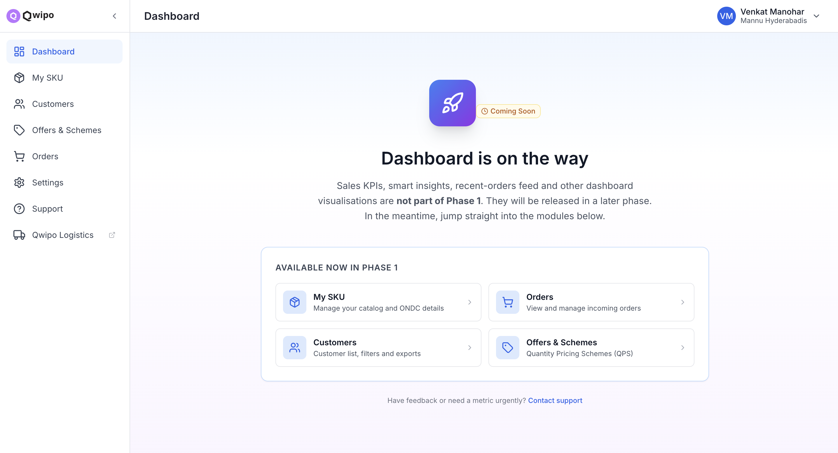
GETTING STARTED
Logging in to the Seller Portal
Login steps
1
Open the Seller Portal URL in your browser.
2
Enter your registered mobile number.
3
Enter the OTP received on that number.
4
Click Verify and Sign In.
5
You'll land on the Dashboard logged in as your business.
Phase 1 dashboard reality
You'll see 'Dashboard is on the way' — KPIs and sales insights are coming in a later phase. The 5 modules in the sidebar are what's live today.
Qwipo Seller Store · Seller Training Guide · v1.1 · Internal Use
6 / 33

Slide 7
MODULE 1
My SKU — Your catalogue is what buyers see
Six steps to take products from your Excel sheet to ONDC-compliant listings on the buyer app.
Qwipo Seller Store · Seller Training Guide · v1.1 · Internal Use
7 / 33

Slide 8
MY SKU · WHY THIS MODULE EXISTS
Without SKUs in the catalogue, no orders. Period.
Each SKU drives 3 things downstream
Two hard dependencies
Visibility — appears in the buyer app and ONDC search
Eligibility — only ONDC-compliant SKUs can be ordered
Pricing — links to the QPS schemes you create
Manufacturer field must equal an existing Company name (created by Super Admin)
Brand field must equal an existing Brand mapped to your seller account
How Company & Brand are used downstream
In the buyer app, products are grouped by Company → Brand → SKU. That's how a retailer browsing 'GRB' sees the GRB ghee, butter, sweets, etc. clustered together. Serviceability is also per Company — i.e. the seller's beats are defined company-by-company. So mismatched names don't just fail the upload, they would also break grouping and routing if force-loaded.
Qwipo Seller Store · Seller Training Guide · v1.1 · Internal Use
8 / 33

Slide 9
MY SKU · STEP 1
Always download a fresh template before each upload
The 4-step shortcut
Template sheets
Click My SKU in the left sidebar
Click Bulk Import (top right)
Click Download Template in the modal
Save SKU_Import_Template.xlsx and open in Excel
Main SKU Upload — paste your data here
Master Data — valid units, categories, dropdowns (reference only)
Validation — DO NOT edit (drives the in-Excel validation)
Why a fresh download every time
Column order and validation rules change between releases. Using a saved or self-made spreadsheet causes silent import failures — the file appears to upload but every row gets flagged. Treat the template as a single-use disposable form.
Qwipo Seller Store · Seller Training Guide · v1.1 · Internal Use
9 / 33

Slide 10
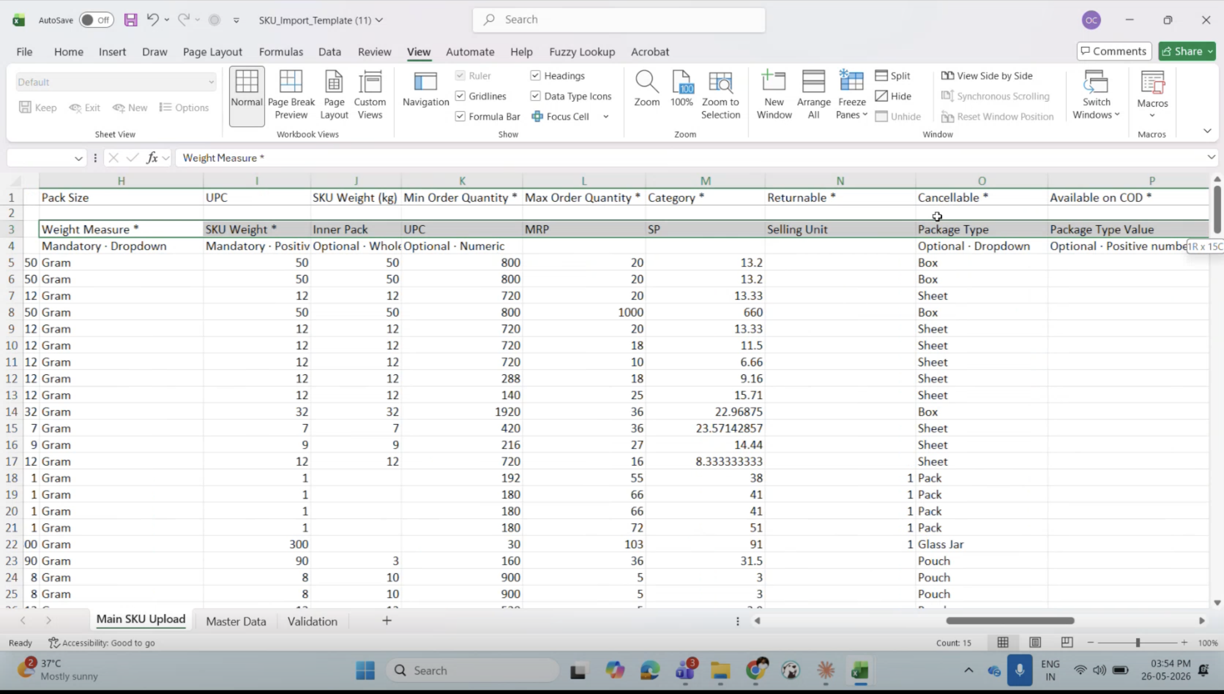
MY SKU · STEP 2
Prepare data — paste as values only
The correct paste flow
Open your existing product data in Excel
Copy the data (no headers — the template has its own)
In the template, go to Main SKU Upload
Right-click the first data row → Paste Special
Choose Values only (second paste option)
Match column order exactly — never add, remove, or reorder
Never paste with formulas
Pasting with formulas pulls broken cell references, breaks the hidden validation logic, and produces unpredictable failures. Values only is the only safe paste.
Qwipo Seller Store · Seller Training Guide · v1.1 · Internal Use
10 / 33

Slide 11
MY SKU · STEP 2
Mandatory fields and acceptable placeholders
Field | Placeholder when real data is missing
Short Description | Any text 10–200 characters — copy the SKU name
Category | Beauty & Hygiene (taxonomy fix coming later)
Manufacturer Address | Seller's business address
Customer Support Number | Seller's registered mobile number
Min / Max Order Quantity | 1 / 1000
Time to Ship | 24 hours
Country of Origin | India
Status | active
Why placeholders are OK for Phase 1
Phase 1 prioritises getting catalogues live on ONDC. Once SKUs are flowing, the seller refines copy, categories, and addresses in subsequent edit cycles. Better to launch with placeholders than to block on perfection.
Qwipo Seller Store · Seller Training Guide · v1.1 · Internal Use
11 / 33

Slide 12

MY SKU · STEP 2 — CRITICAL
The ONDC 'Unit' constraint
Use only these 4 units
Not accepted by ONDC
Gram
✕
Piece / Pcs
Kilogram
✕
Pack
Litre
✕
Nos
Millilitre
Workaround: use Gram as a temporary unit. Limitation is under review.
Why this restriction exists
The ONDC protocol — the open network that connects sellers to buyer apps — only accepts these 4 weight/volume units. Any other unit causes the SKU to be rejected at the marketplace layer, even if the seller portal accepts the upload.
Qwipo Seller Store · Seller Training Guide · v1.1 · Internal Use
12 / 33

Slide 13
MY SKU · STEP 2 — CRITICAL
Manufacturer name must exactly match the Company
Saved in system (Company) | Will fail upload (Manufacturer in file)
GRB DAIRY FOODS PVTLTD | GRB DAIRY FOODS PVT.LTD.
N Ranga Rao Sons Private Limited | N. Ranga Rao & Sons Private Limited
Raghav Lifestyle Products | Raghav Lifestyle Products (trailing space)
Why even a dot or space matters
The Manufacturer column is matched character-by-character against the Company list created by the Super Admin. There is no fuzzy matching — that's intentional. If 'GRB DAIRY FOODS PVTLTD' were treated the same as 'GRB DAIRY FOODS PVT. LTD.', a buyer app could end up showing two separate company tiles for the same brand and routing orders to the wrong seller. Before uploading, confirm the exact Company name with your Super Admin and copy it as-is.
Qwipo Seller Store · Seller Training Guide · v1.1 · Internal Use
13 / 33

Slide 14
MY SKU · STEP 3
Upload the prepared file
Upload flow
What validation checks
Go to My SKU → Bulk Import
Click Add SKU — Bulk Import
Upload your prepared .xlsx file
System runs Import Validation automatically
Wait for the validation summary screen
Mandatory fields are populated
Units are one of the 4 ONDC-accepted values
Manufacturer exists as a Company in your account
Brand exists and is mapped to your seller
Description, quantity, time-to-ship ranges are valid
Use the same file name each retry — easier to track
Qwipo Seller Store · Seller Training Guide · v1.1 · Internal Use
14 / 33

Slide 15
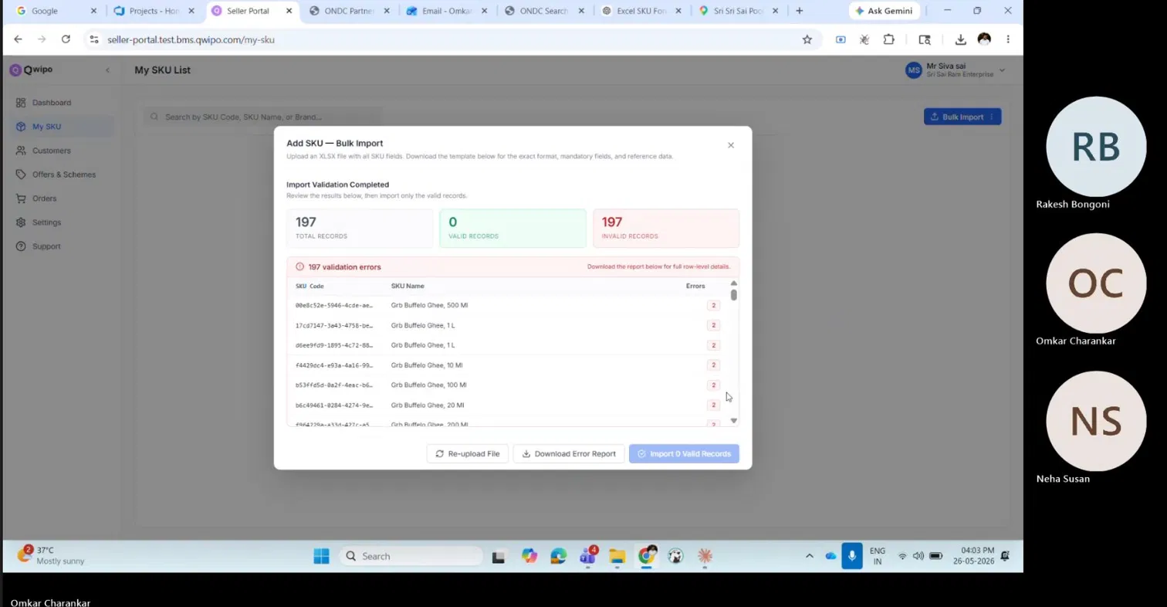
MY SKU · STEP 4
Read the validation summary
Total Records
All rows in your file
Valid Records
Rows that passed all checks
Invalid Records
Rows that need fixing — download the error report
Why a two-step (validate → import) flow
The system never commits a partial catalogue. Valid + Invalid rows are reported together, but nothing is saved until you click Import. This prevents half-uploaded SKUs that would mislead the buyer app or break grouping.
Qwipo Seller Store · Seller Training Guide · v1.1 · Internal Use
15 / 33

Slide 16
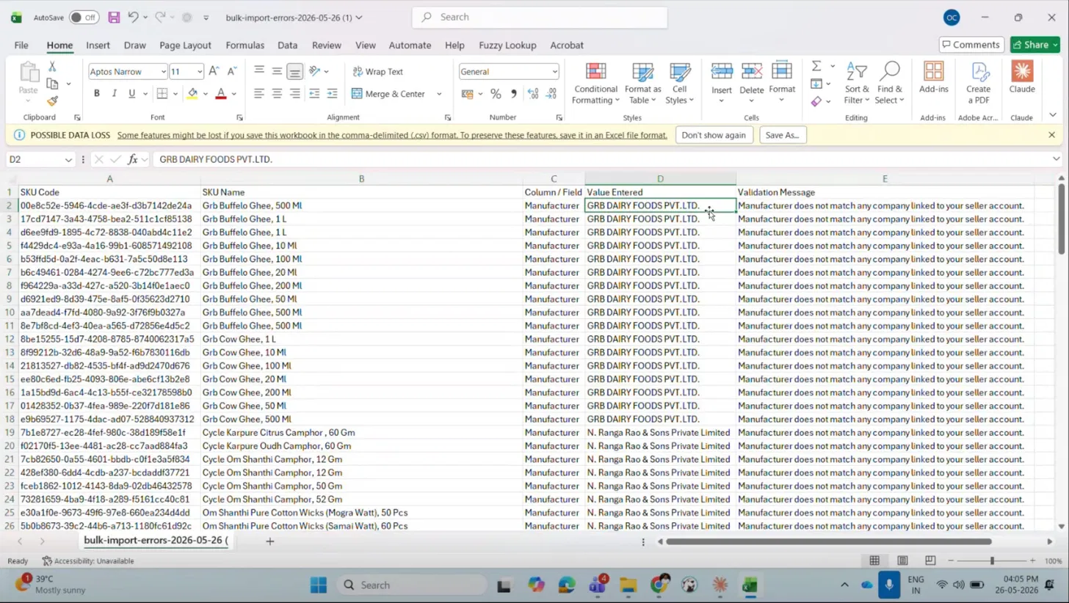
MY SKU · STEP 4
Download the error report and fix
Error message | What to do
Manufacturer does not match any company | Copy exact Company name from Super Admin portal
Short description must be 10 to N characters | Paste the SKU name or any 10+ char text
Invalid unit | Change to Gram, Kilogram, Litre, or Millilitre
Category cannot be empty | Use Beauty & Hygiene as a placeholder
Min/Max order quantity cannot be empty | Use 1 for min, 1000 for max
Fix → Re-upload → Repeat
Always re-download a fresh error report after each retry — fixing one error may surface a different validation that was hidden behind the first.
Qwipo Seller Store · Seller Training Guide · v1.1 · Internal Use
16 / 33

Slide 17
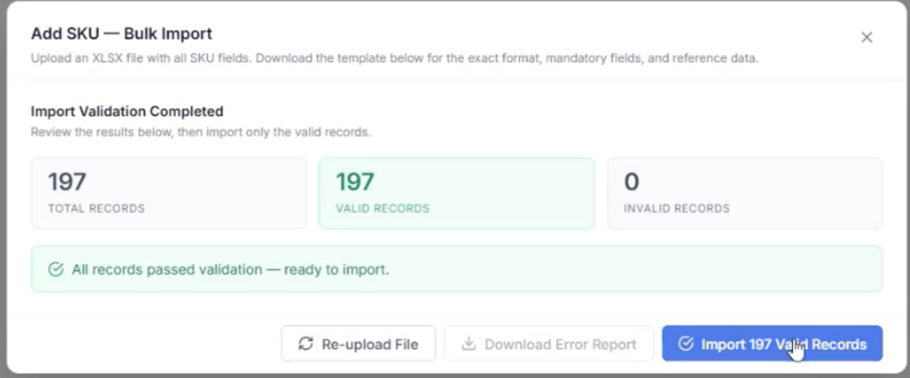
MY SKU · STEP 5
Successful validation — commit the import
What 'green' means
Total = Valid, Invalid = 0
Banner: 'All records passed validation — ready to import.'
Click Import [X] Valid Records
SKUs now appear on My SKU List
After commit — what changes
Your SKUs are stored in the seller catalogue but are NOT yet visible to buyers. They will all show 'Non-compliant' in the ONDC Compliance column because images are still missing. That's the next step.
Qwipo Seller Store · Seller Training Guide · v1.1 · Internal Use
17 / 33

Slide 18
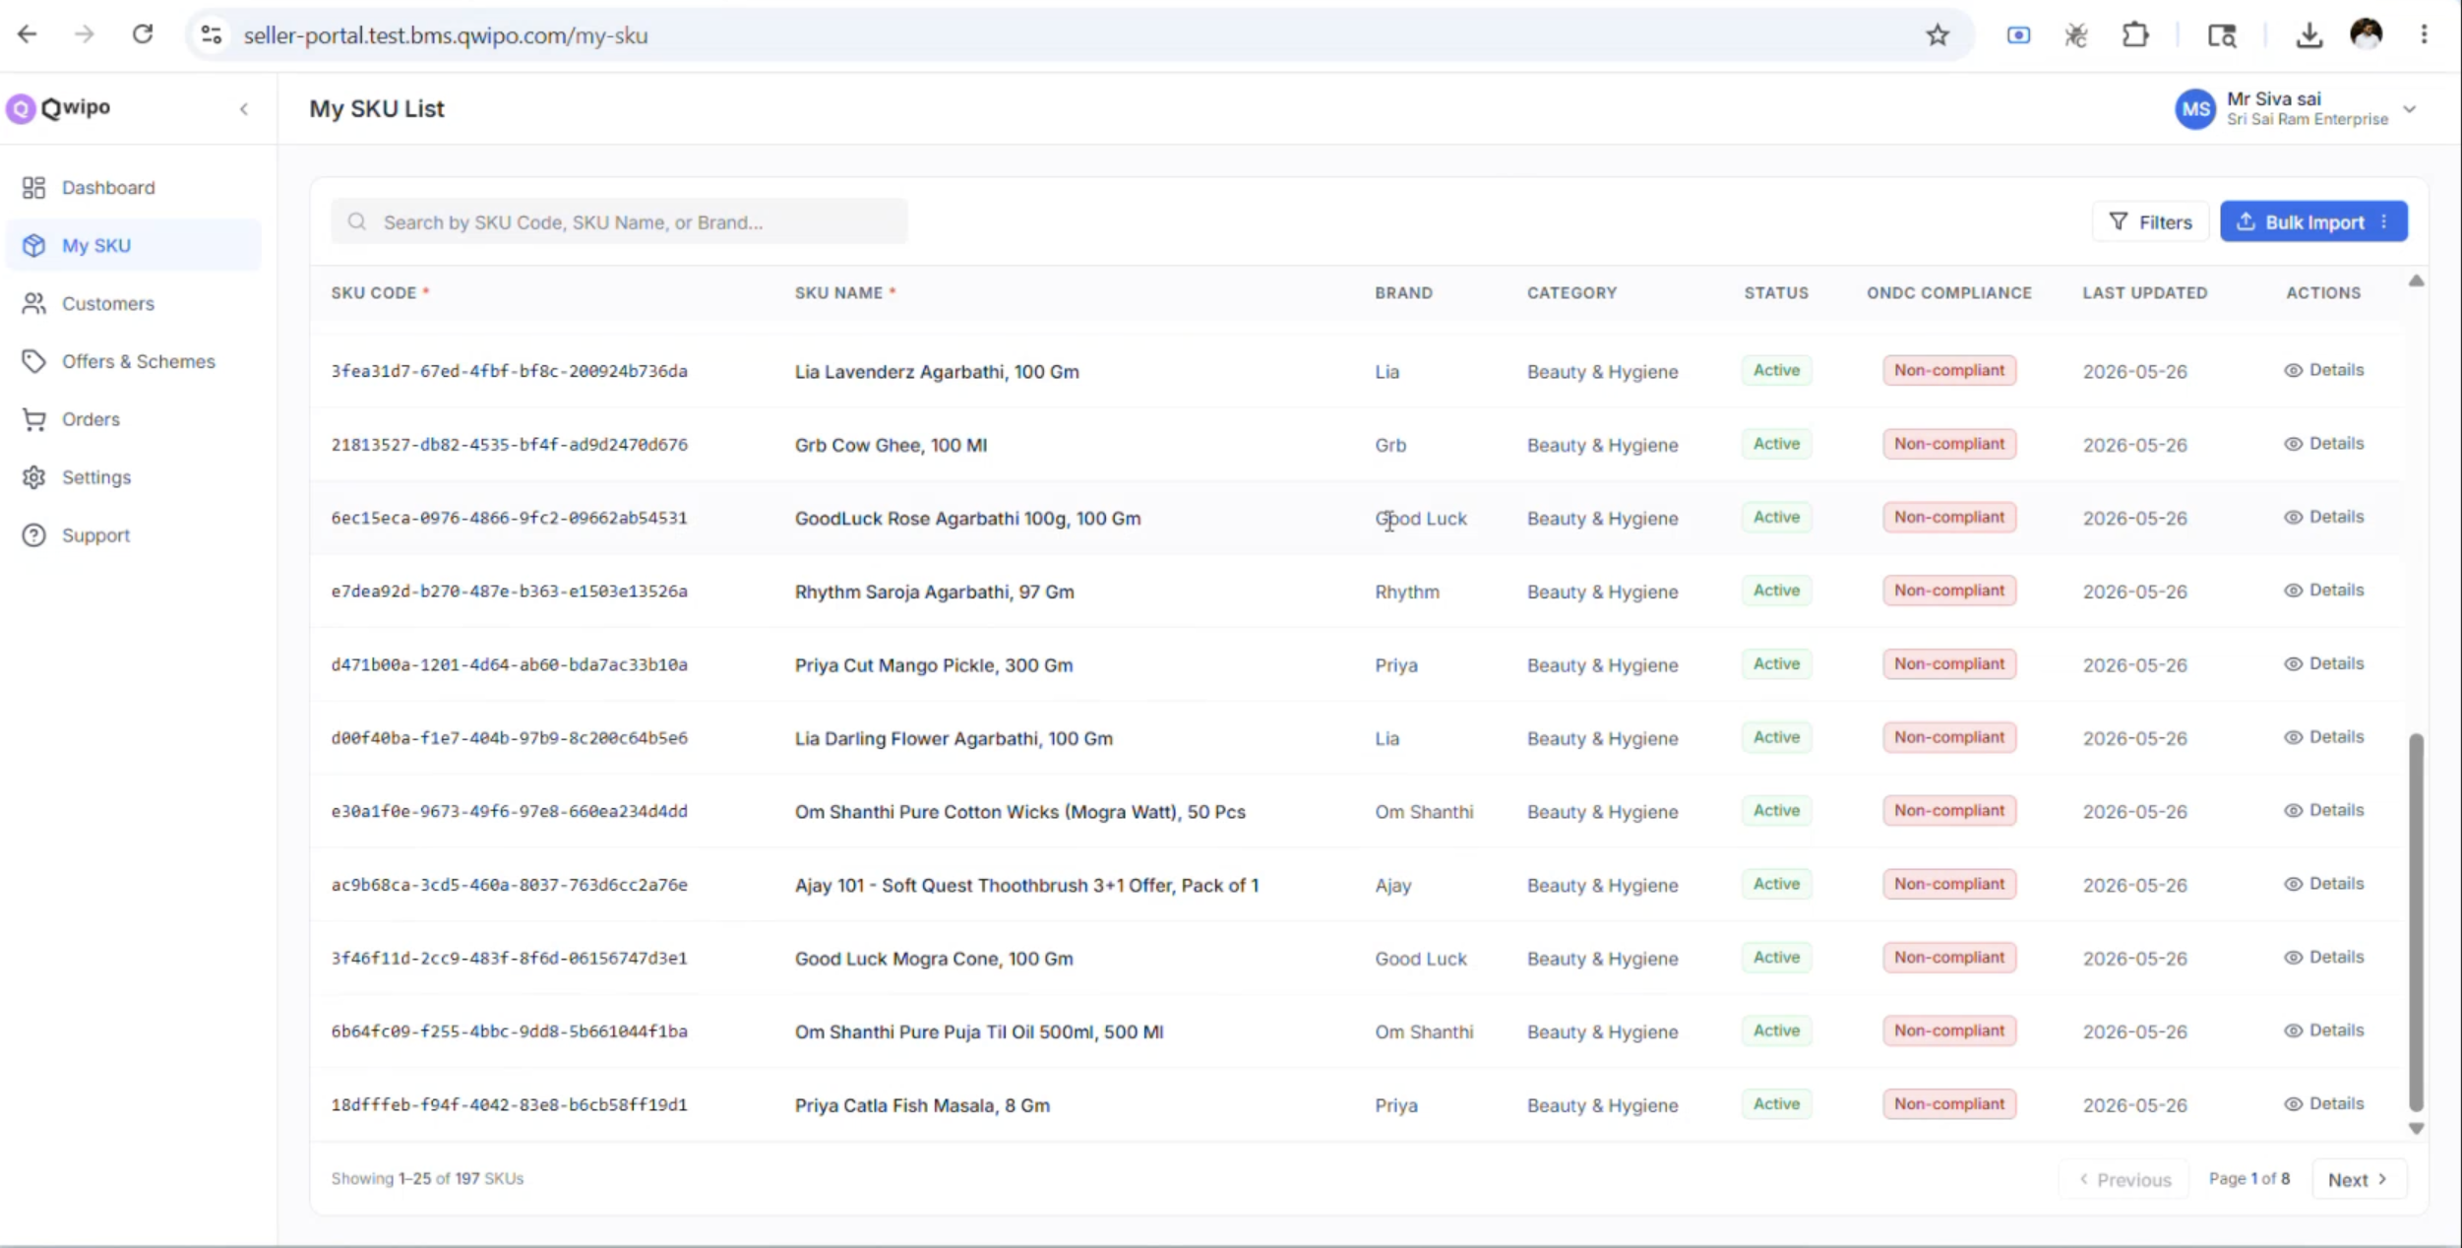
MY SKU · STEP 6
ONDC compliance — images flip the switch
Image upload pipeline
Reads the SKU list from the portal
Matches each SKU Code to its image in the brand folder
Uploads the image to each SKU
ONDC Compliance auto-flips: Non-compliant → Compliant
Why images are mandatory for ONDC
ONDC requires at least one image per SKU before it can be published to any buyer app — without it, the SKU is invisible to consumers. A separate Claude skill (sku-image-upload) automates this so sellers don't upload images one-by-one.
Qwipo Seller Store · Seller Training Guide · v1.1 · Internal Use
18 / 33

Slide 19
MODULE 2
Customers — who buys from you
Read-only view of the retailers connected to your seller account.
Qwipo Seller Store · Seller Training Guide · v1.1 · Internal Use
19 / 33

Slide 20
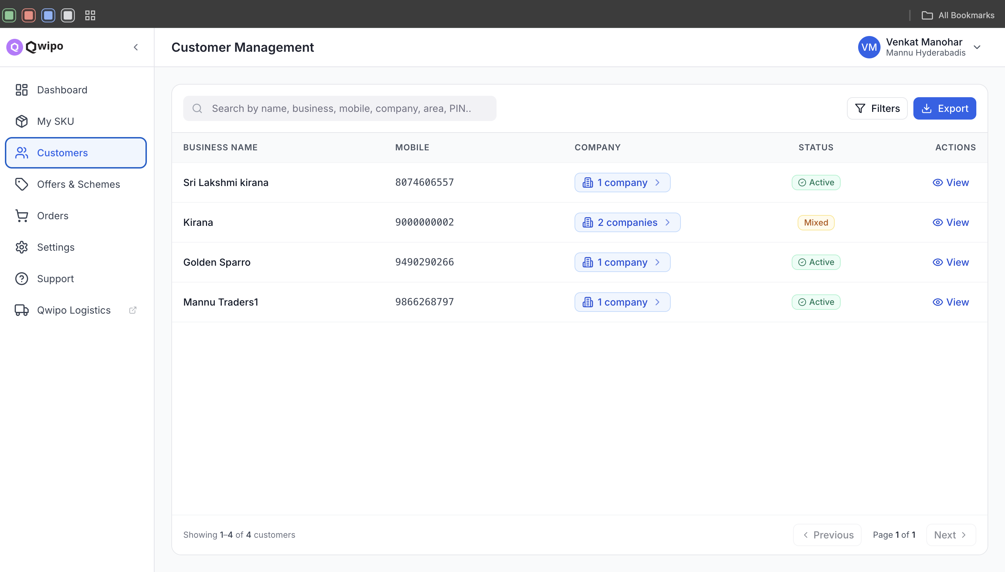
CUSTOMERS
What this module is — and what it isn't
What you can do here
Search by name, business, mobile, company, area, PIN
Filter by status or company
Export the full customer list
Click View → see order history per customer
Why it's read-only
Customers are not created in the seller portal — they come in from the buyer app or are linked by the Super Admin. A seller seeing 'Active' and 'Mixed' status here is just observing the result of those upstream actions, not editing them.
Qwipo Seller Store · Seller Training Guide · v1.1 · Internal Use
20 / 33

Slide 21
MODULE 3
Offers & Schemes — pricing levers
Phase 1: Quantity Pricing Scheme (QPS) only. Everything else is roadmap.
Qwipo Seller Store · Seller Training Guide · v1.1 · Internal Use
21 / 33

Slide 22
OFFERS & SCHEMES
What's available now vs. coming soon
Offer type | What it does | Status
QPS | Quantity-based price slabs with tiered discounts | Available now
Value Slab | Order value-based discount tiers | Coming soon
BOGO | Buy X get Y free | Coming soon
Case Bonus | Extra cases free on bulk purchase | Coming soon
Off-Invoice | Flat discount on invoice total | Coming soon
Display Allowance | Incentive for in-store display | Coming soon
Launch Incentive | Special pricing for new launches | Coming soon
Loyalty Rebate | Cashback rebate for repeat purchases | Coming soon
Combo Bundle | Bundled products at discount | Coming soon
Early Payment | Discount for early invoice settlement | Coming soon
Qwipo Seller Store · Seller Training Guide · v1.1 · Internal Use
22 / 33

Slide 23
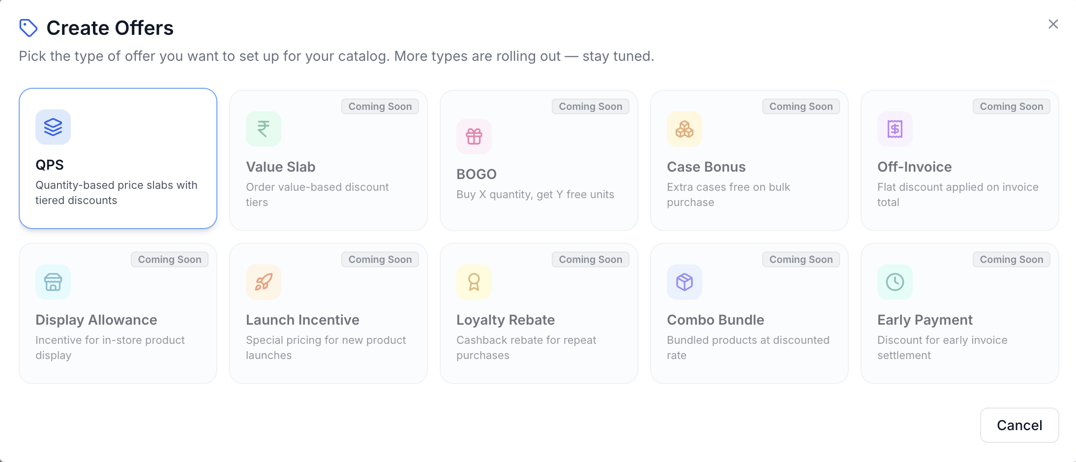
OFFERS & SCHEMES
Create a QPS scheme — step by step
Fields explained
Scheme Name — display name (e.g., QPS - Boost)
SKU — single product the scheme applies to
Start Date — auto-set to today
End Date — last day the scheme is valid
Pricing Slabs — quantity range + discount %
How slabs are interpreted
Each slab defines a quantity range and a discount %. The portal calculates 'Customer Pays' and 'Saving' live as you type. Orders above the last slab's max quantity continue to receive the highest slab's discount — i.e. the top tier is open-ended.
Qwipo Seller Store · Seller Training Guide · v1.1 · Internal Use
23 / 33

Slide 24
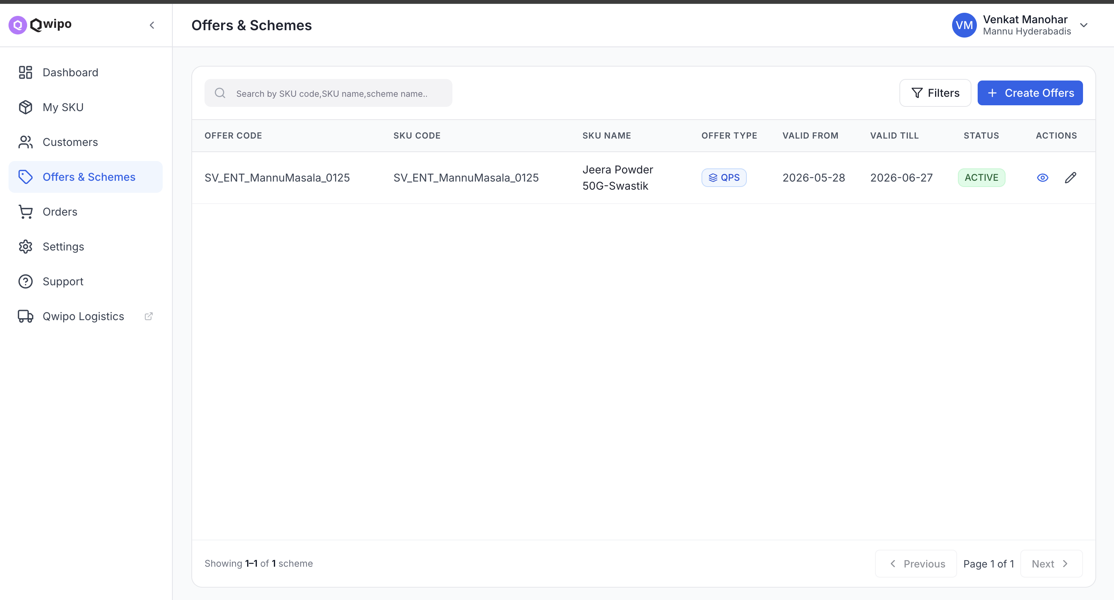
OFFERS & SCHEMES
Viewing and editing active schemes
What the list shows
Offer Code — system-generated identifier
SKU — product the scheme applies to
Offer Type — QPS in Phase 1
Validity dates — start / end
Status — Active / Inactive
Eye icon → view, Pencil icon → edit
Qwipo Seller Store · Seller Training Guide · v1.1 · Internal Use
24 / 33

Slide 25
MODULE 4
Orders — the revenue moment
Every successful confirmation here turns a buyer-app cart into your dispatch.
Qwipo Seller Store · Seller Training Guide · v1.1 · Internal Use
25 / 33

Slide 26
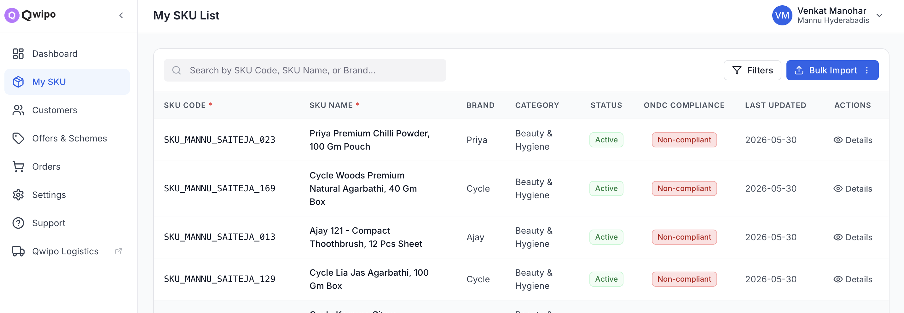
ORDERS
Where orders come from and how to navigate
All
New
Confirmed
Delivered
Cancelled
Every order regardless of status
Just received — awaiting confirmation
Accepted by you — being prepared
Completed deliveries
Rejected or buyer-cancelled
Qwipo Seller Store · Seller Training Guide · v1.1 · Internal Use
26 / 33

Slide 27
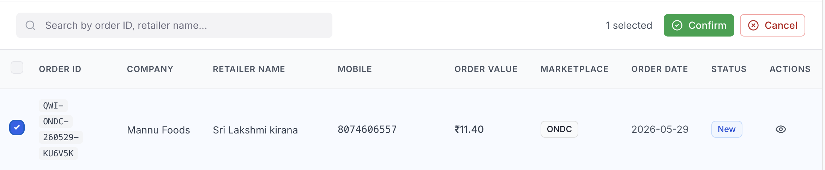
ORDERS
Confirming an order
Confirm flow
Open the New tab
Tick the checkbox on the order row
Confirm and Cancel appear at top right
Click Confirm to accept the order
Status moves to Confirmed — retailer is notified
Use Export (top right) to download orders for reconciliation
Order columns at a glance
Order ID — unique reference (QWI-ONDC-...)
Company — the manufacturer the order is for
Retailer Name + Mobile — the buyer/shop
Order Value — total amount
Marketplace — where the order originated (e.g., ONDC)
Order Date — when it was placed
Status — New / Confirmed / Delivered / Cancelled
Qwipo Seller Store · Seller Training Guide · v1.1 · Internal Use
27 / 33

Slide 28
MODULE 5
Settings — store, orders, comms
Three sub-sections that control how your store accepts business.
Qwipo Seller Store · Seller Training Guide · v1.1 · Internal Use
28 / 33

Slide 29
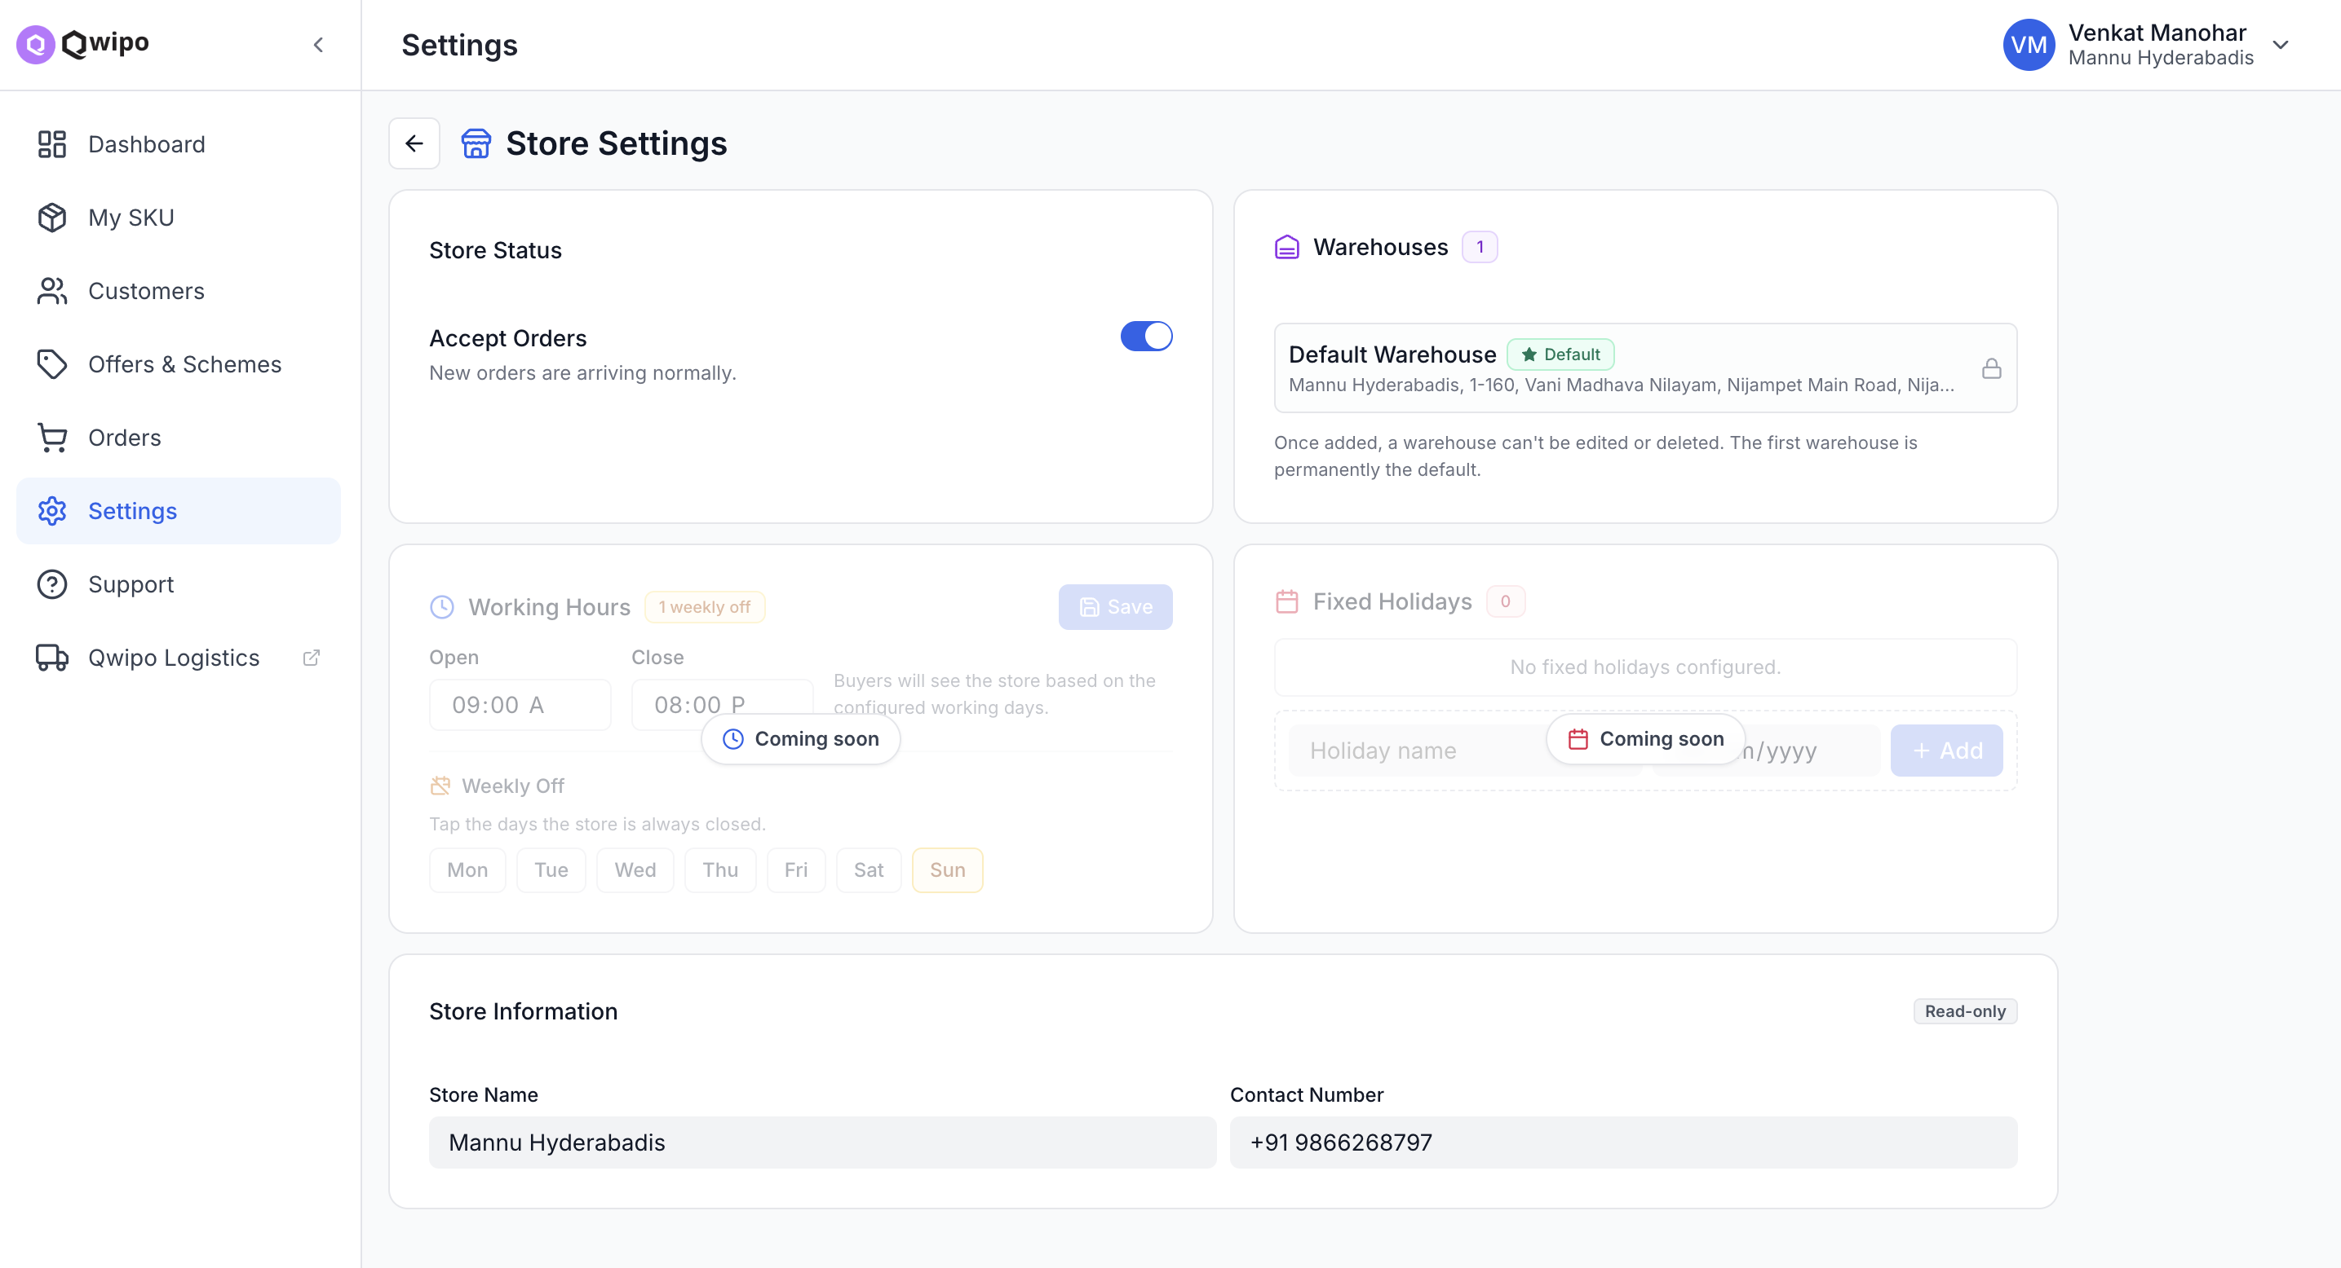
SETTINGS · STORE
Warehouse = your dispatch origin
Settings on this screen
Accept Orders — master ON/OFF switch
Warehouses — set ONCE, cannot edit or delete
Working Hours — open/close (coming soon enforcement)
Weekly Off — days the store is closed
Fixed Holidays — specific holiday dates
Store Information — read-only (Super Admin set)
Why the warehouse address is locked after creation
The Super Admin enters the seller's address with latitude and longitude when creating the seller. Those lat/long values become the default warehouse coordinates here — i.e. the origin point for every dispatch and the centre of every serviceability beat. Changing it later would invalidate routing distances, ETA estimates, and serviceability polygons, so the system intentionally freezes it. Always confirm with the seller before saving.
Qwipo Seller Store · Seller Training Guide · v1.1 · Internal Use
29 / 33

Slide 30
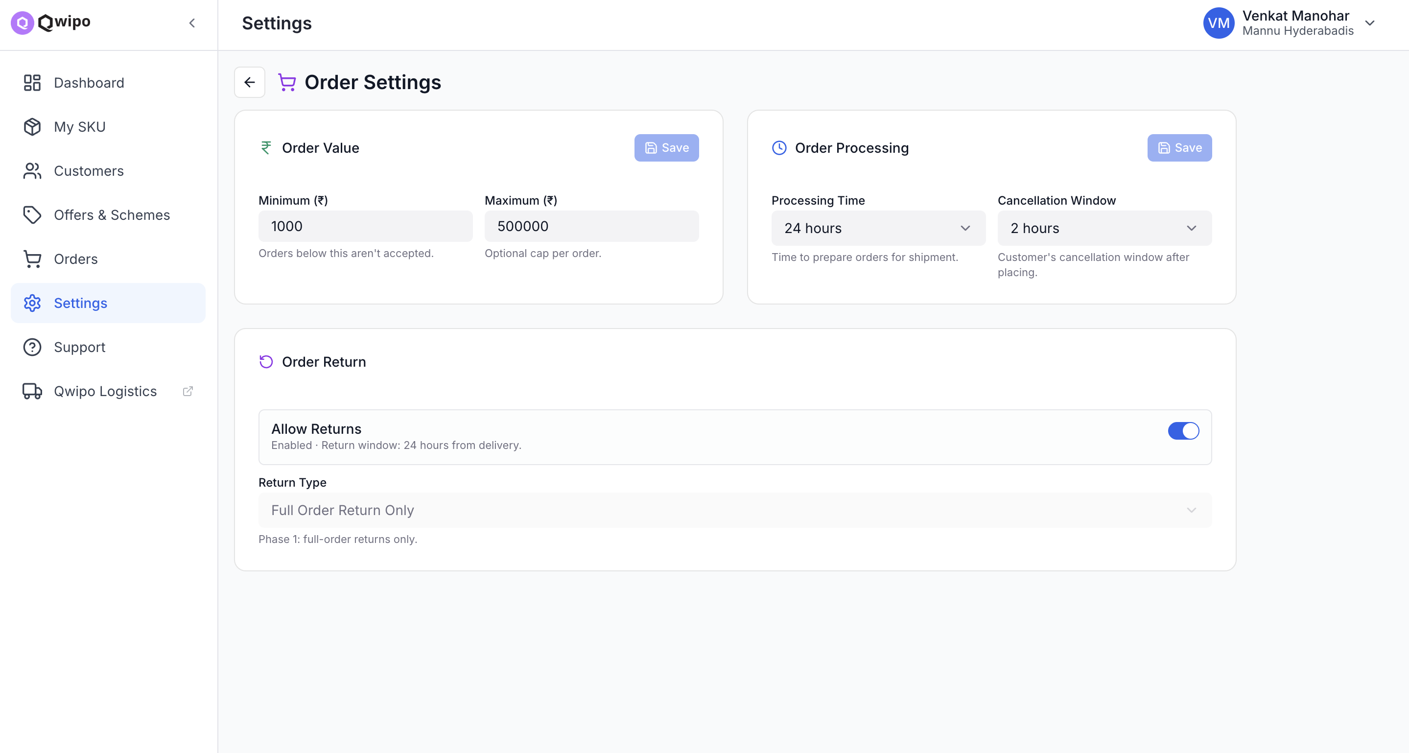
SETTINGS · ORDERS
Set the rules buyers play by
Setting | Effect
Minimum Order Value | Orders below this won't be accepted (e.g., ₹1,000)
Maximum Order Value | Optional upper cap per order
Processing Time | Time you need before shipment (e.g., 24h)
Cancellation Window | Buyer's cancel window after placing
Allow Returns | Enable / disable returns (24h window today)
Return Type | Phase 1: Full Order Return Only
These rules feed the buyer app's checkout
Min/Max value and Processing Time appear on the buyer-side product detail page — buyers see your terms before placing the order. Click Save in each section to commit changes.
Qwipo Seller Store · Seller Training Guide · v1.1 · Internal Use
30 / 33

Slide 31
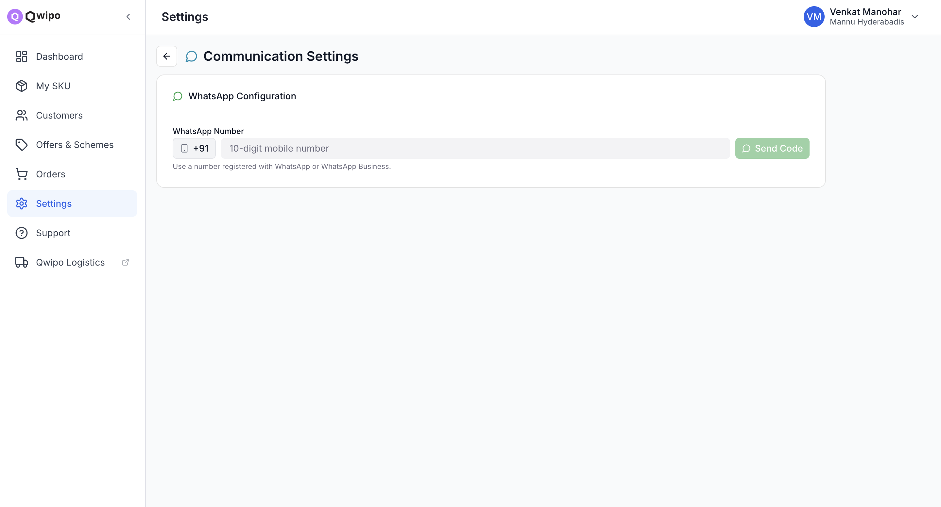
SETTINGS · COMMUNICATION
Connect WhatsApp for order alerts
How to connect
Go to Settings → Communication Settings
Enter 10-digit WhatsApp number
Click Send Code
Enter verification code from WhatsApp
Click Save
Why WhatsApp for ops, not just email
Most distributors operate from mobile. New-order alerts, confirmations, and cancellations are pushed to WhatsApp so the seller (or their dispatch person) sees them in real time — no need to keep the portal open.
Qwipo Seller Store · Seller Training Guide · v1.1 · Internal Use
31 / 33

Slide 32
QUICK TROUBLESHOOTING
Common issues and how to fix them
Problem | Fix
Import fails immediately | File must be .xlsx — not CSV or XLS
All rows show manufacturer mismatch | Copy exact Company name from Super Admin portal
Short description errors | Add 10+ characters — copy group name as filler
Still erroring after re-upload | Re-download fresh error report; check a different column
SKUs show Non-compliant after import | Images are missing — run the image upload pipeline
Cannot log in | Verify mobile number with Super Admin; OTP any 6 digits on test
Orders not appearing | Check Super Admin has completed Serviceability setup
QPS not applying | Verify Active status and order date inside validity window
WhatsApp not getting alerts | Number must be registered with WhatsApp / Business
Warehouse address wrong | Cannot edit — contact Super Admin for backend correction
Qwipo Seller Store · Seller Training Guide · v1.1 · Internal Use
32 / 33

Slide 33
RECAP
Six things every seller-trainer should leave with
1
The Seller Portal depends on Super Admin setup. Companies, Brands, Serviceability — all must exist first.
2
Manufacturer in the SKU file must EXACTLY equal a Company name. Even a dot or trailing space fails the row.
3
Only 4 units are accepted by ONDC: Gram, Kilogram, Litre, Millilitre. Everything else needs the Gram workaround.
4
SKUs go live only when the image upload pipeline runs and ONDC Compliance flips to Compliant.
5
The seller's address Lat/Long becomes the warehouse. It's locked after creation — confirm before saving.
6
WhatsApp number unlocks real-time alerts. Without it, the seller has to keep refreshing the portal.
For Super Admin setup (Company, Seller, Serviceability), see the Super Admin User Guide deck.
Qwipo Seller Store · Seller Training Guide · v1.1 · Internal Use
33 / 33

