Slide 1
INTERNAL TRAINING
Qwipo Seller Store
Super Admin User Guide
How a new distributor goes from zero to live — Companies, Brands, Sellers, Mapping, Serviceability.
Phase 1 · Version 1.0 · 27 May 2026

Slide 2
ABOUT THIS GUIDE
Who runs Super Admin, and what they unblock
Who this is for
Why Super Admin goes first
Onboarding ops setting up new distributors
Customer success owners managing existing sellers
Trainers teaching the team the foundation flow
Sellers can't log in until their profile exists here
SKU uploads fail if Company / Brand names don't pre-exist
Orders can't route without Serviceability beats
Address lat/long here becomes the seller's warehouse
Mental model
Think of Super Admin setup as 'pouring the foundation' for a distributor. Every later screen — the seller's portal, the buyer app, ONDC routing — references the entities created here. Spending an extra minute getting names and coordinates right saves hours of cleanup later (and some fields cannot be edited at all).
Qwipo Seller Store · Super Admin Training Guide · v1.0 · Internal Use
2 / 21

Slide 3

END-TO-END SUMMARY
The five steps, in the only order that works
1
2
3
4
5
Login via Mobile OTP
Create Company + Brands
Create Seller Profile
Map Companies & Brands
Configure Serviceability
Super Admin signs in to the portal
Manufacturer entity + its brands
Business, address, lat/long → warehouse
Tell the system which brands this seller carries
Beat + delivery day (per company)
Why sequence matters
A seller cannot be mapped to a company that doesn't exist yet. Serviceability needs both seller and company. Each step depends on the previous one — skipping ahead causes setup failures that look like 'system bugs' but are really missing data.
Qwipo Seller Store · Super Admin Training Guide · v1.0 · Internal Use
3 / 21

Slide 4




MENTAL MODEL
The four entities you'll create and connect
Company
Brand
Seller
Serviceability
Manufacturer or parent legal entity. Holds the SKUs.
A label sitting under one Company. Buyers browse by brand.
Distributor identity. Address → default warehouse.
Where + when this seller delivers (per company).
How they connect
Brand belongs to Company. Seller is mapped to Companies (and the brands beneath them). Serviceability is configured per (Seller × Company). One bad name breaks the whole chain.
Qwipo Seller Store · Super Admin Training Guide · v1.0 · Internal Use
4 / 21

Slide 5
CONCEPT · COMPANY
Why it exists and where the name is reused
What a Company is
Where the Company name shows up
The manufacturer or parent legal entity (e.g., GRB Dairy Foods, Raghav Lifestyle)
Every SKU and every Brand sits under one Company
Created ONCE — cannot be edited at the UI level after creation
SKU upload — Manufacturer column must match exactly
Buyer app — products are grouped by Company → Brand
Seller mapping — only mapped Companies appear in the seller's catalogue
Serviceability — each Beat is per Company
Orders list — the Company column tells the seller which manufacturer the order is for
Qwipo Seller Store · Super Admin Training Guide · v1.0 · Internal Use
5 / 21

Slide 6


CONCEPT · ADDRESS & WAREHOUSE
Why latitude / longitude matters more than the street line
Seller address — what's captured
How it becomes a Warehouse
PIN code
— resolves City and State automatically
Latitude + Longitude
— geo-coordinates of the business
Locality / Street
— neighbourhood + door-level address shown on invoices
The Lat/Long you enter here is what the system writes into the seller's Settings → Warehouse.
That warehouse becomes the default dispatch origin for every product the seller lists.
Serviceability beats are drawn relative to it — i.e. retailers nearby vs far affect routing and delivery day.
The address is locked once saved — the seller cannot edit it from their portal.
Net-net: verify Lat/Long with the seller before saving. It cannot be self-fixed.
Qwipo Seller Store · Super Admin Training Guide · v1.0 · Internal Use
6 / 21

Slide 7
STEP 1 · LOGIN
Sign in to the Super Admin portal
Login sequence
Test environment tip
Open the Super Admin portal URL
Enter your registered mobile number
Wait for the OTP on that number
Enter the OTP to log in
Top-right confirms: 'Qwipo Seller Super Admin — Super Admin Portal'
On the test portal, any 6-digit OTP is accepted
On production, OTP is sent only to the registered mobile
Confirm the registered mobile matches the user before creating their profile — used for all future logins
Qwipo Seller Store · Super Admin Training Guide · v1.0 · Internal Use
7 / 21

Slide 8
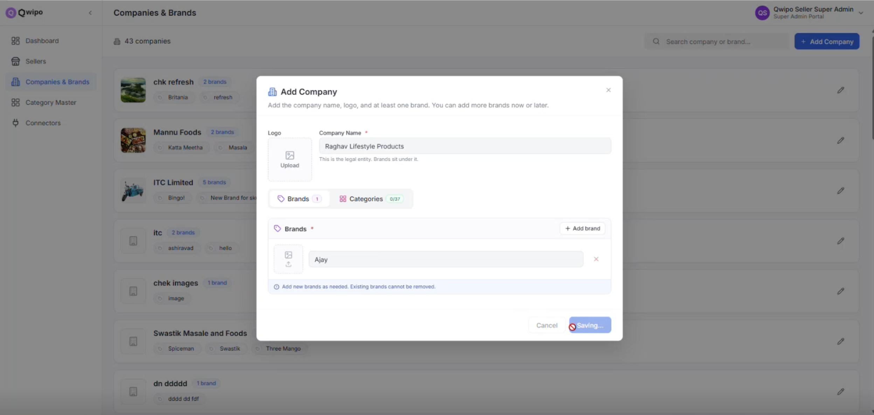
STEP 2 · CREATE COMPANY
Add Company modal — what each field does
How to add
Open Companies & Brands in sidebar
Use Search to confirm it doesn't already exist (43 today)
Click + Add Company (top right)
Enter Company Name, upload Logo
Add Brands one by one in the lower section
Click Create Company
Before you click + Add Company
Always search first. A duplicate Company name creates a fork in the data — sellers mapped to the duplicate won't see SKUs that referenced the original, and there's no UI to merge them.
Qwipo Seller Store · Super Admin Training Guide · v1.0 · Internal Use
8 / 21

Slide 9
STEP 2 · NAMING RULES — CRITICAL
The Company Name you save here is the contract
Save it as (correct) | Common mistake
GRB DAIRY FOODS PVTLTD | GRB DAIRY FOODS PVT.LTD
Ushodaya Enterprises Private Limited | Ushodaya Enterprises Pvt. Limited
Raghav Lifestyle Products | Raghav Lifestyle Products (trailing space)
Why dots, spaces, and punctuation matter
The seller's SKU file uses this exact string in its Manufacturer column. Matching is character-by-character — no fuzzy logic. A tiny typo here forces every row that references this Company to fail the seller's upload. Company records also cannot be edited at the UI level — a typo is permanent unless fixed at the DB layer.
Qwipo Seller Store · Super Admin Training Guide · v1.0 · Internal Use
9 / 21

Slide 10
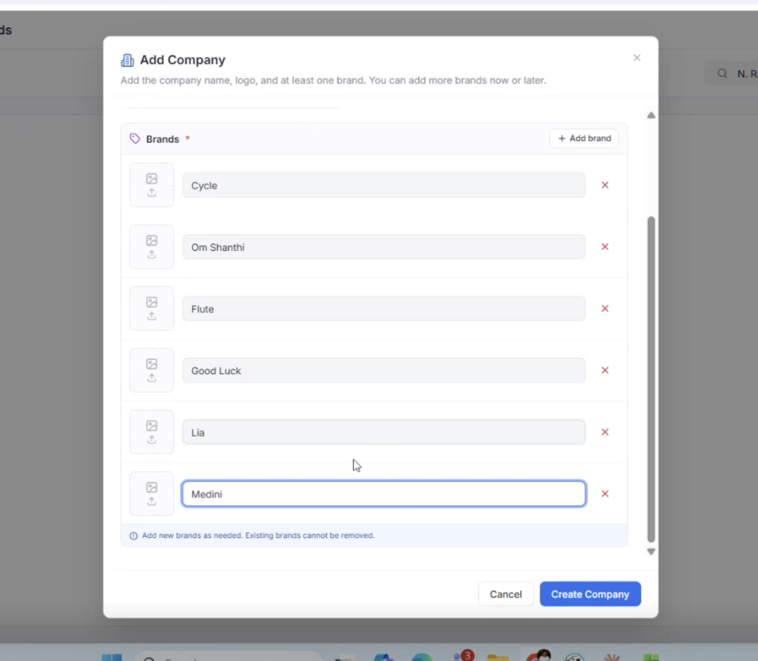
STEP 2 · BRANDS UNDER COMPANY
Add every brand the company sells
How to add brands
Under Brands, click + Add brand and type the name
Repeat for each brand of this Company
Each brand gets its own row — clean and explicit
Brands cannot be removed — plan ahead
The UI tells you: 'Existing brands cannot be removed.' You can ADD a new brand later, but you can never delete an old one. Confirm the full brand list with the seller before saving so the dropdown isn't polluted with placeholder names.
Qwipo Seller Store · Super Admin Training Guide · v1.0 · Internal Use
10 / 21

Slide 11
STEP 2 · EXAMPLE MAPPINGS
Real Company → Brand examples from the system
Company (as entered) | Brands
Raghav Lifestyle Products | Ajay
Ushodaya Enterprises Private Limited | Priya
GRB DAIRY FOODS PVTLTD | GRB
N Ranga Rao Sons Private Limited | Cycle, Om Shanthi, Flute, Good Luck, Lia, Medini, Naivedya, Rhythm
Filter & sort from your existing Excel before typing here
A common approach: keep one master Excel sheet of Companies and Brands. Filter it for the seller you're onboarding, copy the Company name as-is, and paste it into the modal. This prevents transcription errors that look harmless on screen but fail every SKU upload.
Qwipo Seller Store · Super Admin Training Guide · v1.0 · Internal Use
11 / 21

Slide 12
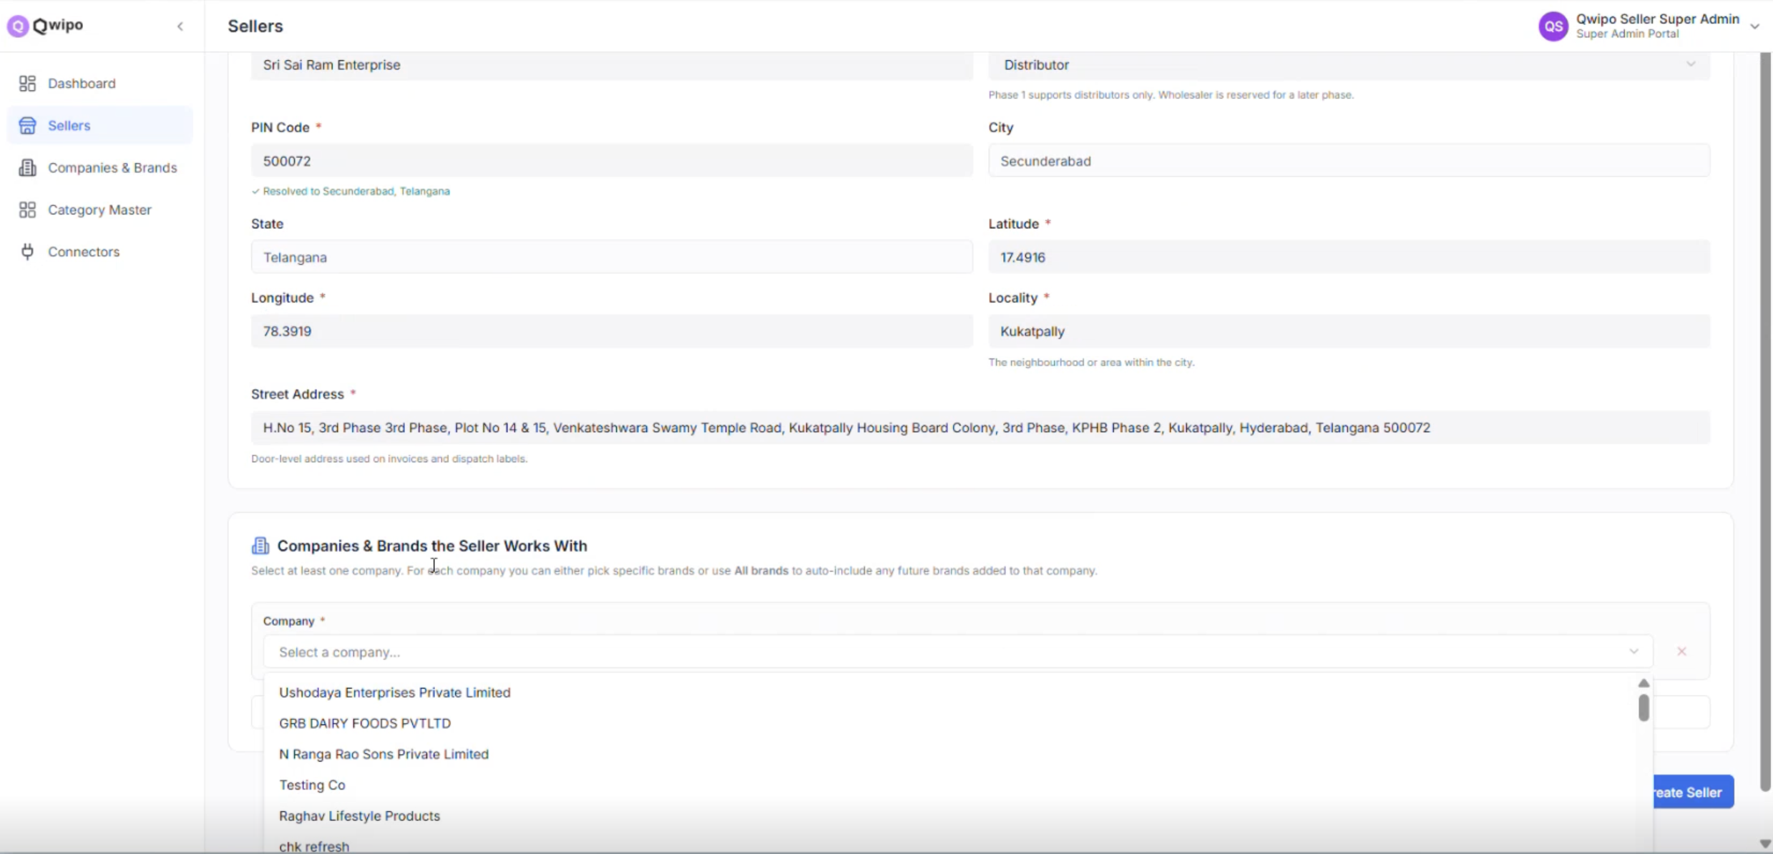
STEP 3 · CREATE SELLER
Add Seller form — what to fill in
How to create
Open Sellers in the left sidebar
Click + Add Seller
Fill the seller's details (see next slide)
Optionally start mapping companies in the lower section
Click Create Seller
Qwipo Seller Store · Super Admin Training Guide · v1.0 · Internal Use
12 / 21

Slide 13
STEP 3 · SELLER FIELDS
Required fields and why each one matters
Field | What it drives downstream
Business Name | Shown in dashboard, invoices, and to retailers in the buyer app
Seller Type — Distributor | Phase 1 only Distributor. Wholesaler reserved for later phase.
PIN Code | Auto-resolves City and State — verify these before saving
Latitude & Longitude | Becomes the warehouse coordinates in Settings → cannot be edited later
Locality | Neighbourhood (e.g., Kukatpally) — shown on order routing maps
Street Address | Door-level — printed on invoices and dispatch labels
Lat/Long discipline
Capture lat/long from Google Maps using the seller's actual godown / dispatch point — not a generic city centre. The serviceability beats (next step) are drawn around this exact point, and the seller cannot reset it from their portal. Get it right the first time.
Qwipo Seller Store · Super Admin Training Guide · v1.0 · Internal Use
13 / 21

Slide 14
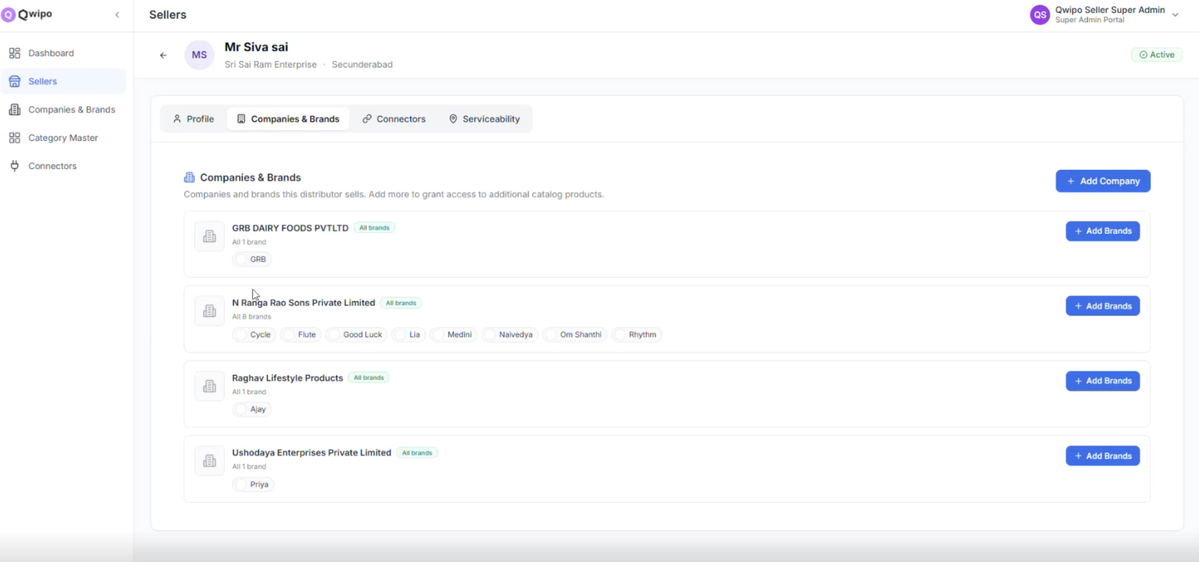
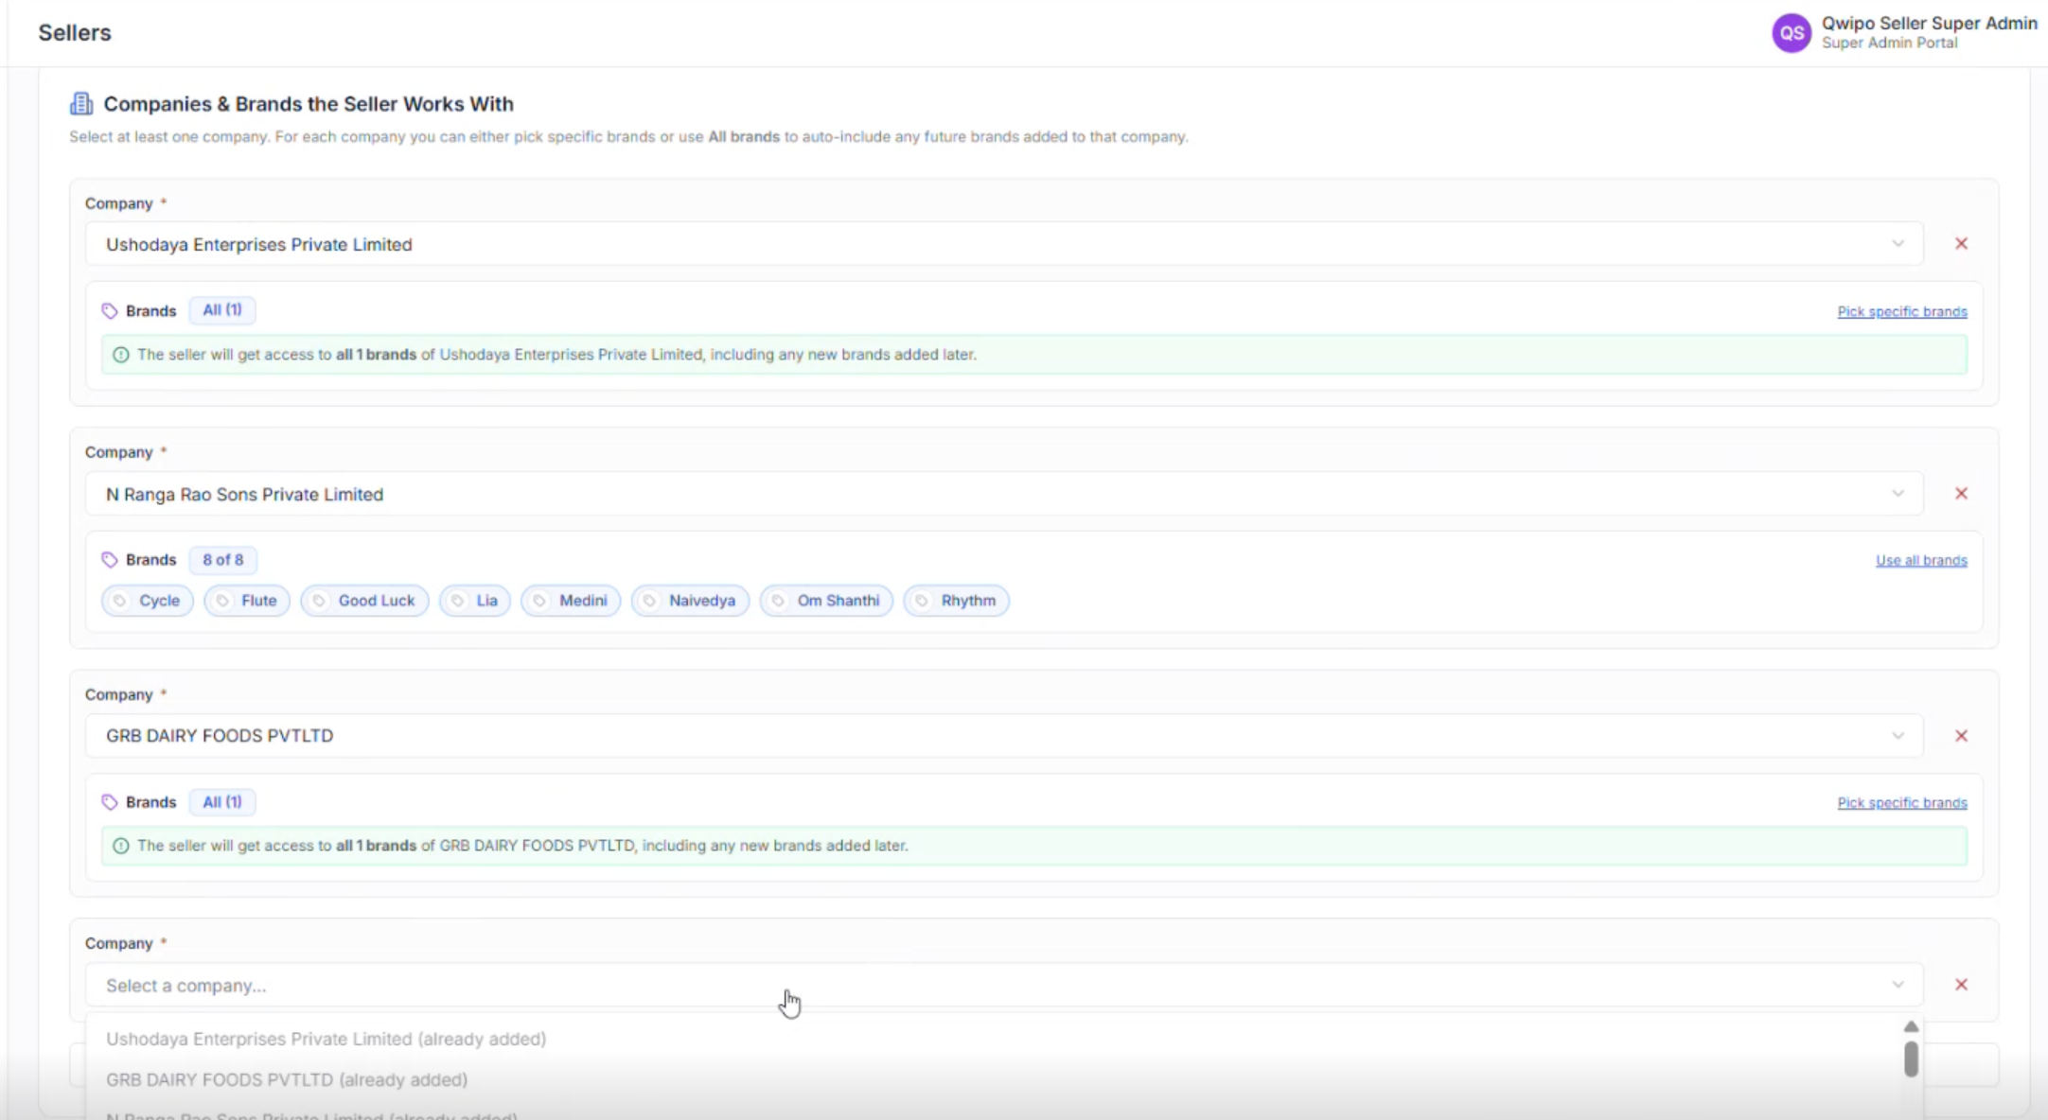
STEP 4 · MAP COMPANIES & BRANDS
Tell the system what this seller actually carries
Without mapping, the seller's catalogue is empty
Only mapped Brands appear in the seller's My SKU module. A seller mapped to 'GRB DAIRY FOODS' but missing the 'GRB' brand will be unable to upload any GRB SKU.
Qwipo Seller Store · Super Admin Training Guide · v1.0 · Internal Use
14 / 21

Slide 15
STEP 4 · ALL BRANDS vs SPECIFIC BRANDS
Two ways to map — pick deliberately
All brands
Pick specific brands
Seller gets every CURRENT brand under this company.
PLUS any FUTURE brand added to this company is granted automatically.
When to use:
• Seller is the official distributor for the whole company
• You expect the company to keep adding new SKUs / brands
Manually select only the brands this seller stocks.
New brands added later DO NOT flow to the seller automatically — you must add them manually.
When to use:
• Seller has territory rights for only some brands
• You want to exclude a brand (e.g., 'Rhythm' not stocked yet)
You can return to the Companies & Brands tab anytime and click + Add Brands to expand later.
Qwipo Seller Store · Super Admin Training Guide · v1.0 · Internal Use
15 / 21

Slide 16
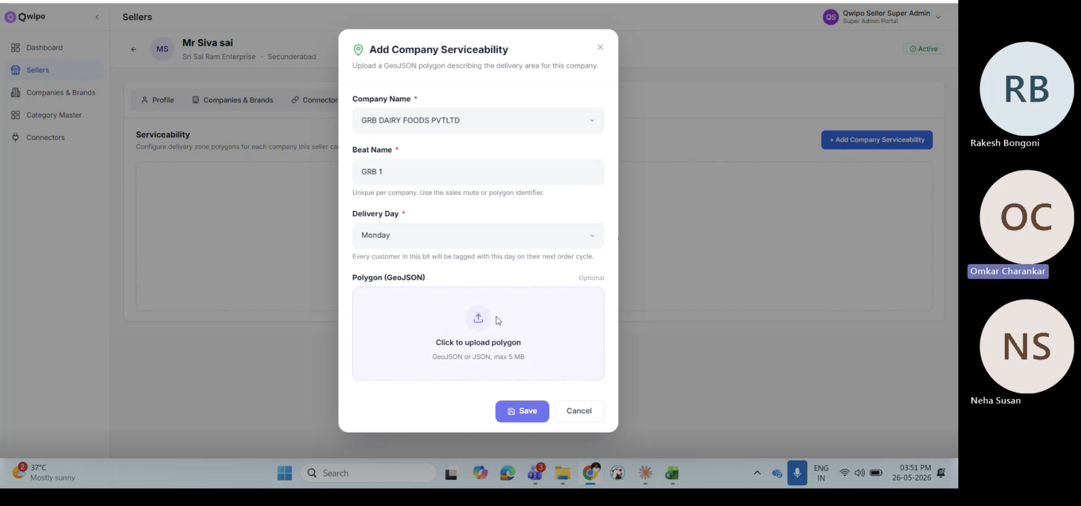
STEP 5 · SERVICEABILITY
Beat name + delivery day per company
Field | Purpose
Company Name | Pick the company this rule applies to (separate entry per company)
Beat Name | Unique route/polygon identifier — e.g., 'GRB 1', 'KPHB 4'
Delivery Day | The weekday customers in this beat are tagged for
Polygon (GeoJSON) | Optional in Phase 1 — upload up to 5 MB GeoJSON file
Phase 1 shortcut: save with just Company + Beat + Day if polygon isn't ready — upload it later.
Qwipo Seller Store · Super Admin Training Guide · v1.0 · Internal Use
16 / 21

Slide 17
STEP 5 · WHY PER-COMPANY
Each manufacturer can have its own beat plan
What 'per-company beat' enables
Common questions
GRB beats can run Mon/Wed; Raghav beats can run Tue/Fri
A retailer in one beat may receive GRB orders but not Raghav (different territory)
A seller carrying 3 companies can manage 3 independent delivery plans
Q: Same beat name across two companies? → Yes, allowed. Beat name only has to be unique PER company.
Q: Can the polygon overlap with another seller's? → Yes — overlap is fine for now; it's an operational call.
Q: Can I skip serviceability for Phase 1? → No — orders won't route without it.
Qwipo Seller Store · Super Admin Training Guide · v1.0 · Internal Use
17 / 21

Slide 18
KEY CONSTRAINTS
What is permanent — and what can be edited later
Permanent (cannot edit in UI)
Can add or extend later
Company Name
Brand Name (also cannot be removed)
Seller's Address — the warehouse Lat/Long
Seller's Mobile Number (used for OTP login)
New brands under an existing Company
New Companies mapped to a Seller
Additional Brands mapped to a Seller
New Serviceability beats and polygons
Qwipo Seller Store · Super Admin Training Guide · v1.0 · Internal Use
18 / 21

Slide 19
TROUBLESHOOTING
Common admin issues and how to fix them
Issue | Likely cause | Fix
Company appears as duplicate | Created before searching | Use the existing entry; map it to seller
Seller cannot log in | Wrong mobile saved, or OTP not received | Verify mobile; ask them to retry OTP
Company missing in seller mapping dropdown | Company not created yet | Go to Companies & Brands and create it first
Serviceability not saving | Beat Name missing or duplicate per company | Ensure Beat Name is unique within the company for this seller
SKU upload still failing manufacturer | Typo in Company Name (dot, space, abbreviation) | Company is unfixable in UI — escalate for DB-level fix
Qwipo Seller Store · Super Admin Training Guide · v1.0 · Internal Use
19 / 21

Slide 20

END-TO-END VERIFICATION
How to know the seller is truly live
Companies & Brands all created with exact, agreed-upon names
Seller profile created with verified mobile and accurate Lat/Long
All required Companies mapped, brand-by-brand or 'All brands'
Serviceability added for every Company the seller carries
Seller can log in via OTP and lands on the Dashboard
Seller can download the SKU template and start a bulk import
After upload, every row passes validation (no manufacturer mismatch)
Qwipo Seller Store · Super Admin Training Guide · v1.0 · Internal Use
20 / 21

Slide 21
RECAP
Five things every Super Admin trainer should leave with
1
Setup order is mandatory: Company → Seller → Mapping → Serviceability. Skipping breaks the chain.
2
Names are contracts. Company and Brand names cannot be edited — typos block every future SKU upload.
3
Address Lat/Long becomes the warehouse, locked after save. Verify against the seller's real godown location.
4
Map exactly what the seller carries — 'All brands' is auto-expanding, 'Pick specific' requires manual updates.
5
Serviceability is per Company. No beat → no orders. Polygon can come later but beat name + day cannot.
For day-to-day seller use (SKU upload, orders, schemes, settings), see the Seller User Guide deck.
Qwipo Seller Store · Super Admin Training Guide · v1.0 · Internal Use
21 / 21

