Slide 1
QWIPO · PHASE 1
Seller Management Platform
Super Admin & Seller Admin — End-to-End Walkthrough
Distributor onboarding · Catalog · Orders · Customers · Offers · Settings
Prepared for the product walkthrough · Built on the live Phase 1 build

Slide 2
AGENDA
01
What we'll cover today
01
02
03
04
Roles & Sign-In
Super Admin
Seller Admin
Recap
Single login surface. Super Admin and Seller see different consoles.
Onboard distributors, manage users, brands, connectors, and approval requests.
Catalog, inventory, customers, orders, offers, settings and reports.
Step-by-step checklist for go-live.
Qwipo · Phase 1 Walkthrough
Agenda

Slide 3
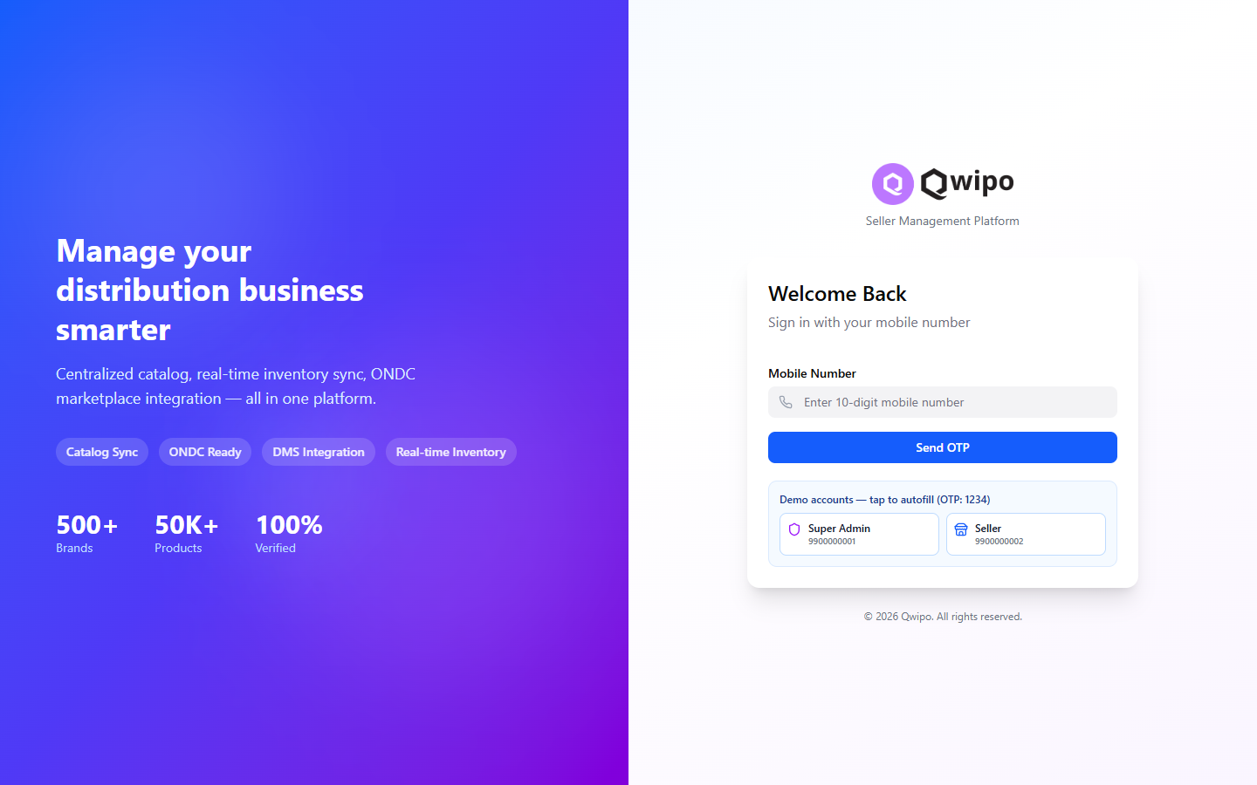
ROLES & ACCESS
02
One login. Two consoles.
Super Admin
9900000001 · OTP 1234 (demo)
Manages distributors, master data, connectors
Approves new requests and assigns brands
Routes to /admin on sign-in
Seller (Distributor)
9900000002 · OTP 1234 (demo)
Catalog, pricing, inventory and orders
Customers, offers, settings, reports
Routes to / on sign-in
Qwipo · Phase 1 Walkthrough
Roles & Sign-In

Slide 4
PART 02
Super Admin
Onboarding distributors and running the network
Sellers
Companies & Brands
Connectors
Requests

Slide 5
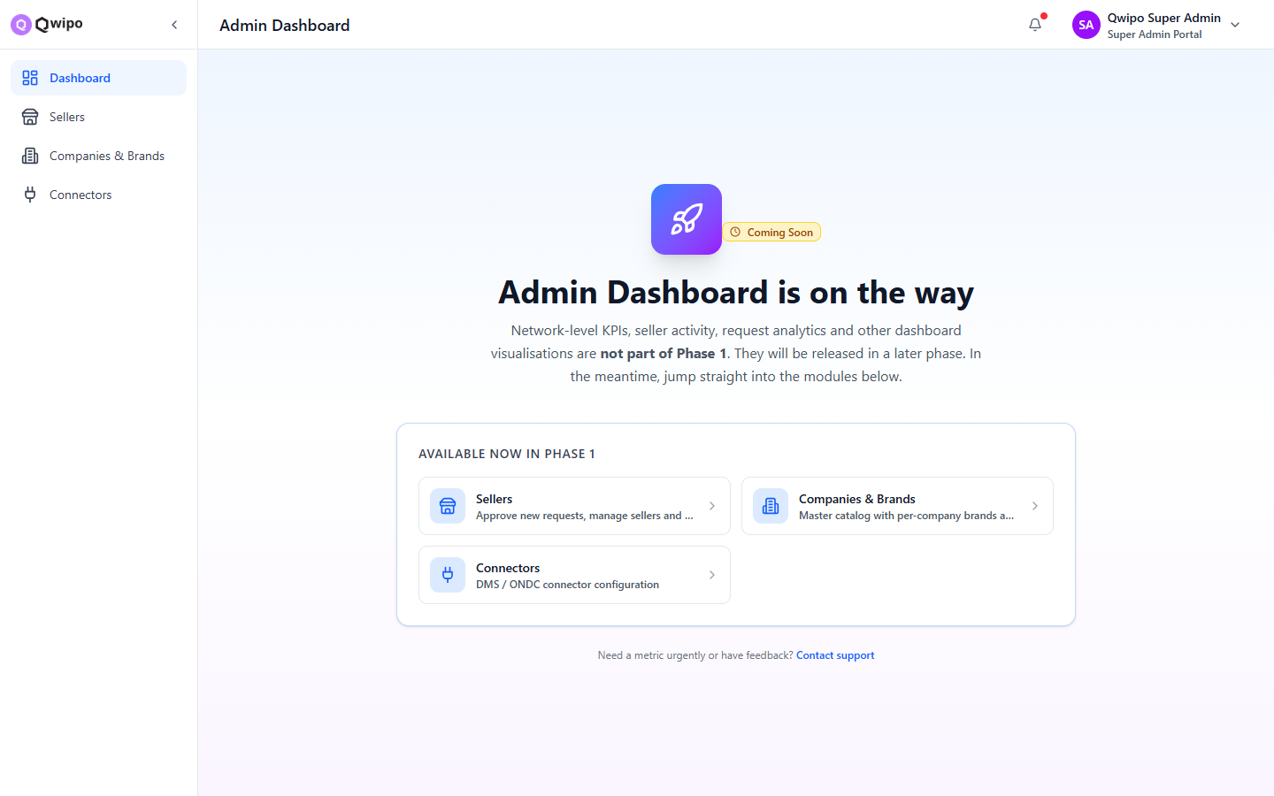
SUPER ADMIN
03
Phase 1 modules at a glance
Available now
Sellers
Approve, manage, edit seller accounts.
Companies & Brands
Master catalog with categories.
Connectors
DMS / ONDC connector configuration.
Requests
Pending seller approvals queue.
Qwipo · Phase 1 Walkthrough
Super Admin · Modules

Slide 6
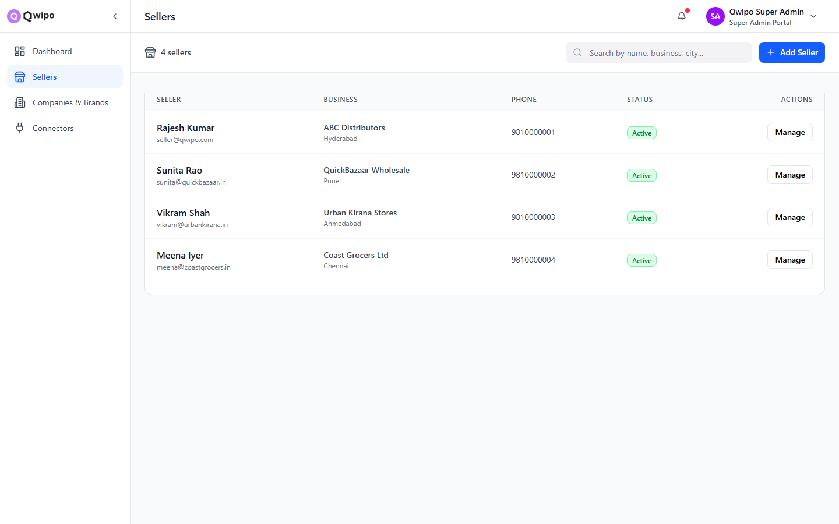
SUPER ADMIN · STEP 1
04
Open Sellers and click "Add Seller"
1
Open Sellers
2
Add Seller form
3
Assign brands
4
Save & activate
Why Sellers first?
Sellers list shows every distributor on the network
Search by name, business, city or phone
"Add Seller" creates a fresh account end-to-end
Click any row to open Seller Detail
Qwipo · Phase 1 Walkthrough
Step 1 of 4

Slide 7
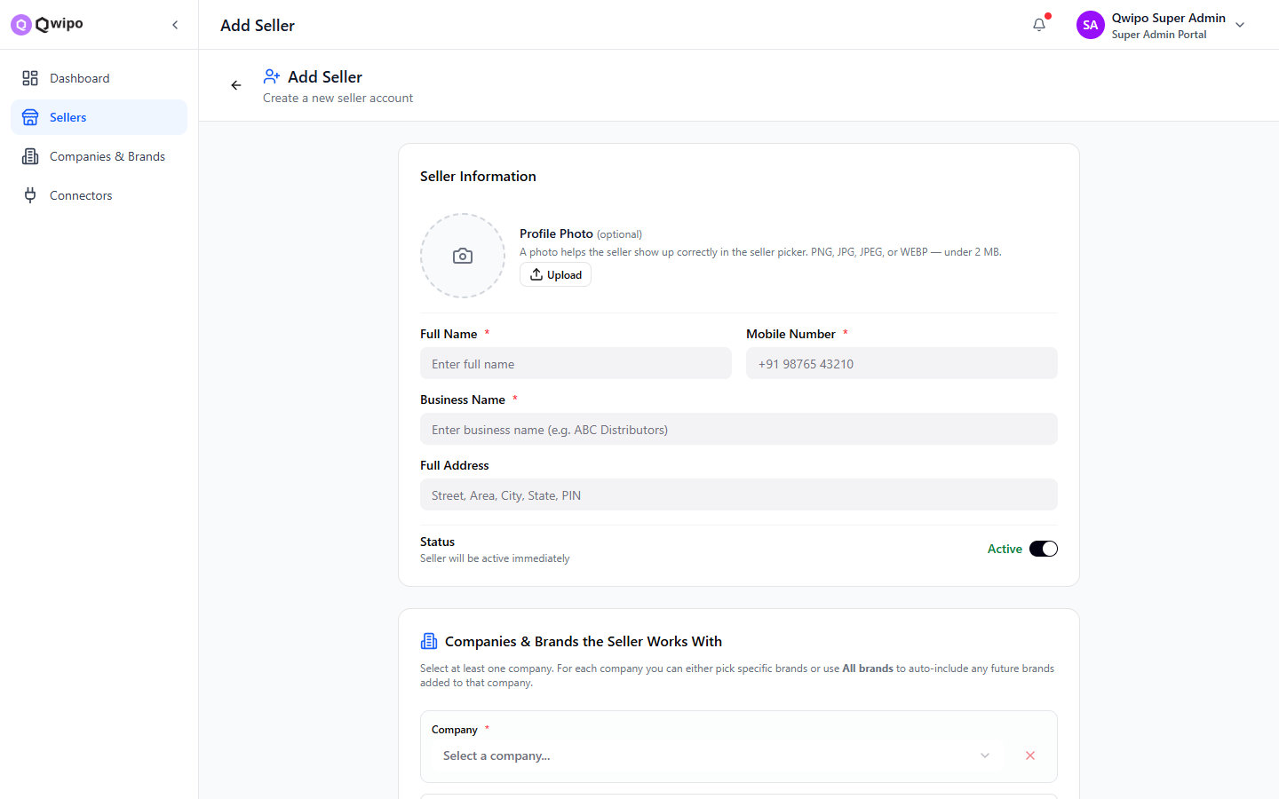
SUPER ADMIN · STEP 2
05
Fill out the Seller details
What to capture
Profile photo
Optional · helps in seller picker
Full Name *
Primary contact's name
Mobile Number *
Used for OTP login
Business Name *
Trading name of the distributor
Full Address
Street, area, city, state, PIN
Status toggle
Active by default — flip if you need to stage
Qwipo · Phase 1 Walkthrough
Step 2 of 4

Slide 8
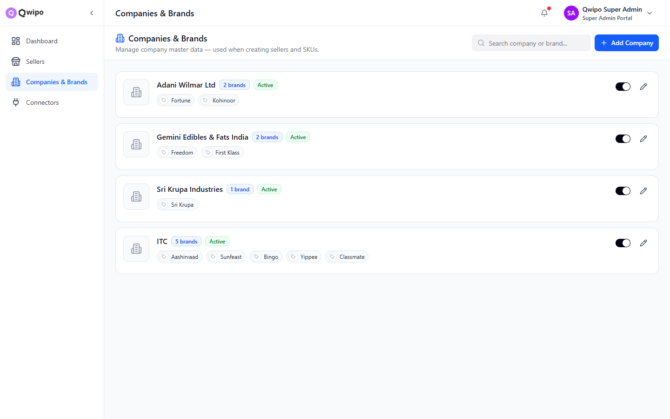
SUPER ADMIN · STEP 3
06
Assign Companies & Brands the seller works with
How assignment works
Pick at least one Company
1
Companies = manufacturers (e.g. ITC, HUL, Nestlé). They live in the master Companies & Brands module.
Choose specific brands or All
2
Either select individual brands, or use "All brands" to auto-include any future brands added to that company.
Stack multiple companies
3
Repeat the picker for every company the distributor carries. Each company can have its own brand mix.
Qwipo · Phase 1 Walkthrough
Step 3 of 4

Slide 9
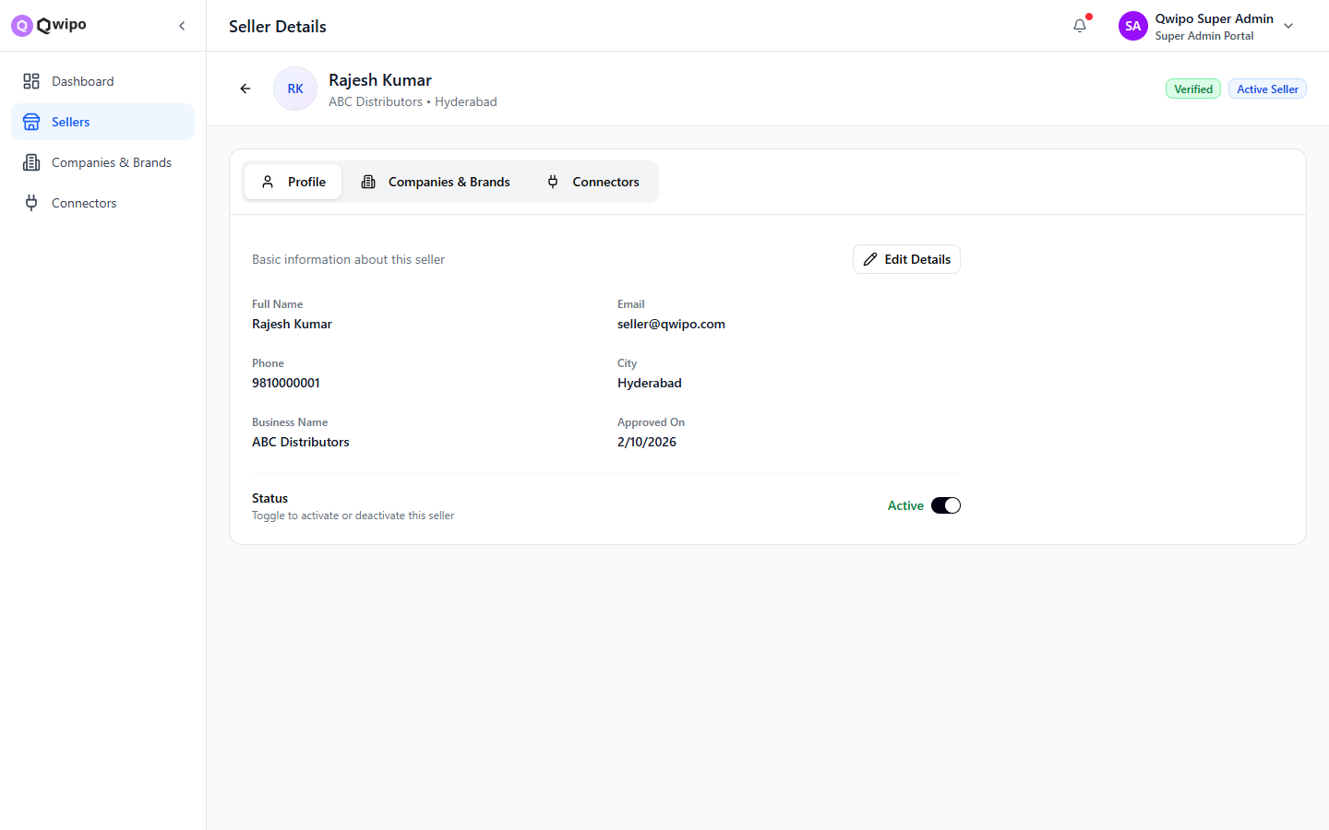
SUPER ADMIN · STEP 4
07
Save — distributor is live and editable
After Save
Account appears in the Sellers list
Mobile number can sign in via OTP
Seller Detail page opens for review
Edit Profile, brand assignment, status
Connectors tab lets you wire DMS / ONDC
Deactivate any time without losing data
Qwipo · Phase 1 Walkthrough
Step 4 of 4

Slide 10
SUPER ADMIN
08
Companies & Brands master data
Why this lives at the top
Companies
Manufacturer-level entities (ITC, HUL …).
Brands
Belong to a company; visible in seller picker.
Categories
Each company carries category tags for filtering.
Single source
Sellers can only pick from this master list.
Qwipo · Phase 1 Walkthrough
Companies & Brands

Slide 11
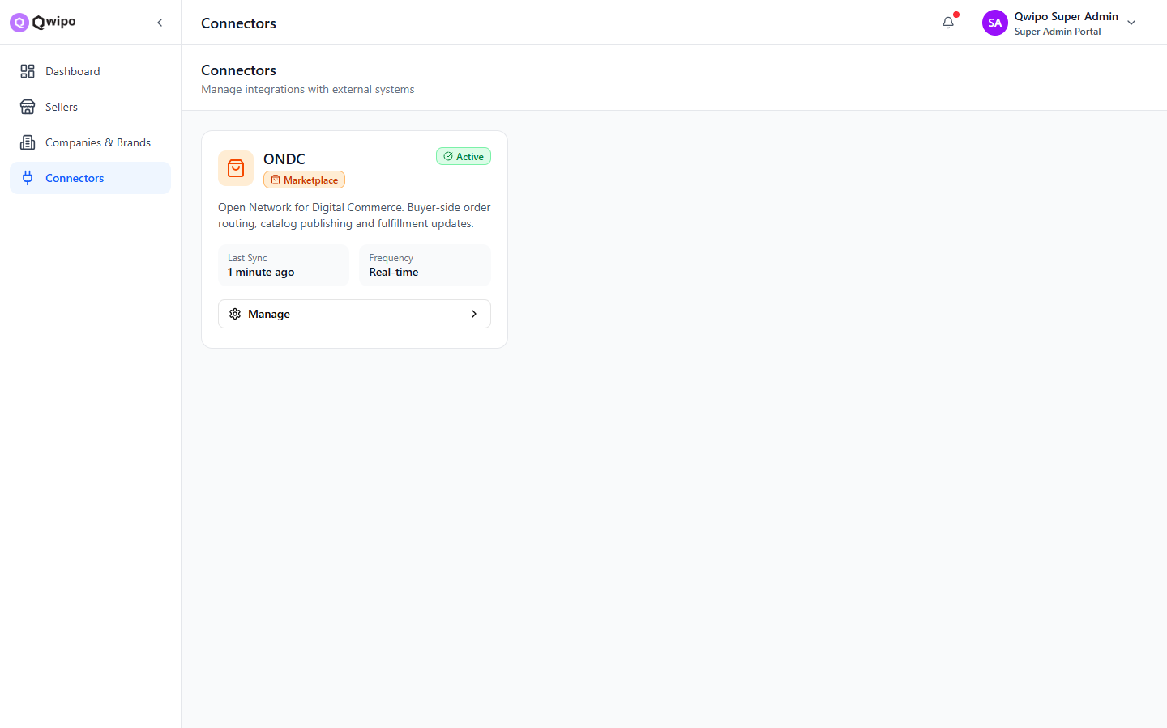
SUPER ADMIN
09
Connectors — DMS & ONDC plumbing
DMS
Distributor Management System sync — masters, stock, pricing.
ONDC
Open Network for Digital Commerce participation.
Per-seller config
Connectors can be wired from the seller detail too.
Qwipo · Phase 1 Walkthrough
Connectors

Slide 12
SUPER ADMIN
10
Distributor onboarding checklist
Create the seller account
Pick companies
1
2
Name, mobile, business name, address, status.
Add every manufacturer the distributor carries.
Assign brands per company
Wire connectors
3
4
Specific brands, or All to auto-include future ones.
DMS for stock & price, ONDC for digital commerce.
Activate
Monitor requests
5
6
Seller can now sign in via OTP at the same login screen.
Watch the Requests queue for approvals & changes.
Qwipo · Phase 1 Walkthrough
Onboarding checklist

Slide 13
PART 03
Seller Admin
Catalog · Inventory · Customers · Orders · Offers · Settings
My SKU
Add SKU
Orders
Customers
Offers & Schemes
Settings
Reports
KYC

Slide 14
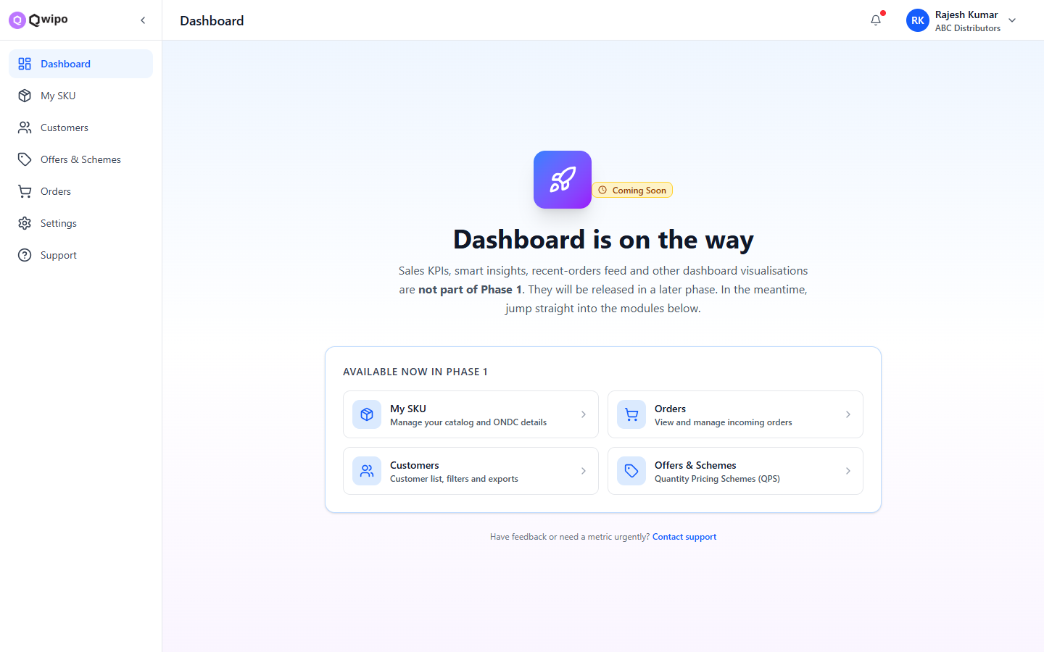
SELLER ADMIN
11
Phase 1 modules at a glance
Available now
My SKU
Catalog & ONDC details.
Orders
View & manage incoming orders.
Customers
Customer list, filters and exports.
Offers & Schemes
Quantity Pricing Schemes (QPS).
Qwipo · Phase 1 Walkthrough
Seller Admin · Modules

Slide 15
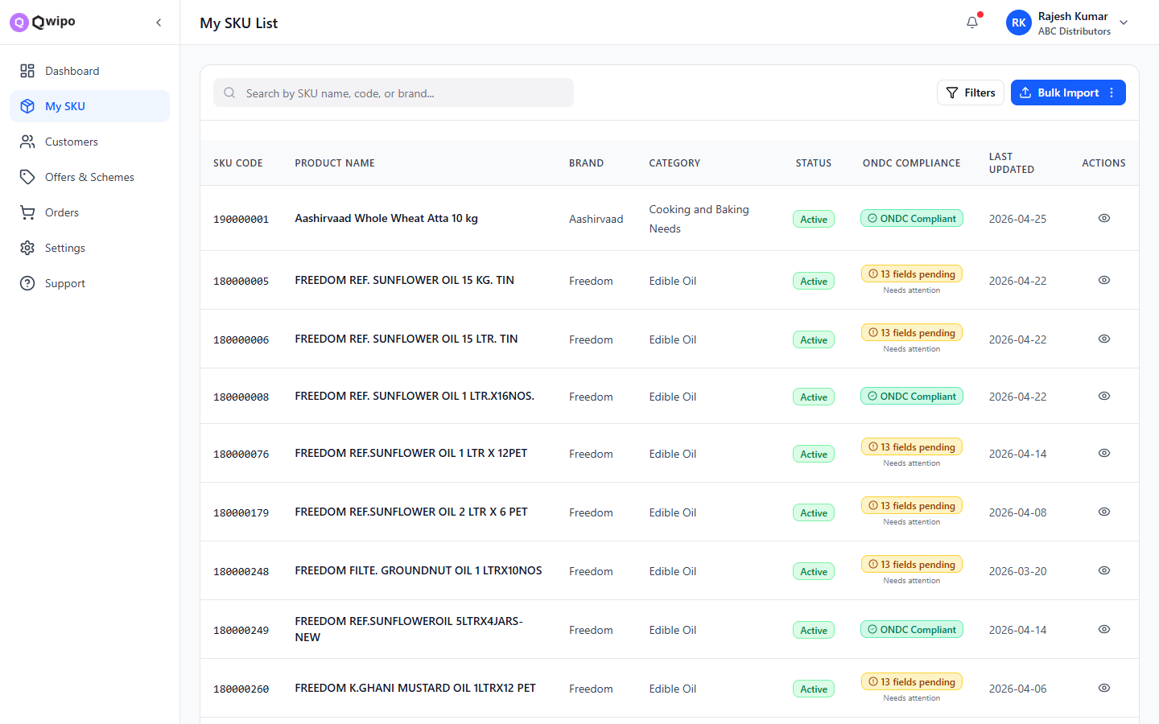
CATALOG · MY SKU
12
Every SKU the seller carries
Highlights
Filters by brand, category, status, ONDC
Search by name, code or HSN
Inline price & inventory edits
Click any row for SKU detail
Bulk actions for status change
Qwipo · Phase 1 Walkthrough
My SKU

Slide 16
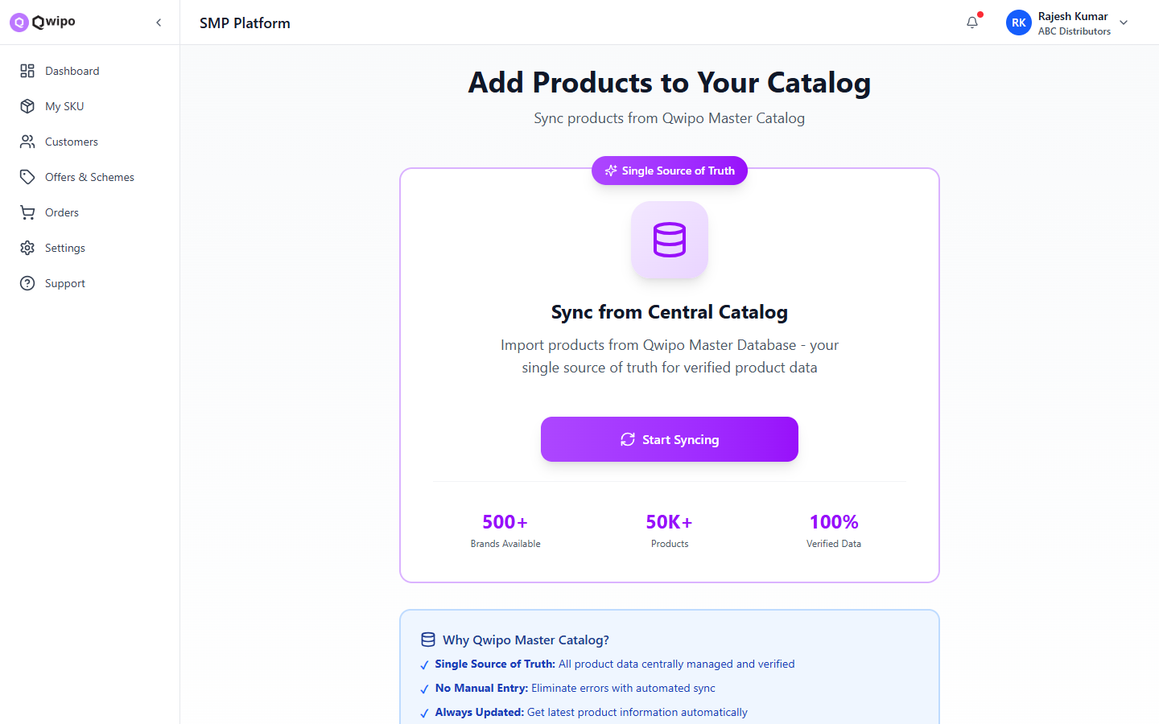
CATALOG · ADD SKU
13
Three ways to grow the catalog
Manual entry
1
One SKU at a time — full control over fields and ONDC attributes.
Bulk import
2
Upload a CSV / Excel template to onboard hundreds of SKUs.
Central Catalog Sync
3
Pull pre-validated SKUs from Qwipo's master catalog.
Qwipo · Phase 1 Walkthrough
Add SKU

Slide 17
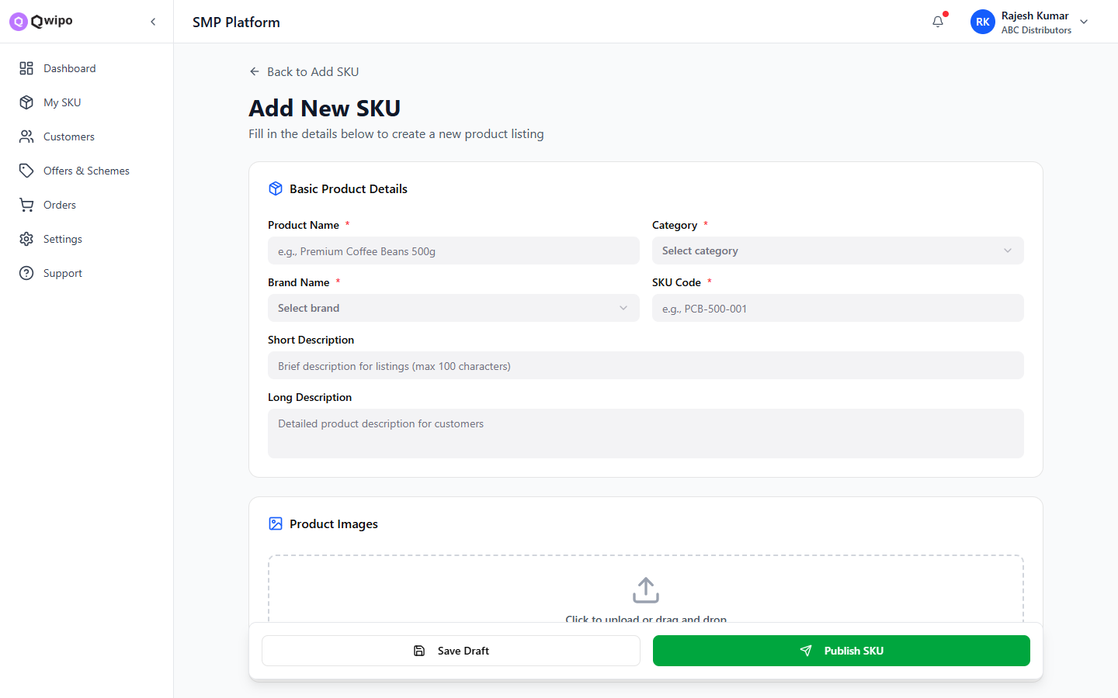
ADD SKU · MANUAL ENTRY
14
Capture product, price, ONDC and media
Identity
Name, brand, category, HSN
Pricing
MRP, list price, GST, discount tiers
Inventory
Pack info, MOQ, stock on hand
ONDC fields
Validation rules from the master sheet
Media
Primary image plus gallery
Qwipo · Phase 1 Walkthrough
Add SKU · Manual

Slide 18
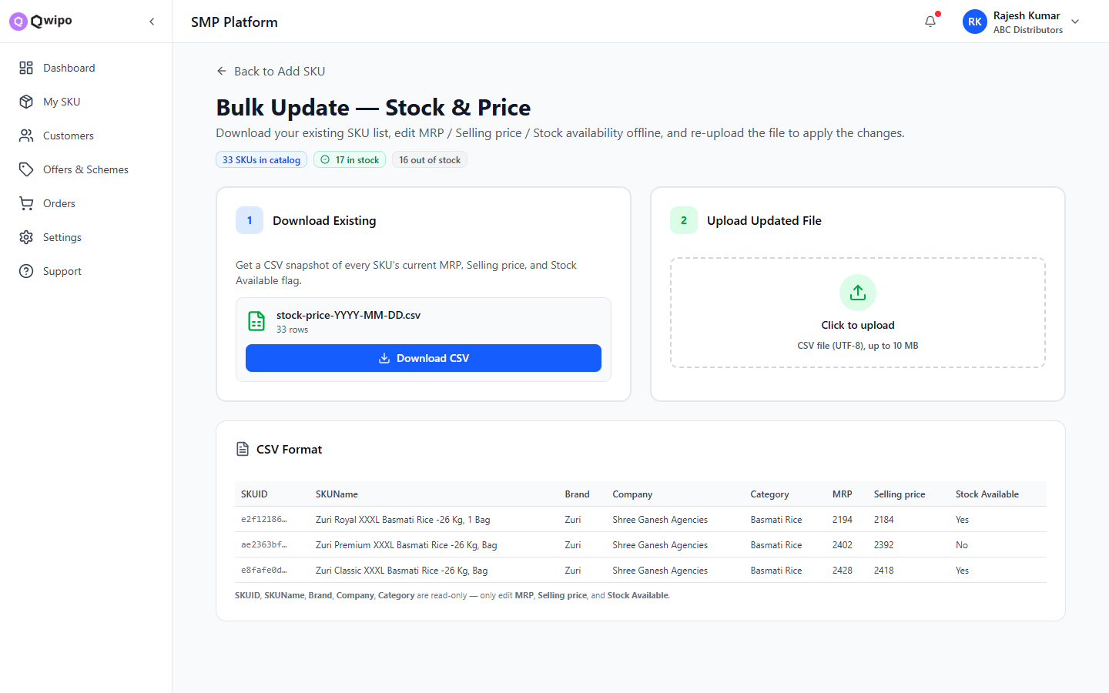
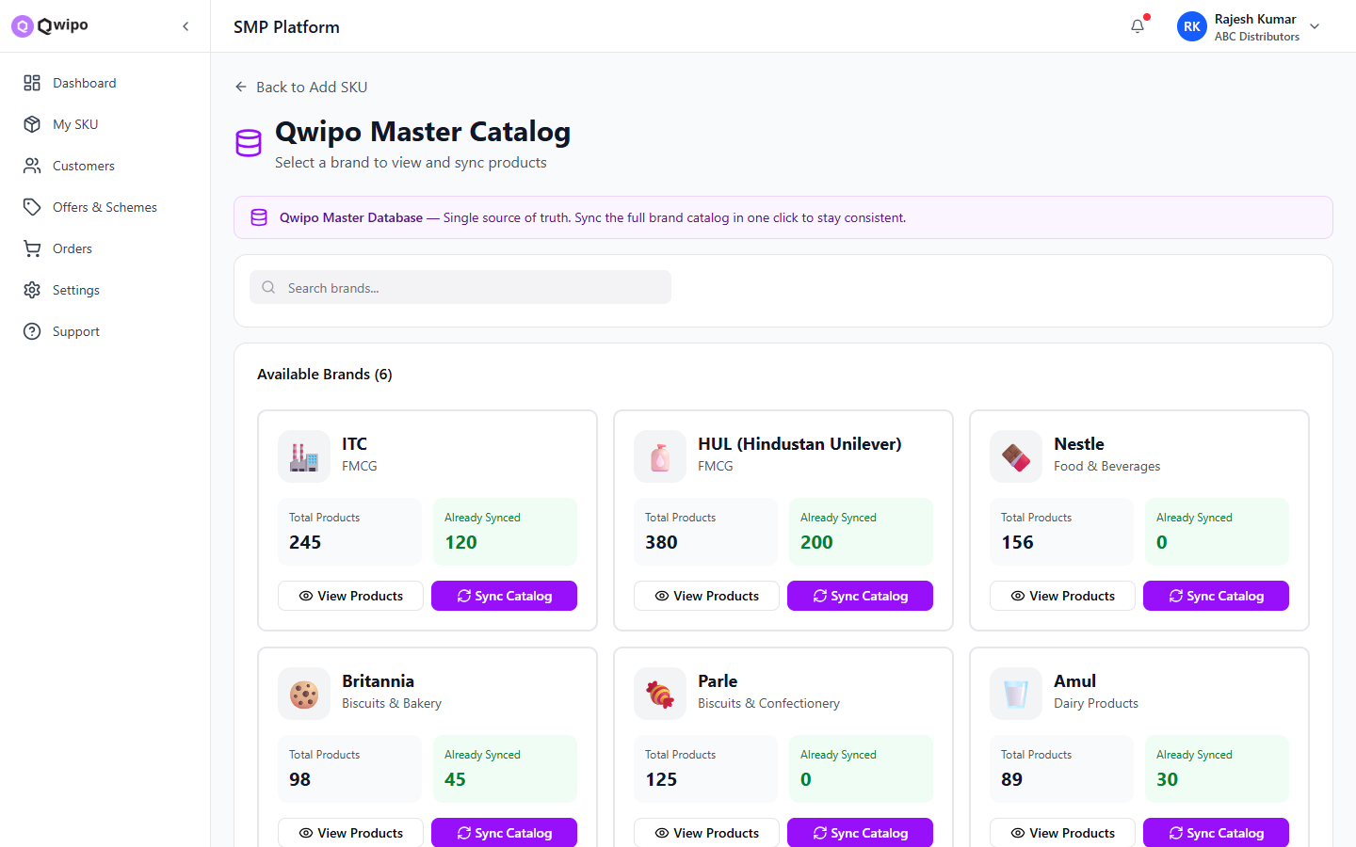
ADD SKU · AT SCALE
15
Bulk Import and Central Catalog Sync
Bulk Import
Central Catalog Sync
Download template (CSV / XLSX)
Upload completed file
Validation report flags ONDC errors
Commit valid rows in one go
Browse Qwipo's master catalog
Filter by brand, category, status
Pick SKUs and add them to your store
Pre-validated for ONDC out of the box
Qwipo · Phase 1 Walkthrough
Add SKU · Scale

Slide 19
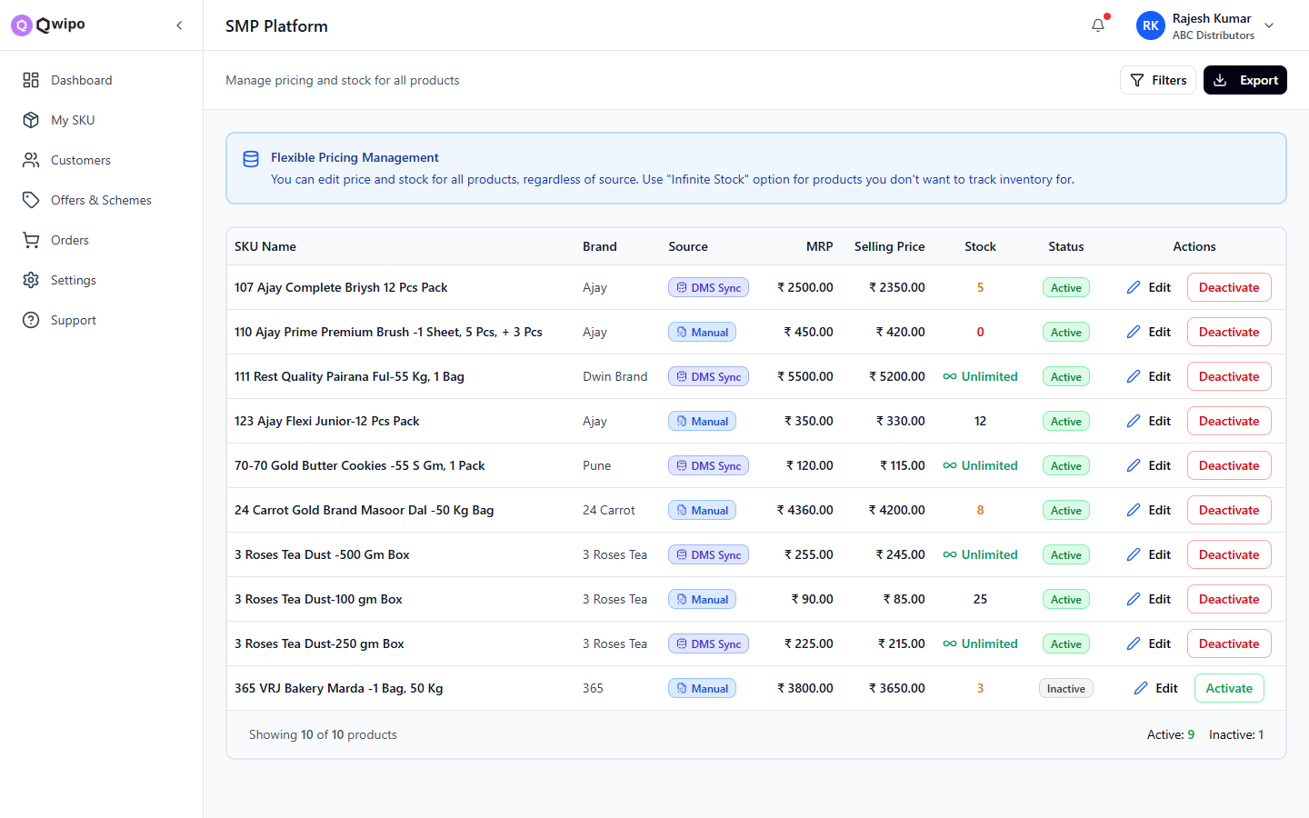
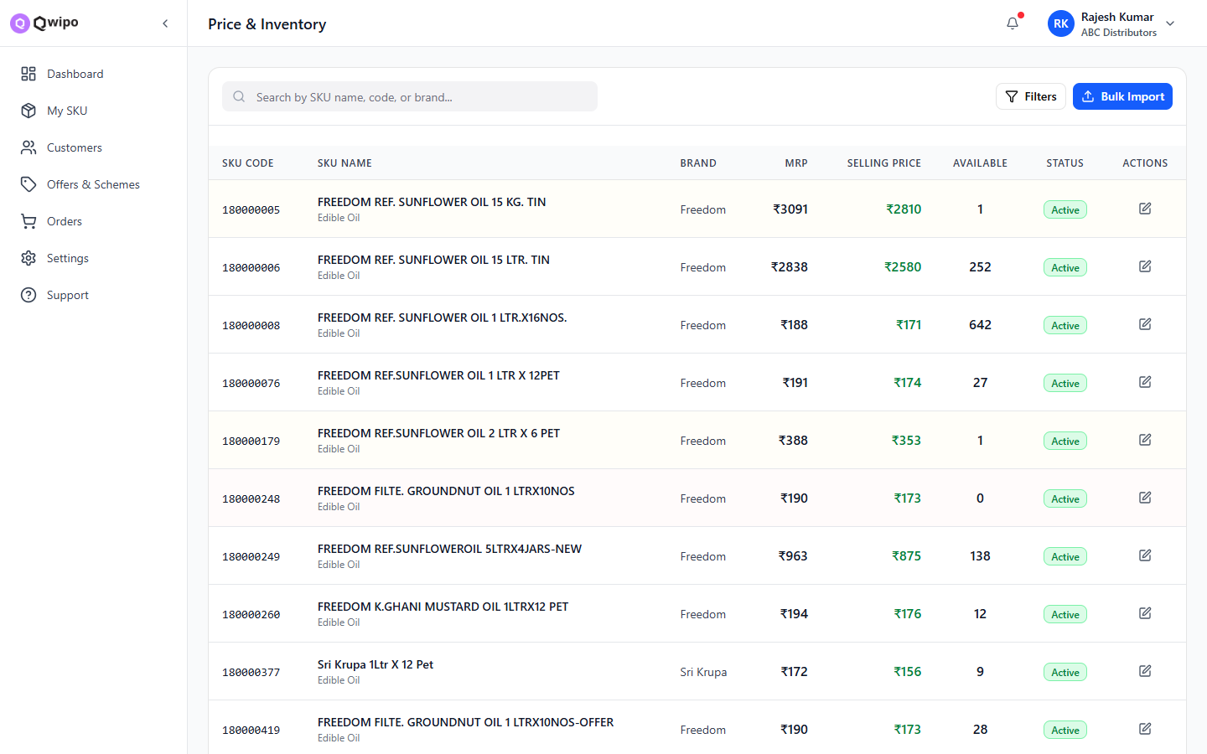
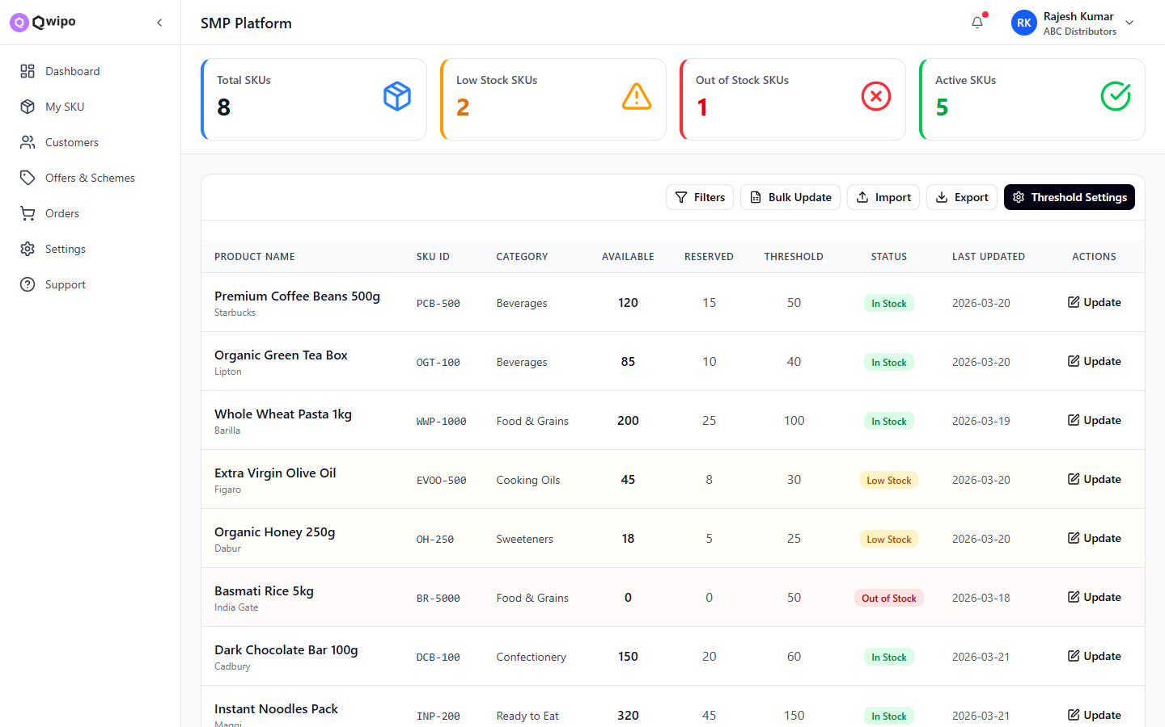
CATALOG · PRICING & STOCK
16
Price list, price-inventory, and stock at a glance
Price List
Price-Inventory
Inventory
Bulk-edit MRP, list price, GST and tier discounts.
Combined pricing + stock view for fast updates.
Stock on hand by SKU with low-stock signals.
Qwipo · Phase 1 Walkthrough
Pricing & Stock

Slide 20
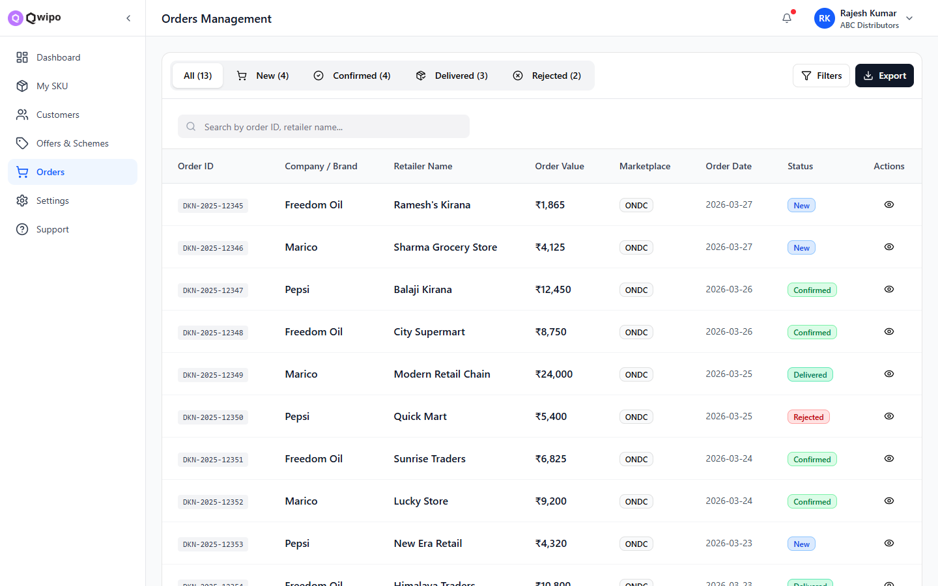
ORDERS
17
Track every incoming order in one queue
On the Orders page
Status pipeline — New, Processing, Shipped, Delivered
Channel filter — ONDC, Amazon, Flipkart, direct
Search by order ID or customer
Quick actions — accept, ship, cancel
Click any row for full detail
Qwipo · Phase 1 Walkthrough
Orders

Slide 21
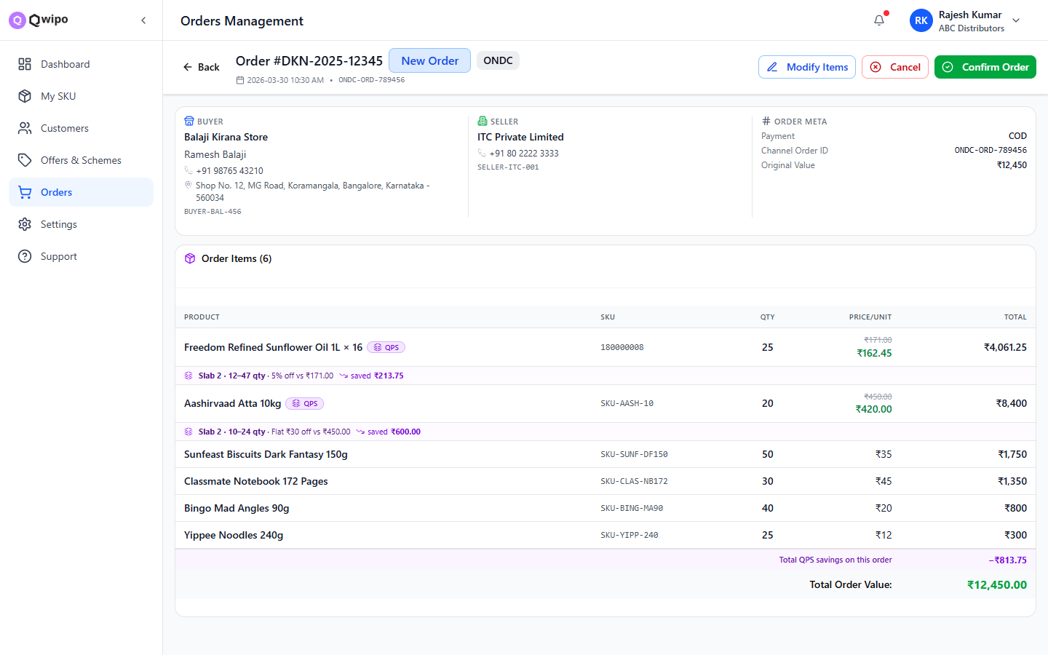
ORDERS · DETAIL
18
Everything about one order on a single page
Customer & address
Who placed it, where it goes.
Line items
SKU, qty, price, taxes, totals.
Timeline
Status changes with timestamps.
Actions
Accept, ship, cancel, invoice.
Qwipo · Phase 1 Walkthrough
Order detail

Slide 22
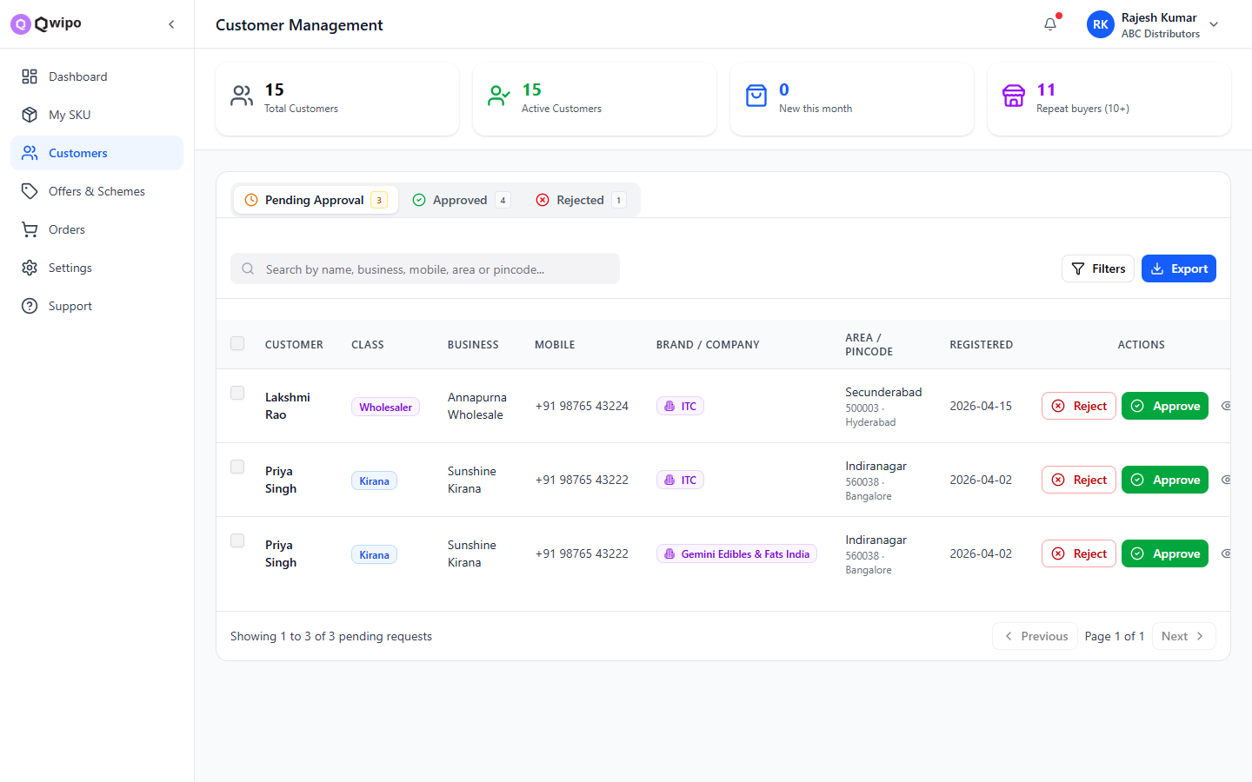
CUSTOMERS
19
All retailers who buy from this distributor
What you can do
Filter by company approval status
Selection key is customer + company
Bulk approve / reject / reopen
Export filtered list to CSV
Click row for full customer detail
Qwipo · Phase 1 Walkthrough
Customers

Slide 23
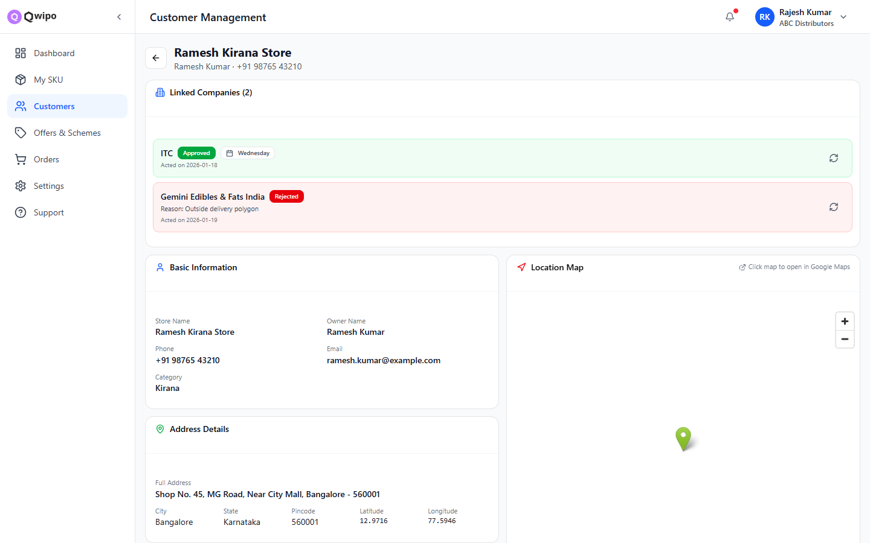
CUSTOMERS · DETAIL
20
Per-company approvals and history
Profile
Name, mobile, GSTIN, address.
Company approvals
Status across each brand company.
Order history
Past orders, totals, frequency.
Per-company actions
Reopen rejected, deactivate, edit.
Qwipo · Phase 1 Walkthrough
Customer detail

Slide 24
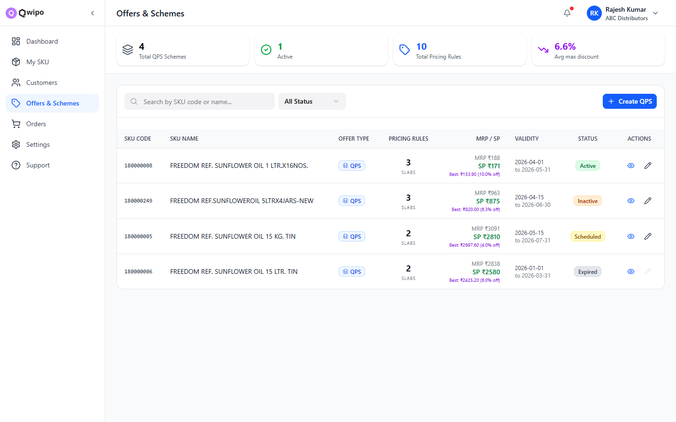
OFFERS & SCHEMES
21
Quantity Pricing Schemes (QPS)
Why QPS matters
Slab-based discounts that drive volume
Scope by brand, category or specific SKUs
Time-bound — start and end dates
Status filter — active, scheduled, expired
One-click duplicate to roll forward
Qwipo · Phase 1 Walkthrough
Offers & Schemes

Slide 25
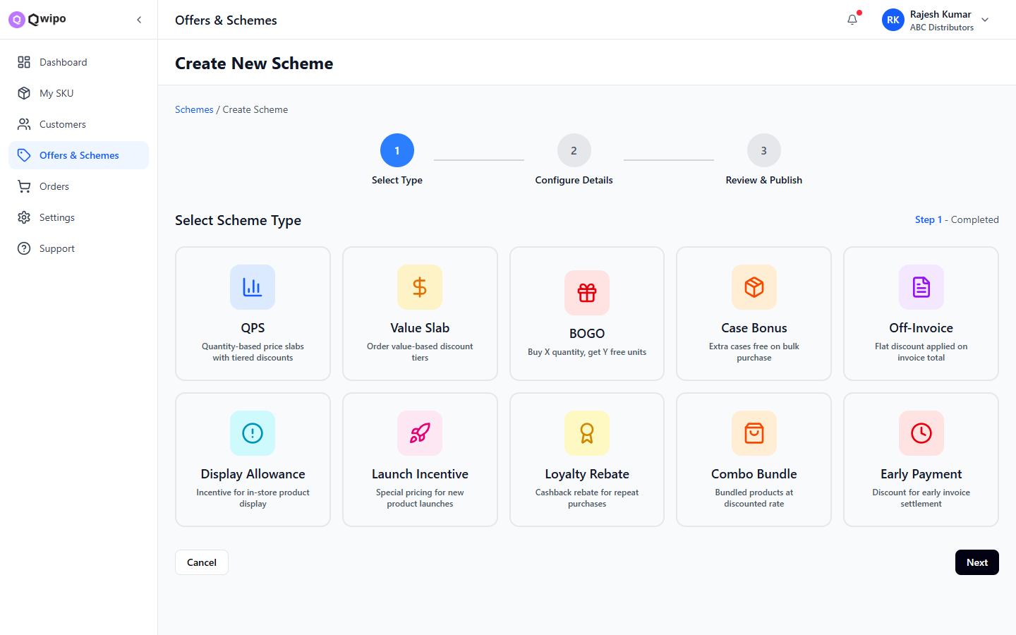
OFFERS · CREATE SCHEME
22
Build a QPS in four small steps
Pick a scope
1
All catalog, brand, category, or specific SKUs.
Define slabs
2
Buy ≥ N → discount %, or buy N get M free.
Schedule it
3
Start date, end date, time zone.
Save & activate
4
Visible to customers immediately on save.
Qwipo · Phase 1 Walkthrough
Create scheme

Slide 26
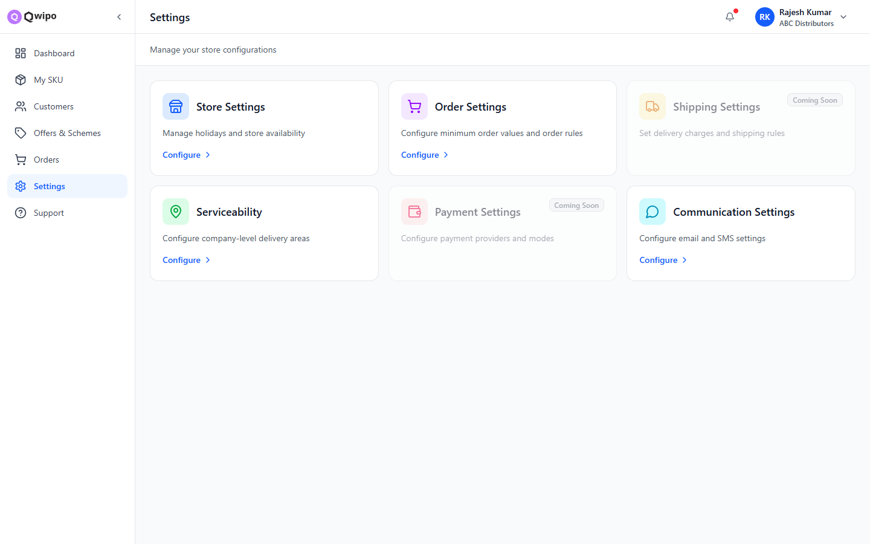
SETTINGS
23
Seven settings groups — configure once, run forever
Store
Branding, business info
Order
Order rules, prefixes, statuses
Shipping
Couriers, weight & rate cards
Serviceability
PIN codes you ship to
Payment
Methods, gateways, terms
Customer
Onboarding & approvals
Communication
SMS, email, WhatsApp templates
Qwipo · Phase 1 Walkthrough
Settings

Slide 27
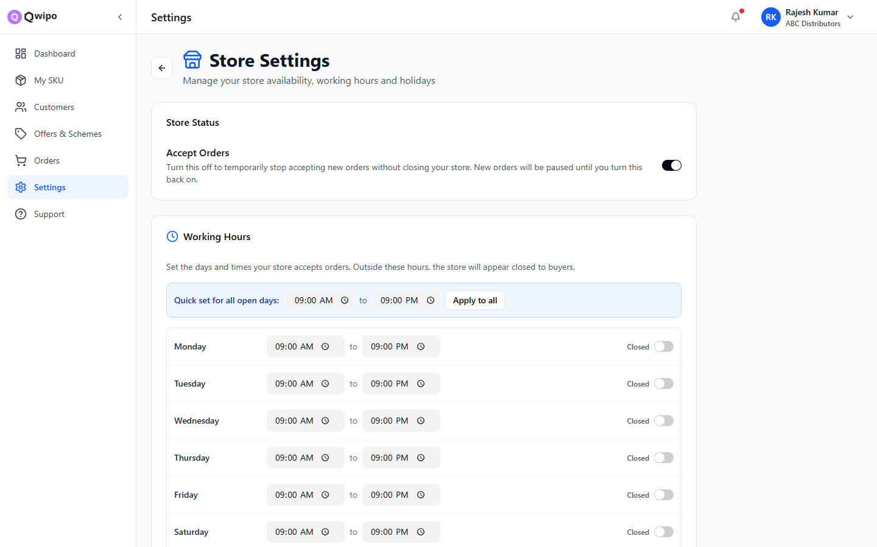
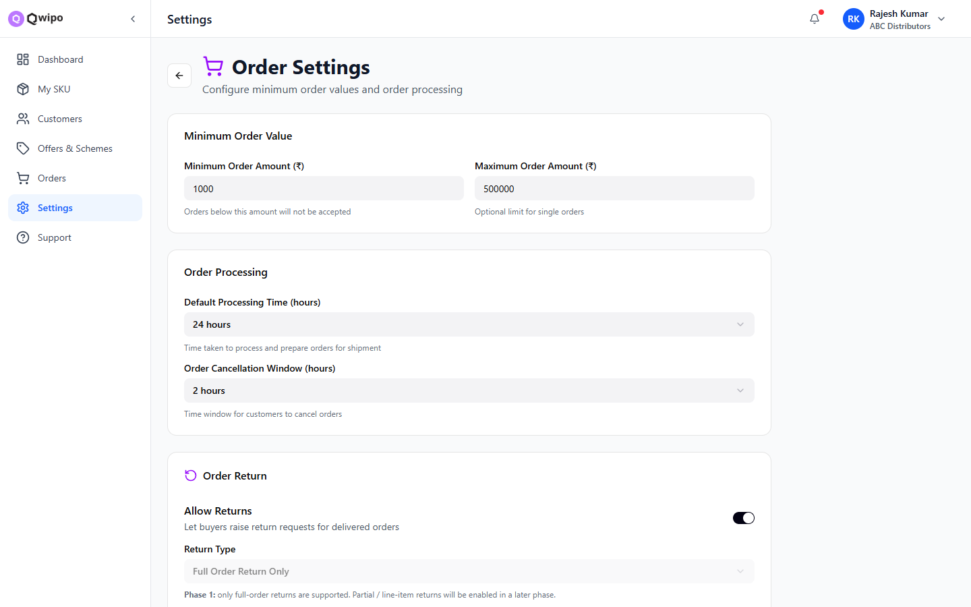
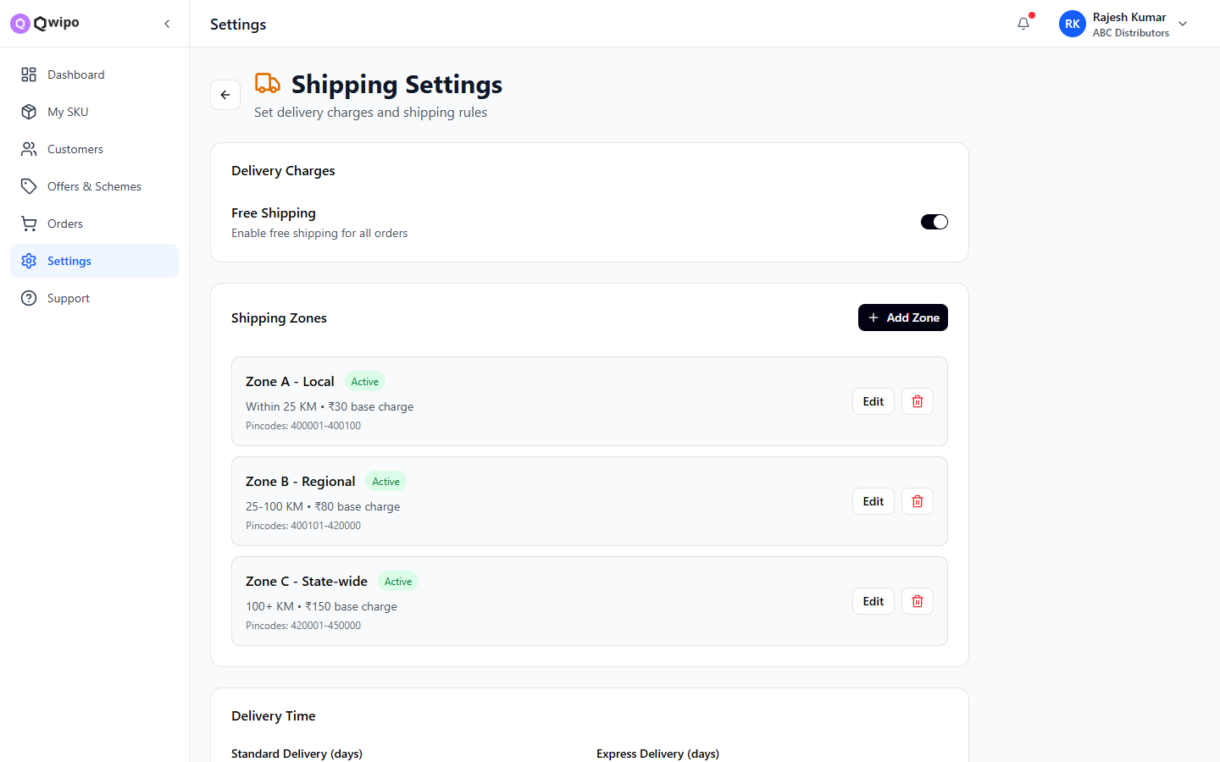
SETTINGS · OPERATIONS
24
Store, Order, Shipping
Store
Order
Shipping
Logo, business profile, registered address.
Order ID prefixes, default statuses, auto-cancel rules.
Carriers, weight bands, rate cards, packaging.
Qwipo · Phase 1 Walkthrough
Settings · Operations

Slide 28
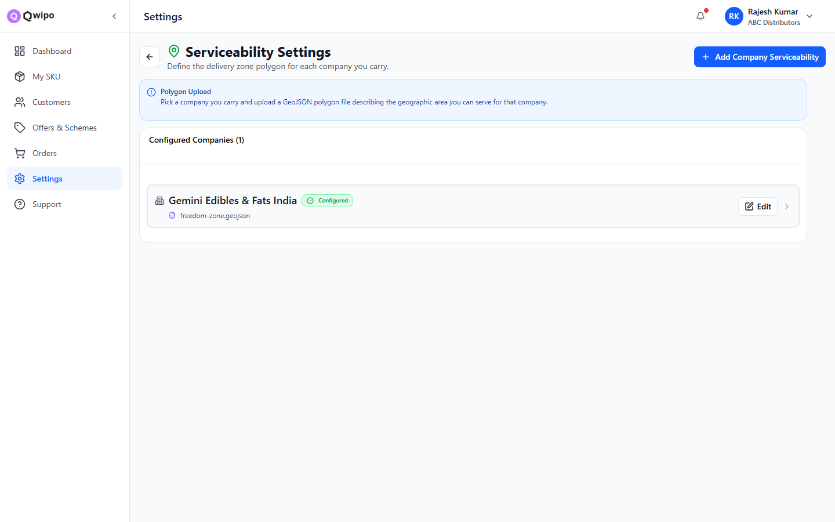
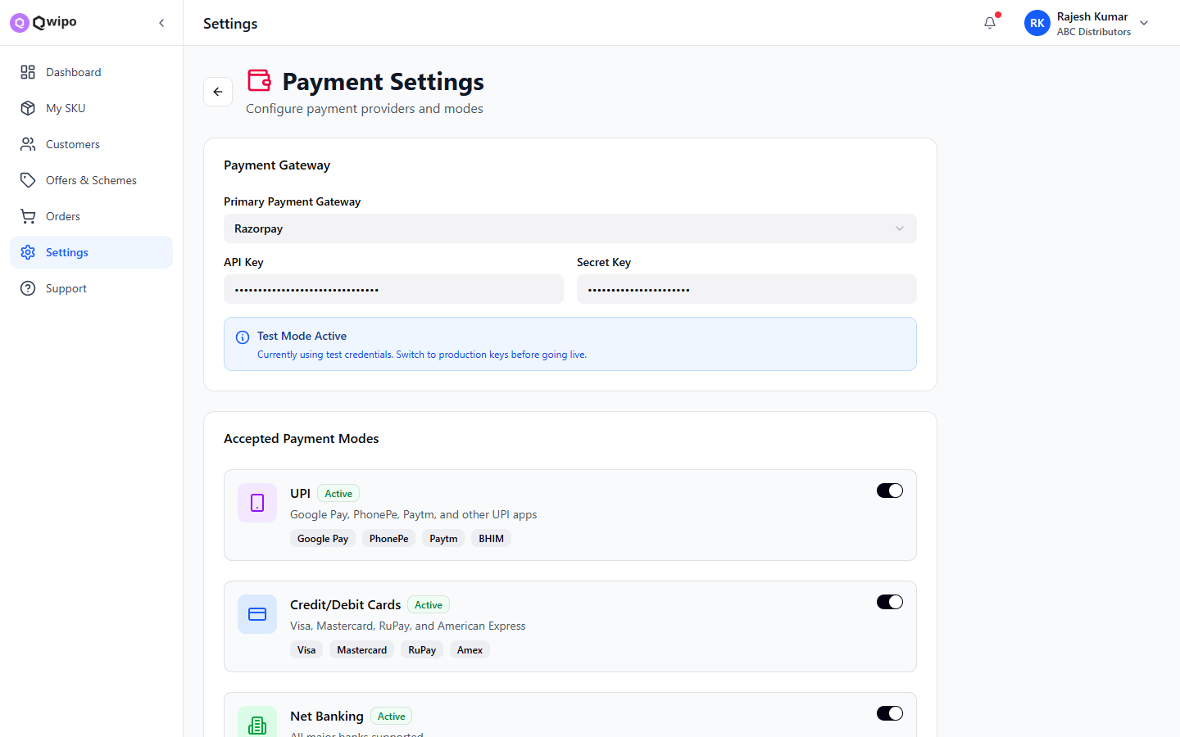
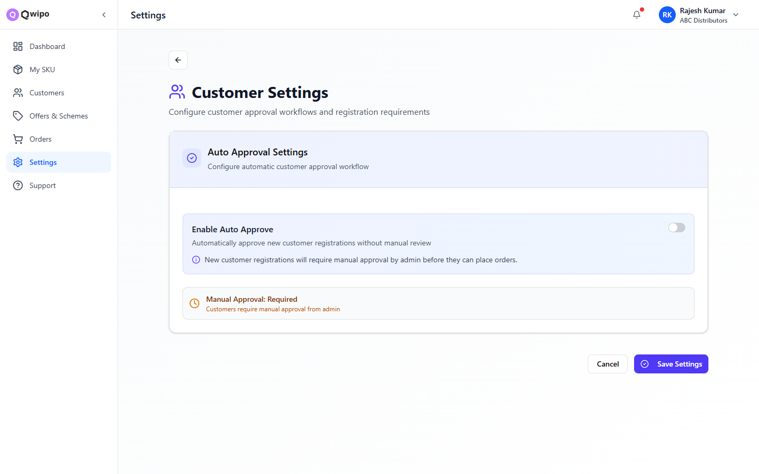
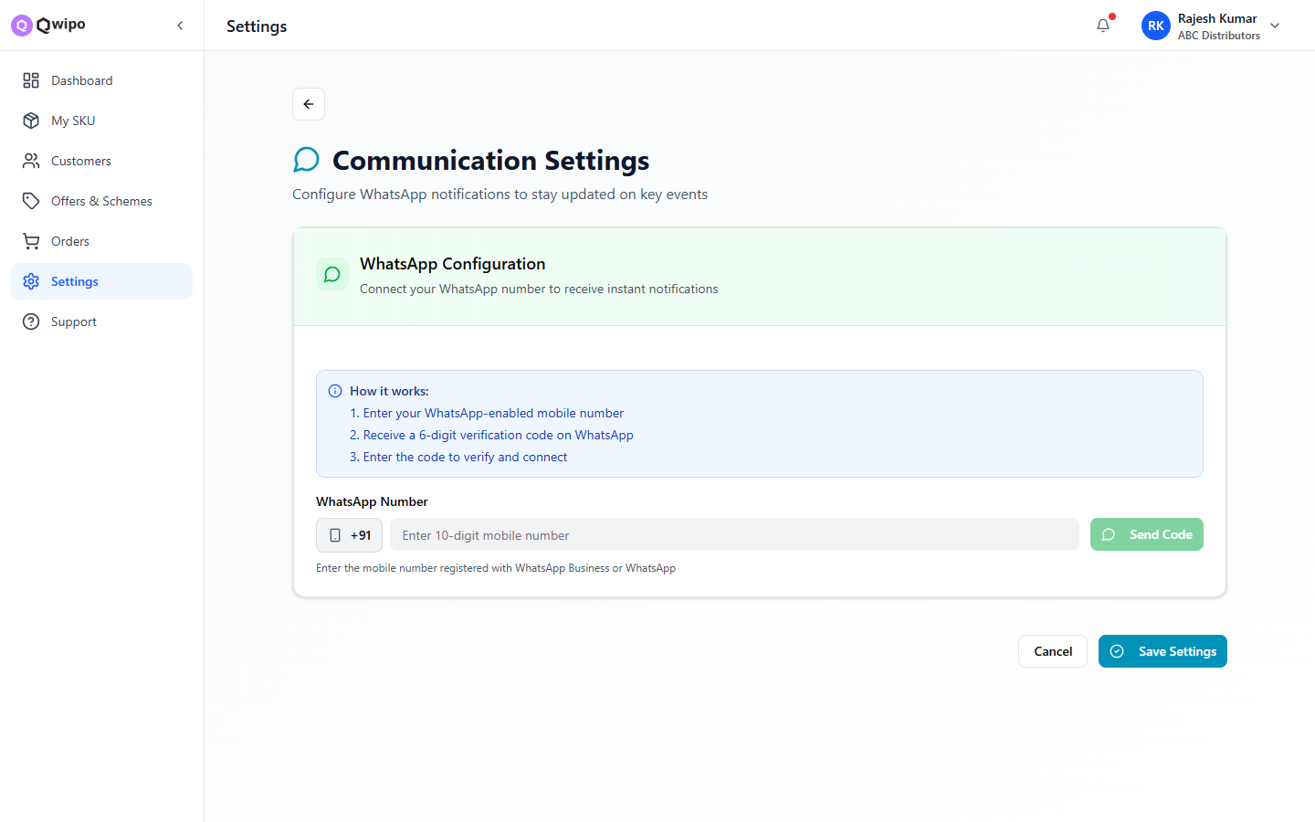
SETTINGS · CUSTOMER-FACING
25
Serviceability, Payment, Customer, Communication
Serviceability
Payment
Customer
Communication
Allowed PIN codes & zones.
Methods, gateways, credit terms.
Onboarding & approval policy.
SMS, email, WhatsApp templates.
Qwipo · Phase 1 Walkthrough
Settings · Customer-facing

Slide 29
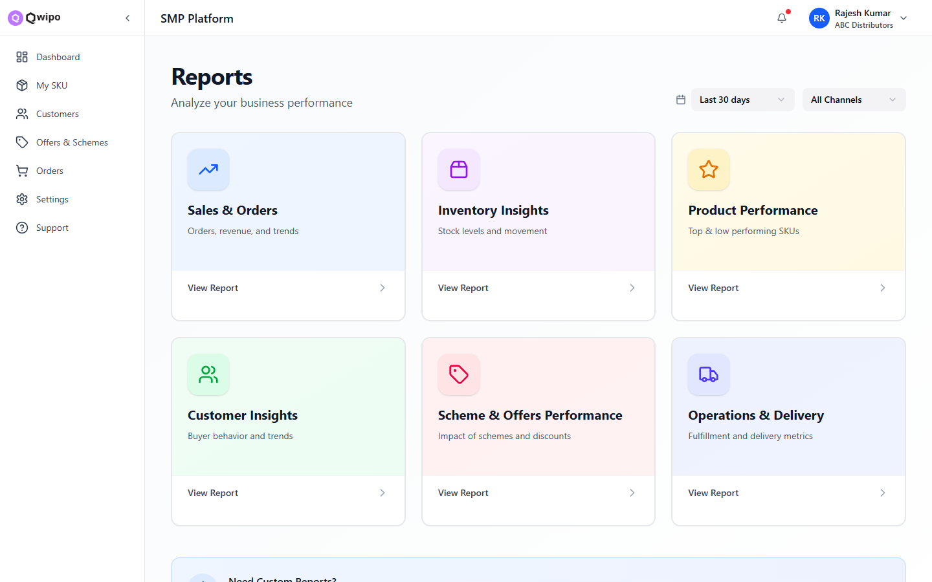
REPORTS
26
Six dashboards covering the whole business
1
Sales & Orders
2
Inventory
3
Product Performance
4
Customer Insights
5
Schemes & Offers
6
Operations & Delivery
Qwipo · Phase 1 Walkthrough
Reports

Slide 30
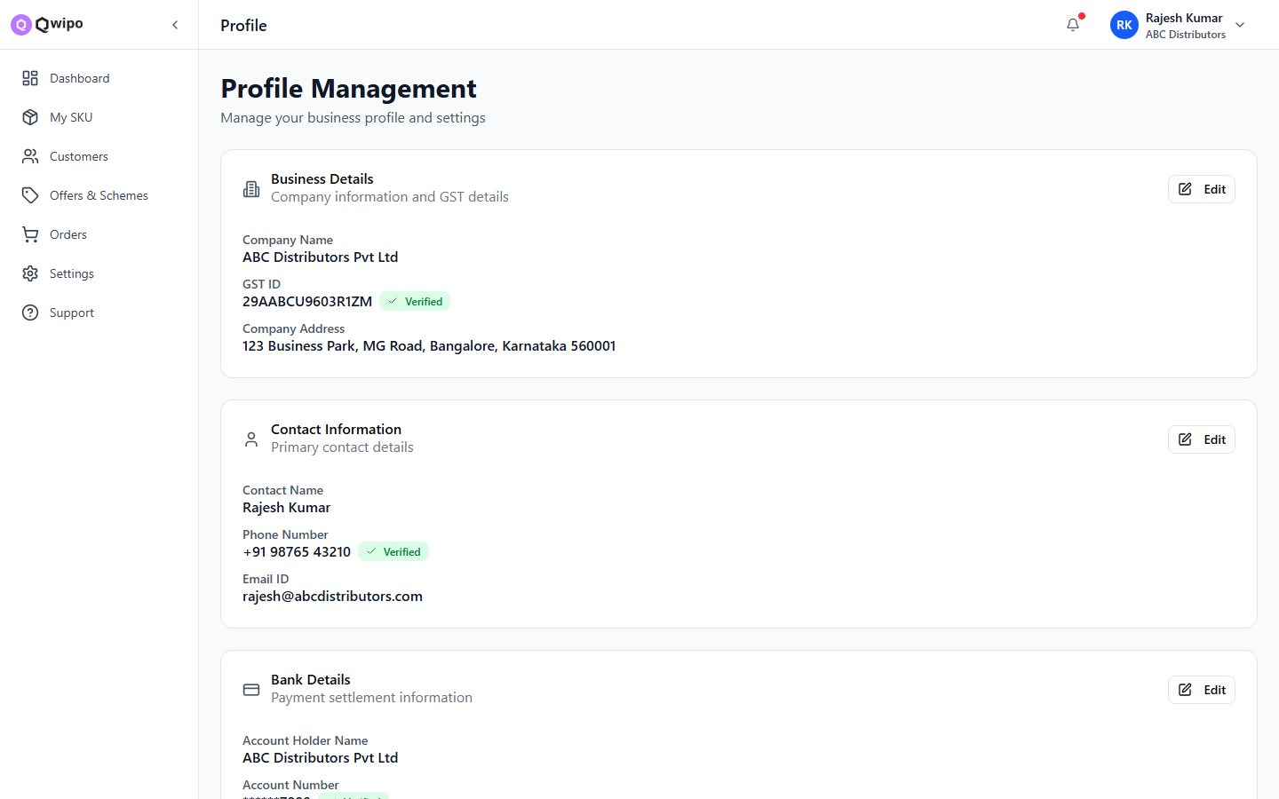
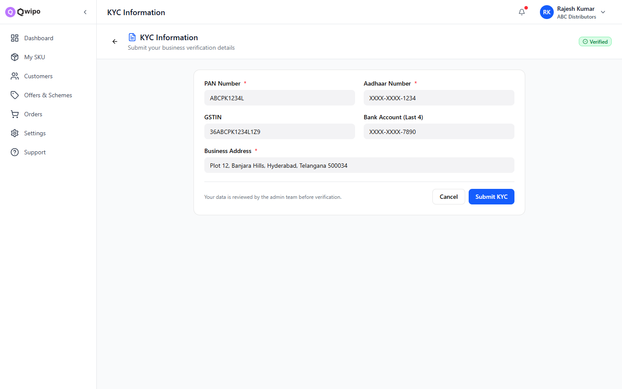
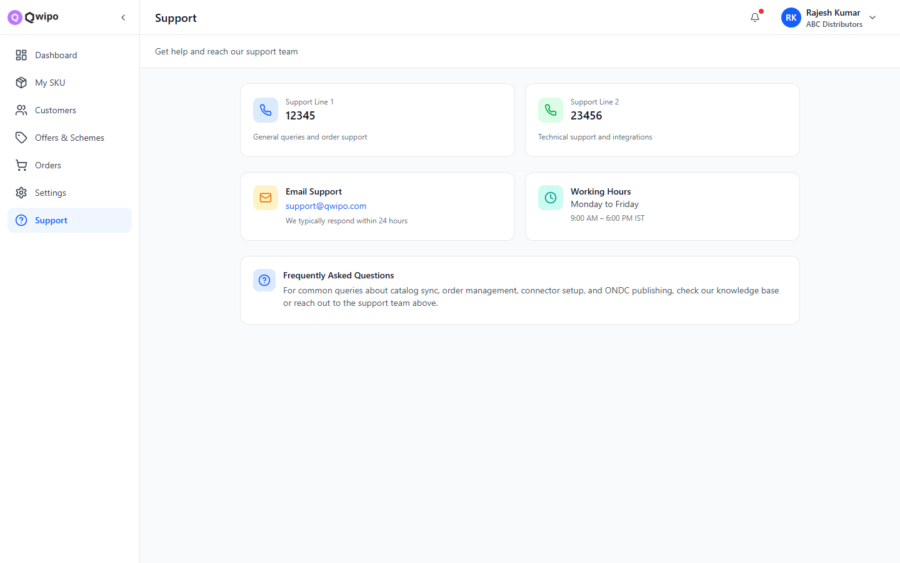
ACCOUNT · KYC · SUPPORT
27
Personal account essentials
Profile
KYC
Support
Personal info, password, mobile, role.
Upload PAN, GST, bank docs and track status.
Raise tickets, track resolution, FAQs.
Qwipo · Phase 1 Walkthrough
Account & support

Slide 31
RECAP
Two roles. One platform. Six steps to live.
Super Admin
Seller
Add seller (name, mobile, business)
Assign companies + brands
Wire DMS / ONDC connectors
Activate & monitor requests
Build catalog — manual / bulk / central
Set price list and inventory
Approve customers, run offers (QPS)
Configure settings, watch reports
Thank you.

