Slide 1
Smart fire control ,
scientific disaster prevention
——Intelligent distributed escape system design
Principal(Yueyuan Liu) Email：229262167@qq.com

Slide 2

SUMMARY
Based on wireless sensor network technology, the project uses sensor technology and image recognition algorithms for intelligent identification and effective early warning of sudden natural disasters, terrorist attacks, fires, etc., and uses 3D modeling to construct regional models for trapped personnel to make effective 3D positioning, and use image recognition algorithm and path algorithm to avoid obstacles on the escape path, and combine the improved artificial potential field escape algorithm with the wireless sensor network and the data information of the upper computer to intelligently plan the optimal escape route to realize the shunt evacuate, in order to maximize the use of escape routes, and guide the public to achieve rapid self-help. At the same time, the rescuer's terminal displays the disaster area of the building , the dangerous goods presence area, etc., assists rescuers to establish rescue routes, speeds up rescue, shortens rescue time, and assists rescuers in accurate rescue.

Slide 3
1
Demand background Domestic status , Potential demand
2
Project Introduction Application Technology , Key Technology
Content
3
Team member Team member , Instructor
4
Future planning Expected economic , Social benefits

Slide 4
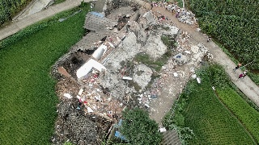
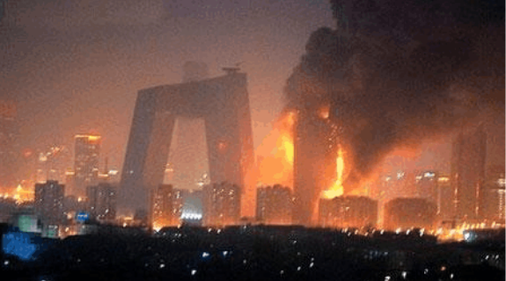
Demand background - domestic status
At 22:55 and 23:36 on June 17, 2019, earthquakes of magnitude 6.0 and 5.1 occurred in Changning County and Qixian County of Sichuan Province respectively. As of 15:00 on June 25, the earthquake caused 17 townships (towns) and 118,321 people to be affected. Four people were killed and 128 people were injured (93 in the town of Yanchang, 8 in Zhenquan Town, and 2 in Didong Town). On June 22, 25 people were injured after the 5.4-magnitude earthquake in Minxian County, 31,654 people were resettled due to disaster transfer (11,953 people were concentrated and 19,701 people were dispersed); 24,485 houses were damaged (69 houses were collapsed, 10,859 houses were seriously damaged) , generally damaged 13,557 houses).
In 2018, the country received a total of 237,000 fires, 1,407 people were killed and 798 people were injured. The direct property loss has been calculated to be 3.675 billion yuan.
In the first quarter of 2019, the country received a total of 73,200 fires, 418 deaths, 206 injuries, and direct property losses of 785 million yuan, down 11.6%, 16.6%, 22.6%, and 19.3% from the same period last year. Among them, 17 fires occurred.

Slide 5
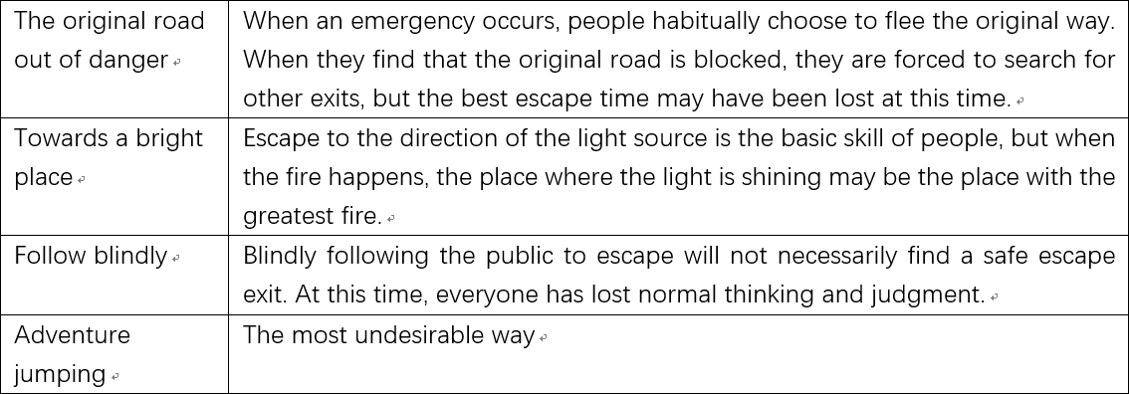
Demand background - domestic status
Common mistake way to escape
The construction of modern cities is developing at a high speed, and buildings with large-scale, high-rise buildings and complex structures have become more and more popular. In many public gathering places with high staff intensity and huge staff turnover, such as shopping malls, large supermarkets, factory workshops, etc., the building area is huge, and the corridors in the building are diverse and varied, and the situation is complex and changeable. If a disaster such as an earthquake or a fire occurs in such a building, if the internal escape personnel cannot obtain an effective escape evacuation instruction or guide the scene to escape the disaster, and quickly travel to the safe area, the consequences are incalculable. There may be huge casualties. In addition, the evacuation plan should be planned for emergencies such as terrorist incidents. Considering the existence of these emergencies, the establishment of an intelligent distributed escape system is conducive to increasing the surviving rate of personnel. It is very necessary.
The right way to escape
Don't panic to run outdoors | If you run out, broken glass, bricks on the roof, billboards, etc., is very dangerous
Protect the head | Protect the head when the earth shakes violently and stands unsteadily
Go hiking during refuge | Under the leadership of the responsible person and the police, the method of taking refuge on foot should be carried out at a minimum.
Don't listen to rumors, don't act rashly | To prevent confusion, it is extremely important for everyone to act calmly based on the right information.

Slide 6
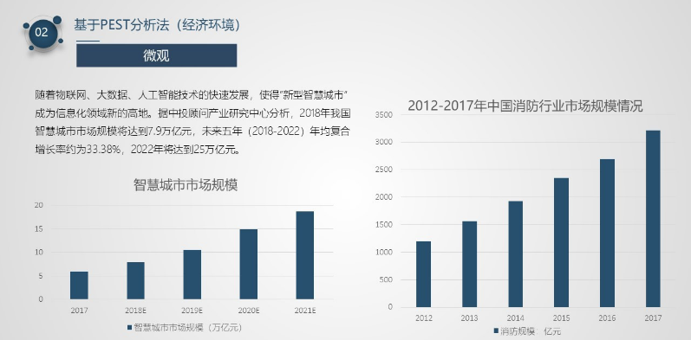
Demand background - potential demand
On November 22, 2018, the fire industry think tank team lasted more than three months of investigation, consultation, research and summary, and released the "2018 Smart Fire Industry Development Service Report". The report pointed out that China invested about 500 billion yuan in the fire protection industry in 2018.
Pulse
Lack of professional escape system science judgement
auscultation
Lack of advanced scientific monitoring techniques
diagnosis
Lack of a large amount of scientific effective warning data

Slide 7
Competitive product analysis
Principle | Company | Detection accuracy | Early warning principle | Early warning method
Location Algorithm | Shandong Lanjian Logistics Technology | ±3m | Ultrasonic positioning | SMS, app, sound and light alarm
 | Beijing Magic Technology Nano Technology | ±3.5m | Naive Bayes
 | Chengdu Jiangye Optoelectronics Technology | ±3m | UWB trilateral positioning
 | CITIC Heavy Industry Machinery | ±2.5m | APIT positioning
Path planning algorithm | Shanxi Keda Automation | ±3m | Dijkstra algorithm | light alarm
 | Triple Robotics | ±2.5m | Bellman algorithm
 | Jiangsu Riel Medical Technology | ±2m | Johnson algorithm
 | Shenyang Shangxian minimally invasive medical equipment | ±2.5m | SPFA algorithm
Zigbee indoor positioning | This project (Combined path planning algorithm and indoor positioning algorithm) | ±0.8 m | Location fingerprint localization algorithm | SMS, app, sound and light alarm
Improve artificial potential field |  | ±0.5 m | Artificial potential field algorithm
At present, the path planning algorithms and indoor positioning algorithms on the market are mostly targeted to certain specific areas, and the recognition accuracy needs to be improved.
The project combines the path planning algorithm with the indoor positioning algorithm and applies it in the intelligent escape system. By improving the performance of the algorithm, the recognition accuracy is improved, and the technical support for the prompt of the subsequent warning information is provided.

Slide 8
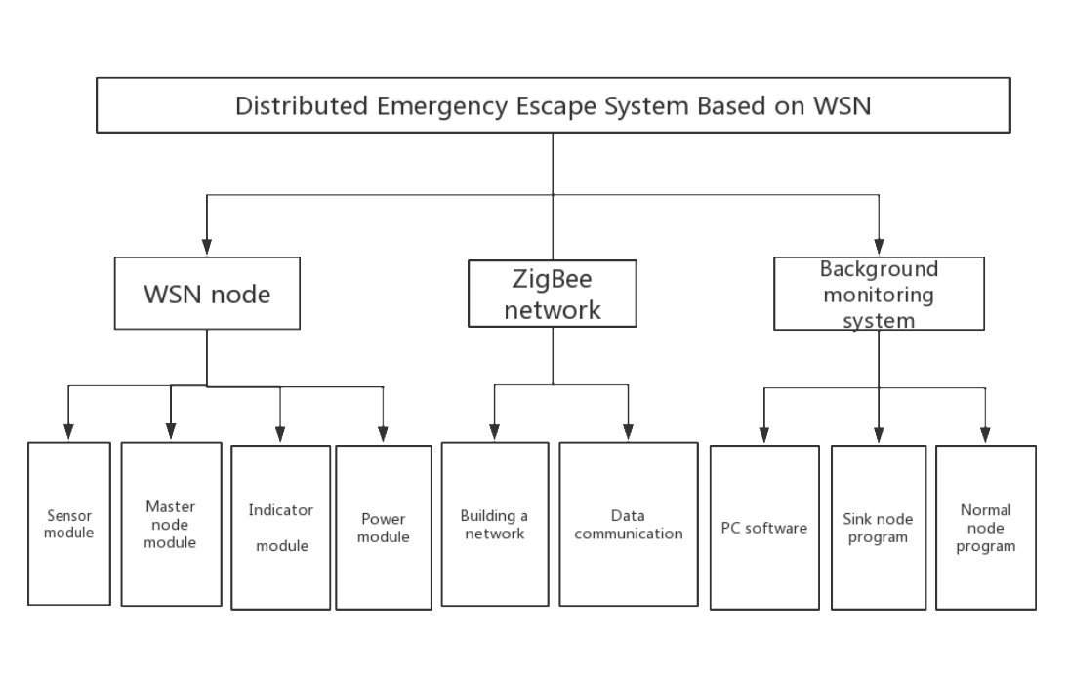
Project Introduction - Application
Two-dimensional plan diagram of distributed emergency escape guidance system
Design:
Application scheme: In order to solve the requirements of distributed escape system, Zigbee cc2530 is used to form a wireless sensor network, collect sensor information in the LAN, communicate data with the host computer in real time, and improve on the original traditional escape algorithm, in order to improve the algorithm. The accuracy is added to the image recognition algorithm for assistance. The above position machine is the core, and each module is controlled by virtual instrument technology to coordinate the work, complete the algorithm writing, testing and data analysis. This set of solutions solves the problem of the traditional distributed escape system, achieves the purpose of testing, and saves the problem. A lot of testing time.

Slide 9
Project Introduction - Application
Monitoring, early warning
escape
Rescue
Sensor module real-time monitoring
ZigBee networking
IBM PowerAI Vision and image recognition technology
Disaster information real-time crawling
Improved artificial potential field escape algorithm combined with cellular automata algorithm
Image recognition algorithm combined with path algorithm
Mobile APP escape tips
Escape sign dynamic confirmation
3D modeling build area model
Indoor positioning algorithm for 3D positioning
Disaster information prompts, assisting in the development of rescue routes

Slide 10
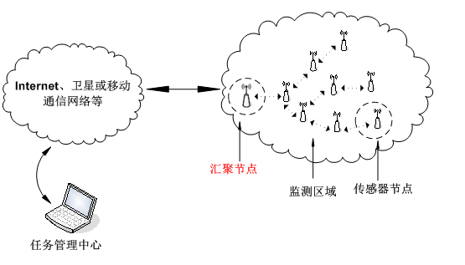
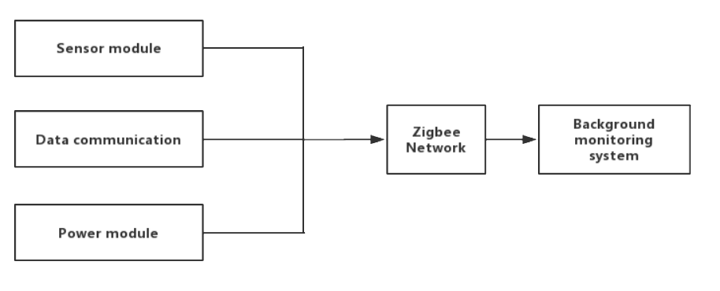
Key technology - short-range wireless communication networking technology
Network architecture diagram
To speed up the development of the test program, IAR Embedded Workbench was used for Zigbee software development. The IAR compiler has a good advantage in the Zigbee development process, and is better than other compilers for program optimization and architecture. In the IAR development environment, you don't need to write the underlying code, you can use the integrated packaged library files to directly write the code, which can shorten the test development time.
Each Zigbee node forms a wireless sensor network in a point-to-multiple manner. Each node carries a temperature and humidity sensor and a smoke sensor. After forming a local area network, the host computer interface can display the sensor data of each node in real time. The nodes are typically arranged at the corners or intersections of the internal passages of the building.

Slide 11
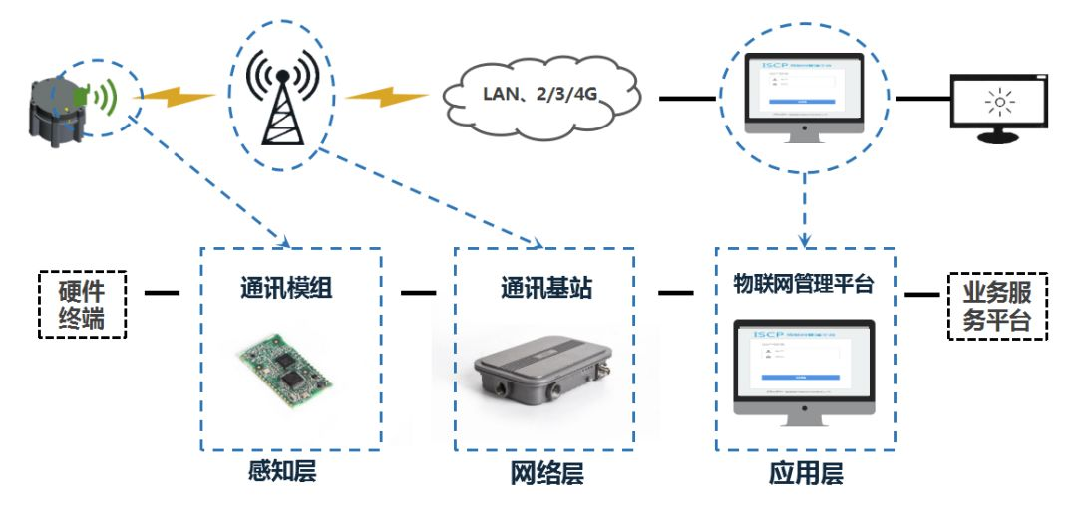
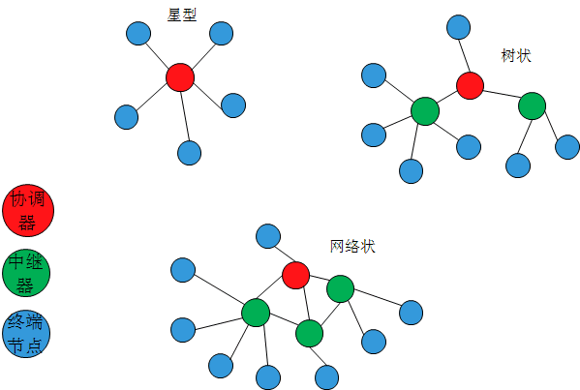
Key technology - data interaction between wireless sensor network and host computer
Key test technical difficulties:
1) Zigbee constitutes the wireless sensor network and the host computer for data interaction. The main function of Zigbee is to build the LAN of the whole system, and the sensor data of each node in the acquisition system is analyzed and uploaded to the upper computer interface for reference by the management personnel. Technical difficulties include:
(1) Network layout and organization of the system: According to the internal structure of the building and the channel information, plan the orientation of the wireless sensor nodes and make them self-assembled.
(2) System security monitoring and maintenance: The background monitoring management center can view the current status of each WSN node deployed in the building in the system in real time, and maintain the entire system to ensure the normal operation of the entire network.
(3) The data interaction between the upper computer and the lower computer adopts wireless transmission, and the effective information is filtered and successfully transmitted to the upper computer so that the data is not lost.
WSN network topology
Zigbee networking diagram

Slide 12
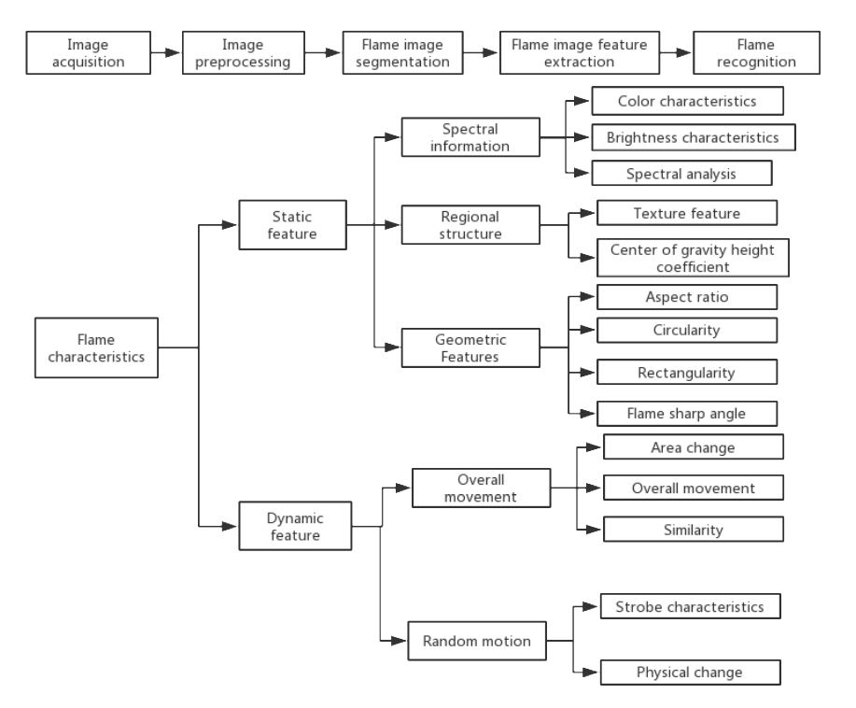
Early warning, monitoring - intelligent identification of disaster information
For natural disasters such as earthquakes and landslides
For fire situations
National Natural Disaster Research Center
Disaster information real-time reception
Real-time planning escape strategy
The occurrence of natural disasters such as earthquakes and landslides has been affected by many factors. It is difficult to monitor and analyze them in real time. The state has specialized research institutions for forecasting research and real-time monitoring and analysis. When the disaster is about to come, it will remind people early. This project does not make detailed prediction research on such natural disasters. For such disasters, the project has established a real-time disaster information receiving system to receive data from the National Natural Disaster Research Center in real time, so as to be application in the project system and effectively remind people to escape reasonably and quickly.
Background modeling of databset, applying the new ViBe modeling method, and Gaussian hybrid model GMM. The biggest highlight of this project is to add a Euler video amplification method before modeling according to the dynamic characteristics of the flame. Which makes the frequency of the flame's motion is magnified, and the modeling accuracy even higher. The second highlight is the combination of two color models, RGB and YRCBC. After many experiments, it is found that the RGB model is very accurate inside the flame. YRCBCR tests the outer contour of the flame very accurately, because Y represents the brightness. After analysis, the brightness of the flame edge will be Higher, so the two color models are combined to further improve the accuracy, F-score is about 90%.

Slide 13
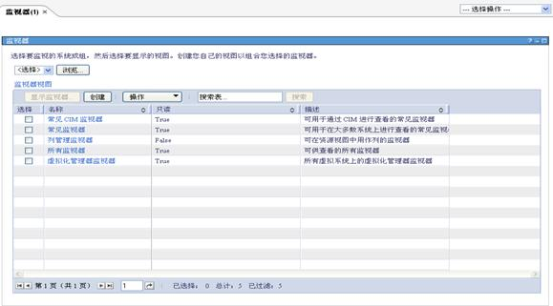
Early warning, monitoring - IBM Systems monitoring hardware environment
This project has been upgraded and improved for the development of the previous PC interface, using IBM Systems Director 6.1 developed by IBM.
IBM Systems Director 6.1 is a strategic, centralized platform management software launched by IBM Systems Software in October 2008. How to continuously monitor real-time monitoring of a large number of systems with different architectures and platforms (such as POWER chip servers, Intel chip-based servers, and blade centers) and quickly find the root cause and solve problems in the event of a failure has been a problem for system administrators.In response to this problem, Director 6.1 provides a series of hardware monitoring managers, providing users with a comprehensive, integrated hardware monitoring solution that enables users to monitor system status and handle hardware failures more easily, conveniently, and in a timely manner.
According to the content of monitoring content, the monitor manager of Director 6.1 is mainly divided into state manager and event manager:
The status manager can provide system monitoring indicators customization, multiple visualization methods to display the real-time status of the system and support status data import and reprocessing analysis functions, etc., to meet all user system status monitoring needs;
The event manager can provide practical help for users to deal with hardware faults by initial problem location for real-time fault alarms. At the same time, the event manager also provides event filtering, event automation processing and other event processing tools to improve user productivity.

Slide 14

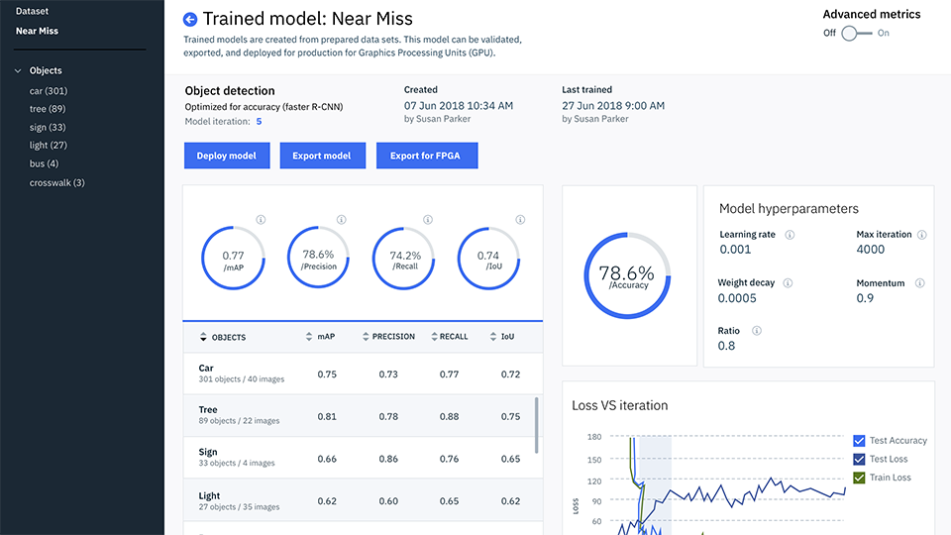
Escape - IBM PowerAI Vision and Image Recognition Technology
PowerAI Vision combines Computer Vision with deep learning to make related features easier to use and perform better. By combining PowerAI Vision software with IBM® Power Systems™ , which is further enhanced, organizations can quickly deploy fully optimized, fully supported and high performance platforms. PowerAI Vison includes an intuitive toolset so topic experts can create Vision models without the need for coding or in-depth learning expertise. In addition, PowerAI Vison includes the most popular deep learning framework and its associated components to help teams quickly and easily deploy models to increase productivity.
The simplified interface of IBM PowerAI Vision makes it easy to deploy data and train models. Train the deep learning model in an iterative manner, automatically tagging the video to create a large number of accurate data sets for training purposes. Train with compute-intensive IBM Power® servers, then export trained models and deploy them to internal environments, clouds, or edge devices. Introducing custom models into TensorFlow eliminates the need for data scientists to train, tune, or deploy. You can deploy with peace of mind because you already know that the entire hardware and software combination has been tested and verified, interoperability is guaranteed, and you can choose to use support services from IBM.

Slide 15
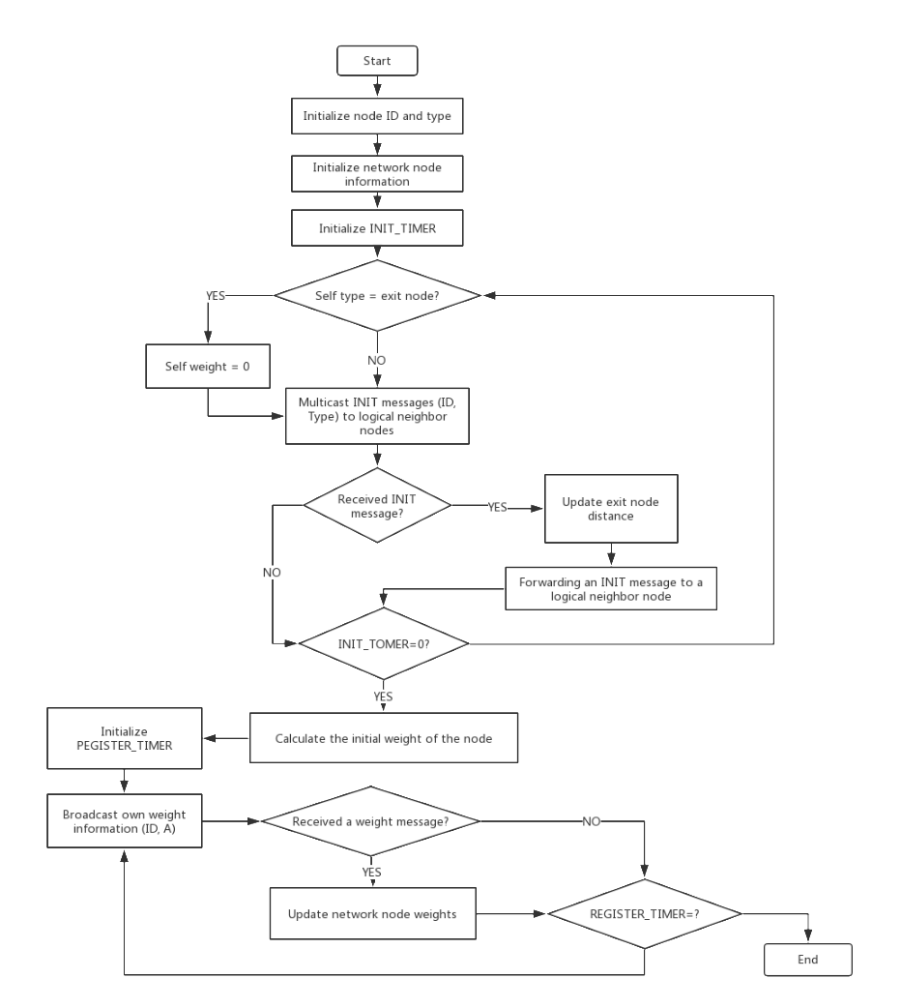
Escape - Improve Artificial Potential Escape Algorithm
Improved artificial potential field escape algorithm node flow chart
In this distributed escape system, the basic idea of ​​using the artificial potential field method is: in the event of a disaster event, the location of the disaster will generate a repulsive force for the trapped and eager to escape to prevent the escape personnel from approaching, and safe. The location of the exit will create an attraction for escapers to attract escapers to the exit. In the traditional artificial potential field algorithm, the calculation method of the magnitude of the repulsive force exerted on the wireless sensor network node by a single disaster is the reciprocal of the distance from the escaped person to the disaster node. The attractiveness of a safe exit is calculated by the number of hops. The final guiding direction of each network sensor node is the next sensor node with the highest attraction and the least repulsive force. Since the traditional artificial potential field algorithm is only applicable to the case of only one safety exit, in order to be applicable to the case of multiple safety exits, the system improves the traditional artificial potential field method, and the system will give each sensor node A weight is assigned, and the degree of danger of each sensor node is evaluated by the weight value. The greater the weight of the node, the higher the risk of the area. When a disaster occurs, each node adjusts its own weight according to the disaster situation. The direction of escape is directed from the sensor node with high weight to the sensor node with low weight.

Slide 16
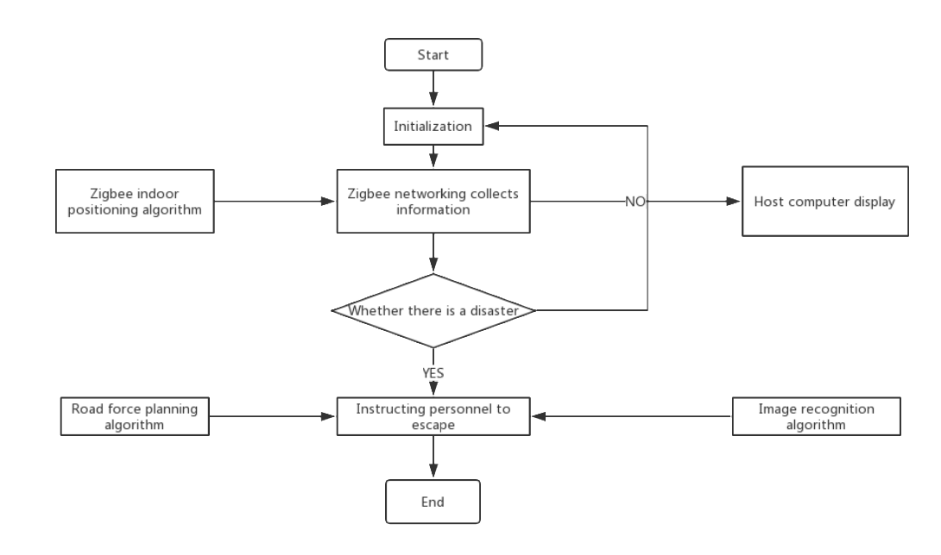
Escape - Image Recognition and Path Algorithm
The combination of image recognition and path planning algorithms
Path planning algorithms and image recognition are critical aspects of the system. The path planning algorithm needs to plan an appropriate escape path immediately in the event of a disaster. Similarly, the image recognition algorithm needs to be alerted immediately when the disaster occurs. Technical difficulties include:
(1) Emergency escape guidance: When a sensor on the node of the wireless sensor network detects that a fire has occurred, an abnormal signal will be sent and broadcast to the WSN, and all other node modules of the entire network will receive it very quickly. The abnormal signals sent, and then the node modules that receive the abnormal information will re-plan the safe escape evacuation path through the system's escape algorithm, ensuring that the personnel can smoothly escape the disaster location.
(2) Alarm system: When the disaster occurs, the accuracy of the image recognition algorithm is very high, and it needs to be recognized and alerted immediately when there is a flame or smoke. The escape system can not only guide the internally trapped personnel to evacuate along the correct escape route, but also can report the outside to notify the external fire rescue personnel to organize effective rescue in a timely manner.
(3) Discriminate the areas where people are densely populated, and design a complete set of mechanisms and mechanisms to provide mobile phone information to all personnel in the area to prompt the escape route.
(4) Emergencies such as earthquakes or terrorist attacks: For situations where the situation is sudden and urgent, the corresponding escape plan is given according to the height of the floor. Therefore, the information collected by the sensors of each node must be accurate, and the positioning algorithm must accurately locate the information of the trapped people.
Software architecture diagram

Slide 17

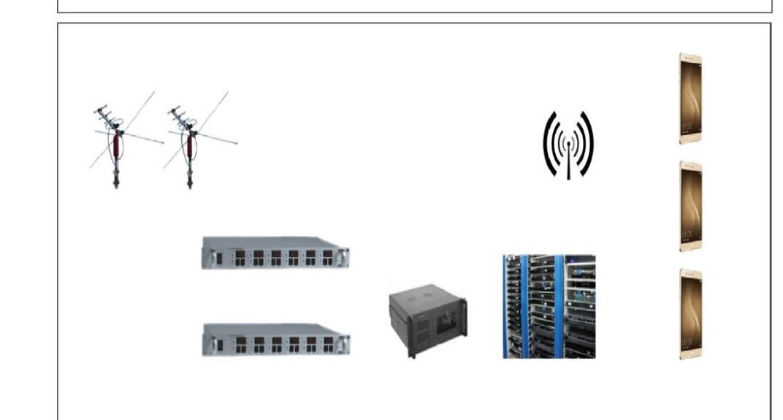
Escape - mobile app warning, escape tips
Figure 1 Schematic diagram of wireless broadcast TV mobile APP monitoring and early warning system
This project is a practical application of mobile APP technology. It is an effective means for wireless signal monitoring and can provide powerful technical support for secure broadcast. After consulting a large number of documents, repeatedly analyzing and demonstrating and combining with the actual situation of this station, the composition principle of the mobile APP monitoring and early warning system we developed is shown in Figure 1.
Signal acquisition: The collection of broadcast TV signals adopts MD730+ (6-channel FM/Amplitude Tuner) and MD740+ (6-channel TV tuner) from Anhui Huixin Company, and completes communication and data acquisition with the industrial computer through its serial port.
Data processing: Run our own self-developed control system software on the industrial computer. The industrial computer communicates with the front-end tuner through the serial port, collects the broadcast TV signal automatically, in real time and in multiple channels, analyzes the quality of the program signal and records the data to the network. .
Network transmission: Transferred by a third-party data transfer service (such as Telecom, Mobile, China Unicom, etc.) to provide a fixed IP address, and data transmission, to send each channel information to a remote client such as a mobile phone.
APP Push: Through the self-developed mobile APP software, the port that receives the alarm information is reserved first, and the transmitted data is analyzed and processed, and the warning push is performed. The APP system pushes the alarm information immediately at the time of the disaster; it can also guide the trapped person to find the nearest escape device; the system background can also preset the permission according to the management level to perform the corresponding operation.
Figure 2 hardware device connection diagram

Slide 18
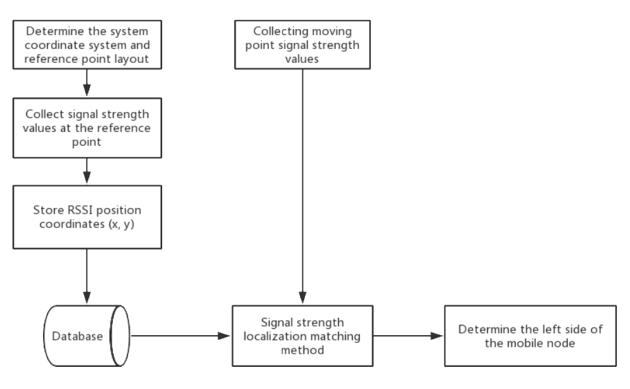
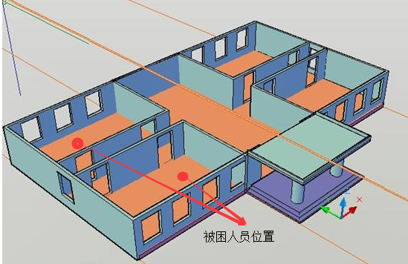
Rescue - indoor positioning algorithm and rescue information prompt
Figure 1 Flow chart of location fingerprint location algorithm
Figure 2 3D positioning display of trapped people
According to the position coordinates returned by the indoor positioning algorithm, combined with the 3D modeling method, the three-dimensional coordinates of the trapped person are transmitted to the rescuer's terminal by wireless transmission. Rescue workers carry out rescue operations based on the location information of the trapped people. According to the height of the floor, the corresponding escape plan is given. Therefore, the information collected by the sensors of each node must be accurate, and the positioning algorithm must accurately locate the information of the trapped people.
Technology development: An emergency rescue package is placed at certain locations in the building. An emergency rescue package can be prepared with a text message and a small positioning node. The system can update the location of the rescue package in real time. Increase the position information of the life-saving equipment, you can query the location information of the fire-fighting equipment and the life-saving equipment through the system, or send the location information of the rescue package to the trapped person through the app. When the disaster comes, the rescuer is instructed to find the nearest emergency rescue package.
The ZigBee wireless communication network is taken as the core and the location fingerprint and triangle centroid algorithm are combined to locate the statistical characteristics of the signal intensity in the experimental scene. From the statistical results, the feasibility analysis of ZigBee signal ranging is optimized. Ranging equation for received signal strength indication (RSSI). The positioning is then accomplished using an improved position fingerprinting method and an optimized reference node layout scheme. The experimental results show that compared with the traditional method, the positioning scheme combined with the position fingerprint and the triangle centroid algorithm greatly improves the positioning accuracy.

Slide 19
Core advantage - patent
Implementation Scheme of a Distributed Escape Algorithm on ZigBee
Field self-organizing network wireless communication system
Accepting two patents

Slide 20
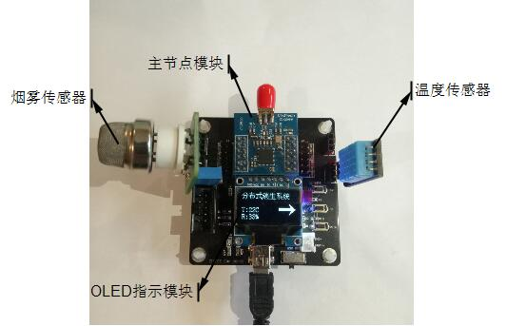
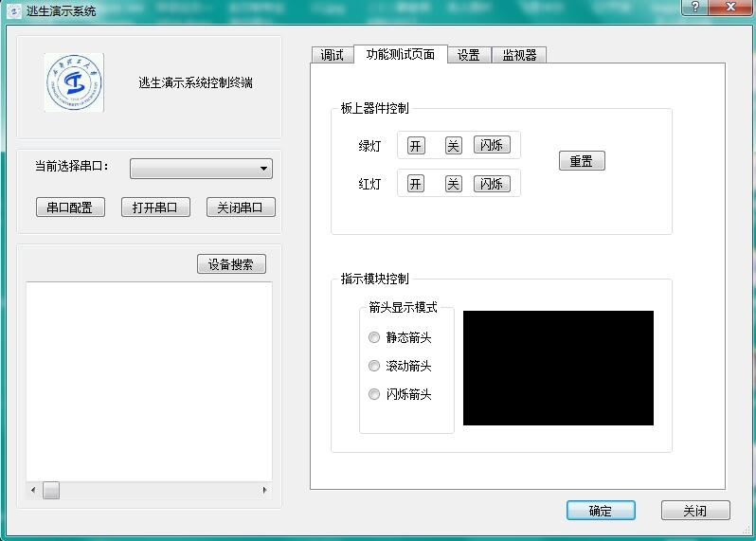
Core strengths - existing research foundation
Completed node module design
Completed interface display design
The temperature parameters and smoke concentration parameters collected by the sensor are processed by the node module to display such information on the OLED display module in real time. In addition, the display module is also marked with an arrow indicating the direction. Under normal circumstances, the arrow The instructions are no different from traditional fire safety exit instructions, but when a disaster occurs, it will make new arrow directions based on the re-planning path after the escape algorithm is processed to help the trapped person quickly travel to the nearest safe area.
The data exchange and communication between the PC side background monitoring program of the distributed escape system and the WSN aggregation node can be realized by serial communication. TI's CC2530 chip has two serial communication interfaces, USART0 and USART1. They have the same function and can be set to asynchronous UART or synchronous SPI. They can be implemented by setting the I/O pin multiplexing function USART. In the escape system, the UART asynchronous serial interface mode is selected for communication between the background and the node.

Slide 21
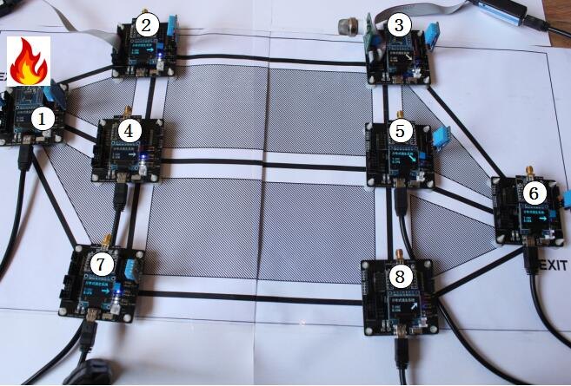
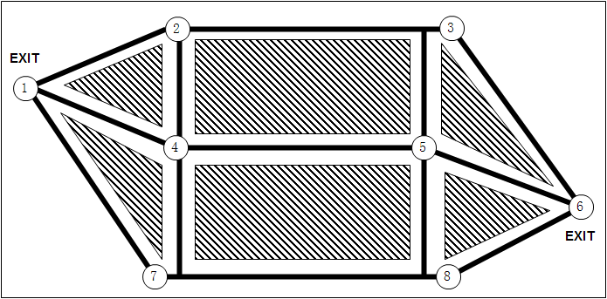
Core strengths - existing research foundation
Field environment for simulation experiments
The scene environment of the simulation experiment of the escape demonstration system is shown in the figure. The black thick line in the figure is the road direction, and the shadow part is the wall, obstacles, etc. In this experiment, a total of 8 sensor terminal nodes are used, which are self-assembled. The entire network of the escape system, the sensor nodes are placed in the serial number of the figure. Among them, nodes 1 and 6 are marked with "EXIT" to represent the safety exit of this floor.
Experiment to simulate the occurrence of a fire emergency. For example, when the No. 1 sensor terminal detects a fire, the No. 1 becomes the disaster occurrence node, and the arrow indications of the No. 2, No. 4, and No. 7 sensor nodes that point to the No. 1 exit at the time of initialization. The direction changed after the escape system processed the escape algorithm based on the acquired disaster information, pointing to another security exit No. 6.

Slide 22
Project members
project members:
Principal(Yueyuan Liu)
Master of Science in Electronics and Communication Engineering, Chengdu University of Technology
Be responsible for:
1. Coordinate the overall planning of the project
2. Organize management and control of project demand analysis, design, R&D and testing
Hardware development(Lidong Jiang)
Master of Science in Electronics and Communication Engineering, Chengdu University of Technology
Be responsible for:
Overall system design, selection and design of each hardware module, including selection of ZigBee solution, implementation of OLED indicator module, etc.
Communication research(Liu Jun)
Master of Science in Electronics and Communication Engineering, Chengdu University of Technology
Be responsible for:
Research on short-range wireless communication related technologies, including Z-Stack protocol stack analysis, RF wireless RF communication technology, serial communication, etc.

Slide 23
Project members
Software development(Zhiyuan Huang)
Undergraduate course in exhibition economics and management at Chengdu University of Technology
Be responsible for:
The design and implementation of the software platform, including the programming implementation of the Z-Stack protocol stack in IAR, the implementation of the PC-side background monitoring program, mobile APP, etc.
Algorithm (Zeng Jie)
Undergraduate degree in Information Engineering, Chengdu University of Technology
Be responsible for:
Research on various algorithms, including indoor positioning algorithms, image recognition and path algorithms, improved artificial potential field escape algorithms, etc.
instructor:
Zeng Wei, a master tutor at Chengdu University of Technology, is working on electronic information technology.

Slide 24
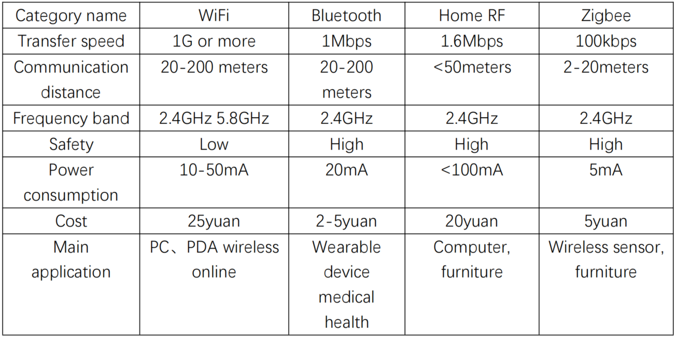
Future planning - expected economic and social benefits
Comparison of performance parameters of wireless sensor network (WSN)
Expected economic and social benefits:
1) The distributed escape system will bring great convenience to national security firefighting. The intelligent application of the escape system has not been professionally tested and popularized in China, so the distributed escape system has broad prospects in the future market. According to statistics, the total assets invested in fire equipment in the domestic market in 2019 have reached 161,759,300 yuan, an increase of 25.40% over the same period last year. The distributed escape system is an effective means to improve the current economic development of China's fire safety and the safety of people's lives, and is also an effective means to change the existing fire fighting mode.
2) The social benefits brought by the intelligent escape system are very large, and fire-fighting enterprises must recognize their responsibilities. Urban fire protection construction will change with the upgrading of the city, because urban development will make the fire protection work complicated, people's fire safety protection problems, if the fire protection products are not upgraded, then the social fire protection construction can not meet the needs of people, the city's The speed of development will also be affected. As a new concept of fire protection construction, the distributed escape system fits the development needs of “smart city” and applies the Internet of Things technology to achieve the goal of integration of urban fire protection construction. We must recognize our responsibility and continuously improve the quality and performance of our products so that the social benefits of our products can be truly realized.
Up to now, no wireless sensor technology (WSN) can become a real mainstream, because there is no absolute perfection for the technology itself; and from the business, it is necessary to combine business characteristics and business models to choose a more suitable one. WSN technology, based on the design requirements of this escape system, considers its cost, power consumption, delay, network self-organization, etc. Finally, choose ZigBee as a simple, efficient and easy to implement wireless communication technology.

Slide 25
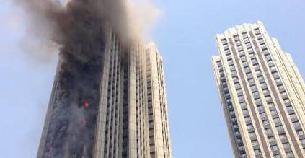
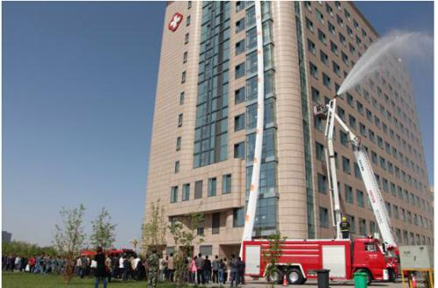
Future planning - application prospects
Project application prospects:
Today's technology is developing rapidly, and the competition is extremely fierce due to the imperfect traditional escape system. In such an environment, shortening the development cycle of the system and improving the overall quality have become the focus of competition among companies. Today's increasingly complex systems require a higher degree of confidence in each module, in other words more and more detailed test items, wider and broader test coverage. The conventional escape system not only has poor linkage, but also the fire equipment is backward. It can hardly design a perfect escape route for people. Therefore, designing a complete distributed escape system becomes a very urgent need.
The distributed escape system can be applied in the following scenarios:
1) Medical buildings, hotels, apartments, elderly buildings and similar functional buildings.
2) Set up a building for song and dance entertainment screenings
3) Shops, libraries, exhibition buildings, conference centers and similar functional buildings
4) Other buildings of 6 floors and above.
6th floor and above
City public building

Slide 26
Future planning - goals
01
02
03
04
January to March
March-June
June-September
September-December
Field research application scenarios, customized system overall solutions and key technical indicators
Complete the writing of the upper computer and realize the data communication between the upper computer and the lower computer
Complete the development of the software part test program, perform the improved algorithm, and realize the function of the algorithm
Reduce system errors, improve the accuracy of the algorithm, and achieve the desired results

Slide 27
Smart fire control ,
scientific disaster prevention
——Intelligent distributed escape system design
Thanks for watching!
Principal(Yueyuan Liu) Email：229262167@qq.com

