Slide 1
5.6 Multiple Syntax Styles
Group 13 – Jisu Seo, Donggyu Lee

Slide 2
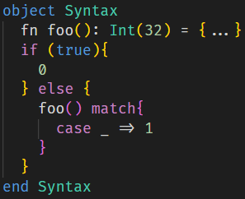
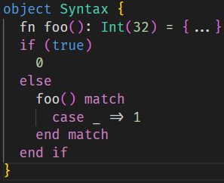
Part 1
Overview
1
주제를 입력하세요
2
주제를 입력하세요
Current Amy syntax
New possible Amy syntax
3
주제를 입력하세요
Currently, Amy syntax supports braces-style(if, match) and end markers-style(object).
Our goal is to allow both styles in everywhere.

Slide 3
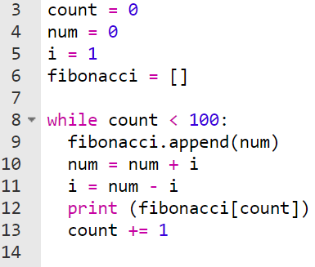
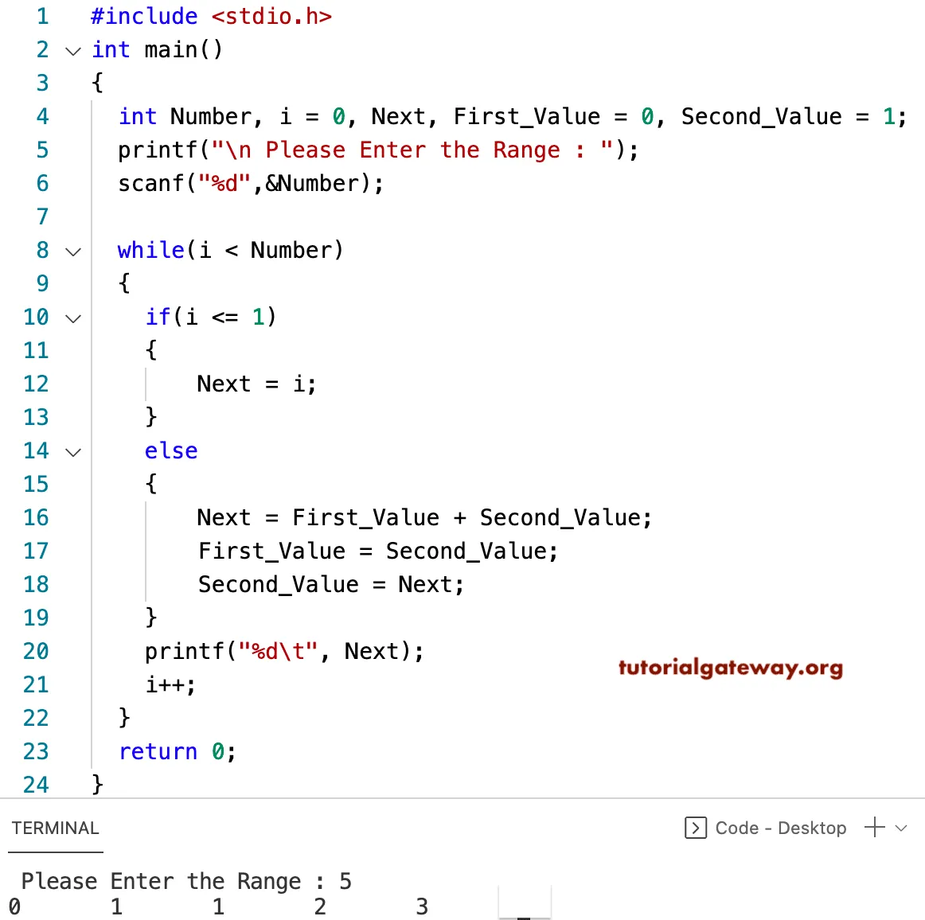
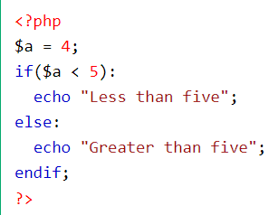
Part 2
Background
1
주제를 입력하세요
2
주제를 입력하세요
Python which use indentation
C language which use curly brackets
PHP which use end markers
3
주제를 입력하세요
There are roughly two methods to identify the scope of the statements. Languages like Python or Haskell use indentation, while languages like C, Java, JavaScript use brackets. Some languages like PHP support the end markers.

Slide 4
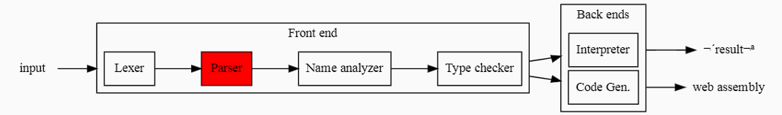

Part 3
Affected Compiler Phases
Add Syntaxes
Affected Compiler Phases
2
주제를 입력하세요
Our extension only affects Lexer and Parser of overall phases. We have to change Lexer to add the keywords of end if and end match, and change parser to accept the both brace style and end marker styles.

Slide 5
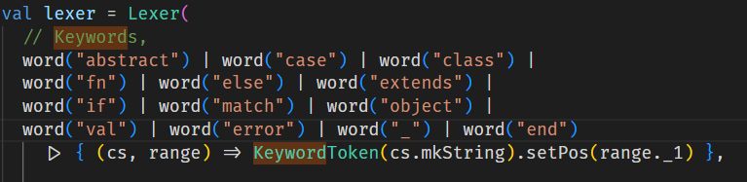
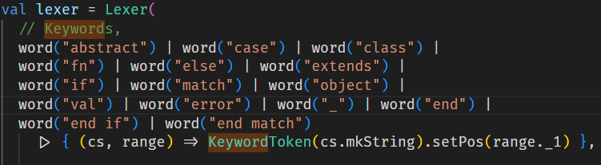
Part 3
Affected Compiler Phases - Lexer
1
주제를 입력하세요
2
주제를 입력하세요
3
주제를 입력하세요
Add new words as KeywordToken

Slide 6
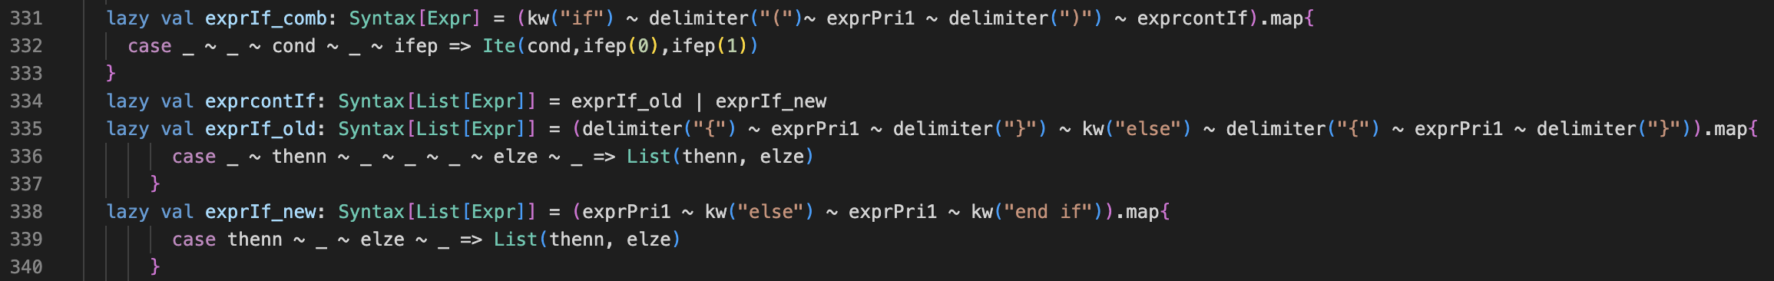
Part 3
Affected Compiler Phases - Parser
Change if statement to accept both braces and end markers
3
Cause LL1 error (First/First conflict)
1
주제를 입력하세요
2
주제를 입력하세요

Slide 7
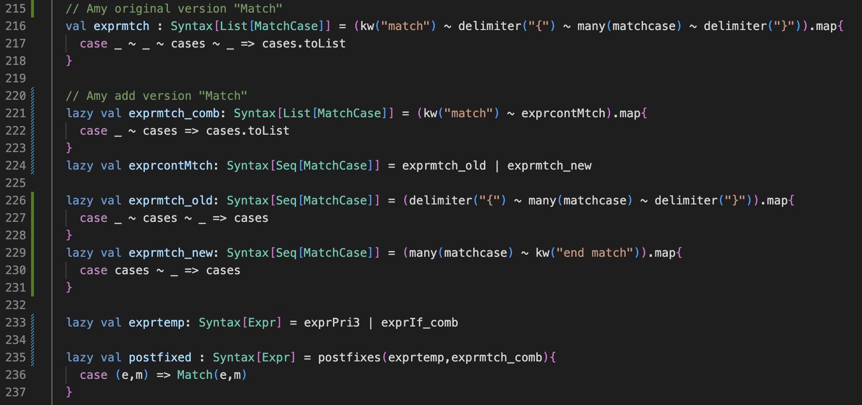
Part 3
Affected Compiler Phases - Parser
Change match statement to accept both braces and end markers
3
Cause LL1 error (First/First conflict)
We already used postfixes method for Expr in Lab3
1
주제를 입력하세요
2
주제를 입력하세요

Slide 8
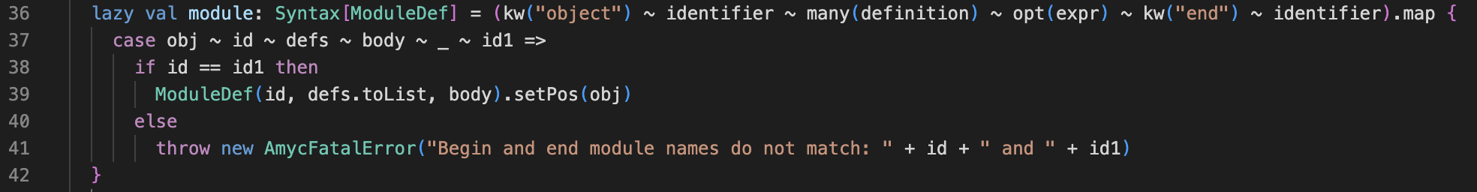
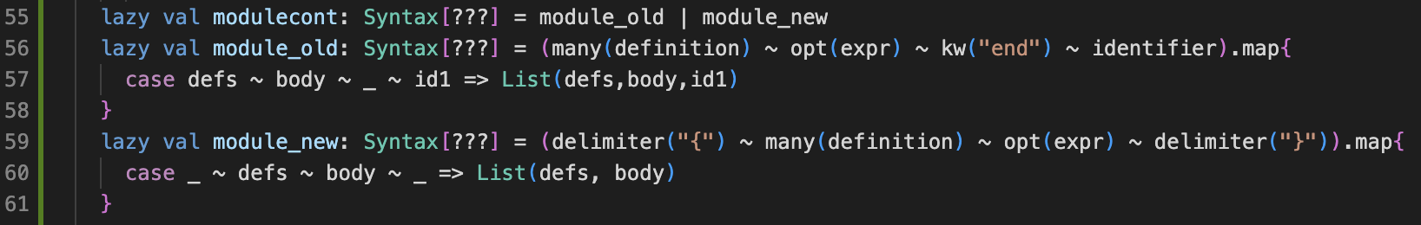
Part 3
Affected Compiler Phases - Parser
Previous method
Change object to accept both braces and end markers
3
1
주제를 입력하세요
2
주제를 입력하세요
Need to solve the type error ! ! !

Slide 9
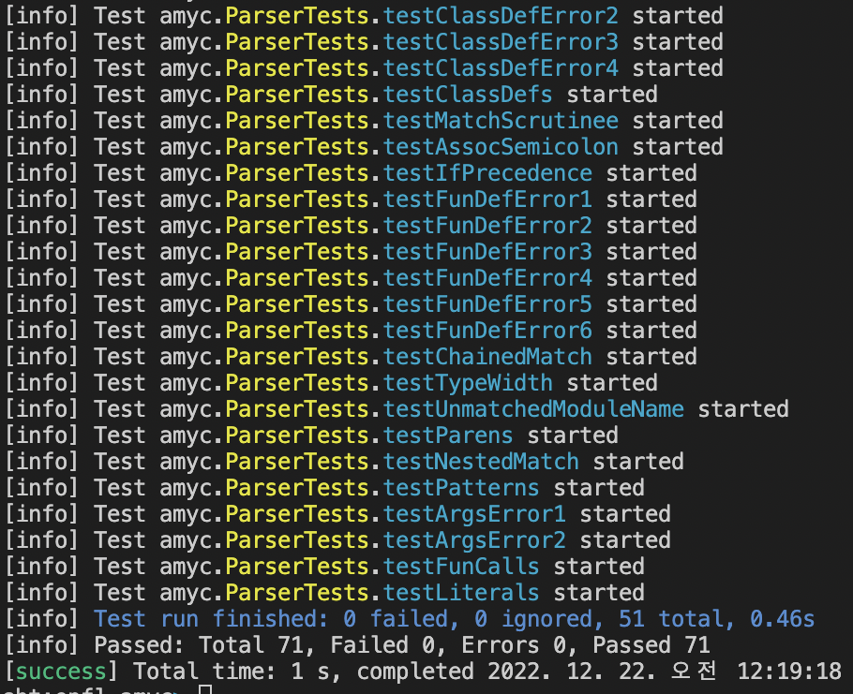
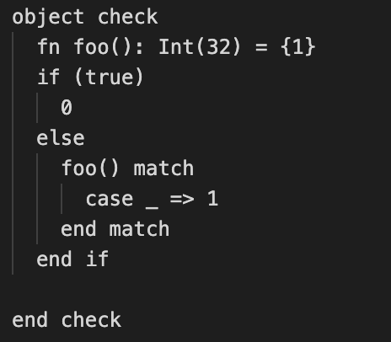
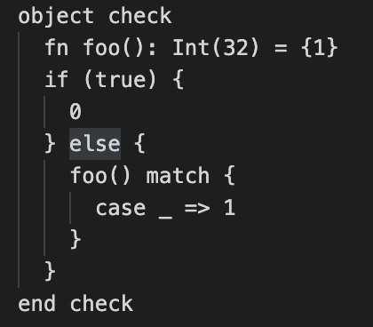
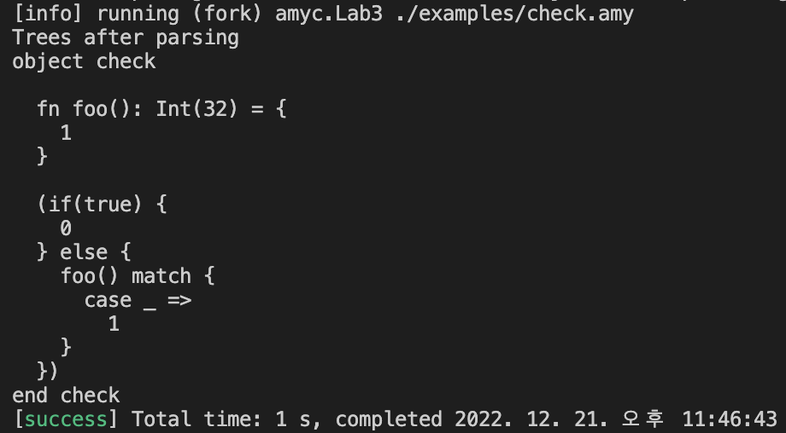
Part 4
Implementation Result
1
주제를 입력하세요
2
주제를 입력하세요
3
주제를 입력하세요
Amy files with end marker style and brace style now parsed in same output!

Slide 10
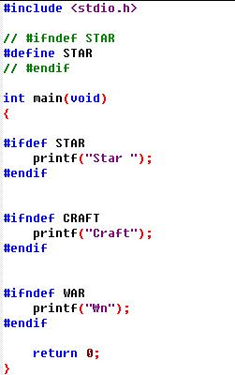
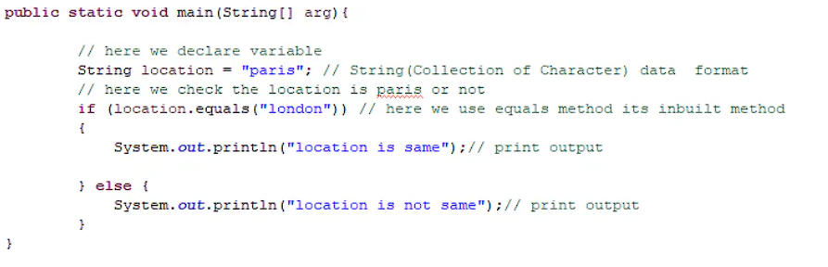
Part 4
Conclusion
1
주제를 입력하세요
2
주제를 입력하세요
Java using braces for if statements
C# using end markers as preprocessor in if statement
3
주제를 입력하세요
Using this extension, users can use both braces and end markers in their taste.
This can help the newcomers of Amy language to learn the language more quickly by using their own familiar styles, and also may help to increase the readability of code.

Slide 11
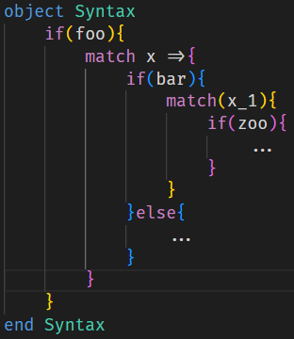
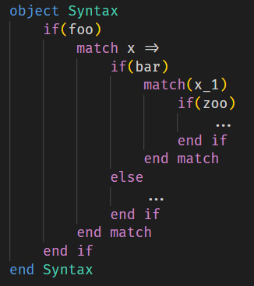
Part 4
Conclusion
1
주제를 입력하세요
VS
2
주제를 입력하세요
Brace style
End marker style
3
주제를 입력하세요
Using this extension, users can use both braces and end markers in their taste.
This can help the newcomers of Amy language to learn the language more quickly by using their own familiar styles, and also may help to increase the readability of code.

Slide 12
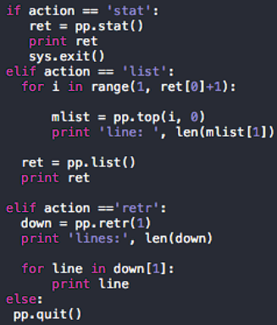


Part 5
Future works and Expansions
1
주제를 입력하세요
2
주제를 입력하세요
Python using only indentation
Add Amy compiler options to force the format
3
주제를 입력하세요
In future works, we can adopt indentation which doesn’t need any braces or end markers, or we may add compiler options to force to one format for the unity of the code.

Slide 13

Thank you for listening!

