Slide 1

Lab 3

Slide 2


Download this lab and run it, you will see the left figure (one triangle only).
This practice ask you to add 2 extra triangles and meet the following requirement
Check the video here: https://www.youtube.com/watch?v=uyJhV_ozx_k&ab_channel=Ko-ChihWang
1. triangle2’s tip always attach at triangle1’s tip
2. triangle3’s tip always attach at triangle2’s right corner
3. consider the three triangles is a complete object. Tips of triangle2 and triangle3 are two joint.
4. if the user press “a” move the whole object to the left. If the user press “d” move the whole object to the right.
5. if the user press “r”, rotate triangle2 along its tip
6. if the user press “l (L)”, elongate triangle2. if the user press “s”, shorten triangle2
7. if the user press “o (O)”, rotate triangle3 along its tip
triangle3
triangle2
triangle1

Slide 3
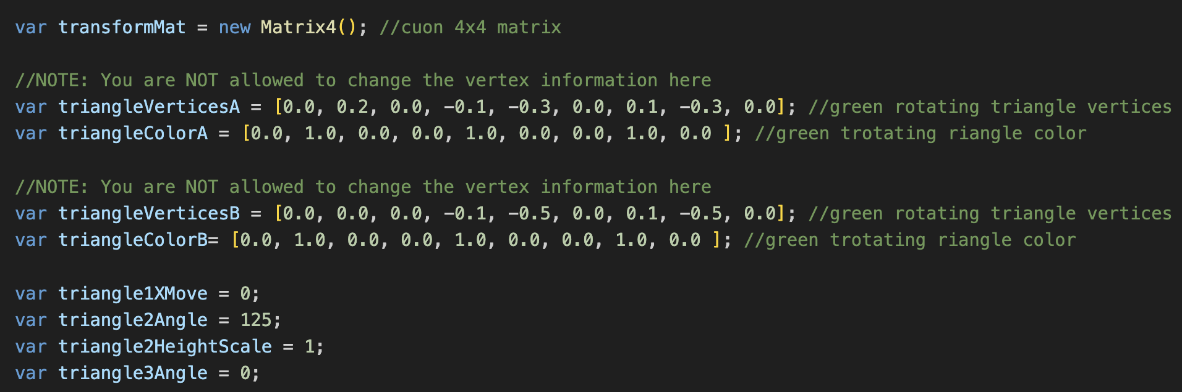
In WebGL.js, I set vertices information here (check the comment), do NOT change any code segment here
I provide two triangle models (A and B). Check the differences and feel free to select any one you prefer to draw your triangles
triangle1XMove: triangle1’s displacement along the horizontal direction
triangle2Angle: triangle2’ rotation angle
triangle2HeightScale: the scale factor of triangle2 along its ‘height’ direction
triangle3Angle: triangle3’ rotation angle

Slide 4
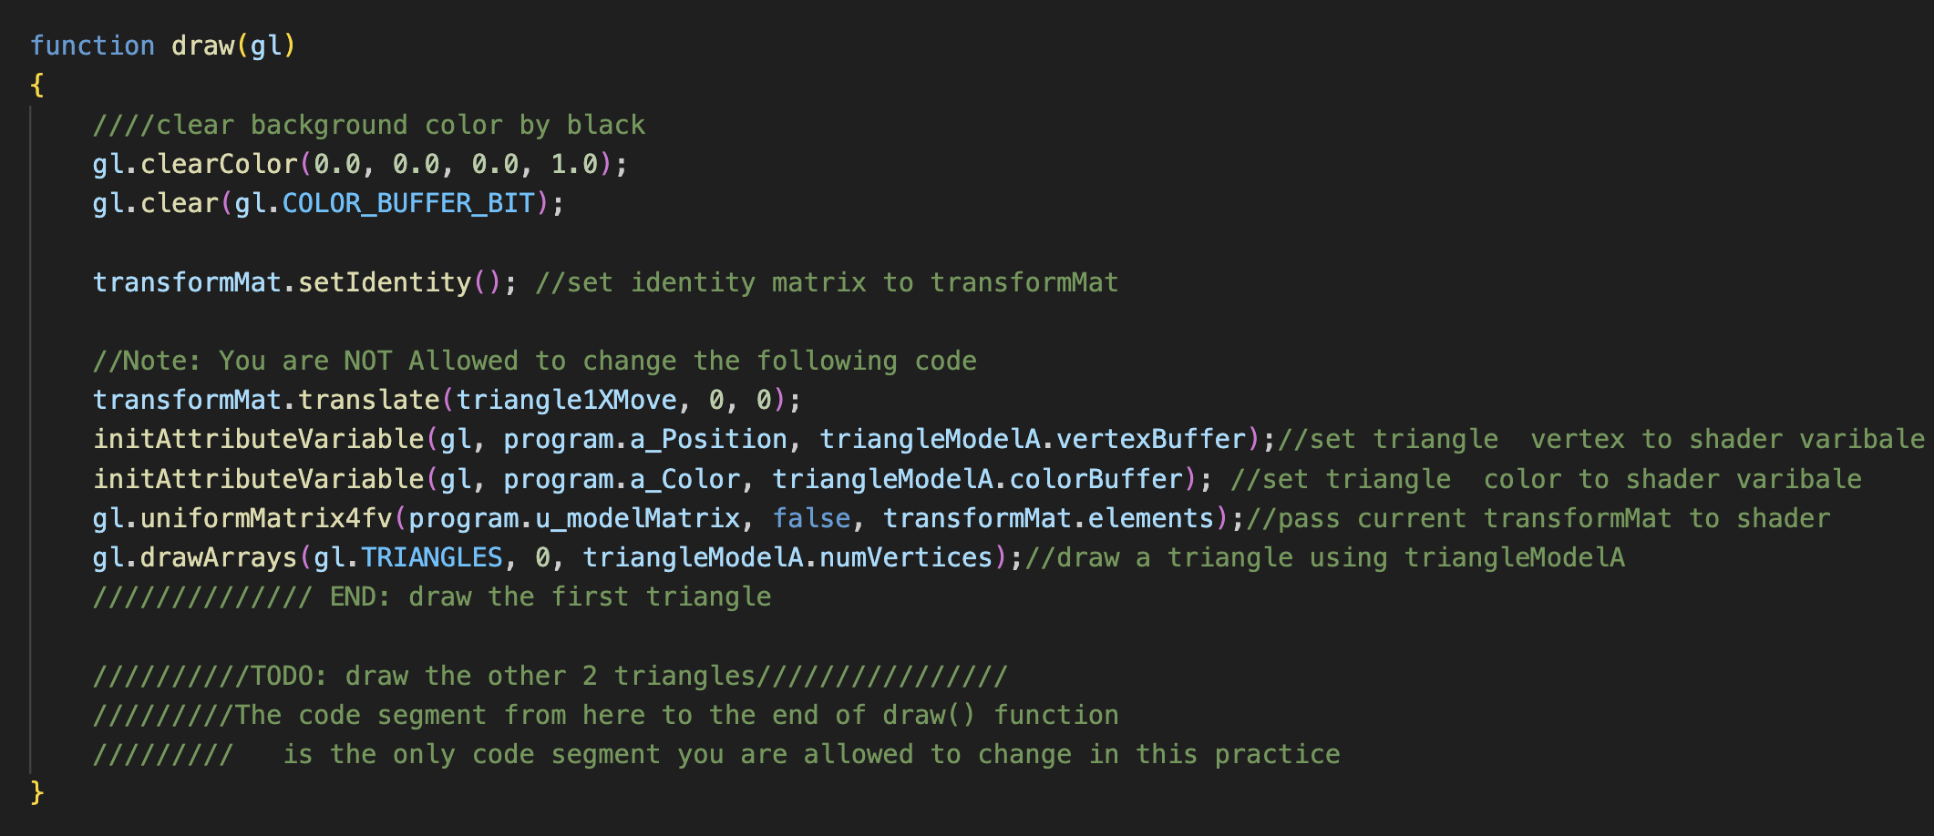
The first triangle
The only code segment you can change in this practice.

Slide 5
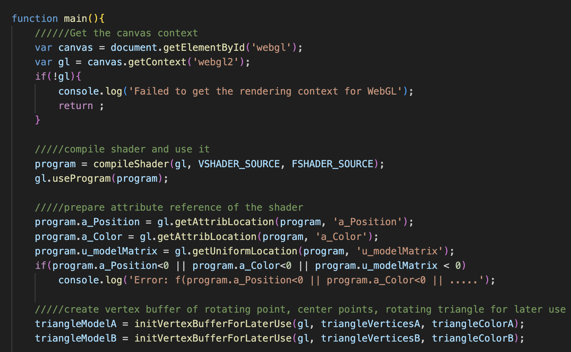
We initialize triangle models here for later use
If you want to draw a triangle by ‘triangleModelB’ you need lines similar to them, but change ‘triangleModelA’ -> ‘triangleModelB’
We will explain more next week

Slide 6
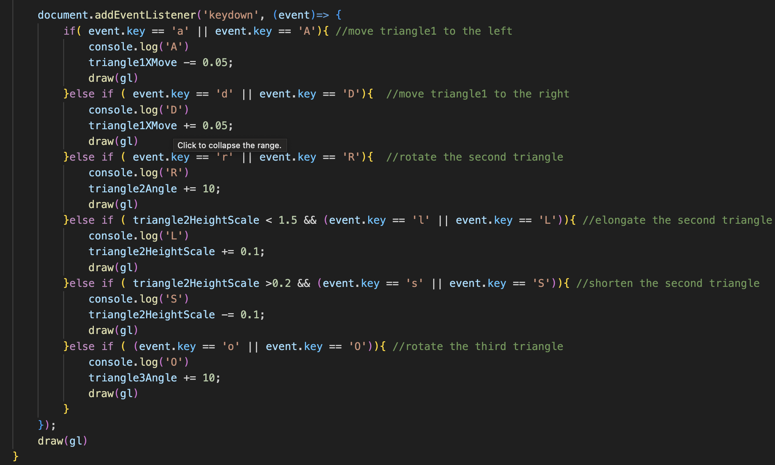
In main(), this code segment is trigger when the user pressed a key. Then, we call draw(gl) and update the screen.
You do not have to change any here.

Slide 7
What You Should Do for “Submission”

Slide 8
Submission Instruction
Create a folder
Put the html and js files in the folder
Zip the folder
Rename the zip file to your student ID
For example, if your student ID is “40312345s”, rename the zip file to “40312345s.zip”
Submit the renamed zip file to Moodle
Make sure
you put all files in the folder to zip
You submit the zip file with correct name
You won’t get any point if
the submitted file does not follow the naming rule,
TA cannot run your code,
or cannot unzip your zip file.

