Slide 1

Lab 8

Slide 2
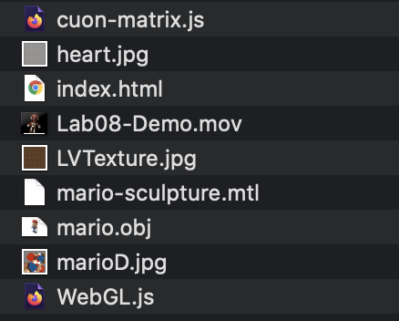
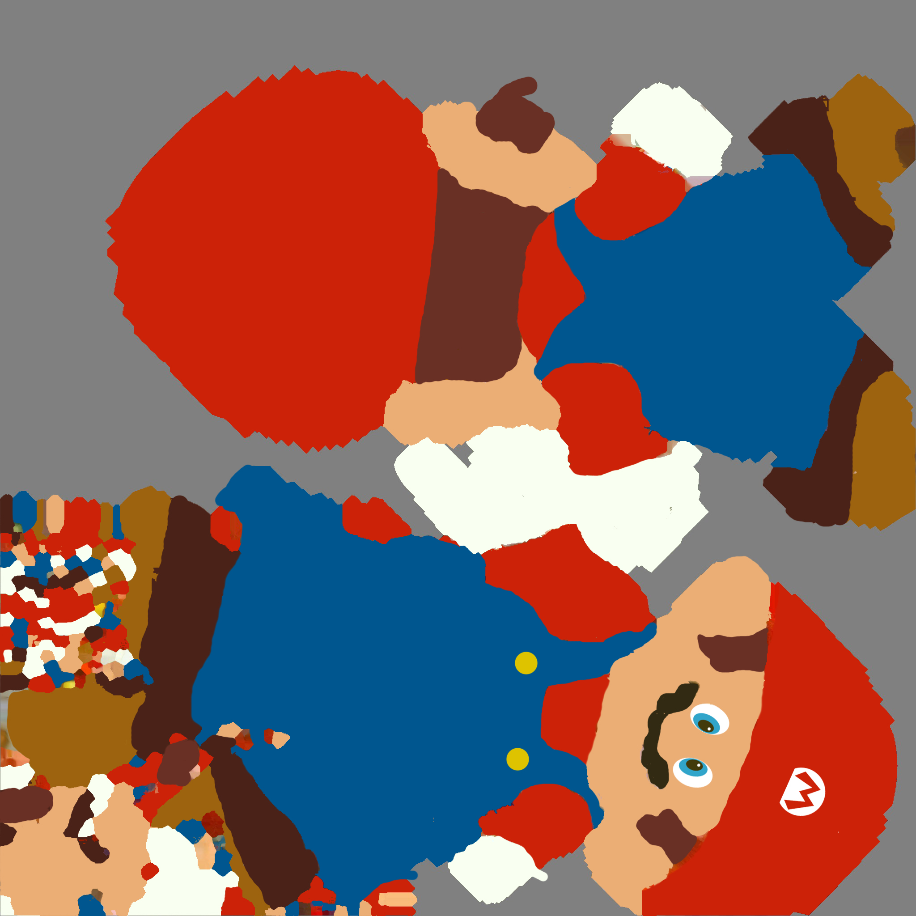
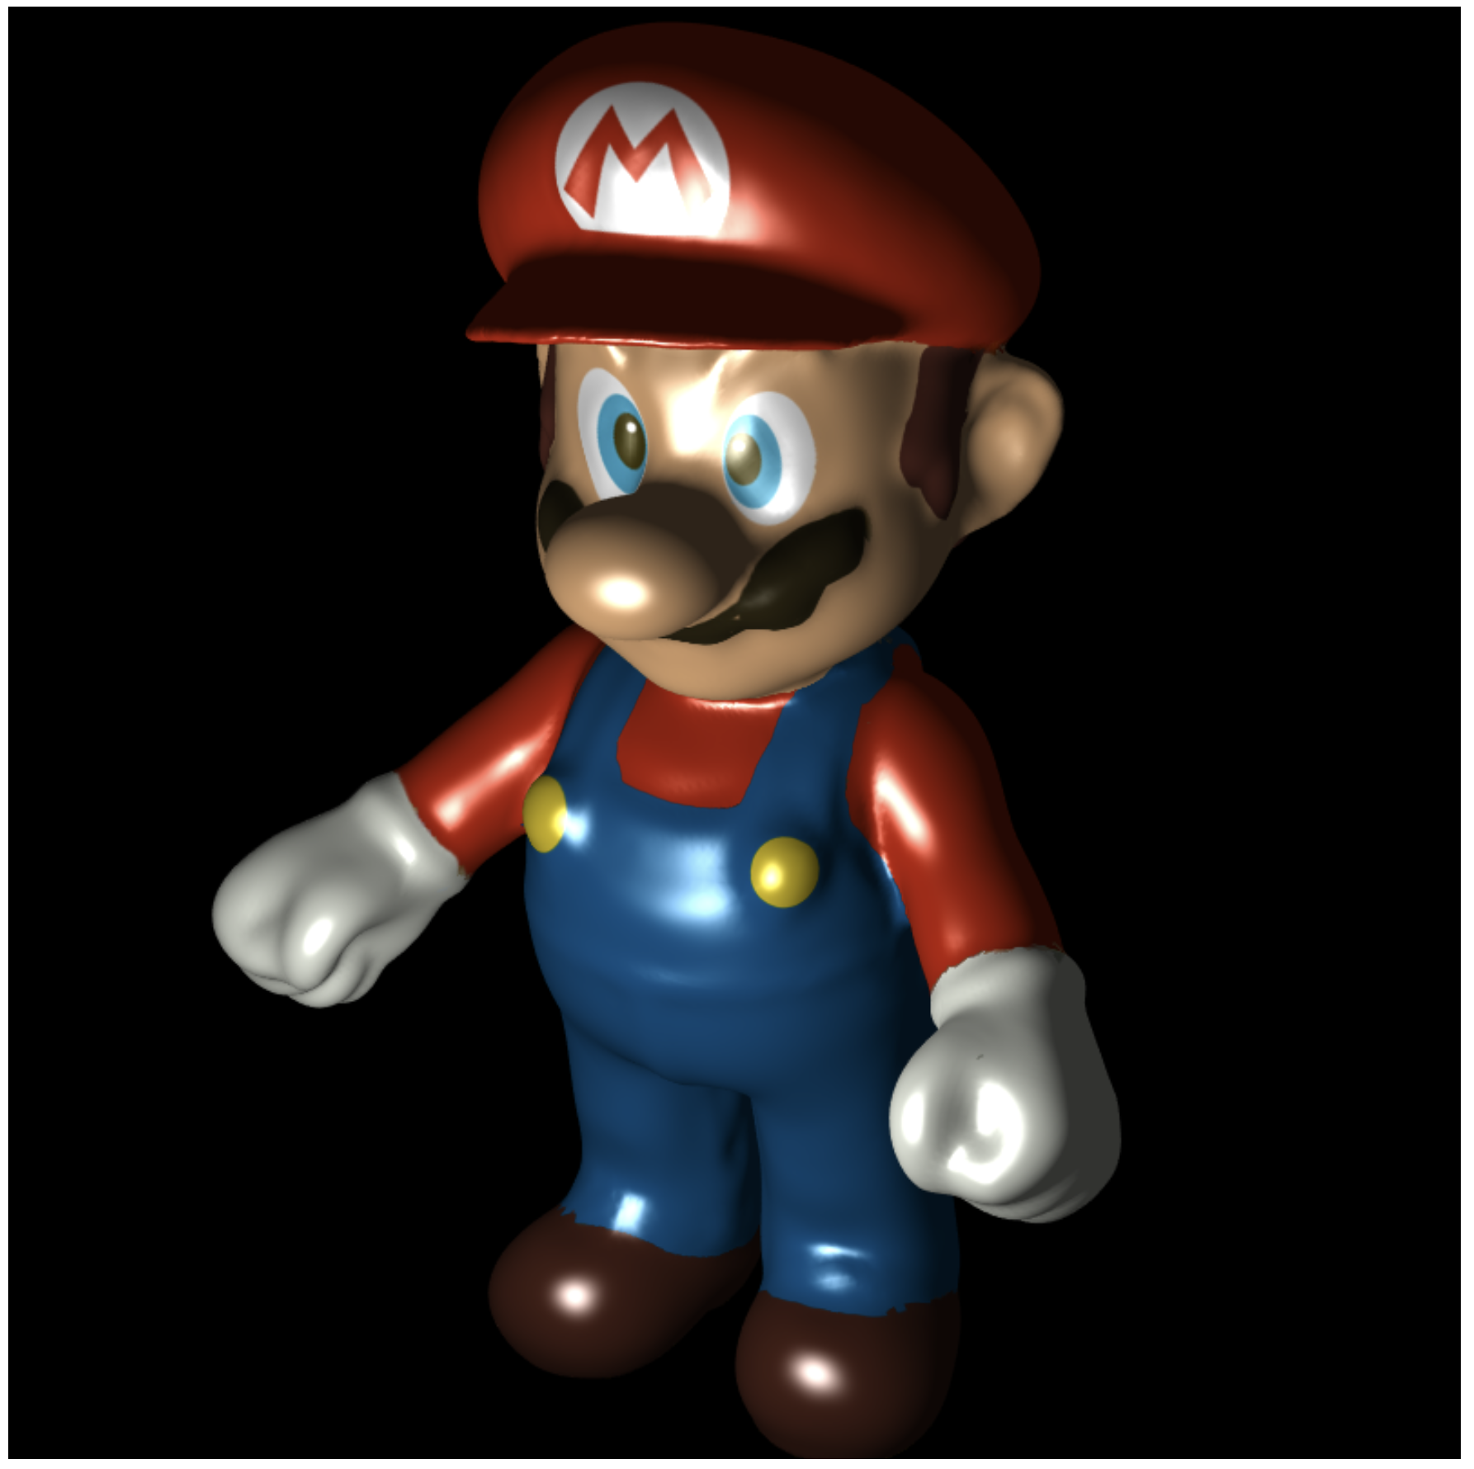
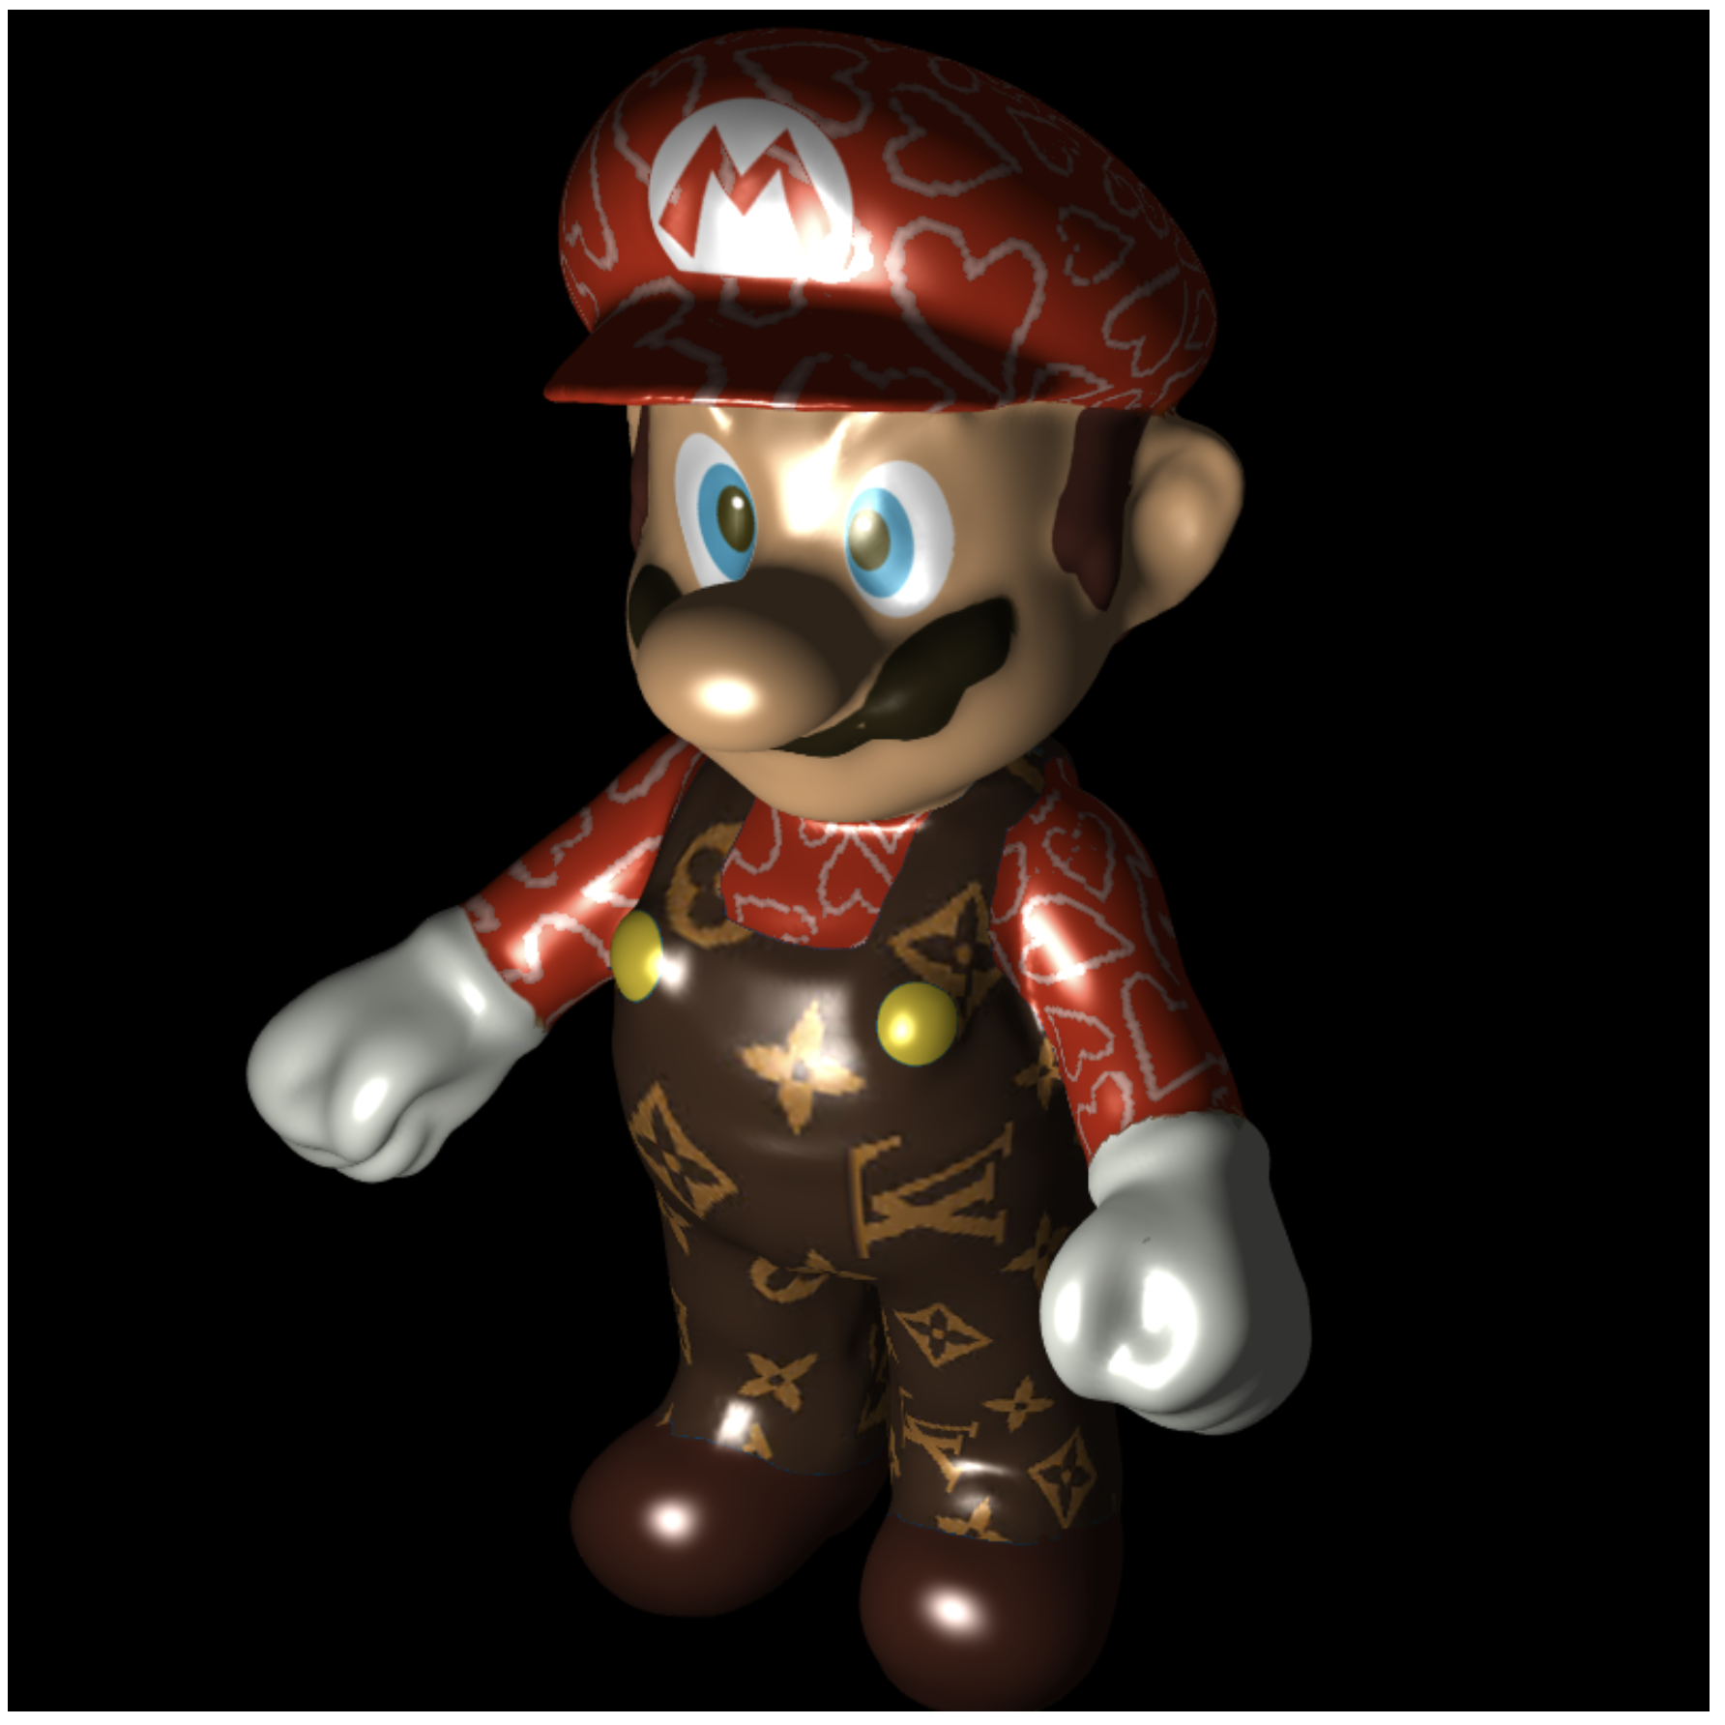
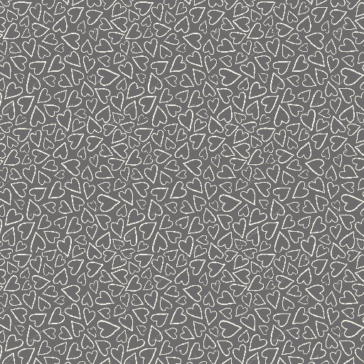
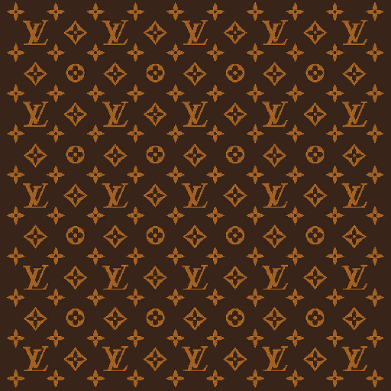
Download the lab8 template
WebGL.js is the same as WebGL.js in Ex08-3 (sonic)
Let’s firstly use texture image, marioD.jpg, to color the mario
Then,
Replace mario’s blue cloth to LV one
Decorate mario’s red hat and red cloth with “hearts”
https://www.youtube.com/watch?v=76lZnT39CNI&ab_channel=Ko-ChihWang

Slide 3
The First Task
You can simply modify the
object file name
content of the variable, “imgNames”
content of the variable, “objCompImgIndex”
and, the value of the variable “objScale”
in WebGL.js to get this result
Then, the challenge comes

Slide 4
The Second Task
1.
You should load the other two texture images, “LVTexture.jpg” and “heart.jpg”
Create texture objects for them
2.
In this task, you need the three texture objects (marioD, LVTexture, heart) at the same time
So, before drawing (call gl.drawArrays()), you should assign them to three different texture units, such as, gl.TEXTURE0, gl.TEXTURE1 and gl.TEXTURE2
In the fragment shader, you also need three sampler2D variables for these three textures

Slide 5
The Second Task
3. To “replace mario’s blue cloth to LV one”
you should identify the fragment which supposed to be colored by blue
then, you color the fragment using the color from the LV texture (look up the texture color using the same texture coordinate) instead of blue color
This is a condition I suggest to identity the blue cloth
distance( colorFromMarioDImage, vec3(0.0, 0.0, 1.0) ) < 0.6

Slide 6
The Second Task
4. Decorate mario’s red hat and red cloth with “hearts”
Idea:
if you find a fragment which should be colored by red (this means the fragment belongs to the hat and the red cloth region)
If you use the same texture coordinate to look up “heart texture” and the color from ”heart texture” is white, this fragment belongs to ”heart contour”
If a fragment belongs to red hat/cloth and heart contour, use the color mixed by marioD texture and heart texture to color the fragment
Otherwise, you still use the color (red) from marioD to color the hat and cloth
This is the equation I suggest to mix the two colors (the fragment inside both red hat/cloth and white heart contour)
colorFromMarioD * 0.4 + colorFromHeartTexture * 0.6
To identify red cloth and hat
I suggest this equation: distance( colorFromMarioDImage, vec3(1.0, 0.0, 0.0) ) < 0.3
To identify heart contour
I suggest this equation: distance( colorFromHeartTexture, vec3(1.0, 1.0, 1.0) ) < 0.7

Slide 7
What You Should Do for “Submission”

Slide 8
Submission Instruction
Create a folder
Put the html and js files in the folder
Zip the folder
Rename the zip file to your student ID
For example, if your student ID is “40312345s”, rename the zip file to “40312345s.zip”
Submit the renamed zip file to Moodle
Make sure
you put all files in the folder to zip
You submit the zip file with correct name
You won’t get any point if
the submitted file does not follow the naming rule,
TA cannot run your code,
or cannot unzip your zip file.

