Slide 1
Transition
Data Visualization

Slide 2
Transitions
When the state of an element changes from current state to desired state, transition helps to apply the change smoothly by interpolating the states between the two end states
https://www.d3-graph-gallery.com/graph/interactivity_transition.html#mostBasic
Applications
Assist interactions
Story-telling a series of visualization connected by interaction and animation
A storytelling demonstration: http://vallandingham.me/scroll_demo/

Slide 3
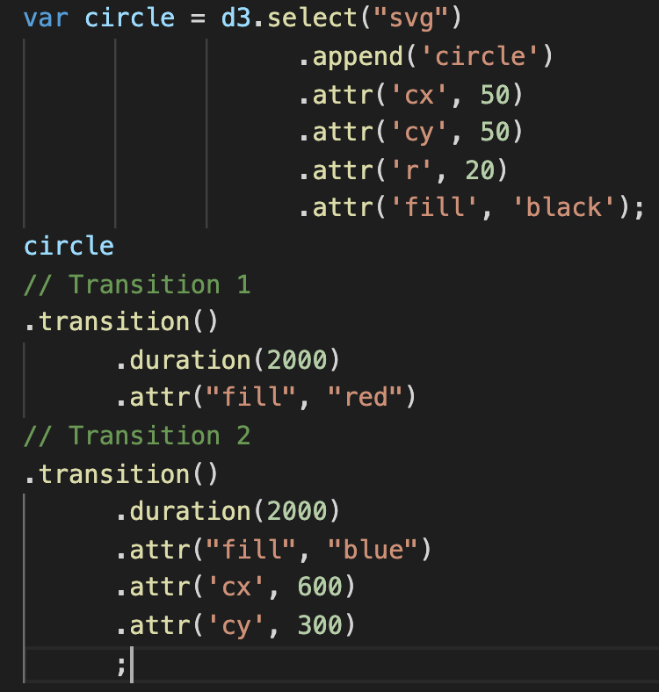




d3.transition() (Ex07-01)
Add a black circle at (20,20)
Color from black to red
Move and change color to blue smoothly

Slide 4
d3.transition() (Ex07-01)
add “.transition()” before modify the attributes of the item, D3 can automatically calculate how to smoothly move from one state to another state
This example: from black to red color
.duration(): this transition should spend 2000milliseconds (2seconds)
Color from black to red
Move and change color to blue smoothly

Slide 5
d3.transition() (Ex07-01)
Transition chaining
We can create multiple transitions
When one transition finishes, next transition in the chain takes off
Color from black to red
Move and change color to blue smoothly

Slide 6
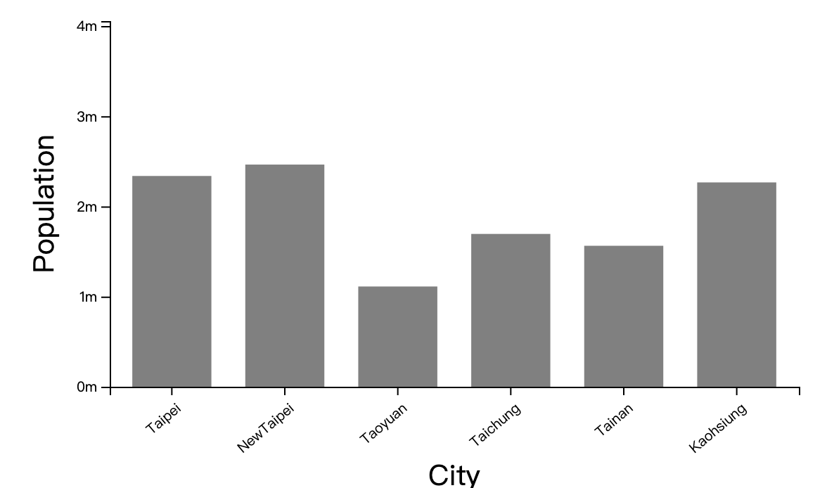
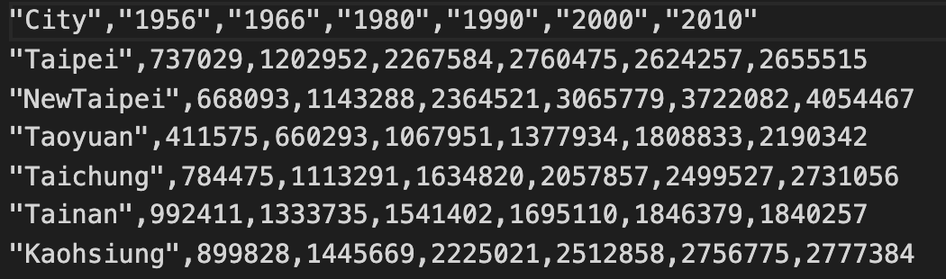
Ex07-02
Animate bar chart
Modify from Ex04-16
cityPopulation.csv
Population of 6 Taiwan sspecial municipalities in 1956, 1966, 1980, 1990, 2000, 2010
Update the bar length by the population in 1956, 1966, 1980, 1990, 2000, 2010

Slide 7
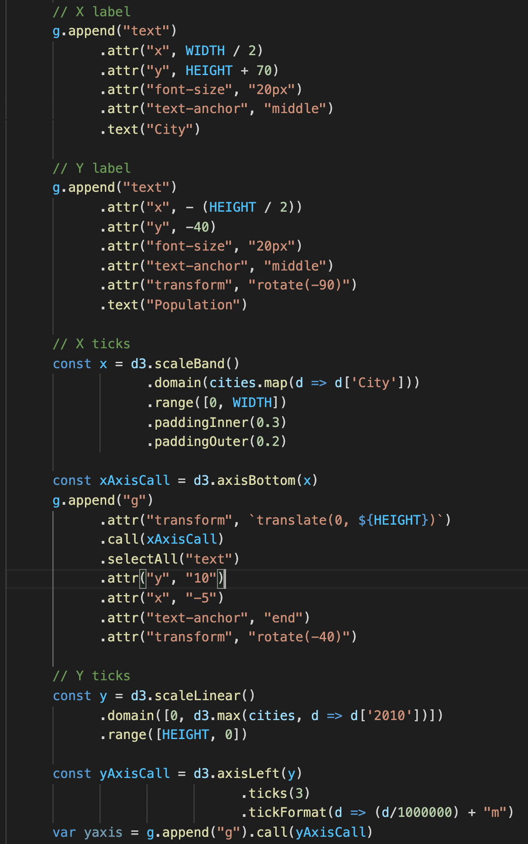
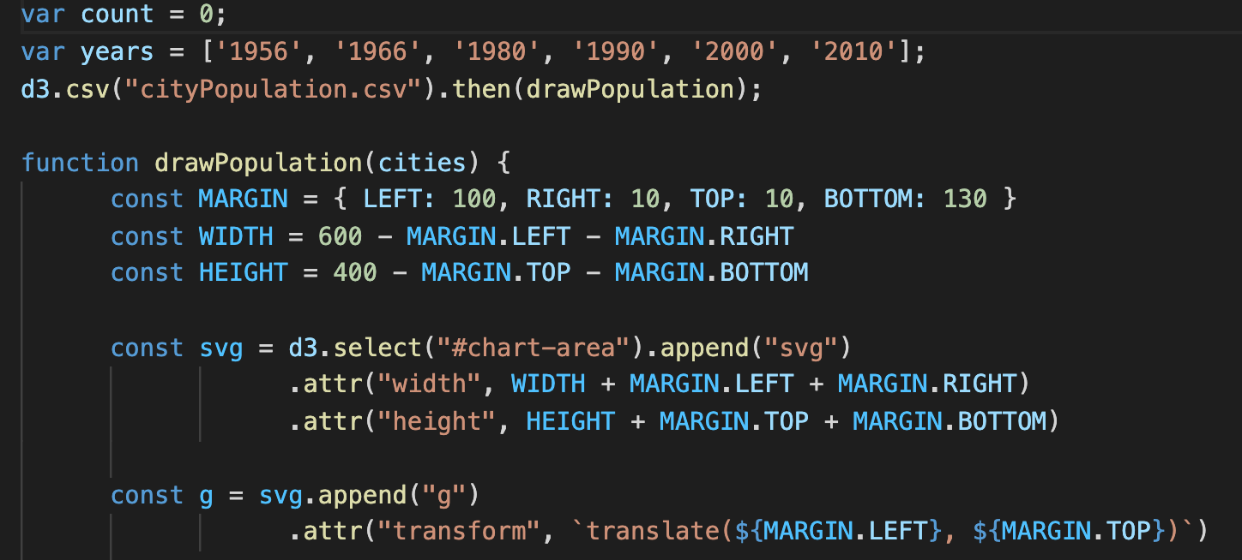
Ex07-02
main.js
Which year to display
All years
Load data. After loading is done, run “drawPopulation()”
Data from “cityPopulation.csv”
Code to setup and display y axis.
We will animate y-axis in Ex07-03
Rest of the code: very similar to Ex04-16 (draw the bar chart)

Slide 8
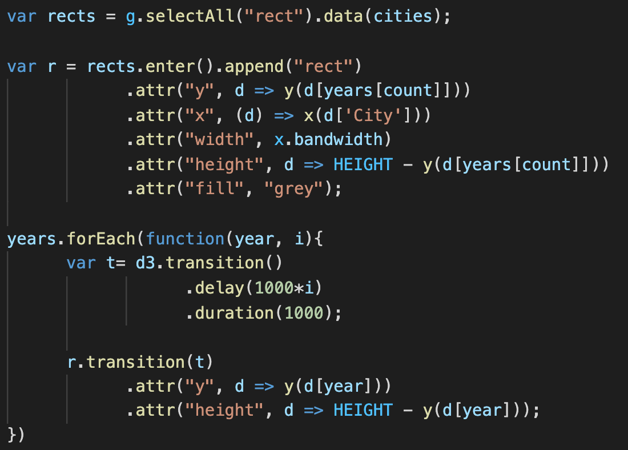
Ex07-02
Count is 0 in the beginning, so years[count] here is ‘1956’ (display data in 1956)
main.js
Draw bars

Slide 9
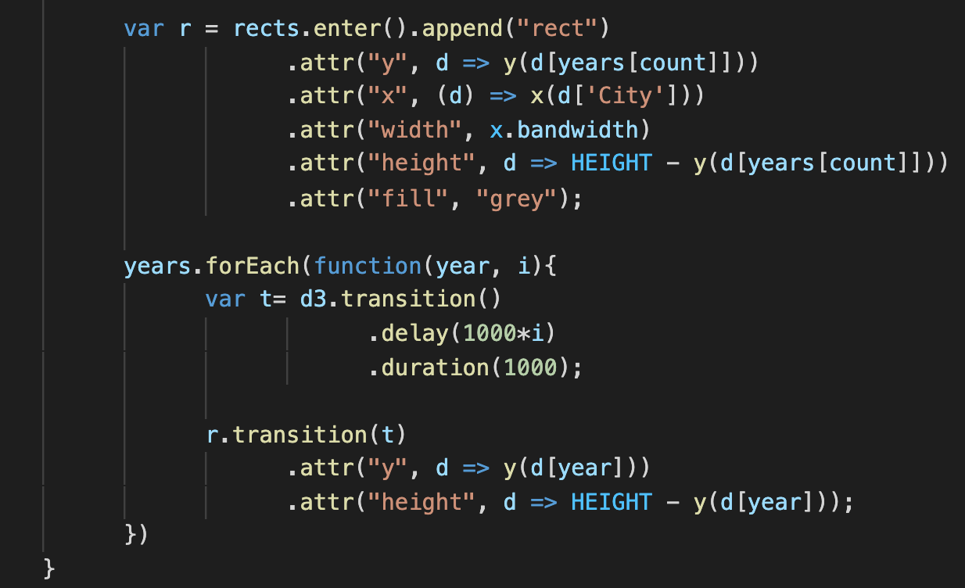
Ex07-02
Red: delay, blue: duration
1956
0
1000
1966
1000
1000
1980
2000
1000
1990
3000
1000
2000
4000
1000
main.js
2010
5000
1000
Iterate through (year, i) =
(1956, 0),
(1966, 1),
(1980, 2),
(1990, 3),
(2000, 4),
(2010, 5),
.delay(): how long to wait (milliseconds) before start the transition animation
This forEach loop finishes and setup all transition from 1956-2010 immediately
Use the transition setting ‘t’ to animate the change

Slide 10
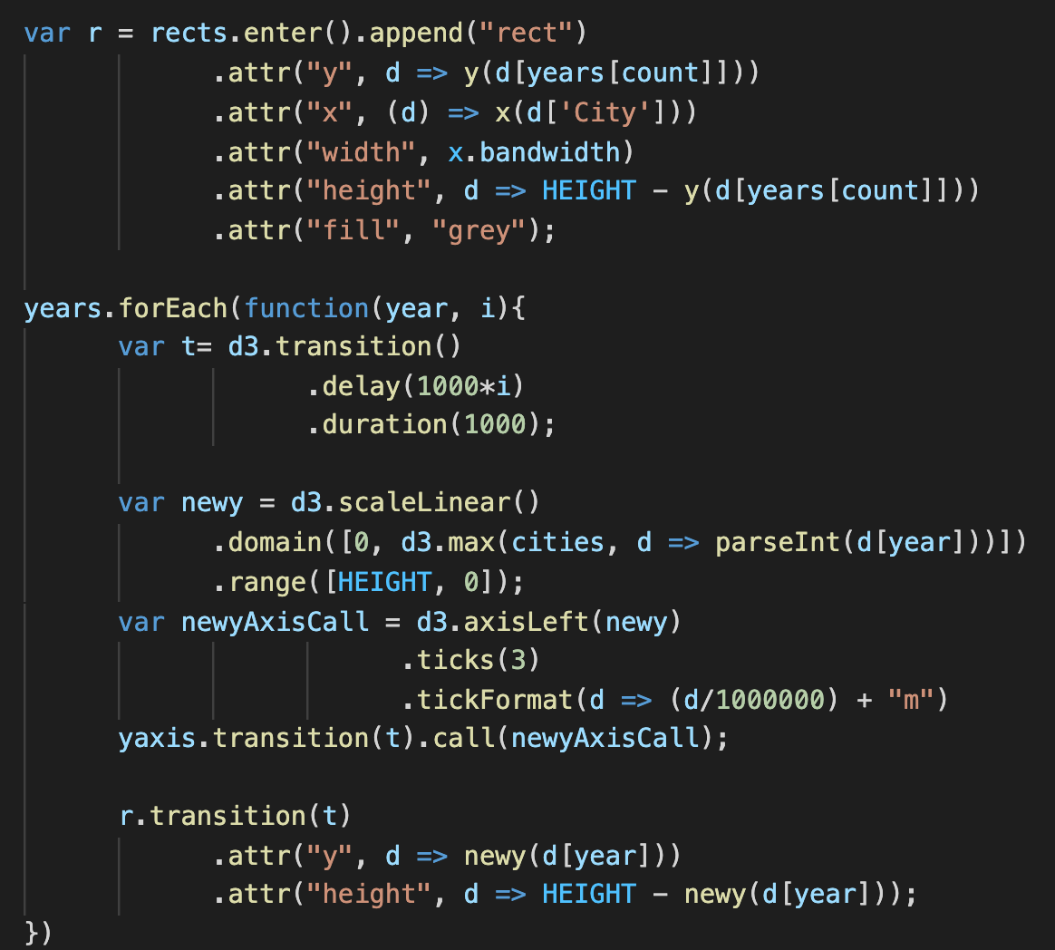
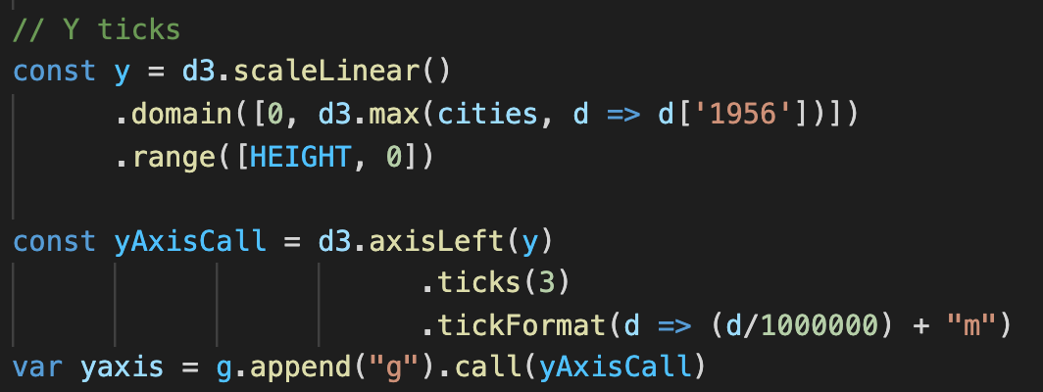
Ex07-03
Animate the y-axis
This is usually how we add y axis
Create a new y scale function by the maximal value of that year
Create new yaxis using new y scale function
Before .call(newAxisCall), call transition(t) to update the y axis smoothly

Slide 11
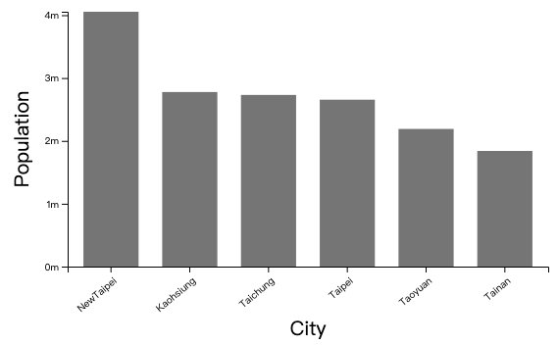
Ex07-04
Animate x-axis and always sort cities by the population

Slide 12
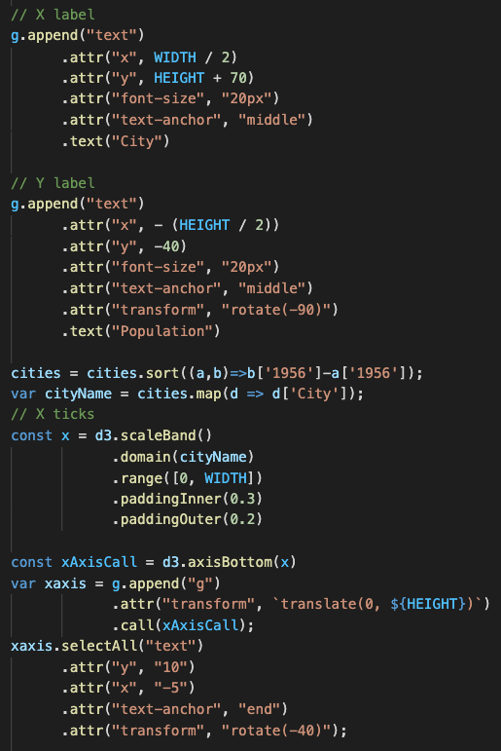
Ex07-04
When we create the first frame, we sort the data by ‘1956’
and retrieve the city name
to create x-axis scale function (scaleBand)

Slide 13
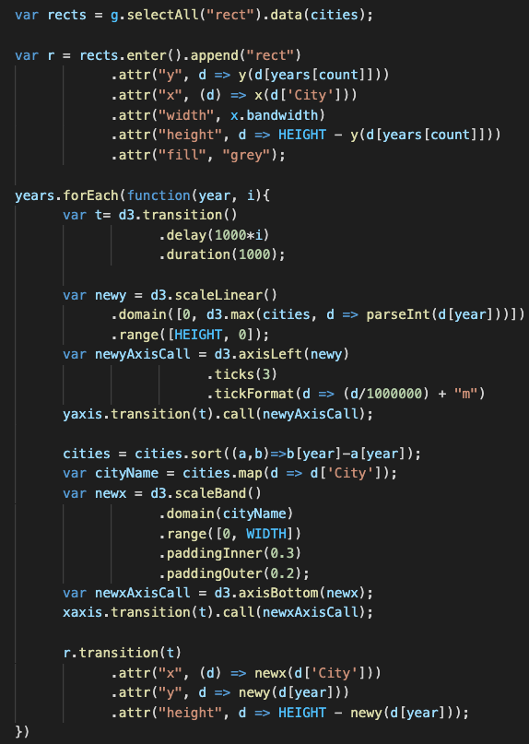
Ex07-04
do the similar thing when we switch to next year
Sort data by the year
Retrieve city name array
Create new x-axis scale function
Draw new x-axis by the new x-axis scale function
Update the x position of bars by new x-axis scale function

