Slide 1
Interaction
Data Visualization

Slide 2
Interaction
It is often required to interact with our visualization to change the appearance of the visual elements or drill down information
Hovering, zooming, clicking etc.
Topics
Mouse event
Tooltip
Drag
Brush
Zoom and pan

Slide 3
Mouse Events
Detect the mouse click, mouse down, mouse enter, mouse leave, mouse over event
selection.on(EventType, listenerFunction)
e.g. d3.selectAll(“rect”).on(“mouseover”, listenerFunction)
EventType: a name(String) of an event type (e.g. “mouseover”)
Any DOM event type supported by your browser may be used (not only mouse events)
Event list: https://developer.mozilla.org/en-US/docs/Web/Events#Standard_events
When a specified event is triggered, the listener function will be invoked

Slide 4
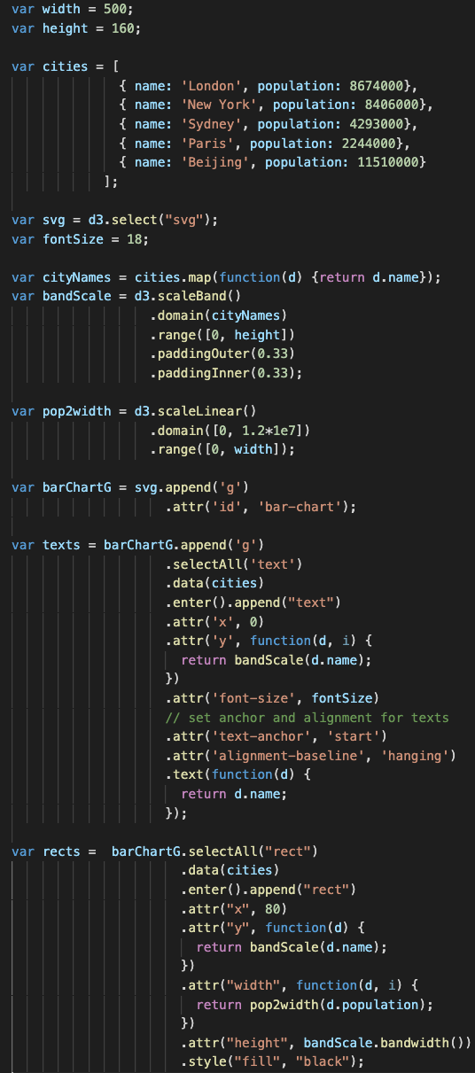
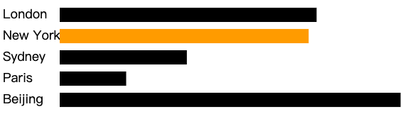
Mouse Events (Ex07-1)
When the cursor is on a bar, the bar is highlighted (by different color)
The screenshot at the right hand side is the first part in main.js
It just draws the bars without mouse event

Slide 5
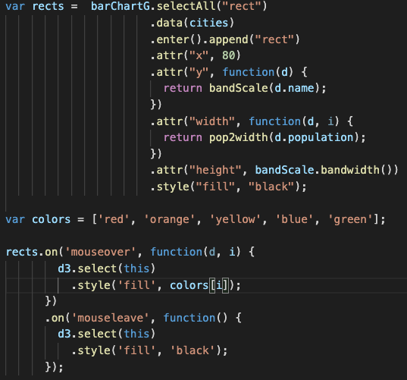
Mouse Events (Ex08-1)
Select all rects
d3.select(this)
rects are all bars
rects.on(….) iterate through all bars
d3.select(this) indicates we are processing which bar “now”
rects
rect
(i=0)
rect
(i=1)
rect
(i=2)
rect
(i=3)
rect
(i=4)
.style(‘fill’, color[0])
.style(‘fill’, color[2])
.style(‘fill’, color[4])
Because “rects” are all rectangles, this statement means that adding these listener functions to all rectangles
.style(‘fill’, color[1])
.style(‘fill’, color[3])

Slide 6
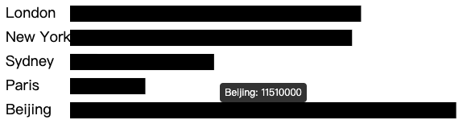
Tooltip - d3.tip()
We can use d3.tip() to pop out a tooltip (small window) and show more details of a items for users

Slide 7
Tooltip - d3.tip()
You can write tool tip function using d3 from scratch
We introduce a plugin library to produce tooltip (make your life easily)
You have to import “d3-tip.js”
I have put “d3-tip.js” in Ex08-02 folder
Steps to use d3.tip() to create a tool tip
1. initializing the tool tip
2. calling the tip in the context of the visualization
3. adding event listener

Slide 8
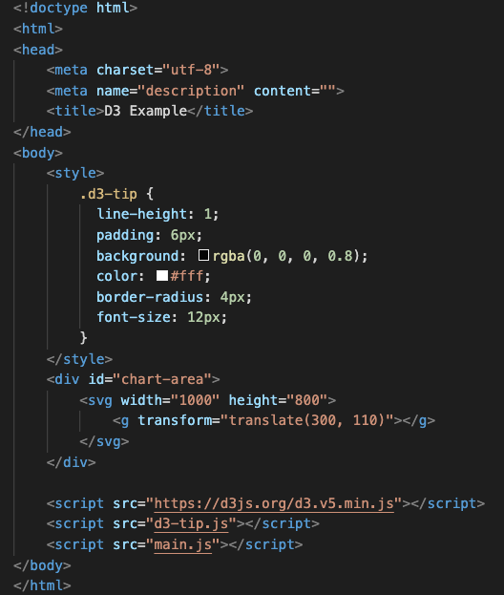
d3.tip() (Ex08-02)
Index.html
What we want
We will go back to check this style later
Import d3-tip.js before main.js
Because we will use it in main.js

Slide 9
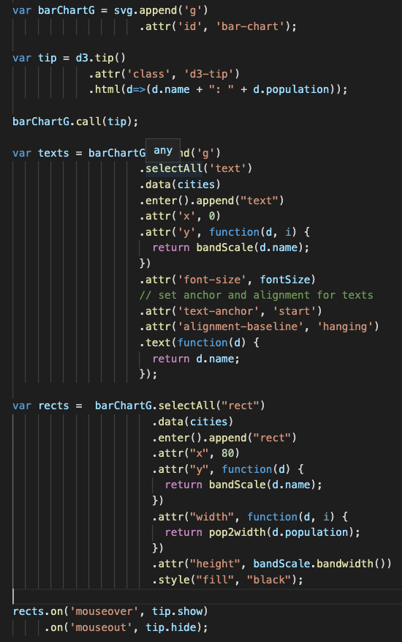
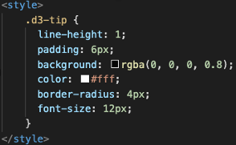
d3.tip() (Ex08-02)
1. initializing the tool tip
Ex08-02 is an extension of Ex08-01. Most of the code in main.js are the same.
We do not introduce the code to create the bar chart again
.attr(‘class’, ‘d3-tip’) determines the appearance of the tooltip
d3-tip? in index.html

Slide 10
d3.tip() (Ex08-02)
1. initializing the tool tip
Ex08-02 is an extension of Ex08-01. Most of the code in main.js are the same.
We do not introduce the code to create the bar chart again
.html(d=>(d.name + “: ” + d.population)) determines what the content of the tooltip is
d is the data item sent to the tooltip

Slide 11
d3.tip() (Ex08-02)
2. calling the tip in the context of the visualization
Ex08-02 is an extension of Ex08-01. Most of the code in main.js are the same.
We do not introduce the code to create the bar chart again
barChartG.call(tip): add/enable the tool tip in barChartG

Slide 12
d3.tip() (Ex08-02)
Ex08-02 is an extension of Ex08-01. Most of the code in main.js are the same.
We do not introduce the code to create the bar chart again
If ’mouseover’, show the tooltip for the item
What to show?
d? the data attached to each rect
If ‘mouseout’, hide the tooltip
3. adding event listener

Slide 13
Mouse Drag Behavior (d3.drag())
Work on an item (such as a rect, a circle…)
Similar to d3.tip()
But you do not need extra plug-in library
2 steps to setup mouse drag event listener
1. initialization and adding event listener
2. calling the “drag” on each item
Three type of events (d3.drag.on(EventType, listener) )
“start”: when you click on the item
“drag”: when you drag the item
“end”: when you release the mouse

Slide 14
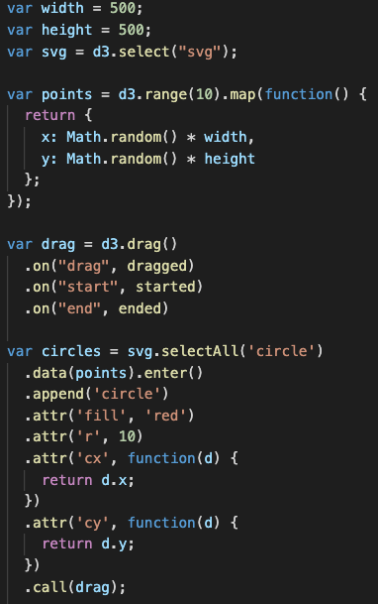
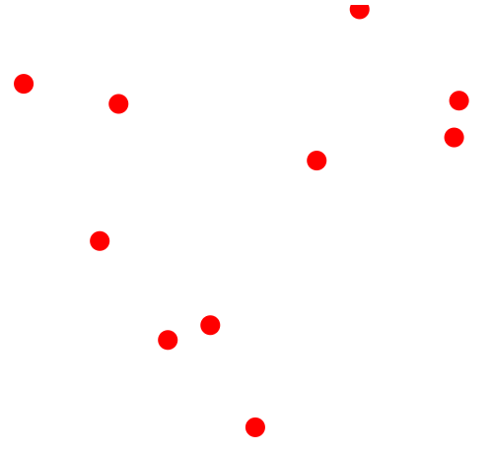
d3.drag() (Ex08-03)
main.js
We will drag to move these circles
Create 10 red circles on the svg with random positions

Slide 15
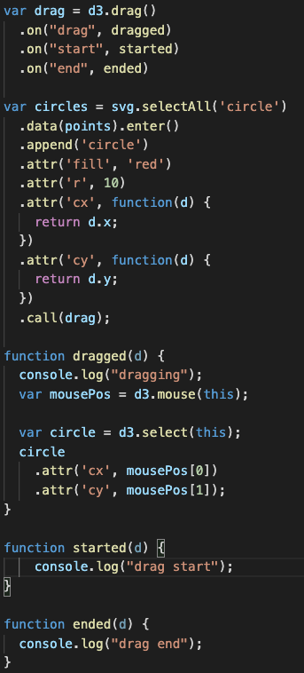
d3.drag() (Ex08-03)
1. initialization and adding event listener
If the drag starts, call “started” function
If dragging, call “dragged” function
If the drag end (release the mouse), call “ended” function
2. calling the “drag” on each item

Slide 16
d3.drag() (Ex08-03)
d3.mouse(this)
Return the x and y coordinates (as an array [x,y]) of the current event relative to the specified container
svg or g
d3.select(this)
Return the item which triggers current event
Change the circle position

Slide 17
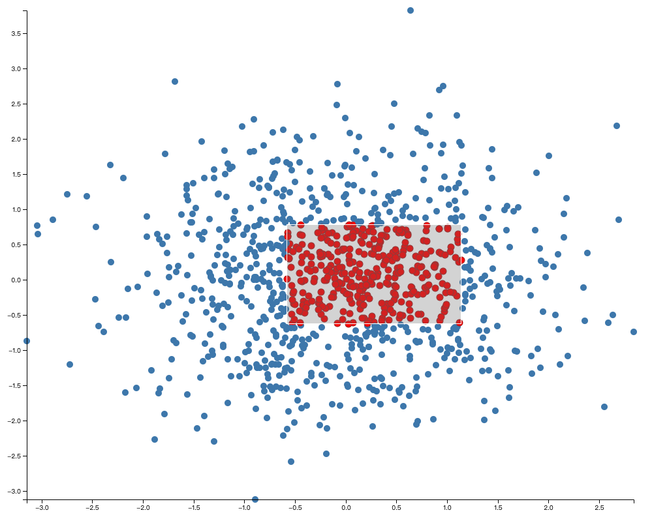
Brushing
Brushing is the interactive specification a one- or two-dimensional selected region using a pointing gesture
Such as by clicking and dragging the mouse
Brushing is often used to select discrete elements, such as dots in a scatterplot or files on a desktop
We creates a scatterplot which supports brushing (Ex08-04)
d3.brush()
Steps (again, similar to mouse drag)
1. initialization, set the brushing area and adding event listener
2. calling the “brush” on the visualization container

Slide 18
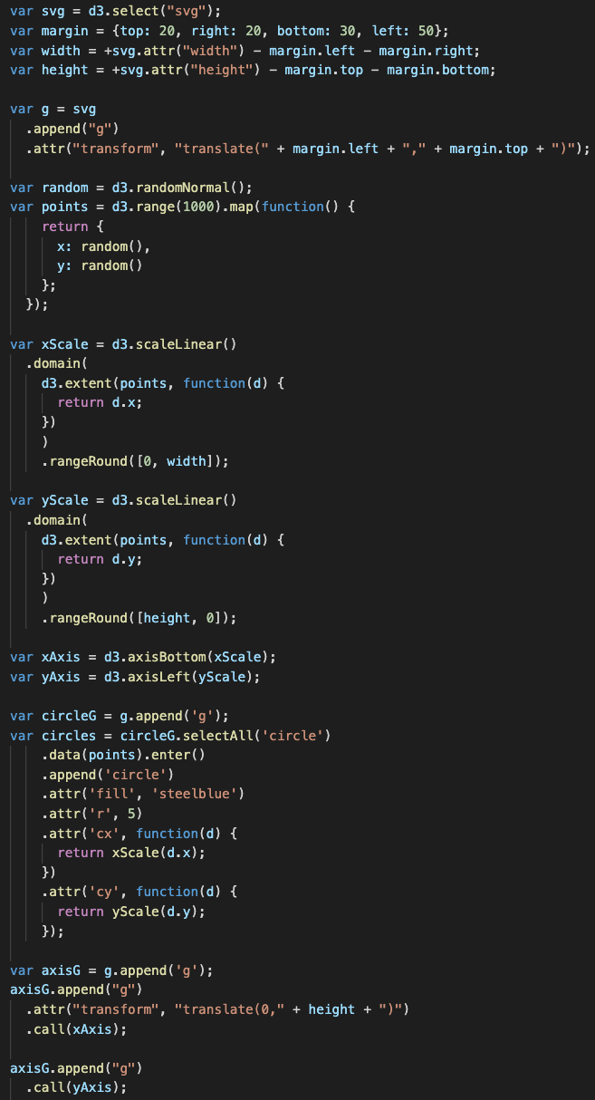
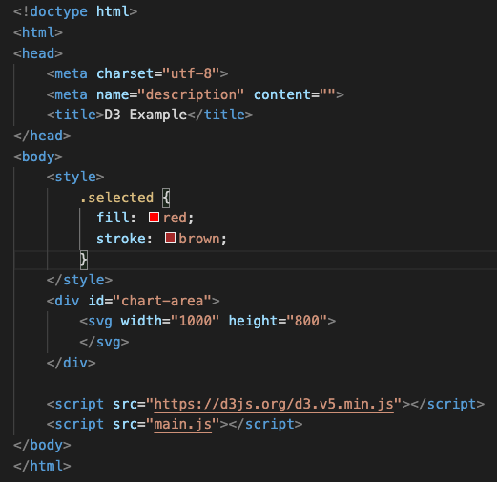
d3.brush() (Ex08-04)
main.js
The first part in main.js is going to draw a scatterplot with axis
index.js
”circleG”: the <g> contains all circles
The style to show the selected circle

Slide 19
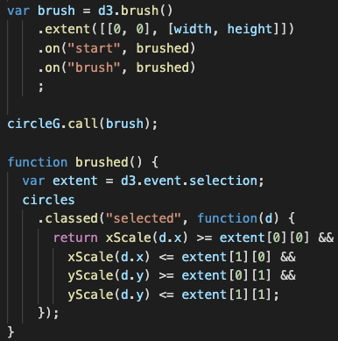
d3.brush() (Ex08-04)
1. initialization, set the brushing area and adding event listener
main.js
d3.brush()
.extent()
Set the brushable area
We limit the brushing behavior within the screen
.on(“start”), .on(“brush”), .on(“end)”
If the brushing “start”/”brushing”/”end”, what should we do?

Slide 20
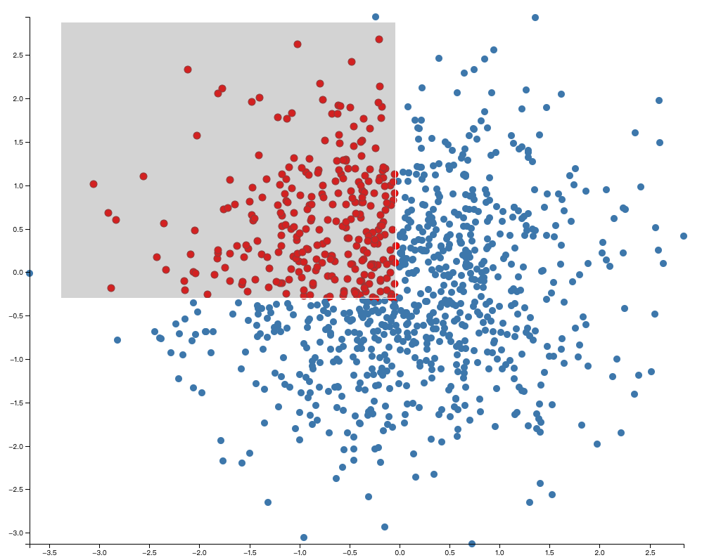
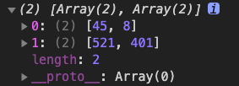
d3.brush() (Ex08-04)
main.js
d3.event.selection
The coordinates of the selected region (top left and bottom right x-y)
If a circle is within the selected area, assign the style “selected” to it

Slide 21
d3.brush() (Ex08-04)
main.js
2. calling the “brush” on the visualization container

Slide 22
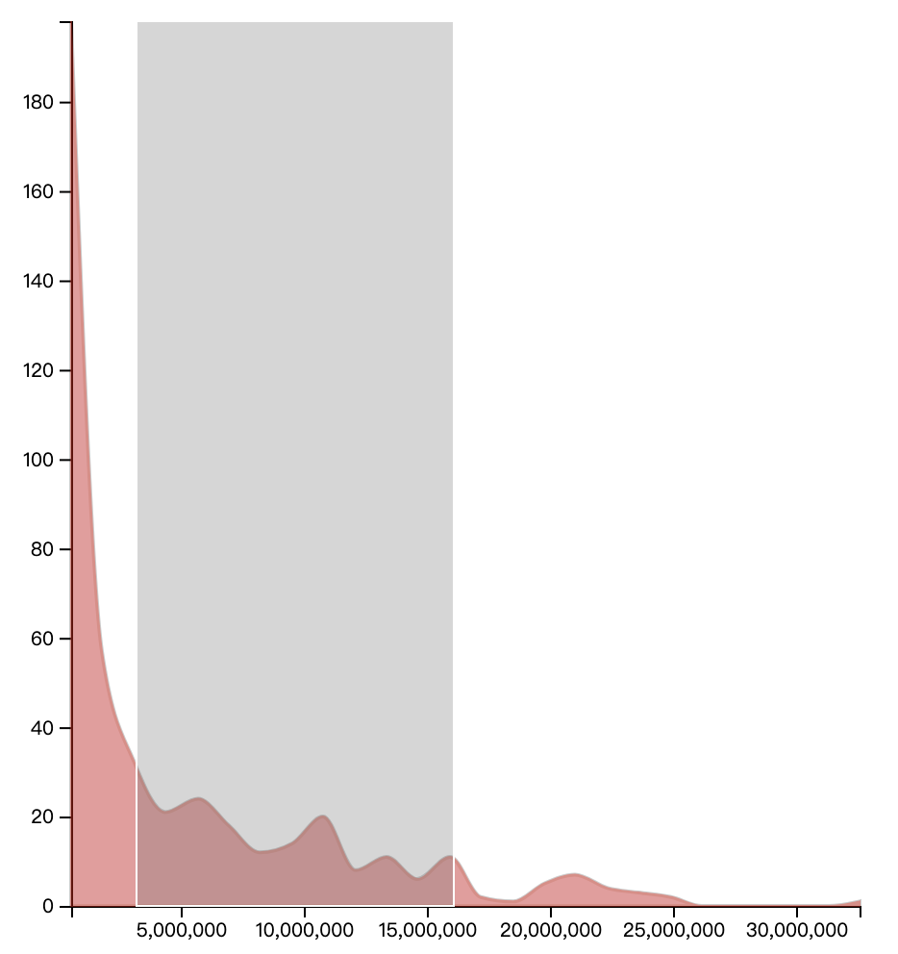
Brush along X or Y-axis only
d3.brushX()
d3.brushY()
Ex: d3.brushX() only allow brushing horizontally

Slide 23
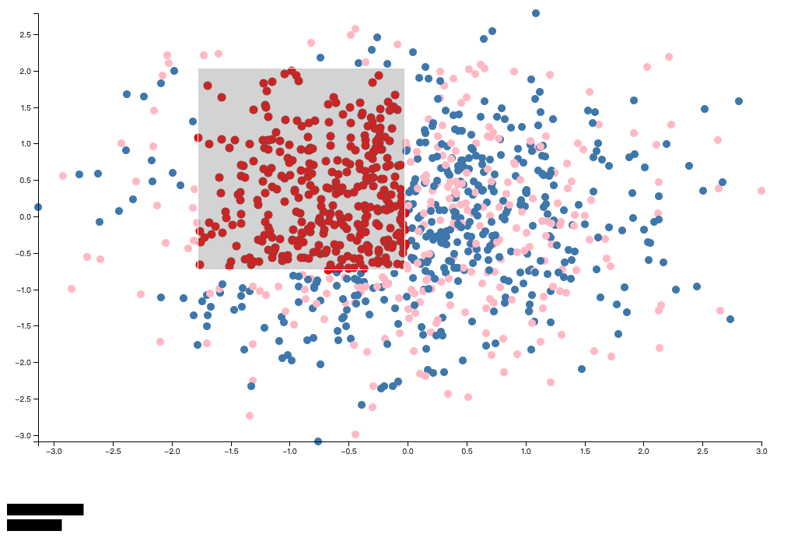
Ex08-05 (Link Views)
Blue: male
Pink: female
Show the selected male and female counts by bar chart
Modify from Ex08-04
File
index.html
main.js
Male and female bars

Slide 24
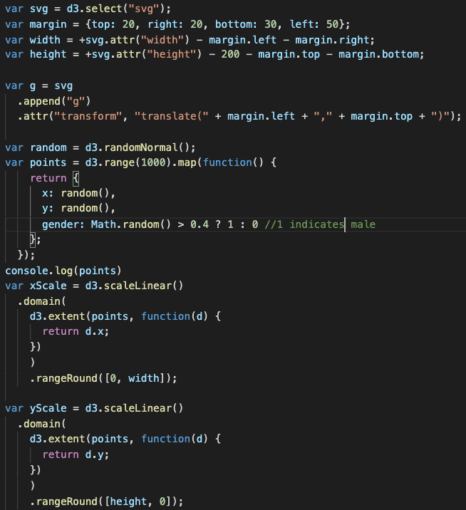
Ex08-05 (Link Views)
Add one more attribute to our data
(Math.random() returns a random number between 0 and 1)

Slide 25
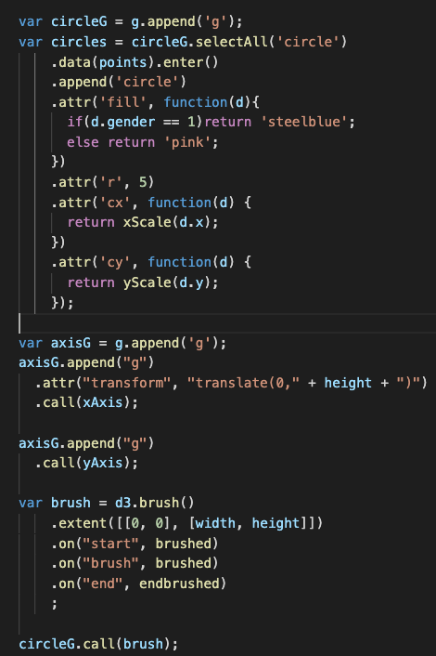
Ex08-05 (Link Views)
If the gender is 1, color the point by steelblue, otherwise, color it by pink
Run “brushed()” when we start to brush and are brushing. (we are going to calculate the number of selected male and female in brushed() )
Run “endbrushed()” when brushing is done. (we are going to update the bar chart in endbrushed() )

Slide 26
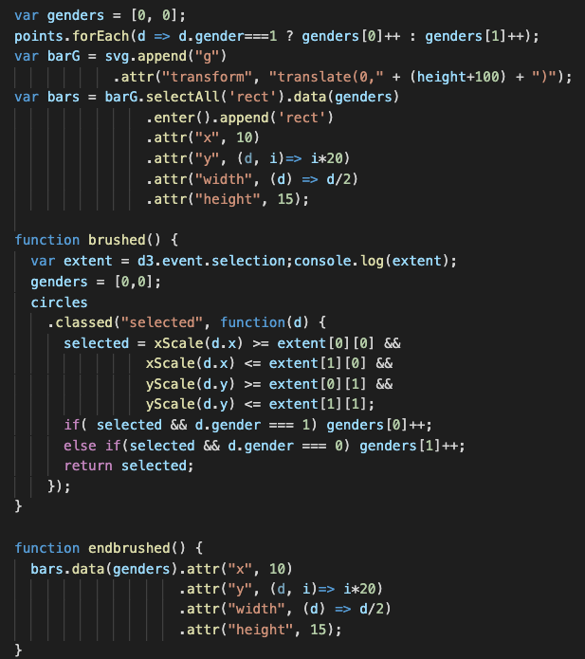
Ex08-05 (Link Views)
Initially, calculate the total number of male and female, and plot the bars
Only for the purpose of link view demonstration, we do not add axis and scale function (just make it short and simple)

Slide 27
Ex08-05 (Link Views)
When the user is brushing, Recalculate the number of selected male and female, and store the result in “genders”

Slide 28
Ex08-05 (Link Views)
When the brushing is done, update the bar chart.
Bind the data (genders) to bars (rect) again and update attributes of rects

Slide 29
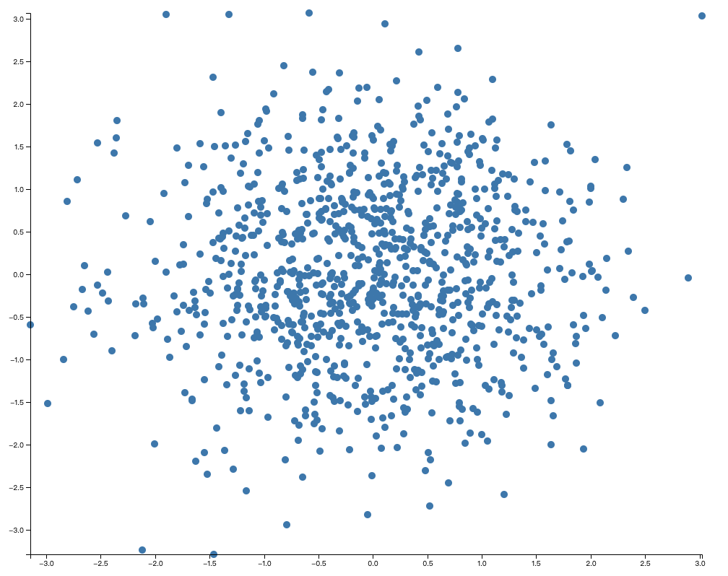
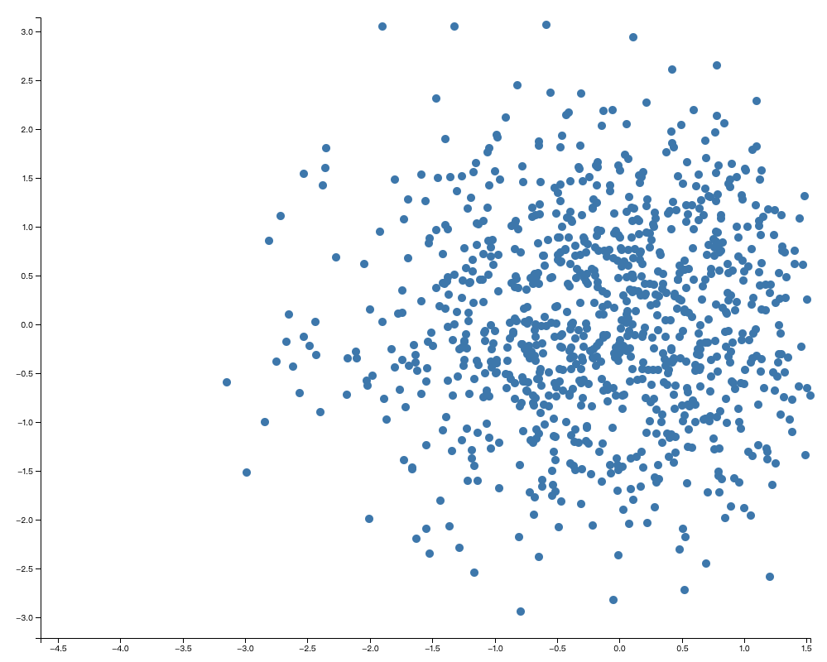
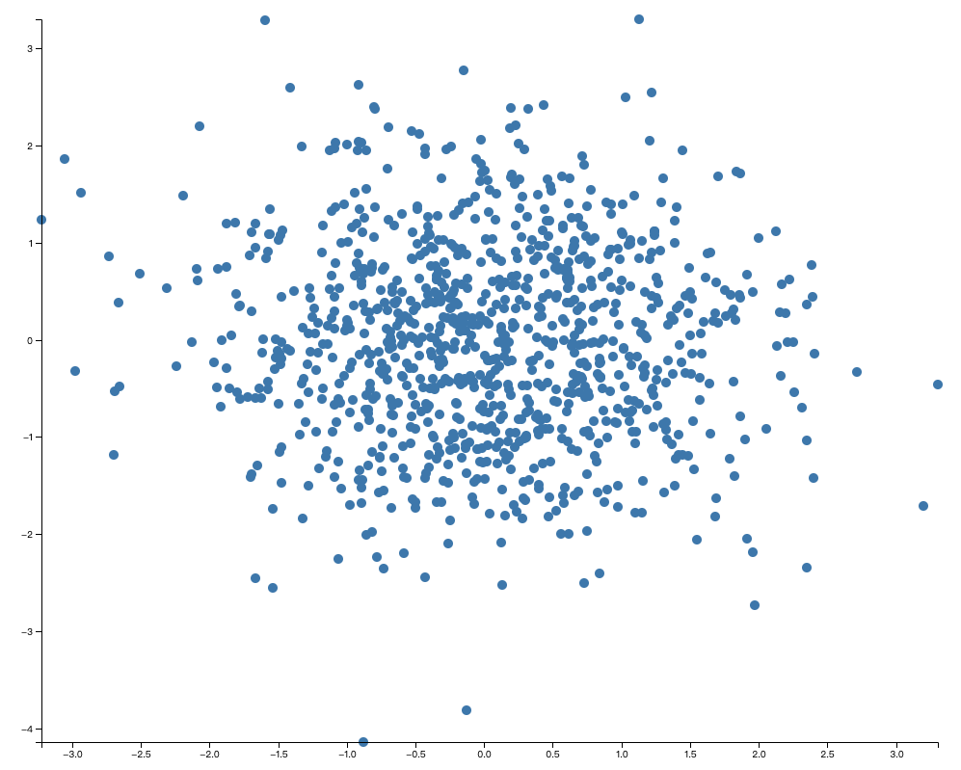
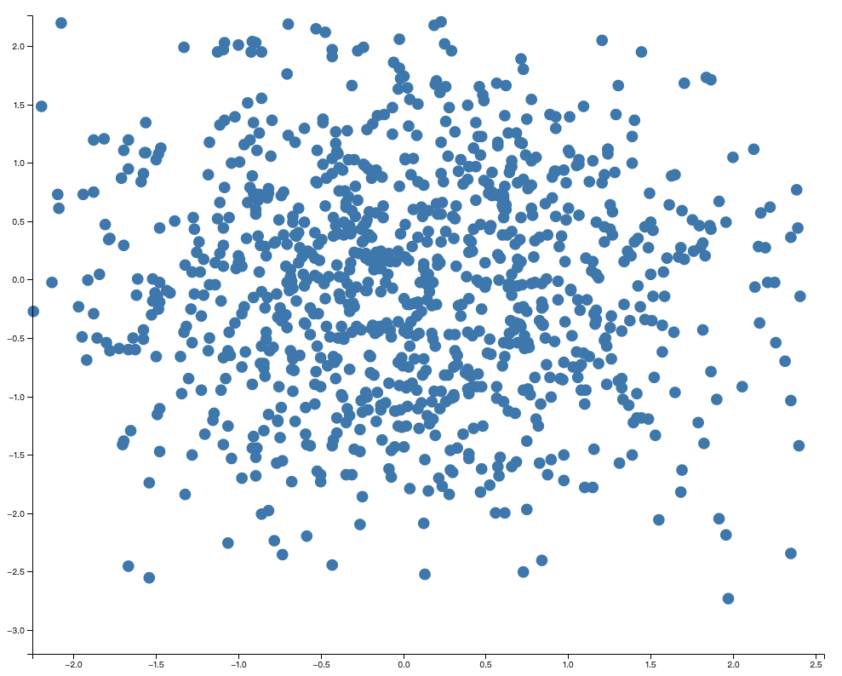
Zooming and Panning
Zooming and panning are popular interaction techniques which let the user focus on a region of interest by restricting the view
Zooming and panning are widely used in web-based mapping, but can also be used with visualization such as time-series and scatterplots
Pan by mouse
zoom in by mouse
To right

Slide 30
Zooming and Panning (Ex08-05)
d3.zoom() for both zooming and panning
Steps (again, similar to brushing)
1. initialization, set the scale extent and adding event listener
2. calling the “zoom” on the visualization container
(you have to handle the x and y axis after panning and zooming)
zoom in by mouse
30

Slide 31
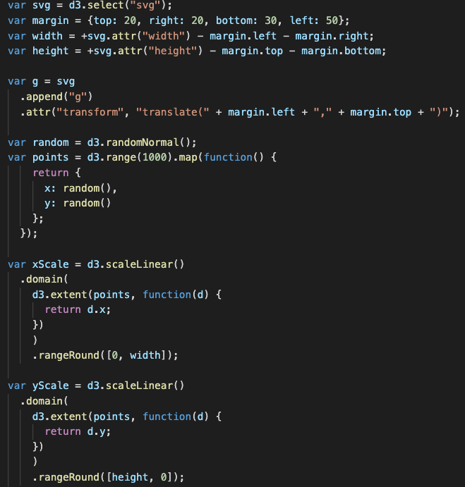
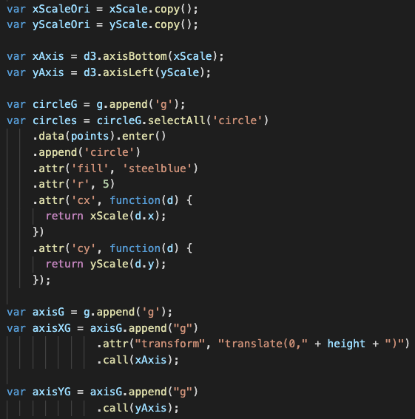
Zooming and Panning (Ex08-05)
main.js (draw the scatterplot with x-y axis first)
xScaleOri and yScaleOri: store the initial scales for x and y axis (we need them later)
X and y axis
All the circles
xScale and yScale: scale functions to create x-y axis and map circles to the plot
axisXG and axisYG: the <g> tags contain x and y axis

Slide 32
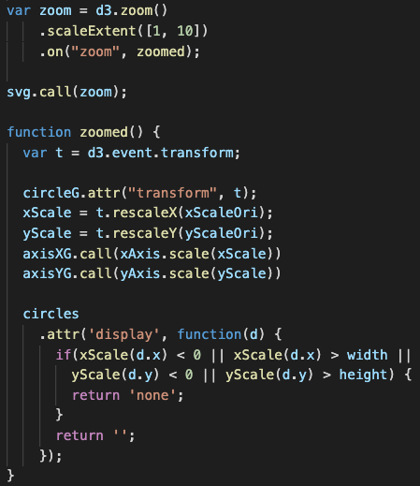
Zooming and Panning (Ex08-05)
main.js
d3.zoom()
.on(”zoom”, listener): trigger the listener when zooming or panning
.scaleExtent([min, max]): sets the min and max zooming factors
E.g.: scaleExtent([1, 10])
Minimal scale factor: original scale
Maximal scale factor: 10x
1. initialization, set the scale extent and adding event listener
2. calling the “zoom” on the visualization container

Slide 33

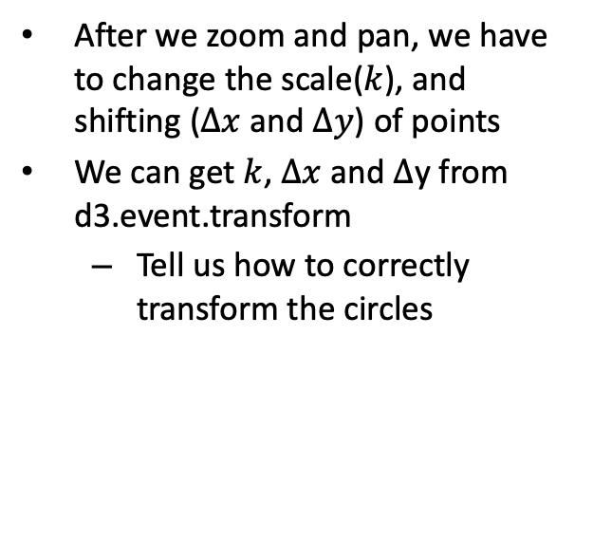
Zooming and Panning (Ex08-05)
main.js
After we zoom and pan, we have to change the scale($k$), and shifting ($∆x$ and $∆y$) of points
We can get $k$, $∆x$ and $∆$y from d3.event.transform
Tell us how to correctly transform the circles
Example
Scale factor: 1.2517
Translate along x axis -539.30 pixels
Translate along y axis – 108.24 pixels

Slide 34
Zooming and Panning (Ex08-05)
main.js
Update the x and y axes
circleG: the <g> contains all circles
Transform it by “t”

Slide 35
Zooming and Panning (Ex08-05)
main.js
Update the x and y axes
circleG: the <g> contains all circles
Transform it by “t”
Use “t” to rescale the original x and y scale functions (xScaleOri and yScaleOri)
And, set x and y axes using the new x and y scale functions

Slide 36
Zooming and Panning (Ex08-05)
main.js
Update the circles
If the circles are still within the plot region, show it. Otherwise, hide it.
How to hide it? Set the circle’s ’display’ attribute to ‘none’
Calculate where to show a circle by sending the the circle’s raw data (x, y) to new x- and y- scale function.
If the position you should draw it is out of the plot area, hide it

