Slide 1
Force-directed Layout
Data Visualization

Slide 2
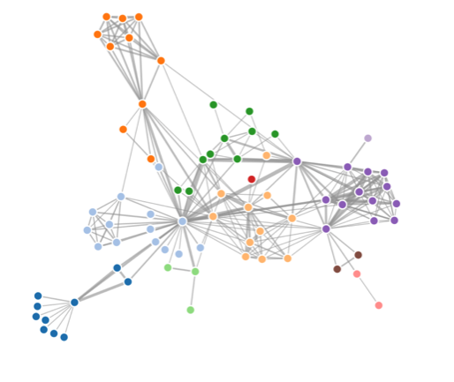
Force-directed Layout
Use a physics-based simulator for positioning visual elements
(Do not define the positions of nodes by you)
Given the conditions (force to attract or repulse nodes)
Forces move nodes each iteration
Settles into a stable configuration
D3: forced directed layout document
https://github.com/d3/d3-force

Slide 3
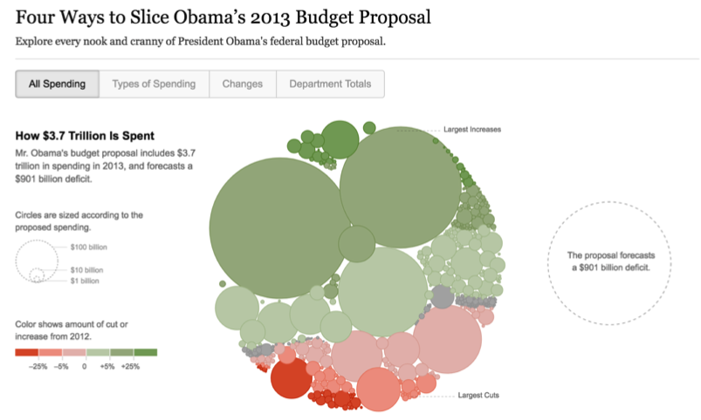
Application
https://archive.nytimes.com/www.nytimes.com/interactive/2012/02/13/us/politics/2013-budget-proposal-graphic.html

Slide 4
Steps to Use D3 Force
Step1: initialize the force simulation
Step2: add force functions to the system
Step3: create a callback function to update SVG positions after every “tick”

Slide 5
D3 Force Functions
forceCenter: for setting the center of gravity of the system
forceManyBody: for making elements attract or repel one another
forceCollide: for preventing elements overlapping
forceX and forceY: for attracting elements to a given point
forceRadial: for force towards a circle of the specified radius centered at (x,y)
forceLink: for creating a fixed distance between connected elements
Example:
simulation.force(‘charge’, d3.forceManyBody())

Slide 6
forceCenter
Centering your elements around a central point of gravity
simulation.force(‘center’, d3.forceCenter(100,100))
All the element will be attracted to (100,100)
force
force
(100, 100)
force

Slide 7
forceManyBody
Making your elements attract or repeal each other (default strength value: -30)
Negative value: repeal each other
Positive value: attract each other
large positive/negative value: attract/repeal each other with more strength
simulation.force(‘charge’, d3.forceManyBody.strength(-20))
-20: repeal each other
Force (repeal)
Force (repeal)
Force (repeal)

Slide 8
forceCollide
Stopping elements from overlapping
Idea
Give each element a radius which defined a round area for each element
If any two of them overlap with each other, force collide will try to push them apart
Not allow to overlap

Slide 9
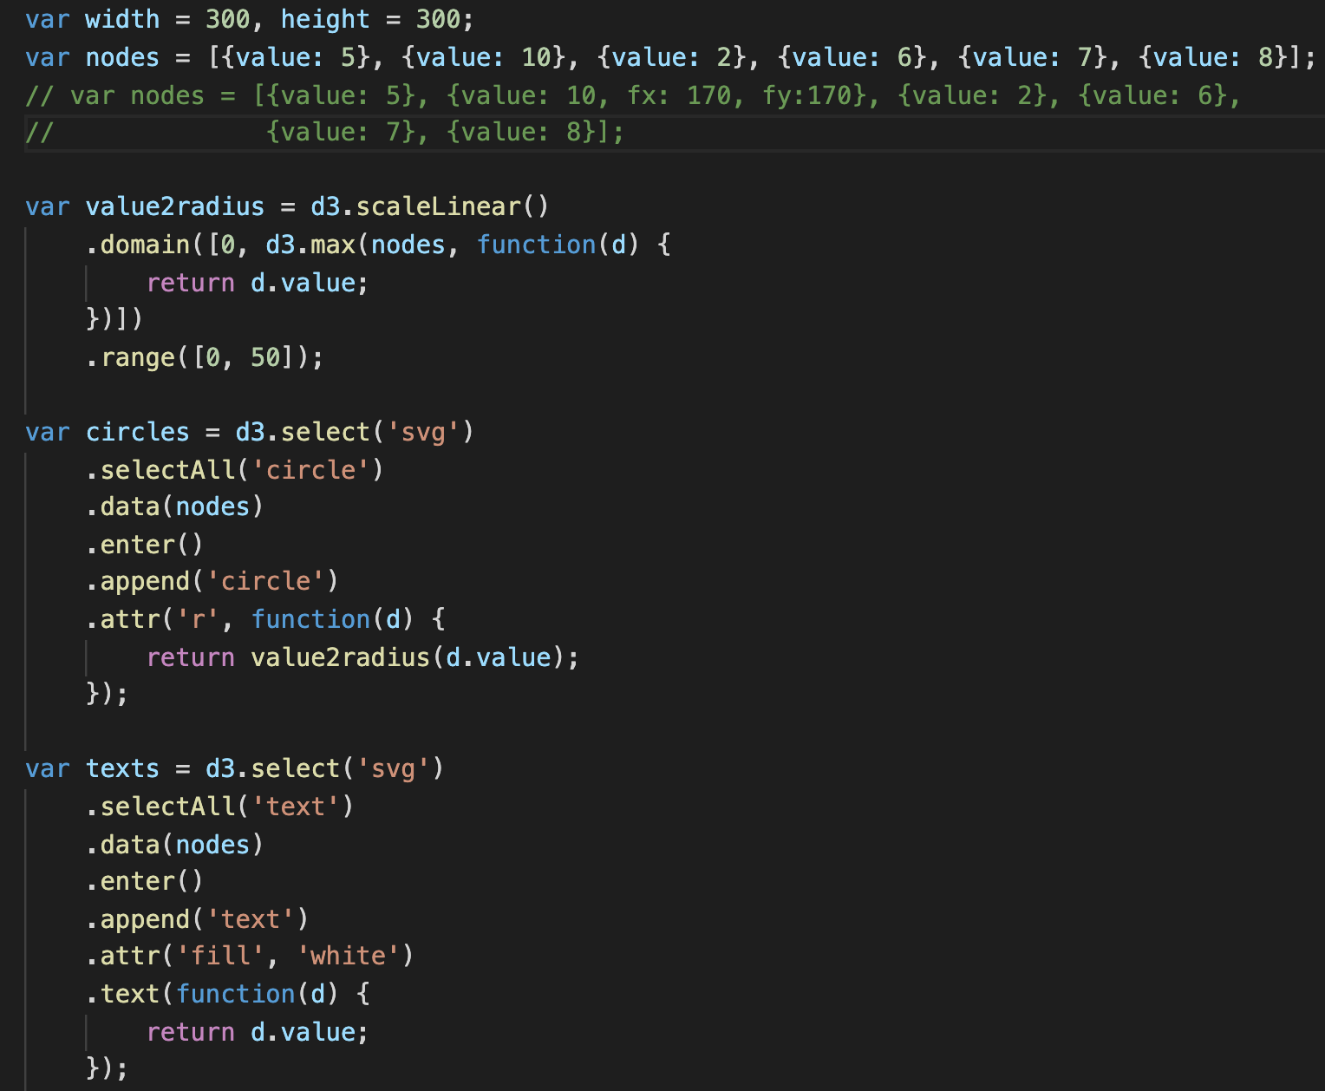
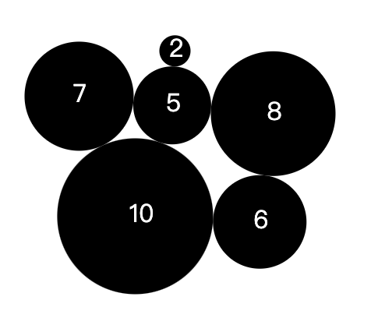
Ex09-01
Radius of each circles To use the simulator, each node (element ) must be a dictionary
main.js
Demonstrate and explain the details of the force simulator
Scale function to map ‘value’ to real circle radius
Add circles to svg
Add texts to each circle

Slide 10
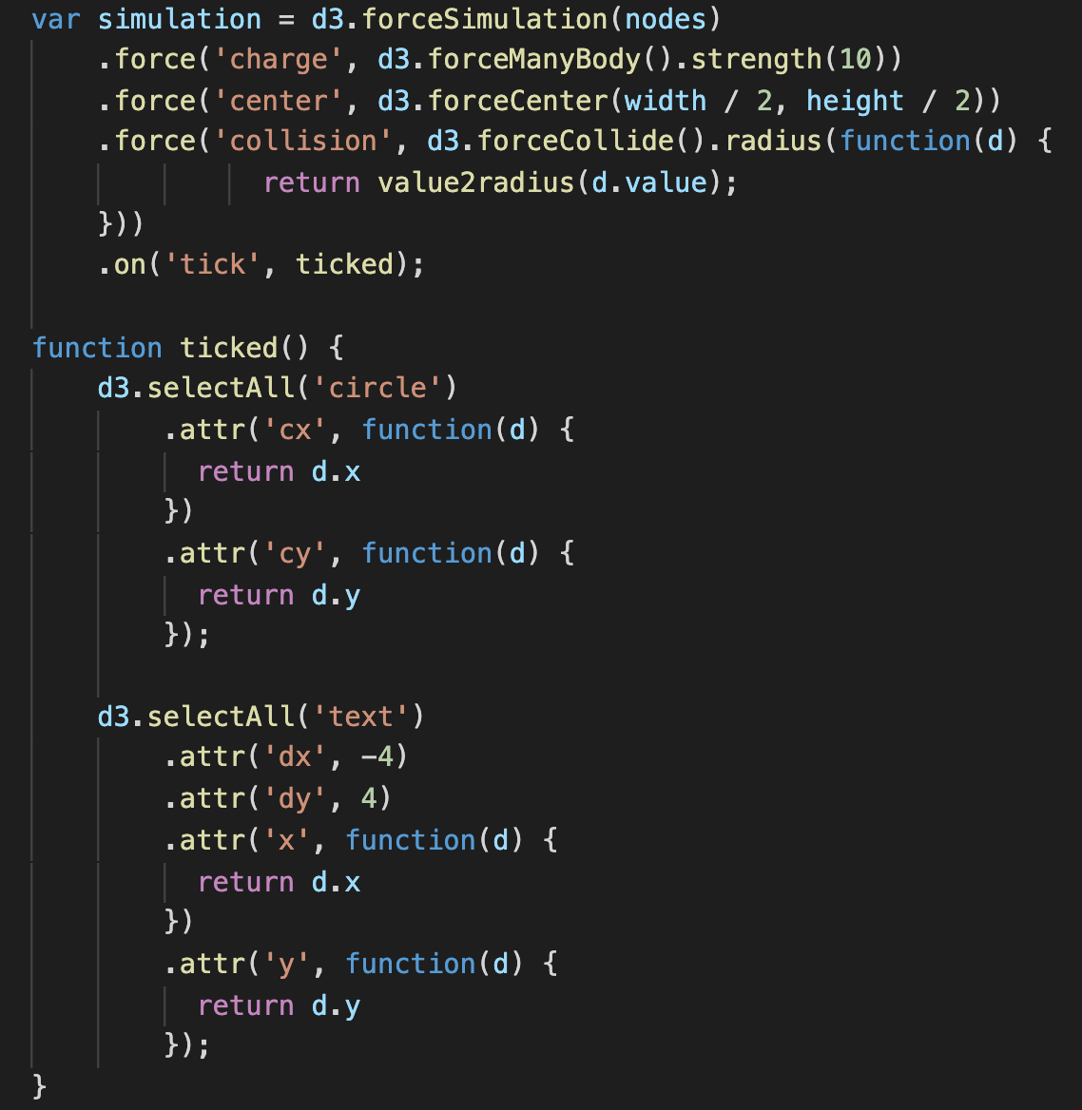
Ex09-01
nodes: your data.
nodes is an array with 6 elements, so simulator knows it has to simulate the force among 6 elements
Step1: initialize the force simulation

Slide 11
Ex09-01
Step2: add force functions to the system
use .force()
d3.forceManyBody().strength(10)
These elements will attract each other

Slide 12
Ex09-01
Step2: add force functions to the system
use .force()
d3.forceCenter(width/2, height/2)
Attract all element to (width/2, height/2)

Slide 13
Ex09-01
Step2: add force functions to the system
use .force()
d3.forceCollide()
These elements should not overlap with each other
.radius()
Give it a function to set “the region” of each circle

Slide 14
Ex09-01
Step2: add force functions to the system
use .force()
The first parameter of .force()?
Just a ‘name’ of the force you assign, you can give it an arbitrary name (such as ‘abc’)
If you want to remove a force from the simulator, you will need the name. For example, “simulation.force("charge", null);”
If you never remove a force, the names are useless.

Slide 15
Ex09-01
Step3: create a callback function to update SVG positions after every “tick”
The simulator iteratively calculates the element positions and try to make all elements positions stable
The simulator automatically call the function (in .on() ) to update states of elements
‘tick’: call the function, ticked after every iteration
What are the data bound with these circles?
what is ‘d’ here?
Update circle’s states (position)

Slide 16
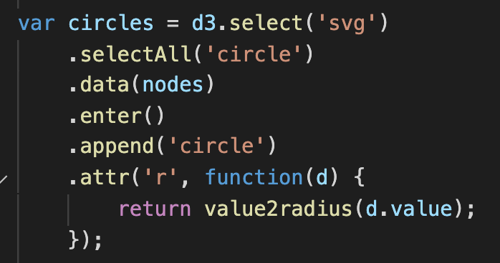
Ex09-01
a
When you bind data to circles, each circle element just points to a data element of the nodes array

Slide 17
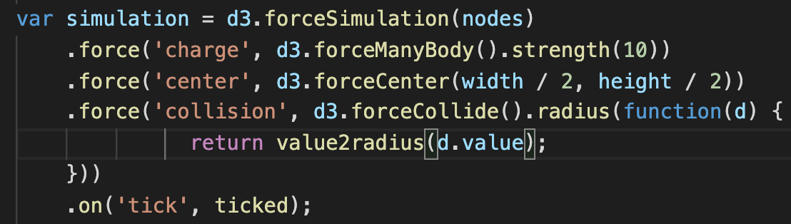
Ex09-01
a
When you bind the data array to the simulator, the simulator also just points to the data array.
When you bind data to circles, each circle element just points to a data element of the nodes array
So, if anyone modifies the data array, ‘nodes’, the data which bind on the circles and the simulator will change as well

Slide 18
Ex09-01
a
When you bind the data array to the simulator, the simulator also just points to the data array.
When you bind data to circles, each circle element just points to a data element of the nodes array
So, if anyone modifies the data array, ‘nodes’, the data which bind on the circles and the simulator will change as well

Slide 19
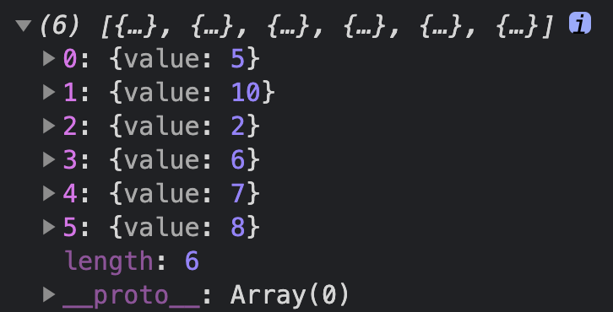
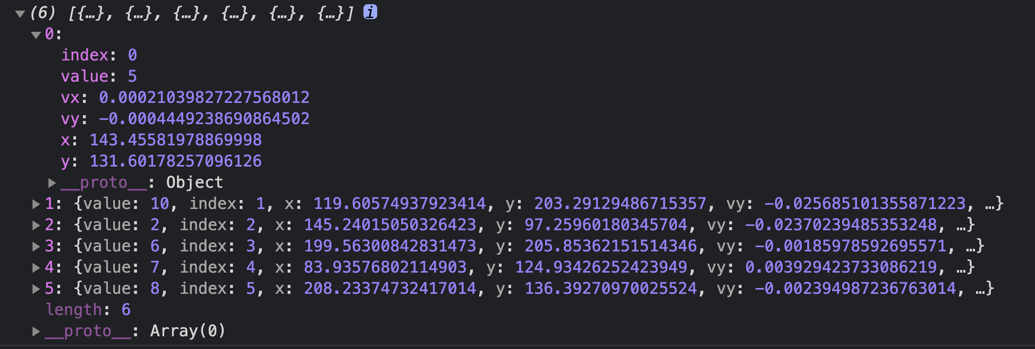
Ex09-01
How does the simulator tell you the information from its force simulation algorithm?
When running the simulation, the simulator modifies the data array (add more key-value into your data array) to tell you where you show display your circles
Index: index is index…
x, y: x and y position now
vx, vy: x and y velocity now
Without the simulation:
console.log(nodes)
With the simulation and after run it:
console.log(nodes)

Slide 20
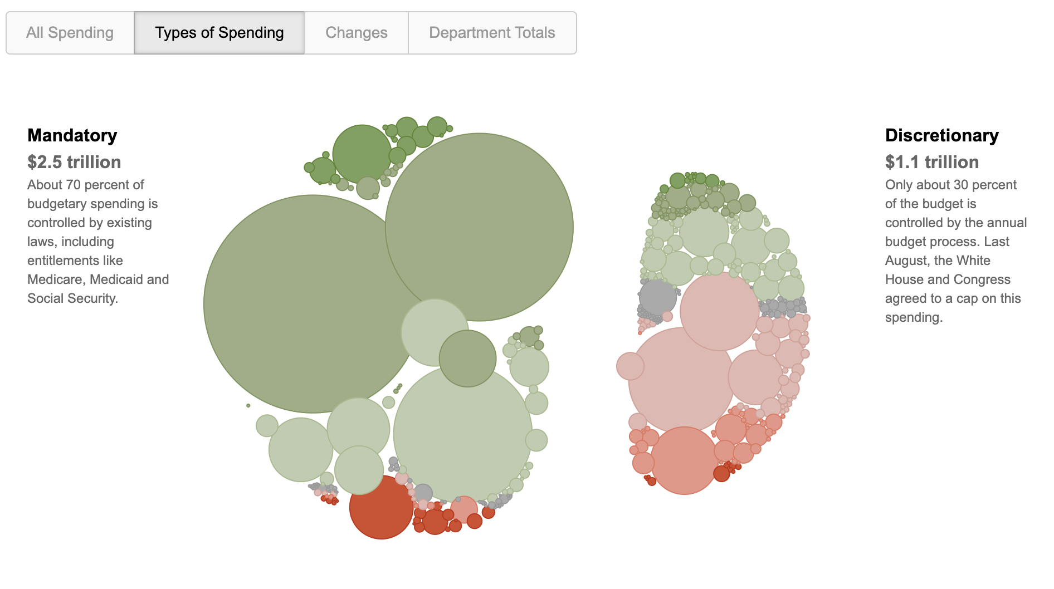
forceX and forceY
Group different categories on the page
Causing elements to be attracted towards a certain x/y position

Slide 21
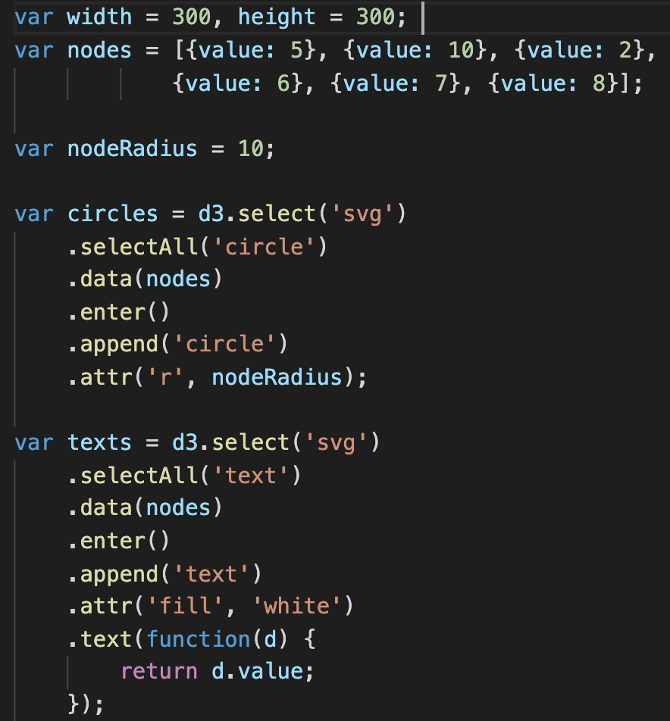
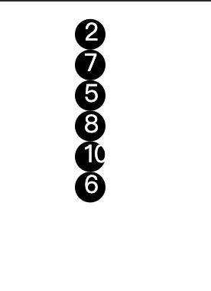
Ex09-02
main.js
Modified from Ex09-01

Slide 22
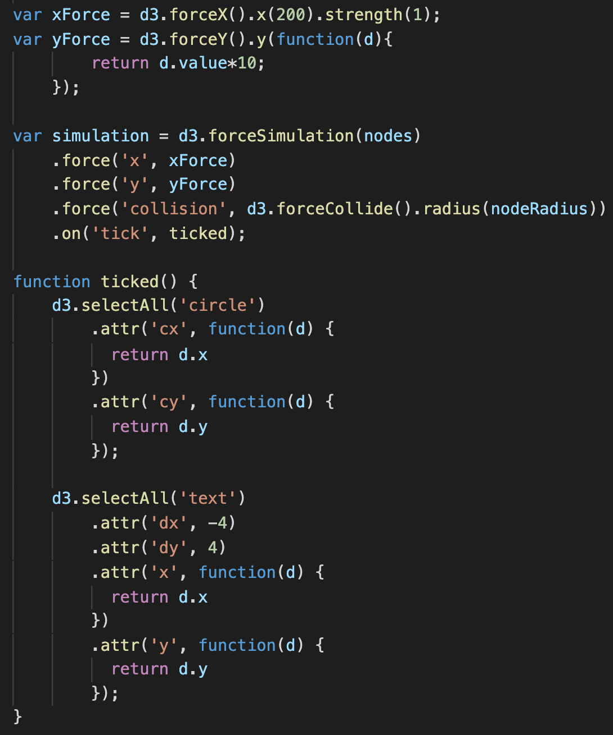
Ex09-02
All the nodes will be attracted to x = 200
main.js
Modified from Ex09-01

Slide 23
Ex09-02
Each node will be attracted to different y position, which is y = “d.value*10”
d (data)??
main.js
Modified from Ex09-01

Slide 24
Ex09-02
main.js
Modified from Ex09-01
The radius for d3.forceCollide() is fixed here (nodeRadius = 10 )

Slide 25
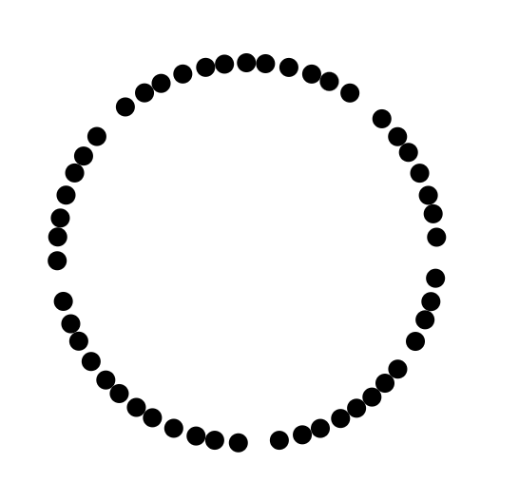
forRadial
Push every node away with a fixed distance from a circle center
r (radius)
The desired locations of all nodes and the center are ‘r’
(centerX, centerY)

Slide 26
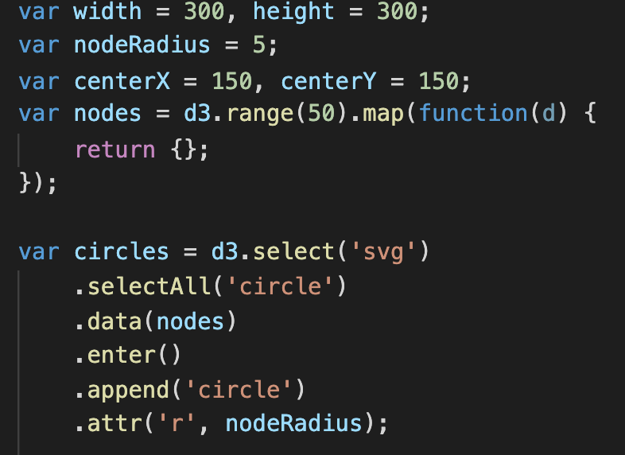
Ex09-03
main.js
Bind data and append 50 circles to svg
Create an array with 50 elements and each data element is a empty dictionary (we do not need value in this example)

Slide 27
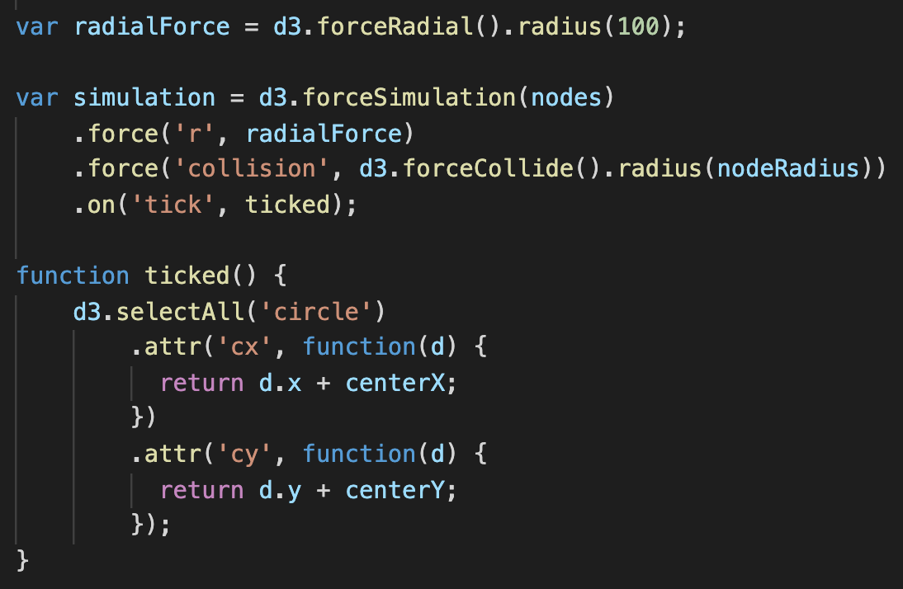
Ex09-03
Our radial force
Collide force
main.js
Default center is (0,0)
100
(centerX, centerY)

Slide 28
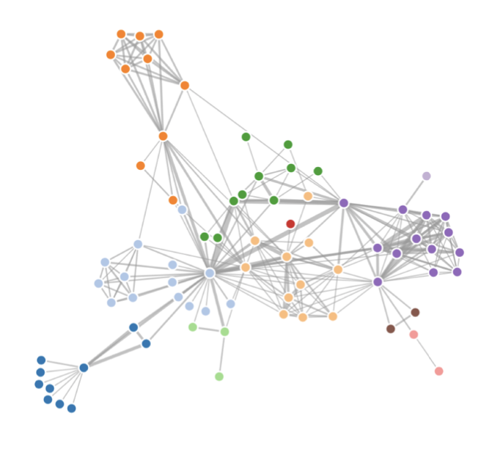
forceLink
Force certain nodes on the graph with certain distance apart
simulation.force(‘link’, d3.forcelink(). link(links))

Slide 29
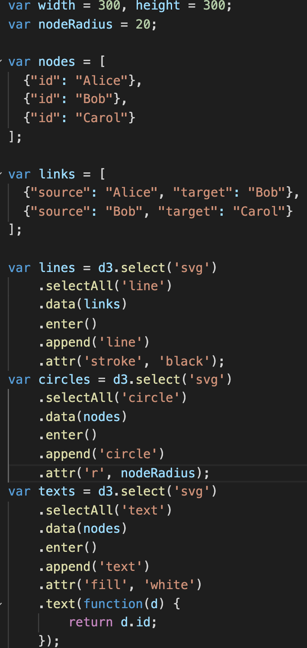
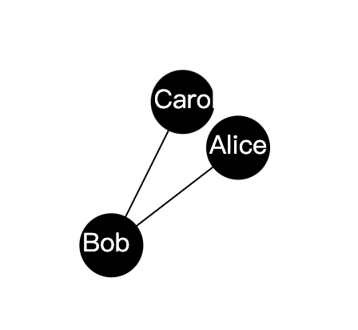
Ex09-04
The way to define the node data is the same as usual, array of dictionary.
We assign ”id” for each node to recognize them by link later
main.js
Links of the graph are also defined by an array of dictionary. Each dictionary is a link with two keys, ‘source’ and ‘target’. The values of ‘source’ and ‘target’ are two nodes of the link.
You can also use ‘index’ instead of node id to indicate nodes (please check d3 document)

Slide 30
Ex09-04
main.js
Add nodes, texts, and links to svg

Slide 31
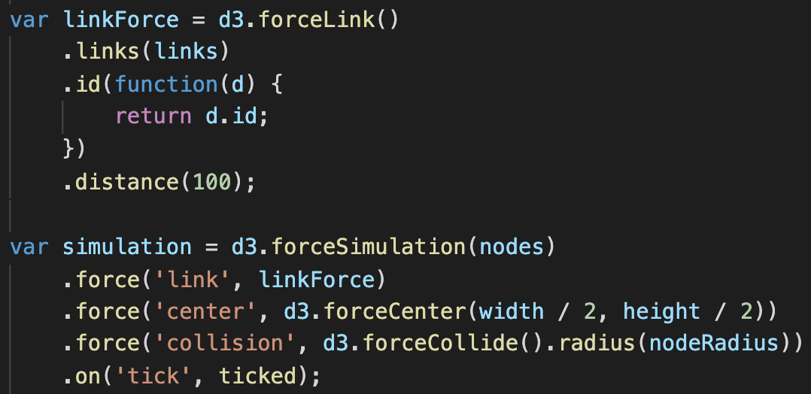
Ex09-04
The link force
Link information
main.js
Define node ID accessor
“Desired” length of a link

Slide 32
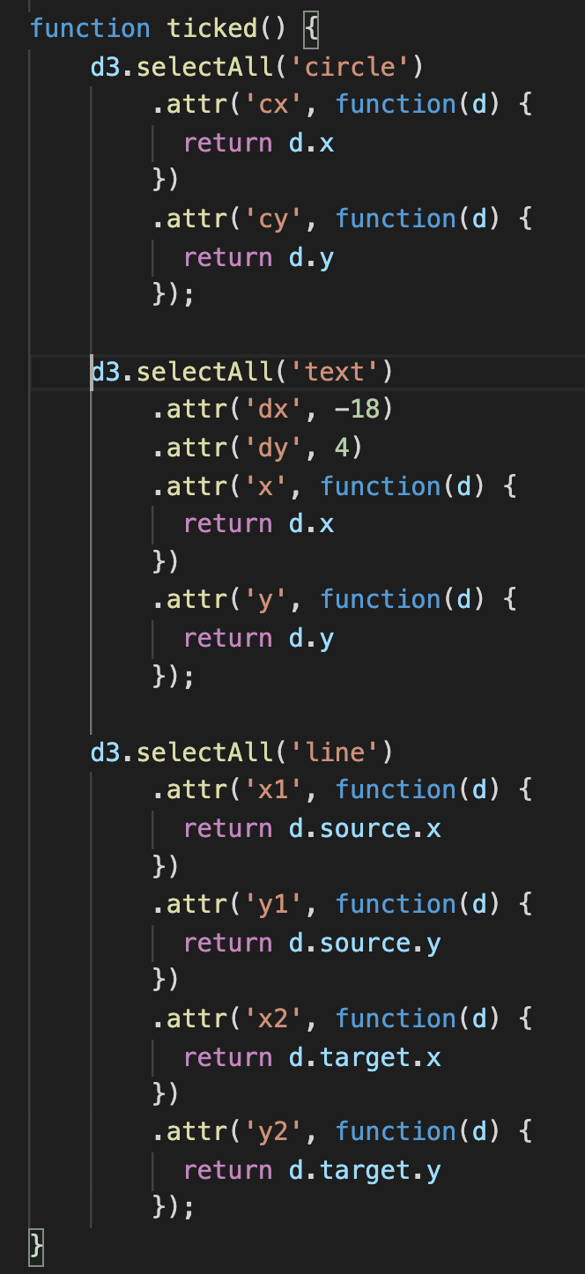
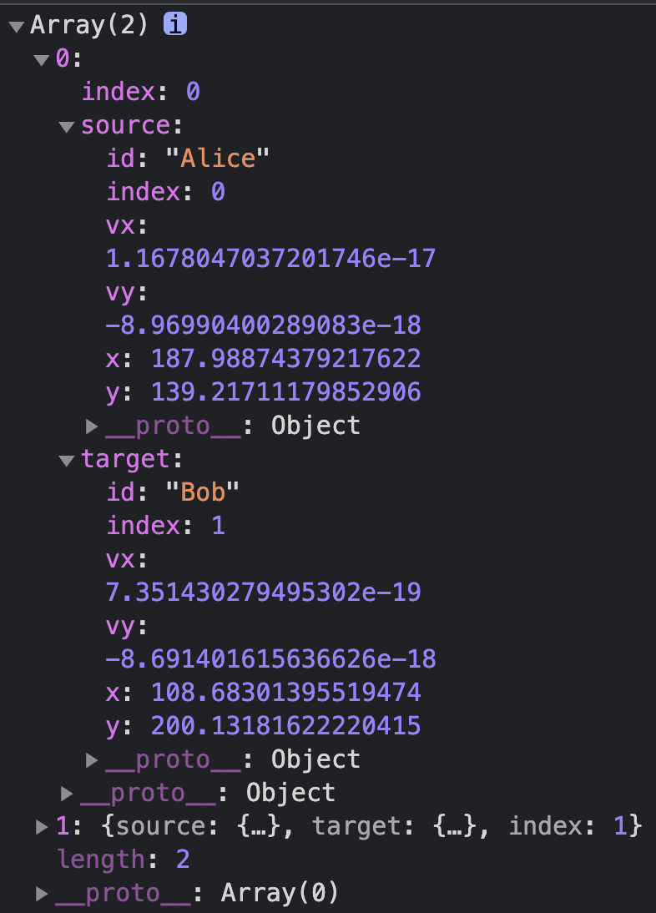
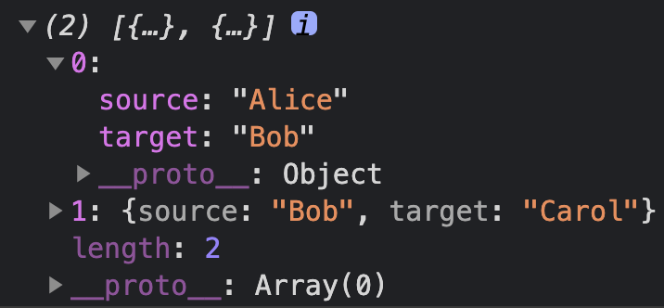
Ex09-04
Update node/text positions
main.js
Update line positions
The concept is the same as updating node position in Ex09-01
The simulator will modify the data bound to d3.forceLink()
Without simulator
Console.log(links)
with simulator
Console.log(links)
The simulator modifies the values of source and target to {id, index, vx, vy, x, y}

