Slide 1
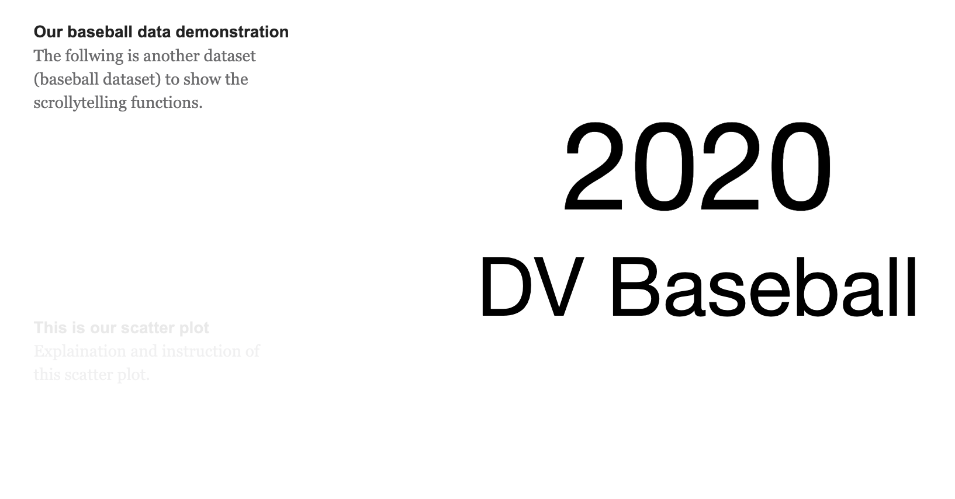
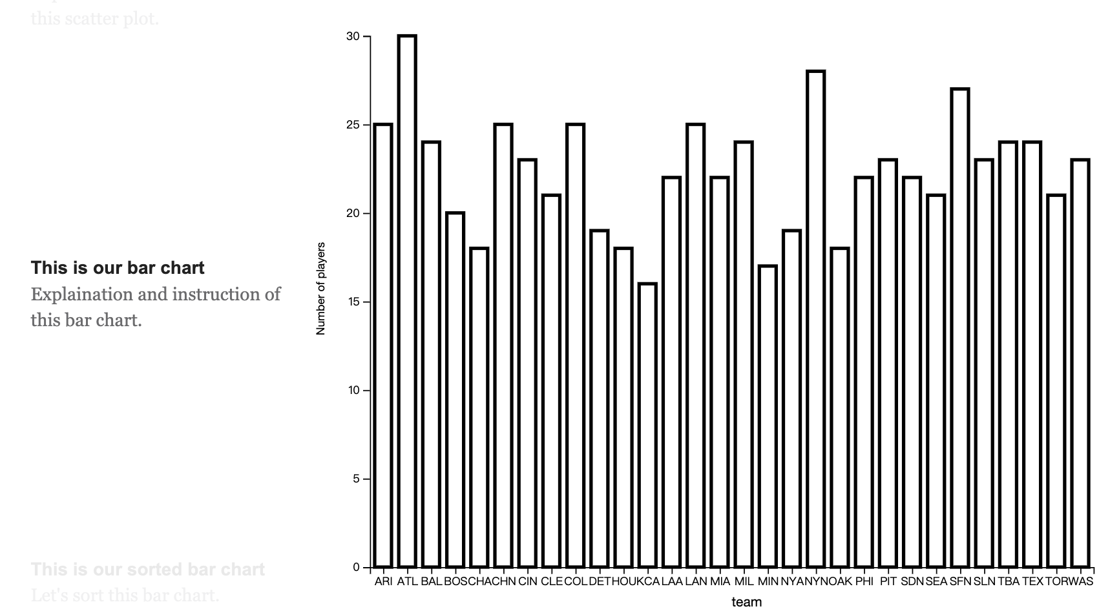
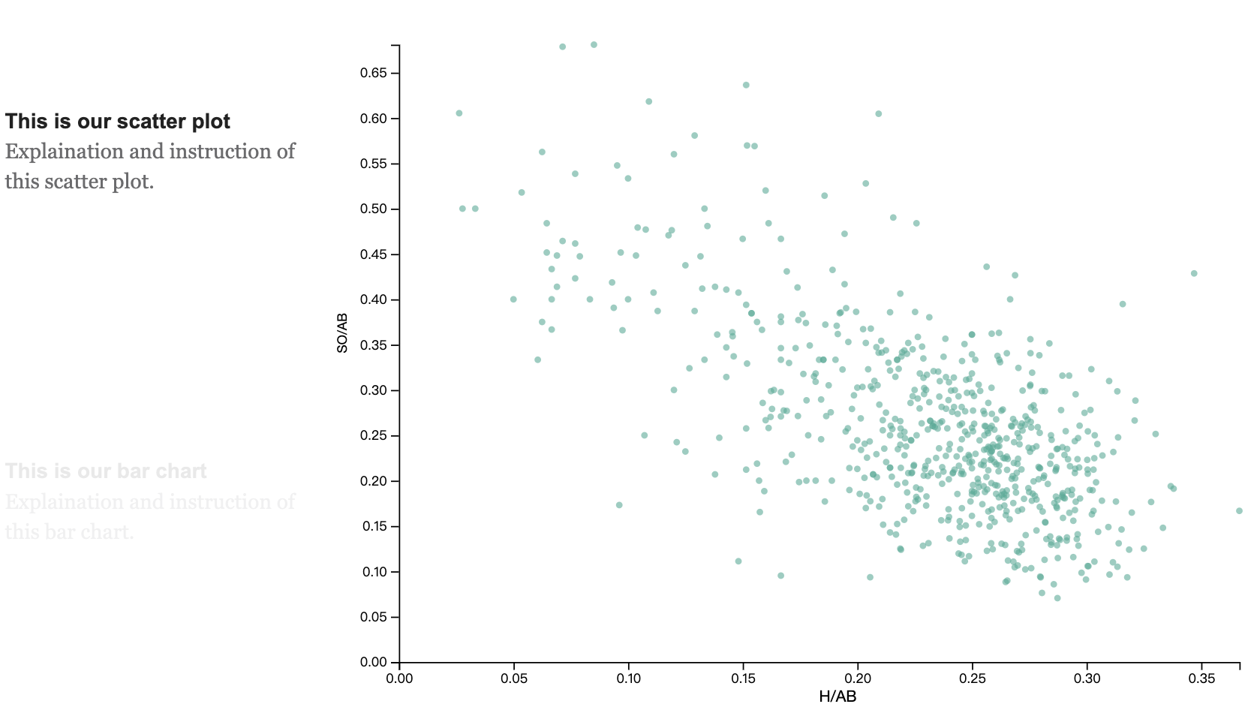
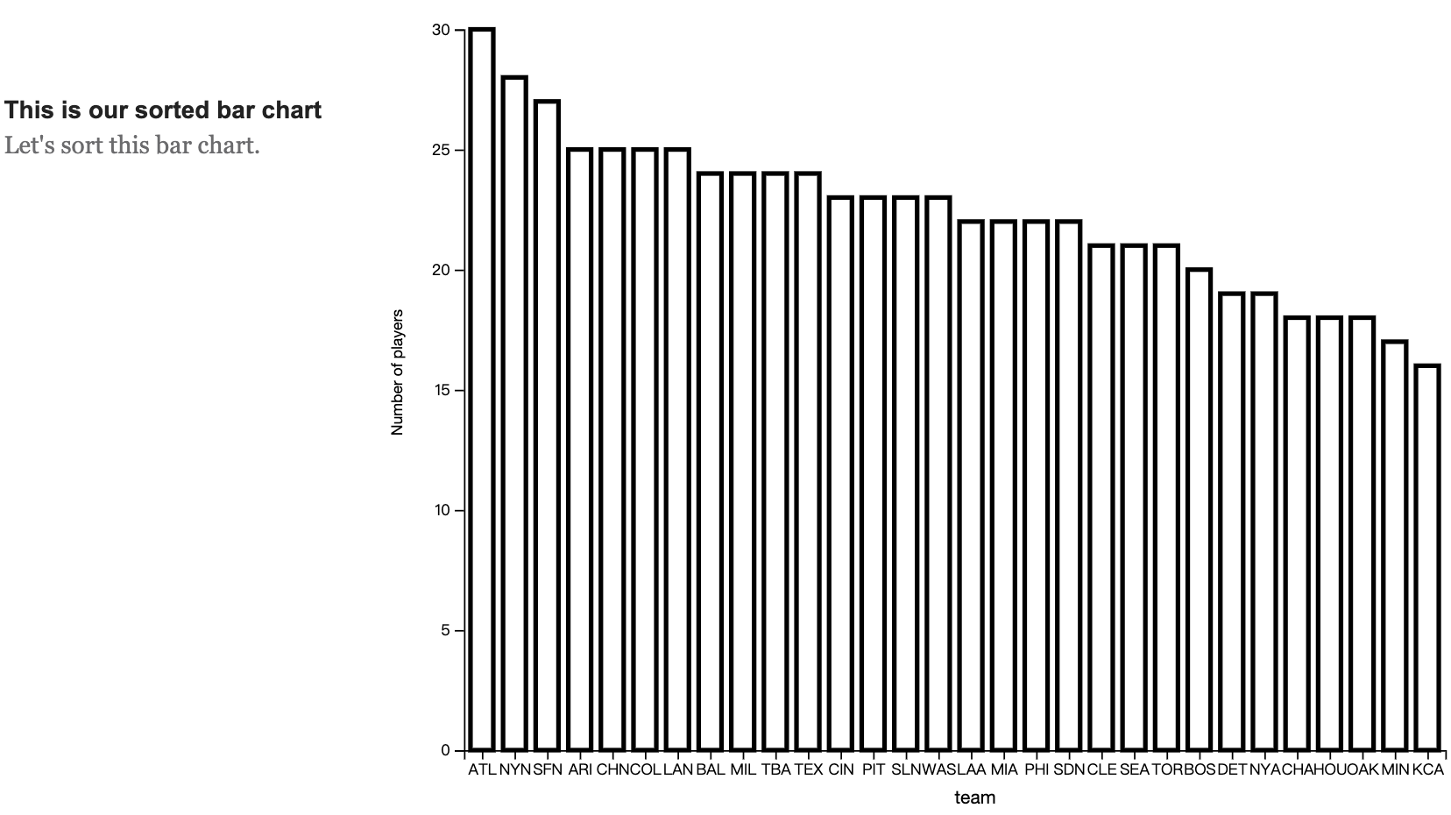

Slide 2
Files
This template use d3.v4 instead of d3.v5
V4 and v5 are similar. One major difference is the function to load data file.
Two files you will modify
Index.html
/js/section.js. (d3 code)
If you want to add styles
/css/style.css
Data files
/data/ (you can put your data in this folder)

Slide 3
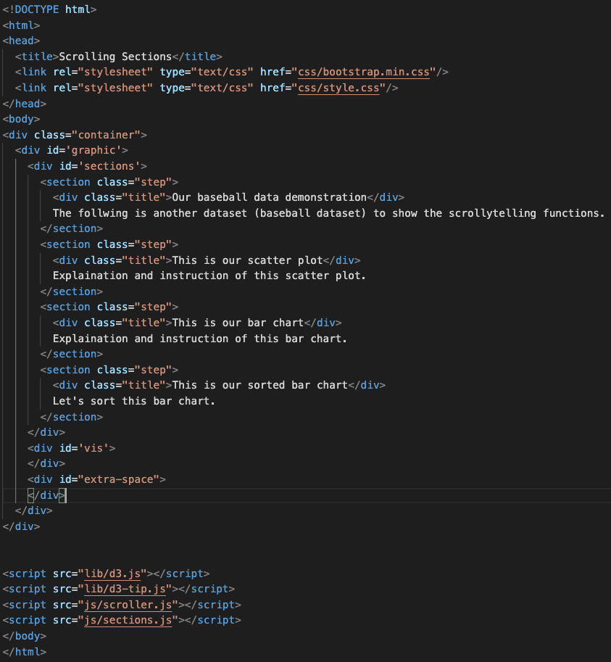
Index.html
The explanation at the left-hand side
We have four pages, so we have four sections here.
If you want more pages, add more sections here

Slide 4
/js/sections.js
You only have to modify scrollVis(), setupVis(), setupSections(), display(), d3.queue() at the very bottom.
Essentially, you do not have to touch any other functions.

Slide 5
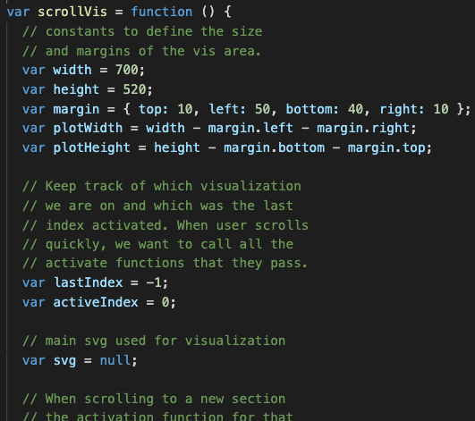
scrollVis()
You can change the plot area size and margin size here
Width and height (include margin)
margin
Plot area width and height
Ex: length of x- and y-axis of a scatter plot
So, always use “plotHeight” and “plotWidth” to set any x and y scale functions

Slide 6
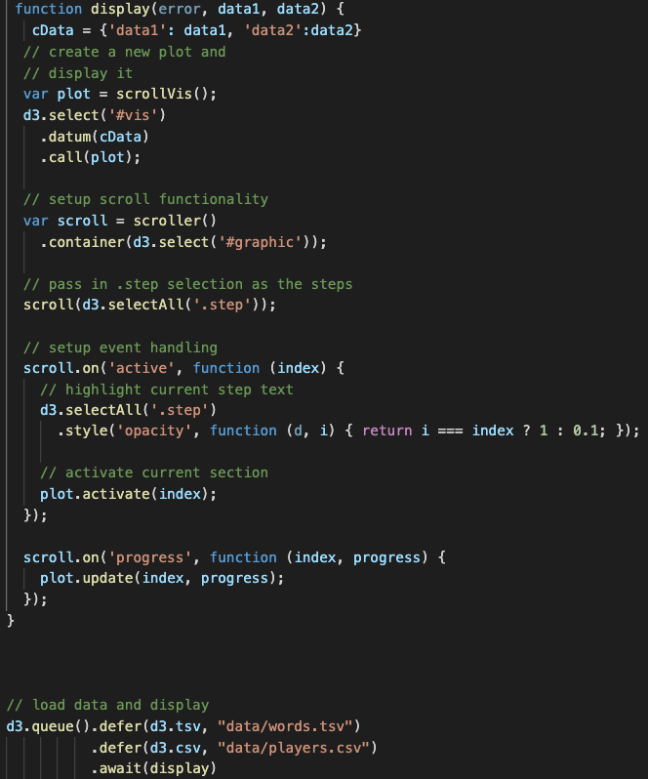
display() and the code at very bottom….
Data from two files will be put into data1 and data2 (if you only have one file, remove data2. If you have 3 data files, add data3)
I demonstrate how to load two data files (although I just use one)
Set two files here
(if you only need one file, you only need one .defer)

Slide 7
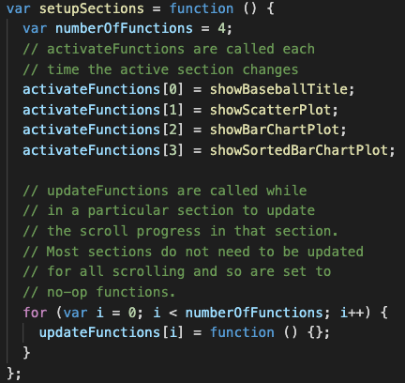
setupSections()
Where to set the number of sections
Set the action function if the user scroll to a section
If you have 5 sections, you will have 5 lines (action functions here)
Action functions

Slide 8
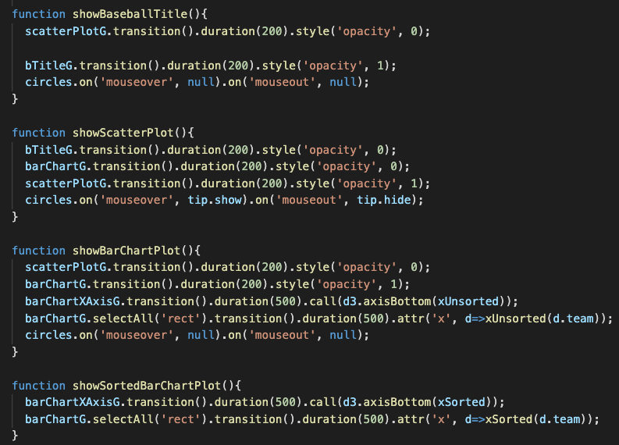
Action functions
You should add action function by your self
(We will explain the logic of action functions later)

Slide 9
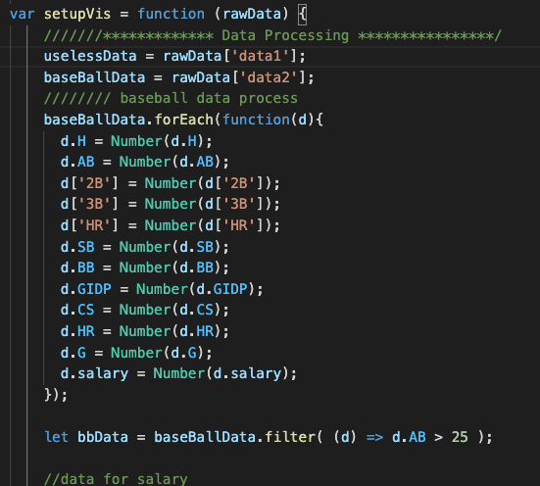
setupVis(rawData)
rawData stores all data from files
You will get your data, process your data and add “all” visualizations in this function
The way to get the data from each file
After having the data, you can start to process the data here if necessary

Slide 10
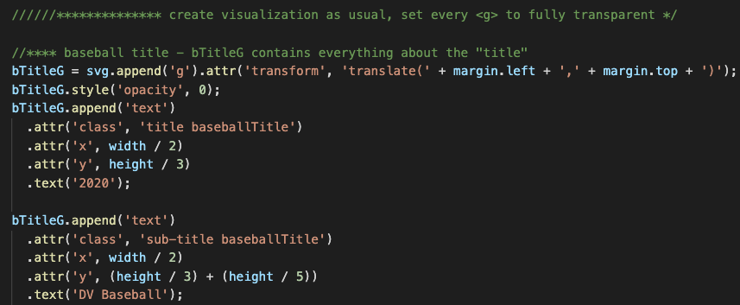
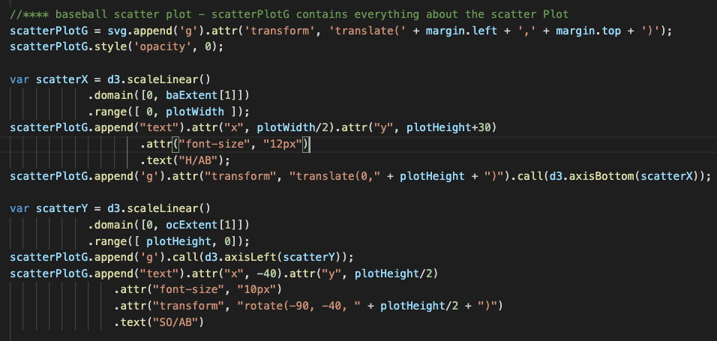
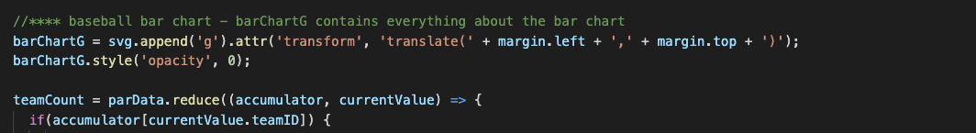
setupVis(rawData)
<g> for title vis
After processing the data you can start to add (all) in this function as usual
Hint:
All variables should have different names (then make all variable be global variable)
No good coding style but easy way to implement in this example
Each visualization should be put into different <g> tag and get the hold of each <g> tag
Use plotWidth, plotHeight and margin to set visualization
Set all <g> to fully transparent here
<g> for scatter plot vis
<g> for bar chartvis

Slide 11
Action Functions
What you want to do?
Essentially, make all <g> which contains irrelevant visualizations of this sections to fully transparent and the <g> contain relevant visualization relevant of this section to fully opaque
, and
Any other things you want………
each action function will be activated if users scroll to the corresponding section
You should define what you want to do in each action functions

Slide 12
If you want to add a new section, what you should do?
After you correctly load the data and you can access it in setupVis()
1. add a new <section> in index.html
2. add/create visualization you want in setupVis() (sections.js)
Remember to set the corresponding <g> tag to fully transparent
3. Modify “setupSection()” and add a corresponding (new) action function
4. carefully write the new action function to control the flow
Make some <g> to be transparent, some <g> to be opaque and add any thing you want…….

Slide 13
Original Tutorial and Code
Tutorial: https://vallandingham.me/scroller.html
Code: https://github.com/vlandham/scroll_demo
(note: the code is developed on d3.v4 instead v5)
Demonstration: http://vallandingham.me/scroll_demo/

