Slide 1
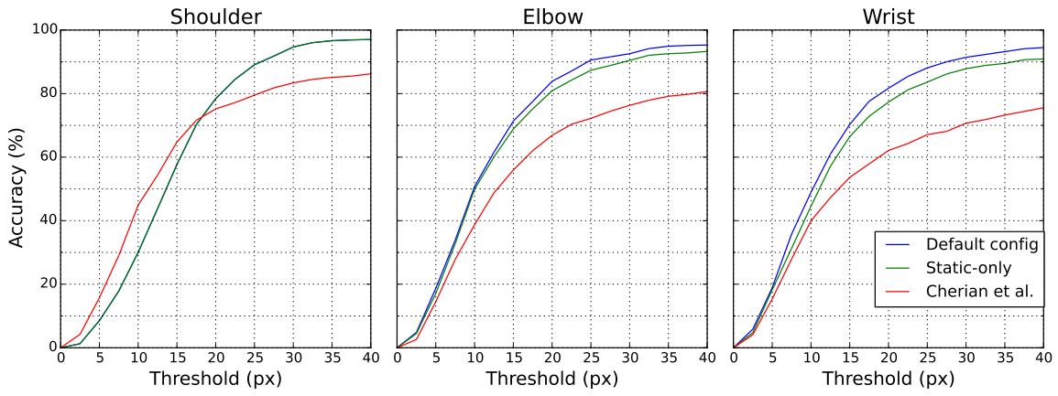
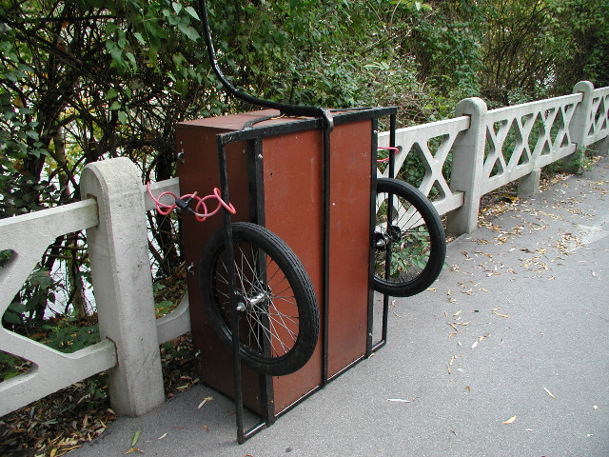
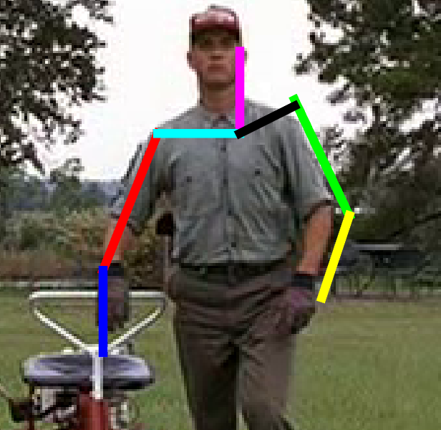
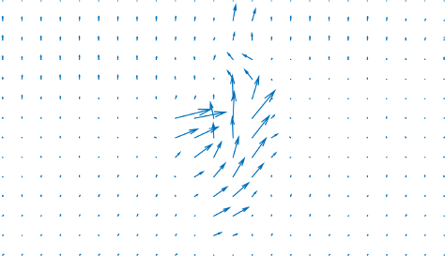
Improving Video Pose Estimation with Deep Learning and Graphical Models
By Sam Toyer, u5568237@anu.edu.au. Supervisor: Anoop Cherian.
1 Motivation and Contributions
Human pose estimation is the task of labelling an image—or, in our case, sequence of video frames—of a person with the locations of keypoints like the wrists, elbows, shoulders, head, and so on. In the jargon of pose estimation, these keypoints are referred to as “joints”, and any pairwise constraints between the locations of joints are called “limbs”; together, a set of joints and limbs forms a “skeleton”, as illustrated below. Note that, whilst the below skeleton includes joints and limbs covering the entire body, the model which we considered only covers the upper body.
2 Method
Our pose estimation pipeline can be decomposed into two stages:
First, we attempt to produce a set of plausible candidate poses for each frame in the input video sequence. To generate this candidate set, we use a single-image pose estimation technique built on that of Chen and Yuille [1]:
  Formulate pose estimation as a task of finding a good assignment of joints to locations in the image, and a good assignment of types to limbs; the type of a limb corresponds to a specific range of lengths and rotations for that limb.
  Use a Convolutional Neural Network (CNN) to produce a heatmap for each joint, and to predict the types of limbs attached to that joint. Type prediction lets the algorithm “guess” the position of one joint from the visual cues given by the image patch around its neighbour.
  Efficiently find the highest-scoring poses in an image using distance transforms, and remove near-identical poses using non-maximum suppression.
Next, we produce a sequence of poses from the joints in each frame's candidate pose set using the method of Cherian et al. [2]:
  Consider each joint individually, from the root joint of the skeleton (head) down to the leaves (wrists).
  Find a temporally consistent sequence of positions for the root joint.
  Find a sequence of positions for each subsequent joint, taking into account both temporal consistency and consistency with the position of the (previously estimated) parent joint.
  Use optical flow to encourage the inference algorithm to localise fast-moving joints (wrists, elbows) in regions of the video with a high degree of motion.
3 Results
We tested our model on the the Poses in the Wild data set. A single joint is considered to be correctly localised if the estimated location for that joint is within some threshold of the ground truth; the percentage of correctly localised joint instances in Poses in the Wild area given below for varying thresholds.
Pose estimation nomenclature
The skeletons produced by a pose estimation system are helpful for higher-level vision tasks, including:
Classifying clothing [4,5]
Action-recognition [6]
Object detection and classification [3]; for instance, a chair could be detected by the presence of a person in sitting position just above it.
The aim of this project was to improve on the state of the art in human pose estimation for video frames; such an improvement could benefit any and all of the applications listed above.
“Limbs”
“Joints”
“Skeleton”, or “pose”
Left: A correctly localised subsequence showing estimated arm locations.
Below: Some representative failures.
Our contributions are:
TODO
3 Discussion and Future Work
Our results show that simply applying Chen and Yuille's CNN-based pose estimator (“Static-only” in the above graphs) independently to each frame yields superior detections to Cherian et al.'s detector, which makes use of optical flow but not deep-learned image features. Combining the two—so that we use the informative CNN-based image features of Chen and Yuille and the temporally-aware recombination method of Cherian et al.—yields even better accuracy for estimation of wrist and elbow positions. This is a significant result, since the size and rapid movement of wrists and elbows make them the most challenging parts to localise.
The major roadblock to application of our technique is computational overhead; for instance, forward propagation of an image through the CNN at multiple scales takes up to a minute per frame, whilst computation of optical flow for a 30 frame sequence takes on the order of five minutes. Whilst these times could be reduced through increased parallelism, it would require a major architectural change to decrease the actual computational burden imposed by the algorithm. One promising avenue of investigation is to simplify the graphical model so that the CNN does not need to estimate as many limb type combinations. Another is to overhaul the architecture entirely by attempting to regress joint coordinates directly with a CNN. Both of these options are currently being investigated.
4 References
X. Chen and A. Yuille. Articulated pose estimation by a graphical model with image dependent pairwise relations. In NIPS, 2014.
A. Cherian, J. Mairal, K. Alahari, and C. Schmid. Mixing body-part sequences for human pose estimation. In CVPR, 2014.
V. Delaitre, D. F. Fouhey, I. Laptev, J. Sivic, A. Gupta, and A. A. Efros. Scene semantics from long-term observation of people. In ECCV. 2012.
S. Liu, Z. Song, G. Liu, C. Xu, H. Lu, and S. Yan. Street-to-shop: Cross-scenario clothing retrieval via parts alignment and auxiliary set. In CVPR, 2012.
K. Yamaguchi, M. H. Kiapour, L. E. Ortiz, and T. L. Berg. Parsing clothing in fashion photographs. In CVPR, 2012.
A. Yao, J. Gall, G. Fanelli, and L. J. Van Gool. Does human action recognition benefit from pose estimation? In BMVC, 2011.
2.1 Training process
K types are derived for each limb using K-means clustering on limb displacements
A CNN is trained to detect joints and classify connected limbs
Weights for the pose-scoring graphical model are found using a structural support vector machine
Lower arm, type 1
Non-poses from negatives set
Finally, recombination parameters are chosen by hand
Lower arm, type 2
Convolutional neural network
Lower arm, type 3
Lower arm, type 4
Elbow
Upper arm type 8
Lower arm type 6
Wrist
Lower arm type 8
Head
Neck type 7
Separating
hyperplane
Ground truth poses
2.2 Using the trained model on a video sequence
A CNN produces limb type and joint presence heatmaps for each frame
The heatmaps are used as input to a graphical model to find the most likely poses in each frame
Non-maximum suppression discards near-identical poses
Optical flow is calculated for each pair of adjacent frames
Recombination produces a temporally consistent sequence of locations for each joint

